Slide 1
Static Code Analysis
Jakub Papcun
Jan Svoboda

Slide 2
Content
Honeywell
Static Code Analysis
Use of SCA in Honeywell
Defect Tracking Integration
Manual Code Review Integration

Slide 3
Honeywell
4 Strategic Business Groups (SBGs)
  Aero
  Automation and Control Solutions (ACS)
  Performance Materials and Technologies (PMT)
  Transportation Systems (TS)
130 000 employees worldwide
ACS Centre of Technologies (ACT)
  Software Excellence Group
  Implements Best Practices for software development
  Implements tools necessary for fulfilling Best Practices requirements

Slide 4
Static Code Analysis
Analysis of the code without executing the program itself
Various types of SCA
  Type checking
    checks for correct assignment of types of objects
  Style checking
    checks the style of the code and its formatting
  Program Understanding
    helps user make sense of large codebase and may include refactoring capabilities
  Program verification and property checking
    attempts to prove that the code correctly implements the specification of the program
  Security review
    uses dataflow analysis for detection of possible code injection
  Bug finding
    looks for places in the code where program may behave in a different way from the way intended by developer

Slide 5
Static Code Analysis - Limitations
SCA identifies only “shallow” errors and does not look for problems in design or functionality
3 types of results
  True positives
    real issues which are code errors and should be fixed before releasing
  False positives
    issues identified by the analysis but not real threats due to for example architecture of the software
  False negatives
    real issues which Static Code Analysis did not identify and are still hidden from the knowledge of the developers
Possibility to adjust the Static Code Analysis rules to the context
Notes:
types of static code analysis
examples of static code analysis (would be nice to have it interactive … give them examples to find)

Slide 6
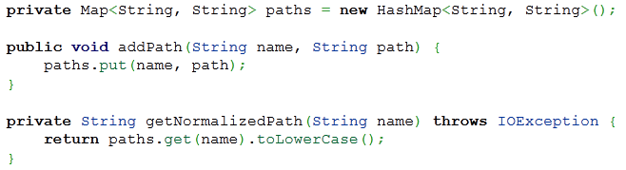
Example 1

Slide 7
Example 1
Can return null
A NullPointerException is thrown in case of an attempt to dereference a null value.

Slide 8
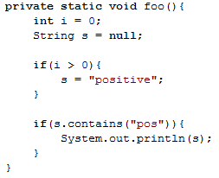
Example 2

Slide 9
Example 2
Statement always true
Statement is always false and never enters the block

Slide 10
Example 2
Statement always true
s may be null
Statement is always false and never enters the block
s variable may be null and NullPointerException may be thrown

Slide 11
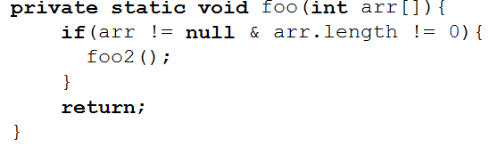
Example 3

Slide 12
Example 3
& or &&
Questionable use of bit operation ‘&’ in expression. Did you mean ‘&&’?

Slide 13
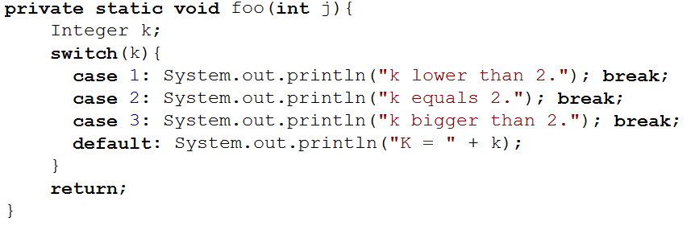
Example 4

Slide 14
Example 4
j is never used
j variable is never used and thus redundant

Slide 15
Example 4
j is never used
k not initialized
j variable is never used and thus redundant
k variable is never initialized and thus unusable

Slide 16
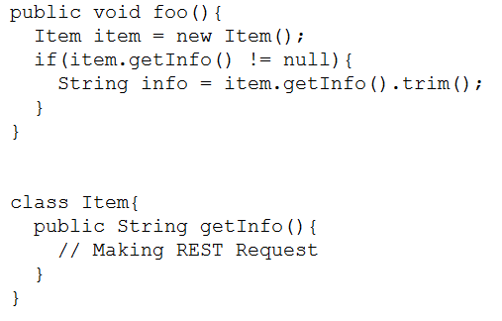
Example 5

Slide 17
Example 5
may return null
REST may fail and return null

Slide 18
Static Code Analysis - Tools
Klocwork
SonarQube
Findbugs
Kiuwan
Others
  Compilers
  IDEs
    IntelliJ Idea
    Eclipse
Notes:
types of static code analysis
examples of static code analysis (would be nice to have it interactive … give them examples to find)

Slide 19
Capability Maturity Model Integration (CMMI)
A set of rules defining the maturity of the company
5 levels
Honeywell achieving level 5
  continuous improvement of the processes and evaluation of the results across all the software development disciplines according to collected measurements and metrics
ACS Software Development Process (ASDP)
  Process used for Software Development across ACS
  Aims to be compliant with CMMI level 5
  Static Code Analysis is one of the steps in the Implementation discipline

Slide 20
Klocwork
Static Code Analysis tool
Supported languages are C/C++, C#, Java
Identifies code vulnerabilities
  Logical errors
  Security vulnerabilities
  Coding standards violations
Klocwork calculates software metrics such as lines of code, lines of comments, cyclomatic complexity, number of functions/methods
Web Interface and user instance of Klocwork
  poor REST API
  various restrictions on the side of Klocwork query language

Slide 21
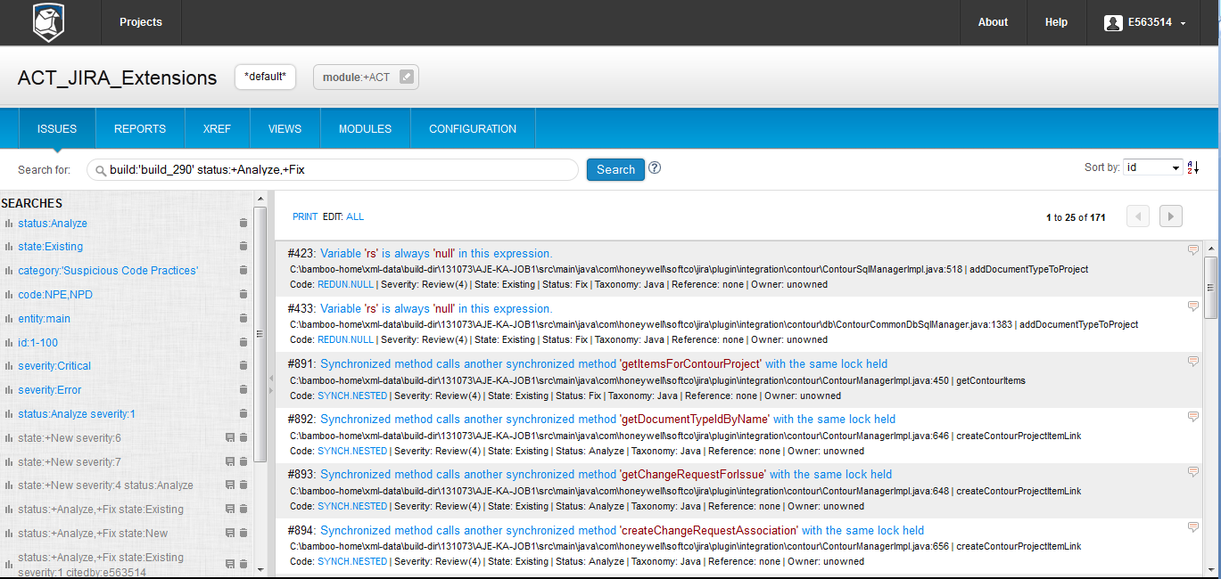
Klocwork

Slide 22
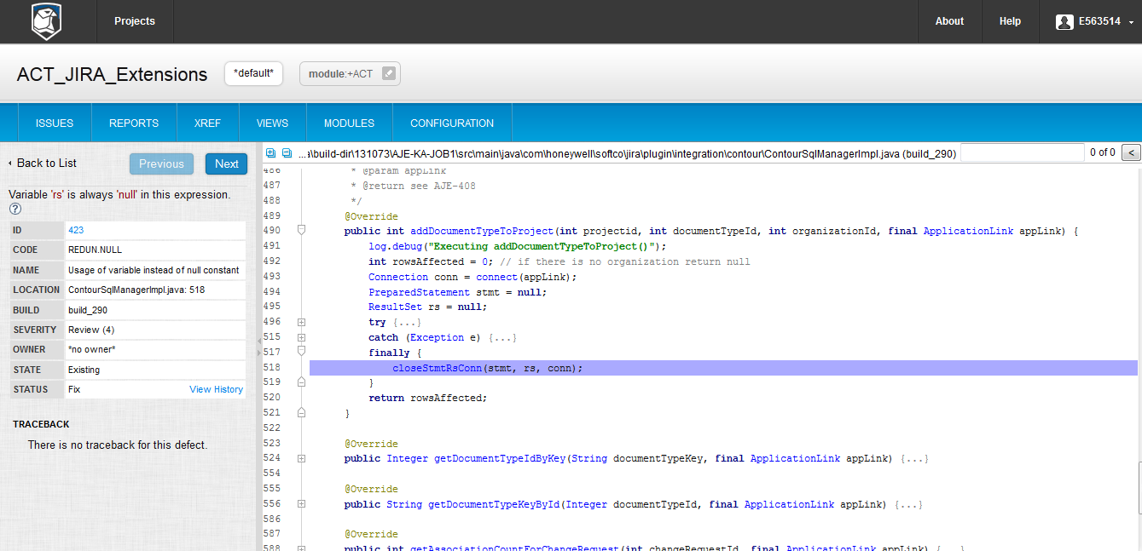
Klocwork

Slide 23
Tools Integrated with Klocwork
JIRA
Crucible/FishEye
Reasons
  Klockwork is not very user friendly
  Results of SCA serve as input parameters for processes
    These processes have majority of required data in other tools
  Simplifying the processes
  Delegation of control over SCA results

Slide 24
Defect Tracking Integration

Slide 25
Issue/Defect Tracking
Honeywell ACS uses JIRA
Issue and Project tracking software
  tracks time spent on resolving issues, progress of the project and various metrics connected to software development
  one of the main tools used across Honeywell ACS
  Issue
    a software bug (defect), a task, a helpdesk ticket, a new feature etc.
  Easily extensible with wide variety of extensibility options
  Great integration capabilities with other Atlassian products

Slide 26
Source Code Management
Fisheye
Web Interface for read only access to SVN
Visualization and reporting capabilities regarding source code
Searching capabilities according to commits, comments, people etc.
Great WEB API for communication between tools

Slide 27
JIRA – Klocwork – Fisheye Integration Overview
Klocwork
Fisheye
Data in
JSON format
Use of Klocwork
WEB API
Fisheye WEB API
Klocwork findings data
Fisheye data
JIRA

Slide 28
Goals
Development cycle time reduction
Code quality improvement
Build basis for creating new more sophisticated metrics combining defect/issue tracking and static code analysis
Set basis for future development of integration and possible defect prediction

Slide 29
Create JIRA defect from Klocwork
A simple button in Klocwork Finding
Creates a JIRA defect with as much information as possible
Stores the data about defect resolving in JIRA
Not able to get line numbers
Not able to get specific faulty code

Slide 30
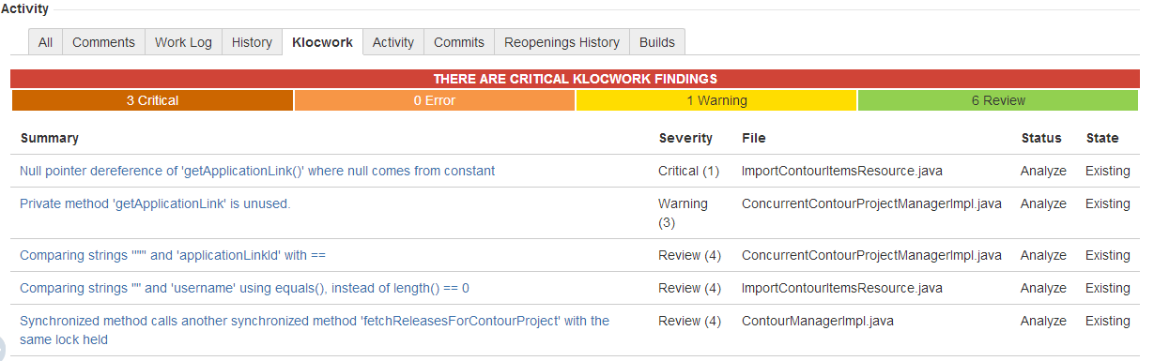
Create a list of Klocwork findings for specific JIRA issue
Integrates data from Fisheye with data from Klocwork and creates a list of Klocwork Findings that were introduced into the code as part of implementation of some Issue
Higher Code Quality
Lower Development Cycle Time
Information about the quality of the feature

Slide 31
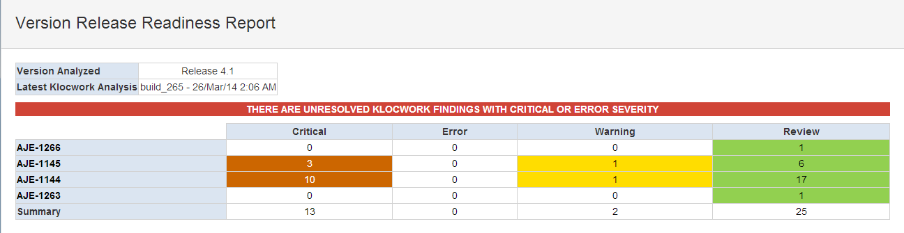
Report
Indicates whether the code is ready for testing and release
Gives overall status about the code quality written as part of the selected version of the product

Slide 32
Manual Code Reviews Integration

Slide 33
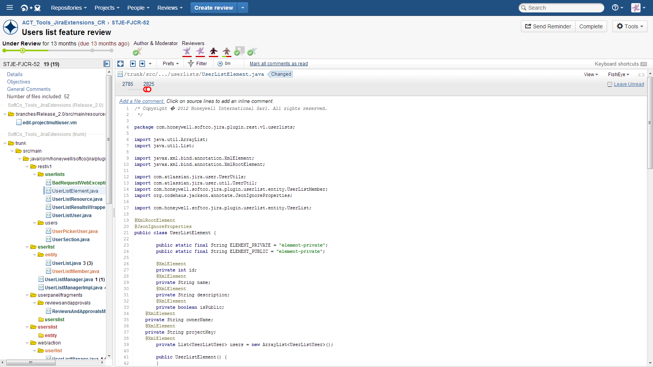
Manual Code Reviews
Systematic examination of the source code
Used to verify the code from various perspectives
Atlassian Crucible

Slide 34
Testing Readiness
Simple rule: cost of a defect rises with the time it is not discovered
  Apply even for defects found during testing activities
Solution: try to find defects as soon as possible
  Apply all available tools/processes
  SCA
  Manual Code Reviews
Not popular activity
  Need to use two tools for very similar activities
  Inspecting more complex code can be confusing
  Human Factor
  Klocwork User Friendliness

Slide 35
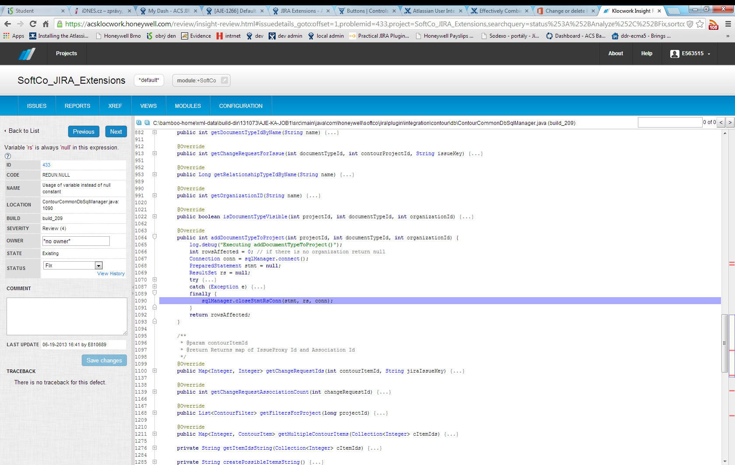
How to improve?

Slide 36
How to improve?

Slide 37
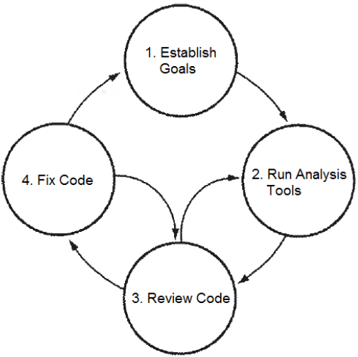
Integration
Both of the tools looks similar
  Why not integrate them?
Benefits:
  Time saving
  User Friendliness
  Process Enforcement
Features
  Source File View
  File Tags
  Analysis Overview panel
  Hot Spot Review

Slide 38
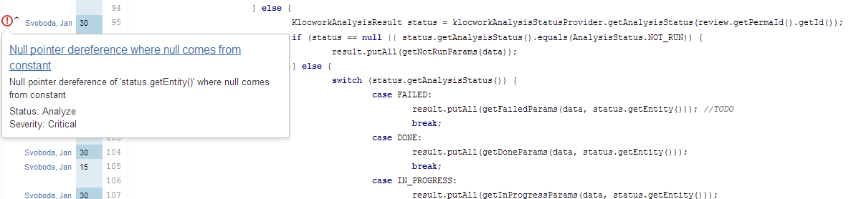
Source File View
Displays Klocwork findings directly in Crucible source code view

Slide 39
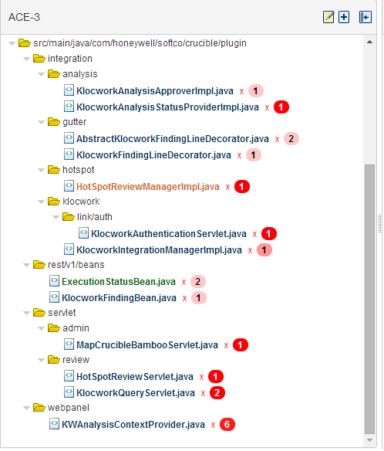
File Tags
Differentiate files under review based on the number and severity of Klocwork findings

Slide 40
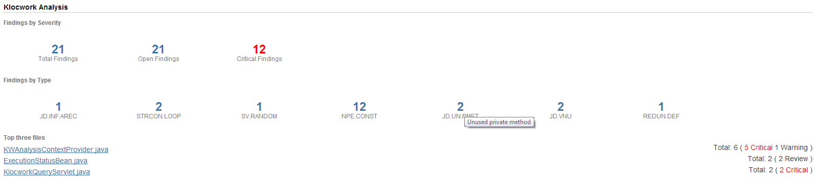
Analysis Overview panel
Displays statistic data about Klocwork findings in the review

Slide 41
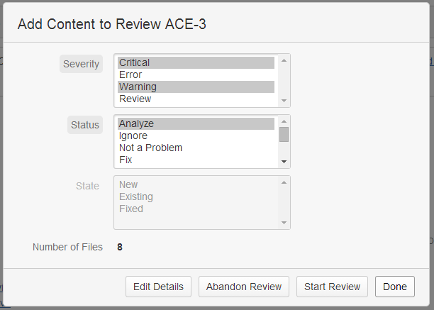
Hot Spot Review
„Hot Spot“ = parts of the code satisfying some condition

Slide 42
Thank You
Q&A

