Slide 1
Marketing Time or rather Online Marketing Time or even better Digital Marketing Time ,-)

Slide 2
Miroslav Jirků – Kentico Software
Marketing Team Leader & WebPro Team Product Owner
mirek.jirku@gmail.com
linkedin.com/in/miroslavjirku

Slide 3
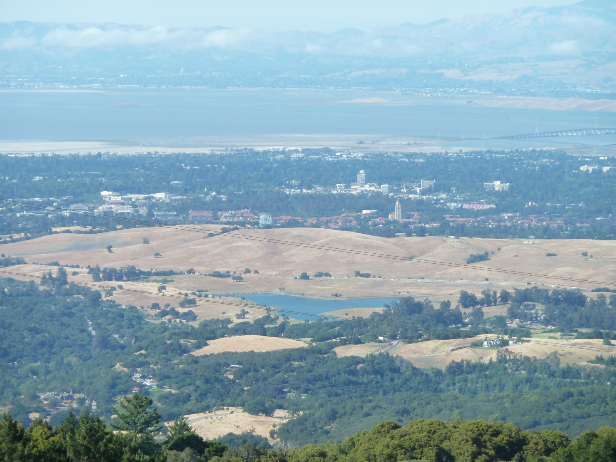
Miroslav Jirků – Kentico Software
Marketing Team Leader & WebPro Team Product Owner
mirek.jirku@gmail.com
linkedin.com/in/miroslavjirku

Slide 4


Slide 5
What will we talk about
Market
Marketing abouts
Business decision making – What, How For Whom
Marketing Process
General Marketing Disciplines
Online Marketing
      Social Media
      AdWords
      PR - Blogs - Forums
      SEO & Content Marketing
      Display
      Email Marketing
      Analytics and Research
Key Takeaways

Slide 6
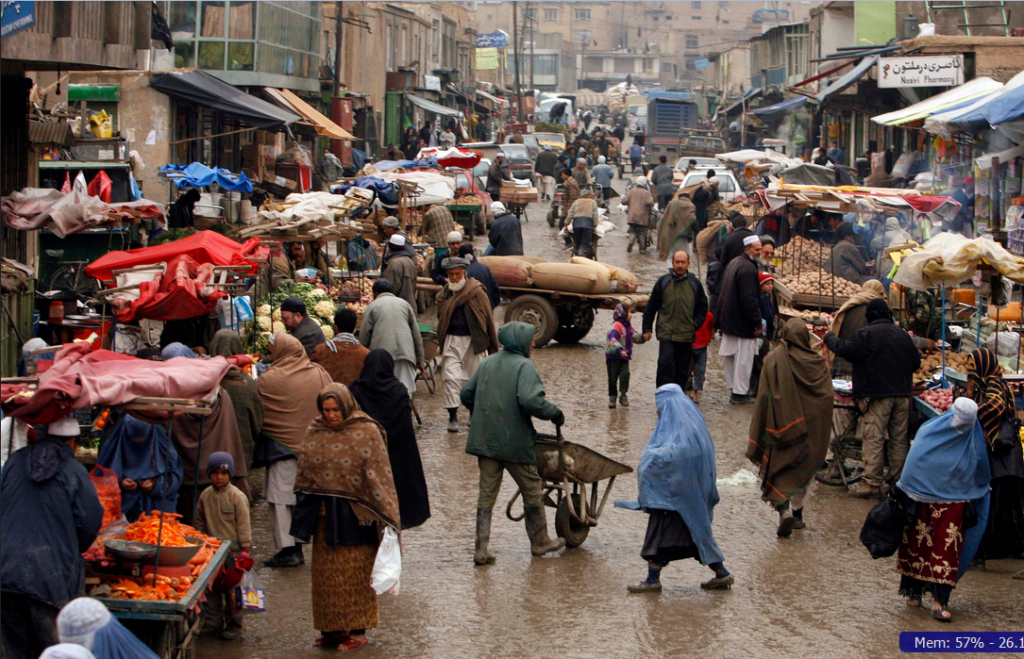
Market[ing]

Slide 7
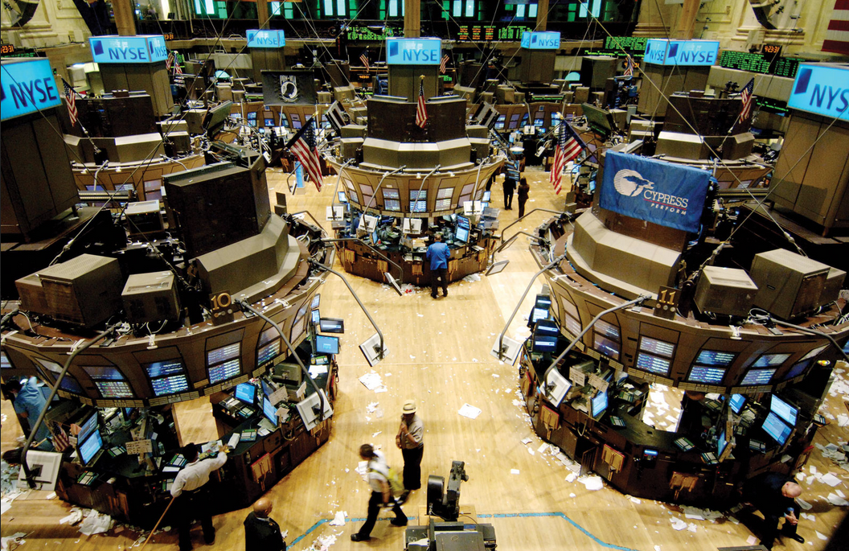
Market[ing]

Slide 8
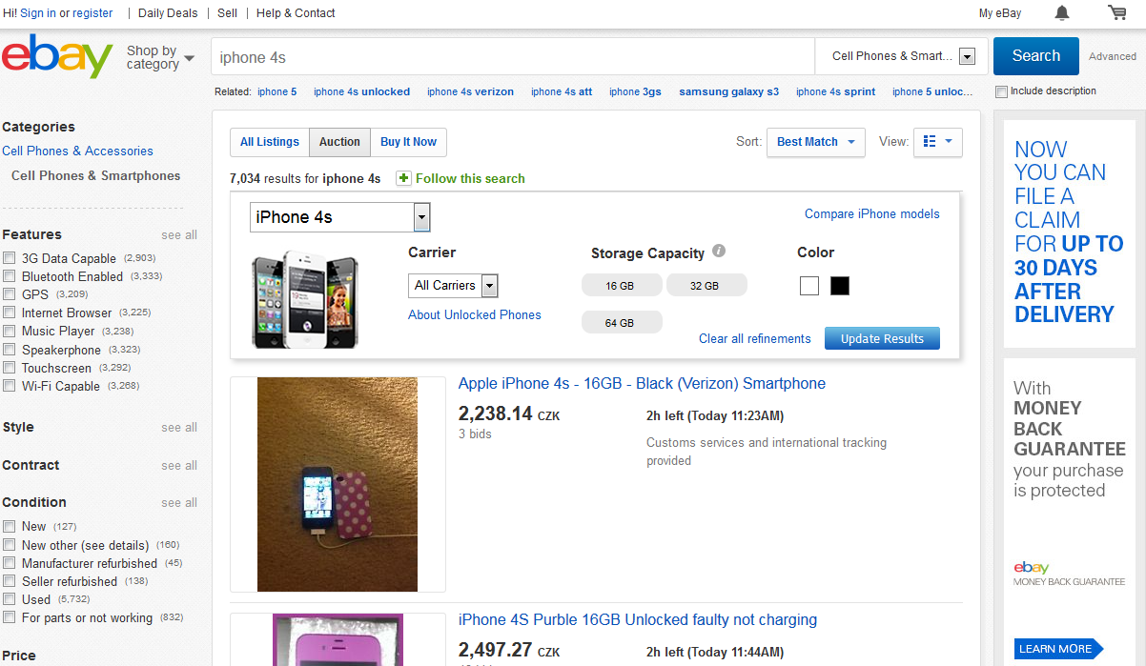
Market[ing]

Slide 9
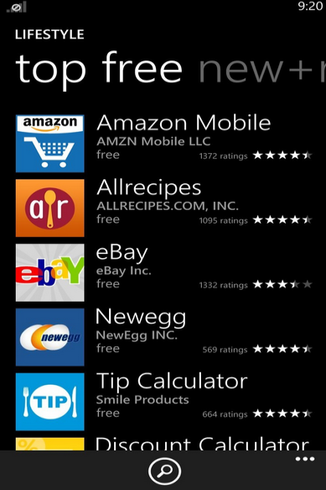
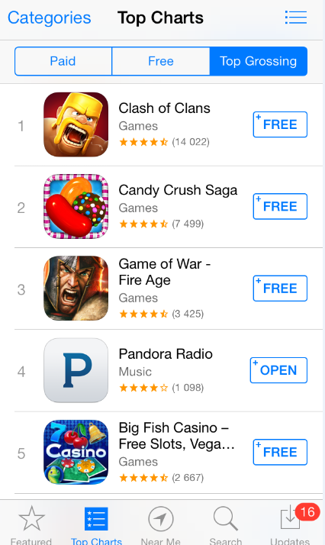

Slide 10
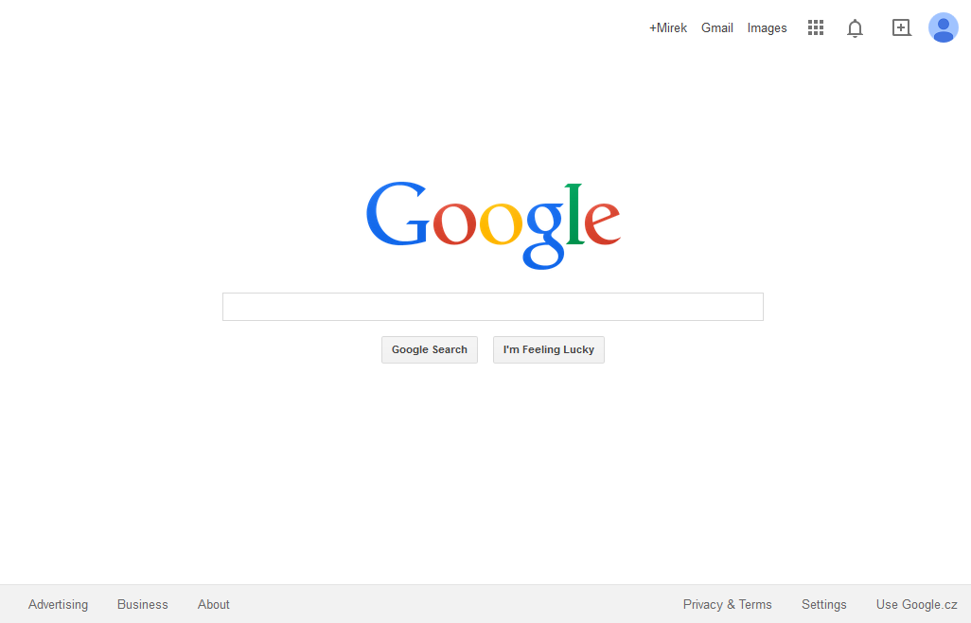
Market[ing]
Market[ing]

Slide 11
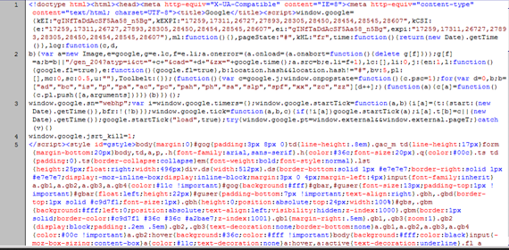
Market[ing]
Market[ing]

Slide 12

Marketing Meets Technology -> Digital Marketing

Slide 13
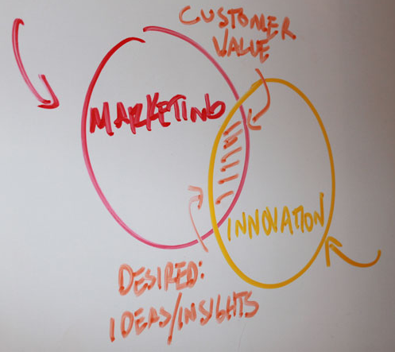
Marketing Abouts
“Business has only two functions – marketing and innovation.”
Milan Kundera

Slide 14
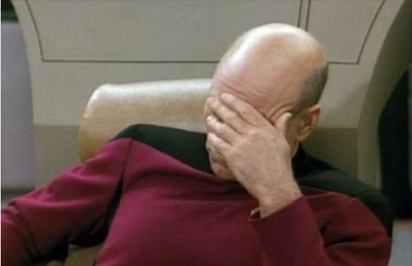
WHAT?
HOW?
FOR WHOM?

Slide 15
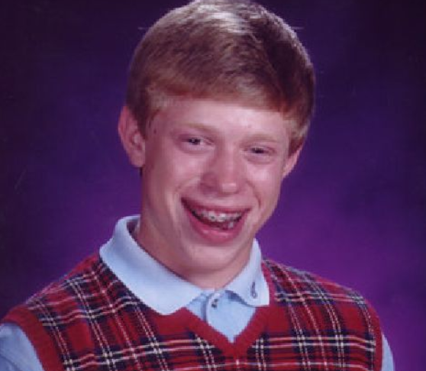
FOR WHOM?
HOW?

Slide 16
WHAT?
HOW?
FOR WHOM?

Slide 17
Marketing Abouts – Marketing Process
WHAT?
HOW?
FOR WHOM?
Marketing Research
Product Development
Adevrtising
Customer Satisfaction Research
Idea
Improvements

Slide 18
Marketing Abouts – General Marketing Disciplines
                Online Marketing
Marketing Research
Branding & Messaging
Product Branding & Marketing
Positioning
Advertising
Public Relation
Content Marketing
Events Marketing & Tradeshows
Pricing
Direct Marketing
…

Slide 19
Marketing Abouts – General Marketing Disciplines
                Online Marketing

Slide 20













Online Marketing - Categories
Bound
Content Marketing
In
Out

Slide 21
Online Marketing - Categories
Social Media
AdWords
PR - Blogs - Forums
SEO - Content Marketing
Display
Email Marketing
Analytics and Research

Slide 22
Online Marketing – SM & AdWords
Social Media
AdWords
PR - Blogs - Forums
SEO - Content Marketing
Display
Email Marketing
Analytics and Research

Slide 23
Online Marketing – PR – Blogs - Forums
Social Media
AdWords
PR - Blogs - Forums
SEO - Content Marketing
Display
Email Marketing
Analytics and Research

Slide 24

Online Marketing – PR – Blogs – Forums
OBRAZEK

Slide 25

Online Marketing – PR – Blogs – Forums
PR – stay in touch with journalists, editors and bloggers
Forums – be active and ready to help

Slide 26
Online Marketing – PR – Blogs – Forums
Blog - have one on your website, write regularly, be relevant, fresh and interesting
Successful content – how to get there:
Pick your topic
Make a research before you start
Write your own way

Slide 27
Online Marketing – PR – Blogs – Forums
Blog - topics that people usually like to read
Guides/Tutorials/How To’s
Lists – “Top Ten Places to find your Remote Control!”
Contests/awards
Answers to FAQ’s
Reviews
“Web gemologist” – reposting blogs in meaningful lists
Success Stories/Failures (case studies)

Slide 28
Online Marketing – PR – Blogs – Forums
Predictions
Interviews or guest blog
Checklists (purchase, processes…)
Research results (hard to obtain)
Recycling own content (press releases, newsletters…)

Slide 29
Online Marketing – SEO – Content Marketing
Social Media
AdWords
PR - Blogs - Forums
SEO - Content Marketing
Display
Email Marketing
Analytics and Research

Slide 30
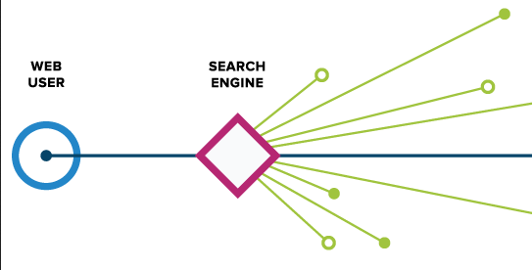
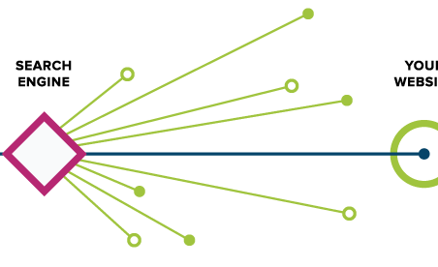

Online Marketing – SEO – Content Marketing
OBRAZEK

Slide 31
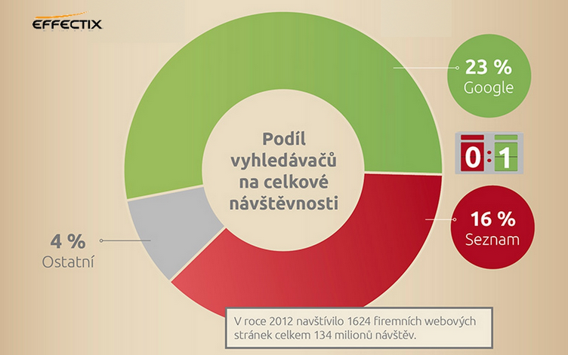
Online Marketing – SEO – Content Marketing

Slide 32
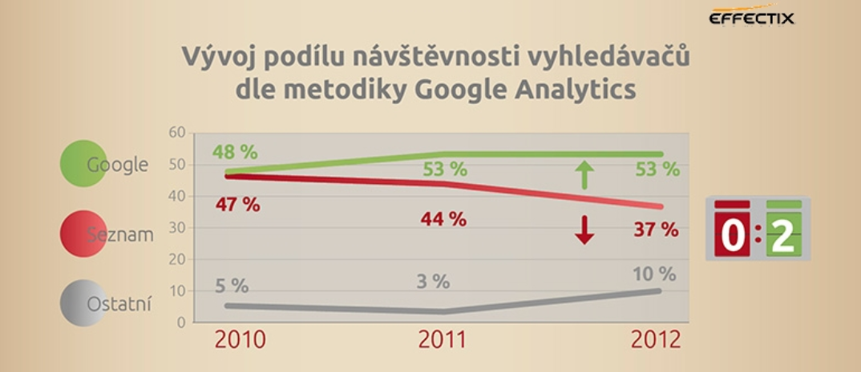
Online Marketing – SEO – Content Marketing

Slide 33
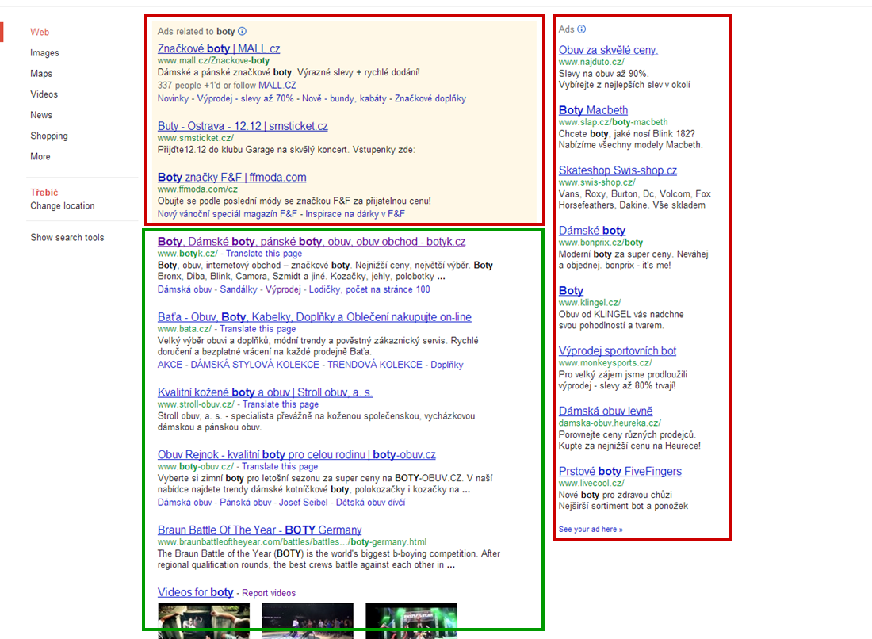

Slide 34
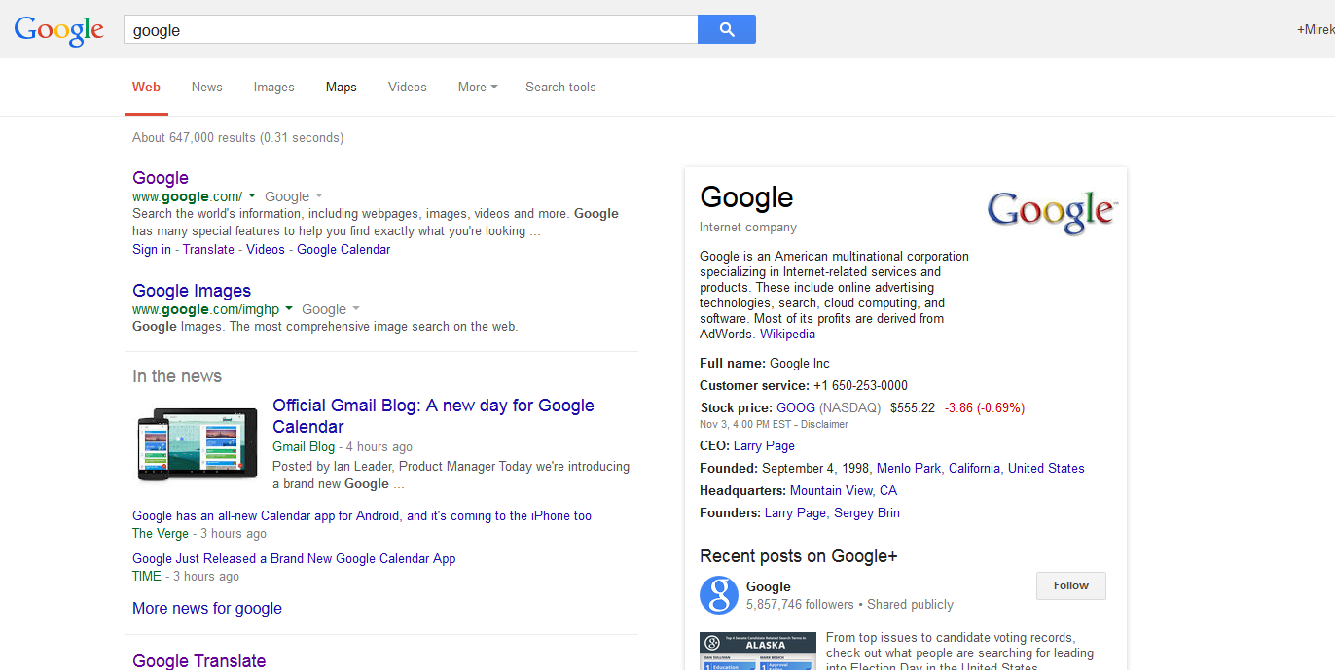
Online Marketing - Categories

Slide 35
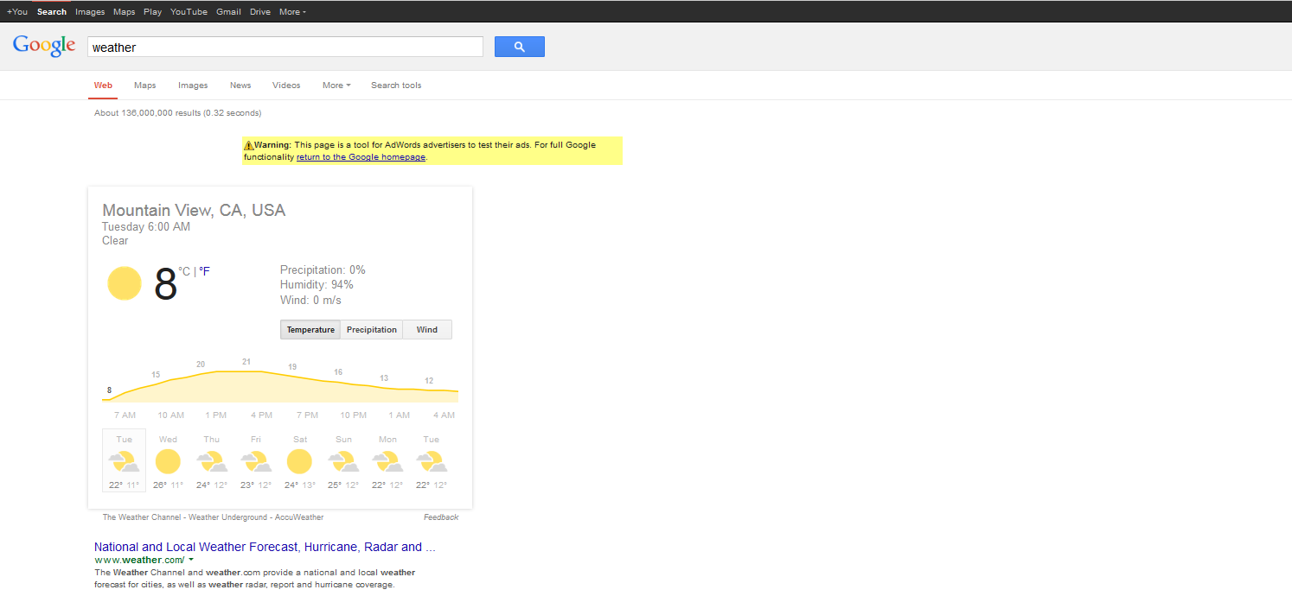
Online Marketing - Categories

Slide 36
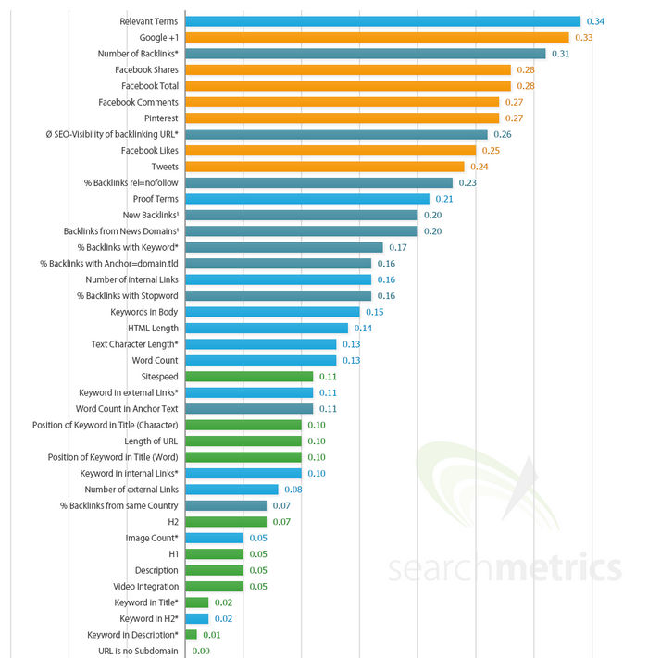

Online Marketing – SEO
Search Ranking Factors
Content relevancy
External backlinks
Social signals
Internal backlinks
Sitespeed

Slide 37

Online Marketing – SEO – Content Marketing
    Content Relevancy
    Relevant and interesting content optimized on relevant keywords
    adwords.google.com/KeywordPlanner
    www.wordtracker.com/
    www.ubersuggest.org/

Slide 38
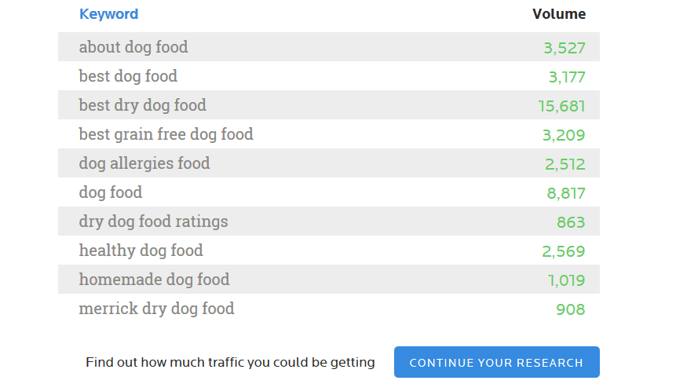
Online Marketing – SEO – Content Marketing

Slide 39
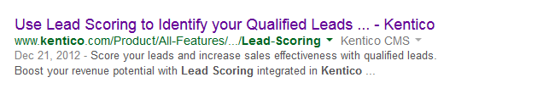
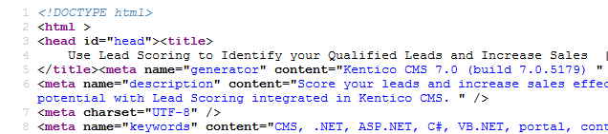
Online Marketing – SEO – Content Marketing
    Optimized Page Titles , Page Description, Relevant page titles (H1, H2) and Image Alt texts
    Character limits: Page Title ~ 55, Page Description ~ 140

Slide 40
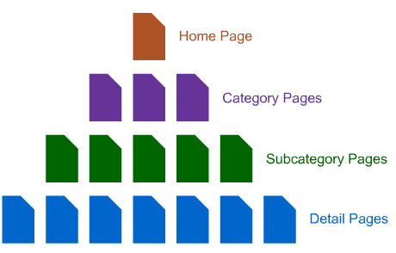
Online Marketing – SEO – Content Marketing
    Good and logical page navigation and page interlinking

Slide 41
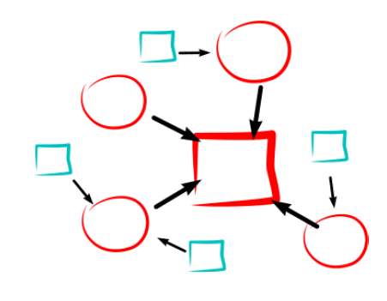
Online Marketing – SEO – Content Marketing
External Links – Link Building
Get links from relevant pages
Get links from Social Media (engagement)
Guest blogging
Backlink requesting
Catalogs and Listings
Be careful about poisoned links
Check GWT and Opensite Explorer

Slide 42
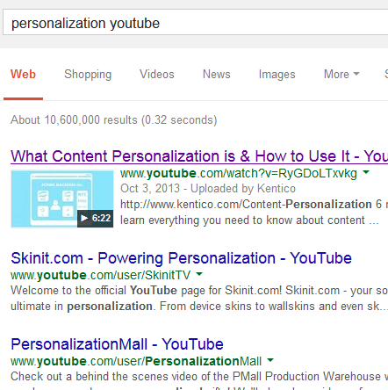
Online Marketing – SEO – Content Marketing
YouTube SEO
The same principles as on Google
Good chance to get on Google with
video snippet
Interlink videos and link back to your
website
Views counts, their source even more
Embed YouTube videos into your page

Slide 43
Online Marketing – Display
Social Media
AdWords
PR - Blogs - Forums
SEO - Content Marketing
Display
Email Marketing
Analytics and Research

Slide 44
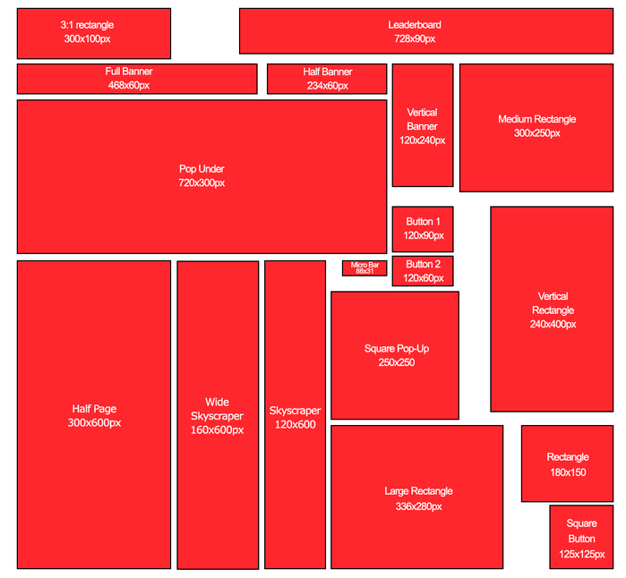

Slide 45
Online Marketing - Categories
Social Media
AdWords
PR - Blogs - Forums
SEO - Content Marketing
Display
Email Marketing
Analytics and Research

Slide 46
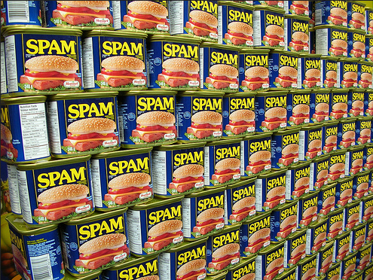

Slide 47
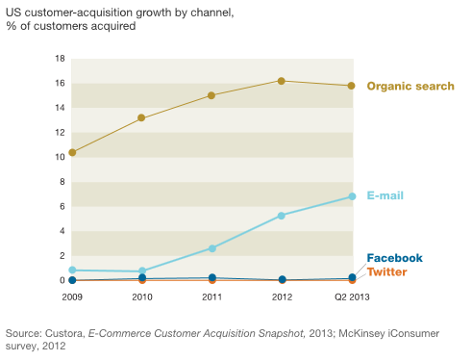
Online Marketing - Categories
Email Marketing
One of the most effective acquisition channel especially in B2B
Can be automated via Marketing Automation
Can be easily personalized
Demands to buy email database or build yours (via newsletter subscription boxes etc.)

Slide 48
Online Marketing - Categories
Social Media
AdWords
PR - Blogs - Forums
SEO & Content Marketing
Display
Email Marketing
Analytics and Research

Slide 49
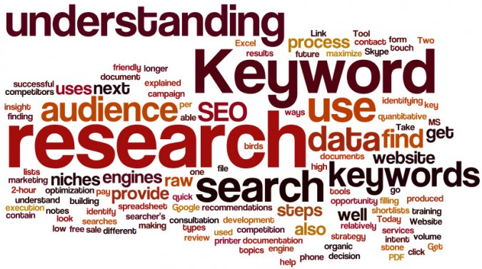
Marketing Research

Slide 50
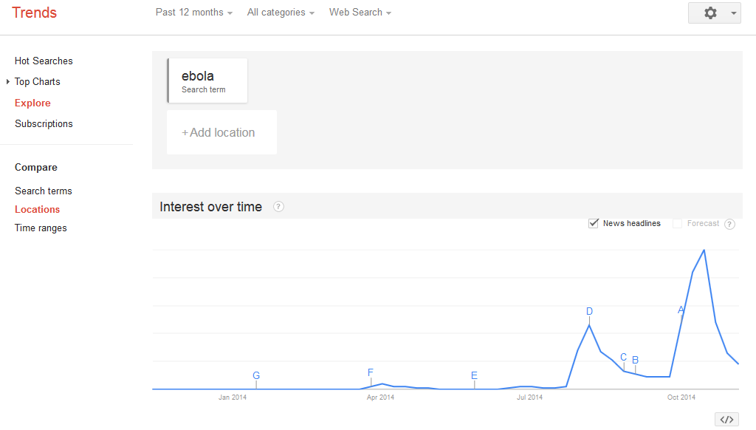
Marketing Research

Slide 51
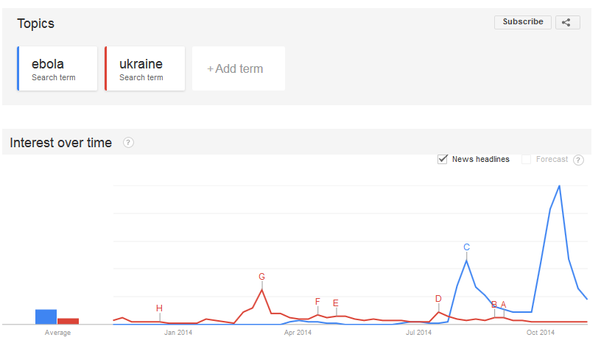
Marketing Research

Slide 52
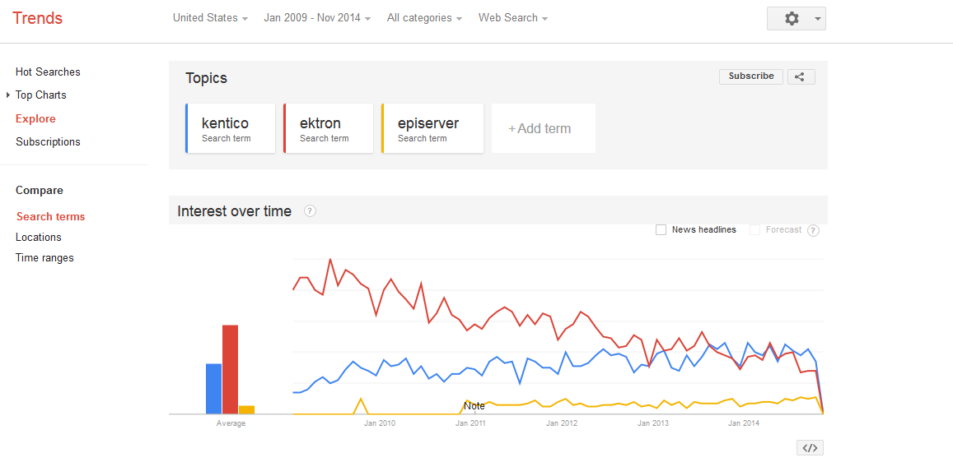
Marketing Research

Slide 53
Online Marketing – Research and Analysis
Survey Monkey / Survio
Installation survey
Satisfaction survey
Uninstallation survey
Google.com/ncr
Google Ad Preview
Ideally use VPN for local specs
Let your community/friends validate your ideas on Social Media or Forums

Slide 54
Online Marketing – Research and Analysis
Mobile Analytics
Google Play Store – Statistics in store by Google
App Annie – Apple Appstore and Google Play Store
Flurry
GA for Google Play Store and Android Apps

Slide 55
Online Marketing – Research and Analysis
Web Analytics
Google Analytics
CrazyEgg
Google Content Experiment (part of GA)
    http://apps.ioninteractive.com/site/contest/guess-which-won

Slide 56
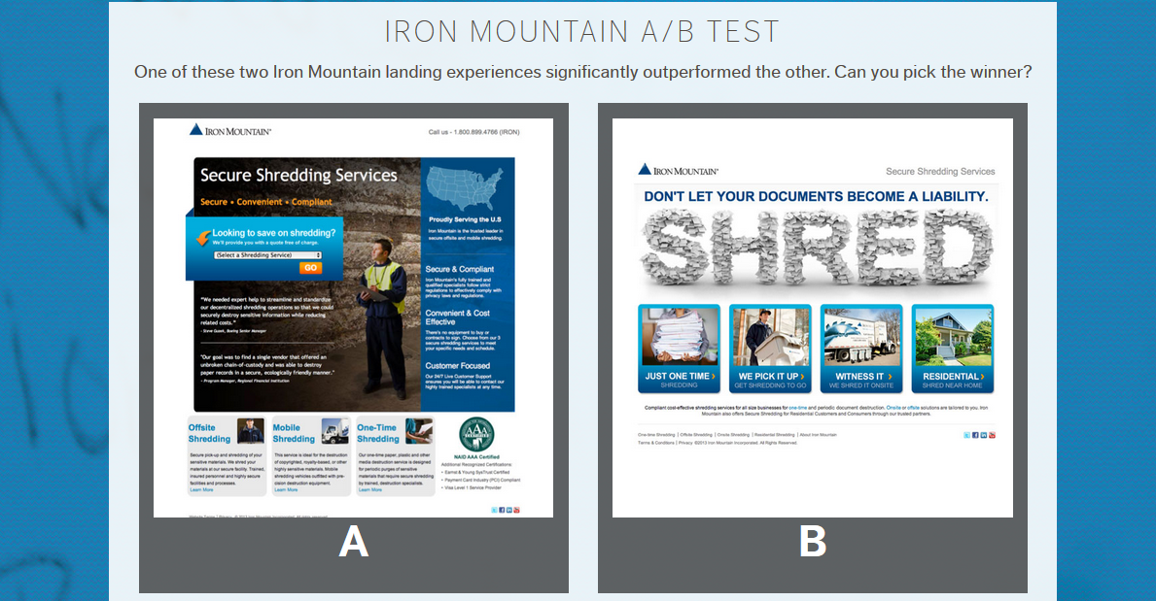
Online Marketing - Categories

Slide 57
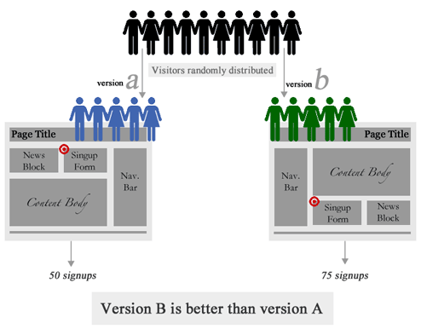

Slide 58
Key Takeaways
Keep trying new things
Measure everything
Keep what works
Leave what doesn’t work
A/B test however use common sense

Slide 59

Thank you

Slide 61
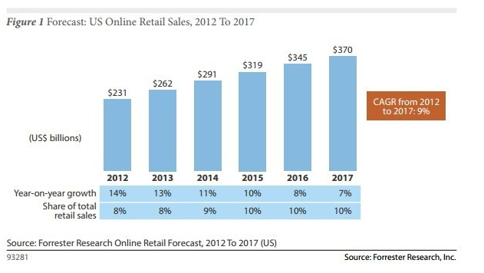

Slide 62
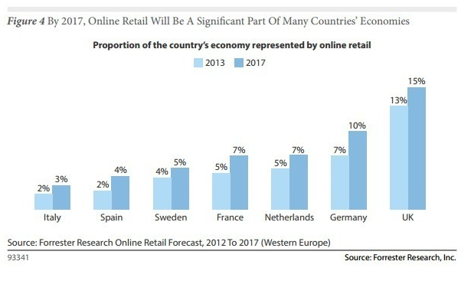

Slide 63
