Slide 1
DISA at ImageCLEF 2014 Annotation Task: results, better results, and future work
Petra Budíková, Michal Batko
DISA seminar, 30. 9. 2014

Slide 2
Outline
A brief history of MUFIN Annotations
DISA at ImageCLEF 2014
  ImageCLEF Scalable Concept Annotation Task
  DISA solution
  Competition results
DISA annotation with DeCAF
  New results
Others at ImageCLEF
Future work

Slide 3
A brief history of MUFIN Annotations
Sometime in 2010:
  We now have a reasonably working image search in large collections. How about using it for search-based image annotation?
2011:
  Budikova, Batko, Zezula: Online Image Annotation. Demo SISAP 2011.
    Very first implementation – take top N most similar images, return top K most frequent words from their descriptions. Merge synonyms using WordNet.
  Budikova, Batko, Zezula: MUFIN at ImageCLEF 2011: Success or Failure?. ImageCLEF 2011.
    Basic annotation implementation combined with face recognition and EXIF tag processing.
    Ranked 13th out of 18 participants. Others mostly used machine learning, which was well applicable since manually preprocessed training data was available.
2012:
  MUFIN Image Annotation software – extension for Firefox
    Provides keyword annotation for arbitrary web image. Still the basic frequency-based annotation.

Slide 4
A brief history of MUFIN Annotations (cont.)
2013:
  Batko, Botorek, Budikova, Zezula: Content-Based Annotation and Classification Framework: A General Multi-Purpose Approach. IDEAS 2013
    A new generic architecture for search-based annotation processing. Multiple modules can be combined to create, expand and clean the annotation.
2014
  Batko, Budikova, Elias Zezula: CLAN Photo Presenter: Multi-modal Summarization Tool for Image Collections. Demo ICMR 2014
    Annotation tool used to assign keyword summaries to image clusters.
  Budikova, Botorek, Batko, Zezula: DISA at ImageCLEF 2014: The search-based solution for scalable image annotation. ImageCLEF 2014
    Exploits a new idea of conceptRank to estimate the probabilities of individual candidate concepts.
    Ranked 5th out of 11 participants.
  Budikova, Botorek, Batko, Zezula: DISA at ImageCLEF 2014 Revised: Search-based Image Annotation with DeCAF Features. Technical Report.
    Annotations with conceptRank and DeCAF features.
    Would have ranked 2nd out of 11 participants!

Slide 5
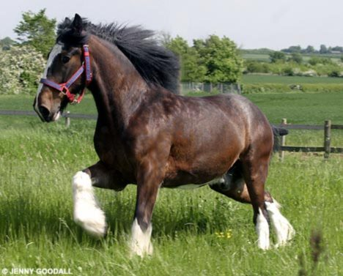
ImageCLEF 2014 Scalable Image Annotation Task
Annotation task definition
  Input: image + set of candidate concepts (40 to 207)
  Expected result: set of relevant concepts
2 datasets
  Development data: 1940 images, ground truth available
  Test data: 7291 images, ground truth not available
aerial airplane baby beach bicycle bird boat bridge building car cartoon castle cat chair child church cityscape closeup cloud cloudless coast countryside daytime desert diagram dog drink drum elder embroidery fire firework fish flower fog food footwear furniture garden grass guitar harbor hat helicopter highway horse indoor instrument lake lightning logo monument moon motorcycle mountain nighttime overcast painting park person plant portrait protest rain rainbow reflection river road sand sculpture sea shadow sign silhouette smoke snow soil space spectacles sport sun sunrise/sunset table teenager toy traffic train tricycle truck underwater unpaved wagon water

Slide 6
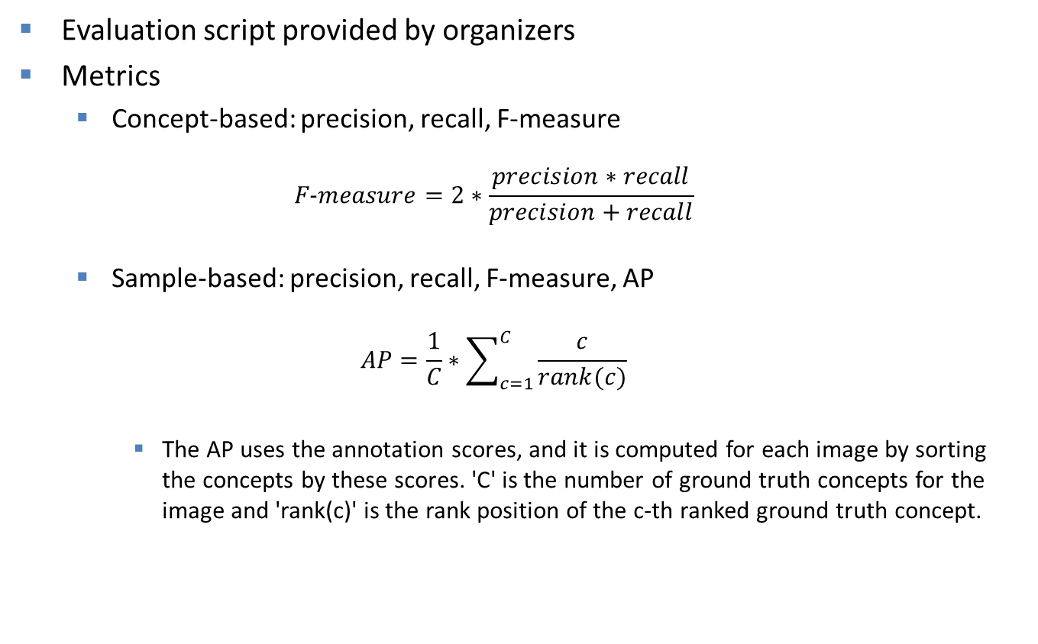
ImageCLEF 2014 evaluation metrics
Evaluation script provided by organizers
Metrics
  Concept-based: precision, recall, F-measure
  $$F\text{−}measure=2∗\frac{precision∗recall}{precision+recall}$$
  Sample-based: precision, recall, F-measure, AP
  $$AP=\frac{1}{C}∗\sum_{c=1}^{C}{\frac{c}{rank(c)}}$$
    The AP uses the annotation scores, and it is computed for each image by sorting the concepts by these scores. 'C' is the number of ground truth concepts for the image and 'rank(c)' is the rank position of the c-th ranked ground truth concept.

Slide 7
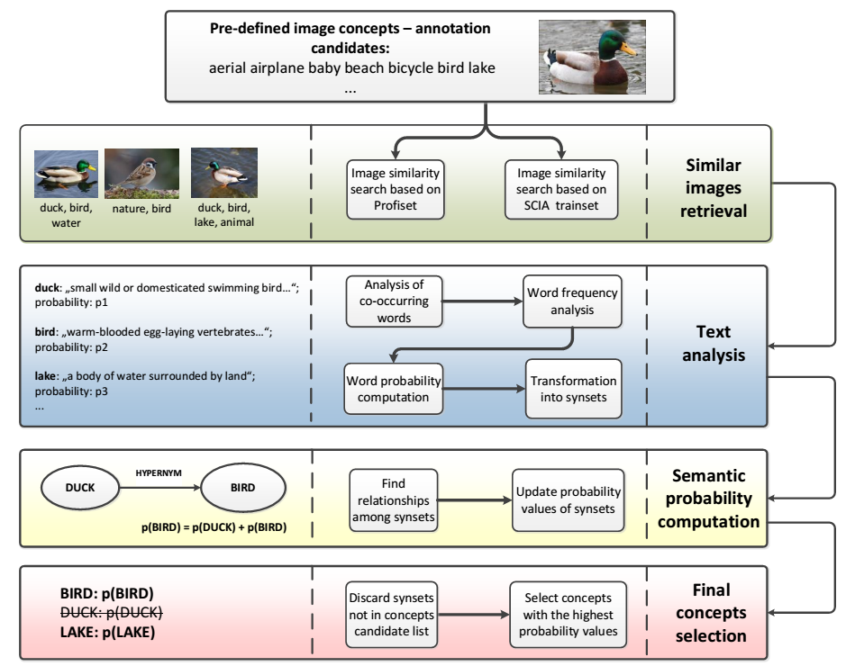
Our solution at ImageCLEF 2014
Search-based annotation with utilization of semantic relationships defined by WordNet

Slide 8
Our solution (cont.)
Image datasets for similarity-based searching:
  Profiset: 20M images with high-quality keywords
  Dataset provided by ImageCLEF organizers (“SCIA trainset”): 500K images from internet, descriptions more noisy, but covers all topics in the contest
Image content extraction:
  Combination of 5 MPEG7 global features
Exploitation of semantic relationships:
  Synonyms
  Probability ranking of possible meanings of each word
  Hypernymy/hyponymy
  Holonymy/meronymy

Slide 9
Other group approaches (first three)
KDEVIR - Computer Science and Engineering department of the Toyohashi University of Technology (Aichi, Japan)
  Used features provided by organizers
  Automatic ontology built per concept using WordNet and Wikipedia
  Training positive and negative samples selected by exploiting ontologies
MIL - Machine Intelligence Lab of the University of Tokyo (Tokyo, Japan).
  Used combination of various descriptors, including FisherVectors & DeCAF
  Linear multi-label classifier by machine learning
MindLab - Machine learning, perception and discovery Lab from the Universidad Nacional de Colombia (Bogotá, Columbia)
  Used DeCAF features
  A logistic regression (soft-max) mode machine learning to classification

Slide 10
ImageCLEF 2014 results
Our solution ranked 5th of the 11 groups
We are more successful in “sample” metrics
  The “concept” metric require that we find the
System | MAP-samples |  |  |  | MF-samples |  |  |  | MF-concepts
 | all | ani. | food | 207 | all | ani. | food | 207 | all | ani. | food | 207 | unseen
KDEVIR 9 | 36.8 | 33.1 | 67.1 | 28.9 | 37.70 | 29.9 | 64.9 | 32.0 | 54.7 | 67.1 | 65.1 | 31.6 | 66.1
MIL 3 | 36.9 | 30.9 | 68.6 | 23.3 | 27.50 | 20.6 | 53.1 | 18.0 | 34.7 | 34.7 | 50.4 | 16.9 | 36.7
MindLab 1 | 37.0 | 43.1 | 63.0 | 22.1 | 25.80 | 17.0 | 45.2 | 18.3 | 30.7 | 35.1 | 35.3 | 16.7 | 34.7
MLIA 9 | 27.8 | 18.8 | 53.6 | 16.7 | 24.80 | 12.1 | 46.0 | 16.4 | 33.2 | 32.7 | 37.3 | 16.9 | 34.8
DISA 4 | 34.3 | 46.6 | 39.6 | 19.0 | 29.70 | 40.6 | 31.2 | 16.9 | 19.1 | 23.0 | 22.3 | 7.3 | 19.0
RUC 7 | 27.5 | 25.2 | 44.2 | 15.1 | 29.30 | 28.0 | 28.2 | 20.7 | 25.3 | 20.1 | 23.1 | 10.0 | 18.7
IPL 9 | 23.4 | 30.0 | 48.5 | 18.9 | 18.40 | 20.2 | 29.8 | 17.5 | 15.8 | 15.8 | 33.3 | 12.5 | 22.0
IMC 1 | 25.1 | 35.7 | 35.6 | 12.9 | 16.30 | 14.3 | 21.0 | 10.9 | 12.5 | 10.2 | 15.1 | 6.1 | 11.2
INAOE 5 | 9.6 | 6.9 | 15.0 | 8.5 | 5.30 | 0.4 | 0.5 | 6.4 | 10.3 | 1.0 | 0.8 | 17.9 | 19.0
NII 1 | 14.7 | 23.2 | 22.0 | 4.6 | 13.00 | 18.9 | 18.7 | 4.9 | 2.3 | 3.0 | 2.1 | 0.9 | 1.8
FINKI 1 | 6.9 | N/A | N/A | N/A | 7.20 | 8.1 | 12.3 | 4.1 | 4.7 | 6.3 | 9.0 | 2.9 | 4.7

Slide 11
New features for image retrieval
DeCAF₇ visual features
  Utilization of deep convolutional network
  Outperformed all participants at ImageNet large scale visual recognition challenge ILSVRC-2012 (Krizhevsky et. al. 2012)
  Adopted as visual descriptor (Donahue et. al. 2013)
    Result from the last hidden layer used as 4096-dimensional visual descriptor
    Similarity using classical L_{p} metric
    Gives better results than traditional features on benchmarks from other domains
Easily used by our similarity-search framework
  PPP-Codes technique able to index 20M collection of data
  Real-time response on a common server hardware
    8 cores, 8GB RAM, 256GB SSD
Improved results of our annotation!
11/11

Slide 12
Evaluation results
Development data
Test data
 | mP-concept | mR-concept | mF-concept | mP-sample | mR-sample | mF-sample | mAP-sample
Baseline (random) | 0.0775 | 0.0641 | 0.0498 | 0.0730 | 0.0969 | 0.0722 | 0.1578
DISA-best with MPEG and Profiset data | 0.2954 | 0.2746 | 0.2184 | 0.3044 | 0.4516 | 0.3352 | 0.4268
DISA-best with MPEG and Profiset+SCIA data | 0.2919 | 0.2778 | 0.2202 | 0.3052 | 0.4533 | 0.3369 | 0.4281
DISA-best with DeCAF and Profiset data | 0.4768 | 0.4899 | 0.4165 | 0.4466 | 0.6152 | 0.4825 | 0.6105
DISA-best with DeCAF and Profiset+SCIA data | 0.4928 | 0.5085 | 0.4315 | 0.4534 | 0.6252 | 0.4901 | 0.6196
 | mF-concept | mF-sample | mAP-sample
Baseline (random) | 0.026 | 0.035 | 0.088
DISA-best with MPEG and Profiset data | 0.154 | 0.279 | 0.316
DISA-best with MPEG and Profiset+SCIA data | 0.191 | 0.297 | 0.343
Competition best | 0.547 | 0.377 | 0.368
DISA-best with DeCAF and Profiset+SCIA data | 0.411 | 0.399 | 0.486
Evaluated by ImageCLEF organizers as a favor after competition deadline

Slide 13
New result evaluation – details
 | mF-concept | mF-sample | mAP-sample
DISA-MU 04 (DISA best in competition) | 19.1 [17.5–21.8] | 29.7 [29.2–30.3] | 34.3 [33.8–35.0]
KDEVIR 09 (competition winner) | 54.7 [50.9–58.3] | 37.7 [37.0–38.5] | 36.8 [36.1–37.5]
DISA-MU NEW | 41.1 [38.3–44.2] | 39.9 [39.3–40.5] | 48.6 [47.9–49.3]
System | MAP-samples |  |  |  | MF-samples |  |  |  | MF-concepts
 | all | ani. | food | 207 | all | ani. | food | 207 | all | ani. | food | 207 | unseen
KDEVIR 9 | 36.8 | 33.1 | 67.1 | 28.9 | 37.70 | 29.9 | 64.9 | 32.0 | 54.7 | 67.1 | 65.1 | 31.6 | 66.1
DISA NEW | 48.6 | 51.0 | 67.2 | 32.3 | 39.90 | 44.4 | 48.5 | 26.7 | 41.1 | N/A | N/A | N/A | 44.9
MIL 3 | 36.9 | 30.9 | 68.6 | 23.3 | 27.50 | 20.6 | 53.1 | 18.0 | 34.7 | 34.7 | 50.4 | 16.9 | 36.7
MindLab 1 | 37.0 | 43.1 | 63.0 | 22.1 | 25.80 | 17.0 | 45.2 | 18.3 | 30.7 | 35.1 | 35.3 | 16.7 | 34.7
MLIA 9 | 27.8 | 18.8 | 53.6 | 16.7 | 24.80 | 12.1 | 46.0 | 16.4 | 33.2 | 32.7 | 37.3 | 16.9 | 34.8
DISA 4 | 34.3 | 46.6 | 39.6 | 19.0 | 29.70 | 40.6 | 31.2 | 16.9 | 19.1 | 23.0 | 22.3 | 7.3 | 19.0
RUC 7 | 27.5 | 25.2 | 44.2 | 15.1 | 29.30 | 28.0 | 28.2 | 20.7 | 25.3 | 20.1 | 23.1 | 10.0 | 18.7
IPL 9 | 23.4 | 30.0 | 48.5 | 18.9 | 18.40 | 20.2 | 29.8 | 17.5 | 15.8 | 15.8 | 33.3 | 12.5 | 22.0
IMC 1 | 25.1 | 35.7 | 35.6 | 12.9 | 16.30 | 14.3 | 21.0 | 10.9 | 12.5 | 10.2 | 15.1 | 6.1 | 11.2
INAOE 5 | 9.6 | 6.9 | 15.0 | 8.5 | 5.30 | 0.4 | 0.5 | 6.4 | 10.3 | 1.0 | 0.8 | 17.9 | 19.0
NII 1 | 14.7 | 23.2 | 22.0 | 4.6 | 13.00 | 18.9 | 18.7 | 4.9 | 2.3 | 3.0 | 2.1 | 0.9 | 1.8
FINKI 1 | 6.9 | N/A | N/A | N/A | 7.20 | 8.1 | 12.3 | 4.1 | 4.7 | 6.3 | 9.0 | 2.9 | 4.7

Slide 14
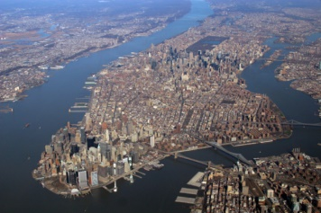
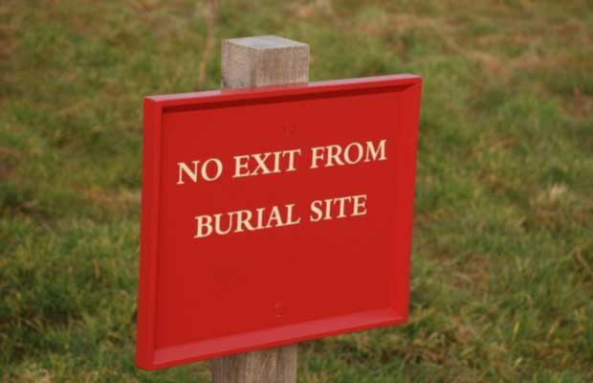
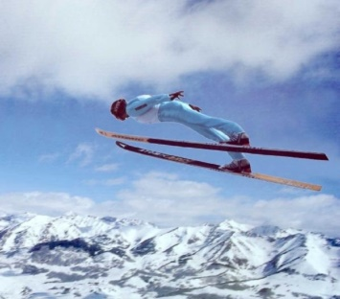
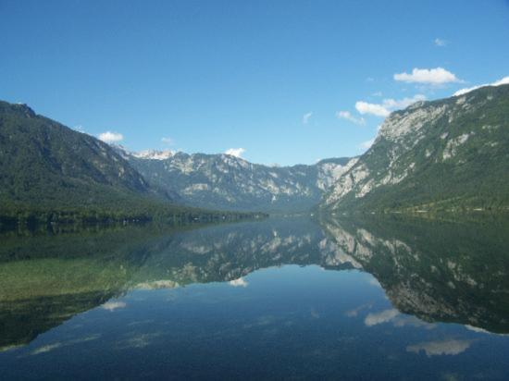
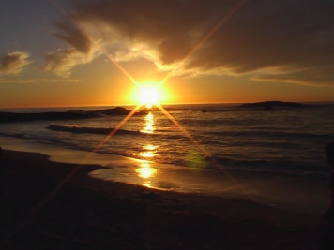

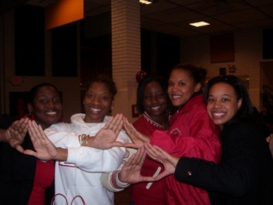
Results illustration – the top 5 concepts (DeCAF-best method, random selection of queries)
Horse, person, grass, daytime, plant
Missing: countryside
Sea, cityscape, water, coast, aerial
Missing: bridge, outdoor, river
Sport, male, water, sea, sky
Missing: cloud, ski, snow
Outdoor, person, tree, food, forest
Missing: grass, sign
Mountain, water, lake, river, sea
Missing: cloud, daytime, reflection
Sunrise/sunset, water, beach, sea, coast
Missing: cloud, reflection, sand, sky, sun
Person, female, male, motorcycle, poster
Missing: cloud, horse, overcast, soil
Person, food, child, indoor, teenager
Missing: --
Notes:
-gtLV2J8mRnRuo9Q, 1Cear3rT3BkcYmHZ, 1_4HQaUUVBzXf-Ld, mN0z3vOSj3gQqF3S, 3JO2X2A5D1nBvTuA, oaYw5NIPG3ntCnLd, PFgeYp5m7lUHjAMe, 2xZmZFKAnRAI1xQN

Slide 15
DeCAF vs. MPEG
Out of 1940 development queries
  AP_{MPEG} is higher than AP_{DeCAF} in 357 cases
  Precision_{MPEG} is higher than Precision_{DeCAF} in 201 cases
  Recall_{MPEG} is higher than Recall_{DeCAF} in 158 cases
When MPEG results are better, typically
  the query image is difficult
  neither MPEG nor DeCAF provide good results
  MPEG-based results often better by small margin
  MPEG-based results often probably better by chance
With very few exceptions, DeCAF-based visual similarity is better

Slide 16
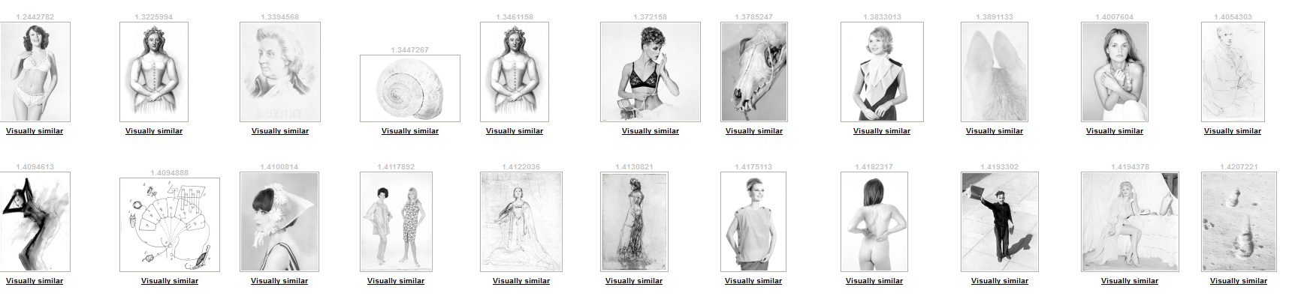
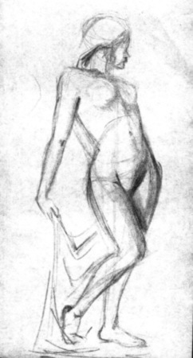
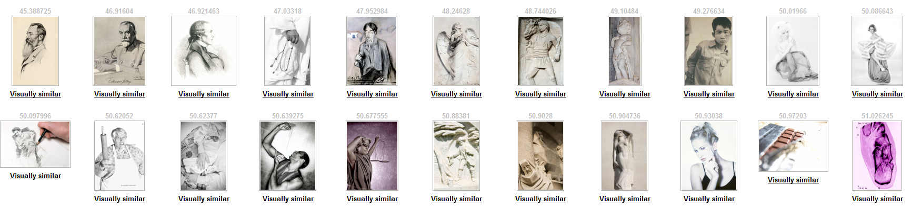
DeCAF vs. MPEG (cont.)
Two examples where MPEG visual similarity is better
  Interesting for further study?
MPEG7 descriptors
DeCAF₇ descriptors
query
Notes:
xTmOlLg4LsnO09sr.jpg

Slide 17
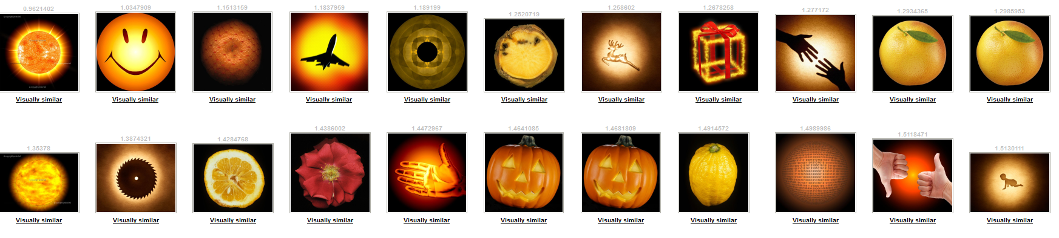
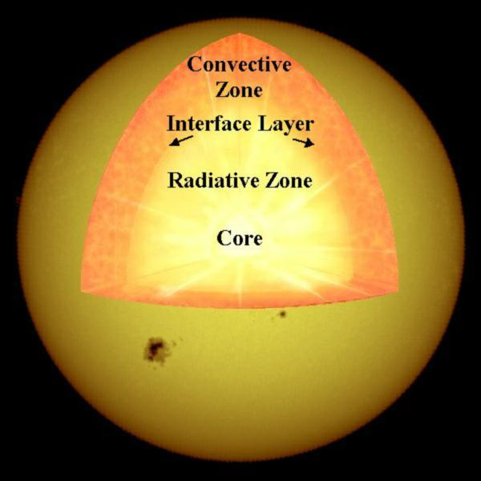
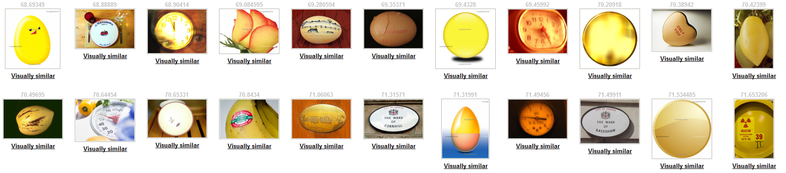
Caffe vs. MPEG (cont.)
MPEG7 descriptors
DeCAF₇ descriptors
query
Notes:
Nwq5x1MXfivYJMcU

Slide 18
Conclusions
Presented modular architecture of DISA annotation tool
  allows easy replacement of any component
Our approach is based on nearest-neighbor search not training
  completely scalable – crawled data can be directly indexed
  no need for ground truth
  generic vocabulary (keyword) annotation – no need to hit predefined classes
New visual similarity by DeCAF features
  The new similarity-search component enabled us to increase the quality of annotations by approximately 10-20 % (depending on the quality measure)
  New DISA results outperform the best results submitted to ImageCLEF 2014 Annotation Challenge in 2 out of 3 quality measures
18/11

Slide 19
Future work
With CVUT: other descriptors/neural network descriptors trained on different data
Refinement of conceptRank algorithm
Relevance feedback
Experiments with other queries+GT
Journal paper (by December)

