Slide 1
Neural networks in modern image processing
Petra Budíková
DISA seminar, 30. 9. 2014

Slide 2
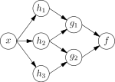
Artificial neural networks
Computational models inspired by an animal's central nervous systems
Systems of interconnected "neurons" which can compute values from inputs
Are capable of approximating non-linear functions of their inputs
  Mathematically, a neuron's network function f(x) is defined as a composition of other functions g_{i}(x), which can further be defined as a composition of other functions.
Known since 1950s
Typical applications: pattern recognition in speech or images

Slide 3
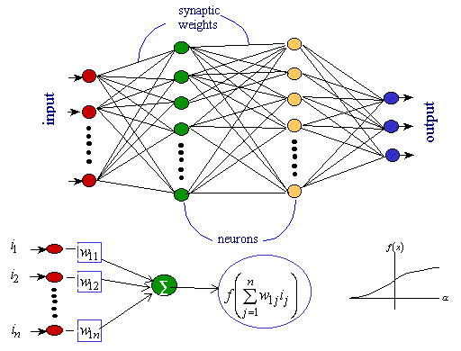
Artificial neural networks (cont.)

Slide 4
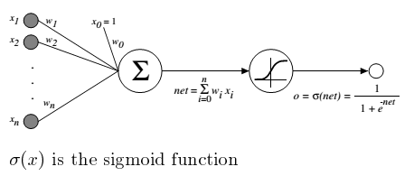
Artificial neural networks (cont.)
Network node in detail
Network learning process = tuning the synaptic weights
  Initialize randomly
  Repeatedly compute the ANN result for a given task, compare with ground truth, update ANN weights by backpropagation algorithm to improve ANN performance

Slide 5
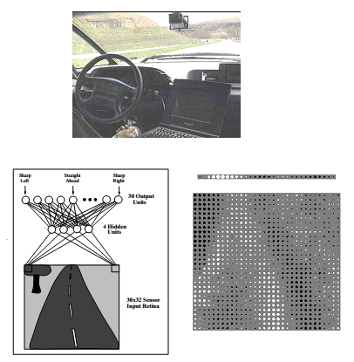
Artificial neural networks – example
ALVINN system for automatic car driving (ANN illustration form [Mitchell97])

Slide 6
Neural networks before 2009(+-) and after
Before 2009: ANNs typically with 2-3 layers
  Reason 1: computation times
  Reason 2: problems of the backpropagation algorithm
    Local optimization only (needs a good initialization, or re-initialization)
    Prone to over-fitting (too many parameters to estimate, too few labeled examples)
  => Skepticism: A deep network often performed worse than a shallow one
After 2009: Deep neural networks
  Fast GPU-based implementations
  Weights can be initialized better (Use of unlabeled data, Restricted Boltzmann Machines)
  Large collections of labeled data available
  Reducing the number of parameters by weight sharing
  Improved backpropagation algorithm
  Success in different areas, e.g. traffic sign recognition, handwritten digits problem

Slide 7
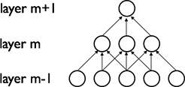
Convolutional neural networks
A type of feed-forward ANN where the individual neurons are tiled in such a way that they respond to overlapping regions in the visual field
  Inspired by biological processes
  Widely used for image recognition
Multiple layers of small neuron collections which look at small portions of the input image
  The input hidden units in the m-th layer are connected to a local subset of units in the (m-1)-th layer, which have spatially contiguous receptive fields

Slide 8

Convolutional neural networks
Shared weights: each sparse filter h_{i} is replicated across the entire visual field. The replicated units form a feature map, which share the same parametrization, i.e. the same weight vector and the same bias.
  Weights of the same color are shared, i.e. are
  constrained to be identical
  Replicating units allows for features to be detected
  regardless of their position in the visual field.
  Weight sharing greatly reduces the number of free parameters to learn.
MaxPooling: another important concept of CNNs
  non-linear down-sampling – the input image is partitioned into a set of non-overlapping rectangles and maximum value is taken for each such sub-region
  Advantages:
    It reduces the computational complexity for upper layers
    It provides a form of translation invariance

Slide 9
Krizhevsky 2012: ImageNet neural network
The ImageNet challenge: recognize 1000 image categories
  Training data: 1.2M manually cleaned training images (obtained by crowdsourcing)
Krizhevsky solution: deep convolutional neural network
  5 convolutional layers, 3 fully connected layers
  60 million parameters and 650,000 neurons
  New function for nodes (Rectified Linear Units)
  Efficient GPU implementation of NN learning, highly-optimized implementation of 2D convolution
  Data augmentation
    generating image translations and horizontal reflections
    five 224 × 224 patches (the four corner patches and the center patch) as well as their horizontal reflection from each 256×256 image
    => transformation invariance, reduces overfitting
  Additional refinements such as the “dropout” regularization method

Slide 10
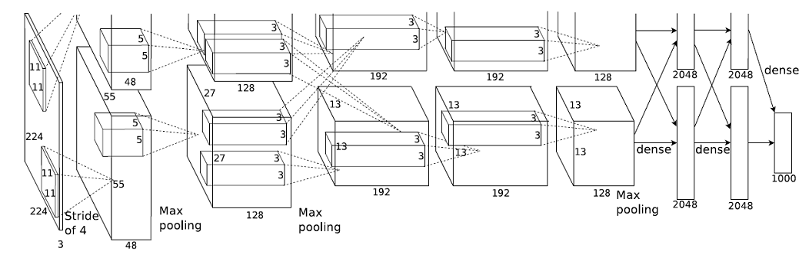
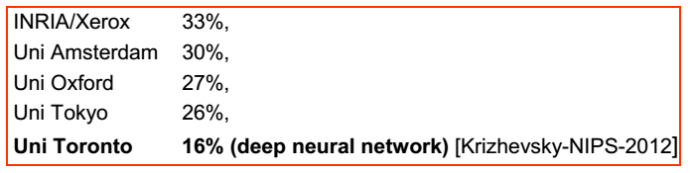
Krizhevsky 2012 (cont.)
Great success!!!

Slide 11
Krizhevsky 2012 – more than just classification?
Indications that the last hidden layers carry semantics!
Suggestion in [Krizhevsky12]:
  Responses of the last hidden layer can be used as a compact global image descriptor
  Semantically similar images should have small Euclidean distance

Slide 12
Convolutional neural network implementations
cuda-convent
  Original implementation by Alex Krizhevsky
decaf
  Python framework for training neural networks
Caffe
  Convolutional Architecture for Fast Feature Embedding
  Berkeley Vision and Learning Center
  C++/CUDA framework for deep learning and vision
  An active research and development community
  Main advantage in comparison with other implementations: it is FAST
  Wrappers for Python and MATLAB

Slide 13
DeCAF
decaf
  Python framework for training neural networks
  Deprecated, replaced by Caffe
DeCAF
  Image features derived from neural network trained for the ImageNet competition
  3 types: DeCAF₅, DeCAF₆, DeCAF₇
    Derived from last 3 hidden layers of the ImageNet neural network
    Descriptor sizes: ??? dimensions for DeCAF₅, 4096 dimensions for DeCAF₆, DeCAF₇

Slide 14
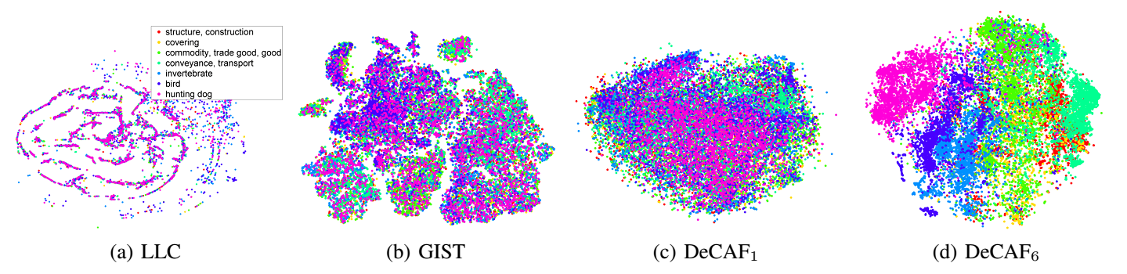
DeCAF (cont.)
Performance of DeCAF features analyzed in [Donahue14] in context of several image classification tasks
  DeCAF₅ not so good
  DeCAF₆ and DeCAF₇ very good, in many cases outperform state-of-the-art descriptors
  DeCAF₆ typically more successful, but only by small margin

Slide 15
Utilization of DeCAF descriptors
Recognition of new (unseen in ImageNet) categories by training (a linear) classifier on top of the DeCAF descriptors
  [Donahue14]
  [Girshick14]
  Two solutions of ImageCLEF 2014 Scalable Concept Annotation Challenge
  …
Very good results reported

Slide 16
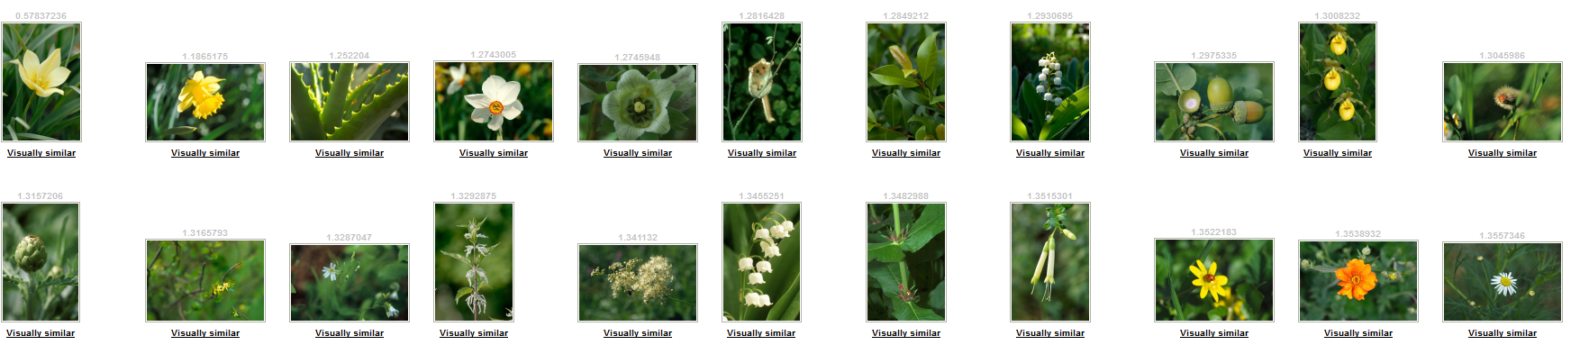
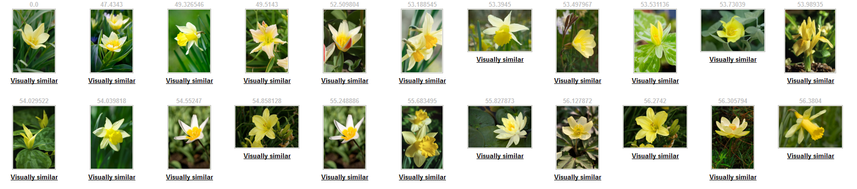
Similarity search: MPEG7 vs. DeCAF₇
Similarity search in 20M images; 1st image is the query
MPEG7 descriptors
DeCAF₇ descriptors
Notes:
MPEG7 similarity search: http://mufin.fi.muni.cz/profimedia/similar?k=25&url=http://mufin.fi.muni.cz/profimedia/images/0010747065
DeCAF similarity search: http://disa.fi.muni.cz/profimedia-neural_network-20M/similar?database=0010747065

Slide 17
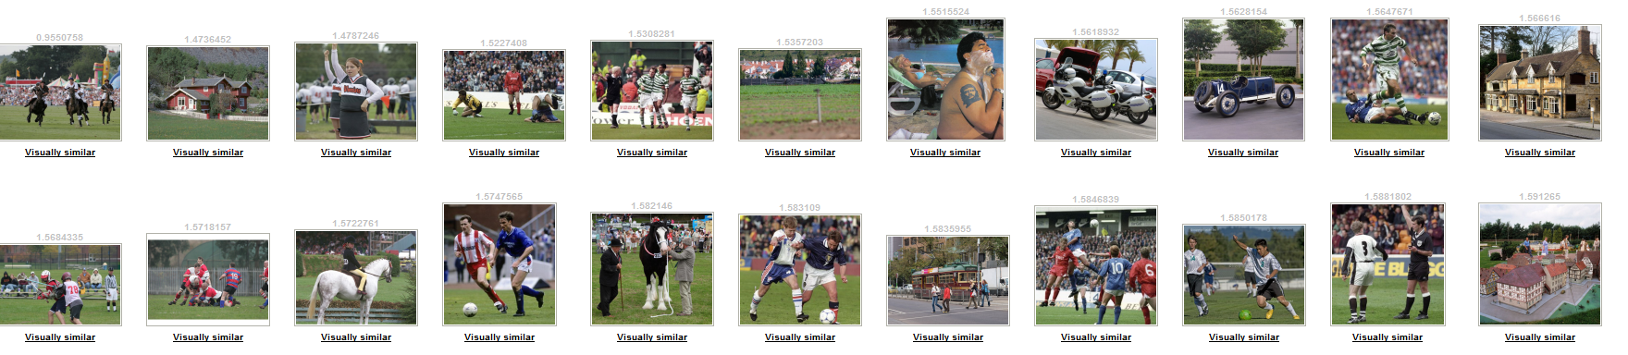
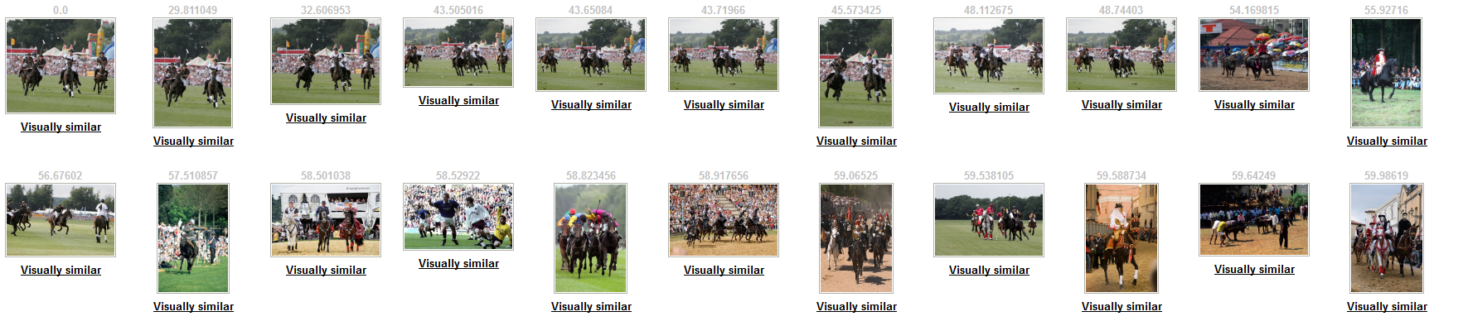
Similarity search: MPEG7 vs. DeCAF₇
MPEG7 descriptors
DeCAF₇ descriptors
Notes:
MPEG7 similarity search: http://mufin.fi.muni.cz/profimedia/similar?k=25&url=http://mufin.fi.muni.cz/profimedia/images/0005692584
DeCAF similarity search: http://disa.fi.muni.cz/profimedia-neural_network-20M/similar?database=0005692584

Slide 18
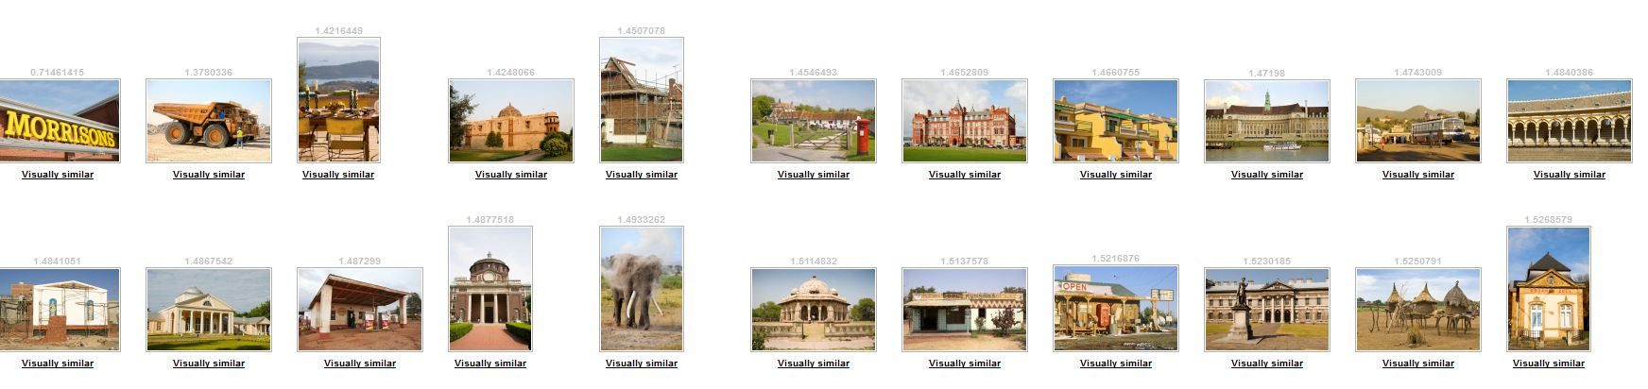

Similarity search: MPEG7 vs. DeCAF₇
MPEG7 descriptors
DeCAF₇ descriptors
Notes:
MPEG7 similarity search: http://mufin.fi.muni.cz/profimedia/similar?k=25&url=http://mufin.fi.muni.cz/profimedia/images/0049986653
DeCAF similarity search: http://disa.fi.muni.cz/profimedia-neural_network-20M/similar?database=0049986653

Slide 19
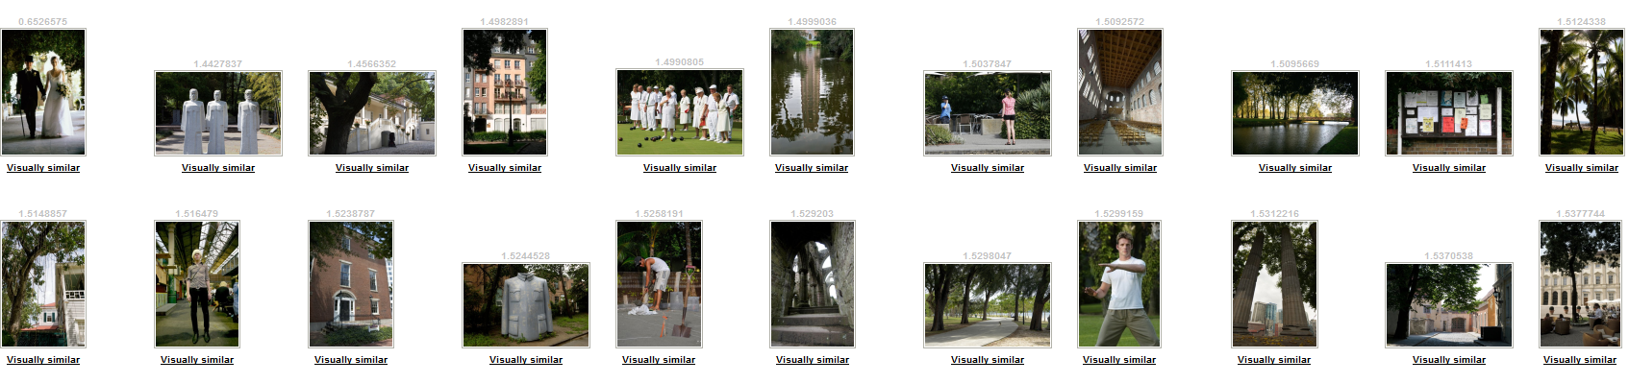
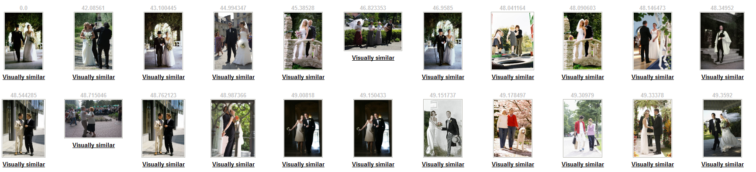
Similarity search: MPEG7 vs. DeCAF₇
MPEG7 descriptors
DeCAF₇ descriptors
Notes:
MPEG7 similarity search: http://mufin.fi.muni.cz/profimedia/similar?k=25&url=http://mufin.fi.muni.cz/profimedia/images/0004834774
DeCAF similarity search: http://disa.fi.muni.cz/profimedia-neural_network-20M/similar?database=0004834774

Slide 20
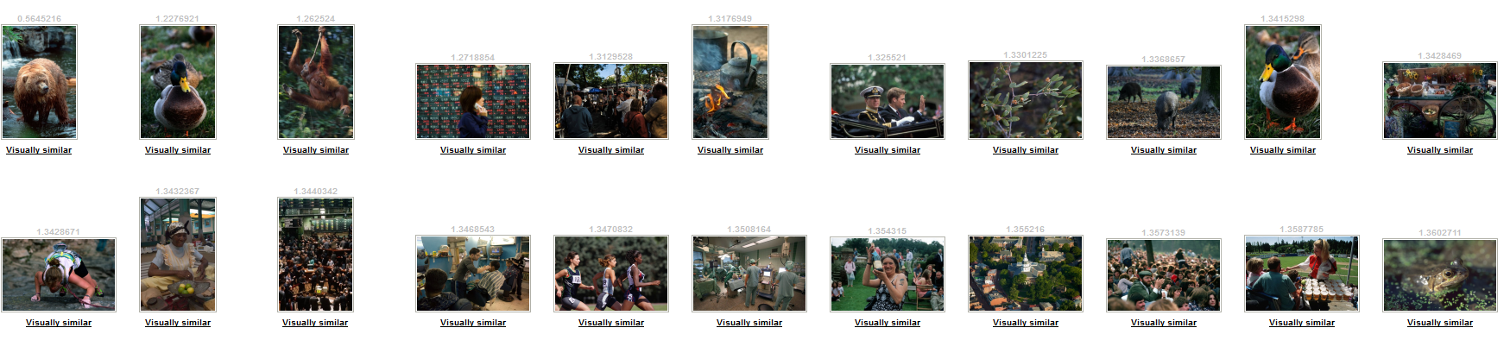
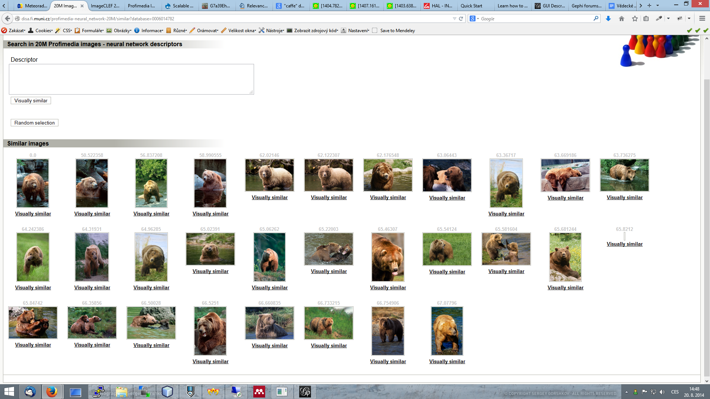
Similarity search: MPEG7 vs. DeCAF₇
MPEG7 descriptors
DeCAF₇ descriptors
Notes:
MPEG7 similarity search: http://mufin.fi.muni.cz/profimedia/similar?k=25&url=http://mufin.fi.muni.cz/profimedia/images/0006014782
DeCAF similarity search: http://disa.fi.muni.cz/profimedia-neural_network-20M/similar?database=0006014782

Slide 21
Literature
Books
[Mitchell97] T. Mitchell. Machine Learning. ISBN 978-0070428072. McGraw Hill, 1997.
Research papers
[Donahue14] J. Donahue, Y. Jia, O. Vinyals, J. Hoffman, N. Zhang, E. Tzeng, and T. Darrell. Decaf: A deep convolutional activation feature for generic visual recognition. ICML, 2014.
[Girshick14] R. Girshick, J. Donahue, T. Darrell, and J. Malik. Rich feature hierarchies for accurate object detection and semantic segmentation. CVPR, 2014.
[Jia14] Y. Jia, E. Shelhamer, J. Donahue, S. Karayev, J. Long, R. Girshick, S. Guadarrama, T. Darrell. Caffe: An Open Source Convolutional Architecture for Fast Feature Embedding. Submitted to ACM MULTIMEDIA 2014 Open Source Software Competition.
[Krizhevsky12] A. Krizhevsky, I. Sutskever, G. E. Hinton: ImageNet Classification with Deep Convolutional Neural Networks. NIPS 2012.

Slide 22
Literature (cont.)
Other
http://caffe.berkeleyvision.org/
J. Materna: Deep Learning: budoucnost strojového učení? http://fulltext.sblog.cz/2013/01/09/deep-learning-budoucnost-strojoveho-uceni/
J. Čech: A Shallow Introduction into the Deep Machine Learning. https://cw.felk.cvut.cz/wiki/_media/courses/ae4m33mpv/deep_learning_mpv.pdf
Basic explanation of convolutional neural networks principles http://deeplearning.net/tutorial/lenet.html

