Slide 1
Asynchronous programming
Tomas Hruby
2015
Notes:
- Time consuming I/O op. or Web Request
- Synchronous calling blocks possible execution of independent code

Slide 2
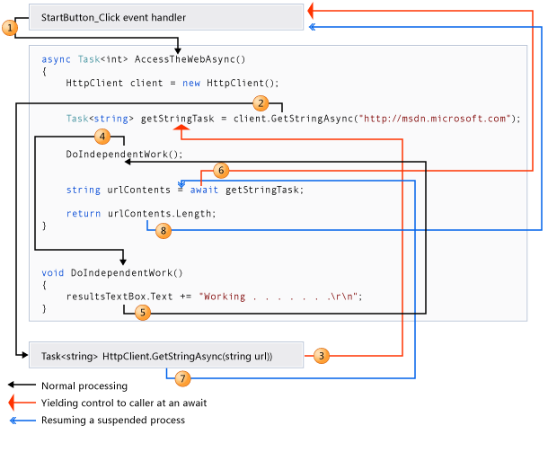

Slide 3
Async-Await
MVC basics
Put async-await only across the whole application
Don’t mix manipulation with threads with async-await
  Blocking context threads causes deadlocks
  To use async code from normal method use Task.Run
Method can continue in a different thread after awaiting
  Don’t depend on the thread context
  HTTP context copies context information to new thread from the thread pool
https://msdn.microsoft.com/en-us/library/hh191443.aspx
http://blog.stephencleary.com/2012/07/dont-block-on-async-code.html
Notes:
Show deadlock when blocking the context thread.

Slide 4
REST APIs
Tomas Hruby
2015
Notes:
Describe REST application role.

Slide 5
The brightest future of .NET
MVC basics
REST API is in fact the only thing that for example a React application needs as a backend.
REST API is platform agnostic
REST API is easy to read and edit/debug
.NET accelerates development of REST APIs
  Programming—Web API, Newtonsoft.Json, OWIN, …
  Deployment—Microsoft Azure
Scalability (horizontal)
  Stateless services + REST API + Azure

Slide 6
Basics revisited
MVC basics
Stateless HTTP communication (Request-Response)
URL identifies an object
  ~/api/users/ngk67
  ~/api/users/ngk67/roles
  Use plural for endpoints (/api/users, /api/projects)
Method identifies action (GET, POST, PUT, PATCH, DELETE)
  GET ~/api/users (get all users)
  DELETE ~/api/users/ngld456 (delete user with given ID)
Request body represents the object identified by URI
  POST ~/api/users (object in request body is inserted as user)
Server answers with HTTP Status Code and response body containing requested object(s)

Slide 7
HTTP Status Codes
MVC basics
Method | URL pattern | Statuses | (Notes)
GET | /api/users | 200
GET | /api/users/{id} | 200, 404
POST | /api/users | 201, 400 | 201 – Created
PUT | /api/users/{id} | 200, 404, 400 | 400 – Bad request
DELETE | /api/users/{id} | 204, 404 | 204 – No content
401 – Unauthorized
500 – Internal Server Error
429 – Too many requests (response should contain time of renewal)
http://www.restapitutorial.com/httpstatuscodes.html
Notes:
Browse default UI showing controllers in action
Create an route without controller (for HomeController)

Slide 8
Filtering & Paging
MVC basics
Filtering using query parameters
  GET ~/api/students?semester=spring
Filtering using query objects
  GET ~/api/students?filter={“subjects”=[“PE”,“maths”],”age”=18}}
  REST calls remain the same even if new filter is added (forward compatible)
  Easy to write by hand in browser URL bar
Paging request
  GET ~/api/students?pagesize=10&page=3
Paging responses
  Pagination info in header (X-Total-Count, X-Page-Size, X-Current-Page)
  Pagination envelope
    { “total”: 40, “pageSize”: 10, “page”: 1, “data”: […] }
  Cursor based pagination (link to next page)

Slide 9
Versioning
MVC basics
Using URL prefixes
  ~/api/v1/users
Using HTTP headers
  X-API-Version: 7.1.3

Slide 10
Special actions
MVC basics
Don’t use special query parameters (as flags). Use special endpoints
  ~/api/students/{id}/disable
  ~/api/users/resetpassword

Slide 11
Few other design tips
MVC basics
Use pretty printed JSON in responses
Put examples into documentation
Use projections (do not return all attributes in case of large objects)
Implement only necessary methods
http://www.vinaysahni.com/best-practices-for-a-pragmatic-restful-api

Slide 12
ASP.NET WebAPI 2
MVC basics
Uses the same engine as MVC (controllers, filters, …)
  Controllers inherit from System.Web.Http.ApiController
Has different types of action results
Has similar request lifecycle
  http://www.asp.net/media/4071077/aspnet-web-api-poster.pdf
http://www.asp.net/web-api
Notes:
Explain key stages in lifecycle

