Slide 1
PA193 - Secure coding principles and practices
Static analysis of source code
Petr Švenda svenda@fi.muni.cz

Slide 2
Overview
Lecture: problems (demo), prevention
  example of problems
  types of static analysis
  common types of errors, problem of false positives
  design for testability
  static analysis tools
Labs
  run and fix results from static checkers (C/C++/Java)

Slide 3
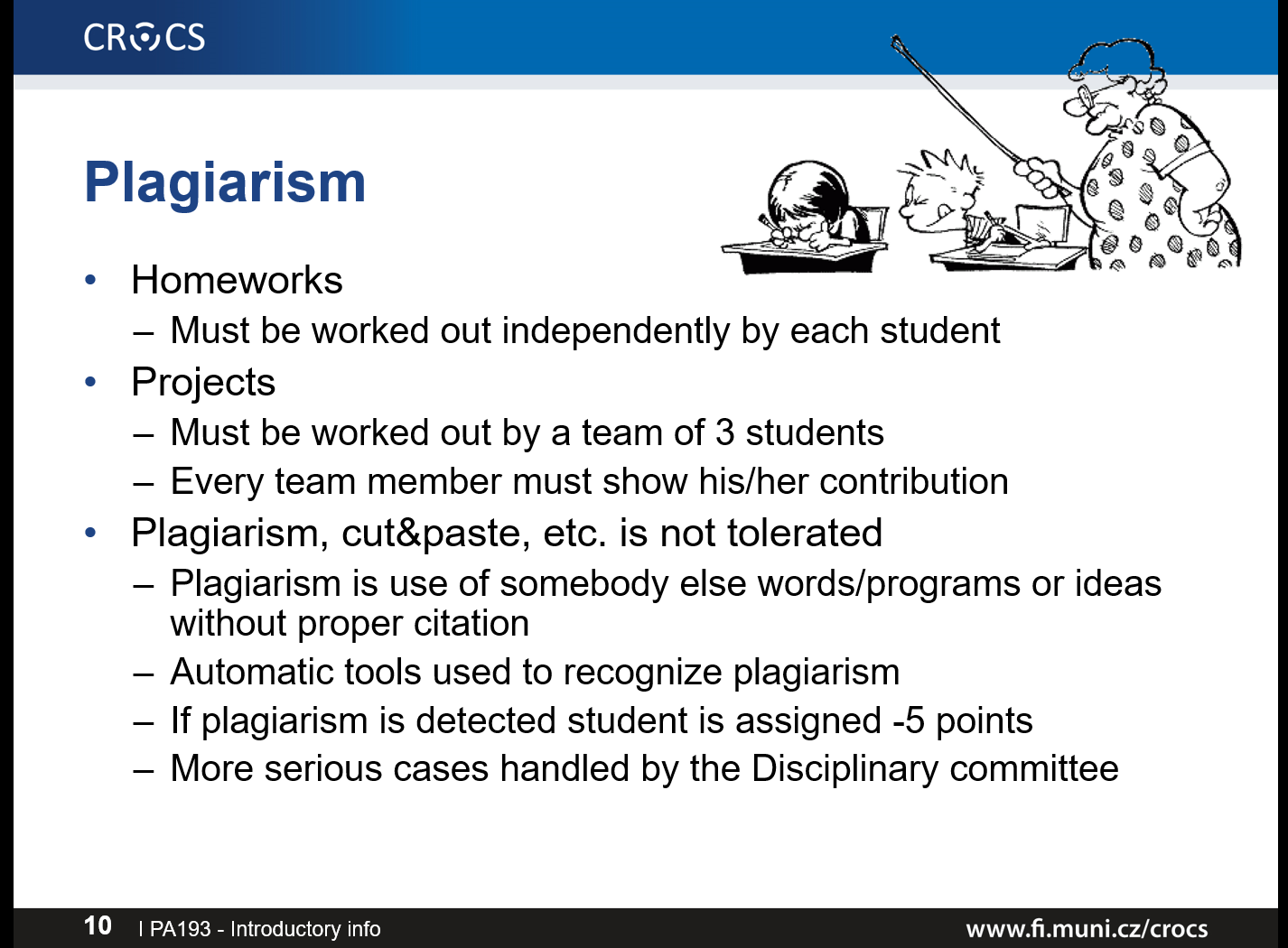
Before we start…
Homework 2 – almost corrected (L. Němec)
Homework 3 – currently in progress, till 27.10.

Slide 4
Problem

Slide 5
Cost of insecure software
Increased risk and failures due to generally increased usage of computers
Fixing bug in released version is more expensive
  testing, announcements…
Liability laws
  need to notify, settlement...
Reputation loss
Cost of defense is decreasing
  better training (like this course ☺), automated tools, development methods

Slide 6
What is wrong with this code?
network_receive(uchar* in_packet, short &in_packet_len); // TLV
uchar* in = in_packet + 3;
short length = make_short(inpacket + 1);
uchar* out_packet = malloc(1 + 2 + length);
uchar* out = out_packet + 3;
memcpy(out, in, length);
network_transmit(out_packet);

Slide 7
OpenSSL Heartbeat – “packet repeater”
network_receive(uchar* in_packet, short &in_packet_len); // TLV
uchar* in = in_packet + 3; short length = make_short(inpacket + 1);
uchar* out_packet = malloc(1 + 2 + length);
uchar* out = out_packet + 3;
memcpy(out, in, length);
network_transmit(out_packet);
unsigned char* in
Type [1B]
length [2B]
Payload [length B]
unsigned char* out
Payload [length B]
Type [1B]
length [2B]
Payload (length B)

Slide 8

Problem?
network_receive(uchar* in_packet, short &in_packet_len); // TLV
uchar* in = in_packet + 3;
uchar* out_packet = malloc(1 + 2 + length);
uchar* out = out_packet + 3;
memcpy(out, in, length);
network_transmit(out_packet);
unsigned char* in
0xFFFF [2B]
Type [1B]
0x0001 [2B]
Payload [1B]
… Heap memory …
in_packet_len != length + 3
unsigned char* out
Type [1B]
0xFFFF [2B]
Payload (65535B)
Payload [1B]
Heap memory (keys, passwords…)
Problem!

Slide 9

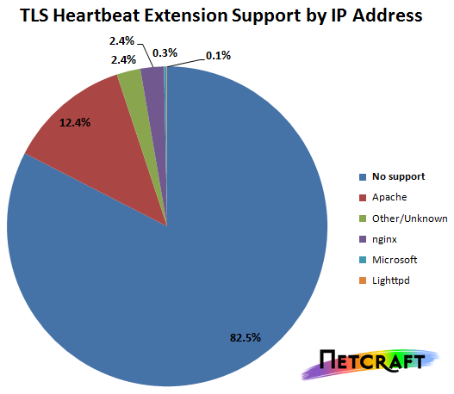
How serious the bug was?
17% SSL web servers (OpenSSL 1.0.1)
Twitter, GitHub, Yahoo, Tumblr, Steam, DropBox, DuckDuckGo…
https://seznam.cz, https://fi.muni.cz …
\
http://news.netcraft.com/archives/2014/04/08/half-a-million-widely-trusted-websites-vulnerable-to-heartbleed-bug.html

Slide 10
Defensive programming
Term coined by Kernighan and Plauger, 1981
  “writing the program so it can cope with small disasters”
  talked about in introductory programming courses
Practice of coding with the mind-set that errors are inevitable and something will always go wrong
  prepare program for unexpected behavior
  prepare program for easier bug diagnostics
Defensive programming targets mainly unintentional errors (not intentional attacks)
  But increasingly given security connotation

Slide 11
“Security features != Secure features”
“Security features != Secure features”
  Howard and LeBlanc, 2002
“Writing security features, although important, is only 10% of the workload of creating secure code. The other 90% of the coding work is meant to ensure that all non-security codebase is secure.”
  Sullivan, Balinsky, 2012
“Reliable software does what it is supposed to do. Secure software does what it is supposed to do, and nothing else.”
  Ivan Arce

Slide 12
Static and dynamic analysis

Slide 13
How to find bugs in code?
Manual “dynamic” testing
  running program, observe expected output
Manual analysis of code
  code review, security code review
Automated analysis of code without compilation
  static analysis (pattern matching, symbolic execution)
Automated analysis of code with execution
  dynamic analysis (running code)
Automated testing of inputs (fuzzing)

Slide 14
Approaches for automated code review
Formal methods (mathematical verification)
  requires mathematical model and assertions
  often requires modeling the system as finite state machine
    verification of every state and transition
    (outside the scope of this course, consider IA169)
Code metrics
  help to identify potential hotspots (complex code)
  e.g., Cyclomatic complexity (number of linearly indep. paths)
Review and inspection
  tries to find suspicious patterns
  automated version of human code review

Slide 15
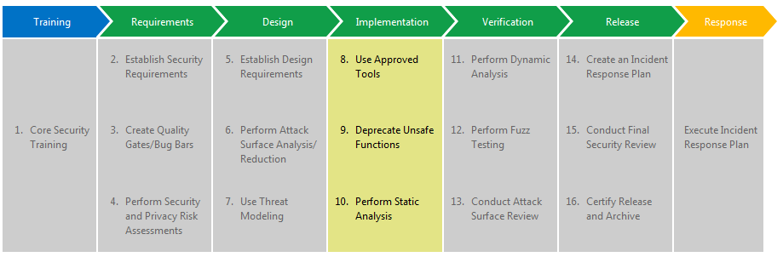
Microsoft’s Secure Development Lifecycle
Taken from http://www.microsoft.com/security/sdl/process/implementation.aspx

Slide 16
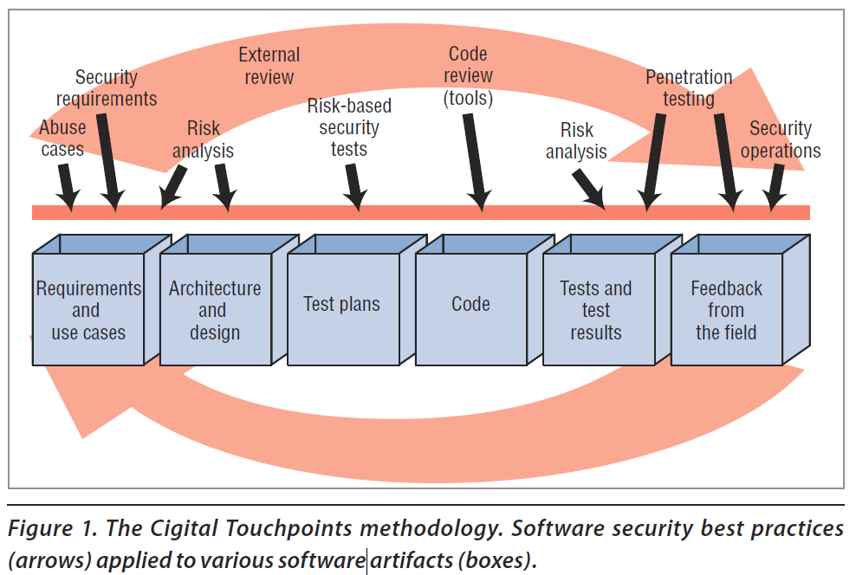
Cigital Touchpoints methodology

Slide 17
Static vs. dynamic analysis
Static analysis
  examine program’s code without executing it
  can examine both source code and compiled code
    source code is easier to understand (more metadata)
  can be applied on unfinished code
  manual code audit is kind of static analysis
Dynamic analysis
  code is executed (compiled or interpreted)
  input values are supplied, internal memory is examined

Slide 18
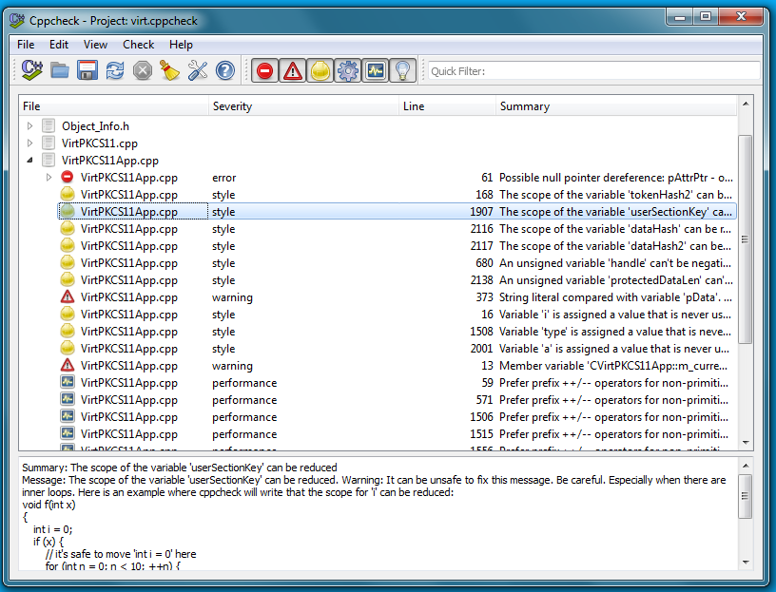
Example of output produced by analyzer

Slide 19
Types of static analysis
Type checking – performed by compiler
Style checking – performed by automated tools
Program formal verification
  annotations & verification of specified properties
Bug finding / hunting
  between style checking and verification
  more advanced static analysis
  aim to infer real problem, not only pattern match
Security Review
  previous possibilities with additional support for review

Slide 20
Static analysis - techniques
Structural rules (unwanted functions / patterns)
  deprecated functions (e.g., gets)
  fixed size arrays (e.g., char buff[100])
Trace of interesting data throw program
  propagation of tainted data (user input → exec(data))
  match of possible lengths for input / output data

Slide 21
Type checking
Type checking – performed by compiler
  errors against language rules prevents compilation
  warnings usually issued when problematic type manipulation occur
  false positives possible (short=int=short), but don’t ignore!
Security problems due to wrong types
  string format vulnerabilities (lecture 3)
  type overflow → buffer overflow (lecture 2)
  data loss (bigger type to smaller type) (lecture 2)
More on type checking later with compiler warnings

Slide 22
Style checking
Style checking – performed by automated tools
  set of required code rules
Separate tools
  MS style checker
  Unix: lint tool (http://www.unix.com/man-page/FreeBSD/1/lint)
  Checkstyle
  PMD (http://pmd.sourceforge.net/)
  Google C++ style checker: C++lint
    http://google-styleguide.googlecode.com/svn/trunk/cppguide.xml
    http://google-styleguide.googlecode.com/svn/trunk/cpplint/cpplint.py
Compiler warnings gcc –Wall gcc -Wextra

Slide 23
Program verification
Prove particular program property
  e.g., all dynamically allocated memory is always freed
Requires mathematical model and assertions
Often requires modeling the system as finite state machine
  verification of every state and transition
(Outside the scope of this course, consider IA169)

Slide 24

Bug finding
No language errors != secure program
  finding bugs, even when language permits it
Examples:
  Buffer overflow possible?
  User input formatted into system() call?
  Hard-code secrets?
Tool must keep false positives low
  do not report as a bug something which isn’t
  there is simply too many potential problems
Tools: FindBugs, PREfast, Coverity...

Slide 25
Security analysis and review
Usage of analysis tool to perform security review
  Usually multiple tools are used during the process
Difference between compiler (e.g., gcc) and additional tool (e.g., cppcheck)
  Compiler must never report error that isn’t (lang. standard)
  Compiler must report low # of false warning (as used by normal “uneducated” developers)
  Tool executed for automatic reporting should have low # of false warnings (otherwise untrusted)
  Tool executed during manual code review / pentest can have higher # of false warnings (filtered by expert)

Slide 26
Before digging to concrete tools…

Slide 27
Static analysis limitations
Overall program architecture is not understood
  sensitivity of program path
  impact of errors on other parts
Application semantics is not understood
  Is string returned to the user? Can string also contain passwords?
Social context is not understood
  Who is using the system? High entropy keys encrypted under short guessable password?

Slide 28
Problem of false positives/negatives
False positives
  errors reported by a tool that are not errors in fact
  too conservative analysis
  inaccurate model used for analysis
  annoying, more code needs to be checked, less readable output, developers tend to have as an excuse
False negatives
  real errors NOT reported by a tool
  missed problems, missing rules for detection

Slide 29

False positives – limits of static analysis
void foo()
{
char a[10];
a[20] = 0;
}
When foo() is called, always writes outside buffer
Should you fixed it even when foo() is not called?
d:\StaticAnalysis>cppcheck example.cpp
Checking example.cpp...
[example.cpp:4]: (error) Array 'a[10]' accessed at index 20, which
is out of bounds.

Slide 30
False positives – limits of static analysis
int x = 0;
int y = 3;
void foo()
{
char a[10];
if (x + y == 2) {
a[20] = 0;
}
}
For x + y != 2 false positive
But analyzer cannot be sure about x & y values
problematic assignment put inside condition
d:\StaticAnalysis>cppcheck example.cpp
Checking example.cpp...
[example.cpp:7]: (error) Array 'a[10]' accessed at index 20, which
is out of bounds.

Slide 31
False positives – limits of static analysis
const added (same for #define)
const int x = 0;
const int y = 3;
void foo()
{
char a[10];
if (x + y == 2) {
a[20] = 0;
}
}
No problem detected – constants are evaluated in compile time and condition is completely removed
d:\StaticAnalysis>cppcheck example.cpp
Checking example.cpp...
d:\StaticAnalysis>cppcheck --debug example.cpp
Checking example.cpp...
##file example.cpp
1:
2:
3:
4: void foo ( )
5: {
6: char a@3 [ 10 ] ;
7:
8:
9:
10: }

Slide 32
False positives – limits of static analysis
void foo2(int x, int y) {
char a[10];
if (x + y == 2) {
a[20] = 0;
}
}
int main() {
foo2(0, 3);
return 0;
}
Whole program is not compiled and evaluated
d:\StaticAnalysis>cppcheck --debug example.cpp
Checking example.cpp...
##file example.cpp
1: void foo2 ( int x@1 , int y@2 ) {
2: char a@3 [ 10 ] ;
3: if ( x@1 + y@2 == 2 ) {
4: a@3 [ 20 ] = 0 ;
5: }
6: }
7: int main ( ) {
8: foo2 ( 0 , 3 ) ;
9: return 0 ;
10:}
[example.cpp:4]: (error) Array 'a[10]' accessed at index 20,
which is out of bounds.

Slide 33
Always design for testability
“Code that isn't tested doesn't work - this seems to be the safe assumption.” Kent Beck
Code written in a way that is easier to test
  proper decomposition, unit tests, mock objects
  source code annotations (with subsequent analysis)
References
  https://en.wikipedia.org/wiki/Design_For_Test
  http://www.agiledata.org/essays/tdd.html

Slide 34
Build-in CompileR analysis

Slide 35
MSVC flags
warning C4018: '>=' : signed/unsigned mismatch
#include <iostream>
using namespace std;
int main(void) {
int low_limit = 0;
for (unsigned int i = 10; i >= low_limit; i--) {
cout << ".";
}
return 0;
}

Slide 36
Warnings – how compiler signals troubles
MSVC /W n
  /W 0 disables all warnings
  /W 1 & /W 2 basic warning
  /W 3 recommended production purposes (default)
  /W 4 recommended for all compilations, ensure the fewest possible hard-to-find code defects
  /Wall == /W4 + extra
GCC -Wall, -Wextra
Treat warnings as errors
  GCC –Werror, MSVC /WX
  forces you to fix all warnings, but slightly obscure nature of problem

Slide 37
Recommendations for MSVC CL
Compile with higher warnings /W4
Control and fix especially integer-related warnings
  warning C4018: '>=' : signed/unsigned mismatch
    comparing signed and unsigned values, signed value must be converted to unsigned
  C4244, C4389 – possible loss of data because of truncation or signed&unsigned variables operation
If existing code is inspected, look for
  #pragma warning (disable, Cxxxx) where xxxx is above
Use compiler /RTC flag

Slide 38

  warning C4018: '>=' : signed/unsigned mismatch
What will be the output of following code?
  string "x > y"
  but also compiler warning C4018
#include <iostream>
using namespace std;
int main(void) {
int x = -100;
unsigned int y = 100;
if (x > y) { cout << "x > y"; }
else { cout << "y >= x"; }
return 0;
}
int → unsigned int
-100 → 0xffffff9c

Slide 39
Recommendations for GCC
GCC –Wconversion
  warn about potentially problematic conversions
  fixed → floating point, signed → unsigned, ...
GCC –Wsign-compare
  signed → unsigned producing incorrect result
  warning: comparison between signed and unsigned integer expressions [-Wsign-compare]
  http://stackoverflow.com/questions/16834588/wsign-compare-warning-in-g provides example of real problem
Runtime integer error checks using –ftrapv
  trap function called when signed overflow in addition, subs, mult. occur
  but significant performance penalty (continuous overflow checking) ☹

Slide 40
GCC -ftrapv
Try this at home!
/* compile with gcc -ftrapv <filename> */
#include <signal.h>
#include <stdio.h>
#include <limits.h>
void signalHandler(int sig) {
printf("Overflow detected\n");
}
int main() {
signal(SIGABRT, &signalHandler);
int largeInt = INT_MAX;
int normalInt = 42;
int overflowInt = largeInt + normalInt; /* should cause overflow */
/* if compiling with -ftrapv, we shouldn't get here */
return 0;
}
http://stackoverflow.com/questions/5005379/c-avoiding-overflows-when-working-with-big-numbers

Slide 41
Static analysis TOOLS

Slide 42
Static analysis tools
List of static checkers
  http://samate.nist.gov/index.php/Source_Code_Security_Analyzers.html
  http://spinroot.com/static/
  http://en.wikipedia.org/wiki/List_of_tools_for_static_code_analysis
  https://security.web.cern.ch/security/recommendations/en/code_tools.shtml
We will be mainly focused on C/C++/Java checkers
  but tools exists for almost any language

Slide 43
Both free and commercial tools
Commercial tools
  PC-Lint (Gimpel Software)
  Klocwork Insight (Klocwork)
  Coverity (now under HP)
  Microsoft PREfast (included in Visual Studio)
Free tools
  Rough Auditing Tool for Security (RATS) http://code.google.com/p/rough-auditing-tool-for-security/
  CppCheck http://cppcheck.sourceforge.net/
  Flawfinder http://www.dwheeler.com/flawfinder/
  Splint http://www.splint.org/
  FindBugs http://findbugs.sourceforge.net (for Java programs)
  Doxygen’s call graphs from source http://www.stack.nl/~dimitri/doxygen/
  ...

Slide 44
Flawfinder
Last version 1.27 (2007-01-16)
Download at http://www.dwheeler.com/flawfinder/
Build by setup.py build
Install by setup.py install
/build/scripts***/flawfinder.py
flawfinder.py --context --html source_dir

Slide 45
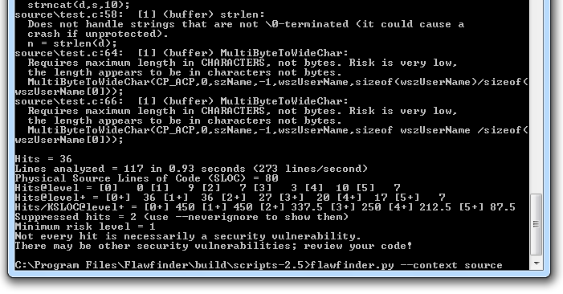
Flawfinder - example

Slide 46
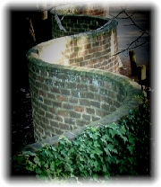
Splint
Secure Programming Lint
Annotation-Assisted Lightweight Static Checking
http://www.splint.org/
  standard static analyzer
  possibility to add annotations
Last version 3.1.2 (2007)
Splint overview
  http://www.slideshare.net/UlissesCosta/splint-the-c-code-static-checker

Slide 47
RATS
Rough Auditing Tool for Security (RATS)
  http://code.google.com/p/rough-auditing-tool-for-security/
Windows and Linux support
Previous version 2.3 (2009)
Last version 2.4 (December 2013)

Slide 48


Cppcheck
A tool for static C/C++ code analysis
  Open-source freeware, http://cppcheck.sourceforge.net/
  Online demo http://cppcheck.sourceforge.net/demo/
Last version 1.76 (2016-10-12)
Used to find bugs in open-source projects (Linux kernel... )
Command line & GUI version
Standalone version, plugin into IDEs, version control...
  Code::Blocks, Codelite, Eclipse, Jenkins...
  Tortoise SVN, Visual Studio …
Cross platform (Windows, Linux)
  sudo apt-get install cppcheck

Slide 49
Cppcheck – what is checked?
Bound checking for array overruns
Suspicious patterns for class
Exceptions safety
Memory leaks
Obsolete functions
sizeof() related problems
String format problems...
See full list http://sourceforge.net/apps/mediawiki/cppcheck/index.php?title=Main_Page#Checks

Slide 50
Cppcheck – categories of problems
error – when bugs are found
warning - suggestions about defensive programming to prevent bugs
style - stylistic issues related to code cleanup (unused functions, redundant code, constness...)
performance - suggestions for making the code faster.
portability - portability warnings. 64-bit portability. code might work different on different compilers. etc.
information - Informational messages about checking problems

Slide 51
Cppcheck

Slide 52
Cppcheck – simple custom rules
User can write own regular expression-based rules
  Perl Compatible Regular Expressions www.pcre.org
  limited only to simpler analysis
  executed over simplified code (code after preprocessing)
    http://sourceforge.net/projects/cppcheck/files/Articles/writing-rules-2.pdf
Regular expression can be supplied on command line
  cppcheck.exe --rule=".+" file.cpp
    match and print any code, used to obtain simplified code
  cppcheck.exe --rule="pass[word]*" file.cpp
    match any occurrence of pass or password or passwordword...
Or via XML file (for stable repeatedly used rules)

Slide 53
Cppcheck – simple custom rules (XML)
XML file with regular expression and information
  pattern to search for
  information displayed on match
<?xml version="1.0"?>
<rule>
<tokenlist>LIST</tokenlist>
<pattern>PATTERN</pattern>
<message>
<id>ID</id>
<severity>SEVERITY</severity>
<summary>SUMMARY</summary>
</message>
</rule>
<?xml version="1.0"?>
<rule version="1">
<pattern>if \( p \) { free \( p \) ; }</pattern>
<message>
<id>redundantCondition</id>
<severity>style</severity>
<summary>Redundant condition. It is valid
to free a NULL pointer.
</summary>
</message>
</rule>
Example taken from http://sourceforge.net/projects/cppcheck/files/Articles/writing-rules-1.pdf/download

Slide 54
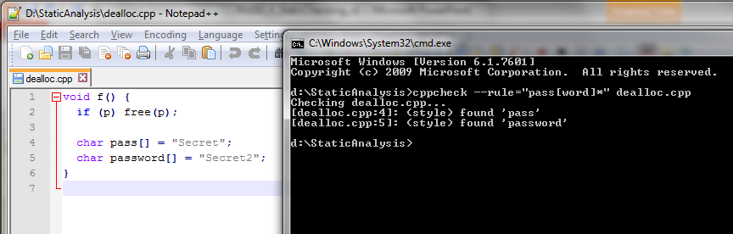
  cppcheck.exe --rule="pass[word]*" file.cpp
cppcheck.exe --rule="if \( p \) { free \( p \) ; }" file.cpp
  will match only pointer with name ‘p’

Slide 55
Cppcheck – complex custom rules
Based on execution of user-supplied C++ code
  possible more complex analysis
Use cppcheck.exe --debug file.cpp
  outputs simplified code including Cppcheck’s internal variable unique ID
Write C++ code fragment performing analysis
Recompile Cppcheck with new rule and execute
Read more details (writing-rules-2 & writing-rules-3)
  http://sourceforge.net/projects/cppcheck/files/Articles/

Slide 56
Custom rules – obtaining variable ID
d:\StaticAnalysis>cppcheck.exe --debug dealloc.cpp
Checking dealloc.cpp...
##file dealloc.cpp
1: void f ( ) {
2: if ( p ) { free ( p ) ; }
3:
4: char pass@1 [ 7 ] = "Secret" ;
5: char password@2 [ 8 ] = "Secret2" ;
6: }
variable pass has ID @1

Slide 57
void CheckOther::dealloc() {
// Loop through all tokens
for (const Token *tok = _tokenizer->tokens(); tok; tok = tok->next()) {
// Is there a condition and a deallocation?
if (Token::Match(tok, "if ( %var% ) { free ( %var% ) ; }")) {
// Get variable name used in condition:
const std::string varname1 = tok->strAt(2);
// Get variable name used in deallocation:
const std::string varname2 = tok->strAt(7);
// Is the same variable used?
if (varname1 == varname2) {
// report warning
deallocWarning(tok);
}
}
}
}
// Report warning
void CheckOther::deallocWarning() {
reportError(tok, // location
Severity::warning, // severity
"dealloc", // id
"Redundant condition"); // message
}
pattern to match
%var% will match any variable
reporting error in standard format

Slide 58
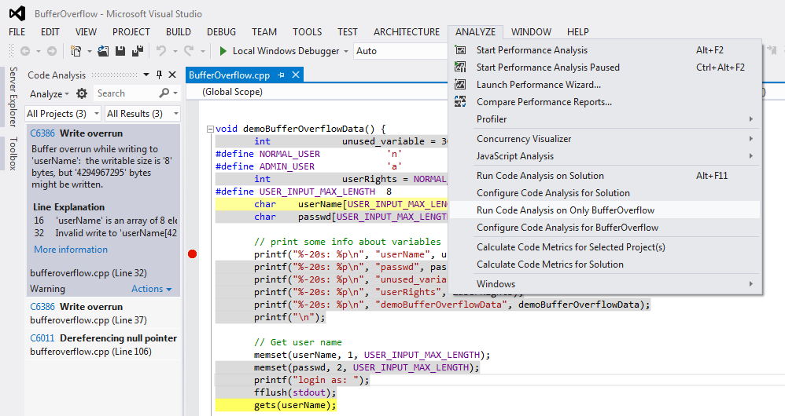
PREfast - Microsoft static analysis tool

Slide 59
PREfast - Microsoft static analysis tool
Visual Studio Ultimate and Premium Editions
  Documentation for PREfast
  http://msdn.microsoft.com/en-us/library/windows/hardware/gg487351.aspx
  PREfast tutorial
  http://www.codeproject.com/Articles/167588/Using-PREfast-for-Static-Code-Analysis
Can be enabled on every build
  not enabled by default, time consuming
Can be extended by source code annotation (SAL)
  (lecture 8)

Slide 60
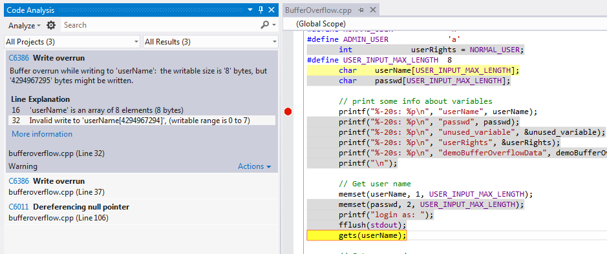
PREfast – example bufferOverflow

Slide 61
PREfast – what can be detected
Potential buffer overflows
Memory leaks, uninitialized variables
Excessive stack usage
Resources – release of locks...
Incorrect usage of selected functions
List of all code analysis warnings http://msdn.microsoft.com/en-us/library/a5b9aa09.aspx

Slide 62
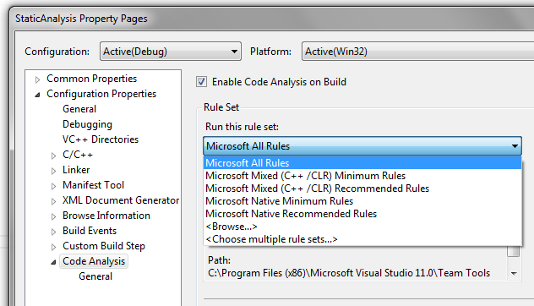
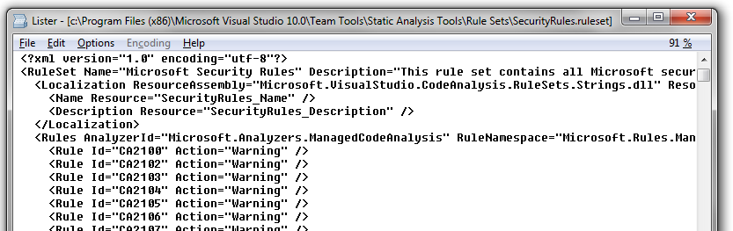
PREfast settings (VS 2015)
http://msdn.microsoft.com/en-us/library/ms182025.aspx

Slide 63
PREfast & MSVC /analyze
Enables code analysis and control options
  http://msdn.microsoft.com/en-us/library/ms173498.aspx
Some analysis rules work only for managed code (C#, VB...)
Available rule sets
  http://msdn.microsoft.com/en-us/library/dd264925%28v=vs.120%29.aspx
Possibility to write custom rules
  http://msdn.microsoft.com/en-us/library/dd380660%28v=vs.120%29.aspx

Slide 64


Coverity (free for open-source)
Commercial static & dynamic analyzer
Free for C/C++ & Java open-source projects
https://scan.coverity.com/
Process
  Register at scan.coverity.com (GitHub account possible)
  Download Coverity build tool for your platform
    Quality and Security Advisor
  Build your project with cov-build
    cov-build --dir cov-int <build command>
  Zip and submit build for analysis (works on binary, not source)
Can be integrated with Travis CI (continuous integration)
  https://scan.coverity.com/travis_ci

Slide 65
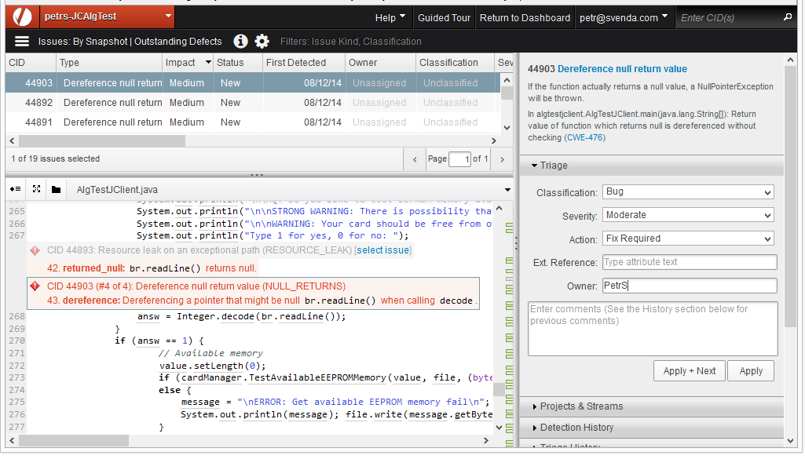

+
+

Slide 66



FindBugs
Static analysis of Java programs
Extended coverage for OWASP Top 10 and CWE
Current version 3.0.1 (2015-03-06)
  http://findbugs.sourceforge.net/
  Command-line, GUI, plugins into variety of tools
  Support for custom rules
FindSecurityBugs 1.5.0. (2016-10-16)
  Additional detection rules for FindBugs
  https://h3xstream.github.io/find-sec-bugs/bugs.htm

Slide 67
How many false positives are too many?
“Because its analysis is sometimes imprecise, FindBugs can report false warnings, which are warnings that do not indicate real errors. In practice, the rate of false warnings reported by FindBugs is less than 50%.”
  FindBugs™ Fact Sheet

Slide 68
Static analysis is NOT panacea

Slide 69
Cppcheck --enable=all
d:\StaticAnalysis>cppcheck --enable=all bufferOverflow.cpp
Checking bufferOverflow.cpp...
[bufferOverflow.cpp:26]: (style) Obsolete function 'gets' called. It is recommended to use
the function 'fgets' instead.
[bufferOverflow.cpp:31]: (style) Obsolete function 'gets' called. It is recommended to use
the function 'fgets' instead.
// Note: GCC and MSVC uses different memory alignment
// Try "12345678DevilEvecosia" as a password for gcc build
// Try "1234567812345678Devil I am. Ha Ha" as a password for MSVC debug build
void demoBufferOverflowData() {
int unused_variable = 30;
#define NORMAL_USER 'n'
#define ADMIN_USER 'a'
int userRights = NORMAL_USER;
#define USER_INPUT_MAX_LENGTH 8
char userName[USER_INPUT_MAX_LENGTH];
char passwd[USER_INPUT_MAX_LENGTH];
// print some info about variables
printf("%-20s: %p\n", "userName", userName);
printf("%-20s: %p\n", "passwd", passwd);
printf("%-20s: %p\n", "unused_variable", &unused_variable);
printf("%-20s: %p\n", "userRights", &userRights);
printf("\n");
// Get user name
memset(userName, 1, USER_INPUT_MAX_LENGTH);
memset(passwd, 2, USER_INPUT_MAX_LENGTH);
printf("login as: ");
fflush(stdout);
gets(userName);
// Get password
printf("%s@vulnerable.machine.com: ", userName);
fflush(stdout);
gets(passwd);
// Check user rights (set to NORMAL_USER and not changed in code)
if (userRights == NORMAL_USER) {
printf("\nWelcome, normal user '%s', your rights are limited.\n\n", userName);
fflush(stdout);
}
if (userRights == ADMIN_USER) {
printf("\nWelcome, all mighty admin user '%s'!\n", userName);
fflush(stdout);
}
// How to FIX:
//memset(userName, 0, USER_INPUT_MAX_LENGTH);
//fgets(userName, USER_INPUT_MAX_LENGTH - 1, stdin);
//memset(passwd, 0, USER_INPUT_MAX_LENGTH);
//fgets(passwd, USER_INPUT_MAX_LENGTH - 1, stdin);
}
From 2. lecture
MSVC /W4
1> BufferOverflow.cpp
1>bufferoverflow.cpp(32): warning C4996: 'gets': This function or variable may be unsafe.
Consider using gets_s instead. To disable deprecation, use _CRT_SECURE_NO_WARNINGS.
1> c:\program files (x86)\microsoft visual studio 11.0\vc\include\stdio.h(261) : see declaration of 'gets'
1>bufferoverflow.cpp(37): warning C4996: 'gets': This function or variable may be unsafe.
Consider using gets_s instead. To disable deprecation, use _CRT_SECURE_NO_WARNINGS.
1> c:\program files (x86)\microsoft visual studio 11.0\vc\include\stdio.h(261) : see declaration of 'gets'
1>bufferoverflow.cpp(78): warning C4996: 'strncpy': This function or variable may be unsafe.
Consider using strncpy_s instead. To disable deprecation, use _CRT_SECURE_NO_WARNINGS.
1> c:\program files (x86)\microsoft visual studio 11.0\vc\include\string.h(191) : see declaration of 'strncpy'
1>bufferoverflow.cpp(81): warning C4996: 'sprintf': This function or variable may be unsafe.
Consider using sprintf_s instead. To disable deprecation, use _CRT_SECURE_NO_WARNINGS.
1> c:\program files (x86)\microsoft visual studio 11.0\vc\include\stdio.h(357) : see declaration of 'sprintf'
MSVC /analyze (PREfast)
1> BufferOverflow.cpp
bufferoverflow.cpp(32): warning : C6386: Buffer overrun while writing to 'userName':
the writable size is '8' bytes, but '4294967295' bytes might be written.
bufferoverflow.cpp(37): warning : C6386: Buffer overrun while writing to 'passwd':
the writable size is '8' bytes, but '4294967295' bytes might be written.

Slide 70
Type overflow – example with dynalloc
From 2. lecture
typedef struct _some_structure {
float someData[1000];
} some_structure;
void demoDataTypeOverflow(int totalItemsCount, some_structure* pItem,
int itemPosition) {
// See http://blogs.msdn.com/oldnewthing/archive/2004/01/29/64389.aspx
some_structure* data_copy = NULL;
int bytesToAllocation = totalItemsCount * sizeof(some_structure);
printf("Bytes to allocation: %d\n", bytesToAllocation);
data_copy = (some_structure*) malloc(bytesToAllocation);
if (itemPosition >= 0 && itemPosition < totalItemsCount) {
memcpy(&(data_copy[itemPosition]), pItem, sizeof(some_structure));
}
else {
printf("Out of bound assignment");
return;
}
free(data_copy);
}
Cppcheck --enable=all
d:\StaticAnalysis>cppcheck --enable=all typeOverflow.cpp
Checking typeOverflow.cpp...
[typeOverflow.cpp:17]: (error) Memory leak: data_copy
MSVC /W4
1> typeOverflow.cpp nothing ☺
MSVC /analyze (PREfast)
1> typeOverflow.cpp
bufferoverflow.cpp(13): warning : C6011: Dereferencing NULL pointer 'data_copy'.

Slide 71
Test suites – vulnerable code, benchmark
SAMATE Juliet Test Suite
  huge test suite which contains at least 45000 C/C++ test cases
  http://samate.nist.gov/SRD/testsuite.php
Static analysis test suite for C programs
  http://mathind.csd.auth.gr/static_analysis_test_suite/
Suitable for testing new methods, but for comparison of existing commercial products
  Public suites, products already optimized for it

Slide 72
Summary

Slide 73
Summary
Static analysis is VERY important tool for writing secure software
  significant portion of analysis done already by compiler (errors, warning)
Multiple tools exist (both free and commercial)
  predefined set of rules, custom rules can be written
  Differ in capability and target audience
Static analysis cannot find all problems
  problem of false positives/negatives
  no substitution for extensive testing and defense programming

Slide 74

Mandatory reading
Coverity open source reports 2013/2014
  Report of analysis for open-source projects
  https://na-sjf.marketo.com/rs/appsec/images/2013-Coverity-Scan-Report.pdf
  http://go.coverity.com/rs/157-LQW-289/images/2014-Coverity-Scan-Report.pdf
How open-source and closed-source compare wrt number of defects? How os/cs address OWASP Top 10?
What are typical issues in C/C++ code?
…
Questions

Slide 76
References
  Fortify’s presentation, overview of static checking
  http://secwg.noc.harvard.edu/archives/talks_files/chess_secure_programming.pdf
Cppcheck presentation
  http://www.slideshare.net/zblair/cppcheck-10316379
Secure Programming: the Seven Pernicious Kingdoms
  http://www.datamation.com/secu/print.php/3686291

Slide 77
Recommended reading
Process of security code review
  http://ieeexplore.ieee.org/stamp/stamp.jsp?arnumber=01668009
Why cryptosystems fail, R. Anderson
  http://www.cl.cam.ac.uk/~rja14/Papers/wcf.pdf
Software Security Code Review
  http://www.softwaremag.com/l.cfm?doc=2005-07/2005-07code
Static code analysis tools
  http://en.wikipedia.org/wiki/List_of_tools_for_static_code_analysis
Security in web applications (OWASP)
  http://www.owasp.org/index.php/Code_Review_Introduction

Slide 78
What is wrong with this code?
year = ORIGINYEAR; /* = 1980 */
while (days > 365) {
if (IsLeapYear(year)) {
if (days > 366) {
days -= 366;
year += 1;
}
}
else {
days -= 365;
year += 1;
}
}

Slide 79
Microsoft’s Zune bug
December 31st 2008
Simultaneous fail of thousands music players
http://techcrunch.com/2008/12/31/zune-bug-explained-in-detail/
Highly embarrassing (blogs)
Contributed to discontinuation
year = ORIGINYEAR; /* = 1980 */
while (days > 365) {
if (IsLeapYear(year)) {
if (days > 366) {
days -= 366;
year += 1;
}
}
else {
days -= 365;
year += 1;
}
}

Slide 80
Microsoft Zuno’s bug
year = ORIGINYEAR; /* = 1980 */
while (days > 365) {
if (IsLeapYear(year)) {
if (days > 366) {
days -= 366;
year += 1;
}
}
else {
days -= 365;
year += 1;
}
}
No luck with Cppcheck
No luck with PREfast
Coverity?
Will be solved in next lecture
  fuzzing

