Slide 1
Chapter 2: Introduction to Switched Networks
Routing and Switching
Notes:
Cisco Networking Academy program
Routing & Switching
Chapter 2: Introduction to Switched Networks

Slide 2
Chapter 2
2.0 Introduction
2.1 Basic Switch Configuration
2.2 Switch Security: Management and Implementation
Notes:
Chapter 2

Slide 3
Chapter 2: Objectives
Upon completion of this chapter, you will be able to:
Explain the advantages and disadvantages of static routing.
Configure initial settings on a Cisco switch.
Configure switch ports to meet network requirements.
Configure the management switch virtual interface.
Describe basic security attacks in a switched environment.
Describe security best practices in a switched environment.
Configure the port security feature to restrict network access.
Notes:
2.

Slide 4
Basic Switch Configuration
Switch Boot Sequence
Power-on self test (POST).
Run boot loader software.
Boot loader performs low-level CPU initialization.
Boot loader initializes the flash file system
Boot loader locates and loads a default IOS operating system software image into memory and passes control of the switch over to the IOS.
Notes:
2.1.1.1 Switch Boot Sequence

Slide 5
Basic Switch Configuration
Switch Boot Sequence (cont.)
To find a suitable Cisco IOS image, the switch goes through the following steps:
Step 1. It attempts to automatically boot by using information in the BOOT environment variable.
Step 2. If this variable is not set, the switch performs a top-to-bottom search through the flash file system. It loads and executes the first executable file, if it can.
Step 3. The IOS software then initializes the interfaces using the Cisco IOS commands found in the configuration file and startup configuration, which is stored in NVRAM.
Note: The boot system command can be used to set the BOOT environment variable.
Notes:
2.1.1.1 Switch Boot Sequence
Note: the BOOT environment variable is set using the boot system global configuration mode command. Use the show bootvar command to see to what the current IOS boot file is set.

Slide 6
Basic Switch Configuration
Recovering from a System Crash
The boot loader can also be used to manage the switch if the IOS cannot be loaded.
The boot loader can be accessed through a console connection by:
  Connecting a PC by console cable to the switch console port. Unplug the switch power cord.
  Reconnecting the power cord to the switch and press and hold the Mode button.
  The System LED turns briefly amber and then solid green. Release the Mode button.
The boot loader switch:prompt appears in the terminal emulation software on the PC.
Notes:
2.1.1.2 Recovering From a System Crash

Slide 7
Basic Switch Configuration
Switch LED Indicators
Each port on Cisco Catalyst switches have status LED indicator lights.
By default, these LED lights reflect port activity, but they can also provide other information about the switch through the Mode button.
The following modes are available on Cisco Catalyst 2960 switches:
  System LED
  Redundant Power System (RPS) LED
  Port Status LED
  Port Duplex LED
  Port Speed LED
  Power over Ethernet (PoE) Mode LED
Notes:
2.1.1.3 Switch LED Indicators

Slide 8
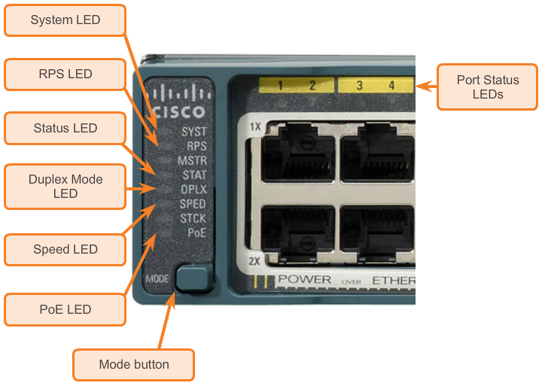
Basic Switch Configuration
Cisco Catalyst 2960 Switch Modes
Notes:
2.1.1.3 Switch LED Indicators

Slide 9
Basic Switch Configuration
Preparing for Basic Switch Management
To remotely manage a Cisco switch, it must be configured to access the network.
An IP address and a subnet mask must be configured.
If managing the switch from a remote network, a default gateway must also be configured.
The IP information (address, subnet mask, gateway) is to be assigned to a switch switch virtual interface (SVI).
Although these IP settings allow remote management and remote access to the switch, they do not allow the switch to route Layer 3 packets.
Notes:
2.1.1.4 Preparing for Basic Switch Management

Slide 10
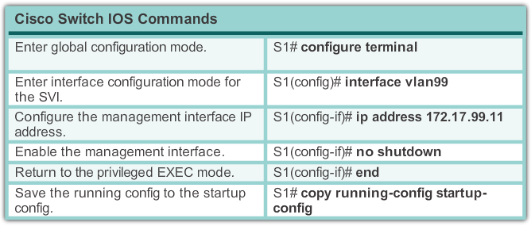
Basic Switch Configuration
Preparing for Basic Switch Management (cont.)
Notes:
2.1.1.4 Preparing for Basic Switch Management

Slide 11
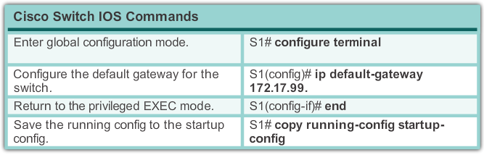
Basic Switch Configuration
Preparing for Basic Switch Management (cont.)
Notes:
2.1.1.4 Preparing for Basic Switch Management

Slide 12
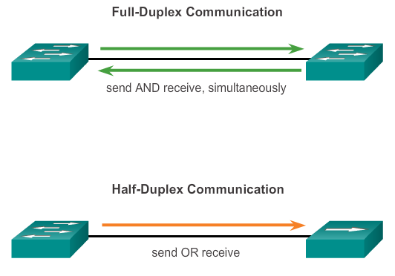
Configuring Switch Ports
Duplex Communication
Notes:
2.1.2.1 Duplex Communication

Slide 13
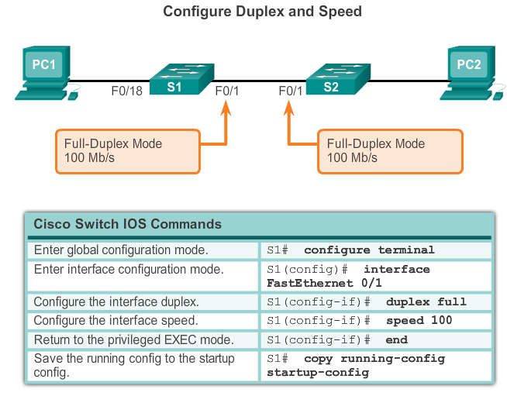
Configuring Switch Ports
Configuring Switch Ports at the Physical Layer
Notes:
2.1.2.2 Configuring Switch Ports at the Physical Layer

Slide 14
Configuring Switch Ports
Auto-MDIX Feature
Certain cable types (straight-through or crossover) were historically required when connecting devices.
The automatic medium-dependent interface crossover (auto-MDIX) feature eliminates this problem.
When auto-MDIX is enabled, the interface automatically detects and appropriately configures the connection.
When using auto-MDIX on an interface, the interface speed and duplex must be set to auto.
Notes:
2.1.2.3 Auto-MDIX Feature

Slide 15
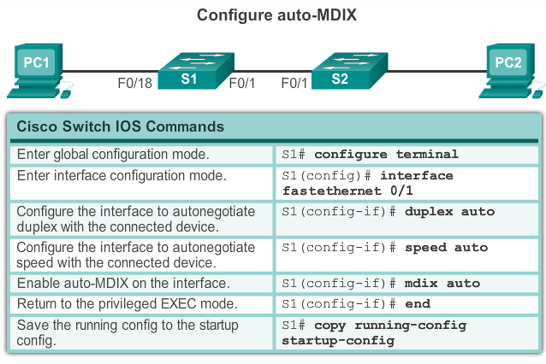
Configuring Switch Ports
Auto-MDIX Feature (cont.)
Notes:
2.1.2.3 Auto-MDIX Feature

Slide 16
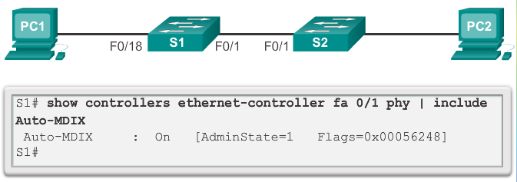
Configuring Switch Ports
Auto-MDIX Feature (cont.)
Notes:
2.1.2.3 Auto-MDIX Feature

Slide 17
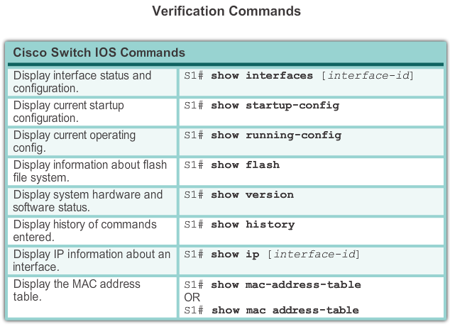
Configuring Switch Ports
Verifying Switch Port Configuration
Notes:
2.1.2.4 Verifying Switch Port Configuration

Slide 18
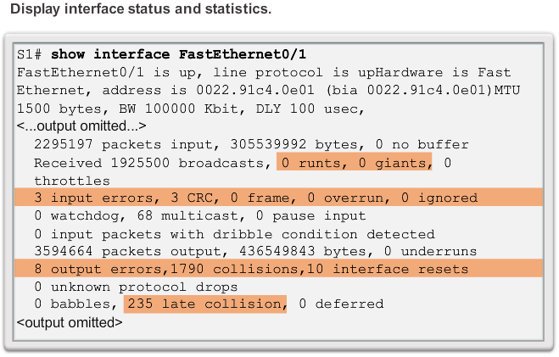
Configuring Switch Ports
Network Access Layer Issues
Notes:
2.1.2.5 Network Access Layer Issues

Slide 19
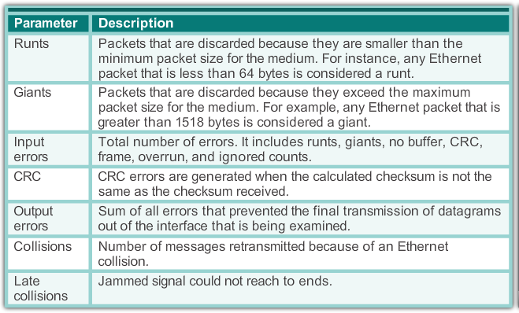
Configuring Switch Ports
Network Access Layer Issues (cont.)
Notes:
2.1.2.5 Network Access Layer Issues

Slide 20
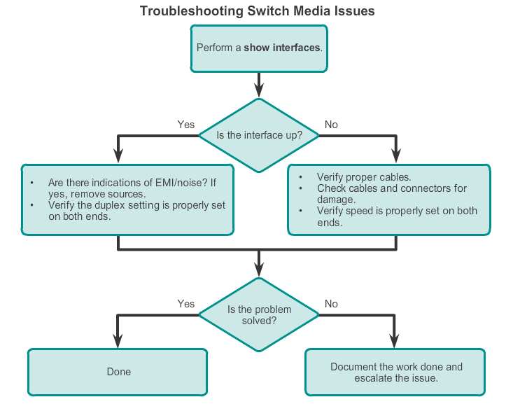
Configuring Switch Ports
Troubleshooting Switch Media (Connection) Issues
Notes:
2.1.2.6 Troubleshooting Network Access Layer Issues

Slide 21
Secure Remote Access
SSH Operation
Secure Shell (SSH) is a protocol that provides a secure (encrypted), command-line based connection to a remote device.
SSH is commonly used in UNIX-based systems.
The Cisco IOS software also supports SSH.
A version of the IOS software, including cryptographic (encrypted) features and capabilities, is required to enable SSH on Catalyst 2960 switches.
Because its strong encryption features, SSH should replace Telnet for management connections.
SSH uses TCP port 22, by default. Telnet uses TCP port 23.
Notes:
2.2.1.1 SSH Operation

Slide 22
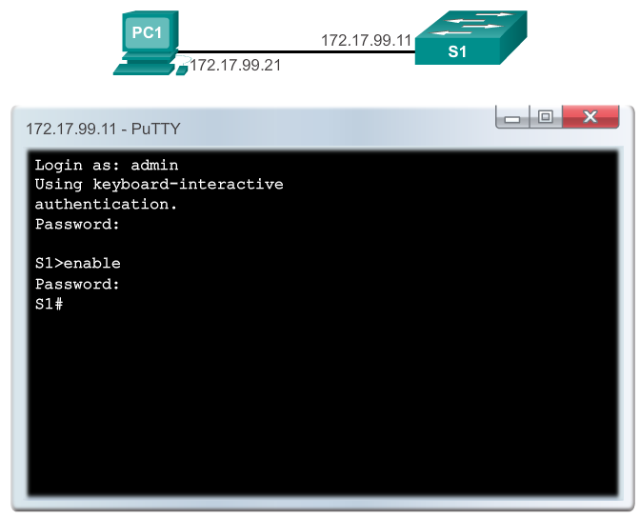
Secure Remote Access
SSH Operation (cont.)
Notes:
2.2.1.1 SSH Operation

Slide 23
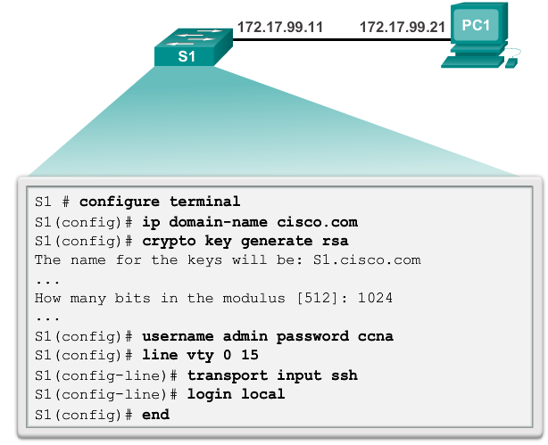
Secure Remote Access
Configuring SSH
Notes:
2.2.1.2 Configuring SSH

Slide 24
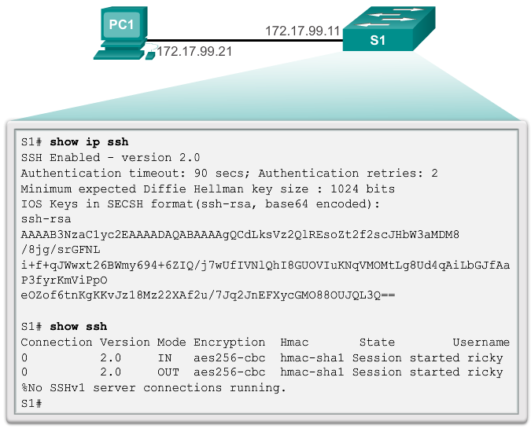
Secure Remote Access
Verifying SSH
Notes:
2.2.1.2 Verifying SSH

Slide 25
Security Concerns in LANs
MAC Address Flooding
Switches automatically populate their CAM tables by watching traffic entering their ports.
Switches forward traffic trough all ports if it cannot find the destination MAC in its CAM table.
Under such circumstances, the switch acts as a hub. Unicast traffic can be seen by all devices connected to the switch.
An attacker could exploit this behavior to gain access to traffic normally controlled by the switch by using a PC to run a MAC flooding tool.
Such tool is a program created to generate and send out frames with bogus source MAC addresses to the switch port.
As these frames reach the switch, it adds the bogus MAC address to its CAM table, taking note of the port the frames arrived.
Notes:
2.2.2.1 MAC Address Flooding

Slide 26
Security Concerns in LANs
MAC Address Flooding (cont.)
Eventually the CAM table fills out with bogus MAC addresses.
The CAM table now has no room for legit devices present in the network and, therefore, never finds their MAC addresses in the CAM table.
All frames are now forwarded to all ports, allowing the attacker to access traffic to other hosts.
Notes:
2.2.2.1 MAC Address Flooding

Slide 27
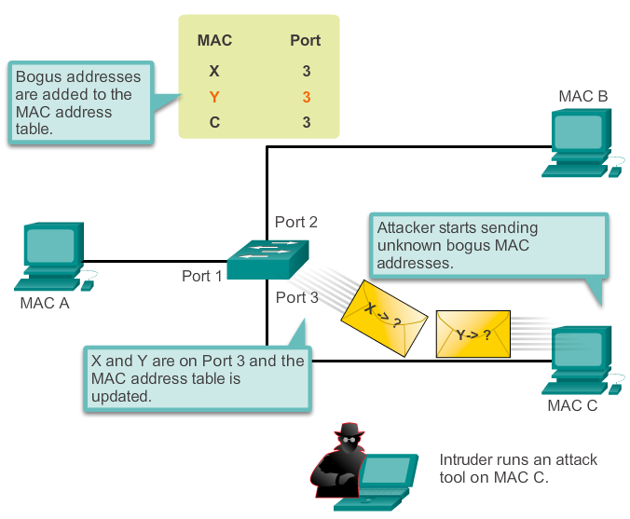
Security Concerns in LANs
MAC Address Flooding (cont.)
An attacker flooding the CAM table with bogus entries.
Notes:
2.2.2.1 MAC Address Flooding

Slide 28
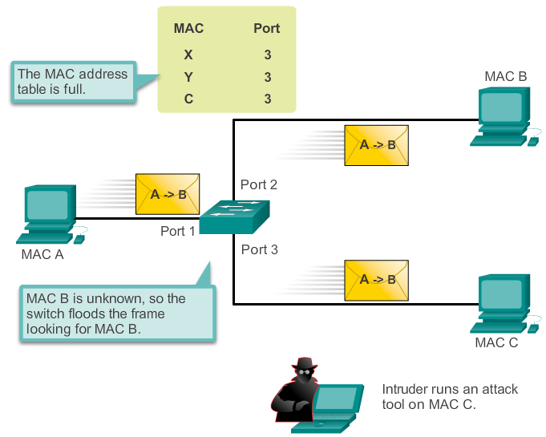
Security Concerns in LANs
MAC Address Flooding (cont.)
The switch now behaves as a hub.
Notes:
2.2.2.1 MAC Address Flooding

Slide 29
Security Concerns in LANs
DHCP Spoofing
DHCP is a network protocol used to automatically assign IP information.
Two types of DHCP attacks are:
  DHCP spoofing
  DHCP starvation
In DHCP spoofing attacks, a fake DHCP server is placed in the network to issue DHCP addresses to clients.
DHCP starvation is often used before a DHCP spoofing attack to deny service to the legitimate DHCP server.
Notes:
2.2.2.2 DHCP Spoofing

Slide 30
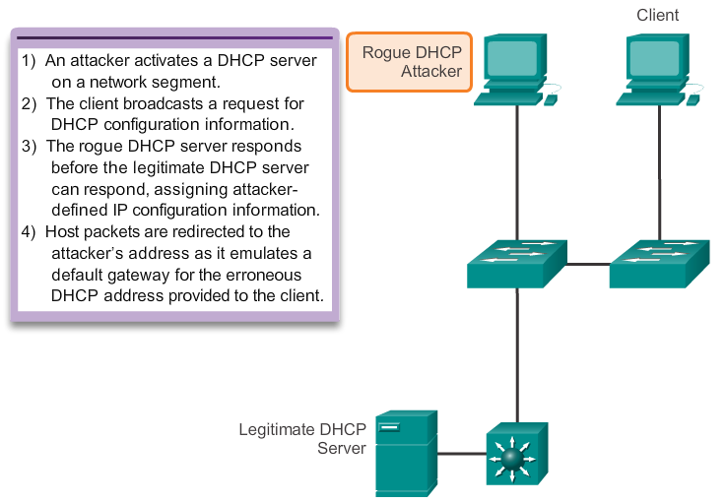
Security Concerns in LANs
DHCP Spoof Attack
Notes:
2.2.2.2 DHCP Spoof Attack

Slide 31
Security Concerns in LANs
Leveraging Cisco Discovery Protocol
The Cisco Discovery Protocol is a Layer 2 Cisco proprietary protocol used to discover other directly connected Cisco devices.
The Cisco Discovery Protocol is designed to allow the devices to auto-configure their connections.
If an attacker is listening to Cisco Discovery Protocol messages, it could learn important information about the device model and running software version.
Note: Cisco recommends disabling CDP when not in use.
Notes:
2.2.2.3 Leveraging Cisco Discovery Protocol

Slide 32
Security Concerns in LANs
Leveraging Telnet
The Telnet protocol is insecure and should be replaced by SSH.
An attacker can use Telnet as part of other attacks:
  Brute force password attack
  Telnet DOS attack
When passwords cannot be captured, attackers will try as many combinations of characters as possible. This attempt to guess the password is known as brute force password attack.
Telnet can be used to test the guessed password against the system.
Notes:
2.2.2.4 Leveraging Telnet

Slide 33
Security Concerns in LANs
Leveraging Telnet (cont.)
In a Telnet DoS attack, the attacker exploits a flaw in the Telnet server software running on the switch that renders the Telnet service unavailable.
This sort of attack prevents an administrator from remotely accessing switch management functions.
This can be combined with other direct attacks on the network as part of a coordinated attempt to prevent the network administrator from accessing core devices during the breach.
Vulnerabilities in the Telnet service that permit DoS attacks to occur are usually addressed in security patches that are included in newer Cisco IOS revisions.
Notes:
2.2.2.4 Leveraging Telnet

Slide 34
Security Best Practices
10 Best Practices
Develop a written security policy for the organization.
Shut down unused services and ports.
Use strong passwords and change them often.
Control physical access to devices.
Use HTTPS instead of HTTP.
Perform backup operations on a regular basis.
Educate employees about social engineering attacks.
Encrypt and password-protect sensitive data.
Implement firewalls.
Keep software up-to-date.
Notes:
2.2.3.1 10 Best Practices

Slide 35
Security Best Practices
Network Security Tools: Options
Network security tools are important to network administrators.
Network security tools allow an administrator to test the strength of the security measures implemented.
An administrator can launch an attack against the network and analyze the results. This is also to determine how to adjust security policies to mitigate those types of attacks.
Security auditing and penetration testing are two basic functions that network security tools perform.
Notes:
2.2.3.2 Network Security Tools: Options

Slide 36
Security Best Practices
Network Security Tools: Audits
Network security tools can be used to audit the network.
By monitoring the network, an administrator can assess what type of information an attacker would be able to gather. For example, by attacking and flooding the CAM table of a switch, an administrator learn which switch ports are vulnerable to MAC flooding and can correct the issue.
Network security tools can also be used as penetration test tools. Penetration testing is a simulated attack and helps to determine how vulnerable the network is when under a real attack.
Weaknesses within the configuration of networking devices can be identified based on penetration test results.
Changes can be made to make the devices more resilient to attacks.
Such tests can damage the network and should be carried out under very controlled conditions.
An offline test bed network that mimics the actual production network is ideal.
Notes:
2.2.3.3 Network Security Tools: Audits

Slide 37
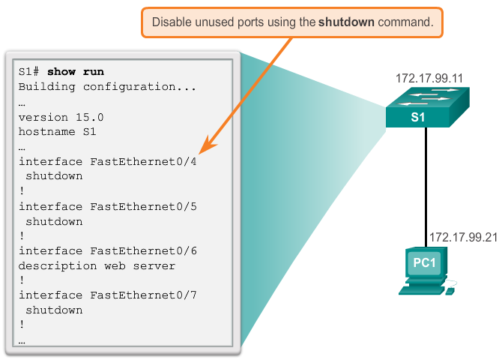
Switch Port Security
Secure Unused Ports
Disabling unused ports is a simple, yet efficient security guideline.
Notes:
2.2.4.1 Secure Unused Ports

Slide 38
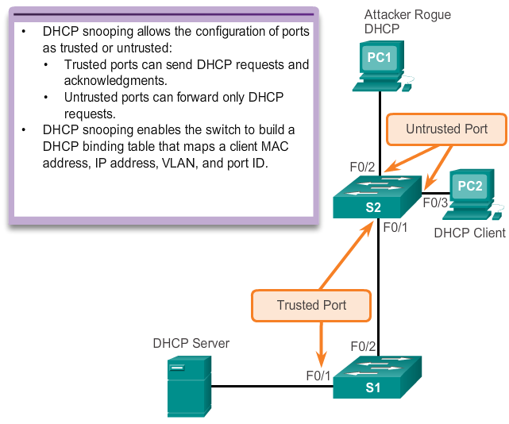
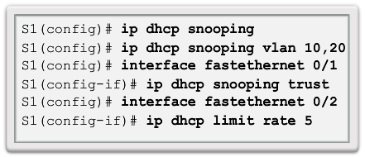
Switch Port Security
DHCP Snooping
DHCP Snooping specifies which switch ports can respond to DHCP requests
Exceeded traffic dropped, you can see it in 'show ip dhcp snooping statistics detail'
Notes:
2.2.4.2 DHCP Snooping

Slide 39
Switch Port Security
Port Security: Operation
Port security limits the number of valid MAC addresses allowed on a port.
The MAC addresses of legitimate devices are allowed access, while other MAC addresses are denied.
Any additional attempts to connect by unknown MAC addresses generate a security violation.
Secure MAC addresses can be configured in a number of ways:
  Static secure MAC addresses
  Dynamic secure MAC addresses
  Sticky secure MAC addresses
Notes:
2.2.4.3 Port Security: Operation

Slide 40
Switch Port Security
Port Security: Violation Modes
IOS considers a security violation when either of these situations occurs:
  The maximum number of secure MAC addresses for that interface have been added to the CAM, and a station whose MAC address is not in the address table attempts to access the interface.
  An address learned or configured on one secure interface is seen on another secure interface in the same VLAN.
There are three possible actions to take when a violation is detected:
  Protect – opatření je na switchi
  Restrict – opatření je na syslogu
    Only difference is that, security violation counters are incremented in restrict, while its not incremented in protect.
  Shutdown
Notes:
2.2.4.4 Port Security: Violation Modes

Slide 41
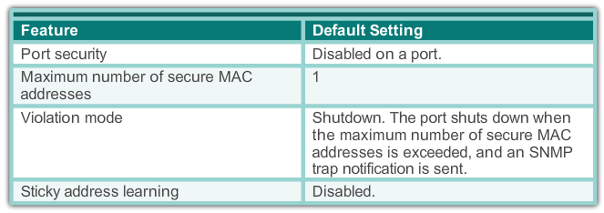
Switch Port Security
Dynamic Port Security Defaults
Aging
Absolute—When using this method, secure MAC addresses are deleted after a specific aging time expires.
Inactivity—When using this method, secure MAC addresses are deleted only if the secure MAC address is inactive for a specific aging time.
Notes:
2.2.4.5 Dynamic Port Security Defaults

Slide 42
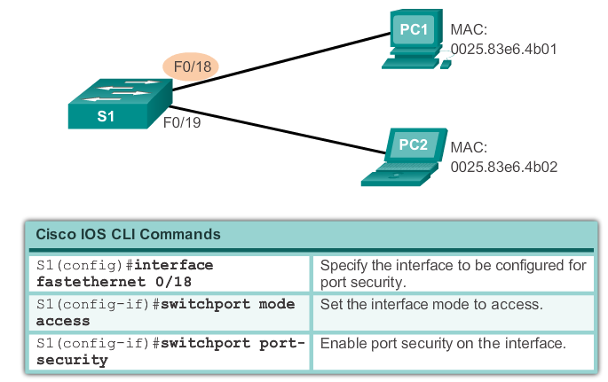
Switch Port Security
Configuring Dynamic Port Security
Notes:
2.2.4.5 Configuring Dynamic Port Security

Slide 43
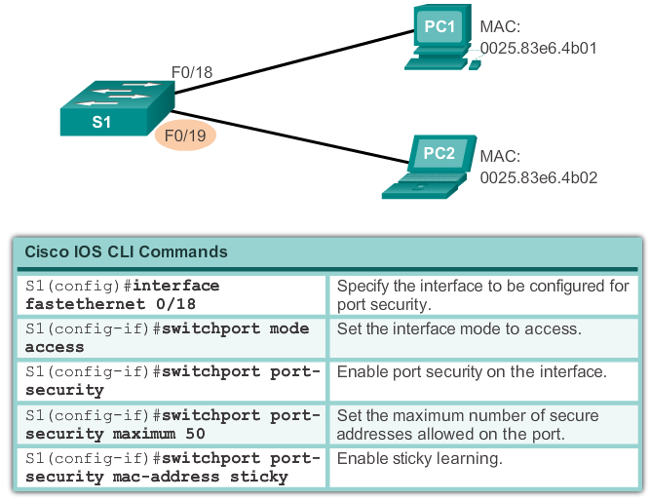
Switch Port Security
Configuring Port Security Sticky
Notes:
2.2.4.5 Configuring Port Security Sticky

Slide 44
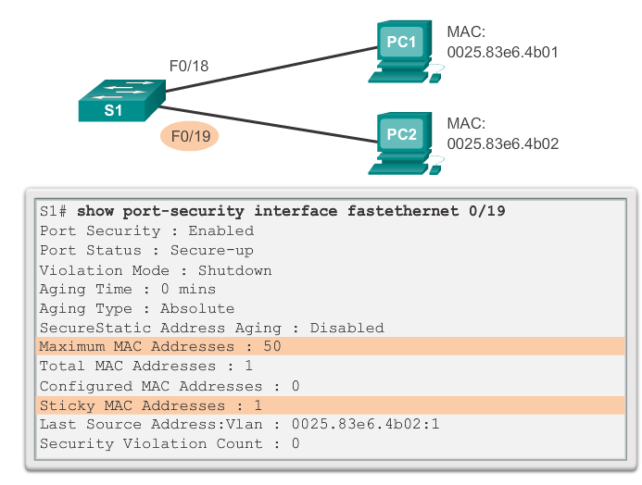
Switch Port Security
Verifying Port Security Sticky
Notes:
2.2.4.6 Port Security: Verifying

Slide 45
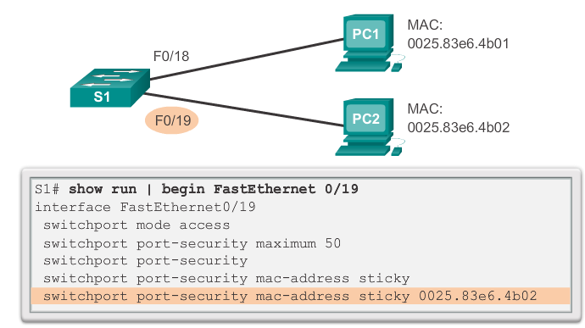
Switch Port Security
Verifying Port Security Stick – Running Configuration
Notes:
2.2.4.6 Verifying Port Security Stick – Running Configuration

Slide 46
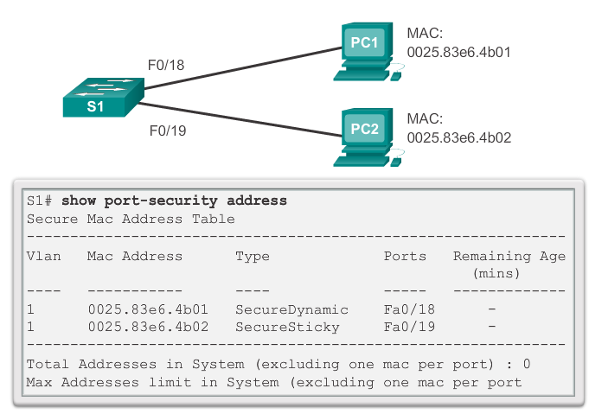
Switch Port Security
Verifying Port Security – Secure MAC Addresses
Notes:
2.2.4.6 Verifying Port Security – Secure MAC Addresses

Slide 47
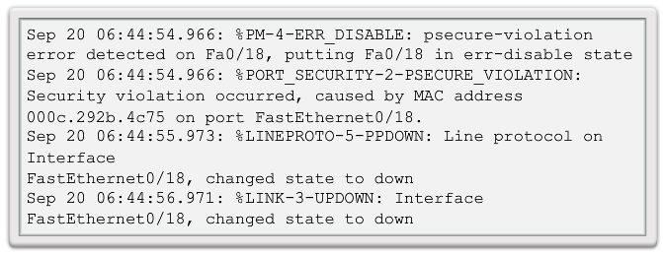
Switch Port Security
Ports in Error Disabled State
A port security violation can put a switch in error disabled state.
A port in error disabled is effectively shutdown.
The switch communicates these events through console messages.
Notes:
2.2.4.7 Ports in Error Disabled State

Slide 48
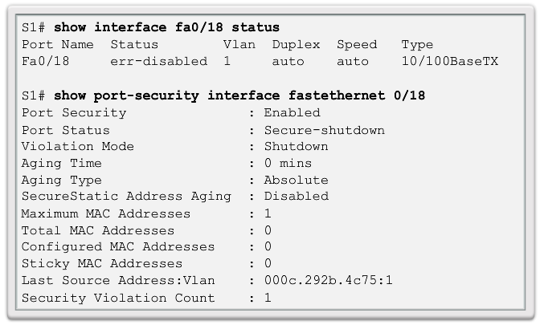
Switch Port Security
Ports in Error Disabled State (cont.)
The show interface command also reveals a switch port on error disabled state.
Notes:
2.2.4.7 Ports In Error Disabled State

Slide 49
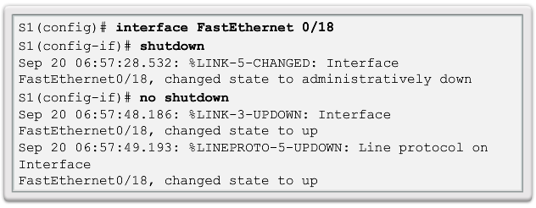
Switch Port Security
Ports in Error Disabled State (cont.)
A shutdown or no shutdown interface configuration mode command must be issued to re-enable the port.
Notes:
2.2.4.7 Ports In Error Disabled State

Slide 50
Switch Port Security
Network Time Protocol
The Network Time Protocol (NTP) is used to synchronize the clocks of computer systems data networks.
NTP can get the correct time from an internal or external time source.
Time sources can be:
  Local master clock
  Master clock on the Internet
  GPS or atomic clock
A network device can be configured as either an NTP server or an NTP client.
See slide notes for more information on NTP.
Notes:
2.2.4.8 Network Time Protocol (NTP)
More info can be found at:
http://tools.ietf.org/html/rfc5905
http://en.wikipedia.org/wiki/Network_Time_Protocol

Slide 51
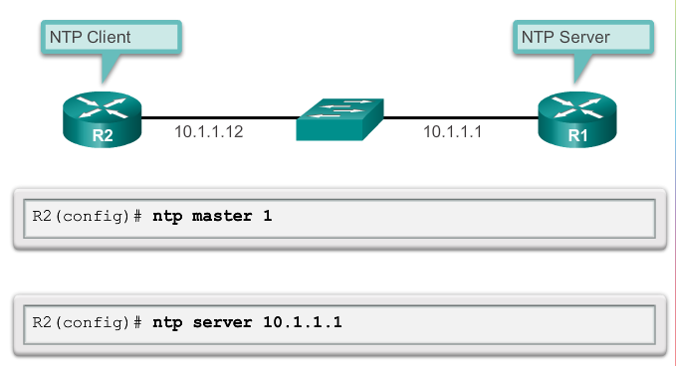
Switch Port Security
Configuring NTP
Notes:
2.2.4.8 Configuring NTP
More info can be found at:
http://tools.ietf.org/html/rfc5905
http://en.wikipedia.org/wiki/Network_Time_Protocol

Slide 52
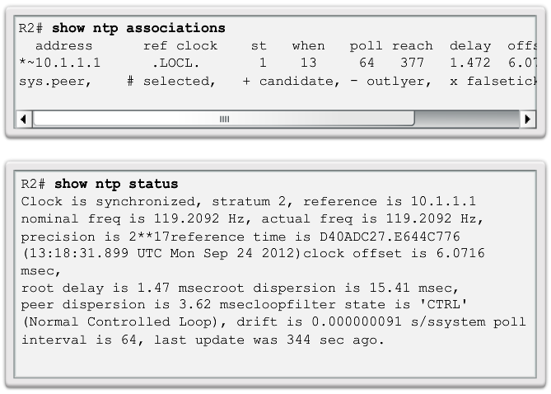
Switch Port Security
Verifying NTP
Notes:
2.2.4.8 Verifying NTP
More info can be found at:
http://tools.ietf.org/html/rfc5905
http://en.wikipedia.org/wiki/Network_Time_Protocol

Slide 53
Chapter 2: Summary
In this chapter, you learned:
Cisco LAN switch boot sequence.
Cisco LAN switch LED modes.
How to remotely access and manage a Cisco LAN switch through a secure connection.
Cisco LAN switch port duplex modes.
Cisco LAN switch port security, violation modes, and actions.
Best practices for switched networks.
Notes:
Chapter 2 Summary

Slide 54


