Slide 1
General overview

Slide 2
Content of the course
Basic of marketing methodology
Management of marketing
Analysis of market environment
Marketing and work with information
Basic marketing tools (marketing mix)

Slide 3
Definition
Marketing is defined by the American Marketing Association [AMA] as "the activity, set of institutions, and processes for creating, communicating, delivering, and exchanging offerings that have value for customers, clients, partners, and society at large."

Slide 4
Why should we concentrate to marketing of services?

Slide 5
Contributions of Service Industries to
Gross Domestic Product

Slide 6
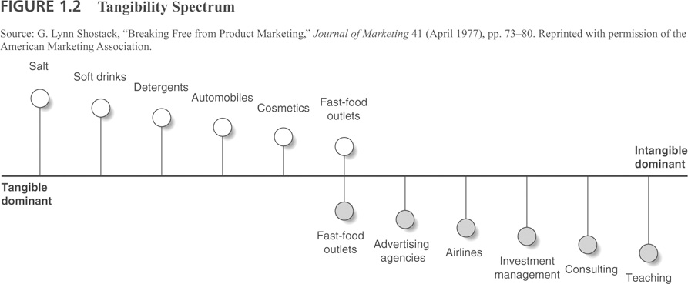
Tangibility Spectrum

Slide 7
Overview: Why Services Matter
Services dominate EU and worldwide economies
Services are growing dramatically
Service leads to customer retention and loyalty
Service leads to profits
Services help manufacturing companies differentiate themselves

Slide 8
What is Service? The New View
Service includes every interaction between any customer and anyone representing the company, including:
Dealers
Salespeople
Receptionists and Schedulers
Management and Executives
Service Employees
Billing and Accounting Personnel
Web site and any e-channel Interaction
Customer
Notes:
8

Slide 9
Marketing framework
5C
Customer
STP
Segmentation
Marketing Mix
4P
Company
Context
Collaborators
Competitors
Targeting
Positioning
7P
4C
7C
4S

Slide 10
Situation Analysis
Customer
Company
Context
Collaborators
Competitors
Who is our typical customer?
Whom are our products designed for?
What value do we bring to the customer?
What is our company background?
What is our position on the market?
How do we manage the company processes?
Whom do we need to finalize our production?
Are there any unreplaceable companies?
What do we expect from our partners?
Do we know our competitors?
What is the highest danger?
How do we map the whole market?
What are political conditions?
Are there any economical issues?
What is level of technological development?

Slide 11
Boston matrix
Relative Market share
Star
???
Cash cow
Dog
High
Low
Market Growth Rate
High
Low

Slide 12
The STP Process
Segmentation is the process of classifying customers into groups which share some common characteristic
Targeting involves the process of evaluating each segments attractiveness and selecting one or more segments to enter
Positioning is arranging for a product to occupy a clear, distinctive and desirable place relative to competing products in the mind of the consumer

Slide 13
Levels of segmentation
Mass Marketing
Same product to all customers
Niche Marketing
Different products to subgroups within segments
(more segmentation)
Segment Marketing
Different products to one or more segments
(some segmentation)
Micromarketing
Products to suit the tastes of individuals and locations
(complete segmentation)
Local Marketing
Tailoring brands/ promotions to local customer groups
Individual Marketing
Tailoring products/ programs to individual customers

Slide 14
Market Targeting
Market Coverage Strategies
Company
Marketing
Market
A. Undifferentiated Marketing
Company
Marketing 1
Segment 1
Company
Marketing 2
B. Differentiated Marketing
Segment 2
Company
Marketing 3
Segment 3
Segment 1
Company
Marketing
Segment 2
C. Concentrated Marketing
Segment 3

Slide 15
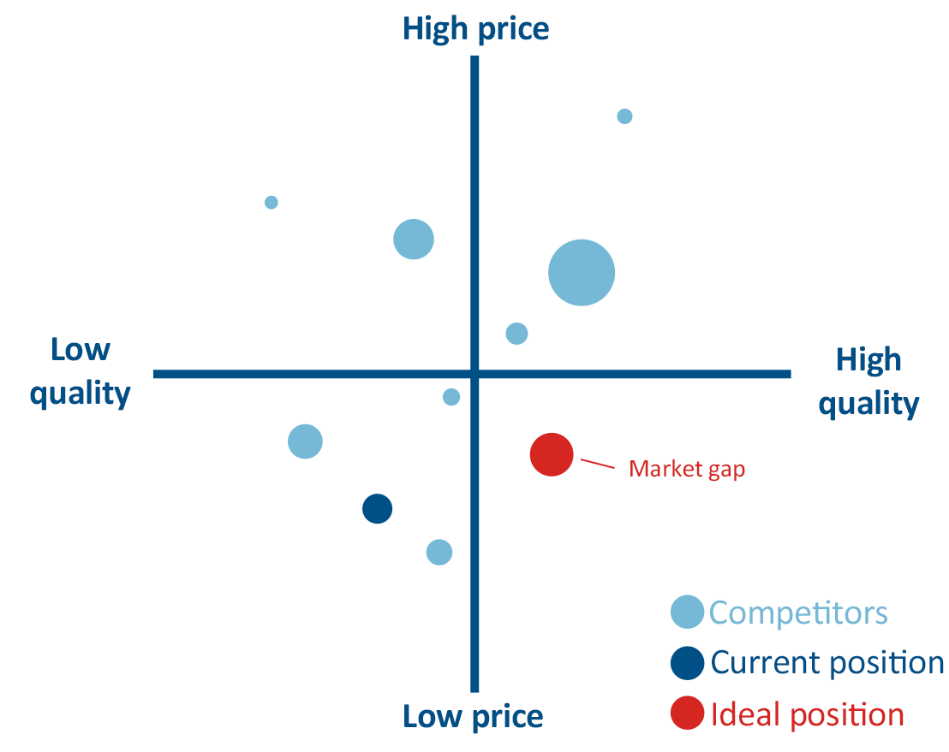
Market Positioning Strategy

Slide 16
Steps in Market Segmentation, Targeting and Positioning
Identify the bases for segmentation
Develop Profiles of Resulting Segments
Develop Selection Criteria
Select Target Segments
Develop Positioning for Each Target Segment
Develop Marketing Mix for Each Target Segment
Market Segmentation
Market Targeting
Market Positioning

Slide 17
Marketing mix
4P
Product
Price
7P
4P +
Scope
4C
Customer
Costs
Placement
Promotion
People
Physical Evidence
Process
4S
Site
Synergy
System
Convenience
Communication
7C
4C +
Community
Channels
Co-Creation

Slide 18
5 key steps in Marketing Research
Define the Problem
Collect the Data
Analyze and interpret the data
Reach a conclusion
Implement your research

Slide 19
A Classification of Marketing Research
Marketing research
Problem Identification Research
Problem Solving Research
Market Potential Research
Market Share Research
Image Research
Market Characteristics Research
Forecasting Research
Business Trends Research
Segmentation Research
Product Research
Pricing Research
Promotion Research
Distribution Research

Slide 20
Qualitative and Quantitative Research
Quantitative Research
Quantitative research looks at patterns in numeric data.
Quantitative research gathers data in numerical form which can be put into categories or measured in units of measurement.
This type of data can be used to construct graphs and tables.
Qualitative Research
Qualitative research gathers information that is not in numerical form.
Qualitative data is typically descriptive data.
When you think of qualitative data, Think of the word 'quality' – because in qualitative analysis we are taking a deep quality look at a phenomenon.

Slide 21
Qualitative methods of marketing research
Mystery shopping
Focus group
SERVQUAL
In depth interview
Observations

Slide 22
Quantitative methods examples
CATI
CAWI
Surveys
In-hall test (CLT)
Computer Assisted Telephonic Interview
Computer Assisted Web Interview
Central Location Test
CAPI
Computer-assisted personal interviewing

Slide 23
Examples of unusual marketing
Niche marketing
Highly specialized product or service
Not suitable for big companies
Customizable products or services
Guerrilla marketing
Innovative ways of marketing
Using ideas, not money

Slide 24



Meme
is an idea, behavior, or style that spreads from person to person within a culture
It represents the idea and the company
Short and useful

Slide 25
Relationship marketing
Firms build long-term relationships in four ways
Gather information about their customers
Monitor interactions with customers
Use customers’ preferences and knowledge
Analyze the data and use it to modify the marketing mix
Core concepts of CRM
Key drivers of RM

Slide 26
Last presentation???
Come and see – but it will be a part of exam!

