Slide 1
MVC 6 introduction
Slavomír Moroz
2016

Slide 2
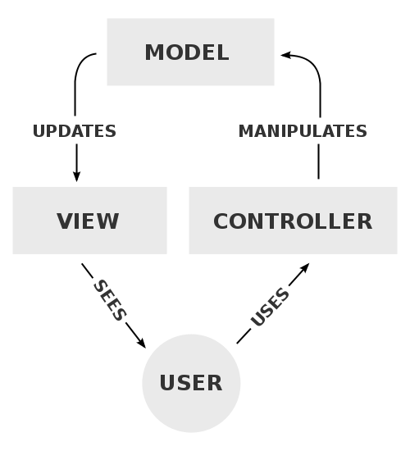
MVC Pattern
MVC 6 introduction
Model-View-Controller architectural pattern for user-interface design (1970 – 1980)
Ruby on Rails, ASP.NET MVC, Spring MVC, …
Model – state of an aspect of the application
View – displays user interface using provided model
Controller – handles user interaction by amending model and passing it to a view
https://docs.asp.net/en/latest/mvc/overview.html
Notes:
Create MVC application from template
-Show structure, startup, bower, staticfiles

Slide 3
Routing
MVC 6 introduction
Convention-based routing
routes.MapRoute(name: "Default", template: "{controller=Home}/{action=Index}/{id?}");
Attribute routing
[Route("api/[controller]")]
public class ProductsController : Controller
{
[HttpGet("{id}")]
public IActionResult GetProduct(int id)
{
...
}
}
https://docs.asp.net/en/latest/mvc/controllers/routing.html
Notes:
Browse default UI showing controllers in action
Create an route without controller (for HomeController)
Mixed routing – RouteAttribute overrides conventional
IActionConstraint – HttpPost, ActionName…

Slide 4
Controllers
MVC 6 introduction
In ASP.NET MVC, a Controller is used to define and group a set of actions. An action (or action method) is a method on a controller that handles incoming requests.
New controller instance for each request
Actions should return an instance of IActionResult (or Task<IActionResult> for async methods) that produces a response.
https://docs.asp.net/en/latest/mvc/controllers/actions.html#defining-actions
Notes:
Structure, activator, Go to link, show ActionResult helper methods

Slide 5
Views
MVC 6 introduction
ASP.NET Core MVC views are .cshtml files stored by default in a Views folder within the application.
When an action returns a view, a process called view discovery takes place.
  Unless a specific view file is specified, the runtime looks for a controller-specific view first, then looks for matching view name in the Shared folder.
    Views/<ControllerName>/<ViewName>.cshtml
    Views/Shared/<ViewName>.cshtml
  When an action returns the View method, like so return View();, the action name is used as the view name
  A view name can be explicitly passed to the method (return View("SomeView");).
https://docs.asp.net/en/latest/mvc/views/overview.html
Notes:
Edit index, remove the markup, put some label in it. Show bootstrap doc for classes.

Slide 6
Razor
MVC 6 introduction
@if (true) {
WriteLiteral("<p>Test</p>");
}
@if (true) {
<p>Text</p>
}
@if (true) {
@:This is text.
}
@if (true)
{
<Text>This is also text.</Text>
}
@if (condition1) {
if (condition2) { <p>Text</p> }
}
@if (condition1) {
<div>
@if (condition2) { @:Text }
</div>
}
https://docs.asp.net/en/latest/mvc/views/razor.html
Notes:
Implicit expression @datime
Explicit <p>Last week this time: @(DateTime.Now - TimeSpan.FromDays(7))</p>

Slide 7
ViewData (ViewDataDictionary Class)
MVC 6 introduction
Represents a container that is used to pass data between a controller and a view
Controllers writes the data, view reads.
ViewData.Model – passed model
ViewData.ModelMetadata – set o information about model
ViewData.ModelState – validation messages
ViewData[“something”] – additional data
  also accessible via ViewBag.
https://msdn.microsoft.com/en-us/library/system.web.mvc.viewdatadictionary(v=vs.118).aspx
Notes:
ViewData.Model = X vs. return View(X)
ViewData[“”] vs Viewbag
Show example of both

Slide 8
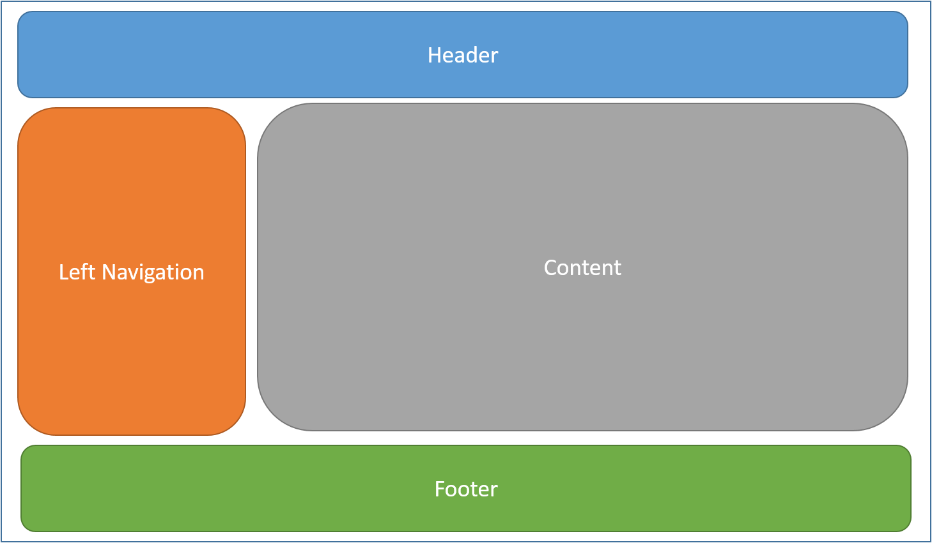
Layouts
MVC 6 introduction
Notes:
Show title

Slide 9
Layouts
MVC 6 introduction
Specifying a Layout
@{
Layout = "_Layout";
}
Layout must call RenderBody. Wherever the call to RenderBody is placed, the contents of the view will be rendered.
Running Code Before Each View
If you have code you need to run before every view, this should be placed in the _ViewStart.cshtml file.
https://docs.asp.net/en/latest/mvc/views/layout.html

Slide 10
Sections
MVC 6 introduction
RenderSection(…) in layout (usually)
Used for view-specific HTML that is not part of body (RenderBody())
  Side bars, adds, action-specific content
  Scripts (~/Views/Shared/_Layout.cshtml)
Not required to be defined in all views (usually, required: false)
Notes:
Show scripts section
Add to home:
@section scripts {
<script>
alert("Welcome! Welcome!");
</script>
}

Slide 11
View model
MVC 6 introduction
Models folder
Represent state of a particuallar aspect of the application
Each controller should have a sub-folder for its models
  Models are usually named by corresponding Actions
Always prefer strongly-typed model to a ViewBag or ViewData
Models should be POCO objects without any business logic
https://en.wikipedia.org/wiki/Plain_Old_CLR_Object
Notes:
Show scaffolding
Switch to project before from zip folder
Show Index action – view, model, controller, automapper mapping

Slide 12
View helpers
MVC 6 introduction
@model MyProject.Models.Product
@using (Html.BeginForm())
{
<div>
@Html.LabelFor(m => p.Name, "Name:")
@Html.TextBoxFor(m => p.Name)
</div>
<input type="submit" value="Create" />
}
@model MyProject.Models.Product
@addtaghelper "Microsoft.AspNet.Mvc.TagHelpers"
<form asp-controller="Products" asp-action="Create" method="post">
<div>
<label asp-for="Name">Name:</label>
<input asp-for="Name" />
</div>
<input type="submit" value="Save" />
</form>
https://docs.asp.net/en/latest/mvc/views/tag-helpers/index.html
https://msdn.microsoft.com/en-us/library/system.web.mvc.htmlhelper_methods(v=vs.118).aspx
Notes:
Add link to layout to games index
Details vs create views
Model display attributes
Import file with inject and usings

Slide 13
Route constraints
MVC 6 introduction
Route constraints generally inspect the route value associated via the route template and make a simple yes/no decision about whether or not the value is acceptable.
Avoid using constraints for input validation, because doing so means that invalid input will result in a 404 (Not Found) instead of a 400 with an appropriate error message.
template: “edit/{id:int}“
defaults: new { controller=“IdObjectController", action=“Edit" }
template: “edit/{guid:guid}“
defaults: new { controller=“GuidObjectController", action=“Edit" }
https://docs.asp.net/en/latest/fundamentals/routing.html#route-constraint-reference
Notes:
Add id rule to routes, create game with integer codename

Slide 14
Model validation (server)
MVC 6 introduction
Setup
Data annotations validation attributes
  Required, DisplayName, StringLength, Range…
  Custom attribute that inherits ValidationAttribute.
Model implementing IValidatableObject
Custom : ViewData.ModelState.AddModelError()
Check
if (!ViewData.ModelState.IsValid)
{
return View(model);
}
repository.Save();
return RedirectToAction("Detail", new { id = id });
https://docs.asp.net/en/latest/mvc/models/validation.html
Notes:
Add attributes and IValidatableObject to view mode create
Show validation place holders in view
Show modelState check
Post – redirect – get

Slide 15
Model validation (client)
MVC 6 introduction
Unobtrusive validation (linked with JQuery)
Supports only attribute validators (doesn’t support IValidatableObject)
  Custom attributes that implements IClientModelValidator
Hard to localize
Setup
Install nugget package Microsoft.JQuery.Unobtrusive.Validation
Link scripts in your layout:
  JQuery
  JQuery-validate
  JQuery-validate-unobtrusive
Notes:
Do nothing

Slide 16
Partial views
MVC 6 introduction
Html.Partial(…) – displays view of given name (no controller/action is called)
Html.RenderAction(…) – calls a controller‘s action, rendering its result
  always use PartialViewResult
Usually view name starts with an underscore
https://docs.asp.net/en/latest/mvc/views/partial.html
Notes:
Place _ValidationScriptsPartial to script section in create view
Explain void methods in views – in link there is a difference between Partial() and RenderPartial

Slide 17
Model binding - passing data
MVC 6 introduction

Slide 18
Customize binding behavior
MVC 6 introduction
MVC contains several attributes that you can use to direct its default model binding behavior to a different source.
  [BindRequired]: This attribute adds a model state error if binding cannot occur.
  [BindNever]: Tells the model binder to never bind to this parameter.
  [FromHeader], [FromQuery], [FromRoute], [FromForm]: Use these to specify the exact binding source you want to apply.
  [FromServices]: This attribute uses dependency injection to bind parameters from services.
  [FromBody]: Use the configured formatters to bind data from the request body. The formatter is selected based on content type of the request.
  [ModelBinder]: Used to override the default model binder, binding source and name.
https://docs.asp.net/en/latest/mvc/models/model-binding.html
Notes:
Add bind attribute, list all desired properties, security

Slide 19
Collections binding
MVC 6 introduction
Primitive type array
ActionResult Edit(string[] array) {…}
PostData
array="John"
array="Mark"
array="Zoey"
Index array (complex type)
ActionResult Edit(Employee[] array) {…}
PostData
array[0].FirstName="John" array[0].LastName="Smith" array[1].FirstName="Zoey" array[1].LastName="Castillo"
Dictionary
ActionResult Edit(
Dictionary<string, Employee> empls
)
PostData
employees[Emp1035].FirstName="John" employees[Emp1035].LastName="Smith" employees[Emp2535].FirstName="Zoey" employees[Emp2535].LastName="Castillo"
Notes:
Primitive array not working in demo from lecture 5 2015 cos of checkbox false value which is adding extra value to non indexed array.

Slide 20
AntiForgeryToken
MVC 6 introduction
Protection against CSRF attacks.
Render token in form
  generates the anti-forgery token with the Form Tag Helper
  <form asp-action="Edit">
Validation in controller
  [ValidateAntiForgeryToken] attribute
https://en.wikipedia.org/wiki/Cross-site_request_forgery

Slide 21
Context
MVC 6 introduction
HttpContext (IHttpContextAccessor service dependency injection)
  Request
  Response
  Session data
  Authentized user
ActionContext (IActionContextAccessor service dependency injection)
  Action metadata
  ModelState
  RouteData
    Encapsulates information about a route.
    Route parameters and values

Slide 22
Resources
MVC 6 introduction
https://docs.asp.net/en/latest/mvc/overview.html
Complete documentation
MVC part is well written
Still in progress, some parts are missing
https://docs.asp.net/en/latest/tutorials/first-mvc-app/controller-methods-views.html
Quick start tutorial
Notes:
Mention config override from environment variable, useful for source control

