Slide 1
Identity & stuff
Slavomír Moroz
2016

Slide 2
Action constraint
Stuff
Supports conditional logic to determine whether or not an associated action is valid to be selected for the given request.
Inherites Attribute, IActionConstraint
[HttpGet][HttpPost]
https://docs.asp.net/en/latest/mvc/controllers/routing.html#understanding-iactionconstraint

Slide 3
Action filters
Stuff
Filters in ASP.NET MVC allow you to run code before or after a particular stage in the execution pipeline. Filters can be configured globally, per-controller, or per-action.
Filter types: Authorization, Resource, Action, Exception, Result
Different filter types run at different points within the pipeline.
https://docs.asp.net/en/latest/mvc/controllers/filters.html
Notes:
Show diagrams from link

Slide 4
Authorization filters
Stuff
Authorization filters are used to determine whether the current user is authorized for the request being made.
Authorization filter attributes
  AuthorizeAttribute
  AllowAnonymousAttribute
https://docs.asp.net/en/latest/mvc/controllers/filters.html#authorization-filters
https://docs.asp.net/en/latest/security/authorization/simple.html
Notes:
Todo custom auth attribute

Slide 5
Claim
Stuff
A claim is a statement that one subject makes about itself or another subject.
The statement can be about a name, identity, key, group, privilege, or capability,
https://msdn.microsoft.com/en-us/library/system.identitymodel.claims.claimtypes(v=vs.110).aspx
Pre-defined claim types:
Notes:
ClaimPrincipal -> ClaimsIdentity vs Custom

Slide 6
Identity
Identity
ASP.NET Core Identity is a membership system which allows you to add login functionality to your application. Users can create an account and login with a user name and password or they can use an external login providers such as Facebook, Google, Microsoft Account, Twitter and more.
You can configure ASP.NET Core Identity to use a SQL Server database to store user names, passwords, and profile data. Alternatively, you can use your own persistent store to store data in another persistent storage, such as Azure Table Storage.
https://docs.asp.net/en/latest/security/authentication/identity.html
Notes:
Requires database

Slide 7
Cookie Middleware
Cookie stuff
Serializes a user claim principal into an encrypted cookie and then, on subsequent requests, validates the cookie, recreates the principal and assigns it to the User property on HttpContext.
If you want to provide your own login screens and user databases you can use the cookie middleware as a standalone feature.
https://docs.asp.net/en/latest/security/authentication/cookie.html
Notes:
Custom backend
Authrocket example
Show code, remove authorize attribute from Games.Details action

Slide 8
Authorization
Authorization stuff
Declarative
  Simple or policy based
  Defined at code level
  Not suitable for multitenant applications
  Leverages authorization filters
Imperative
  Authorization per resource handled by our own code
  Leverages ChallengeResult
https://docs.asp.net/en/latest/security/authorization/index.html
Notes:
Show simple auth attribute and claim policy
Explain custom policy on doc
Limitations of cookie if not mentioned before – cookie length, claims validation
Explain resource auth and why should they need it – resources are not loaded with declarative approach (declarative vs imperative)
Challenge result, show example in doc
Mention schema – middleware targeting, Redirect uri props of challenge result

Slide 9
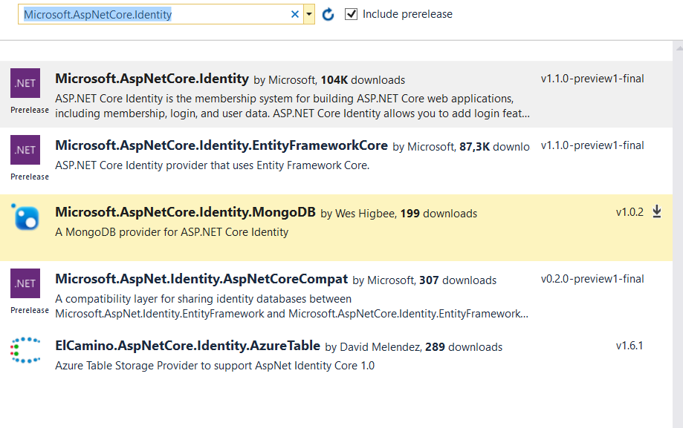
Identity
Identity
Microsoft.AspNetCore.Identity
    the core set of interfaces for ASP.NET Core Identity.
  Microsoft.AspNetCore.Authentication.Cookies
  middleware that enables an application to use cookie based authentication.

Slide 10
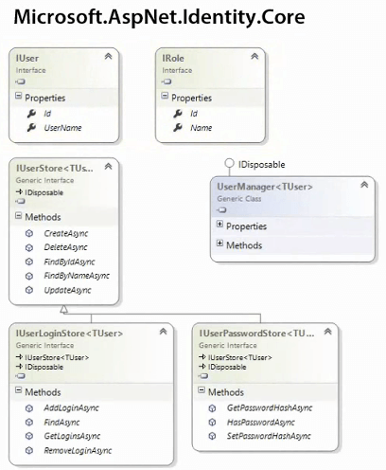
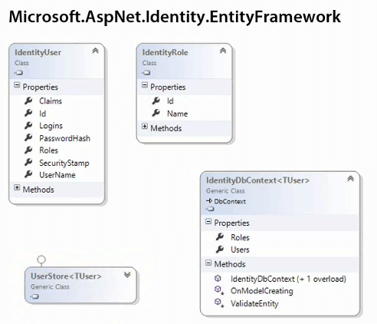
Identity
Notes:
Mentioned available providers
Explain why they cant use EF6 with aspnetcore.identity on 4.6 (the compatibility provider requires .net standard 1.6 which is available only in core projects.
Show template with entity framework core.

Slide 11
Identity class overview
Identity & OWIN
IdentityUser – implementation of IUser
UserManager – APIs to CRUD user, claim and auth info via UserStore
RoleManager – APIs to CRUD roles via RoleStore
UserStore – Talks to data layer to store users, login providers (external auth), user claims, user roles
RoleStore – Talks to data layer to store roles
SignInManager
  High level API to sign in users

Slide 12
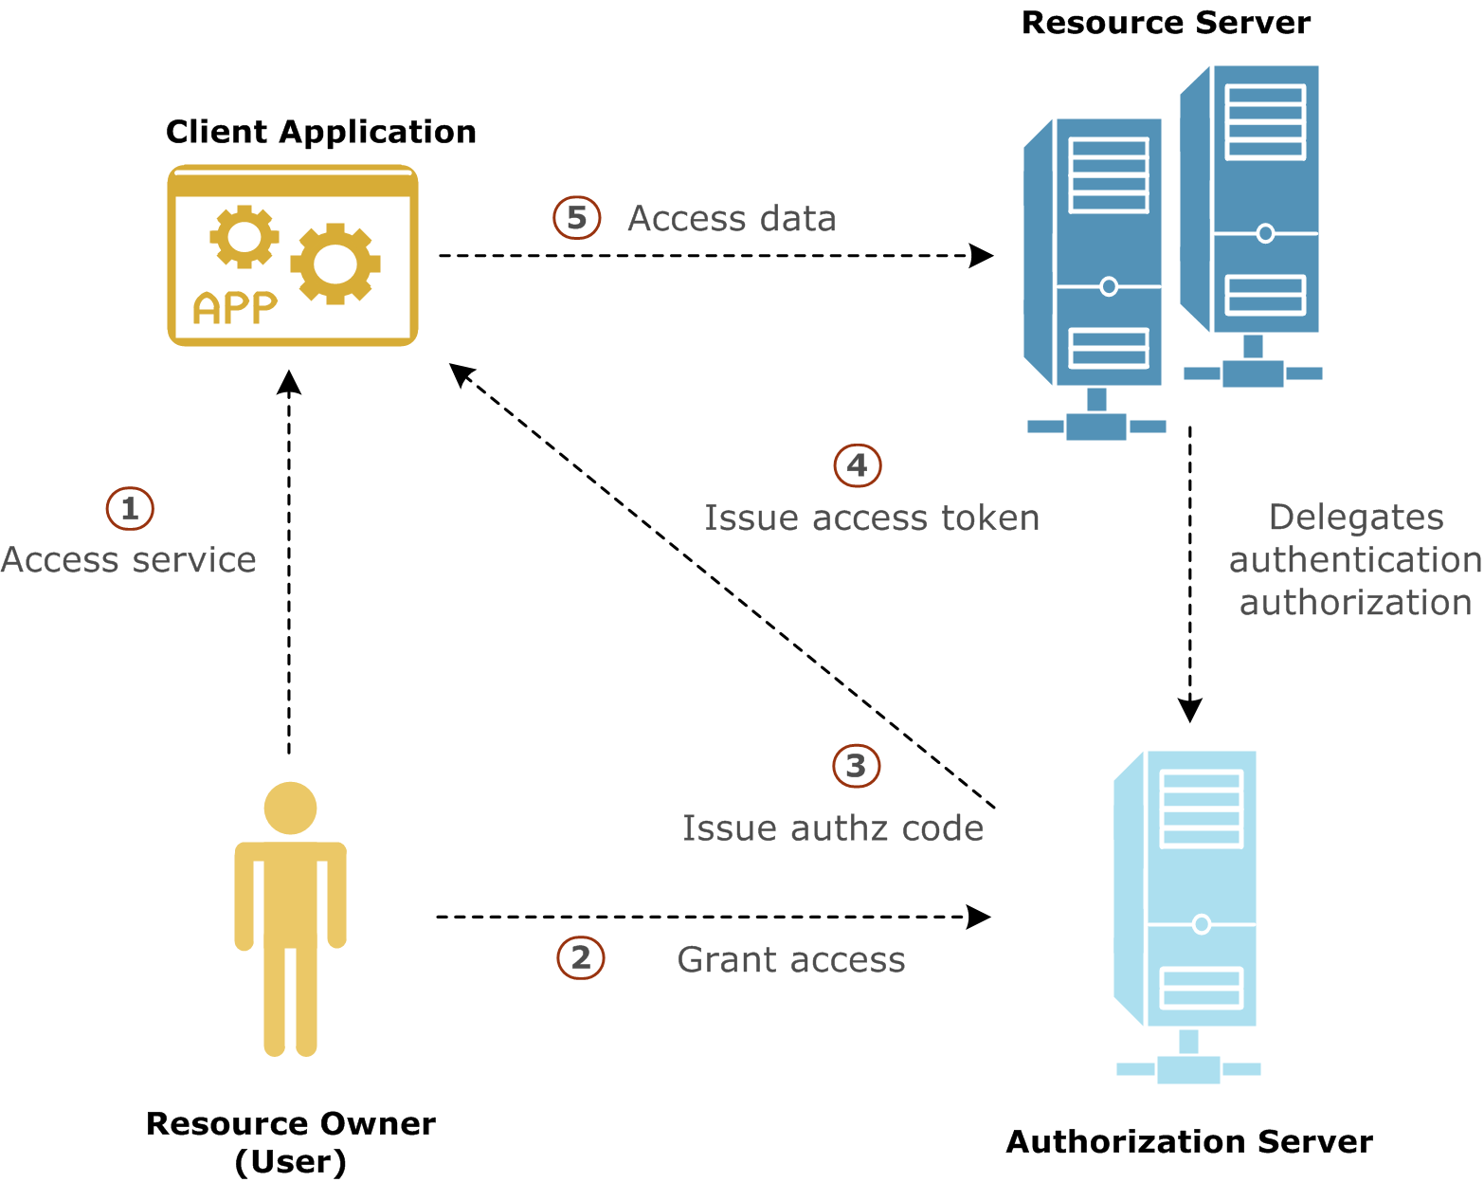
OAuth
Authentication stuff
Notes:
Add google middleware, setup google app https://console.developers.google.com/ Do not forget to enable Social API
Setup middleware, add login button, show claims in debug
Show middleware side by side, schema (middleware identification)
Show sample with redirect uris and google user activation.

Slide 13
View components
Stuff
Similar to partial views
Intended anywhere you have reusable rendering logic that is too complex for a partial view
Can have parameters and business logic
https://docs.asp.net/en/latest/mvc/views/view-components.html
Notes:
Show view component in google auth sample project

Slide 14
Resources
Stuff
https://docs.asp.net/en/latest/security/authentication/index.html
https://docs.asp.net/en/latest/security/authorization/index.html
Notes:
New syllabus

