Slide 1
MUFIN Image Annotation vs.
Google Label Detection:
Who Wins?
Petra Budíková, Michal Batko

Slide 2



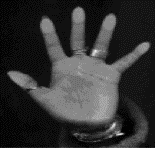




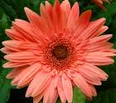



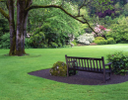

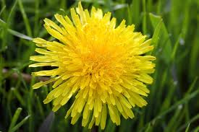
Motivation
There are many images out there…
To enable text search, we need images with keywords
dog?
Flower, yellow, dandelion, detail, close-up, nature, plant, beautiful
  Manual annotation
  Automatic annotation
    MUFIN Image Annotation
    Google Label Detection
P. Budikova, M. Batko, P. Zezula. Semantic Image Annotation by ConceptRank.
Submitted to Multimedia Tools And Applications, October 2016.

Slide 3
Presentation Outline
MUFIN Image Annotation
  Basic idea of the search-based approach
  ConceptRank algorithm outline
  Implementation details
Google Label Detection
  Basic idea of the model-based approach
  Known and unknown details
Comparison
  Data and metrics
  Results
  Examples
Conclusion

Slide 4
MUFIN Image Annotation
Part I

Slide 5
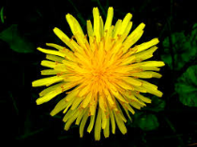
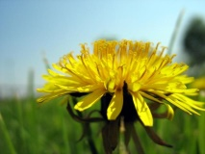
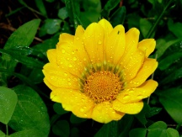
Solution Overview
Search-based annotation
Annotated image collection
Similar annotated images
d = 0.2
d = 0.5
d = 0.6
?
Content-based
image retrieval
Yellow, bloom, pretty
Meadow, outdoors, dandelion
Mary’s garden, summer
Final candidate keywords
with probabilities
Semantic resources
Candidate
keyword
processing
Plant 0.3
Flower 0.3
Garden 0.15
Sun 0.05
Human 0.1
Park 0.1

Slide 6
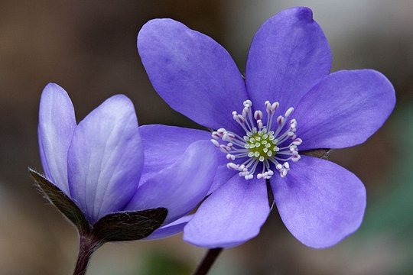
Phase 1: Content-based retrieval for annotations
What we need:
  Large collection of reliably annotated images: Profiset
    20 million general-purpose photos from the Profimedia photostock company
    Descriptive keywords for each photo provided by authors who want to sell the pictures → rich and reliable annotations
  Efficient and effective search: DeCAF descriptors and PPP-codes
    DeCAF: 4096-dimensional vector obtained from the last layer of a neural network image classifier
    PPP-codes: effective permutation-based metric space indexing method
Profiset keywords: botany, close, closeup, color, daytime, detail, exterior, flower, germany, hepatica, horticulture, laughingstock, liverwort, lobed, mecklenburg, nature, nobilis, outdoor, outside, plant, pomerania, purple, round, western

Slide 7
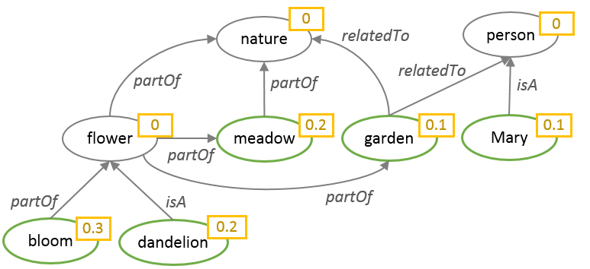
Phase 2: ConceptRank
Candidate keyword analysis inspired by Google PageRank
Uses semantic connections between candidate keywords to determine the probability of individual candidates
Main steps:
  Construct a graph of candidate keywords related by WordNet semantic links
  Apply biased random walk with restarts to compute the score of each keyword
Similar annotated images
d = 0.2
d = 0.5
d = 0.6
Yellow, bloom, pretty
Meadow, outdoors, dandelion
Mary’s garden, summer

Slide 8
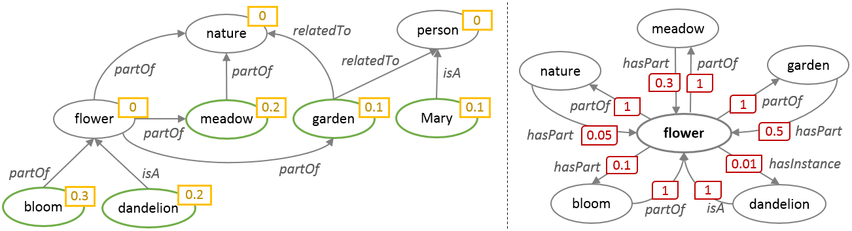
ConceptRank – semantic network
Semantic network: graph representation of semantic relationships
  Nodes: candidate objects
    Node probability: current probability of the respective candidate concept
  Edges: relationships between candidate objects
    Edge weight: conditional probability of the target node concept, given that the source node concept is relevant
Semantic network construction
  Initial nodes and their probabilities taken from CBIR result
  For each node, relationships are found in the WordNet lexical database -> new edges and nodes

Slide 9









ConceptRank – node probability computation
Random walk idea (general directed graph)
  User starts in random node and walks randomly in the graph. The importance of each node is equal to the probability that the random walker ends up in the given node.
  Let M be a matrix describing the edges in the graph. Mathematically, we are looking for a vector r of node weights that satisfies the equation r = M.r
    This can be computed by repeatedly multiplying a random initial vector r₀ by M until the steady state is found
  Problem: in many real-world graphs, the matrix M is such that the equation does not work as expected
1
Transition matrix:
$$M=\left(\begin{matrix}0 & 0 & 0 \\ 0.5 & 0 & 0 \\ 0.5 & 1 & 1\end{matrix}\right)$$
C
0.5
1
Node probabilities:
$r_{0}$ $=\left(\begin{matrix}0.333 \\ 0.333 \\ 0.333\end{matrix}\right)$
$r_{1}$ $=\left(\begin{matrix}0 \\ 0.166 \\ 0.833\end{matrix}\right)$
$r_{2}$ $=\left(\begin{matrix}0 \\ 0 \\ 1\end{matrix}\right)$
A
0.5
B
Transition matrix:
$$M=\left(\begin{matrix}0 & 0 & 0 \\ 0.5 & 0 & 0 \\ 0.5 & 1 & 0\end{matrix}\right)$$
C
0.5
1
Node probabilities:
$r_{0}$ $=\left(\begin{matrix}0.333 \\ 0.333 \\ 0.333\end{matrix}\right)$
$r_{1}$ $=\left(\begin{matrix}0 \\ 0.166 \\ 0.5\end{matrix}\right)$
$r_{2}$ $=\left(\begin{matrix}0 \\ 0 \\ 0.166\end{matrix}\right)$
$r_{3}$ $=\left(\begin{matrix}0 \\ 0 \\ 0\end{matrix}\right)$
A
0.5
B

Slide 10










ConceptRank – node probability computation II
Random walk with restart
  Proposed by Google to eliminate the problems of basic random walk + model more realistically real web users
  With a given probability P_{restart}, the random walker can decide in each step whether to follow the links, or to randomly restart in any node
C
Transition matrix:
$$M=\left(\begin{matrix}0 & 0 & 0 \\ 0.5 & 0 & 0 \\ 0.5 & 1 & 0\end{matrix}\right)$$
0.5
1
0.5
Node probabilities:
$r_{0}$ $=\left(\begin{matrix}0.333 \\ 0.333 \\ 0.333\end{matrix}\right)$
$r_{1}$ $=\left(\begin{matrix}0 \\ 0.166 \\ 0.5\end{matrix}\right)$
$r_{2}$ $=\left(\begin{matrix}0 \\ 0 \\ 0.166\end{matrix}\right)$
$r_{3}$ $=\left(\begin{matrix}0 \\ 0 \\ 0\end{matrix}\right)$
A
B
0.33
P_{restart} = 0.15
0.05
C
0.05
Stochastic transition matrix:
$M=\left(\begin{matrix}0.05 & 0.05 & 0.333 \\ 0.475 & 0.05 & 0.333 \\ 0.475 & 0.9 & 0.333\end{matrix}\right)$
0.05
0.425
0.85
0.05
0.33
0.33
A
0.425
B
Node probabilities:
$r_{0}$ $=\left(\begin{matrix}0.333 \\ 0.333 \\ 0.333\end{matrix}\right)$
$r_{1}$ $=\left(\begin{matrix}0.144 \\ 0.286 \\ 0.569\end{matrix}\right)$
$r_{2}$ $=\left(\begin{matrix}0.211 \\ 0.272 \\ 0.515\end{matrix}\right)$
…
$r$ $=\left(\begin{matrix}0.197 \\ 0.281 \\ 0.520\end{matrix}\right)$
0.05
0.05

Slide 11





ConceptRank – node probability computation III
Random walk with biased restart
  In standard RWR, all nodes are equal – the restart is equally probable in any node
  Biased restart prefers some nodes over others for the restart
    e.g. selected reliable web nodes
ConceptRank
  Biased RWR on the semantic network model of candidate concepts
  The probability of restart reflects the initial probability of nodes
  The non-restart edges represent semantic relationships
0.1
P_{restart} = 0.15
0.1
C
$$M=\left(\begin{matrix}0.105 & 0.105 & 0.7 \\ 0.455 & 0.03 & 0.2 \\ 0.44 & 0.865 & 0.1\end{matrix}\right)$$
0.015
0.015
Stochastic transition matrix:
0.105
0.425
0.85
0.03
0.7
0.2
$r_{0}$ $=\left(\begin{matrix}0.333 \\ 0.333 \\ 0.333\end{matrix}\right)$
$r_{1}$ $=\left(\begin{matrix}0.303 \\ 0.228 \\ 0.468\end{matrix}\right)$
$r_{2}$ $=\left(\begin{matrix}0.383 \\ 0.238 \\ 0.377\end{matrix}\right)$
$r$ $=\left(\begin{matrix}0.346 \\ 0.246 \\ 0.406\end{matrix}\right)$
A
0.425
B
Node probabilities:
…
0.7
0.105
0.03
0.2

Slide 12
MUFIN Image Annotation – recapitulation
CBIR:
  20M Profiset images
  DeCAF descriptors, PPP-codes
  100-NN query
Semantic analysis:
  Initial candidate keywords provided by CBIR results
  Semantic network built from initial candidates, using selected semantic relationships from WordNet
  ConceptRank algorithm computes the final probability of all nodes
Output selection:
  Postprocessing: remove instances and auxiliary semantic nodes
  Return the most probable keywords

Slide 13
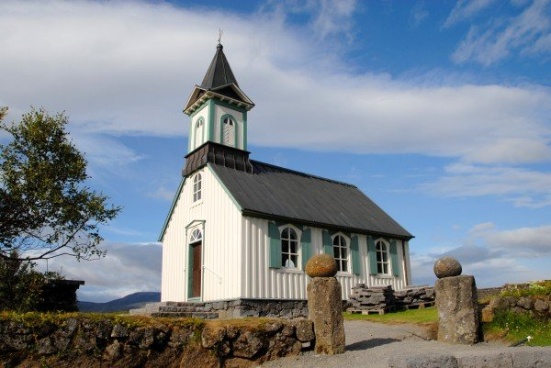
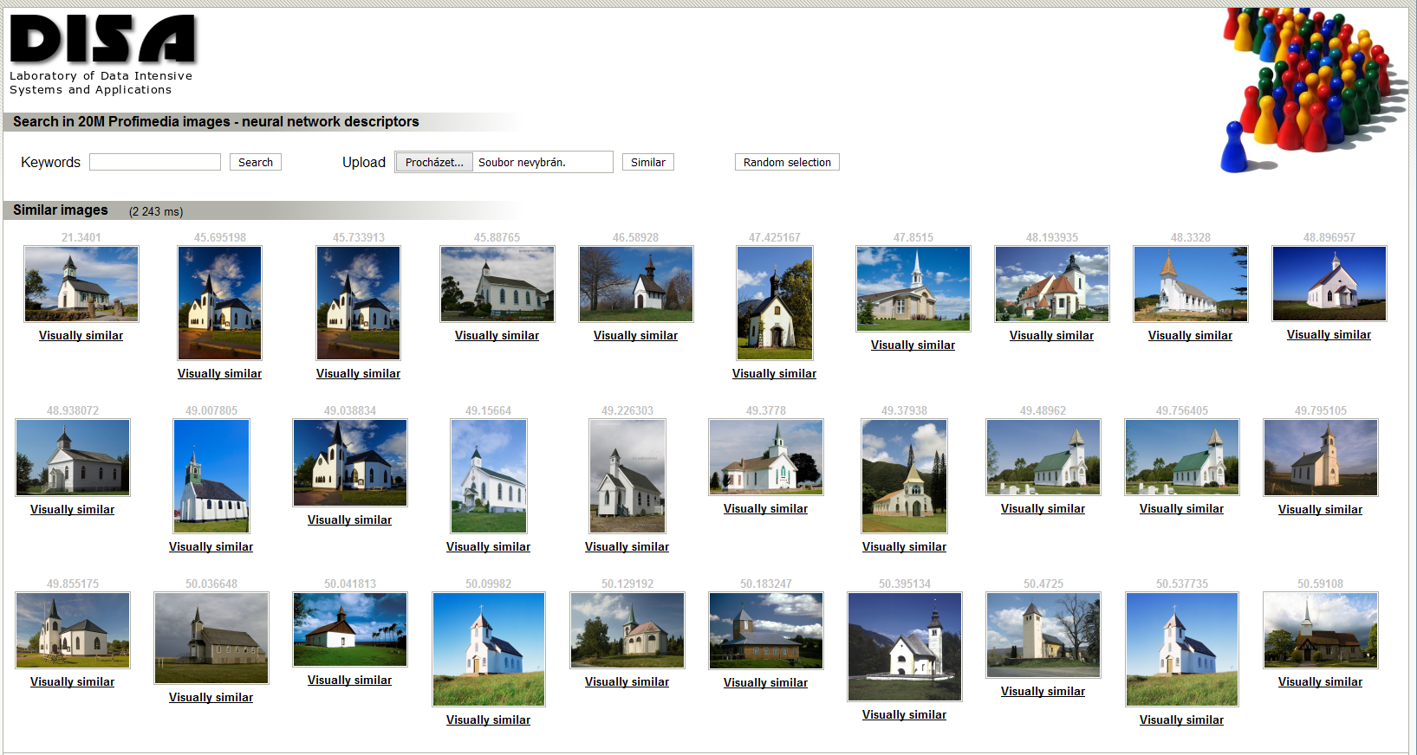
MUFIN Image Annotation – example
Retrieve 100 similar images from Profiset
Merge their keywords, compute frequencies
Build the semantic network using WordNet
Compute the ConceptRank
Apply postprocessing & return 20 most probable keywords
Candidate keywords after CBIR
church, architecture, travel, europe, building, religion, germany, buildings, north, churches, christianity, america, religious, exterior, st, historic, world, tourism, united, usa, …
Semantic network
4 relationships: hypernym (dog → animal), hyponym (animal → dog), meronym (leaf → tree), holonym (tree → leaf)
270 network nodes, 471 edges
ConceptRank scores
building (2.53), structure (2.41), LANDSCAPE (2.10), BUILDINGS (1.87), OBJECT (1.84), NATURE (1.78), place_of_worship (1.75), church (1.74), Europe (1.68), religion (1.64), continent (1.51), …
Final keywords
building, structure, church, religion, continent, group, travel, island, sky, architecture, tower, person, belief, locations, chapel, christianity, tourism, regions, country, district

Slide 14
MUFIN Image Annotation: summary
Main components
  CBIR
    DeCAF, PPP-codes, Profiset data
  ConceptRank semantic analysis
    WordNet
  Final result selection
    The K most probable keywords
      From the whole English vocabulary!

Slide 15
Google Label Detection
Part II

Slide 16

Google Cloud Platform
https://cloud.google.com/
Commercial service
Offers various tools for developers
  Computation power (Batch processing, Web Application Engines, Containers, …)
  Storage and Databases (Cloud key-value store, Bigtable NoSQL, …)
  Networking (Virtual networks, Load-balancing, …)
  Big Data support (Warehousing, Data exploration, …)
  Machine learning (Model training, Deep neural networks, …)
    Tools for: speech, vision, language translation, natural language processing
  Management tools (Monitoring, Logging, Debugging, …)
  Developer Tools (Cloud SDK, Application deployment, …)
  Identity and Security (Access control, Authentication, …)
Support for mobile applications
Trial period for any services
  Free credit for using any commercial service
  Small amounts of data can be processed for free

Slide 17

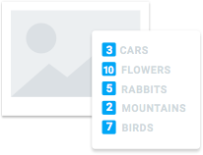
Google Cloud Vision API
https://cloud.google.com/vision/
Image analysis tools
  Derive insight from images based on content
  Exploits machine learning models
Classification of images
  From flowers, animals, or transportation to thousands of categories
    e.g., "sailboat", "lion", "Eiffel Tower"
  Improves over time as new concepts are introduced and accuracy is improved
Detection of faces
  Sentiment analysis
Text recognition within images
Offensive content filtering
Product logo detection
Available via REST API
  Works either on images in Google storage or uploaded in the request

Slide 18
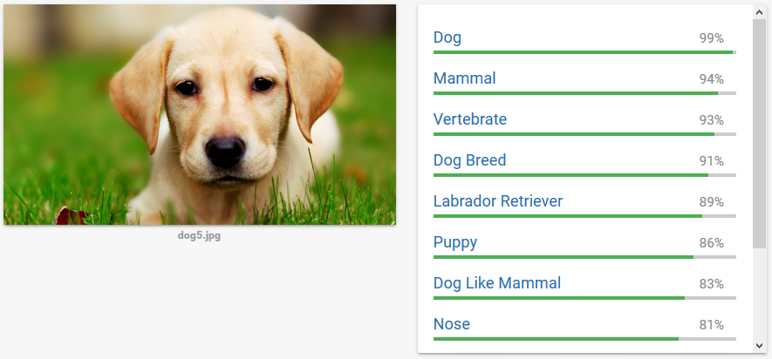
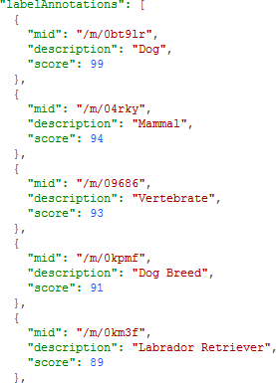
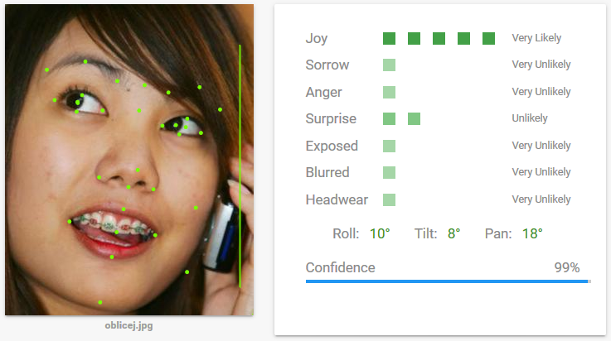
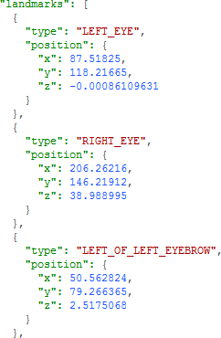
Vision REST API Example
https://cloud.google.com/vision/
Notes:
Google Knowledge Graph (https://developers.google.com/knowledge-graph/)

Slide 19
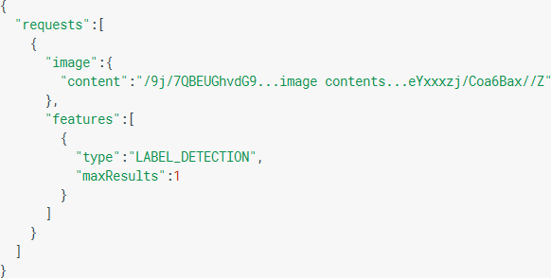
Vision REST API
https://cloud.google.com/vision/
One request method
Request specifies the image and the features to extract as JSON
Types of features to extract
  LABEL_DETECTION, TEXT_DETECTION, FACE_DETECTION, IMAGE_PROPERTIES, LANDMARK_DETECTION, LOGO_DETECTION, SAFE_SEARCH_DETECTION
POST https://vision.googleapis.com/v1/images:annotate

Slide 20
Pricing
Feature | 1 - 1000 units/month | 1001- 1,000,000 units/month | 1,000,001 to 5,000,000 units/month | 5,000,001 - 20,000,000 units/month
Label Detection | Free | $5.00 | $4.00 | $2.00
OCR | Free | $2.50 | $1.50 | $0.60
Explicit Content Detection | Free | $2.50 | $1.50 | $0.60
Facial Detection | Free | $2.50 | $1.50 | $0.60
Landmark Detection | Free | $2.50 | $1.50 | $0.60
Logo Detection | Free | $2.50 | $1.50 | $0.60
Image Properties | Free | $2.50 | $1.50 | $0.60

Slide 21
Vision API – Under the Hood?
Only vague phrases mentioned by Google
  Uses deep neural network
  Classification into several thousands of labels
  Specifics are not disclosed
Our guess
  Probably some improved deep convolutional “Inception” model
    Currently v3 (https://github.com/tensorflow/models/tree/master/inception)
    Based on ImageNet training data
    TensorFlow implementation (https://www.tensorflow.org)
  We have seen quite specific detection of animals and cars
  Not so good detection of person-related labels
    But face-detection seems to work well, so it can be potentially combined
      Google does not include the results of face detection and sentiment in labels?
  Presents labels only if their scores are greater than 50%

Slide 22
Comparison
Part III

Slide 23
Data & Evaluation Metrics
Queries
  166 images from Promedia: 86 photos selected manually, 80 chosen randomly
  The query images were removed from the Profiset collection
    so there is no overlap between the test queries and the annotated image collection used as knowledge base for the MUFIN Image Annotation processing
Ground Truth
  Manual GT – created by manual evaluation of keywords provided by MUFIN and Google
    Two types: GT-R contains all keywords assessed as “relevant”, GT-HR contains only “highly relevant”
  Profiset GT – the original image descriptions
Quality measures
  Precision: can be computed w.r.t. all types of GT
  Recall w.r.t. Profiset GT
    The manual GT is not complete

Slide 24
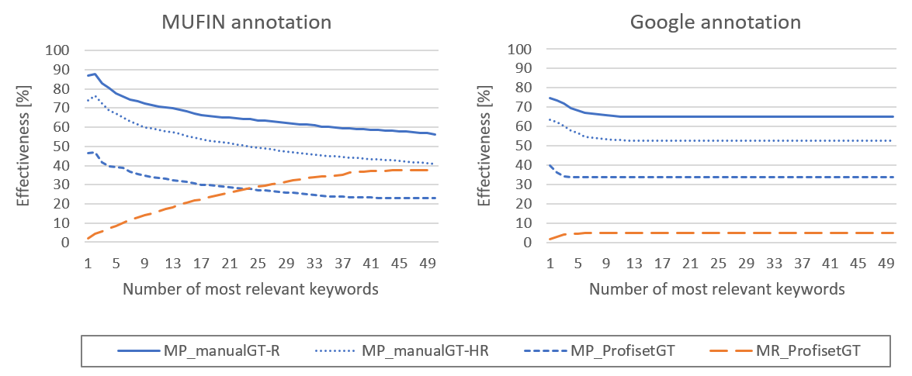
Results
On the first positions, MUFIN about 8 % better!
For the same precision, MUFIN gives significantly better recall

Slide 25
Results (cont.)
Failed annotations:
  Google returned no keywords for 11 images out of 166
  MUFIN failed to return anything relevant among the top 5 keywords only for 3 images
Average result size:
  MUFIN: 50 keywords
  Google: 5.7 keywords (maximum 16)
Average overlap:
  1.9 keywords appear in both results
  out of these, 1.75 keywords is relevant

Slide 26
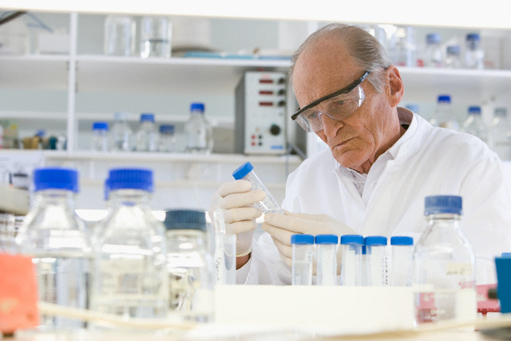

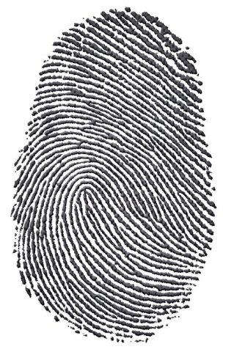
Where MUFIN wins
Google keywords
product
MUFIN keywords
person, adult, animals, activity, scientist, woman, knowledge, people, health, research, work, wellbeing, science, indoors, one, laboratory, head, mid, years, man, clothing, female, medical, doctor, coat, care, prosperity, hospital, men, worker, male, think, equipment, personnel, technician, researcher, working, young, professionals, color, occupations, technology, bioscience, organization, two, photography, healthcare, holding, african
Google results
t_shirt
MUFIN results
person, school, juvenile, blackboard, adult, classroom, mathematics, knowledge, science, student, subject, woman, female, objects, room, communication, child, one, activity, education, people, young, years, educator, teenager, teacher, indoors, professionals, youth, males, girl, hair, boy, teen, learning, mid, length, arithmetic, writing, building, head, color, man, teaching, part, board, ethnicity, high, schools, location
Google results
line
MUFIN results
fingerprint, finger, print, individual, group, identification, hand, crime, evidence, thumbprint, identity, ideas, white, finding, concept, black, information, digit, change, smudge, discovery, biometrics, thumb, unique, id, security, recognition, closeup, representation, people, vector, close, criminal, privacy, police, science, safety, photo, tech, background, touch, heritage, theft, curves, verify, investigation, offender, ink, state, symbol

Slide 27
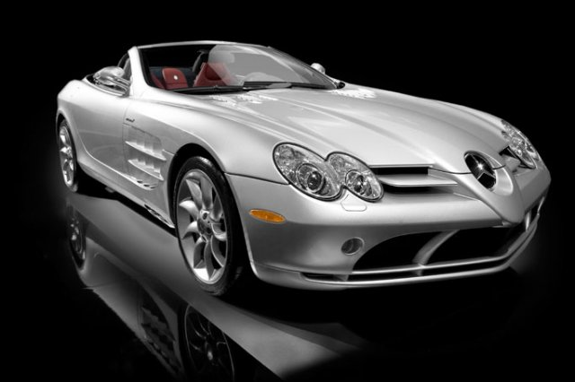
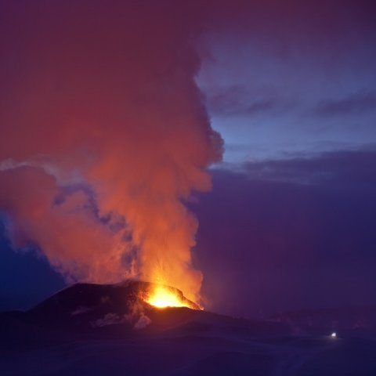
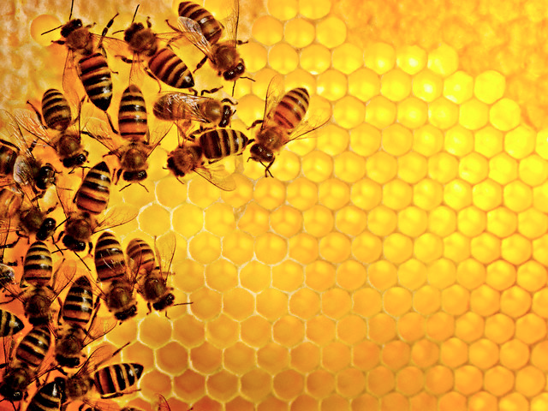
Where Google wins
Google keywords
bumper, automotive_design, automotive_exterior, vehicle, car, wheel, land_vehicle, sports_car, mercedes_benz, supercar, automobile_make, mercedes_benz_slr_mclaren, model_car
MUFIN keywords
car, show, vehicle, travel, transport, sports, motor, automobile, speed, person, luxury, coupe, new, museum, road, indoors, concept, color, view, manufacturers, front, three, automotive, horizontal, expensive, nobody, convertible, business, photography, roadster, industry, european, study, transportation, fast, photo, silver, modern, salon, make, street, white, showpiece, cars, black, republic, city, studio, district, state
Google results
volcanic_landform, lava, phenomenon, geological_phenomenon, landform
MUFIN results
sky, evening, water, ocean, change, island, set, cloud, sunrise, formations, dusk, clouds, light, sunset, morning, mountain, group, sundown, national, lava, nature, outdoors, daylight, volcanoes, color, sea, travel, weather, big, natural, geyser, scenery, sun, red, park, night, horizontal, scenic, coast, gap, vacation, region, rock, people, environment, eruption, power, shore, landscape, countries
Google results
insect, pollen, pattern, membrane_winged_insect, honey_bee, flower
MUFIN results
tree, autumn, plant, season, travel, change, yellow, fall, leaves, flower, color, aspen, animal, quality, nature, poplar, sunflower, insect, discolored, person, arthropod, water, nobody, colors, horizontal, close, background, flora, invertebrate, summer, forest, image, detail, colour, creek, group, natural, outdoors, river, bee, mountains, grunge, deciduous, national, sierra, new, beautiful, supply, locations, treetop

Slide 28
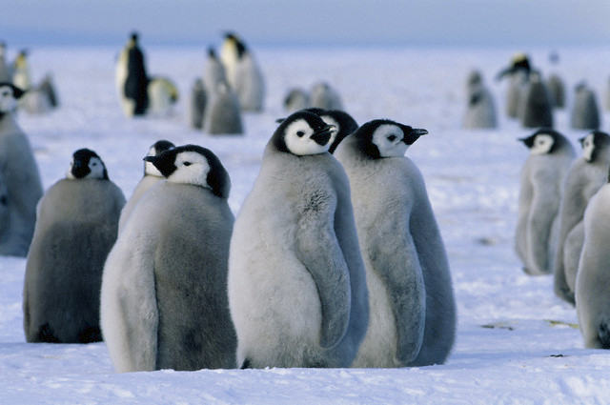
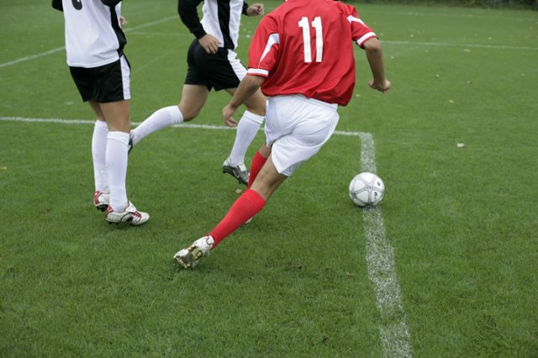
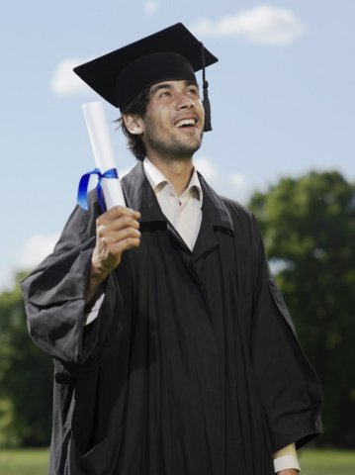
Where both MUFIN and Google are successful
Google results
penguin, flightless_bird, vertebrate, bird,
MUFIN results
penguin, animal, group, bird, seabird, aptenodytes, wildlife, chicks, snow, continent, baby, emperor, children, hill, offspring, young, island, outdoors, sea, ice, water, nobody, birds, daytime, cold, weather, nature, color, flightless, wild, laughingstock, colony, adult, day, glacier, fauna, outdoor, body, polar, travel, photography, marine, antarctic, horizontal, region, natural, peninsula, cute, outside, regions,
Google results
goal, soccer_kick, soccer_player, player, football_player, sports, soccer, kick,
MUFIN results
person, activity, football, recreation, sport, soccer, golf, adult, young, years, woman, game, men, ball, man, features, player, people, length, group, male, outdoors, color, athlete, view, playing, two, play, green, grass, child, equipment, one, team, compete, action, lifestyle, examining, juvenile, competition, female, rugby, baseball, ballgame, full, attitude, locations, lawn, outside, field,
Google results
graduation, academic_dress, mortarboard,
MUFIN results
person, graduation, group, completion, student, body, clothing, adult, college, communication, woman, diploma, gown, young, juvenile, people, school, university, get, dress, cap, certificate, achievement, activity, graduate, education, headgear, years, document, female, smiling, man, teenager, male, glasses, portrait, eye, youth, asian, length, kids, happy, communicate, academic, ethnicity, holding, mid, men, caucasian, studio,

Slide 29
Efficiency
MUFIN: approximately 700 ms needed for single image annotation
  54 ms for DeCAF descriptor extraction (GPU implementation)
  390 ms for content-based search in 20M images (PPP-codes + PCA)
  40 ms for semantic network construction
  200 ms for ConceptRank computation (approximate RWR)
Google: approximately 200 ms needed for single image annotation
  Including uploading the image and the REST service overhead
  Network overhead (RTT) about 8ms

Slide 30
Conclusions
Part IV

Slide 31
Conclusions
MUFIN Image Annotation works!
  In our experiments, even better than Google
  Very good results also in the ImageCLEF competition
MUFIN Image Annotation is effective, efficient, and scalable
The MUFIN and Google solutions are in several aspects complementary
  different basic approach (search-based vs. model-based)
  provides different types of annotations
  what is problematic to MUFIN is often easy for Google and vice versa
Promising direction for future: combining the two approaches
  Ideally in a generalized ConceptRank model

