Slide 1
PA193 - Secure coding principles and practices
Language level vulnerabilities:
Buffer overflow, type overflow, strings
Petr Švenda svenda@fi.muni.cz

Slide 2
What secure programming means?
Generic good security practices
  Education, testing, defence in depth, code review…
Use of secure primitives
  Random numbers, password handling, secure channel…
Deployment, maintenance, mitigation
  Update process, detection of issues in 3rd party libs…
Usability
  Hard for users to make a mistake, limit its impact…
Language-specific issues and procedures
  Buffer overflow (C/C++), reflection (Java)

Slide 3


Overview
Lecture: problems, prevention
  buffer overflow (stack/heap/type)
  string formatting problems
  compiler protection
  platform protections (DEP, ASLR)
Labs
  compiler flags, buffer overflow exercises

Slide 4
Problem?

Slide 5
Motivation problem
Quiz – what is insecure in given program?
Can you come up with attack?
Classic buffer overflow
Detailed exploitation demo during labs this week
#define USER_INPUT_MAX_LENGTH 8
char userName[USER_INPUT_MAX_LENGTH];
gets(userName);

Slide 6
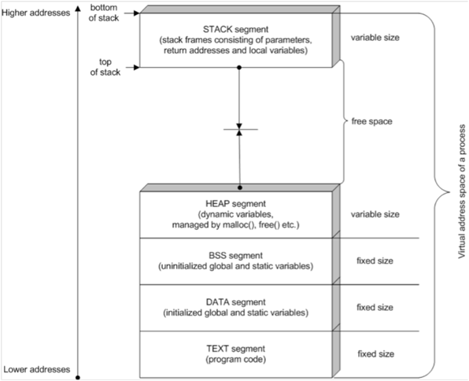
Process memory layout
http://www.drdobbs.com/security/anatomy-of-a-stack-smashing-attack-and-h/240001832#
Notes:
Nejsou videt detaily

Slide 7
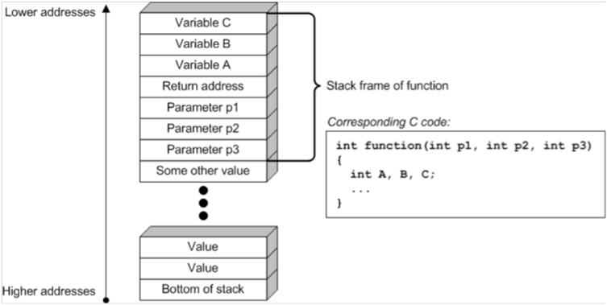
Stack memory layout
http://www.drdobbs.com/security/anatomy-of-a-stack-smashing-attack-and-h/240001832#

Slide 8
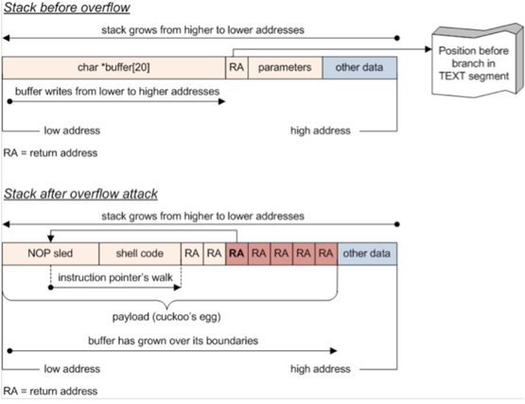
Stack overflow
http://www.drdobbs.com/security/anatomy-of-a-stack-smashing-attack-and-h/240001832#

Slide 9
Memory overflow - taxonomy
Buffer overflows
Stack overflows
Format strings
Heap overflows
.data/.bss segment overflows

Slide 10
// Note: GCC and MSVC uses different memory alignment
// Try "12345678DevilEvecosia" as a password for gcc build
// Try "1234567812345678Devil I am. Ha Ha" as a password for MSVC debug build
void demoBufferOverflowData() {
int unused_variable = 30;
#define NORMAL_USER 'n'
#define ADMIN_USER 'a'
int userRights = NORMAL_USER;
#define USER_INPUT_MAX_LENGTH 8
char userName[USER_INPUT_MAX_LENGTH];
char passwd[USER_INPUT_MAX_LENGTH];
// print some info about variables
printf("%-20s: %p\n", "userName", userName);
printf("%-20s: %p\n", "passwd", passwd);
printf("%-20s: %p\n", "unused_variable", &unused_variable);
printf("%-20s: %p\n", "userRights", &userRights);
printf("\n");
// Get user name
memset(userName, 1, USER_INPUT_MAX_LENGTH);
memset(passwd, 2, USER_INPUT_MAX_LENGTH);
printf("login as: ");
fflush(stdout);
gets(userName);
// Get password
printf("%s@vulnerable.machine.com: ", userName);
fflush(stdout);
gets(passwd);
// Check user rights (set to NORMAL_USER and not changed in code)
if (userRights == NORMAL_USER) {
printf("\nWelcome, normal user '%s', your rights are limited.\n\n", userName);
fflush(stdout);
}
if (userRights == ADMIN_USER) {
printf("\nWelcome, all mighty admin user '%s'!\n", userName);
fflush(stdout);
}
// How to FIX:
//memset(userName, 0, USER_INPUT_MAX_LENGTH);
//fgets(userName, USER_INPUT_MAX_LENGTH - 1, stdin);
//memset(passwd, 0, USER_INPUT_MAX_LENGTH);
//fgets(passwd, USER_INPUT_MAX_LENGTH - 1, stdin);
}
Try this at home!

Slide 11
Variable containing current access rights
void demoBufferOverflowData() {
int unused_variable = 30;
#define NORMAL_USER 'n'
#define ADMIN_USER 'a'
int userRights = NORMAL_USER;
#define USER_INPUT_MAX_LENGTH 8
char userName[USER_INPUT_MAX_LENGTH];
char passwd[USER_INPUT_MAX_LENGTH];
// print some info about variables
printf("%-20s: %p\n", "userName", userName);
printf("%-20s: %p\n", "passwd", passwd);
printf("%-20s: %p\n", "unused_variable", &unused_variable);
printf("%-20s: %p\n", "userRights", &userRights);
printf("\n");
// Get user name
printf("login as: ");
gets(userName);
// Get password
printf("%s@vulnerable.machine.com: ", userName);
gets(passwd);
// Check user rights (set to NORMAL_USER and not changed in code)
if (userRights == NORMAL_USER) {
printf("\nWelcome, normal user '%s', your rights are limited.\n\n", userName);
}
if (userRights == ADMIN_USER) {
printf("\nWelcome, all mighty admin user '%s'!\n", userName);
}
}
Array with fixed length (will be overwritten)
Help output of address of local variables stored on the stack
Reading username and password (no length checking)
Print information about current user rights

Slide 12
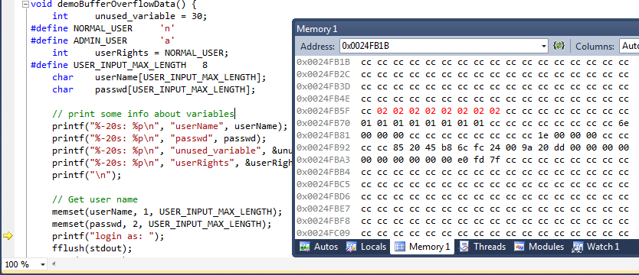
Data in memory
userName
passwd
userRights
unused_variable

Slide 13
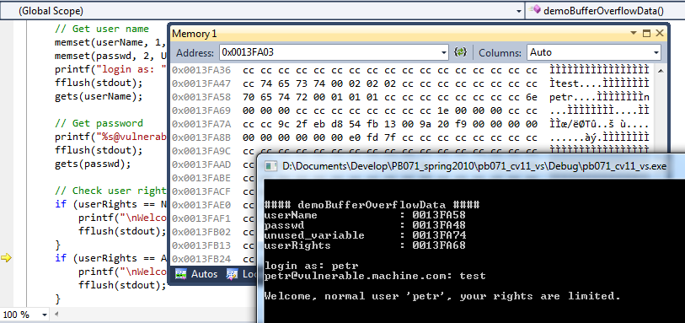
Running without malicious input
userName
passwd

Slide 14
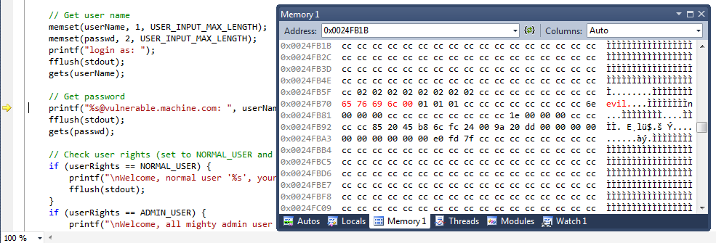
Running with malicious input – userName
insert ‘evil’ into userName

Slide 15
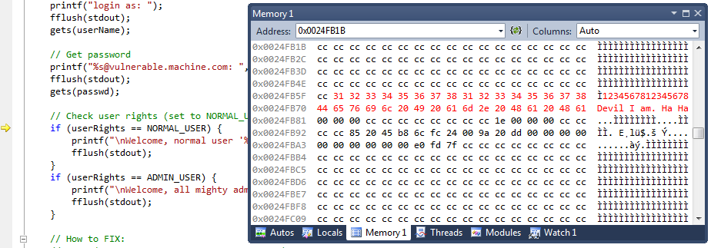
Running with malicious input - passwd
Insert
‘1234567812345678Devil I am. Ha Ha’ into passwd
Too long password overflow userName and userRights

Slide 16
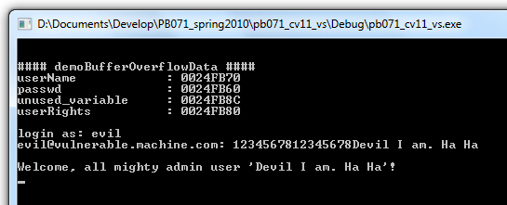
Running with attacker input - result

Slide 17
Other stack overflow demos
Try this at home!
Stack overflow – auth. privileges change
Adjacent memory overflow – reveal password
Smash function return address – attacker code exec
Type overflow – overflow integer causing BO
Buffer overflow - shell execution
Example with debugging with instruction-wise mode

Slide 18
void demoAdjacentMemoryOverflow(char* userName, char* password) {
// See more at http://www.awarenetwork.org/etc/alpha/?x=5
// Once string is not null terminated, lot of functions will behave wrongly:
// sprintf, fprintf, snprintf, strcpy, strcat, strlen, strstr, strchr, read...
// memcpy, memmove - if length to copy is computed via strlen(string)
char message[100];
char realPassword[] = "very secret password nbu123";
char buf[8];
// print some info about variables
printf("%-20s: %p\n", "message", message);
printf("%-20s: %p\n", "userName", userName);
printf("%-20s: %p\n", "password", password);
printf("%-20s: %p\n", "realPassword", &realPassword);
printf("%-20s: %p\n", "buf", &buf);
printf("\n");
memset(buf, 0, sizeof(buf));
memset(message, 1, sizeof(message));
strncpy(buf,userName,sizeof(buf)); // We will copy only characters which fits into buf
// Now print username to standard output - nothing sensitive, right?
sprintf(message, "Checking '%s' password\n",buf);
printf("%s", message);
if (strcmp(password, realPassword) == 0) {
printf("Correct password.\n");
}
else {
printf("Wrong password.\n");
}
// FIX: Do not allow to have non-terminated string
// Clear buffer for text with zeroes (terminating zero will be there)
// strncpy(buf,arg1,sizeof(buf) - 1);
}
Try this at home!

Slide 19
void vulnerable_function(const char* input) {
char buf[10];
memset(buf, 0, sizeof(buf));
printf("%-20s: %9p\n", "buf", &buf);
printf("My stack looks like:\n%9p\n%9p\n%9p\n%9p\n%9p\n%9p\n%9p\n%9p\n%9p\n%9p\n%9p\n%9p\n\n");
fflush(stdout);
strcpy(buf, input);
printf("Now the stack looks like:\n%9p\n%9p\n%9p\n%9p\n%9p\n%9p\n%9p\n%9p\n%9p\n%9p\n%9p\n%9p\n\n");
fflush(stdout);
}
/**
* This function contains code that attacker likes to execute.
* It may be otherwise inaccessible privileged function (e.g., something like "admin_createNewUser()")
* or code not originally present in the program code, but inserted by an attacker into the memory
* (with starting address set at the begin of inserted code)
*/
void attackers_code(void) {
printf("Augh! I've been hacked!\n");
system("mmc.exe lusrmgr.msc");
//system("rm -rf");
}
void demoBufferOverunFunction() {
// Example taken from Howard and LeBlanc, modified to run with gcc compiler
// This is a bit of cheating to make life easier - we will print the addresses of functions
// In real scenario, attacker needs to find it by himself (e.g., multiple tests on test machine, dump)
printf("Address of vulnerable_function() = %p\n", vulnerable_function);
printf("Address of attackers_code() = %p\n", attackers_code);
printf("Address of demoBufferOverunFunction = %p\n", demoBufferOverunFunction);
fflush(stdout);
vulnerable_function("12345678"); // No problem
vulnerable_function("1234567812aaaaaaa"); // Writing behind the array, but still nothing happens
vulnerable_function("1234567812aaaaaaaa\x14\xff\x22\x01\xde\x16\x40"); // But now its works - attackers_code()!
}
Try this at home!

Slide 20
Type-overflow vulnerabilities - motivation
Quiz – what is insecure in given program?
Can you come up with attack?
And what about following variant?
  Be aware: char can be both signed (x64) or unsigned (ARM)
  for (unsigned char i = 10; i >= 0; i--) {
  /* ... */
  }
  for (char i = 10; i >= 0; i--) {
  /* ... */
  }

Slide 21
Type overflow – basic problem
Types are having limited range for the values
  char: 256 values, int: 2³² values
  add, multiplication can reach lower/upper limit
  char value = 250 + 10 == ?
Signed vs. unsigned types
  for (unsigned char i = 10; i >= 0; i--) {/* ... */ }
Type value will underflow/overflow
  CPU overflow flag is set
  but without active checking not detected in program
Occurs also in higher level languages (Java…)

Slide 22

Make HUGE money with type overflow
Mining block reward
(was 50BTC at 2010, is 12.50BTC now)
Bitcoin block 74638 (15th August 2010)
CBlock(hash=0000000000790ab3, ver=1, hashPrevBlock=0000000000606865, hashMerkleRoot=618eba,
nTime=1281891957, nBits=1c00800e, nNonce=28192719, vtx=2)
CTransaction(hash=012cd8, ver=1, vin.size=1, vout.size=1, nLockTime=0)
CTxIn(COutPoint(000000, -1), coinbase 040e80001c028f00)
CTxOut(nValue= 50.51000000, scriptPubKey=0x4F4BA55D1580F8C3A8A2C7)
CTransaction(hash=1d5e51, ver=1, vin.size=1, vout.size=2, nLockTime=0)
CTxIn(COutPoint(237fe8, 0), scriptSig=0xA87C02384E1F184B79C6AC)
CTxOut(nValue=92233720368.54275808, scriptPubKey=OP_DUP OP_HASH160 0xB7A7)
CTxOut(nValue=92233720368.54275808, scriptPubKey=OP_DUP OP_HASH160 0x1512)
vMerkleTree: 012cd8 1d5e51 618eba
Block hash: 0000000000790ab3f22ec756ad43b6ab569abf0bddeb97c67a6f7b1470a7ec1c
Transaction hash: 1d5e512a9723cbef373b970eb52f1e9598ad67e7408077a82fdac194b65333c9
Input transaction (with 0.5BTC)
https://blockexplorer.com/tx/237fe8348fc77ace11049931058abb034c99698c7fe99b1cc022b1365a705d39
2 output transactions (each with 9*10¹⁰ BTC) !!!
Should have been rejected by miners as value(output) >> value(input), but was not!

Slide 23
More details: Payment in Bitcoin
Payment example
  You can’t say “I pay 1 bitcoin to address A₁”
  You must take previous valid block B with amount X
  Then create transaction which will split value from B into 1 send to A₁ and X-1 send to (your) A₂
Transaction fee – payed to miners as incentive to incorporate your transaction into block
  Was 0 or very small in 2010 (is significant now ~$2)
  Miners fee is difference (CTxIn – Σ(CTxOut))

Slide 24

Bug dissection
Bitcoin code uses integer encoding of numbers with fixed position of decimal point (INT64)
  Smallest fraction of BTC is one Satoshi (sat) = 1/10⁸ BTC
  33.54 BTC == 33.54 * 10⁸ => 3354000000
BTW: Why using float numbers is not a good idea?
CTxOut value:92233720368.54275808 BTC = 0x7ffffffffff85ee0
INT64_MAX = 0x7fffffffffffffff
Sum of 2 CTx = 0xfffffffffff0bdc0 (overflow)
= -1000000₁₀ ⁼ -0.01BTC
  Difference between input and output is a miner fee

Slide 25
Type overflow – Bitcoin
Try this at home!
#include <iostream>
#include <iomanip>
using namespace std;
// Works for Visual Studio compiler, replace __int64 with int64 for other compilers
int main() {
const __int64 valueMaxInt64 = 0x7fffffffffffffffLL;
const float COIN = 100000000; // should be __int64 as well, made float for simple printing
__int64 valueIn = 50000000; // value of input transaction CTxIn
cout << "CTxIn = " << valueIn / COIN << endl;
__int64 valueOut1 = 9223372036854275808L; // first out
cout << "CTxOut1 = " << valueOut1 / COIN << endl;
__int64 valueOut2 = 9223372036854275808L; // second out
cout << "CTxOut2 = " << valueOut2 / COIN << endl;
__int64 valueOutSum = valueOut1 + valueOut2; // sum which overflow
cout << "CTxOut sum = " << valueOutSum / COIN << endl;
// Difference between input and output is interpreted as fee for a miner (0.01 BTC)
__int64 fee = valueIn - valueOutSum;
cout << "Miner fee = " << fee / COIN << endl;
return 0;
}

Slide 26
Bug impact (CVE-2010-5139)
2 * 92233720368.54275808 + 0.01 BTC artificially created in single transaction
Detected 1.5 hours after the transaction occurred
Code patched and blockchain hard forked to abandon branch with malicious transaction
  Hard fork was possible in early days of Bitcoin, would be more difficult now
  BTW: Ethereum had hard fork after $60M DAO hack
https://en.bitcoin.it/wiki/Common_Vulnerabilities_and_Exposures#CVE-2010-5139
https://bitcointalk.org/index.php?topic=822.0

Slide 27
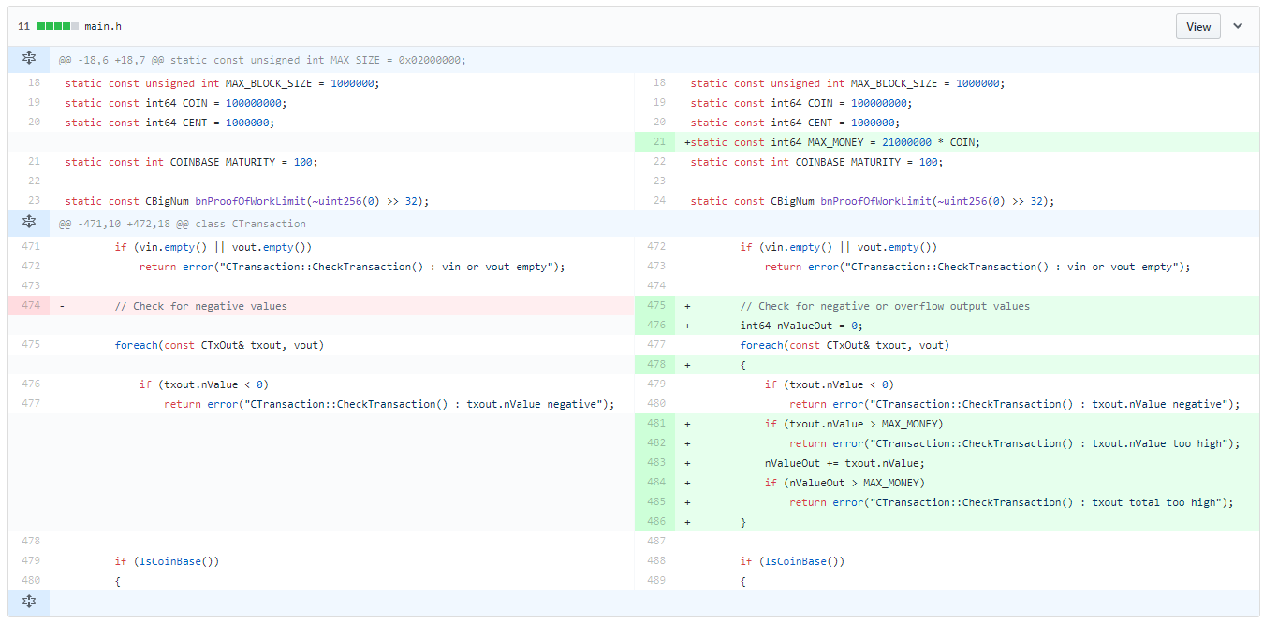
BugFix – proper checking for overflow
https://github.com/bitcoin/bitcoin/commit/d4c6b90ca3f9b47adb1b2724a0c3514f80635c84#diff-118fcbaaba162ba17933c7893247df3aR1013

Slide 28
Questions
Try this at home!
When exactly overflow happens?
Why mining reward was 50.51 and not exactly 50?
  CTxOut(nValue= 50.51000000
How to check for type overflow?

Slide 29
Type overflow – example with dynalloc
Try this at home!
typedef struct _some_structure {
float someData[1000];
} some_structure;
void demoDataTypeOverflow(int totalItemsCount, some_structure* pItem,
int itemPosition) {
// See http://blogs.msdn.com/oldnewthing/archive/2004/01/29/64389.aspx
some_structure* data_copy = NULL;
int bytesToAllocation = totalItemsCount * sizeof(some_structure);
printf("Bytes to allocation: %d\n", bytesToAllocation);
data_copy = (some_structure*) malloc(bytesToAllocation);
if (itemPosition >= 0 && itemPosition < totalItemsCount) {
memcpy(&(data_copy[itemPosition]), pItem, sizeof(some_structure));
}
else {
printf("Out of bound assignment");
return;
}
free(data_copy);
}
Basic idea:
Data to be copied into newly allocated mem.
Computation of required size type-overflow
Too small memory chunk is allocated
Copy will write behind allocated memory

Slide 30
Safe add and mult operations in C/C++
Compiler-specific non-standard extensions of C/C++
GCC: __builtin_add_overflow, __builtin_mul_overflow …
  Result returned as third (pointer passed) argument
  Returns true if overflow occurs
  https://gcc.gnu.org/onlinedocs/gcc/Integer-Overflow-Builtins.html
MSVC: SafeInt wrapper template (for int, char…)
  Overloaded all common operations (drop in replacement)
  Returns SafeIntException if overflow/underflow
  https://msdn.microsoft.com/en-us/library/dd570023.aspx
bool __builtin_add_overflow (type1 a, type2 b, type3 *res)
#include <safeint.h>
using namespace msl::utilities; // Normal use
SafeInt<int> c1 = 1; SafeInt<int> c2 = 2; c1 = c1 + c2;

Slide 31
Safe add and mult operations in Java
Java SE 8 introduces extensions to java.lang.Math
ArithmeticException thrown if overflow/underflow
public static int addExact(int x, int y)
public static long addExact(long x, long y)
public static int decrementExact(int a)
public static long decrementExact(long a)
public static int incrementExact(int a)
public static long incrementExact(long a)
public static int multiplyExact(int x, int y)
public static long multiplyExact(long x, long y)
public static int negateExact(int a)
public static long negateExact(long a)
public static int subtractExact(int x, int y)
public static long subtractExact(long x, long y)
public static int toIntExact(long value)

Slide 32
Format string vulnerabilities - motivation
Quiz – what is insecure in given program?
Can you come up with attack?
int main(int argc, char * argv[]) {
printf(argv[1]);
return 0;
}

Slide 33
Format string vulnerabilities
Wide class of functions accepting format string
  printf("%s", X);
  resulting string is returned to user (= potential attacker)
  formatting string can be under attackers control
  variables formatted into string can be controlled
Resulting vulnerability
  memory content from stack is formatted into string
  possibly any memory if attacker control buffer pointer

Slide 34
Information disclosure vulnerabilities
Exploitable memory vulnerability leading to read access (not write access)
  attacker learns some information from the memory
Direct exploitation
  secret information (cryptographic key, password...)
Precursor for next step (very important with DEP&ASLR)
  module version
  current memory layout after ASLR (stack/heap pointers)
  stack protection cookies (/GS)

Slide 35

Format string vulnerability - example
Example retrieval of security cookie and return address
int main(int argc, char* argv[]) {
char buf[64] = {};
sprintf(buf, argv[1]);
printf("%s\n", buf);
return 0;
}
argv[1] submitted by an attacker
E.g., %x%x%x….%x
Stack content is printed
Including security cookie and RA
Don’t let user/attacker to provide own formatting strings

Slide 36
Non-terminating functions - example
What is wrong with following code?
int main(int argc, char* argv[]) {
char buf[16];
strncpy(buf, argv[1], sizeof(buf));
return printf("%s\n",buf);
}

Slide 37
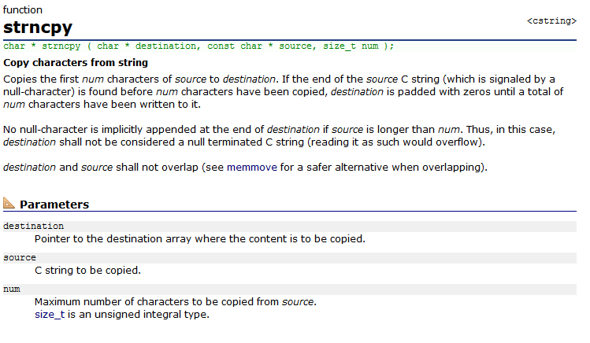
strncpy - manual
http://www.cplusplus.com/reference/cstring/strncpy/?kw=strncpy

Slide 38
Non-terminating functions for strings
strncpy
snprintf
vsnprintf
mbstowcs
MultiByteToWideChar
Non-null terminated Unicode string more dangerous
  C-string processing stops on first zero
  any binary zero (ASCII)
  16-bit aligned wide zero character (UNICODE)
wcsncpy
snwprintf
vsnwprintf
wcstombs
WideCharToMultiByte

Slide 39
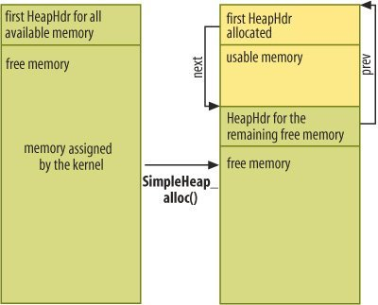
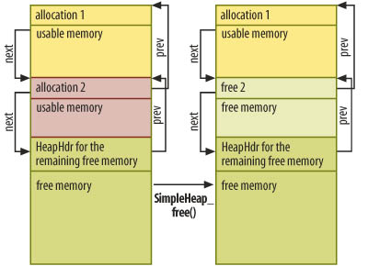
Heap overflow
Buffer overflow in allocation 1 overwrites header for allocation 2
(and possibly other)
Linked list between allocated blocks
Corrupted allocation 2 data are later processed by unlink() function
Felix "FX" Lindner, http://www.h-online.com/security/features/A-Heap-of-Risk-747220.html

Slide 40
Heap overflow – more details
Assumption: buffer overflow possible for buffer at heap
Problem:
  attacker needs to write his pointer to memory later used as jump
  no return pointer (jump) is stored on heap (as was for stack)
Different mechanism for misuse
  overwrite malloc metadata (few bytes before allocated block)
    only next, prev, size and used can be manipulated
    fake header (hdr) for fake block is created
  let unlink function to be called (merge free blocks)
    fake block is also merged during merge operation
    hdr->next->next->prev = hdr->next->prev;
address in stack that will be interpreted later as jump pointer
address of attacker’s code

Slide 41
Source code protections
Compiler protections
Platform protections

Slide 42
How to detect and prevent problems?
Protection on the source code level
  languages with/without implicit protection
    containers/languages with array boundary checking
  usage of safe alternatives to vulnerable function (this lecture)
    vulnerable and safe functions for string manipulations
  proper input checking (next lectures)
  automatic detection by static and dynamic checkers (next lectures)
  Code review, security testing (next lectures)
Protection by compiler (+ compiler flags) (this lecture)
  runtime checks introduced by compiler (stack protection)
Protection by execution environment (this lecture)
  DEP, ASLR...

Slide 43
How to write code securely (w.r.t. BO) I.
Be aware of possibilities and principles
Use language with array boundary checks
Never trust user’s input, always check defensively
Use safe versions of string/memory functions
Always provide a format string argument
Use self-resizing strings (C++ std::string)
Use automatic bounds checking if possible
  C++ std::vector.at(i)instead of vector[i]

Slide 44
How to write code securely (w.r.t. BO) II.
Run application with lowest possible privileges
Let your code to be reviewed
Use compiler-added protection
Use protection offered by platform (privileges, DEP, ASLR, sandboxing...)

Slide 45
Secure C library
Secure versions of commonly misused functions
  bounds checking for string handling functions
  better error handling
Also added to new C standard ISO/IEC 9899:2011
Microsoft Security-Enhanced Versions of CRT Functions
  MSVC compiler issue warning C4996, more functions then in C11
Secure C Library
  http://docwiki.embarcadero.com/RADStudio/XE3/en/Secure_C_Library
  http://msdn.microsoft.com/en-us/library/8ef0s5kh%28v=vs.80%29.aspx
  http://msdn.microsoft.com/en-us/library/wd3wzwts%28v=vs.80%29.aspx
  http://www.drdobbs.com/cpp/the-new-c-standard-explored/232901670

Slide 46
Secure C library – selected functions
char *gets(
char *buffer
);
char *gets_s(
char *buffer,
size_t sizeInCharacters
);
Formatted input/output functions
  gets_s
  scanf_s, wscanf_s, fscanf_s, fwscanf_s, sscanf_s, swscanf_s, vfscanf_s, vfwscanf_s, vscanf_s, vwscanf_s, vsscanf_s, vswscanf_s
  fprintf_s, fwprintf_s, printf_s, printf_s, snprintf_s, snwprintf_s, sprintf_s, swprintf_s, vfprintf_s, vfwprintf_s, vprintf_s, vwprintf_s, vsnprintf_s, vsnwprintf_s, vsprintf_s, vswprintf_s
  functions take additional argument with buffer length
File-related functions
  tmpfile_s, tmpnam_s, fopen_s, freopen_s
    takes pointer to resulting file handle as parameter
    return error code

Slide 47
Secure C library – selected functions
Environment, utilities
  getenv_s, wgetenv_s
  bsearch_s, qsort_s
Memory copy functions
  memcpy_s, memmove_s, strcpy_s, wcscpy_s, strncpy_s, wcsncpy_s
Concatenation functions
  strcat_s, wcscat_s, strncat_s, wcsncat_s
Search functions
  strtok_s, wcstok_s
Time manipulation functions...

Slide 48
CERT C/C++ Coding Standard
CERT C Coding Standard
  https://www.securecoding.cert.org/confluence/display/seccode/CERT+C+Coding+Standard
CERT C++ Coding Standard
  https://www.securecoding.cert.org/confluence/pages/viewpage.action?pageId=637
Cern secure coding recommendation for C
  https://security.web.cern.ch/security/recommendations/en/codetools/c.shtml
Smashing the stack in 2011
  https://paulmakowski.wordpress.com/2011/01/25/smashing-the-stack-in-2011/

Slide 49
Source code protections
Compiler protections
Platform protections

Slide 50
MSVC Compiler security flags - /RTC
Microsoft’s MSVC in Visual Studio
  http://msdn.microsoft.com/en-us/library/aa290051%28v=vs.71%29.aspx
Nice overview of available protections
  http://msdn.microsoft.com/en-us/library/bb430720.aspx
Visual Studio → Configuration properties → C/C++ → All options
Run-time checks
  /RTCu switch
    uninitialized variables check
  /RTCs switch
    stack protection (stack pointer verification)
    initialization of local variables to a nonzero value
    detect overruns and underruns of local variables such as arrays
  /RTC1 == /RTCsu
/RTC is intended for DEBUG mode, unused for RELEASE

Slide 51
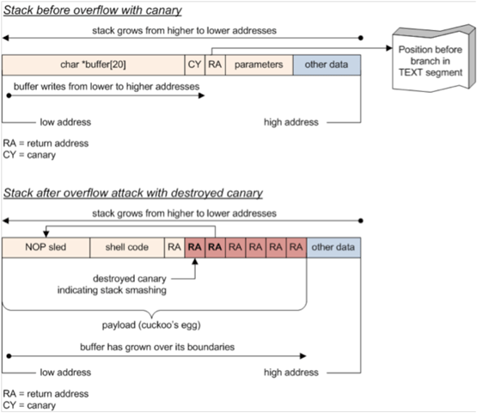
Stack without canary word
Canary word (CY)
  randomized cookie between local variables and return address
  function prolog (add security cookie)
  and epilog (check cookie)
http://www.drdobbs.com/security/anatomy-of-a-stack-smashing-attack-and-h/240001832#

Slide 52
MSVC Compiler security flags - /GS
/GS switch (added from 2003, evolves in time)
  http://msdn.microsoft.com/en-us/library/8dbf701c.aspx
  multiple different protections against buffer overflow
  mostly focused on stack protection
/GS protects:
  return address of function
  address of exception handler
  vulnerable function parameters (arguments)
  some of the local buffers (GS buffers)
/GS protection is (automatically) added only when needed
  to limit performance impact, decided by compiler (/GS rules)
  #pragma strict_gs_check(on) - enforce strict rules application
/GS is applied in both DEBUG and RELEASE modes

Slide 53
/GS Security cookie (‘canary’) - details
/GS Security cookie
  random DWORD number generated at program start
  master cookie stored in .data section of loaded module
  xored with function return address (pointer encoding)
  corruption results in jump to undefined value
__security_init_cookie
  http://msdn.microsoft.com/en-us/library/ms235362.aspx
Stack without /GS
Function parameters
Function return address
Frame pointer
Exception Handler frame
Locally declared variables and buffers
Callee save registers
Stack after /GS
Function parameters
Function return address
Frame pointer
Cookie
Exception Handler frame
Locally declared variables and buffers
Callee save registers

Slide 54
/GS buffers
Buffers with special protection added
  http://msdn.microsoft.com/en-us/library/8dbf701c.aspx
  automatically and heuristically selected by compiler
Applies to:
  array larger than 4 bytes, more than two elements, element type is not pointer type
  data structure with size more than 8 bytes with no pointers
  buffer allocated by using the _alloca function
    stack-based dynamic allocation
  any class or structure with GS buffer

Slide 55
/GS – vulnerable parameters
Protection of function’s vulnerable parameters
  parameters passed into function
  copy of vulnerable parameters (during fnc’s prolog) placed below the storage area for any other buffers
  variables prone to buffer overflow are put on higher address so their overflow will not overwrite other local variables
Applies to:
  pointer
  C++ reference
  C-structure containing pointer
  GS buffer

Slide 56
Is /GS protection bulletproof?
Function parameters
Function return address (of Y == X)
Frame pointer
Cookie
Exception Handler frame
Locally declared variables and buffers
Callee save registers
Return address of X can be overwritten inside Y
Incorrect jump is executed only later after X ends
…
Y
Function parameters
Function return address (of X)
Frame pointer
Cookie
Exception Handler frame
Locally declared variables and buffers
Callee save registers
X

Slide 57
/GS – what is NOT protected
/GS compiler option does not protect against all buffer overrun security attacks
Corruption of address in vtable
  (table of addresses for virtual methods)
Example: buffer and a vtable in an object, a buffer overrun could corrupt the vtable
Functions with variable arguments list (...)

Slide 58
/GS – more references
Compiler Security Checks In Depth (MS)
  http://msdn.microsoft.com/en-us/library/aa290051%28v=vs.71%29.aspx
/GS cookie effectiveness (MS)
  http://blogs.technet.com/b/srd/archive/2009/03/16/gs-cookie-protection-effectiveness-and-limitations.aspx
Windows ISV Software Security Defenses
  http://msdn.microsoft.com/en-us/library/bb430720.aspx
How to bypass /GS cookie
  https://www.corelan.be/index.php/2009/09/21/exploit-writing-tutorial-part-6-bypassing-stack-cookies-safeseh-hw-dep-and-aslr/

Slide 59
GCC compiler - StackGuard & ProPolice
StackGuard released in 1997 as extension to GCC
  but never included as official buffer overflow protection
GCC Stack-Smashing Protector (ProPolice)
  patch to GCC 3.x
  included in GCC 4.1 release
  -fstack-protector (string protection only)
  -fstack-protector-all (protection of all types)
  on some systems enabled by default (OpenBSD)
    -fno-stack-protector (disable protection)

Slide 60
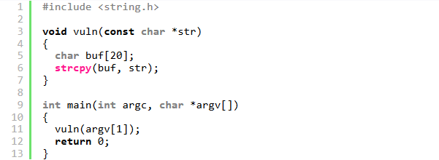
GCC compiler & ProPolice - example
http://www.drdobbs.com/security/anatomy-of-a-stack-smashing-attack-and-h/240001832#

Slide 61
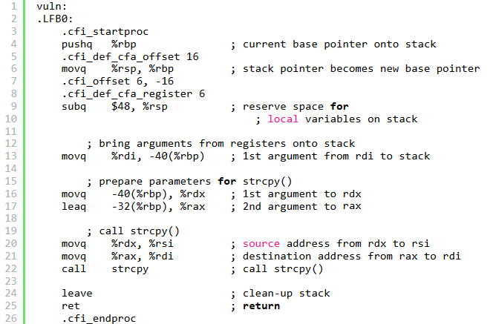
GCC -fno-stack-protector

Slide 62
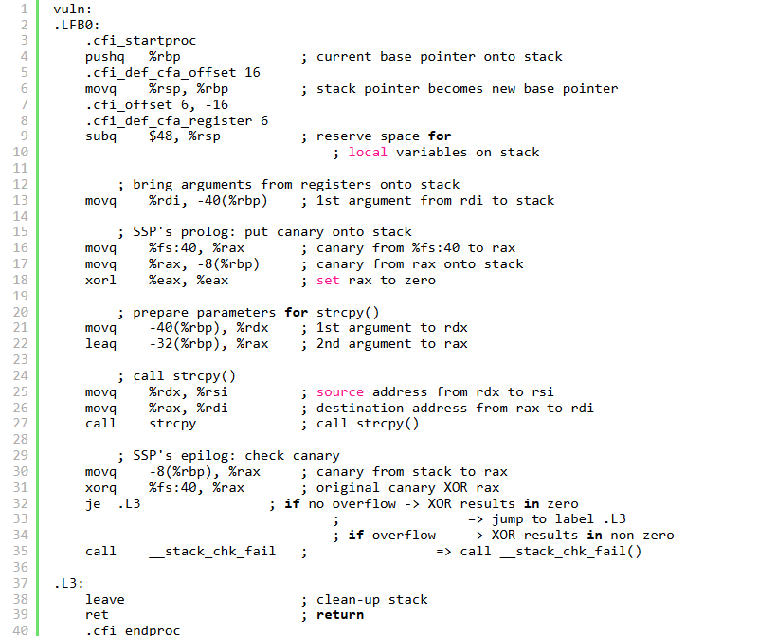
GCC -fstack-protector-all

Slide 63
How to bypass stack protection cookie?
Scenario:
  long-term running of daemon on server
  no exchange of cookie between calls
Obtain security cookie by one call
  cookie is now known and can be incorporated into stack-smashing data
Use second call to change only the return address

Slide 64
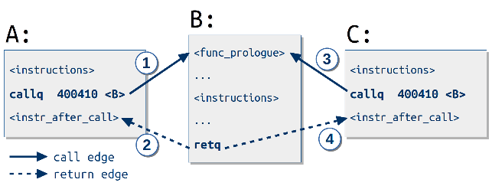
Control flow integrity
Promising technique with low overhead
Classic CFI (2005), Modular CFI (2014)
  avg 5% impact, 12% in worst case
  part of LLVM C compiler (CFI usable for other languages as well)
Analysis of source code to establish control-flow graph (which function can call what other functions)
Assign shared labels between valid caller X and callee Y
When returning into function X, shared label is checked
Return to other function is not permitted
https://class.coursera.org/softwaresec-002/lecture/view?lecture_id=49
https://www.usenix.org/system/files/conference/usenixsecurity15/sec15-paper-carlini.pdf

Slide 65
Source code protections
Compiler protections
Platform protections

Slide 66
Data Execution Prevention (DEP)
  Motto: When boundary between code and data blurs (buffer overflow, SQL injection…) then exploitation might be possible
Data Execution Prevention (DEP)
  prevents application to execute code from non-executable memory region
  available in modern operating systems
    Linux > 2.6.8, WinXPSP2, Mac OSX, iOS, Android…
  difference between ‘hardware’ and ‘software’ based DEP

Slide 67
Hardware DEP
Supported from AMD64 and Intel Pentium 4
  OS must add support of this feature (around 2004)
CPU marks memory page as non-executable
  most significant bit (63th) in page table entry (NX bit)
  0 == execute, 1 == data-only (non-executable)
Protection typically against buffer overflows
Cannot protect against all attacks!
  e.g., code compiled at runtime (produced by JIT compiler) must have both instructions and data in executable page
  attacker redirect execution to generated code (JIT spray)
  used to bypass Adobe PDF and Flash security features

Slide 68
Software “DEP”
Unrelated to NX bit (no CPU support required)
When exception is raised, OS checks if exception handling routine pointer is in executable area
  Microsoft’s Safe Structured Exception Handling
Software DEP is not preventing general execution in non-executable pages
  different form of protection than hardware DEP

Slide 69
Return-oriented programming (ROP) I.
Return-into-library technique (Solar Designer, 1997)
  http://seclists.org/bugtraq/1997/Aug/63
  method for bypassing DEP
  no write of attacker’s code to stack (as is prevented by DEP)
  function return address is replaced by pointer of selected standard library function instead
  library function arguments are also replaced according to attackers needs
  function return will result in execution of library function with given arguments
Example: system call wrappers like system()

Slide 70
Return-oriented programming (ROP) II.
But 64-bit hardware introduced different calling convention
  first arguments to function are passed in CPU registers instead of via stack
  harder to mount return-into-library attack
Borrowed code chunks
  attacker tries to find instruction sequences from any function that pop values from the stack into registers
  necessary arguments are inserted into registers
  return-into-library attack is then executed as before
Return-oriented programming extends previous technique
  multiple borrowed code chunks (gadgets) connected to execute Turing-complete functionality (Shacham, 2007)
  automated search for gadgets possible by ROPgadget
  https://www.youtube.com/watch?v=a8_fDdWB2-M
  partially defended by ASLR (but information leakage)

Slide 71
Blind ROP
Recent technique (IEEE S&P 2015)
  Randomization assumed
  But no re-randomization on restart if server crash
Information leak for reading the stack
Find gadgets at runtime to affect write()
Dump binary to find gadgets (same as before)

Slide 72
Address Space Layout Randomization (ASLR)
Random reposition of executable base, stack, heap and libraries address in process’s address space
  aim is to prevent exploit to reliably jump to required address
Performed every time a process is loaded into memory
  random offset added to otherwise fixed address
  applies to program and also dynamic libraries
  entropy of random offset is important (bruteforce)
Operating System kernel ASLR (kASLR)
  more problematic as long-running (random, but fixed until reboot)
Introduced by Memco software (1997)
  fully implemented in Linux PaX patch (2001)
  MS Vista, enabled by default (2007), MS Win 8 more entropy (2012)

Slide 73
ASLR – how much entropy?
Usually depends on available memory
  possible attack combination with enforced low-memory situation
Linux PaX patch (2001)
  around 24 bits entropy
MS Windows Vista (2007)
  heap only around 5-7 bits entropy
  stack 13-14 bits entropy
  code 8 bits entropy
  http://www.blackhat.com/presentations/bh-dc-07/Whitehouse/Presentation/bh-dc-07-Whitehouse.pdf
MS Windows 8 (2012)
  additional entropy, Lagged Fibonacci Generator, registry keys, TPM, Time, ACPI, new rdrand CPU instruction
  http://media.blackhat.com/bh-us-12/Briefings/M_Miller/BH_US_12_Miller_Exploit_Mitigation_Slides.pdf

Slide 74
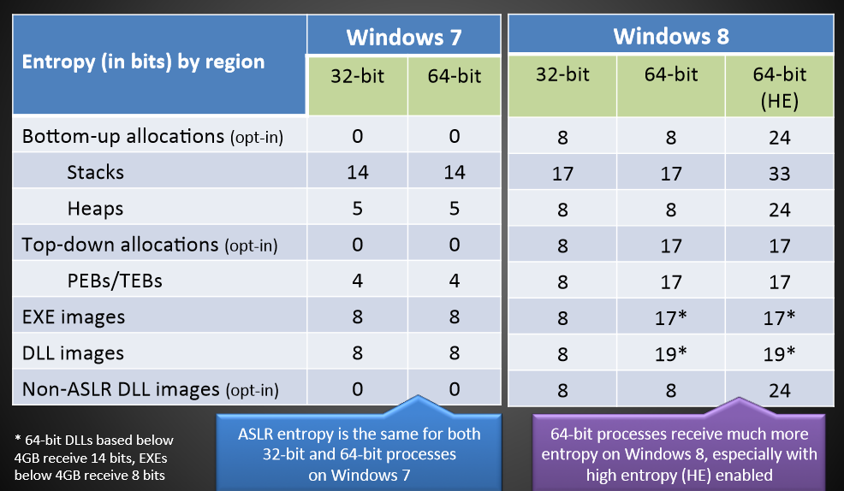
ASLR entropy in MS Windows 7&8 (2012)
$Taken from \text{Ken} \text{Johnson}\text{, }\text{Ma}\text{tt} \text{Mille}\text{r}$ (Microsoft Security Engineering Center), BlackHat USA 2012
$$http://media.blackhat.com/bh−us−12/Briefings/M_Miller/BH_US_12_Miller_Exploit_Mitigation_Slides.pdf$$

Slide 75
DEP&ASLR – MSVC compilation flags
  /NXCOMPAT (on by default)
  program is compatible with hardware DEP
  /SAFESEH (on by default, only 32bit programs)
    software DEP
  /DYNAMICBASE (on by default)
  basic ASLR
  Property Pages → Configuration Properties → Linker → Advanced → Randomized Base Address
  http://msdn.microsoft.com/en-us/library/bb384887.aspx
  /HIGHENTROPYVA (on by default, only 64bit programs)
  ASLR with higher entropy
  http://msdn.microsoft.com/en-us/library/dn195771.aspx

Slide 76
ASLR – impact on attacks
ASLR introduced big shift in attacker mentality
Attacks are now based on gaps in ASLR
  legacy programs/libraries/functions without ASLR support
    ! /DYNAMICBASE
  address space spraying (heap/JIT)
  predictable memory regions, insufficient entropy

Slide 77
DEP and ASLR should be combined
“For ASLR to be effective, DEP/NX must be enabled by default too.” M. Howard, Microsoft
/GS combined with /DYNAMICBASE and /NXCOMPAT
  /NXCOMPAT (==DEP)
  prevents insertion of new attackers code and forces ROP
  /DYNAMICBASE (==ASLR) randomizes code chunks utilized by ROP
  /GS prevents modification of return pointer used later for ROP
  /DYNAMICBASE randomizes position of master cookie for /GS
Visual Studio → Configuration properties →
  Linker → All options
  C/C++ → All options

Slide 78
Summary

Slide 79
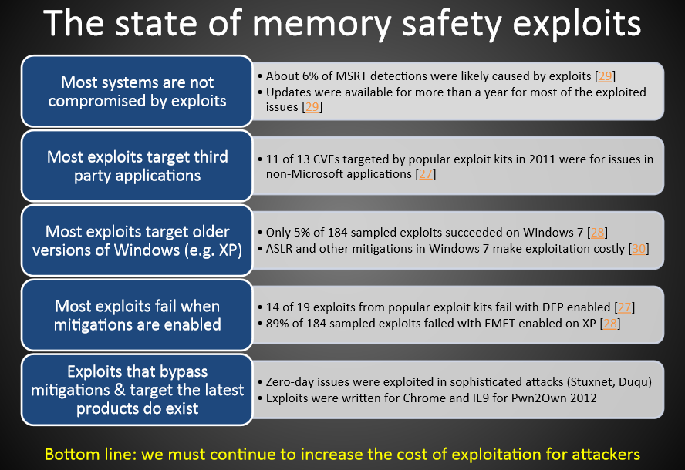
$Taken from \text{Ken} \text{Johnson}\text{, }\text{Ma}\text{tt} \text{Mille}\text{r}$ (Microsoft Security Engineering Center), BlackHat USA 2012
$$http://media.blackhat.com/bh−us−12/Briefings/M_Miller/BH_US_12_Miller_Exploit_Mitigation_Slides.pdf$$

Slide 80
Final checklist
Be aware of possible problems and attacks
  Don’t make exploitable errors at the first place!
  Automated protections cannot fully defend everything
Use safe versions of vulnerable functions
  Secure C library (xxx_s functions)
  Self-resizing strings/containers for C++
Compile with all protection flags
  MSVC: /RTC1,/DYNAMICBASE,/GS,/NXCOMPAT
  GCC: -fstack-protector-all
Apply automated tools
  BinScope Binary Analyzer, static and dynamic analyzers, vulns. scanners
Take advantage of protection in the modern OSes
  and follow news in improvements in DEP, ASLR...

Slide 81
Mandatory reading
SANS: 2016 State of Application Security
  https://www.sans.org/reading-room/whitepapers/analyst/2016-state-application-security-skills-configurations-components-36917
  How mature is AppSec in companies? Which industry leads?
  Which applications are of main security concern?
  What is expected time to deploy patch for security vulnerability?
  What about third-party components?
SoK: Eternal War in Memory
  http://www.cs.berkeley.edu/~dawnsong/papers/Oakland13-SoK-CR.pdf
  http://www.slideshare.net/daniel_bilar/song-2013-so-k-eternal-war-in-memory
  What are techniques to ensure memory safety?
  What is performance penalty for memory protection techniques?

Slide 82

Questions

Slide 84
Additional reading
Compiler Security Checks In Depth (MS)
  http://msdn.microsoft.com/en-us/library/aa290051%28v=vs.71%29.aspx
GS cookie effectiveness (MS)
  http://blogs.technet.com/b/srd/archive/2009/03/16/gs-cookie-protection-effectiveness-and-limitations.aspx
Design Your Program for Security
  http://www.dwheeler.com/secure-programs/Secure-Programs-HOWTO/internals.html
Smashing The Stack For Fun And Profit
  http://www-inst.cs.berkeley.edu/~cs161/fa08/papers/stack_smashing.pdf
Practical return oriented programming
  http://365.rsaconference.com/servlet/JiveServlet/previewBody/2573-102-1-3232/RR-304.pdf

Slide 85
Books - optional
Writing secure code, chap. 5
Security Development Lifecycle, chap. 11
Embedded Systems Security, D., M. Kleidermacher

Slide 86
Tutorials - optional
Buffer Overflow Exploitation Megaprimer (Linux)
  http://www.securitytube.net/groups?operation=view&groupId=4
Tenouk Buffer Overflow tutorial (Linux)
  http://www.tenouk.com/Bufferoverflowc/bufferoverflowvulexploitdemo.html
Format string vulnerabilities primer (Linux)
  http://www.securitytube.net/groups?operation=view&groupId=3
Buffer overflow in Easy RM to MP3 utility (Windows)
  https://www.corelan.be/index.php/2009/07/19/exploit-writing-tutorial-part-1-stack-based-overflows/

Slide 87
Heap overflow - references
Detailed explanation (Felix "FX" Lindner, 2006)
  http://www.h-online.com/security/features/A-Heap-of-Risk-747161.html?view=print
Explanation in Phrack magazine (blackngel, 2009)
  http://www.phrack.org/issues.html?issue=66&id=10#article
Defeating heap protection (Alexander Anisimov)
  http://www.ptsecurity.com/download/defeating-xpsp2-heap-protection.pdf
Diehard – drop-in replacement for malloc with memory randomization
  http://plasma.cs.umass.edu/emery/diehard.html
  https://github.com/emeryberger/DieHard

Slide 88
ROP - references
Explanation of ROP
  https://www.usenix.org/legacy/event/sec11/tech/full_papers/Schwartz.pdf
Blind ROP
  Return-oriented programming without source code
  http://www.scs.stanford.edu/brop/
Automatic search for ROP gadgets
  https://github.com/0vercl0k/rp

Slide 89
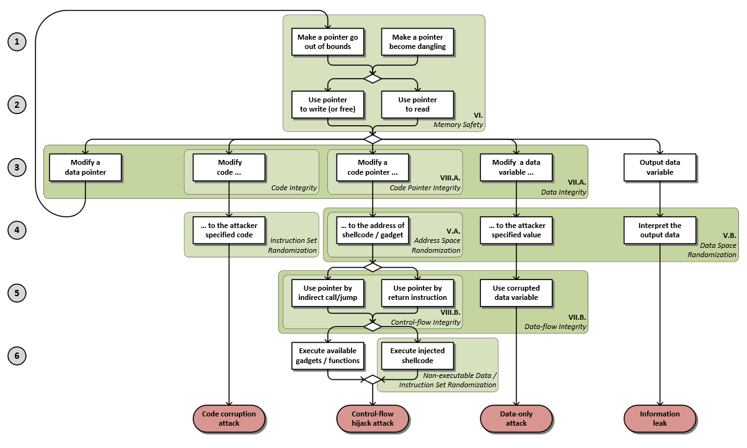
SoK: Eternal War in Memory
http://www.cs.berkeley.edu/~dawnsong/papers/Oakland13-SoK-CR.pdf

Slide 90
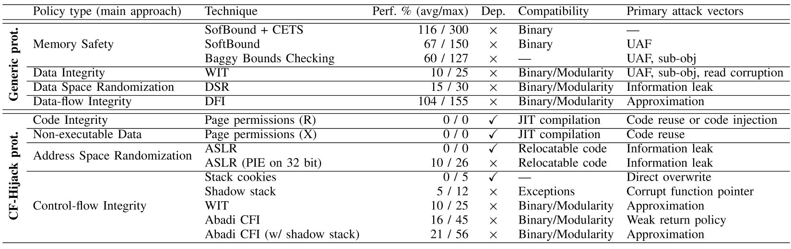
SoK: Eternal War in Memory
http://www.cs.berkeley.edu/~dawnsong/papers/Oakland13-SoK-CR.pdf

