Slide 1
PV247

Slide 2
Course organization
PV247
18.9. | Modern JS stack
25.9 | React part 1
2.10 | React part 2
16.10 | Redux
23.10 | Promises, router
30.10 | Automated tests
6.11 | Agile/Scrum
13.11 | Lean software development
20.11 | ITIL
27.11 | Google Ventures sprint
4.12 | Modern soft skills
11.12 | DevOps

Slide 3
Modern JS stack
Slavomír Moroz

Slide 4
Prerequisites
PV247
Html
CSS
Git
HTTP
  Methods
  Statuses
  Query string
  Headers
  State (cookies, session, local storage)
REST

Slide 5
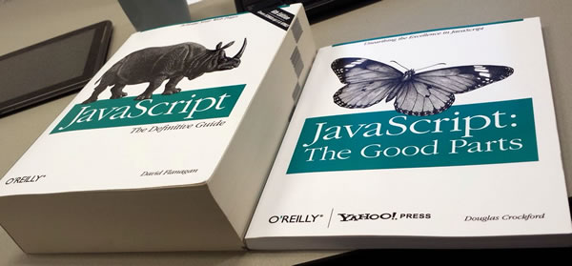
JavaScript basics
PV247
Prototypes
Closures
“this” & “arguments” context
Undeclared vs undefined vs null
Function / method invocation
Constructor functions
Curry (apply, call, bind)
JavaScript The Good Parts by Douglas Crockford (first 60 pages)
Functional programming in JavaScript (video)
Notes:
Demo:
this + method / function / apply invocation
Prototype inheritance + constructor

Slide 6
ECMAScript
PV247
ECMAScript: A language standardized by ECMA International.
JavaScript: The commonly used name for implementations of the ECMAScript standard.
ECMAScript 5 (ES5): The 5th edition of ECMAScript, standardized in 2009. This standard has been implemented fairly completely in all modern browsers
ECMAScript 6 (ES6)/ ECMAScript 2015 (ES2015): The 6th edition of ECMAScript, standardized in 2015. This standard has been partially implemented in most modern browsers. To see the state of implementation by different browsers and tools, check out these compatibility tables.
ECMAScript 7 / 2016
ECMAScript 8 / 2017

Slide 7
ES6 new features
PV247
Constants, let
Default arguments
String interpolation
Property shorthands
Spread operators
Object & array destructuring
Arrow functions (lambda expressions)
Promises
Classes & class inheritance
All features - http://es6-features.org
https://egghead.io/courses/learn-es6-ecmascript-2015
Notes:
Show and explain these in linked examples or use codepen.io
Var vs let, promise examples - https://codepen.io/slavomirm/pen/EXMKLj?editors=1010

Slide 8
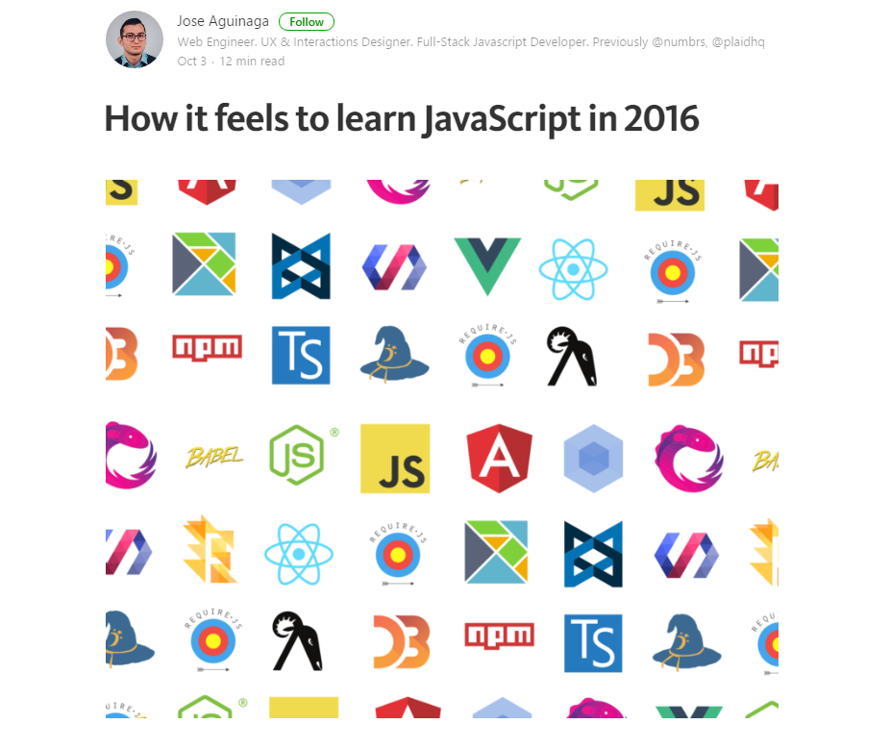
PV247
https://hackernoon.com/how-it-feels-to-learn-javascript-in-2016-d3a717dd577f
Notes:
Vanilla JS je tezko pouzitelny.
Spatne api .. Collections, dom.
Cross browser compatibilita novsich standardov
Spatna typova kontrola a detekce chyb
Synchronni moduly nejde pouzivat v browseru
Za ty roky co je javascript na vzestupu vzniklo obrovske mnozstvi knihoven (npmjs – 340000)
99% odpad
1% to co je dobre
3.5 tisice moznosti jak delat frontend
-> neni to tak jednoduche
Spousta z toho je toolingu
Velka vstupni bariera
Navzdory tomu je vyvoj Front-end aplikaci (SPA) na vzestupu
Duvod -Hlavne Nej UX pro uzivatele
Priklad – Produkty google – Gmail, Photos, Kalendar
Stejne nebo lepsi ux nez desktopove appky

Slide 9


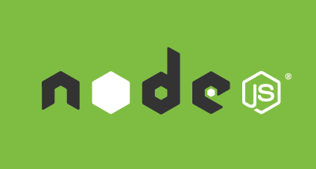
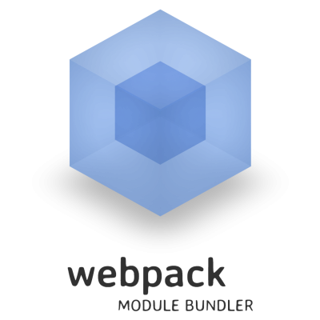



PV247

Slide 10
PV247
https://babeljs.io
Notes:
Pouzivame syntax z ECMAScript 2015 ktera neni podporovana v browseru
Babel je JavaScript compiler
Podporuje posledni verzi standard
Kompiluje do ES 5 -> vsechny browser ok
Podporuje pluginy
Napriklad JSX
Ukaz priklad z babeljs.io

Slide 11
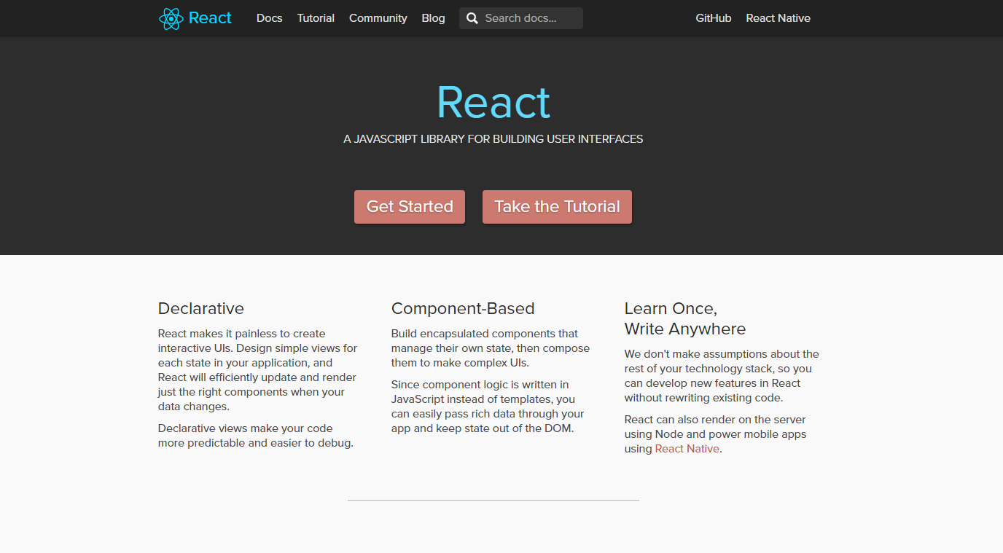
React
Notes:
Pouziva se jako knihovna pro staveni uzivatelskeho rozhrani
Vznikla ve Facebooku
Hodne popularni
Pouziva Facebook, Kentico Draft, Kiwi, Twitter, Uber, …
Zajistuje cross-browser kompatibilitu
Skvely vykon
Pouzitelna i pro vyvoj mobilniho UI

Slide 12

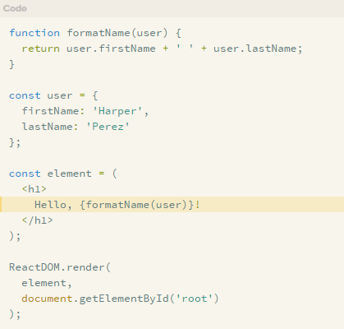
React
https://facebook.github.io/react/docs/introducing-jsx.html
Notes:
Jde ruku k ruce s Reactem
Pouziva se vyhradne s reactem
Vtipna syntaxe – neni to HTML ani JavaScript
Je to rozsireni javascriptu
Dava to celkem smysl
Lepe se pise markup
Lepe se v tom orientuje
https://codepen.io/collection/DxRWVW/
JSX – jsx html elements, JS expressions in JSX
Components, state, lifecycle

Slide 13
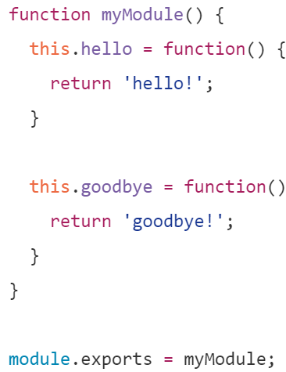
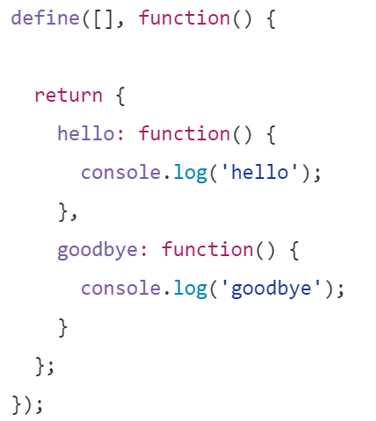
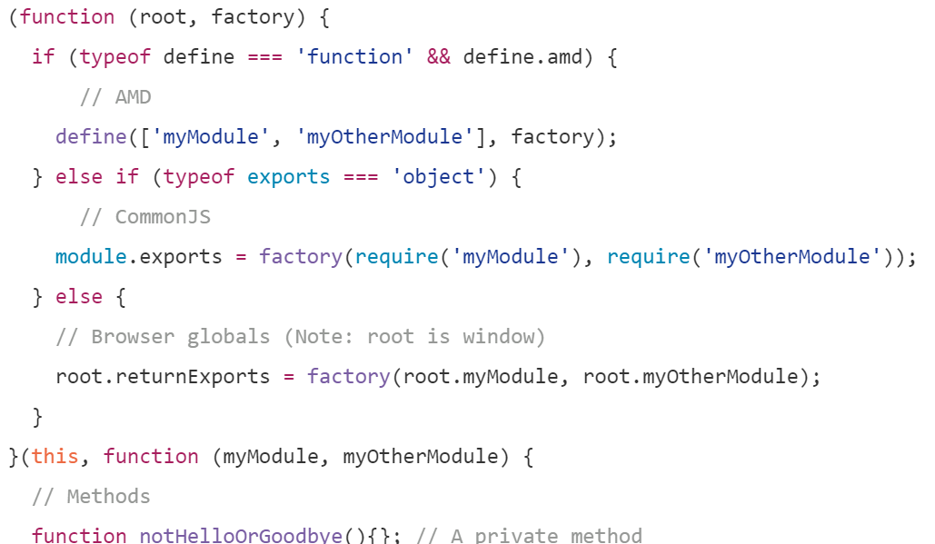
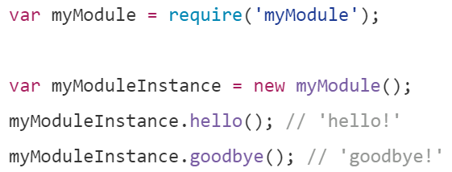
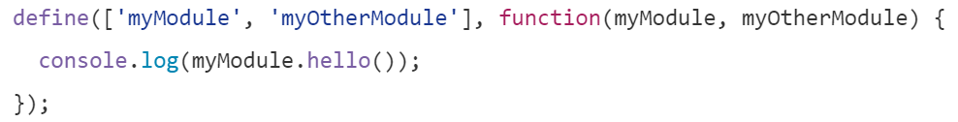
PV247
CommonJS (Node.js)
AMD (Browser)
UMD
Notes:
CommonJs
Every module has it’s own namespace
Avoids global space pollution
Compact syntax
Synchonne nacita moduly
Nepouzitelny v browseru
AMD
Asynchronne nacita moduly – ma to v nazvu
Prvni parameter – zavislosti
Druhy parameter – fukce ktera se zavola jakmile jsou vsechny zavislosti nacteny
Universal Moduler Definition
V realu
CommonJS + Module bundler (webpack)

Slide 14
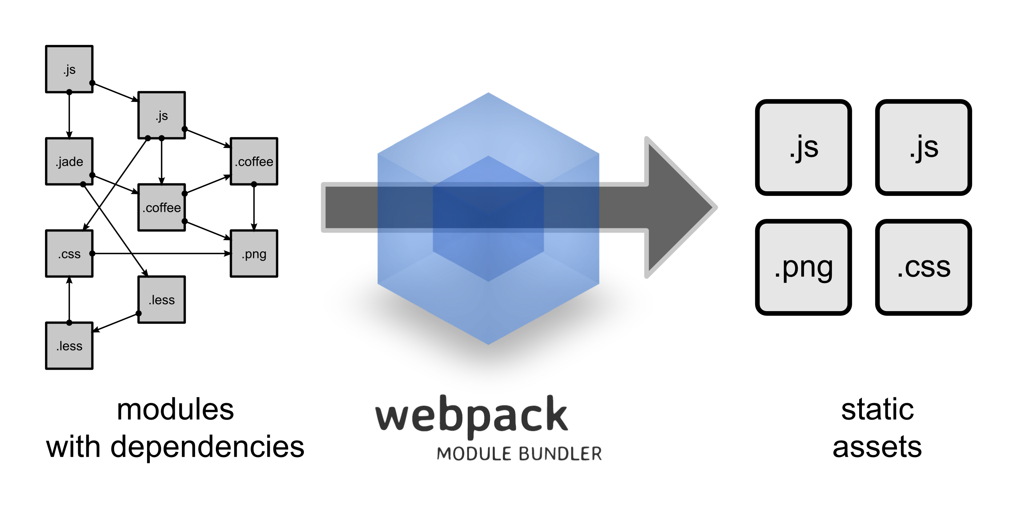
PV247
https://webpack.js.org/concepts/
Notes:
takes modules with dependencies and generates static assets representing those modules.
Pouziva loader
Jednim z nich je babel
Dalsi muze byt less loader
Typescript loader
…
Silny plugin system
Minifikace
Proc pouzit webpack misto toho abych primo pouzil babel?
Babel kompiluje soubor po souboru
Webpack usnadnuje development - watch

Slide 15
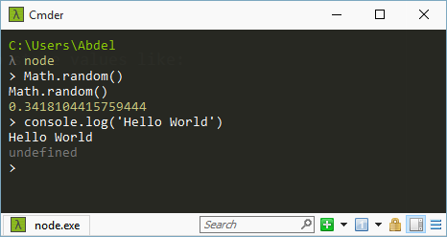
PV247
npm init
npm install
npm run …
https://docs.npmjs.com/getting-started/what-is-npm
Notes:
Node is a program for running JavaScript
Used by everyone who writes some javascript
Server, tooling
Show node interpreting some commands
Npm is package manager …
Show npm site, pakcges…
Install webpack as local package npm install --save-dev webpack
explain devdependencies, add build script (webpack command from bin folder), webpack config (go to page webpack concepts), perform build
npm install --save-dev babel-loader babel-core babel-preset-env
npm install --save react react-dom
npm install --save-dev babel-plugin-transform-react-jsx
Config babel loader, babel react plugin,
Create app.jsx, edit html add script to the end

Slide 16
PV247
tool for identifying and reporting on patterns found in ECMAScript/JavaScript code, with the goal of making code more consistent and avoiding bugs.
http://eslint.org/docs/user-guide/getting-started
Notes:
npm install eslint --save-dev
./node_modules/.bin/eslint –init
npm install eslint-loader --save-dev
loaders order in webpack config
Extends, react plugin
Eslint integration with IDE
Eslint rule disable for temp debug code

Slide 17
Debug
PV247
When debugging in a browser, how to tell where the original code is?
Source maps
  Mapping between the original and the transformed source code.
  Inline
    Add the mapping data directly to the generated files.
    Thanks to their speed, inline source maps are ideal for development.
  Separate
    Emit the mapping data to separate source map files and link the original source to them using a comment.
    Given they make the bundles big, separate source maps are the preferable solution for production.
It's possible you don't want to generate a source map for your production bundle as this makes it effortless to inspect your application. By disabling them you are performing a sort of obfuscation.
[Chrome] Search in source files: CTRL + P
https://survivejs.com/webpack/building/source-maps
https://webpack.js.org/configuration/devtool/
Notes:
Show app.js in web tools
Configure source maps and environments (dev, production)

Slide 18
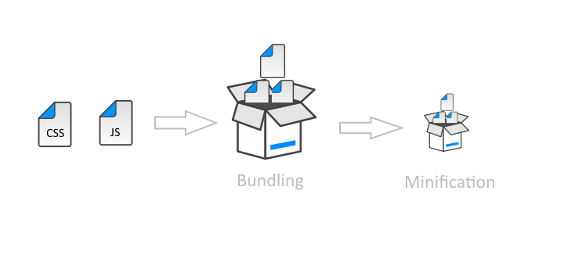
Minification
PV247
process of removing all characters that are not necessary from the Javascript source code
UglifyJS Webpack Plugin
https://github.com/webpack-contrib/uglifyjs-webpack-plugin
Notes:
Configure uglify
Webpack watch

Slide 19
Resources
PV247
https://github.com/facebookincubator/create-react-app
Notes:
Open create react app, show features

