Slide 1
React
Slavomír Moroz

Slide 2
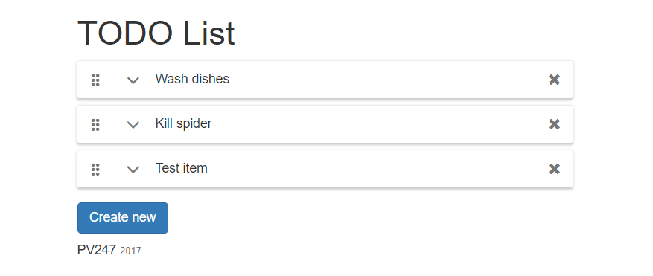
PV247

Slide 3
Styles & Resources
6-bootstrap-css-setup
Need to add styles?
  css-loader | sass-loader | less-loader
How do you want them to be linked?
  Inline: style-loader
  Separate file: extract-loader + file-loader
Need some pictures?
  Graphics, fonts & other binary resources
  file-loader | url-loader
Notes:
Install bootstrap design framework
npm install --save bootstrap (in case version 4 get released, install v3 not latest)
Import bootstrap.css from node modules
Build – nada
npm install style-loader css-loader url-loader file-loader extract-loader --save-dev
add css and style loader to config
2) Build – nada – font icons and graphics are missing loaders
Add url-loader for bootrap glyph icons
Add some markup to app.jsx to demo styles
Build and showcase inline styles
3) Add extract-loader and file-loader for styles
Do not use publicPath option in extract loader
Add link to css file to the app.html
Show broken relative path
Add publicPath

Slide 4
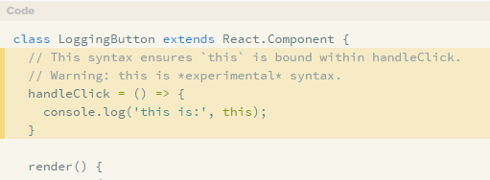
Getting started…
7-TodoList-component, 8-immutable-state-class-property-initializer
Learning materials that covers commit 7-TodoList-component:
Named vs default exports
State & lifecycle
  Do Not Modify State Directly
  State Updates May Be Asynchronous
  State Updates are Merged
React components
  Constructor()
  SetState()
Elements List & Keys
Handling events
  If calling bind annoys you, and you are using the experimental property initializer syntax, you can use property initializers to correctly bind callbacks:
  Stage-X (Experimental Babel Presets) + babel-eslint parser
Notes:
Import REACT, write component class, render method with “not implemented text,” showcase default vs named export
Constructor with default state, items without ids
Render list in render method, array.map, element key =>array index, nullable description
Add button, _onAddClick function, this undefined => bind,
array.push && setState
Change of state triggers re-render
onAdd as lambda without bind, install babel-eslint –save-dev, eslint: “^3.x”, enable stage 2 experimental features
Uuid instead of index and why
npm install uuid --save
setState && mutable array, showcase whats wrong. Next slide Immutable

Slide 5
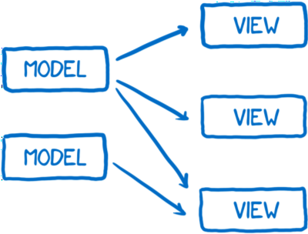
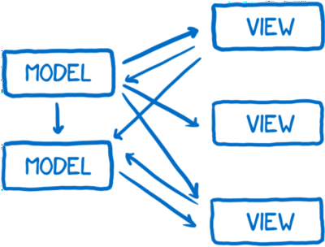
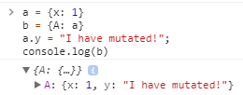
Immutable
Changes made to objects and arrays by direct mutation will not be detected, and components will not re-render.
Side effects like mutation or asynchronous behavior will cause time travel to alter behavior between steps, breaking the application.
Notes:
Facebook notifications bug

Slide 6
Object immutability
8-immutable-state-class-property-initializer
Cloning an object
Object.assign(target, ...sources)
  var obj = { a: 1 }; var copy = Object.assign({}, obj); console.log(copy); // { a: 1 }
Spread operator
  var obj = { a: 1 }; var copy = {…obj}; console.log(copy); // { a: 1 }
Immutable object implementations
Flow or Typescript objects / interfaces without mutation capabilities
  interface IObj { readonly a: number }
Immutable-js - immutable collections for JavaScript
Immutable-js Record – immutable objects
Notes:
Install immutable.js
Replace array with list, set state with previous state (function)

Slide 7
Composing components
9-TodoListItem-component
Components accept inputs (called "props") and return React elements describing what should appear on the screen.
Components can refer to other components in their output.
Components must return a single root element.
Props
A component must never modify its own props - all React components must act like pure functions with respect to their props.
PropTypes - React built-in typechecking abilities.
https://facebook.github.io/react/docs/components-and-props.html
Notes:
https://facebook.github.io/react/docs/components-and-props.html
https://facebook.github.io/react/docs/typechecking-with-proptypes.html
Create TodoListItem class component
Add PropTypes.Shape for TodoItem, mention flow a typescript
Render <li> item
Styling components… show slide with image, talk about layout… Atomic Design, Bem, Styled components
Add styles npm install --save styled-components
Showcase how to write styled components
Insert styles from demo, update render method + TodoList.jsx (render + styles)
https://raw.githubusercontent.com/KenticoAcademy/PV247-2017/9e567e940726905f9299e7ce85906ece213998ba/DemoReactApp/src/todo-list/TodoListItem.jsx
Add onDelete prop. Write onDelete handler in TodoList.jsx
Immutable list delete vs filter

Slide 8
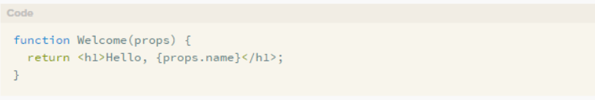
Functional components
10-TodoListItem-functional-component
A.K.A Stateless components
This function is a valid React component because it accepts a single "props" object argument with data and returns a React element.
Notes:
Rewrite TodoListItem class to function component.

Slide 9
Browser events & DOM attributes
11-TodoListEditedItem-component, 12-TodoItem-edit-save
Some attributes work differently in React and HTML
https://facebook.github.io/react/docs/dom-elements.html#differences-in-attributes
SyntheticEvent
a cross-browser wrapper around the browser's native event.
works identically across all browsers.
similar interface to native event
  includes stopPropagation() and preventDefault()
SyntheticEvent object will be reused and all properties will be nullified after the event callback has been invoked.
  You cannot access the event in an asynchronous way.
Notes:
Download commit with TodoListEditemItem.
Show basic form, editedItemId state + start / cancel edit, moved styles to separate file (shared between two components)
Attributes – className, show htmlFor in TodoListEditedItem
Events
prevent-default in TodoListEditedItem
Make saving work
Copy props to state to enable edit
OnChange – async setState – access event, in async call – explain why it wont work, use spread operator, must not modify props
OnSave - Copy title and desc when saving. We will need this to showcase shallow compare in pure components

Slide 10
Lifecycle
13-component-lifecycle-local-storage
Each component has several "lifecycle methods" that you can override to run code at particular times in the process.
  Methods prefixed with will are called right before something happens
  methods prefixed with did are called right after something happens
https://facebook.github.io/react/docs/react-component.html#the-component-lifecycle
Notes:
When to use which method
Setup browser events not supported in react
Setup timers
WillReceiveProps – Load to edited item to component state if props changed
WillMount – load from local storage – constructor is better
componentWillUpdate save to local storage if state changed
Will not save edited item because we are mutating the existing one. Shallow compare won’t work.
Remove mutation with spread operator

Slide 11
Pure components
14-pure-component
shouldComponentUpdate()
The default behavior is to re-render on every state & props change
If shouldComponentUpdate() returns false, then componentWillUpdate(), render(), and componentDidUpdate() will not be invoked.
To improve performance you may inherit from React.PureComponent which implements shouldComponentUpdate() with a shallow prop and state comparison.
use immutable objects to facilitate fast comparisons of nested data
shallow equality check of immutable objects produces same results as deep equality check of mutable object, but it’s faster
https://facebook.github.io/react/docs/react-api.html#react.purecomponent
https://facebook.github.io/react/docs/optimizing-performance.html#shouldcomponentupdate-in-action
Notes:
Inherit from component
- All is fine, we are using spread operators

Slide 12
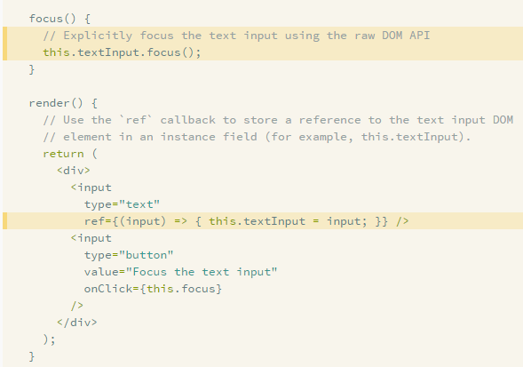
Refs to DOM elements
When the ref attribute is used on an HTML element, the ref callback receives the underlying DOM element as its argument.
When to Use Refs
Managing focus, text selection, or media playback.
Calculating viewport position.
Triggering imperative animations.
Integrating with third-party DOM libraries.
Notes:
16.5-container-components – components/todo-list/TodoListEditedItem.jsx

Slide 13

Children
15-react-css-transition
In JSX expressions that contain both an opening tag and a closing tag, the content between those tags is passed as a special prop: props.children.
https://facebook.github.io/react/docs/jsx-in-depth.html#children-in-jsx
Demo example – React Transition Group
Notes:
npm install react-transition-group –save
Transition – adds classnames based on transition state
TransitionGroup– detects mount / unmounts in children and triggers transitions

Slide 14
Higher order components
16-HoC-react-dnd
A higher-order component (HOC) is an advanced technique in React for reusing component logic.
Concretely, a higher-order component is a function that takes a component and returns a new component.
HOC composes the original component by wrapping it in a container component.
Demo example – React-dnd

Slide 15
Container components
16.5-container-components
idea of separating presentation markup from logic in react components
Presentational and Container components
Container components
 | Presentational Components | Container Components
Purpose | How things look (markup, styles) | How things work (data fetching, state updates)
To read data | Read data from props | Subscribe to state
To change data | Invoke callbacks from props | Set state

Slide 16
Debug
React dev tools
lets you inspect the React component hierarchy, including component props and state.
Component display name
The displayName string is used in debugging messages.
babel-plugin-add-react-displayname
  Automatically detects and sets displayName for React components.
babel-plugin-styled-components
  adds the components' name and displayName to the class name attached to the DOM node
  <button class="sc-Button-asdf123 asdf123" /> instead of just <button class="asdf123" />.
Notes:
Styled components – I couldn’t make it work without explicitly specifying the displayName
styled.div.withConfig({displayName: 'TitlePane’})
JSX sets display name automatically, show example

