Slide 1
Redux
“… predictable state container for JavaScript apps.” -- Redux docs
Zuzana Dankovčíková
Notes:
State management library
Framework agnostic, but ideal for React apps

Slide 2


Why do we need Redux?
We have already solved many problems of state management by
treating data as immutable objects and
having most of the data stored in the root component.
Notes:
Problems:
- cycle in dependant mutations
- how to access data
Props explosion?
…

Slide 3
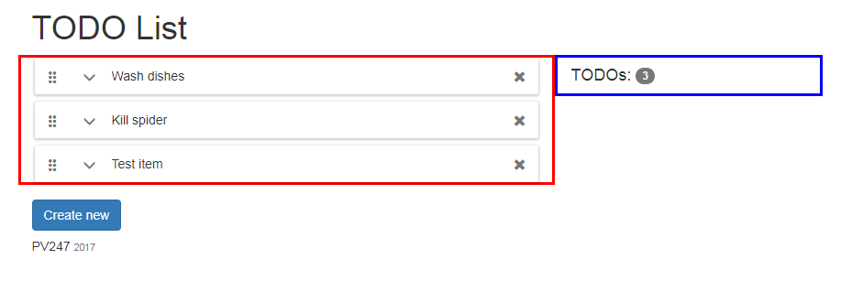
Problem 1: What is “root component”
New feature request:
→ Displaying number of TODOs next to the avatar of the logged-in user?
→ “Unrelated” components dependent on the same data.
→ Lifting state up. But until when? How to make it scalable?
Notes:
In a small app, it is easy. But what if it starts to grow?
Adding more pages to your single page app. TODO app is just one part of it. What if you wanted to display number of TODOs in the navigation next to the logged-in user avatar?
Draw on the whiteboard: http://mherman.org/node-workshop/slides/redux-intro/images/state-change-without-redux.jpg

Slide 4
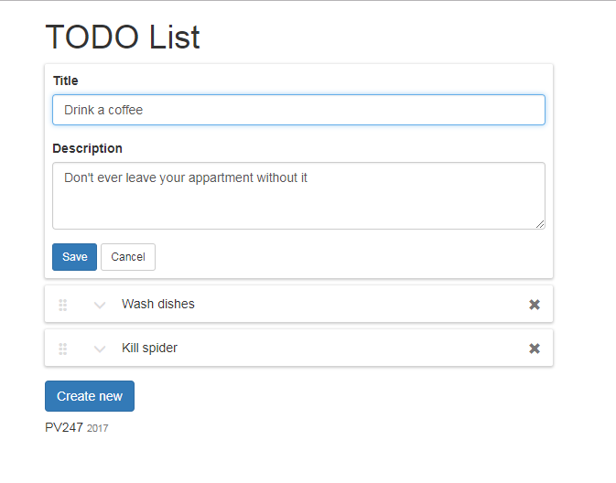
Problem 2: Callbacks chain
Submit button
EditItem component
EditItem container
TodoList component
TodoList container
Click!
Notes:
Simple click on save button when editing the component must bubble-up through 5 components in order to change state of the root component. And this is still quite a small app.

Slide 5
Problem 2: Callbacks chain
Submit button
EditItem component
EditItem container
TodoList component
TodoList container
class TodoListContainer extends React.Component {
// other methods
// ...
render() {
return (
<TodoListComponent
list={this.state.list}
editedItemId={this.state.editedItemId}
createNewFormVisible={this.state.createNewFormVisible}
isDragging={this.state.isDragging}
onDelete={this._deleteItem}
onExpand={this._startEditing}
onCancel={this._cancelEditing}
onSave={this._updateItem}
onReorder={this._moveItem}
onCreateNewClick={this._showCreateNewForm}
onCreateCancel={this._hideCreateNewForm}
onCreate={this._createNewItem}
onDragStarted={this._itemDragStarted}
onDragEnded={this._itemDragEnded}
/>
);
}
}
Notes:
And as you see it is not just the problem of the onSave callback.

Slide 6
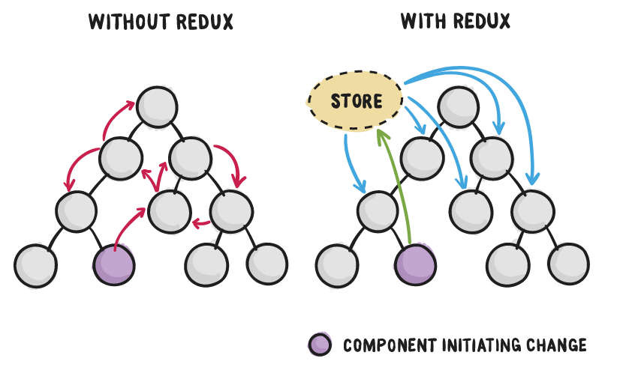
Notes:
What is the solution? You introduce state management library such as Redux.
-> all state is stored in the single place but it is not the root component it is you app's store → deterministic and robust
-> components subscribe to store and only take data they are interested in
-> data and their presentation is decoupled → won’t break on UI change

Slide 7
Motivation
Complex state management made easy
Scalable state management
Deterministic and easily traceable changes
State is decoupled from presentation (won’t break with every UI change)
Better dev tools than console.log()
Better testability

Slide 8

3 Principles of Redux
Single source of truth:
"The whole state of your app is stored in an object tree inside a single store."
State is read-only:
"The only way to change the state tree is to emit an action, an object describing what happened."
Changes are made with pure functions:
“To specify how the actions transform the state tree, you write pure reducers."
Notes:
Other:
Immutability
State normalization

Slide 9
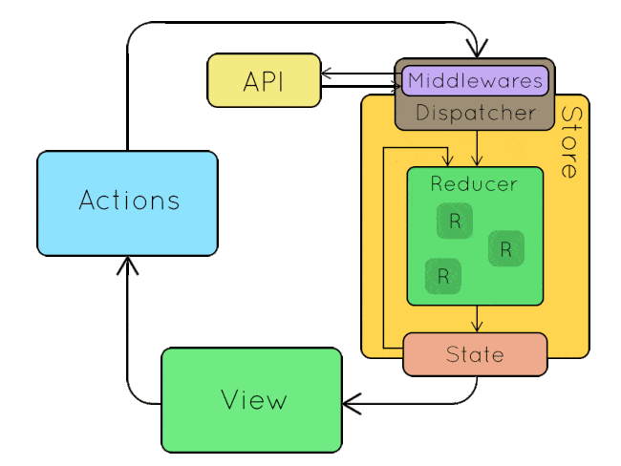
Building blocks
Action
describes UI changes
Store
receives action via dispatcher
calls root reducer
Reducer
(prevState, action) => newState
View
gets notified about state change
rerenders with new data
Notes:
Draw separate image on the whiteboard and explain on one use case (adding new TODO).
There is 1 root reducer that can delegate state changes to other reducers.
One store entity managed by redux, takes care of state and is pretty much defined by reducers.
-> all user interactions are done by dispatching actions (saying what has happened)
-> store (its reducer) reacts to dispatched actions and update the state accordingly
-> subscribed components are notified about the changes and update accordingly
-> remember your view is only a function of data!
Observer Pattern, (Hollywood principle: “Don’t call us, we call you!”)
Demo introduction:
Explain what we are going to do with our app
Moving state from root component to redux store
Move list of items to redux in DEMO, rest will be just shown as a final result
Code along with the next slides, redux will be installed later, for now just actions and reducers

Slide 10
Actions & Action creators
17-redux-action-creators
“Actions are payloads of information that send data from your application to your store. They are the only source of information for the store.”
A new developer can go through all defined actions and immediately see the entire API - all user interactions that are possible in your app.
Action - simple JS objects describing data change
Action creator - helper function for creating actions
{
type: 'TODO_LIST_ITEM_CREATE',
payload: {
id: 42,
text: 'Buy milk'
}
}
const createItem = (text) => ({
type: TODO_LIST_ITEM_CREATE,
payload: {
id: uuid(),
text: text
}
});
Notes:
DEMO
Define action types
Explain why they need to be defined as constants in an extra file (glue between action and reducer)
Explain why they are prefixed with the name of the subapplication (need to be unique application-wide, cos the root reducer recieves each action)
TODO_LIST_ITEM_CREATE
TODO_LIST_ITEM_DELETE
TODO_LIST_ITEM_MOVE
TODO_LIST_ITEM_UPDATE
Write action creators
Talk about need of having it in one place so that we do not define the actions by hand every time in components
It also serves as some kind of documentation of the UI capabilities
createNewItem has whole item as payload and the id is generated there

Slide 11
Reducers
Action describes WHAT has happened, reducer specifies HOW the state should change
1 root reducer that can be composed from many others
Pure function (prevState, action) => nextState
What is a pure function? (args) => result
It does not make outside network or database calls.
Its return value depends solely on the values of its parameters.
Its arguments should be considered "immutable" (must not be changed)
Calling a pure function with the same set of arguments will always return the same value.
Notes:
https://css-tricks.com/learning-react-redux/
Show some examples what is and what is not a pure function

Slide 12
Pure or impure?
const getMagicNumber = () => Math.random();
const time = () => new Date().toLocaleTimeString();
const addFive = (val) => val + 5;
var count = 0;
cosnt increaseCount = (val) => count += val;
Notes:
Excercise

Slide 13
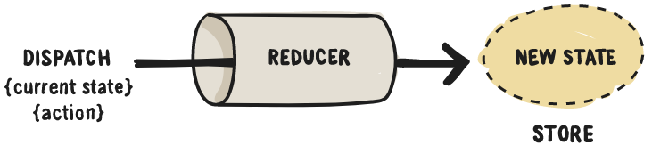
Reducers
18-redux-reducers
function counter(state = 0, action) {
switch (action.type) {
case 'INCREMENT':
return state + 1;
case 'DECREMENT':
return state - 1;
default:
return state;
}
}
Previous state argument
Specify default value
Return same reference for irrelevant action type
Notes:
INITIAL STATE will be explained later.
What does a typical reducer look like?
- Always a pure function, never mutating arguments!
- Switch statement
- Always default statement returning previous state
- Always initial state (default argument, important for initial call by redux where whole state is created)
DEMO
Fix eslint indents for case statements ("indent": ["error", 4, {"SwitchCase": 1+ }],)
Create reducers:
ItemsList reducer (copy the case statements from txt file)
Reducer composition on next slide

Slide 14
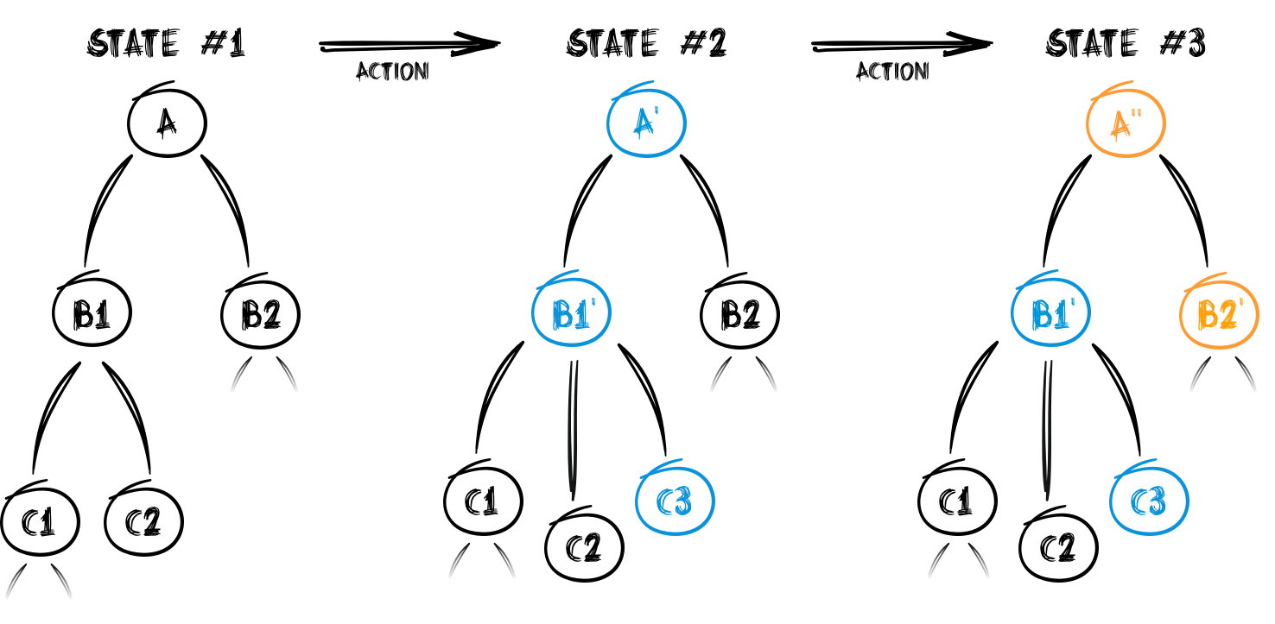
Reducer composition
18-redux-reducers
Notes:
DEMO
Checkout commit with 18-redux-reducers
Explain reducer composition
Each reducer is responsible for some small part of the state
If we wanted the updateItem could be implemented as separate reducer...
Explain how this works with immutability (returining prevState on irrelevant action type)
Create App and todoApp reducers

Slide 15
Store
Single store for whole app managed by Redux (we only provide a root reducer)
Holds application state;
Allows access to state via getState();
Allows state to be updated via dispatch(action);
Registers listeners via subscribe(listener);
Handles unregistering of listeners via the function returned by subscribe(listener).
-- Redux docs
Notes:
NO setters or direct access to the state object. All changes are described via actions and state manipulation is defined by reducers as pure functions.

Slide 16
Minimalistic API
19-install-redux
createStore(rootReducer)
store.getState()
store.dispatch(action)
store.subscribe(listener)
combineReducers({…})
What is the store lifecycle?
→ initial call to reducer + call on every dispatched action
Notes:
Most of the time you only write pure JS functions.
What does createStore() do?? It calls the root reducer with undefined, thus the state is populated with default values of the prevState function argument.
DEMO – checkout, show app.jsx
Npm install –save redux
Import createStore to app.jsx
Copy contents of utils/getItems() and initialize store state
Console.log(store.getState())
Use combineReducers() for app and todoApp reducers
Explain lifecycle -> call to createStore() calls the root reducer with undefined and sets the result value as the default state

Slide 17
React-redux integration
20-connect-root-component
You can connect your existing app to the store by hand.
But you would loose many optimizations react-redux package brings.
Use react-redux library instead:
Wrap your root component in <Provider>
Connect components to redux store
  connect(mapStateToProps, mapDispatchToProps)(Component)
Notes:
Make sure to explain syntax connect(…)(Component)
DEMO
Npm install –save react-redux
Clean up app.jsx, (const initialState = { todoApp: { itemsList: getInitialItems() } };)
Wrap the root component in Provider
Create a container in containers-redux folder
Carefully update container/TodoList
https://github.com/KenticoAcademy/PV247-2017/commit/7730e35156612e677daa8ba0d3957d19bc5a2b57
At the end of the lecture the file will be deleted completely
Define prop types (list, onCreateNew, onUpdate, onDelete, onMove)
Delete part of state
Remove _getDefaultTodoList
Rewrite all state.list to props.list
Carefull about _createNewItem method and _updateItem

Slide 18
Moving more state to the Redux store
21-move-state-to-store
All state from the root component shall be moved to the store
New actions,
New reducers
No internal state in TodoList.jsx
→ the old container is basically useless
Notes:
DEMO:
Checkout next commits where all the state from TodoList component is moved to redux store.
Show how it looks like.
Notice editedItemId - not only explicit actions to change store but ALL actions we are interested in -> saving /updating edited item closes the editor

Slide 19


Be declarative
Action describes what has happened, reducer decides how to react
const editedItemId = (state = null, action) => {
switch(action.type) {
case TODO_LIST_ITEM_START_EDITING:
return action.payload.id;
case TODO_LIST_ITEM_CANCEL_EDITING:
case TODO_LIST_ITEM_UPDATE:
case TODO_LIST_ITEM_DELETE:
return null;
default:
return null;
}
};
dispatch({
type: 'SET_EDITED_ITEM_ID',
payload: {
id: 42
}
});
dispatch({
type: 'CLEAR_EDITED_ITEM_ID'
});
Notes:
Declarative vs imperative approach.
You want your actions to say what has happened on the UI, NOT telling reducers what to do.

Slide 20
Should all components be stateless?
“How much” state should we move to the redux store?
Does your state influence more components in your application?
(and the common parent is way up in the hierarchy)
move state to redux store
TodoList.jsx
Is the state well encapsulated and local for the component?
It can stay in the stateful component.
TodoListEditedItem.jsx
Notes:
Statefull vs Stateless:
Explain on our todo app..
E.g. TodoListEditedItem
Until user clicks save, no temporary state is relevant for other parts of the application… at max they may be interesting in knowing one of the components is being edited to disable some other functions.

Slide 21
Benefits
State described as plain object and arrays:
Inject initial state during server rendering
Persist to and load from localStorage
UI is function of state (state -> UI -> deterministic behavior)
Immutability (React performance)
State changes described as plain objects
Replaying the history (reproducing bugs)
Pass actions over network in collaborative environments (google docs, trello live updates)
Implementing undo
Awesome tooling
State modification as pure functions
Testability
Hot reloading
3rd party modules integration (middleware, libs that need to store state...)
Notes:
Hot reloading -> show image from code cartoons: https://code-cartoons.com/a-cartoon-intro-to-redux-3afb775501a6
Time travel debugging -> show example
Middleware support -> logging etc.

Slide 22
Drawbacks
Boilerplate & Verbosity
-> have a look at Repatch
"One huge object"
-> pretty much eliminated by reducer composition and ImmutableJS
"Component state vs Redux store" dilema
-> see #1287 and: "Do whatever is less akward."

Slide 23
3 Principles of Redux - revised
Single source of truth:
"The whole state of your app is stored in an object tree inside a single store."
State is read-only:
"The only way to change the state tree is to emit an action, an object describing what happened."
Changes are made with pure functions:
“To specify how the actions transform the state tree, you write pure reducers."

Slide 24
Part 2

Slide 25
What about our props explosion?
<TodoListComponent
list={this.state.list}
editedItemId={this.state.editedItemId}
createNewFormVisible={this.state.createNewFormVisible}
isDragging={this.state.isDragging}
onDelete={this._deleteItem}
onExpand={this._startEditing}
onCancel={this._cancelEditing}
onSave={this._updateItem}
onReorder={this._moveItem}
onCreateNewClick={this._showCreateNewForm}a
onCreateCancel={this._hideCreateNewForm}
onCreate={this._createNewItem}
onDragStarted={this._itemDragStarted}
onDragEnded={this._itemDragEnded}
/>
<TodoListComponent
list={this.props.list}
editedItemId={this.props.editedItemId}
createNewFormVisible={this.props.isCreateNewFormOpen}
isDragging={this.props.isDragging}
onDelete={this.props.onDelete}
onExpand={this.props.onStartEditing}
onCancel={this.props.onCancelEditing}
onSave={this.props.onUpdate}
onReorder={this.props.onMove}
onCreateNewClick={this.props.onCreateNewClick}
onCreateCancel={this.props.onCreateNewCancel}
onCreate={this.props.onCreateNew}
onDragStarted={this.props.onDragStarted}
onDragEnded={this.props.onDragEnded}
/>
Notes:
We haven’t helped the callback chain presented at the beginning of the lecture very much.
Motivation for connecting more than just root component to redux store.

Slide 26
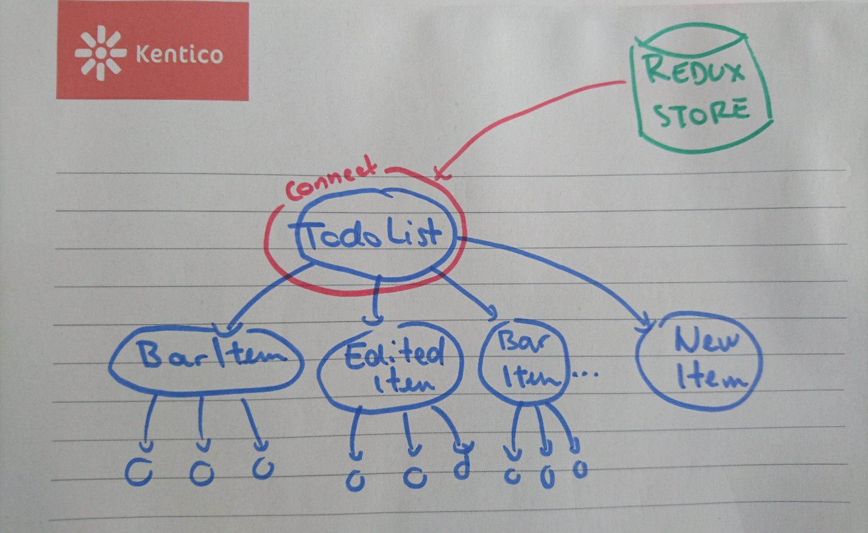
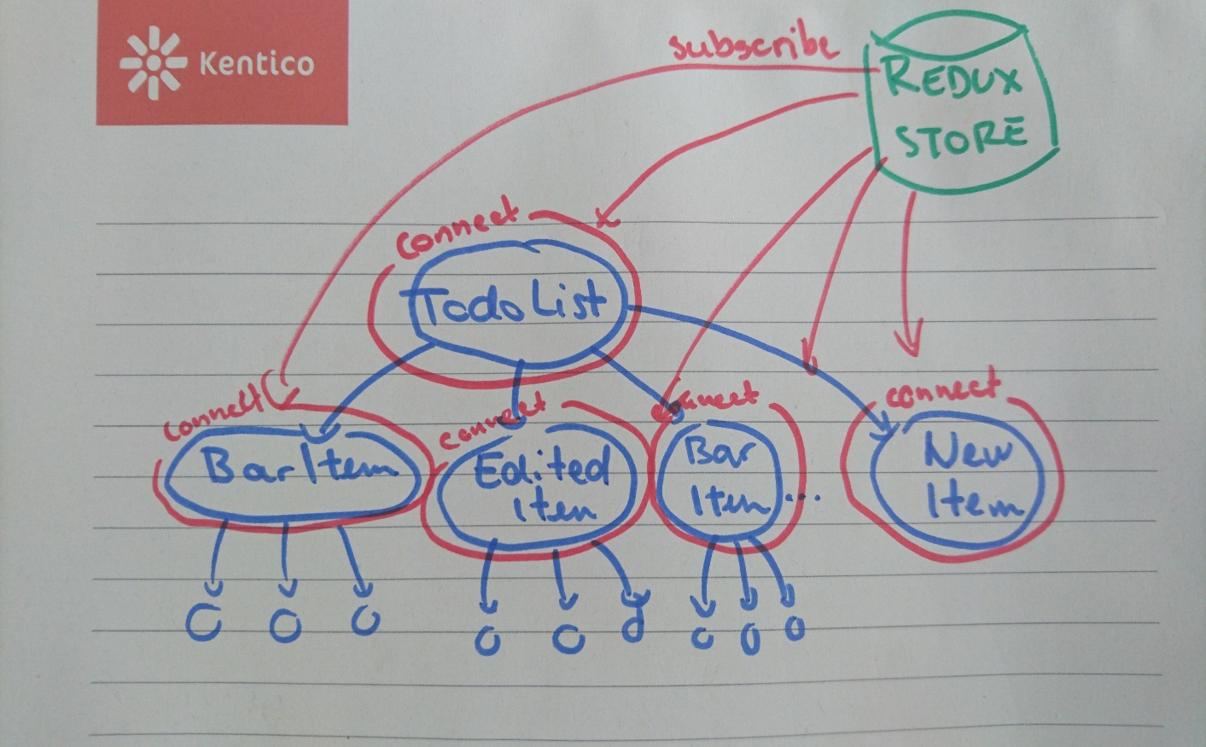
Connecting more components
Notes:
Every container passes only data relevant for the wrapped component.

Slide 27
Connecting more components to store
22-connect-more-components
<TodoListComponent
list={this.state.list}
editedItemId={this.state.editedItemId}
createNewFormVisible={this.state.createNewFormVisible}
isDragging={this.state.isDragging}
onDelete={this._deleteItem}
onExpand={this._startEditing}
onCancel={this._cancelEditing}
onSave={this._updateItem}
onReorder={this._moveItem}
onCreateNewClick={this._showCreateNewForm}a
onCreateCancel={this._hideCreateNewForm}
onCreate={this._createNewItem}
onDragStarted={this._itemDragStarted}
onDragEnded={this._itemDragEnded}
/>
<TodoListComponent
list={this.props.list}
editedItemId={this.props.editedItemId}
createNewFormVisible={this.props.isCreateNewFormOpen}
onCreateNewClick={this.props.onCreateNewClick}
/>
Notes:
Checkout commits and click around, show some containers.

Slide 28
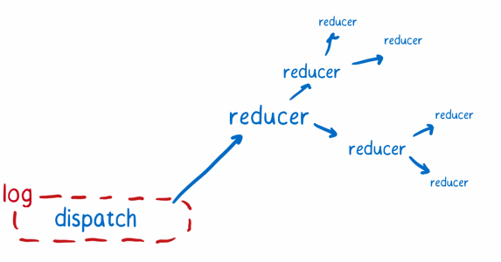
Middleware
One of the greatest things about Redux is its modularity
Logging
Complex actions (Thunk, promise)
devTools
…
createStore(app, initialState, applyMiddleware(...middleware));

Slide 29
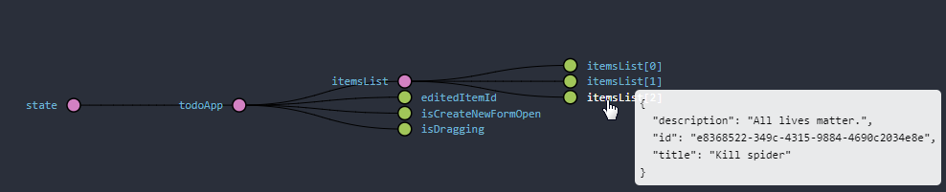
Redux-devtools
23-redux-devtools
All your actions and state visualized
You can replay history
Install chrome extension
See kentico cloud or kiwi.com
Notes:
DEMO
Checkout commit that has devtools and logger and showcase
Beware, once enabling redux-devtools for our demo project, you have to allow access to file URLs for chrome extension, see: https://github.com/zalmoxisus/redux-devtools-extension/blob/master/docs/Troubleshooting.md

Slide 30
Redux-thunk
Where to handle side-effects in Redux app?
(async code (API communication), data generation like new Date() or Math.random())
Components?
Reducers?
Action creators?
→ “thunk” action creators
Notes:
Components – bad testability, too much logic in one place, which component…
Reducers – no way, those must be pure
Action creators – how, they only return plain object with action

Slide 31
Thunk actions
“In computer programming, a thunk is a subroutine used to inject an additional calculation into another subroutine. Thunks are primarily used to delay a calculation until it is needed, or to insert operations at the beginning or end of the other subroutine.”
-- Wikipedia
Function that can dispatch other actions:
export const saveItems = () =>
(dispatch, getState) => {
dispatch(savingStarted());
setTimeout(() => {
const items = JSON.stringify(getState().todoApp.itemsList.toJS());
localStorage.setItem('todoList', items);
dispatch(savingFinished());
}, 1000);
};
Notes:
Explain code snippet:
We do not have an API yet
localStorage access is synchronous
For demo purposes, we wrap it in setTimeout, so that it appears async and we can display the loader

Slide 32
Saving items to localStorage
24-autosaving-component
Getting rid of Dummy TodoList container
New component
Displays saving status
Watches for changes in todoList part of state
On changes dispatches a thunk action to save items
Install redux-thunk
Define savingStarted & savingFinished action types and creators
Introduce reducer with saving flag
Create SavingStatus component
Wrap component in a container (list data & save callback)
<SavingStatus />
Notes:
DEMO:
Checkout the commits with SavingStatus component and explain what has been done

Slide 33


Data normalization
Immutable.List<Item>
vs.
Immutable.Map<id, Item> & Immutable.List<id>
Data should be stored in a normalized form (same as in relation DB)
Easier manipulation – reducers (entity vs collection)
No duplication (for complex nested objects)

Slide 34

Data normalization
{
authors: {
byId: {
'410237': { id: '410237', name: 'Suzii' },
'325335': { id: '325335', name: 'Slavo' },
},
},
items: {
allIds: ['1', '2', '3'],
byId: {
'1': {
id: '1',
title: 'Buy milk',
author: '410237',
},
'2': {
id: '2',
title: 'Learn redux',
author: '410237',
},
'3': {
id: '3',
title: 'Be awesome',
author: '325335',
},
},
},
}
{
itemsWithAuthors: [
{
id: '1',
title: 'Buy milk',
author: { id: '410237', name: 'Suzii' },
},
{
id: '2',
title: 'Learn Redux',
author: { id: '410237', name: 'Suzii' },
},
{
id: '3',
title: 'Be awesome',
author: { id: '325335', name: 'Slavo' },
},
],
};
Notes:
Explain the problem of duplicated data and how it can be solved.

Slide 35
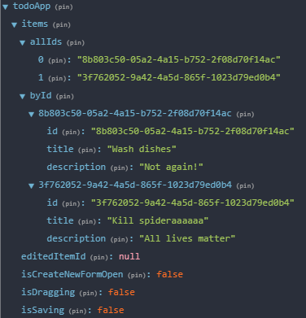
Normalizing todo list
24-todo-list-normalization
We replace the itemsList with data structure:
{
items: {
allIds: [], // list of ids
byId: {}, // map of items indexed by id
}
}
Notes:
Dame as in DB, interconnected just by ID, no data duplication.
However, if there is 1-n or 1-1 relationship, it might be sometimes easier to denormalize.

Slide 36
Memoization
25-todos-memoization
What do we pass to TodoList container?
Two options:
Both byId and allIds
We create list of item in container and do not need to change the component at all
But we are creating new instance of list every time mapStateToProps is called
ANY change in state,
The component is ALWAYS rerendered
MEMOIZE
const getListOfItems = (items) => items.allIds.map(id => items.byId.get(id)).toList();
const getListOfItemsMemoized = memoizee(getListOfItems);

Slide 37
Unit testing
Action creators:
Very easy to test, however, most of the times unnecessary
Thunk action creators:
If you inject your dependencies → easy to test
Reducers:
Pure functions → super-easy to test
MapStateToProps/Selectors (reselect library)
Should be a pure function mapping data from store to another data structure → easy to test
Notes:
The next lecture will handle unit testing so just simply mention how well testable a redux codebase is.
How would you test all the data flow it you did not have Redux in your app?
complex state modifications (reducers) or,
data transformation (selectors/mapStateToProps) or,
communication with API should be definitely tested.

Slide 38
Interesting libraries, concepts
Redux is widely used in the community and there are tons of other packages that work with it.
Integration with React: react-redux
React router: react-router-redux
Forms: redux-form
Computing derived data: reselect
Memoizing: memoizee
Normalizing data from server: normalizr
Middleware: redux-logger, redux-thunk
And lots more…

Slide 39
Alternatives
Flux
"It is cool that you are inventing better Flux by not doing Flux at all.“ – reduxjs.org
More stores, dispatcher entity, action handlers
RePatch
Redux with less boilerplate
MobX
Functional reactive programming
Others
There are new libraries every day

Slide 40
Sources
http://redux.js.org
https://css-tricks.com/learning-react-redux/
https://code-cartoons.com/a-cartoon-intro-to-redux-3afb775501a6

Slide 41
Questions?
zuzanad@kentico.com
410237@mail.muni.cz

