Slide 1
Lecture 5
Petr Svirák
Notes:
State management library
Framework agnostic, but ideal for React apps

Slide 2
Table of contents
Routing (react-router, connected-react-router, react-helmet)
Forms (redux-forms, classes)
Fetch API (isomorphic-fetch, promise, async/await, file upload)
Web project assignment (assignment, prototype, features, REST API)
There are few bugs in some of the tags mentioned in slides‘ headers that follow. While there is stable code under the latest tag (lecture-5), you need to fix bugs manually when checking out a bug-affected commits. See tags in GitHub repository to find what to fix and how fix it.

Slide 3
Routing

Slide 4
React 16
27-static-files
React 16
Fiber
Better errors handling
Return multiple elements
Read on:
https://reactjs.org/blog/2017/09/26/react-v16.0.html
https://edgecoders.com/react-16-features-and-fiber-explanation-e779544bb1b7
Notes:
Describe reconciliation (within the 2nd link)

Slide 5
Static files
27-static-files
Serving media files
Changing app.html
Read on:
https://stackoverflow.com/a/27651720/1138663
Notes:
New favicon.ico

Slide 6
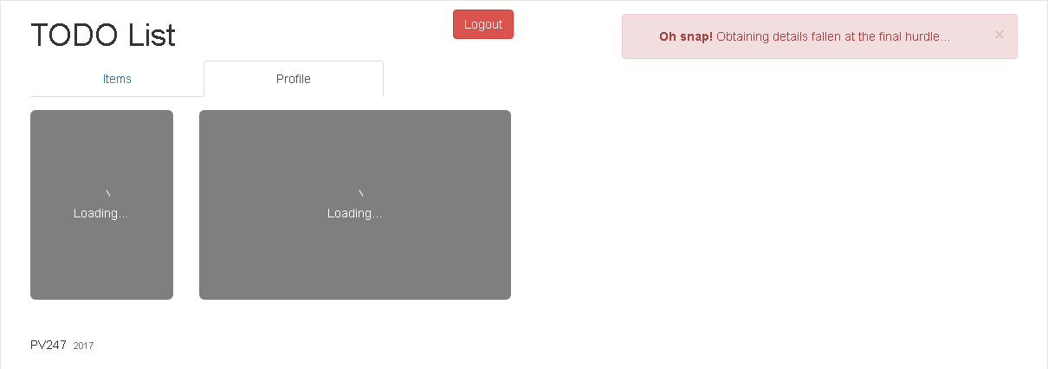
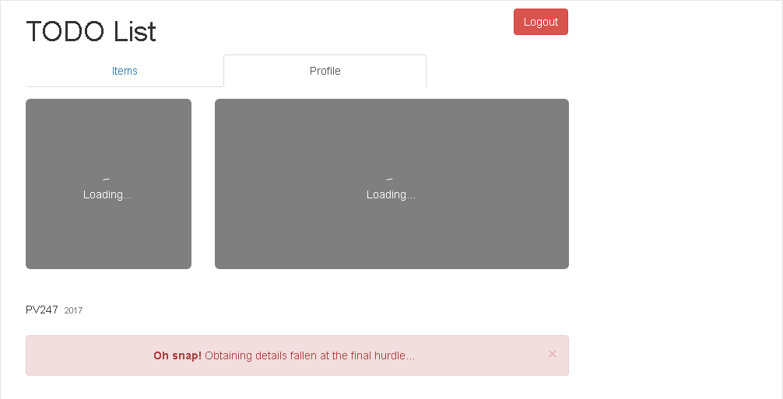
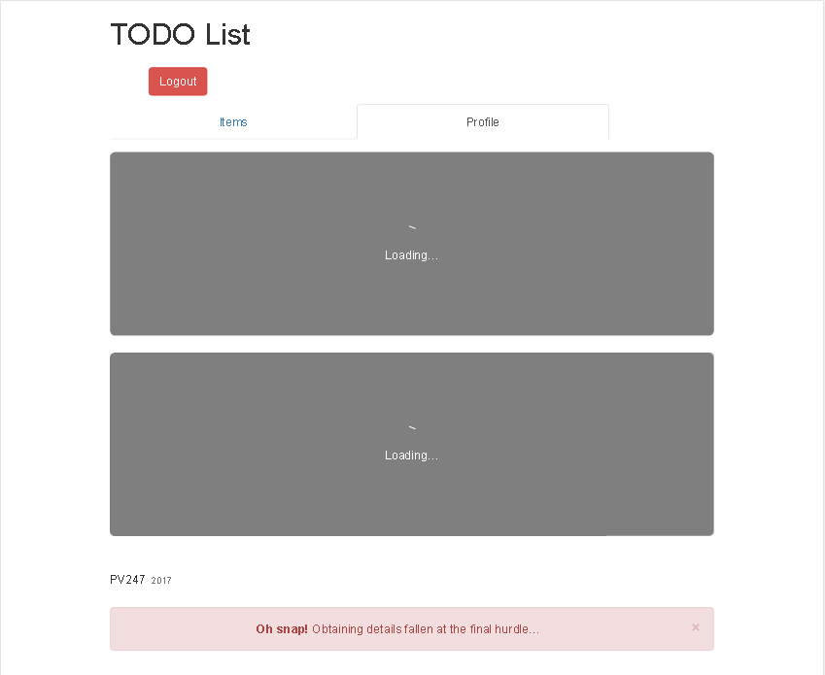
Layout
28-layout-tabs
Structure changes
strongly affected by bootstrap design
matter of taste/personal (dis)ability
Notes:
Just visual, clicking does nothing – hence routing

Slide 7
Routing philosophy
Static routing
Routes as component (single all-mighty switch)
pre-v4 react-router
Dynamic routing
Route as you render (per-component switch)
More aligned with React philosophy
v4 react-router
Read on:
https://reacttraining.com/react-router/core/guides/philosophy

Slide 8
react-router – different routers
29-react-router-basic
BrowserRouter
Based on HTML5 history API
Requires server handling dynamic requests (response to any possible URI)
HashRouter
Based on window.location.hash
Can be used with static websites (server-less)
MemoryRouter & StaticRouter – mostly used for testing
Read on:
https://medium.com/@pshrmn/a-simple-react-router-v4-tutorial-7f23ff27adf
https://reacttraining.com/react-router/web/api/Router
Notes:
See app.jsx
routes.js are not static routes, just bunch of string constants
Great docs on router, not so much on react (aweful code from time to time)

Slide 9
react-router – routing
29-react-router-basic
Route
path → [component¹|render¹|children²]
¹ - renders only when path matches ² - always renders
exact
no sub-path makes match
not by default
Enhances inner components‘ props
Link
Renders link to given route
Nastily customizable
Read on:
https://reacttraining.com/react-router/web/example/basic
https://reacttraining.com/react-router/web/api/Route
https://reacttraining.com/react-router/web/api/Link
Notes:
Add ./app/ to the Layout.jsx (ups O:-))
See Layout.jsx (SavingStatus dynamically routed) & Content.jsx & TabLink.jsx
routes.js are not static routes, just bunch of string constants
Great docs on router, not so much on react (aweful code from time to time)

Slide 10
With Redux
30-connected-react-router
react-router-redux (official plugin, but alfa only)→ connected-router-redux (same API)
Why
Enabled time-traveling
Allows changing route based on an user action (redux thunk)
Read on:
http://redux.js.org/docs/advanced/UsageWithReactRouter.html
https://github.com/supasate/connected-react-router
https://github.com/reactjs/react-router-redux
Notes:
Add ./app/ to the Layout.jsx (ups O:-))
Checkout Profile page addition first, see time-traveling before and after checkout of the tag

Slide 11
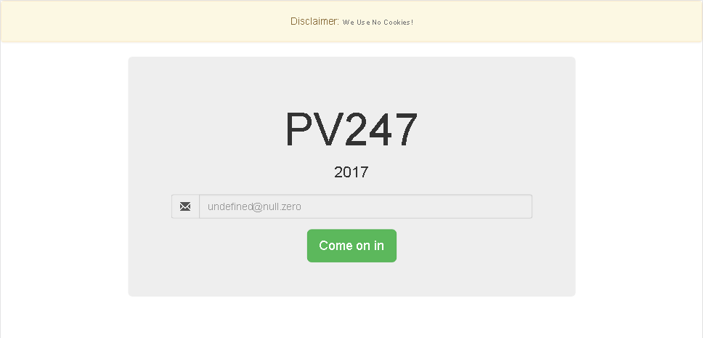
Complex example: Login page
31-login-page-example
Unauthenticated → login page
Authentication → persist token
Logout → a button
Support refresh → token in storage
Notes:
Checkout login page only first (/login route)
See LayoutSelector.jsx & AuthenticatedRoute & app.jsx
Checkout connecting
Start at actionCreators.js
Checkout local storage
See actionCreators & getPersistedToken.js

Slide 12
Page head
32-browser-history
Browser history shows static title (in great numbers)
Many sites requires/reads specific tags (SEO, social networks, …)
Read on:
https://github.com/nfl/react-helmet
Notes:
See browser history before checkout (title, title, title, title, …)

Slide 13
Forms

Slide 14
redux-forms
33-redux-forms
Most applications has something for user to fill in
Most react-redux application solve the same problems (and in the same way)
Field
Wrapper component
props.input & props.metadata
reduxForm
HoC like connect
static & dynamic configuration
Read on:
https://redux-form.com/7.0.1/docs/gettingstarted.md/
Notes:
Start at the web
Checkout Create Input – just refactoring
Checkout Connecting Details
See Details.jsx (container)

Slide 15
Merging classes
34-redux-forms-validation
Usually required when rendering eye-candy components (e.g. validate input fields)
Code becomes clutter with if statements (not so eye-candy in the inside)
NPM to the rescue (for example): https://www.npmjs.com/package/classnames

Slide 16
redux-forms - validation
34-redux-forms-validation
Validation
Field-level validation
code readability
Form-level validation
sort-of legacy
client-side validation in general speeds up UX & prevents unnecessary traffic
Server (async) validation
Some validations (e.g. uniqueness) need most up-to-date state to work properly
Form/App should not freeze only because of request
Read on:
https://redux-form.com/7.0.1/examples/fieldlevelvalidation/
https://redux-form.com/7.0.1/examples/asyncvalidation/
https://redux-form.com/7.0.1/examples/syncvalidation/
Notes:
Even more meta (data required)
See Input.jsx & Details.jsx & UpdatePane (to inform user)

Slide 17
Fetch

Slide 18
(Isomorphic) fetch
(36-fetch-get)
Replacement API for XMLHttpRequest
Provides way to make asynchronous calls via HTTP
Not support by all browsers
Good polyfill: https://www.npmjs.com/package/isomorphic-fetch
fetch is but a function (window.fetch)
Only connection failures are reported as errors
Requires promises to work, supports Node & Browserify
Read on:
https://github.com/github/fetch
https://developer.mozilla.org/en-US/docs/Web/API/Fetch_API
Notes:
See fetchReceive.js & validateResponse.js

Slide 19
Promises
(35-fetch-auth)
Promise is an object
Promise always returns Promise
Promise is always either: Pending or Fulfilled or Rejected
Represent eventual completion (or failure) of an asynchronous operation
Newly created Promise accepts resolve and reject callbacks
Object returned from a promise’s then/catch methods means new fulfilled promise
Object thrown from a promise’s then/catch methods means new rejected promise
Helps solving callback hell (pyramid of doom)
Read on:
https://developer.mozilla.org/en-US/docs/Web/JavaScript/Reference/Global_Objects/Promise
https://strongloop.com/strongblog/node-js-callback-hell-promises-generators/
https://github.com/stefanpenner/es6-promise

Slide 20
Complex example: Authentication
35-fetch-auth
Token authentication
API requires an email (no passwords in this API) before providing a token
Token is needed for all other API requests
Token expiration
API sends no information about token‘s expiration
Assume a time span when token is surely valid and throw token away after given time
This avoids unnecessary API call that will surely fail
Any call can still fail when token really expires → this indicates no further request will succeed → user should be logged out (this is not implemented in this example)
Read on:
https://developer.mozilla.org/en-US/docs/Web/HTTP/Headers/Authorization
https://scotch.io/tutorials/the-ins-and-outs-of-token-based-authentication
https://jwt.io/
https://www.npmjs.com/package/react-loader-advanced
Notes:
See api.js & fetchAuthToken.js & authenticateUser.js

Slide 21
Complex example: Get profile details
36-fetch-get
Load details from API
Data were pre-stored in customData field
Authenticated GET request is required by API
User should be logged out when token is invalid (status code 401)
User should be informed that an asynchronous operation is running
Show errors on the right side of the app
Notes:
Checkout Display generic Errors
See errors.js (reducer) & authenticateUser.js
Checkout Load real user details
api.js add: export const createApiUserUri = (userEmail) => `${API_URI}/${API_APP_ID}/user/${userEmail}`; (upss O:-))
errorActionFactory: add = {} to the errors (forgotten)
& disable connection
See fetchUserDetails & fetchReceive & Profile.jsx (component) & reducers

Slide 22
Async/await
(37-fetch-put)
Async functions always return Promise
Allows flattening nesting Promise hell
Allows using try-catch(-finally) to handle Rejected promises
Read on:
https://developer.mozilla.org/en-US/docs/Web/JavaScript/Reference/Statements/async_function
https://strongloop.com/strongblog/node-js-callback-hell-promises-generators/
https://hackernoon.com/6-reasons-why-javascripts-async-await-blows-promises-away-tutorial-c7ec10518dd9
https://babeljs.io/docs/usage/polyfill/

Slide 23
Complex example: Change profile details
37-fetch-put
User updates their details
API does not validate details in any way
stores them as a string in customData field
User should be notified the data are being stored since the operation can take some tike
Notes:
Checkout
Restart web-pack
See fetchRequest.js & UpdatePane.jsx & uploadUserDetails.js

Slide 24
Upload file
37.5-drop-zone, (38-fetch-post-file)
FormData API
react-dropzone
Allows handling file upload in a React way
https://www.npmjs.com/package/react-dropzone
Read on:
https://developer.mozilla.org/en-US/docs/Web/API/FormData
https://abandon.ie/notebook/simple-file-uploads-using-jquery-ajax
Notes:
Checkout
See withOverlay.js & AvatarLoader.jsx

Slide 25
Complex example: Upload avatar
38-fetch-post-file
Hovering over existing avatar shows an overlay
Overlay allows clicking or dragging an image in supported format to it
Image is uploaded to the server storage
User‘s custom data are updated with uploaded image id
Avatar is reloaded (new link is used)
Notes:
Checkout
See fetchFileUpload.js & uploadUserAvatar.js & fetchUserDetails.js & AvatarLoader.jsx

