Slide 1

Academic Communication Skills in English (DACSE)
Autumn Term 2018

Slide 2
DACSE 2018
course instructor
course administration
course introduction

Slide 3
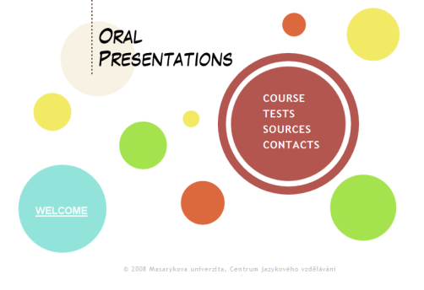
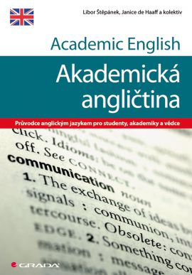
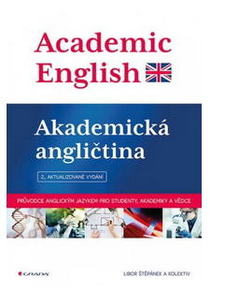
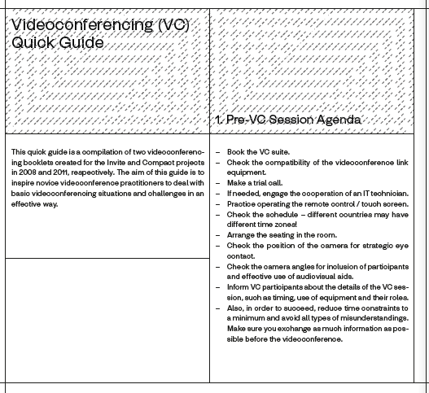
LIBOR ŠTĚPÁNEK (libor.stepanek@cjv.muni.cz)
Masaryk University Language Centre (CJV MU) Komenského nám 2
Education:
  MA in English
  (MA in History & PhD in Political Science)
Specialization and Research:
  Academic Public Speaking
  Academic Writing
  Creative Approach Language Teaching

Slide 4
course objectives
After completing this course you will be able to:
communicate effectively within the international academic community setting
be a successful participant of an international conference/meeting;
recognize various organizational patterns found in academic speaking;
adjust communication to different tasks;
write short formal academic texts.

Slide 5
course organisation
4 block sessions
theoretical input combined with diverse practical activities based on individual needs

Slide 6
materials
IS study materials
  face-to-face classes
IS (or other) discussion forum
  collaborative activities

Slide 7
requirements
Active participation in:
  presentations / talks / teaching sessions giving
  face-to-face discussions
  online discussions
  writing assignment

Slide 8
introduction

Slide 9
introduction
peer2peer → class

Slide 10
