Slide 1
Service Science and Relation to other disciplines
© Leonard Walletzký

Slide 2
On previous lesson
Knowing information
  Perfect, imperfect and asymmetric information
Knowing the behaviour of the others and rules
  Imperfect
  Incomplete
Searching and consequences
Information about price and quality
Auction models

Slide 3

Information gap
Subjects on the opposite sides of the market have a different information about the subject of exchange
  Seller has better information about the car
  The insurance company must trust in its clients responsibility
Information gap is the difference between two subjects on the market
  Is positive – if the subject knows the information
  Is negative – if the subject does not know the information

Slide 4
How to fit information gap?
Filling the gap
  By distribution of the information?
  Removal of subject‘s disadvantage, based on nascence of particular information
Subject must be willing to invest to filling of the gap
The first condition is to identify the gap
The filling is the function of time
Questions
  How will the subject fill the gap?
  Can the gap be filled by itself?

Slide 5
Filling the information gap
Absolute
  The information are distributed from one side to the other
  Example
    Register of insured persons
        To know a history of new client
    Register of debtors
        To eliminate to risky clients
Subjects facing negative gaps can join even if they are competitors

Slide 6
Filling the information gap
Relative
  If there is no way how to get the information
  Example
      Bankrupt of travel agency
        The client has no power nor possibility to find the information
      Mandatory insurance of travel agency
        The client does not need to take care about travel agency finance
      Mandatory car insurance
  Relative filling is the eliminating of the gap’s influence

Slide 7
Service Science and Management
Management is focused on
  Negotiations
  Finding source of the problem
  Competencies of the people
  Leadership
The most important is synergy

Slide 8
Synergy in management
To create synergy means
  Understand mission of the company
  Share the vision of the company
  Learn the strategy of the company
Any organization is example of service environment

Slide 9
Organization as service environment
Internal services
  Supporting main business of the company
    IT services, Cleaning services, Backup office, Accounting
  Representing relations between people
    Cooperation on the project
    Communication in the company
External services
  Services company buys or sells

Slide 10
Organization Service Environment
P
C
P
C
T
Provider
Client
T
P
C
T
Target

Slide 11
Management of Service company
A lot of new methodologies inpired by services
New business models
Switch from Business model Canvas to Lean Canvas

Slide 12
Business model Canvas

Slide 13
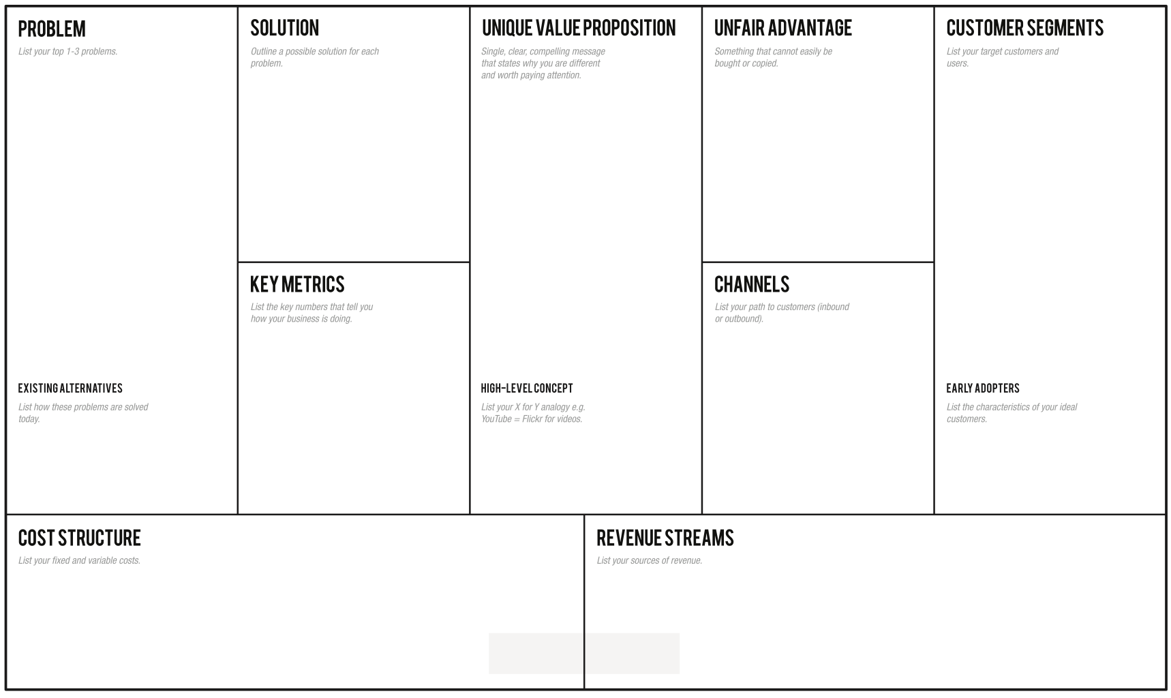
Lean Canvas

Slide 14
Service Science and Marketing
Marketing is complex tool
  how to promote your services
  How to set up communication
On some universities, service science is taken just like marketing tool
Service Science is more complex
It provoke the changes in understanding of marketing

Slide 15
Service Science and Marketing
The main changes to marketing thinking
  Always think about the customer
  Build long time relationship
  Involve the customer into value creation proces
Switch from pushing relationship to synergy relationship
  Relationship marketing
It always help in the building customer loyalty

Slide 16
Service Science and Economics
Economics of information
Service dominant logic is specific approach to economics reality
It does not change the basic economics principles
It looks to them from other point of view
Moral Hazard as the motivation of creating service systems

Slide 17
If the information gap is
More state regulations
The right to know must be protected
Misuse of information in business
Data privacy
GDPR
Support of innovations
Pleatforms to build new ways of knowledge management
Support of information sharing
Responsibility in the praivate data usage
Dissadvantage
Advantage

Slide 18
Service Science and Soft Skills
Key factor for multidisciplinarity approach
To be able to set up a service systém you need communication skills
  To understand the position of customer
  To find the problém
  To present correct solution
Service Science is affecting many other disciplines
Complete switch of the world understanding

Slide 19
Service Science and Soft Skills
Soft skills are mostly connected with
  Communication
  Behavior
  Cognitive methods
  Adaptation
In Service Science peaple also tend to call „Soft Skills“ all knowledge thai is not dominat

Slide 20
Service Science and IT
Gives meaning to IT
Analyzing environment
  Gives examples of data usage
  Is inseparable part of the environment development
Helps to develop IT supported services
Parent – child relation
Cooperative relation
Relation to information

Slide 21
Parent – child relation
SeS was developed on IT field
  We analyse knowledge and information intensive services (KIIS)
  Service Science means curricula, training, and research programs that are designed to teach individuals to apply scientific, engineering, and management disciplines that integrate elements of computer science, operation research, industrial engineering, business strategy, management sciences, and social and legal sciences, in order to encourage innovation in how organizations create value for customers and shareholders that could not be achieved through such disciplines working in isolation. (U.S. National Innovation Investment Act, 2007)
Notes:
Začít od konce
Definice SeS, důležitost poznala i vláda USA – je to podstatné pro společnost
Použít slovo multidisciplinární
Pozor – Jim Spohrer definuje Knowledge intensive and customized service

Slide 22
Cooperative relation
The purpose of IT is to provide service
  Usage of IT is a service
  It has power to support other services more than others
SeS helps to adapt the service for particular user
SeS says how to retain the user
SeS defines how the product's value is developed
The development of IT tools must not be purposeless (without specific aim)
The concrete IT experts need to have multidisciplinary knowledge
Notes:
Většina rozsáhlejších služeb se bez IT služeb neobejde
Product value – odkázat na SDL
Příklad – Staníček
Otázka, zda zvolit pozitivní nebo negativní přístup
Jak se dostanu k poslednímu bodu?
K všem bodům jsou třeba multidisciplinární znalosti – otázka, kdo je musí mít?

Slide 23
Relation to information
Work of informatics specialists is about work with information
    Do they know all semantics and consequences?
SeS is the reaction to moral hazard problem on IT market
  a tendency to take undue risks because the costs are not born by the party taking the risk
Double moral hazard
  If both subjects are mutually in the relationship that causes moral hazard problem
Notes:
Vysvětlení definice a její správné chápání vysvětlím na následujícím příkladu.

Slide 24
Conclusion
Management and Service Scinece
Marketing and Service Scinece
Economics and Service Scivence
IT and Service Science
Understanding the musltidisciplinarity

