Slide 1
Service Modeling
How to work in multidisciplinary teams?
© Leonard Walletzký, 2018

Slide 2
Universal modelling
CMM
metrics for process and products quality measurement
Accidental
Repeatable
Optimized
Defined
Managed
descriptions exists
experience from
the past
capability of
continual
process
improvement
base for process monitoring
comparing of projects
ad hoc,
non-formal
How long does it take for regular ISs to adjust
in order to support newly optimized processes?

Slide 3
Current Modelling Tools
Current CASE tools, BPMT, PMT, … allow to record only such objects and relationships, which had their creators in minds in the time when they were developing the tool.
Objects and relationships, we focus on when modeling various aspects of business, are continually changing.
Problem of effective communication within any IT project lies nearly always on boundaries of capability of a given modeling tool (… thus the model doesn’t represent the reality appropriately)
Except of some isolated cases, there are only few ways to extend used MT by constructs which are needed for current specific requirements.
A problem arises in integration of some partial views into one common view.

Slide 4
Meta-modelling
Generic MT
Domain-specific MT
Domain model
Ability to develop and adjust domain-specific modelling tools
Helps to construct the domain in terms comprehensible to domain experts
Hierarchy of modelling tools

Slide 5
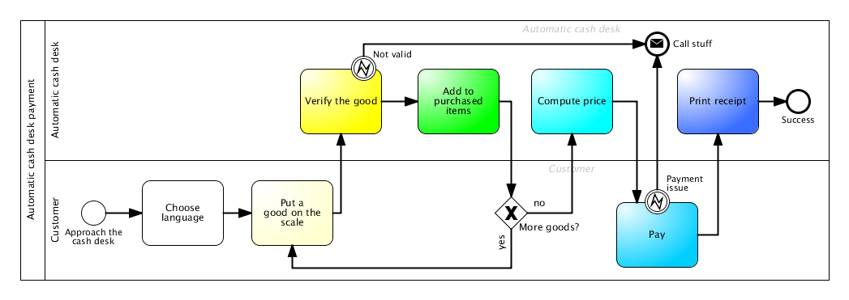
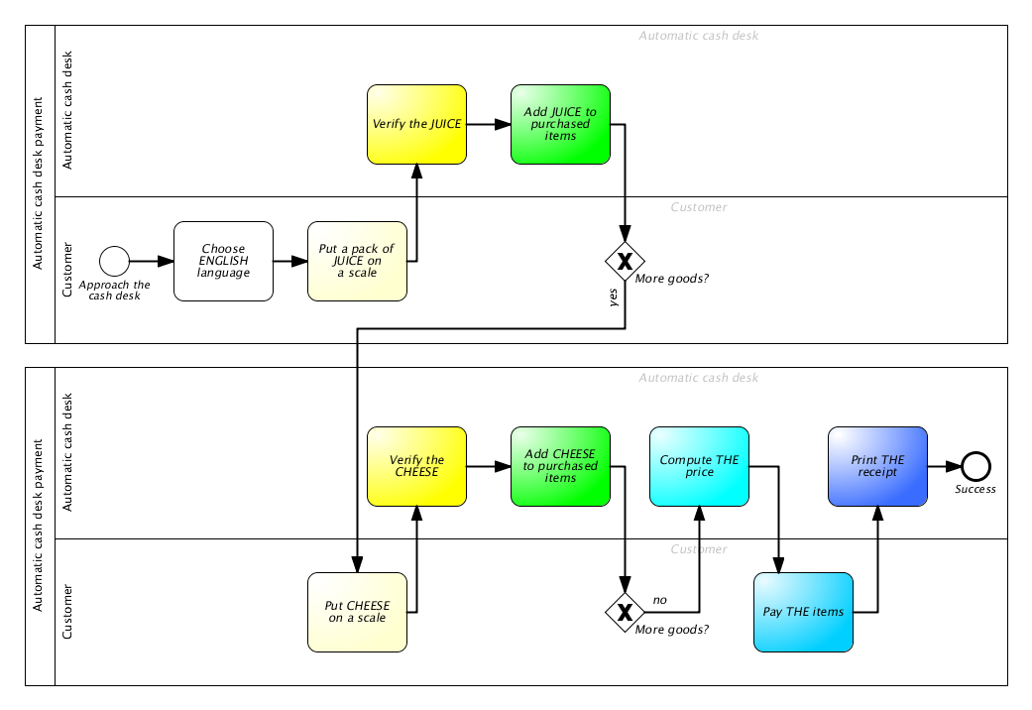

Slide 6
How do we model reality in our heads?
We identify...
Object
-s
...we find interesting

Slide 7
Then, we find...
Relationship
-s
...between our...
Object
-s

Slide 8
Each relationship can connect multiple objects...
Relationship
Relationship
Relationship
Object
Object
Object
...and each object can be present in multiple connections.

Slide 9
Each relationship can connect multiple objects...
Relationship
projection
Object
...and each object can be present in multiple connections.

Slide 10
Which objects do we find interesting for modelling?
Relationship
Category
Rule
Operation

Slide 11
MENTION – USE duality
Relationship
R
P
Category
R
Object
R
Rule
R
Operation

Slide 12
Diamond of Attention Focussing
Relationship
characteristic
characteristic
R
P
Category
R
Object
R
Rule
R
characteristic
characteristic
Operation

Slide 13
Diamond of Attention Focussing
Objects and relationships between them
Mention-use duality
  Modelling a modelling tool
  Referring to itself
Relationship
characteristic
characteristic
R
P
Category
R
Object
R
Rule
characteristic
R
characteristic
Operation

Slide 14
Classification example
killing
killing
Juliet
In love with
Romeo
In love with
killing
Paris

Slide 15
We can see that some connections are somehow similar – they belong to the same category:
killing
killing
Juliet
In love with
Romeo
In love with
killing
Paris

Slide 16
It‘s possible to classify everything we see in the diagram. But how to classify our objects?
killing
killing
Juliet
In love with
Romeo
In love with
killing
Paris

Slide 17
We could certainly divide the objects to men and women:
killing
killing
Juliet
In love with
Romeo
In love with
killing
Paris

Slide 18
But won‘t it be more useful to show, which chatacter belongs to the house of Montague and which one to the house of Capulet?
killing
killing
Juliet
In love with
Romeo
In love with
killing
Paris

Slide 19
It probably depends on a context – a mental model we want to build. Sometimes, both categorizations may be useful:
killing
killing
Juliet
In love with
Romeo
In love with
killing
Paris

Slide 20

Classifications are blurred
Good or bad?

Slide 21
Certainty
Items (= objects as such, not their constructs) belongs to a category with a given certainty
Category
CI-connection
Item

Slide 22
Attention
The fact is manifested with a certain attention in a given context
Category
CI-connection
Item
Context
Manifestation

Slide 23
R-edges
In some cases, it might be also useful to mention non-trivial concepts – contexts, categories, classifications or manifestations
Romeo killing Romeo
Resulting in
Juliet killing Juliet
Romeo belonging to Monteques
Romeo in love with Juliet
Juliet belonging to Capulets
Fact1
Fact2
Fact3
<fact1> and <fact2> and <fact3>
Story plot
Belonging to

Slide 24
R-edges
Category
R
CI-connection
Item
R
Context
R
R
Manifestation

Slide 25
Context base
Context serves as a model. The base edge defines the set of categories to classify its items to
Category
base
R
CI-connection
Item
R
Context
R
R
Manifestation

Slide 26
Example modelling tool: ERD
Attribute
Cardinality
Name
Entity attributes
Entity
Participants
Relationship
Associative entity

Slide 27
Attribute
Cardinality
Name
Entity attributes
Entity
Participants
Relationship
Associative entity
Forms category base for:
Phone no.
Date of birth
Name
Person

Slide 28
Attribute
Cardinality
Name
Entity attributes
Entity
Participants
Relationship
Associative entity
Here is a little more complex example of a model created in modelling tool above.
Phone no.
Name
Id
Date of birth
Working in
Name
Person
*
*
Company

Slide 29
Interconnected models
The same object classified to different categories, manifested in different context
Class diagram 1
ERD 1
Customer
Class diagram 1: Context
ERD 1: Context
Customer
-name: string
-address: string
-invoices: Invoice[]
1
Inv. As Class in CD1: Manifestation
Inv. As Entity in ERD 1: Manifestation
0..*
Invoice
Invoice as Class: CI-connection
Invoice as Entity: CI-connection
-cust: Customer
-good: string
-amount: int
-singlePrice: float
Invoice
-getTotal (): float
-print(): void
Class: Category
Invoice: Item
Entity: Category

Slide 30
Diamond-Path Framework
Overview
See
Recognize
Attention
Focussing
Cognitive
Elements
Relationship
Category
base
characteristic
characteristic
R
P
R
Category
R
Object
R
Rule
CI-connection
R
Item
R
Context
characteristic
R
characteristic
R
Operation
Manifestation

