Slide 1
Service Modeling II
© Leonard Walletzký

Slide 2
Why we need diamonds?
We need to describe things
And their relations
In some given context
Than we need to organize/plan operations
And execute them in some time perspective
Our natural language is
  Redundant
  Ambiguous

Slide 3
4 diamonds
See
  Describing things (objects) and basic relations
Recognize
  Adding context to relations
Organize
  How agents behave to recognized objects, what kind of operations we can do
Do
  Executing planned operations and getting results

Slide 4
See
We are describing the seen object
It has
  Particular shape or form
  There can be some different variets of this object
  It can be used for some purposes
  Using this object is under some rules
There can be connections to other objects

Slide 5
Which objects do we find interesting for modelling?
Relationship
Category
Rule
Operation

Slide 6
MENTION – USE duality
Relationship
R
P
Category
R
Object
R
Rule
R
Operation

Slide 7
Universality Principle Implementation
Edges R1, R2, R3 and R4 are together called R-edges. R-edges serve to perform transitions between mentioning and using and vice-versa.
If we focus on a concrete object of the class #Object, which was spoken of in a way (MENTION), then by the operation USE we will pass the relevant R-edge and we will reach represented sequence (#Connection) or operation (#Operation) or category (#Category) or rule (#Rule), which could be then directly used, or we will reach nothing.
If we focus any vertex of the Diamond graph on the other hand (which we used in a way - USE), then by the operation MENTION we will pass the relevant R-edge and we will reach this vertex representing object, which we can speak of directly.

Slide 8
Diamond of Attention Focussing
Relationship
characteristic
characteristic
R
P
Category
R
Object
R
Rule
R
characteristic
characteristic
Operation

Slide 9
Container (#Object)
Dmt-objects dwell in container (#Object) in Diamond. Containers used in Diamond will be defined by specification of their member elements.
Container (#Object) is deﬁned in such a way that it contains all such dmt-objects which can be mentioned in DMT, i.e. which can be assigned certain properties.

Slide 10
Container (#Connection)
Container (#Connection) is deﬁned in such a way that every of its elements is a sequence of the length n (n-tuple) of dmt-objects, where n is some ﬁnite natural number.
Every element of the container (#Connection) is called a connection or a sequence.
Container (#Connection) contains by definition one special element ⊥ called improper connection. It is not possible to determine objects constituting improper connection.

Slide 11
Container (#Operation)
Container (#Operation) is deﬁned in such a way that every of its elements is an algorithmically computable transformation of one state of DMT to, generally, another state of DMT.
By the state of DMT we mean one particular ﬁlling of DMT (as a container) by elements-instances, that may dwell in DMT.
We assume there always are two (boolean) objects in DMT, one of them codes True, the other False.
The elements of the container (#Operation) are called operations.
Some operations may fail, i.e. return object coding False, under certain circumstances and succeed under different circumstances. Some operations always succeed.

Slide 12
Container (#Category)
Container (#Category) is deﬁned in such a way that every of its elements has the following properties:
  1. it is a container for dmt-objects,
  2. it is one-to-one mapped to the pair <Cn, Op>, where
    Cn ∈ (#Connection), Op ∈ (#Operation), and
  3. it holds about the operation Op that by means of the connection Cn it can recognize whether a given object is or is not in this container.
The elements of the container (#Category) are called categories.
The connection Cn is called a deﬁning connection of this category, the operation Op is called a deﬁning operation or an evaluator of this category.

Slide 13
Certainty
Items (= objects as such, not their constructs) belongs to a category with a given certainty
Category
CI-connection
Item

Slide 14
Attention
The fact is manifested with a certain attention in a given context
Category
CI-connection
Item
Context
Manifestation

Slide 15
R-edges
Category
R
CI-connection
Item
R
Context
R
R
Manifestation

Slide 16
Context base
Context serves as a model. The base edge defines the set of categories to classify its items to
Category
base
R
CI-connection
Item
R
Context
R
R
Manifestation

Slide 17
3rd diamond
Organizing diamond
How is your life / position / work organized
How can be some agent
  Member of some team
  Work on projects
  Be educated or teach

Slide 18
Diamond of Agent-Team Organization
Goal
follower
establisher
Agent
author
learner
superior
collaborator
Activity

Slide 19
Goal
follower
establisher
Action
Agent
Flow
organizer
organizer
member
member
author
learner
superior
collaborator
Activity

Slide 20
Goal
reaching
reaching
fulfilling
fulfilling
follower
establisher
Action
Agent
Flow
organizer
organizer
member
member
author
learner
covering
superior
collaborator
focusing
Activity

Slide 21
GBS
Goal
reaching
reaching
fulfilling
fulfilling
follower
establisher
composite
Action
Agent
Flow
organizer
organizer
member
member
author
learner
covering
superior
collaborator
focusing
Activity
detail

Slide 22
GBS
R22
Goal
reaching
reaching
fulfilling
fulfilling
follower
establisher
composite
R11
Action
Agent
Flow
organizer
organizer
member
member
author
learner
covering
superior
collaborator
focusing
Activity
detail
R33

Slide 23
GBS
R22
Goal
reaching
reaching
fulfilling
fulfilling
follower
establisher
composite
R11
Action
Agent
Flow
organizer
organizer
member
member
author
learner
covering
superior
collaborator
focusing
R01
R02
Activity
detail
R33

Slide 24
Diamond of Organization
Summary
Matrix-based organization: Action vs. Flow
Activity vs. Action / Flow
R-edges
GBS
R22
Goal
reaching
reaching
fulfilling
follower
fulfilling
establisher
composite
R11
Action
Agent
Flow
organizer
organizer
member
member
author
learner
covering
superior
collaborator
focusing
R01
Activity
R02
detail
R33

Slide 25
4th Diamond - DO

Slide 26
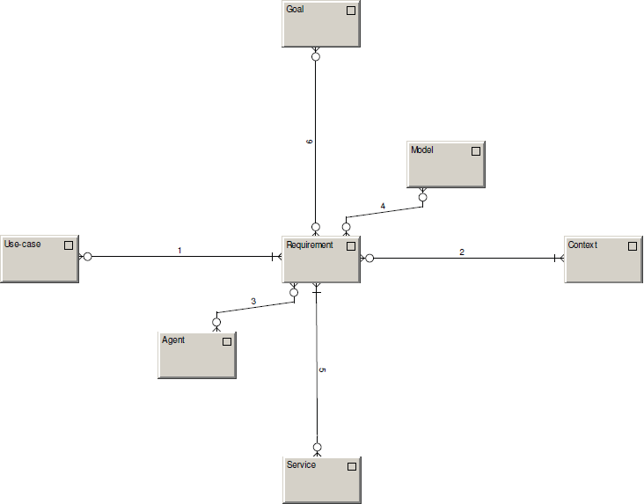
fulfilling
recorded in
forming / formed by
occuring within
addressing
solved by

Slide 27
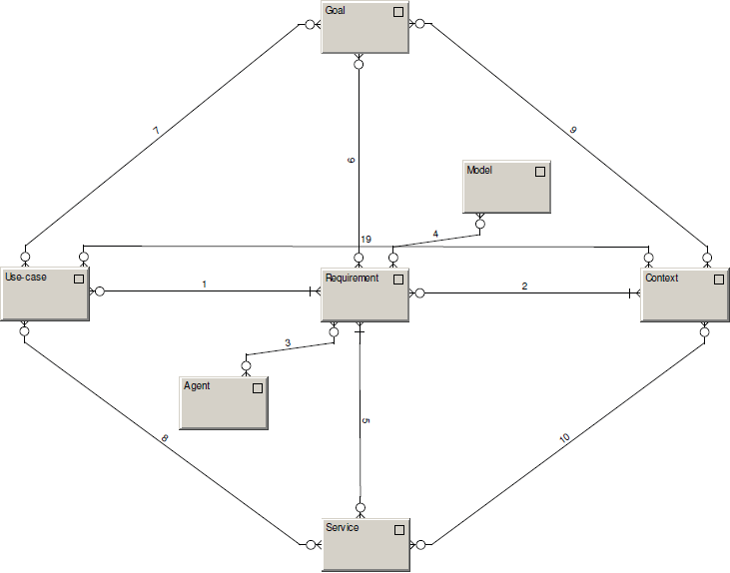
achievable within
achievable by
Identified within
creatable by
creatable within

Slide 28
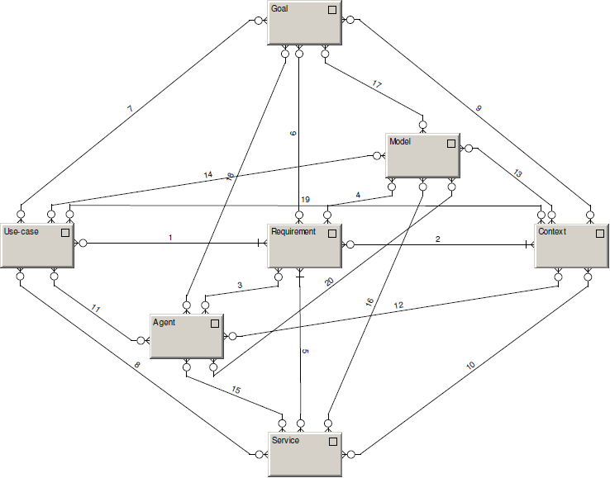
Model records.
Agent wishes, defines, does.

Slide 29
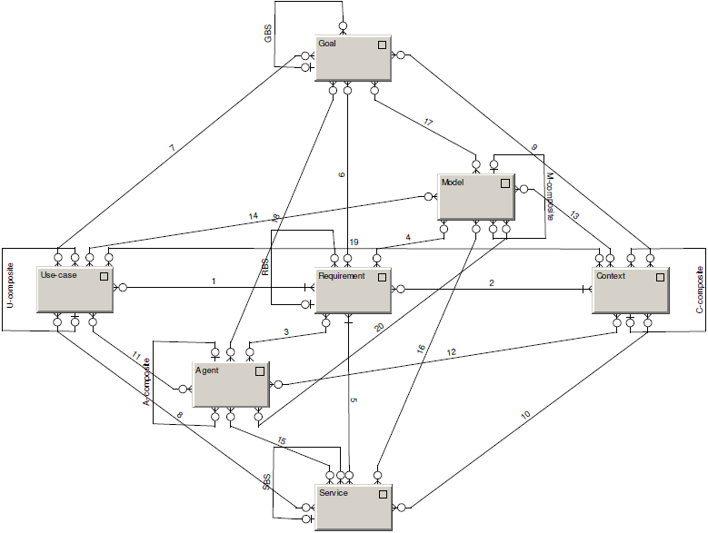
Composites

Slide 30
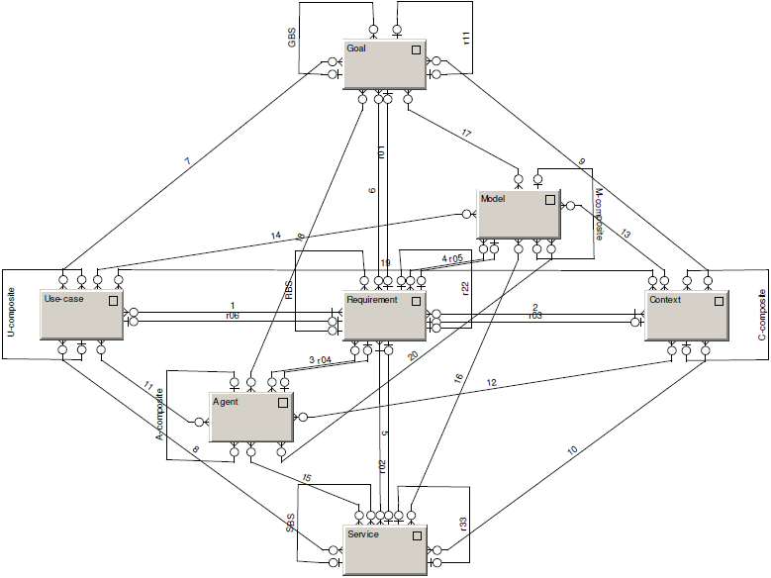
R-edges

Slide 31

Diamond of Predictive Behaviour
Depicts the motivation of agents to DO
Everything can be seen as a requirement
Forming and being formed by behavioral patterns
Models as a system memory

Slide 32
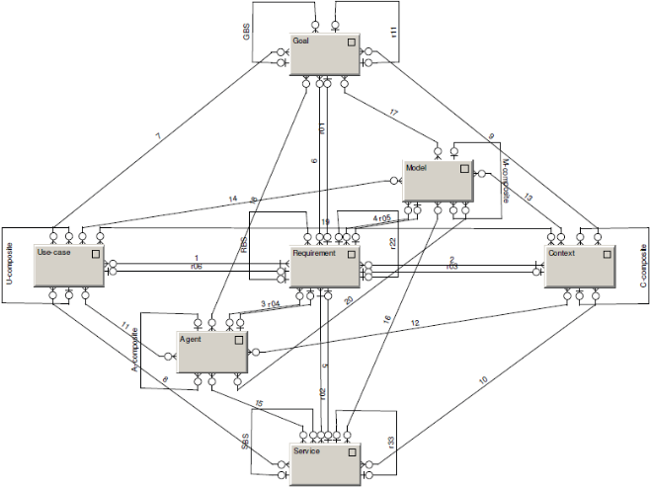
Diamond-Path Framework
Overview
See
Recognize
Organize
Do
Attention
Focussing
Cognitive
Elements
Agent-Team
Organization
Predictive
Behaviour
Category
base
R
CI-connection
R
Item
R
Context
GBS
R22
Relationship
Goal
characteristic
characteristic
R
reaching
reaching
fulfilling
follower
fulfilling
R
P
Manifestation
establisher
composite
R11
Category
R
Object
R
Rule
Action
organizer
Agent
organizer
Flow
member
member
author
learner
collaborator
characteristic
R
characteristic
covering
superior
focusing
Operation
R01
Activity
R02
detail
R33

Slide 33
Reflection
Do you find it interesting?
And useful?
Why has it remained a pure theoretical concept?
Is it too complex?

Slide 34
Follow-up Efforts
Several academical works, none has made it to the business practice
...with one exception

Slide 35
GridMind
Simulation environment designed to benchmark technological solutions of future-energy grids
Combines objects on various levels of abstraction
object
energy-grid element
secondary substation
BR_1234
Comprises a number of mental contexts: distribution network, communication network, information scope, devices, technical processes, ...
Very complex, difficult environment – worth systematical thinking

