Slide 1
Introduction to service marketing

Slide 2
Content of the course
Basic of marketing methodology
Management of marketing
Analysis of market environment
Marketing and work with information
Basic marketing tools (marketing mix)

Slide 3
Course evaluation
Team work
  Student will make a group of 2 – 4 members
  Prepare short presentation (5 minutes) of marketing of selected company (case)
  Try to answer:
    What is unique on this company (approach)?
    Why have you chosen it?
  The presentations will held at the beginning of each lesson.
Written exam at the end of the course

Slide 4
Definition
Marketing is defined by the American Marketing Association [AMA] as "the activity, set of institutions, and processes for creating, communicating, delivering, and exchanging offerings that have value for customers, clients, partners, and society at large."

Slide 5
Why should we concentrate to marketing of services?

Slide 6
Introduction to Services
What are services?
Why services marketing?
Service and Technology
Characteristics of Services Compared to Goods
Services Marketing Mix
Staying Focused on the Customer

Slide 7
Introduction to Services
Explain what services are and identify important trends in services.
Explain the need for special services marketing concepts and practices and why the need has developed and is accelerating.
Explore the profound impact of technology on service.
Outline the basic differences between goods and services and the resulting challenges and opportunities for service businesses.

Slide 8
Examples of Service Industries
Health Care
  hospital, medical practice, dentistry, eye care
Professional Services
  accounting, legal, architectural
Financial Services
  banking, investment advising, insurance
Hospitality
  restaurant, hotel/motel, bed & breakfast
  ski resort, rafting
Travel
  airline, travel agency, theme park
Others
  hair styling, pest control, plumbing, lawn maintenance, counseling services, health club, interior design

Slide 9
Contributions of Service Industries to
Gross Domestic Product

Slide 10
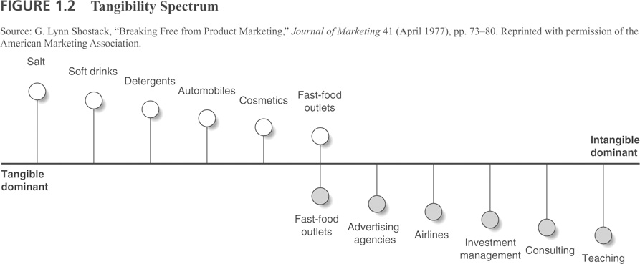
Tangibility Spectrum

Slide 11
Overview: Why Services Matter
Services dominate EU and worldwide economies
Services are growing dramatically
Service leads to customer retention and loyalty
Service leads to profits
Services help manufacturing companies differentiate themselves

Slide 12
Why do firms focus on Services?
Services can provide higher profit margins and growth potential than products
Customer satisfaction and loyalty are driven by service excellence
Services can be used as a differentiation strategy in competitive markets
Notes:
Jerome
The are 3 main reasons why our program is focusing on services.
It provides a higher profit margin than tangible products,
Increases satisfaction and retention,
Provides a competitive advantage over others.
I am going to use two examples to illustrate these points.
The automotive industry has typically been perceived as a manufacturing industry. However,
after-sale services and parts account for nearly 80% of all revenue opportunities, and more than 50% of the average automobile dealer’s profits
It is by far the largest creator of shareholder value on a percentage basis. A GM study revealed that $9 billion in after sale revenue produced $2 billion in profits (22% margin). Profits from $150 billion car sales were much lower.
JD Power and Associates published a report showing a strong correlation between customer satisfaction with after-sale services and customer intent to repurchase the same brand (Lexus and Saturn cars)
Hyundai’s success is due largely to its differentiation strategy of offering 10 year - 100,000 mile guarantee. The service offering is changing customer’s perception of the brand
The same can be said about the personal computer industry.
With the advancement of technology, personal computers are now becoming more and more of a commodity. While 25% of revenue opportunities are in the initial sale, most revenue opportunities are from after-sale.
Company responsiveness to customer calls is the biggest driver customer satisfaction with its product.
Dell revolutionized the industry by being the first to offer mass customization of personal computers.
-------------------------
Across manufacturing companies, after-sale services and parts contributes about 25% of total revenue, and 40%-50% of all profits
Services related revenue exceeds first-time product sales by 500% - 2000%
Retail industry derive largest margins from sale of extended warranties
It is a program that is designed in response to a business environment that is increasingly moving away from a product orientation to a service-focus
GE, IBM other good examples.

Slide 13
Why study Services Marketing?
Service-based economies
Service as a business imperative in manufacturing and IT
Deregulated industries and professional service needs
Services marketing is different
Service equals profits

Slide 14

What is Service? The Old View
Service is a technical after-sale function that is provided by the service department.
Old:
Service =
wrench time
Old view of service =
Customer Service Center
Notes:
14

Slide 15
What is Service? The New View
Service includes every interaction between any customer and anyone representing the company, including:
Dealers
Salespeople
Receptionists and Schedulers
Management and Executives
Service Employees
Billing and Accounting Personnel
Web site and any e-channel Interaction
Customer
Notes:
15

Slide 16



Service Can Mean all of These
 | Directory
 | Academic Areas
 | Centers & Institutes
 | The Kenan Institute
 | Contact Us
 | Kenan-Flagler Gear
Service as a product
Customer service
Services as value add for goods
Service embedded in a tangible product
 | UNC | | | UNC Directory | | | Site Map | | | Equal Opportunity Policy | | | Terms of Use & Privacy Policy | | | Webmaster

Slide 17
Characteristics of Services
Compared to Goods
Intangibility
Heterogeneity
Simultaneous
Production
and
Consumption
Perishability

Slide 18
Implications of Intangibility
Services cannot be inventoried
Services cannot be easily patented
Services cannot be readily displayed or communicated
Pricing is difficult

Slide 19
Implications of Heterogeneity
Service delivery and customer satisfaction depend on employee and customer actions
Service quality depends on many uncontrollable factors
There is no sure knowledge that the service delivered matches what was planned and promoted

Slide 20
Implications of Simultaneous Production and Consumption
Customers participate in and affect the transaction
Customers affect each other
Employees affect the service outcome
Decentralization may be essential
Mass production is difficult

Slide 21
Implications of Perishability
It is difficult to synchronize supply and demand with services
Services cannot be returned or resold

Slide 22
Comparing goods and services
Goods | Services | Resulting Implications
Tangible | Intagible | Services cannot be inventoried. Services cannot be easily patented. Services cannot be readily displayed or communicated. Pricing is difficult.
Standardized | Heterogenous | Service delivery and customer satisfaction depend on employee and customer actions Service quality depends on many uncontrollable factors. There is no sure knowledge that the service delivered matches what was planned and promoted
Production separate from consumption | Simultaneous production and consumption | Customers participate in and after the transaction. Customer affect each other. Employees affect the service outcome. Decentralization may be essential. Mass production is difficult.
Nonpershable | Pershable | It is difficult to synchronize supply and demand with services. Services cannot be returned or resold.

Slide 23
Challenges for Services
Defining and improving quality
Ensuring the delivery of consistent quality
Designing and testing new services
Communicating and maintaining a consistent image
Accommodating fluctuating demand
Motivating and sustaining employee commitment
Coordinating marketing, operations, and human resource efforts
Setting prices
Finding a balance between standardization versus customization

Slide 24







Examples of Goods Companies that are Expanding into Services

Slide 25
Thank you for the attention

