Slide 1
Quality of Service in Marketing
Mouzhi Ge
PV240 Introduction to Service Marketing

Slide 2
Learning Objectives
Evaluation for marketing purpose
Understand the importance of QoS
Position service quality in information systems
Describe the five dimensions of service quality
Understand the gap model in QoS
Perform SERVQUAL deployment
Able to plan for service recovery
Perform a walk-through in SERVQUAL and RATER
Evaluation
Position
Measurement
Model
Summary

Slide 3
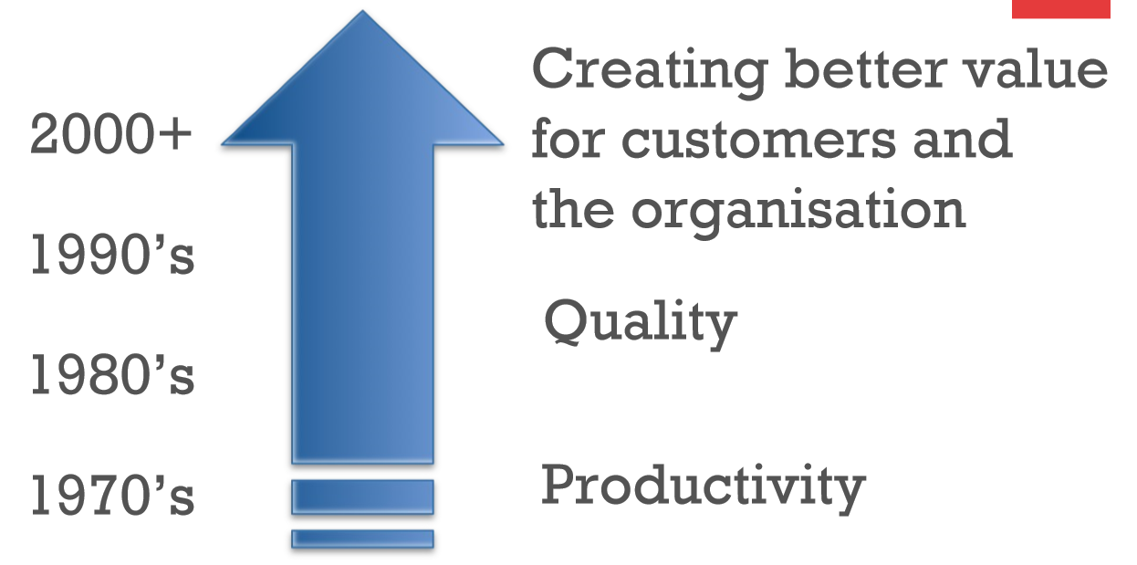
Marketing focus shifting

Slide 4
Motivation in Marketing
Superior product/service quality relative to competitors is the most important factor affecting profitability (Profit Impact of Market Strategy - PIMS study)
Premium prices
Customer preference
Customer retention
Market expansion/market share
Other benefits: productivity, advertising, distribution/access

Slide 5
Concept to clarify: Quality
“although we cannot define quality, we know what quality is” (Pirsig, 1987)
“quality is fitness for use, the extent to which the product successfully serves the purpose of the user during usage” (Juran, 1974)
“quality is zero defects - doing it right the first time”, Parasuraman, Zeithaml and Berry, 1985)
“quality is exceeding what customers expect from the service”, Zeithaml, Parasuraman and Berry, 1990)

Slide 6
Quality in practice
Conformance quality
  producing the product/service according to specification every time, with no correction required
Quality-in-use
  customer judgements about quality received and resultant level of customer satisfaction
Technological quality
  superior performance features of product/service derived from advanced new technologies

Slide 7
Service Quality – early definitions
"service quality results from a comparison of what customers feel a service provider should offer (i.e. their expectations) with the provider’s actual performance" (Parasuraman, 1996: 145)
"Service quality is a measure of how well the service level delivered matches customer expectations. Delivering quality service means conforming to customer expectations on a consistent basis" Lewis and Booms (1983)

Slide 8
Service Quality - shifting focus
In the past, industry focused particularly on defining and meeting internal quality or technical standards
Today the focus has shifted to quantifying customers’ assessments of services and products (external measurement) and then translating these into specific internal standards
Delivering quality service is fundamental to corporate success because research shows it is closely linked to profits

Slide 9
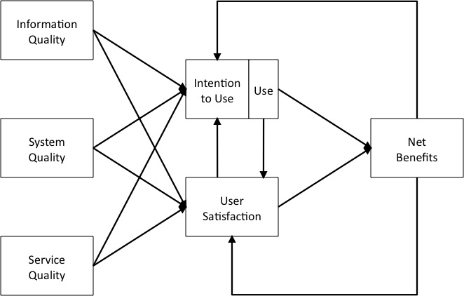
QoS in Information Systems
Delone and Mclean, Information Systems Success Theory

Slide 10
Service Quality – profits
Increase profits, particularly to:
  fewer customer defections
  stronger customer loyalty
  more cross-selling of products and services
Improving service quality cuts costs
  fewer customers to replace
  less corrective work to do
  fewer inquiries and complaints to handle
  lower staff turnover and dissatisfaction

Slide 11
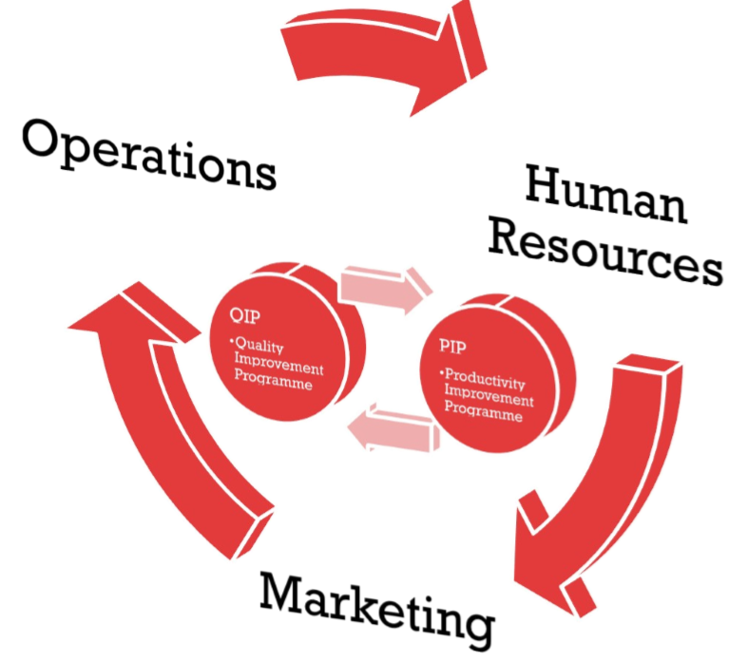
Enhancing service value

Slide 12
Concept to clarify: Evaluation
There are two types of evaluations
(1) Get a concrete score, like your exam
(2) Comparision
We mainly focus on (2) Comparision today

Slide 13
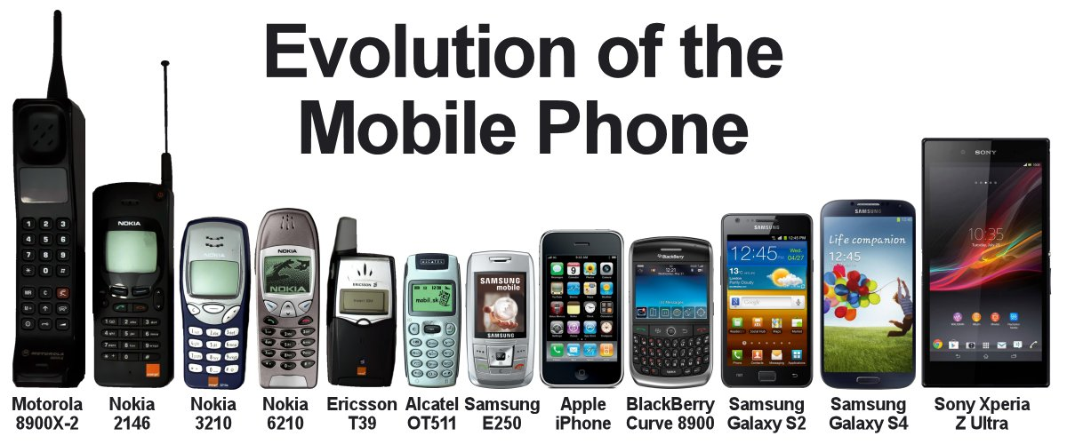
Comparision in real life

Slide 14
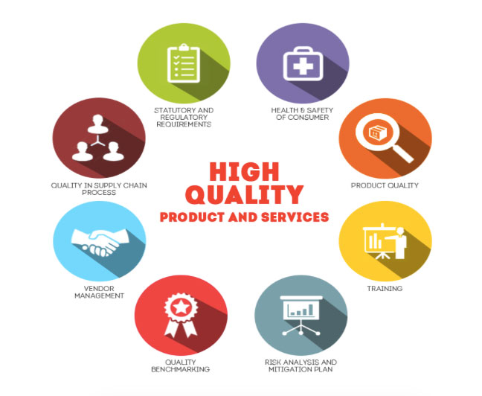
Service Quality or Quality of Service

Slide 15
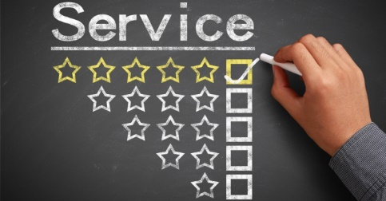
How good your service is?
When there is certain service, how good this service is?

Slide 16
Scope of Service Quality
View quality from five perspectives
  Content – are standard procedures being followed?
  Process – is the sequence of events in the service process appropriate?
  Structure – are the physical facilities and organizational design adequate for the service?
  Outcome – what change in the status has the service effected? Is the consumer satisfied?
  Impact – what is the long-range effect of the service on the consumer?

Slide 17
Service Quality Example
Hotel example
Supporting facility
  Design of the building
Facilitating goods
  Room furnishings like: bedside tables, carpet cleaning
Explicit services
  Maids are trained to clean and make up rooms
Implicit services
  Pleasant appearances of individuals at front office

Slide 18
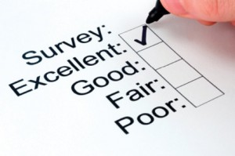
Evaluation of Service Quality
Metircs/Criteria/Dimensions

Slide 19
Service Quality
Reliability
Responsive-ness
Empathy
Tangibles
Assurance
SERVQUAL

Slide 20
SERVQUAL: The Five Key Service Dimensions
Dimension | No. of Items in Questionnaire | Definition
Reliability | 5 | The ability to perform the promised service dependably and accurately
Assurance | 5 | The knowledge and courtesy of employees and their ability to convey trust and confidence
Tangibles | 4 | The appearance of physical facilities, equipment, personnel and communication materials
Empathy | 5 | The provision of caring, individualized attention to customer
Responsiveness | 4 | The willingness to help customers and to provide prompt service

Slide 21
Dimensions of Service Quality (1)
Reliability:
  Perform promised service dependably and accurately.
  Example: receive mail at same time each day.
Responsiveness:
  Willingness to help customers promptly.
  Example: avoid keeping customers waiting for no apparent reason.
  Quick recovery, if service failure occurs

Slide 22
Dimensions of Service Quality (2)
Assurance:
  Ability to convey trust and confidence.
  Give a feeling that customers’ best interest is in your heart
  Example: being polite and showing respect for customer.
Empathy:
  Ability to be approachable, caring, understanding and relating with customer needs.
  Example: being a good listener.
Tangibles:
  Physical facilities and facilitating goods.
  Example: cleanliness.

Slide 23
SERVQUAL Attributes
RELIABILITY
EMPATHY
Providing service as promised
Dependability in handling customers’ service problems
Performing services right the first time
Providing services at the promised time
Maintaining error-free records
Giving customers individual attention
Employees who deal with customers in a caring fashion
Having the customer’s best interest at heart
Employees who understand the needs of their customers
Convenient business hours
RESPONSIVENESS
Keeping customers informed as to when services will be performed
Prompt service to customers
Willingness to help customers
Readiness to respond to customers’ requests
TANGIBLES
Modern equipment
Visually appealing facilities
Employees who have a neat, professional appearance
Visually appealing materials associated with the service
ASSURANCE
Employees who instill confidence in customers
Making customers feel safe in their transactions
Employees who are consistently courteous
Employees who have the knowledge to answer customer questions
4-23

Slide 24
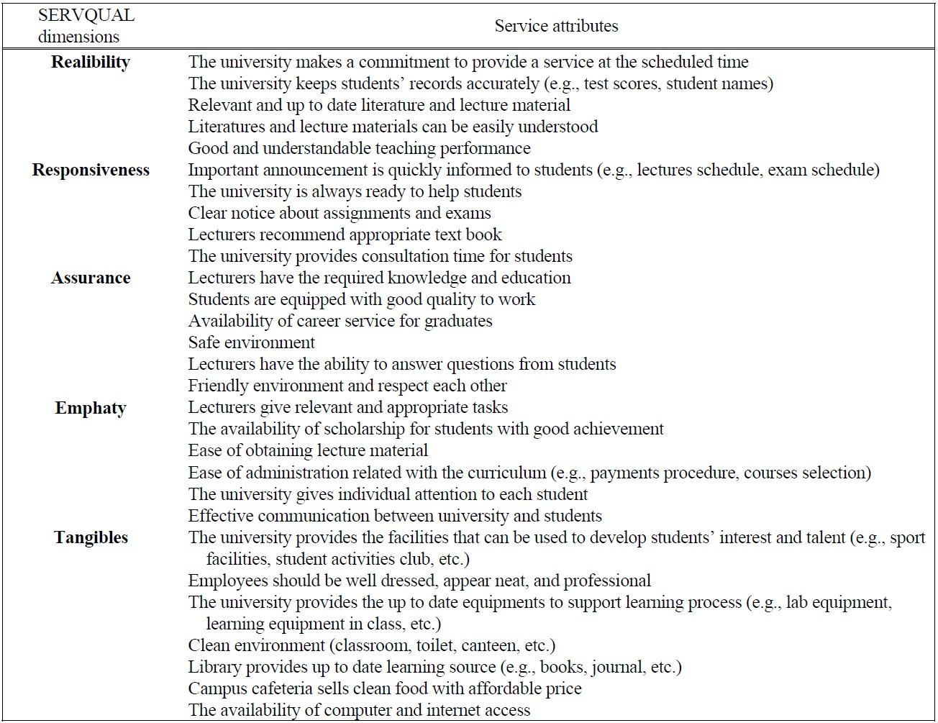
SERVQUAL Example in University

Slide 25
Gap Model in Service Quality

Slide 26
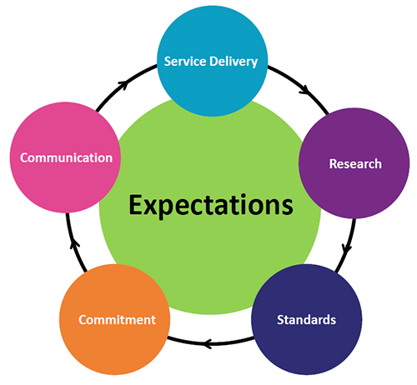
Concept to clarify: Expectation
Expectations can be formulated in terms of “what should be done” and “what will be done”

Slide 27
Concept to clarify: Perception
“perception is defined as the process by which an individual selects, organizes and interprets stimuli into a meaningful and coherent picture of the world” (Schiffman and Kanuk, 1987)
subjective and selective
resulting attitudes about a particular service provider may change over time (long-term attitudes may be more stable than immediate attitudes)

Slide 28
Word of
mouth
Personal
needs
Past
experience
Service Quality
Dimensions
Reliability
Responsiveness
Assurance
Empathy
Tangibles
Expected
service
Service Quality Assessment
1. Expectations exceeded
ES<PS (Quality surprise)
2. Expectations met
ES~PS (Satisfactory quality)
3. Expectations not met
ES>PS (Unacceptable quality)
Perceived
service

Slide 29
Gap Model of Service Quality
CUSTOMER
Word-of-mouth
Communications
Personal Needs
Past experience
Expected Service
Gap 5
Perceived Service
PROVIDER
Service
Delivery
External
Communications
To Customers
Gap 4
Gap 3
Gap 1
Service Quality
Specs
Gap 2
Management
Perceptions of
Customer Expectations

Slide 30
What are the Servqual Gaps?
Gap 1: The difference between management perceptions of what customers expect and what customers really do expect
Gap 2: The difference between management perceptions and service quality specifications - the standards gap

Slide 31
What are the Servqual Gaps?
Gap 3: The difference between service quality specifications and actual service delivery - are standards consistently met?
Gap 4: The difference between service delivery and what is communicated externally - are promises made consistently fulfilled?

Slide 32
What are the Servqual Gaps?
Gap 5: The difference between what customers expect of a service and what they actually receive
  expectations are made up of past experience, word-of-mouth and needs/wants of customers
  measurement is on the basis of two sets of statements in groups according to the five key service dimensions

Slide 34
Problems with Gaps in Service Quality
Gap1: Market research gap
  Management may not understand how customers formulate their expectations from past experience, advertising, communication with friends
    Improve market research
    Foster better communication between employees and its frontline employees
    Reduce the number of levels of management that distance the customer
Gap 2: Design gap
  Management unable to formulate target level of service to meet customer expectations and translate them to specifications
    Setting goals and standardizing service delivery tasks can close the gap

Slide 35
Problems with Gaps in Service Quality
Gap 3: Conformance gap
  Actual delivery of service cannot meet the specifications set by management
    Lack of teamwork
    Poor employee selection
    Inadequate training
    Inappropriate job design
Gap 4: Communication gap
  Discrepancy between service delivery and external communication
    Exaggerated promises in advertising
    Lack of information provided to contact personnel to give customers

Slide 36
Problems with Gaps in Service Quality
Gap 5: Customer expectations and perceptions gap
  Customer satisfaction depends on minimizing the four gaps that are associated with service delivery

Slide 37
Summary for Service Quality

Slide 38
Methodology of SERVQUAL
The method essentially involves conducting a sample survey of customers so that their perceived service needs are understood.
For measuring their perceptions of service quality for the organization in question, customers are asked to answer numerous questions within each dimension that determines:
  The relative importance of each attribute.
  A measurement of performance expectations that would relate to an “excellent” company.
  A measurement of performance for the company in question.
This provides an assessment of the gap between desired and actual performance. This allows an organization to focus its resources where necessary and to maximize service quality whilst costs are controlled

Slide 39
Functions of SERVQUAL
To assess a company's service quality along each of the 5 SERVQAL dimensions. E.g. XYZ Events Ltd carries out the servqual survey to know where it stands in the perception of customers.
To track customer's expectations and perceptions over time. E.g. XYZ Events Ltd wants to compare its score of last year against that of the current year to know whether it has improved or has to improve
To compare a company's SERVQUAL scores against competitors. E.g.: XYZ Events Ltd wants to compare its score against that of 1570 Events Ltd to see who is the best.
To identify and examine customer segments that differ significantly in their assessment of a company's service performance.
To assess internal service quality (interdepartmental comparison)

Slide 40
Applications of SERVQUAL
Service quality has become an important research topic because of its apparent relationship to costs, profitability, customer satisfaction, and customer retention
SERVQUAL has been a keyword in 41 publications which incorporate both theoretical discussions and applications of SERVQUAL in a variety of industrial, commercial and not-for-profit settings.
Some of the published studies include :
Hotels ,travel and tourism
Car servicing, business schools
Accounting firms, architectural services
Airline catering
Mobile Telecommunications in Macedonia

Slide 41
Summary
SERVQUAL is considered to be useful model for qualitatively exploring and assessing customers' service experiences
It is an efficient model in helping an organization shape up their efforts in bridging the gap between perceived and expected service
SERVQUAL is used to track customer's expectations and perceptions over time to compare the company's SERVQUAL scores against competitors.
Although SERVQUAL's face and construct validity are in doubt, it is widely used in modified forms (RATER) to measure customer expectations and perceptions of service quality.

Slide 42
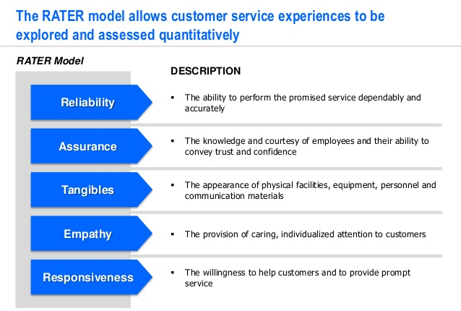
RATER

Slide 43
Remarks for SERVQUAL
We can assess service quality from the customer’s perspective
We can track customer expectations and perceptions over time and the discrepancies between them
We can compare a set of Servqual scores against those of competitors or best practice examples

