Slide 1
Marketing Information Systems: part 1
Course code: PV250
Dalia Kriksciuniene, PhD
Faculty of Informatics, Lasaris lab., ERCIM research program

Slide 2
Syllabus 1
Marketing domain area
The user’ requirements for the information content, inputs, retrieval and presentation
Definitions, functions, requirements for the marketing information systems (MKIS).
MkIS structure and concepts
Investigation of the theoretical and experimental research in MkIS area in the scientific literature.

Slide 3
Marketing as a domain area
Many definitions of marketing- different accents (AMA-American marketing association defines)
Marketing is a social process by which individuals an groups obtain what they need and want through creating and exchanging products and value with others (Kotler, Turner, 1985)
Keywords:
Needs, wants, demands
Products
Values and satisfaction
Exchange and transactions
Markets

Slide 4
Needs, wants, demands
Need is a state of felt deprivation of some basic satisfaction
E.g. food, clothing –things of survival. These needs are not created by society or marketers, they exist n human biology
Wants are desires for specific satisfiers of deeper needs.
They are different is various societies: a person needs food and wants oyster, needs clothing and wants a Chanel outfit, needs esteem and wants fancy necklace. Wants are continuously reshaped by social forces and communities (families, schools, church, etc.)

Slide 5
Needs, wants, demands
Demands are wants for specific products that are backed up by an ability and willingness to obtain them by exchange.
Wants become demands when backed up by purchasing power.
Companies have to measure not only how many people want their product but how many would actually be willing and able to buy it.

Slide 6
Needs, wants, demands
These distinctions answer frequent critics for marketing “marketers create needs” or “marketers get people to buy things they don’t want”.
Marketers do not create needs- they preexist marketers. E.g. marketers do not create need for social status.
Along with other influential forces marketers influence wants. They suggest to consumers or try to point out how particular product would satisfy need (e.g. BMW car or Parker pen for satisfying need for social status)
Marketers try to influence demand by making product attractive, affordable, available

Slide 7
Products
Broad understanding of product : anything that can be offered to someone to satisfy a need or want.
Product as a physical object serves as a vehicle for getting service (e.g. car for riding it).
Services are carried by other vehicles such as persons, places, activities, organizations, ideas. Product covers all vehicles that are capable of delivering satisfaction of a want or need
Tangible and intangible products. Other terms for product: offer, satisfier, resource.

Slide 8
Values and satisfaction
How do consumers choose among the products that might satisfy a given need ?
E.g. how can we travel ? By foot, roller skates, bicycle, car, plane or cruise ship.
The list makes a choice set.
According it we make a product set
The goal set which we want to satisfy in need for traveling, e.g. speed, cost, ease. Each product has difference capacity to satisfy goals.
What is the ideal product ?
Product space is the rating of products by customer perception how far is is from ideal. Value (or utility) is greater if product is nearer to ideal

Slide 9
Exchange and transactions
Marketing exists when people decide to satisfy needs and wants in way we call exchange.
Four ways of exchange:
Self production (e.g. relieve hunger by fishing) - no marketing, as there is no interaction
Coercion (e.g. wrest food from other) – no benefit is offered to other party
Begging (e.g. approach other)- no tangible to offer, except gratitude
Exchange (offer resource in exchange for good: money, another good, service)- marketing arises from this approach

Slide 10
Exchange and transactions
Exchange is the defining concept underlying marketing- the act of obtaining desired product from someone offering something in return
Terms for exchange: leave them both better or not worse, that’s why exchange is a value creating process
Exchange has to be seen as a process not event (two partied finding each other, negotiating, moving towards agreement)
If the agreement is reached, transaction occurs.

Slide 11
Markets
Economist view: market is the place where buyers and sellers gather
Marketers view: market consists of all potential customers sharing a particular need or want, able for exchange to satisfy it.
Market are seen as buyers (their groupings), the sellers-as industry. They are connected with flows:
Communication
Products (goods/services)
Money
Information

Slide 12
Summary of marketing concepts
Marketing means human activity that takes place in relation to markets.
Marketer seeks for resource form someone and willing to offer something of value in exchange.
Marketer is seeking response from other party, and can take a role of seller or buyer.

Slide 13
Marketing management
It is the analysis, planning, implementation and control of programs
designed to create, build, and maintain beneficial exchanges and relationships with target markets
for the purpose of achieving organizational objectives
The organization forms the idea of a desired level of transactions with the target market. It has a task of influencing the level, timing, composition of demand according to goals.
States of demand to cope: negative absent, latent, falling, irregular, full, overfull, unwholesome demand

Slide 14
Marketing management concepts
Marketing orientation | Focus | Means | Ends
Production concept | Mass production lowering costs and price | High production efficiency and wide distribution coverage | Sell what is produced. Leads to impersonality of consumer
Product concept | Consumer favors only products that offer most quality, performance and features | Make good products and improve them over time | Sell what producers “love” cause marketing “myopia” losing sight what customer wants
Selling concept | Product | Selling and promotion | Profits through sales volume
Marketing concept | Meet customer needs | Integrated marketing | Profits through customer satisfaction.
Societal marketing concept | Determine customer needs | Deliver needs fulfillment better than competitors | Preserve and ensure long-run society welfare

Slide 15
Marketing’s role in a company
Equal function or primary four: marketing, production, finance, personnel
More important function
Central major function
Customer –central function for controlling 4 primary functions
Customer as controlling, marketing and integrative function in the centre

Slide 16
Marketing’s role in a company
Production
Finance
Marketing
Personnel
Marketing
Production
Finance
Personnel
Production, Finance, Personnel
Marketing
Customer

Slide 17
Marketing theories
Most prevailing theory is 4P (McCarthy, 1968)- marketing mix (customer, markets, etc. missing here).
Extension by Kotler (megamarketing) 4+2P
Booms&Bitner (Service marketing) 4+3P
Baumgartner (1991) – 15P
The mix concept was initially developed by Neil Burden (1964) derived from Culliton (1948) : marketing is a mix of ingredients (12 elements +4 forces) (Product planning, pricing, branding, channels of distribution, personal selling, advertising, promotions, packaging, display, servicing, physical handling, fact finding and analysis) + (behavior of : consumers buying, trades’ (ret.wh), competitors and their position, governmental
Search for suitable set of ingredients for each transaction with customer.

Slide 18
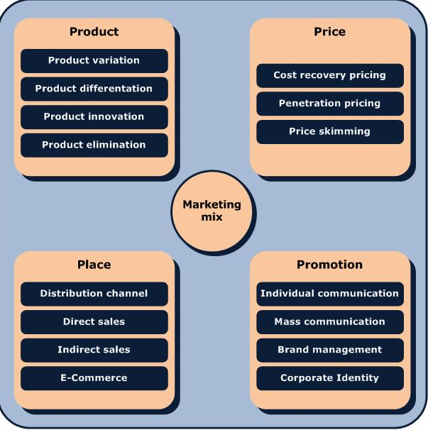
4P – marketing mix components

Slide 19
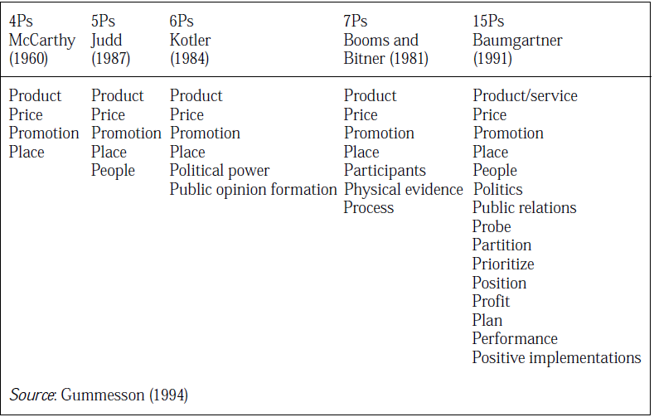
Marketing theories evolution

Slide 20
Marketing theories
Relationship marketing theory (Gronroos1996, Gummesson,1999 and USA “school”.
Christopher, Payne, Ballantyne (1991) Six markets
Kotler (1992) Ten players
Morgan, Hunt (1994) Ten partnerships
Gummesson 30R :classical relationships (3), special (14), mega (6), nano (7)
Relationship history of communication with customer leads to future activities including transactions.
Relationship processes can be considered as tangible, as they use resources and can be measured by quantitative indicators. They have life cycle. (Gronroos, 1996).

Slide 21
Marketing and management processes (functions)
5 Key Functions of Management
Plan
Organise
Make decisions (Command)
Co-ordinate
Control
If the specialist does not perform any of these functions, he cannot be considered as manager.

Slide 22
MIS & Related Organisational Functions (Lucey, T.)
Strategic Management:
Provides an organisation with overall direction and guidance – mission and vision (e.g. presidents, vice-prez.)
Strategic
Mgmt
EIS
ERP
Tactical Management:
Develops the goals and strategies outlined by Strategic Management (e.g. Head of marketing department
ES
Tactical
DSS
Management
Transaction
Process Control
Operational Management
Manages and directs the day-to-day operations and implementations of the goals and strategies, e.g. sales manager
Operational Mgmt
Non – Management employees: Producing goods and services – serving customers, order processing.

Slide 23
Marketing work and careers
Sales manager
Sale representative
Advertising and promotion manager
Marketing researcher
Customer service manager
Product manager
Market manager
Marketing vice-president
Extensive career specifications exist in enterprises

Slide 24
Marketing work and careers (e.g. certification)
Identify information and research requirements for business and marketing decisions.
Manage the acquisition of information and the Marketing Information System (MkIS).
Contribute information and ideas for business and marketing decisions.
Create a competitive operational marketing plan appropriate to the organization's context.
Integrate appropriate marketing mix tools and manage them to achieve the effective implementation of plans

Slide 25
Marketing work and careers (e.g.certification)
Define and use appropriate measures to evaluate the effectiveness of marketing plans and activities.
Create an effective communications plan for a specific campaign.
Manage marketing communications activities.
Develop and manage support to customers and members of marketing channels.
Plan a marketing project.
Manage a team for marketing project or tasks.
Make recommendations for changes and innovations to the marketing process for value enhancement

Slide 26
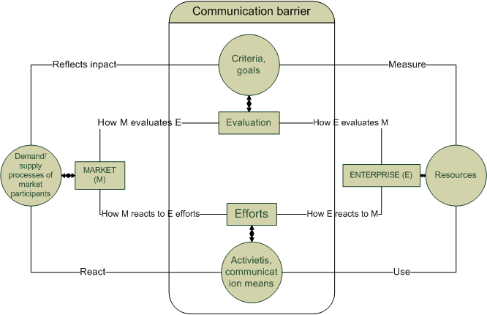
“Battlefield” for performing marketing tasks

Slide 27
MkIS as information equivalent of marketing management of the enterprise
Management information systems have to reflect reality. By looking at the system we should be aware of structure and dynamics of processes of the entire scope of marketing.
E.g. accounting system of the enterprise consists of chart of accounts interrelated by double entry principle.
What are the components of marketing system, can we consider their entirety as information equivalent of marketing?

Slide 28
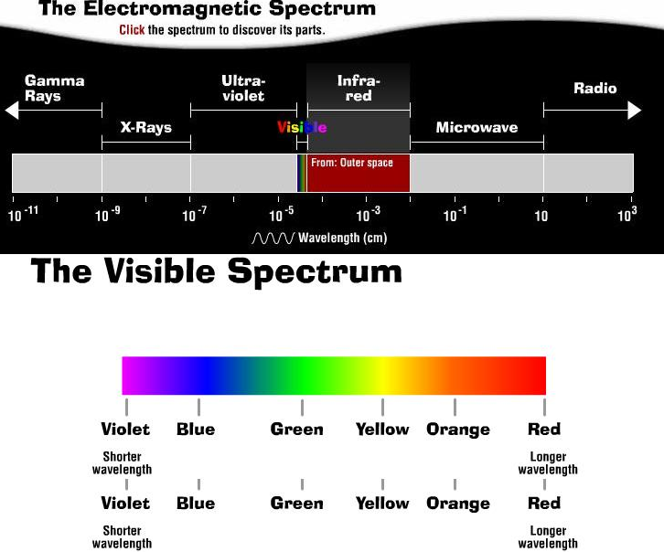
MkIS and marketing of the enterprise. What entirety we understand as system ?

Slide 29
Definitions of MkIS
MIS may be defined as a set of procedures and methods for the regular, planned collection, analysis, and presentation of information for use in making marketing decisions(Cox &Good, 1967)
MkIS comprises all computer and non-computer systems, which assist the marketing function to operate effectively. MkIS include many systems, which are not generally thought of in marketing terms, e.g. general ledger or production-planning systems.(O’Connor & Galvin 1997)
Marketing information systems are people, equipment, and procedures to gather, sort, analyze, evaluate, and distribute needed, timely, and accurate information to marketing decision makers (Armstrong & Kotler, 2007)
.. there are many more authors and definitions..

Slide 30
Requirements for MkIS by definitions

Slide 31
MkIS definition summary
The essence of a modern MkIS is people,
who take part in the processes of marketing management
by using the most recent achievements of IT.
These processes are based on the flow of information,
which enables to solve encountered decision problems
and generate adequate marketing decisions.

Slide 32
MkIS definition summary
MkIS definitions echo the management information system, no specific marketing-related features are presented.
The marketing manager is mentioned in the definitions without distinguishing between various types of activities, marketing tasks or hierarchical level.
MkIS is not defined as a general type of system (I-O-F), rather it is composed of computerized and non-computerized elements assisting marketing management processes.
The MkiS structure is not stable, due to changing needs in each stage of marketing processes, availability of information technologies and data, risk, uncertainty.

Slide 33
MkIS definition summary
The managers become part of group which plans information needs and implementation of MkIS. That makes MkIS unique in each enterprise.
The qualification of mangers is related to information quality. Improvement of information quality characteristics should go in tune with increasing skills.
The changing environment for marketing decisions requires flexibility of inclusion required information sources.
It means that the process of creating MkIS can become ongoing, its structure composed in a flexible way from various subsystems, and corresponds to subjective needs of the managers.

Slide 34
Influence of marketing theories to MkIS
Marketing is planned according to the 4P, it is implemented by performing different specialized tasks (market analysis, advertising, sales, customer service, etc.), it is controlled by applying historical financial indicators, although all marketing activities aim to bring changes in future.
Relationship marketing suggests describing marketing of the enterprise by its set of relationships and their dynamics.
Therefore in contrary to “4P” , the RM can serve as basis for information equivalent of the enterprise.
4P marketing is implemented by special department, and in RM all employees ar considered as “part-time marketers” (Gummesson, 1999)

Slide 35
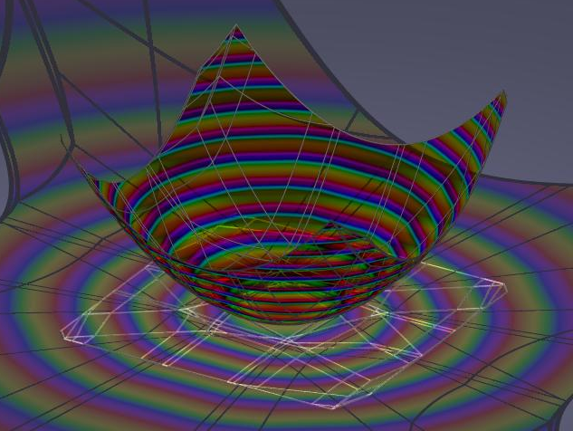
MkIS and marketing of the enterprise. What entirety makes the model of MkIS system ?
Structure of the model
Dynamics of the processes
Information describing the processes
Evaluation of the performance (measures)
Different levels of MkIS representation suggest of its multidimensional origin

Slide 36
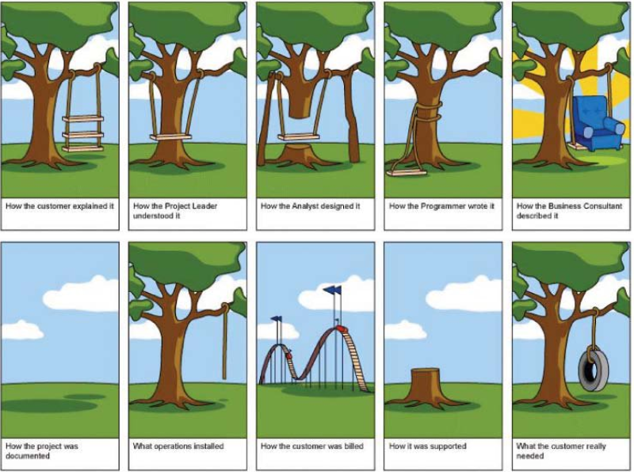
Importance of MkIS concept and model as adequate information equivalent of marketing

Slide 37
Marketing information system concepts
IS as a mirror of organization processes
IS as digital transformation of business
IS as disruptive innovation for building new business models

Slide 38
Digital marketing tools

Slide 39
Complexity of marketing tasks

Slide 40
Marketing and technologies

