Slide 1
Student Involvement and Peer Review
Masaryk University Language Centre
Czech Republic

Slide 2
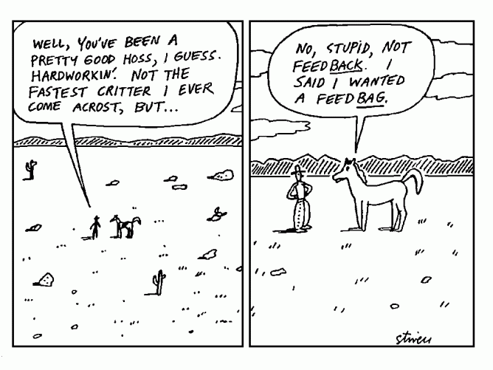
Feedback

Slide 3
What is feedback and how to provide it
Feedback is not about correcting mistakes and editing
Feedback is providing guidance
See what the positive and negative features of your fellow student’s work are
Focus only on several key areas
Start with a positive point and keep your comments balanced
Be encouraging

Slide 4

Comment on a letter written by a fellow student.
In your comments consider the following aspects
Content (Do you understand the message of the letter?)
Structure (clear, logical, linking words, …)
Style (appropriate, formal, …)
Vocabulary (range, accuracy, collocations, …)
Grammar (range, accuracy – especially word order)

Slide 5
Sources:
Adapted from:
MU Language Centre at the Faculty of Law
http://www.betterwritingfeedback.com/

