Slide 1
PV045
Management informačního systému
Management of information system
Radek Foltýn
Leonard Walletzký

Slide 2
New lecturers
Ing. Leonard Walletzký, Ph.D.
  On Faculty of informatics since 2011
  Master degree – Business Economy (Accounting software in business)
  Ph.D. – Economics of Information
Focus of research
  Implementation of information systems (with the focus to ERP systems)
  Service Science and its IT application
  Smart Cities and Communities

Slide 3
Lecturers
Mgr. Radek Foltýn
  Master degree – SSME (Faculty of informatics)
  Topic: Deployment of ERP system
  Business experience:
    ERP consultant – Helios
    Private consultant

Slide 4
Focus of the course
Not general management of information systems
Course is now focused to ERP systems
Why?
  There are many courses focused to IS (PV043, PV028) and management of them
  There is no course that shows the structure, meaning and importance of ERP systems to the company
  It is necessary to understand the complexity of ERP system from the point of view of customer, implementing company and developer

Slide 5
New structure of the course
Course contains two blocks:
  4 lectures
    Necessary theory and knowledge presentation
  8 seminars
    Practical work on your implementation of ERP system
Why?
  New aim of the course
  To teach you practically basic consequences of architecture of ERP systems

Slide 6
New evaluation
Two parts of evaluation
Project – practical example of your own customization or development in ERP system (70%)
  Only part if you have just colloquium
Test from theoretical background (30%)

Slide 7
What you will learn?
The structure of the course
Lectures
  The basic introduction
  Basic types of information systems and their value for the company
  Role of information system in company
  ERP system and its architecture

Slide 8
Structure of the seminars
The basic modules of ERP system
The customization of ERP system
Development in ERP system
Installation and initial configuration of ERP system
Why so brief?
We do not want to scare you!!!
What might be scary on this?

Slide 9
Possibly scary facts
We will work with economic relations and examples
Are you familiar with the topics like:
  Invoicing
  Stock management
  Bank and cash management
  VAT
  Financial reporting
NO?
  DO NOT BE AFFRAID!

Slide 10
Why not to be scared?
We will explain you the necessary principles
We do not want you to be economics experts
But you need to understand the problem on other side
  You will probably act on side of developer
  You need to understand why it needs to be done exactly in this way
    Although other (maybe shorter and more direct) could seems to be better

Slide 11
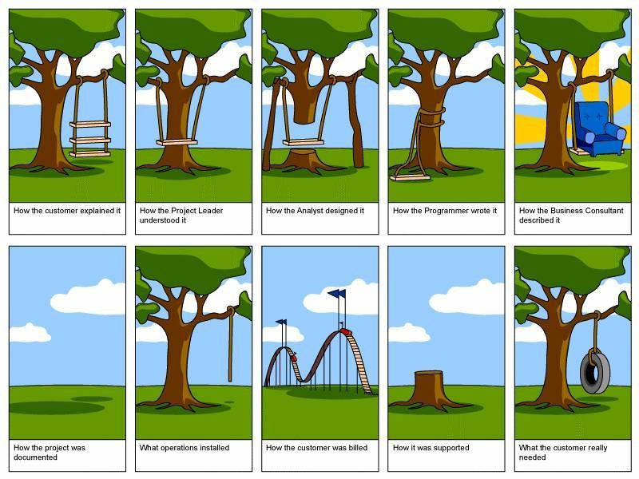
Because how does it look like very often?

Slide 12
Questions to introduction?

Slide 13
Basic enterprise information systems
CRM - Customer Relationship Management
FMS – Financial Management System
SCM - Supply Chain Management
MRP – Manufacturing Resource Planning
HRM – Human Resources Management
PMS – Project Management System
MIS - Management Information System
CMS - Content Management System
KMS - Knowledge Management System

Slide 14
CRM - Customer Relationship Management
Contains all information about ALL entities we are in business with
Customer are only one, but the most important group
  Vendors
  Suppliers
  Business partners
We record every single activity with every entity (order, invoice, payment, phone call, contracts)
We collect all the contact information in one place

Slide 15
CRM is important to
Knowing the contact data
Analysing the history of relation
  Offers to be sent
  Realized business cases
  Payments (in time, how much)
  Reported problems or issues
Having marketing information
  Behaviour on the e-shop
  Lifestyle preferences

Slide 16
FMS - Financial Management System
Is used to drive the finance of the company
What is our current cash status?
Can we pay our costs?
Will we have the money to pay our employees?
What is our planned income / outcome?
What is our revenue structure?
Are we able to realize this business?

Slide 17
Why are finance so important?
Money are the blood of the company?
If company have no money, it bankrupts.
FMS helps to see the complex situation.
  If we have a money and if we will have a money
Cash-flow / Profit problem
  Company can have a big profit, but no money
  Profit is realized when invoice is released
  Cash flow is positive when money are received

Slide 18
SCM - Supply Chain Management
To support the business with suppliers
The company can be just „a link in the long string“
We need to:
  Be able to offer particular components
  To manage their delivery
  To minimize the costs of the stock
  To know if we get exactly what we want and nothing less or more
And the same to our customers and collaborators

Slide 19
HRM - Human Resources Management
To manage the most important part of the company
The system of the wages
  Fixed part
  Variable part – depending on the performance of person, unit, department or company
  Holidays, Evidence of shifts, working hours etc.
  Taxation, Social and Health insurance
Evidence of the new positions, current structure etc.

Slide 20
MIS - Management Information System
Used to generate reports
Combining data from many different systems
Do we have enough business cases?
  For next week?
  For next month?
What is average profitability?
Can we invest into new equipment?
Do we need to improve some part of our performance?

Slide 21
KMS - Knowledge Management System
We need to take care not only to our employees but also about their knowledge and competencies
Why?
  What company do if the key developer(s) leave(s)?
  The main competitive advantage is in minds of your people!
It need to stored
  Internal WiKi or other systems

Slide 22
MRP – Manufacturing Resource Planning
Necessary for any tangible production
The process of manufacturing must be
  Planed
  Controlled
  Evaluated (do we have any issues, problems?)
All the supplements needs to be ready in time
  Cooperation with SCM
We need what to produce and when

Slide 23
PMS – Project Management System
To support any project development
Based on standards of Project Management
We have many tools (MS Project, JIRA….)
The project needs to be managed not independently, but as the part of the project portfolio of the company
Project has its consequences to company health
Ignoring those consequences leads to serious problems

Slide 24
CMS - Content Management System
It really can be a part of the internal system!
Intranet – only for the employees
It can be also related with economical activities of the company
E-shop needs to share or use the same data
Managing directly the web pages of the company

Slide 25
What is ERP
Enterprise Resource Planning, integrated system that help business to manage internal and external resources.
Built on a centralized database and normally utilizing a common computing platform,
ERP systems consolidate all business operations into a uniform and enterprise-wide system environment
ERP can integrates all systems mentioned before

Slide 26
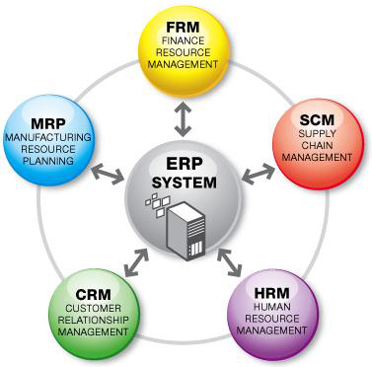
Example of the structure of ERP

Slide 27
History of information systems
Timeline | System | Description
1960s | Inventory Management & Control | The activities include identifying inventory requirements, setting targets, providing replenishment techniques and options, monitoring item usages, reconciling the inventory balances, and reporting inventory status.
1970s | Material Requirement Planning (MRP) | MRP generates schedules for the operations and raw material purchases based on the production requirements of finished goods, the structure of the production system, the current inventories levels and the lot sizing procedure for each operation.
1980s | Manufacturing Requirements Planning (MRP II) | Manufacturing Requirements Planning or MRP utilizes software applications for coordinating manufacturing processes, from product planning, parts purchasing, inventory control to product distribution.
1990s | Enterprise Resource Planning (ERP) | ERP systems often integrates business activities across functional departments, from product planning, parts purchasing, inventory control, product distribution, fulfillment, to order tracking. ERP software systems may include application modules for supporting marketing, finance, accounting and human resources.
2000s | ERP as a Service | ERP system is provided for the customers portfolio, optimized and configured for every particular customer, but using one general platform

Slide 28


Providing ERP
ERP as a Service
Inventory, MRP, Production, Project, Accounting, CRM, HRM, etc.
ERP
1960
1990
2000

Slide 29
Why do we need such a complex system?
Could we use just specialized systems for each activity?
Do we need such a robust solution when it is:
  Though for maintenance
  Hard to learn (so many functions)
  We do not need to have all the functions?

Slide 30
Example
The most common example
The customer ordered particular good (mobile, dress, TV) and wants to deliver it to his house. Payment is realized after delivery.
What does it mean for the business processes and their management?

Slide 31
Example
Store / Shipment
Sales
Accounting
Sales Order
Sales Order
Internal documents
Costing
Stock card
Delivery note
customer
Invoice
Invoicing
Billing
Receipt
Banking

Slide 32
Example
ERP
Store / Shipment
Accounting
Sales
Sales Order
Sales Order
Internal documents
Stock card
Costing
Delivery note
customer
Invoice
Invoicing
Billing
Receipt
Banking

Slide 33
Conclusion
Every (even) small economic activity produce a lot of documents
Problems
  Managing all the documents together with their relations (metadata)
  Consistency of the documents
  Part of them is basis for the taxations
We do not need to store data only
We need them back!
  Analysed, compressed, providing information about our business

Slide 34
Questions?

