Slide 1
Implementation of ERP system
Leonard Walletzký

Slide 2
Enterprise information systems
CRM - Customer Relationship Management
FMS – Financial Management System
SCM - Supply Chain Management
MIS - Management Information System
CMS - Content Management System
KMS - Knowledge Management System
DSS - Decision Support System
GIS - Geographic Information System

Slide 3
What is ERP
Enterprise Resource Planning, integrated system that help business to manage internal and external resources.
Built on a centralized database and normally utilizing a common computing platform,
ERP systems consolidate all business operations into a uniform and enterprise-wide system environment
ERP can integrates all systems mentioned before

Slide 4
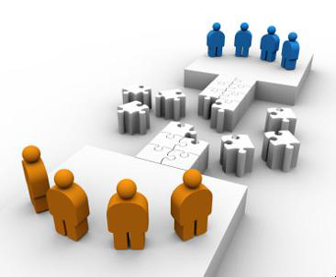
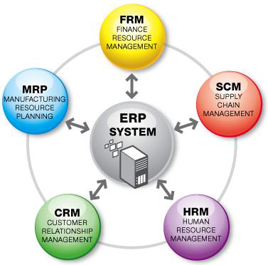

Providing ERP
ERP as a Service
Inventory, MRP, Production, Project, Accounting, CRM, HRM, etc.
ERP
1960
1990
2000

Slide 5
Example
ERP
Store / Shipment
Accounting
Sales
Sales Order
Sales Order
Internal documents
Stock card
Costing
Delivery note
customer
Invoice
Invoicing
Billing
Receipt
Banking

Slide 6
Basic facts
Every (even) small economic activity produce a lot of documents
Problems
  Managing all the documents together with their relations (metadata)
  Consistency of the documents
  Part of them is basis for the taxations
We do not need to store data only
We need them back!

Slide 7
Critical situation
When organization has not any ERP system at all
  Small or beginning companies
When they have bad system or their system is out of date, not power enough etc.
  Growing companies
  Join ventures

Slide 8
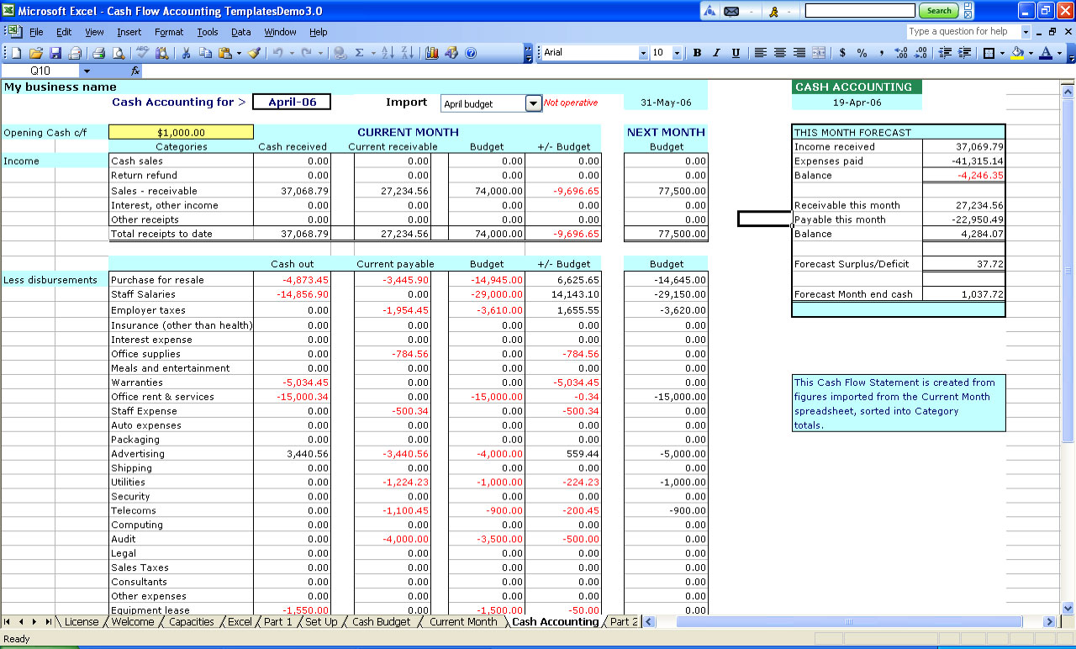
How to recognize problem?
Usage of Excel to manage your activity is not enough
External accountant does not give you all data you need
Data processing (document generating) takes more and more time, you need to control everything 2 – 3 times
You need pen and paper for the key decision, because you are not able to get all data from your accounting

Slide 9
How to identify out dated system?
You need to enter data more than 1 time
  To the accounting and than to internet banking
You are not able to use modern ways of collaboration (document sharing)
Your system has technical problems, it freezes or crash very often
Your system is no longer supported
Your system is not compatible with other systems you use (e-shop)
You need more than 30 minutes to crate report

Slide 10
Basic modules in ERP system
Sales – from the order to invoice
Purchases – from order to invoice
Banking and cash
Warehouse
Property and inventory
Human resources
Relation with customers
Accounting

Slide 11
Outside connections to and into ERP system
Banks and payment systems
POS
  Trade
  Restaurants / Hotels
  Others
Document management
Content management system
  Web shop
  Intranet
Other specialized systems
  DSS, MIS…

Slide 12
Features of „ideal“ ERP system
Optimizes and simplifies the processes
Centralize the information
Optimizes data and document sharing
Is accessible from everywhere
It helps with your communication to your customers
Accelerate report´s generating
Gets you complete information about status of your company
Is open for the third party product (e-shops, Office, banking and payment systems, POS)

Slide 13
Value based objectives or ERP implementation
What are customers expecting from ERP system?
How to validate the objectives?
What is their structure?
How are they organized?

Slide 14
Fundamental objectives
Minimize costs
Ensure ERP benefits realization
Enhance product and service improvement
Maximize customer relationship effectiveness
Based on study made by May, Dhilĺon and Caldeira

Slide 15
Minimizing costs
One of the main objectives
Structure of the main costs
  Start-up
  Implementation
  Maintenance
Cost must be compared with the expected reduction of other costs of the company (return of investment)

Slide 16
Ensure ERP benefits realization
Depending of key areas
  Knowledgeable and proactive organization
  Proper change management control
  Minimization of adaptation constraints
  Clarity of investment objectives
  Delivery of responsibility to individuals in the organization
ERP benefits depending on the level of customer and provider co-creation of the final value

Slide 17
Enhance product and service improvement
Key factors
  Support of new product development
  Any system that may be considered for adoption will support growth of existing product lines
  ERP system enables the identification of new product opportunities
To ensure key factors ERP supplier needs to know and analyse customer´s business

Slide 18
Maximize customer relationship effectiveness
Key factors
  Support of the customer oriented processes
  Ability to understand customer desires
  Efficient marketing channel design
Critical for service organizations
Supplier needs to know the structure of customer segments, the ways of communication the customers are use to.

Slide 19
Mean objectives
Providing the way how the fundamental objectives can be reached
Important is also the sequence how the objectives are reached
Focus to objectives development is the key factor in value creation process

Slide 20
Mean objectives
Creating environment inside and outside the organization
Agreement among functional divisions
Working relationships of external consultants and project teams
Minimizing negative cultural impact
organization wide knowledge of ERP systém
Organization specific knowledge or competence
Competence of external consultants
Competence of ERP selection and implementation team
Organizational ability of strategic systém use
To handle any restructuralization
System processes:
  ERP system processes fit organizational requirements
  ERP system processes fit existing business processes
Business processes:
  Administrative processes
  Manufacturing processes
    Maximizing performaance
  Procedural redundancy is minimized
Key element of ensuring the success of implementation
Availability of external support
Availability of internal support
Minimazint the dependence on individual IT experts
Between outside consultants / vendors and inside project teams
ERP system does not break or alter
  existing business processes
  course of business
Maximize productive working realtionships
Maximize trust
Maximize IT competence
Ensure technical support
Minimize information dispersion
Maximize system use
Maximize proces effectiveness
Ensure business continuity
Maximize compliance
Maximize data analysis
Maximize information richeness
Maximize information security
Information tends to be dispersed in different functional areas
Information repositories must be consolidated in one place
Reliability of vendor-client business critical data must be ensured
Comformity to any proffesional standards
Conformity to legal requirements
Question of choosing proper ERP system
Easy to use?
Environment inside ithe organization promote wide systém use
Level of flexibility
Continuous system use
ERP system can handle the data analysis
Data conversion
Pattern recognition capability
Real time information for given users are up-to date and correct
Ability to capture business critical data
Information will be available for appropriate users
Minimizing data redundancy
Maximizing data integrity
Unauthorized access to business critical data is minimized

Slide 21
Mean and fundamental objectives
Maximize organizational IT experience
Maximize trust
Ensure ERP benefits realization
Technical support
Productive working relationships
Maximize system use
Maximize system process effectiveness
Maximize compliance
Maximize product and service improvement
Maximize business analysis
Maximize business process effectiveness
Maximize customer realitionship effectiveness
Maximize information richeness
Maximize information security
Minimize information dispersion
Minimize costs
Ensure business continuity

Slide 22
Important for cost calculation
Commercial software
  Licence
  Customization can be limited
    Only certified partner
  Usually made on Microsoft platform
Open source software
  No fees for the licence
  Customization can be done by anyone
    Problem of partner finding
  Made on Java, Python, php etc.

Slide 23
How manage the project
How long time will it take?
Who should participate?
What do you expect from ERP system?
How can management prepare themselves to this process?
Risks of the project of ERP implementation

Slide 24
Choosing Consultants and Vendors
One person cannot fully understand a single ERP system
Before choosing a software vendor, most companies:
  Study their needs
  Hire an external team of software consultants to help choose the right software vendor(s) and the best approach to implementing ERP

Slide 25
The Significance and Benefits of ERP Software and Systems
More efficient business processes that cost less than those in unintegrated systems
Easier global integration
Integrates people and data while eliminating the need to update and repair many separate computer systems
Allows management to manage operations, not just monitor them
Can dramatically reduce costs and improve operational efficiency

Slide 26
Questions About ERP
How much does an ERP system cost?
Should every business buy an ERP package?
Is ERP software inflexible?
What return can a company expect from its ERP investment?
How long does it take to see a return on an ERP investment?
Why do some companies have more success with ERP than others?

Slide 27
How Much Does an ERP System Cost?
Size of the ERP software
  Corresponds to the size of the company it serves
Need for new hardware that is capable of running complex ERP software
Consultants’ and analysts’ fees
Time for implementation
  Causes disruption of business
Training
  Costs both time and money

Slide 28
How to manage the project
Project can take from 3 months (small companies) to more than year
All departments involved to the work with ERP system should participate
  Not only IT Department!!
First we must analyse company, its situation and than we look for suitable ERP system
The best solution is to make SWOT and develop strategies

Slide 29
What Return Can a Company Expect from Its ERP Investment?
ERP eliminates redundant efforts and duplicated data; can generate savings in operations expense
ERP system can help produce goods and services more quickly
Company that doesn’t implement an ERP system might be forced out of business by competitors that have an ERP system
Smoothly running ERP system can save a company’s personnel, suppliers, distributors, and customers much frustration

Slide 30
What Return Can a Company Expect from Its ERP Investment?
Cost savings and increased revenues occur over many years
  Difficult to put an exact dollar figure to the amount accrued from the original ERP investment
ERP implementations take time
  Other business factors may be affecting the company’s costs and profitability
  Difficult to isolate the impact of the ERP system alone
ERP systems provide real-time data
  Improve external customer communications

Slide 31
How Long Does It Take to See a Return on an ERP Investment?
Return on investment (ROI): assessment of an investment project’s value
  Calculated by dividing the value of the project’s benefits by the project’s cost
ERP system’s ROI can be difficult to calculate
Peerstone Research study
  63 percent of companies that performed the calculation reported a positive ROI for ERP
  Most companies felt that nonfinancial goals were the reason behind their ERP installations

Slide 32
Why Do Some Companies Have More Success with ERP Than Others?
Usually, a bumpy rollout and low ROI are caused by people problems and misguided expectations, not computer malfunctions
  Executives blindly hoping that new software will cure fundamental business problems that are not curable by any software
  Executives and IT managers not taking enough time for a proper analysis during planning and implementation phase
  Executives and IT managers skimping on employee education and training

Slide 33
Why Do Some Companies Have More Success with ERP Than Others?
Usually, a bumpy rollout and low ROI are caused by people problems and misguided expectations, not computer malfunctions (cont’d.)
  Companies not placing ownership or accountability for the implementation project on the personnel who will operate the system
  Unless a large project such as an ERP installation is promoted from the top down, it is doomed to fail
  ERP implementation brings a tremendous amount of change for users

Slide 34
Why Do Some Companies Have More Success with ERP Than Others? (cont’d.)
For many users, it takes years before they can take advantage of many of an ERP system’s capabilities
Most ERP installations do generate returns

Slide 35
Conclusion
Critical situation of ERP need
Value of ERP for the customer
Special position of accounting
Basic of ERP development (customer side)

