Slide 1

PV181 Laboratory of security and applied cryptography
Symmetric cryptography
Marek Sýs, Zdeněk Říha

Slide 2
Cryptography - brief overview
Notes:
Concept, goals, primitives, brief,

Slide 3
Goals of Cryptography
Confidentiality (privacy) - preventing open access
  ciphers
Authentication:
  Entity – identity verification – various (password, MAC, …)
  Data origin – identity of message originator – MAC
Integrity - preventing unauthorized modification
  hash functions
Non-repundation - preventing denial of actions
  digital signature

Slide 4
Crypto primitives
Ciphers – encryption/decryption of data using key
  Symmetric ciphers – same key for enc/dec
  Asymmetric ciphers – different key for enc/dec
Random number generators (RNGs)
  Key generation
Hash functions – “unique” fingerprint of data
Based on previous: MAC, PBKDF, Digital signature

Slide 5
Symmetric cryptosystem
Shared secret key
encryption
decryption
Alice
Bob
message
Encrypted
message
Decrypted
original
message
Adapted Network and
Internetwork Security (Stallings)

Slide 6
Asymmetric cryptosystem
Public key of Bob
Private key of Alice
encryption
decryption
Alice
Bob
message
Encrypted
message
Decrypted
original
message
Adapted Source: Network and
Internetwork Security (Stallings)

Slide 7
Random number generators
Used to generate: keys, IV, …
Truly RNG - physical process
  aperiodic, slow
Pseudo RNG (PRNG) – software function
  deterministic, periodic, fast
  initialized by seed – fully determines random data
Combination often used:
  truly RNG used to generate seed for PRNG
  dev/urandom, dev/random in Linux, Fortuna scheme

Slide 8
Hash function
Cryptographic hash function
Input of arbitrary size
Output of fixed size: n bits (e.g. 256 bits).
Function is not injective (there are “collisions”).
Hash is a compact representative of input (also called imprint, (digital) fingerprint or message digest).
Hash functions often used to protect integrity. First the has is computed and then only the hash is protected (e.g. digitally signed).

Slide 9
Standards
Everything defined in standard:
implementation, settings, usage, etc.
If you need something look into standard
Different types:
FIPS PUB 197 – AES block cipher
RFC1321 – md5 hash function
NIST SP,…

Slide 10
Implementation testing - test vectors
Examples of input/output (and also intermediate) for the reference implementation
MD5 defined in RFC 1321:
  MD5(“”) = d41d8cd98f00b204e9800998ecf8427e
  MD5(“message digest”) = f96b697d7cb7938d525…
AES defined in FIPS197:
  Plaintext: 00112233445566778899aabbccddeeff
  Key 000102030405060708090a0b0c0d0e0f
  Ciphertext 69c4e0d86a7b0430d8cdb78070b4c55a

Slide 11
Symmetric cryptography

Slide 12


Block cipher
Input divided into blocks of fixed size (e.g 256 bits)
  Padding - message is padded to complete last block
Different modes of operation:
  Insecure basic ECB mode – leaks info
  Secure modes: CBC, OFB,CFB,CTR,…
CBC, OFB,CFB need initialization
  Initialization vector (IV) – must be known
Source: https://en.wikipedia.org/wiki/Block_cipher_mode_of_operation

Slide 13
Block ciphers - padding
Standard method
ANSI X.923
ISO 10126
PKCS7
ISO/IEC 7816-4
Zero padding
... | DD DD DD DD DD DD DD DD | DD DD DD DD 00 00 00 04 |
... | DD DD DD DD DD DD DD DD | DD DD DD DD 81 A6 23 04 |
... | DD DD DD DD DD DD DD DD | DD DD DD DD 04 04 04 04 |
... | DD DD DD DD DD DD DD DD | DD DD DD DD 80 00 00 00 |
... | DD DD DD DD DD DD DD DD | DD DD DD DD 00 00 00 00 |

Slide 14
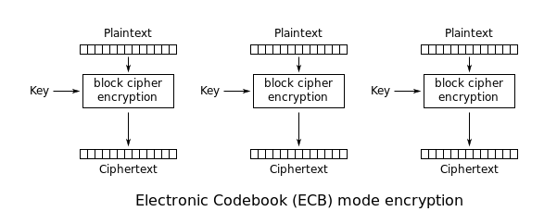
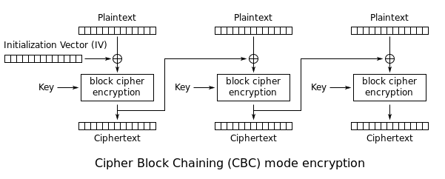
Block ciphers: ECB vs CBC mode
Source: https://en.wikipedia.org/wiki/Block_cipher_mode_of_operation

Slide 15
Hash functions - examples
MD5
  Input: „Autentizace“.
  Output: 2445b187f4224583037888511d5411c7 .
  Output 128 bits, written in hexadecimal notation.
  Input: „Cutentizace“.
  Output: cd99abbba3306584e90270bf015b36a7.
  A single bit changed in input → big change in output,
  so called “Avalanche effect”
SHA-1
  Input: „Autentizace“.
  Output: 647315cd2a6c953cf5c29d36e0ad14e395ed1776
SHA-256
  Input: „Autentizace“.
  Output: a2eb4bc98a5f71a4db02ed4aed7f12c4ead1e7c98323fda8ecbb69282e4df584

Slide 16
Secure Hash Algorithm (SHA)
SHA-1
  NIST standard, collision found in 2016, 160 bits hash
SHA-2
  function family: SHA-256, SHA-384, SHA-512, SHA-224
  defined in FIPS 180-2
  Recommended
SHA-3
  New standard 2015
  Keccak sponge function family: SHAKE-128, SHA3-224, …
  defined in FIPS 202, used in FIPS-202, SP 800-185
  Recomended

Slide 17
Password protection password hashing & salting
Clear password could be stolen:
  store hash of password
  hash = H(password)
  Checking: password is correct if hash matches
Attack (brute force or dictionary)
  trying possible passwords “aaa”, “aab”…“zzz” – N tests
  N test for single but also for 2,3,… passwords !!!
Slow down attack - increase password size:
  random “salt” is added to password,

Slide 18
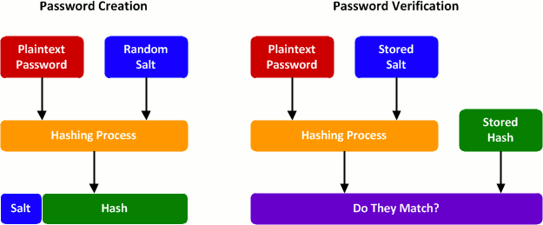
Password protection password hashing & salting
Source: http://blog.conviso.com.br/worst-and-best-practices-for-secure-password-storage/

Slide 19
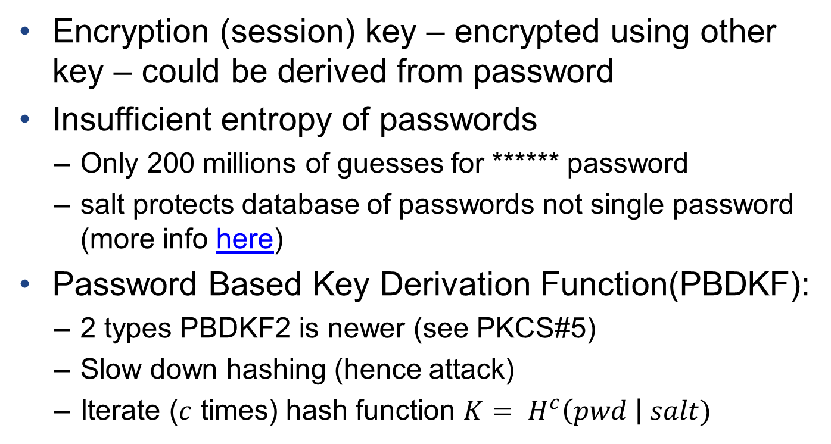
Key/password protection
Encryption (session) key – encrypted using other key – could be derived from password
Insufficient entropy of passwords
  Only 200 millions of guesses for ****** password
  salt protects database of passwords not single password (more info here)
Password Based Key Derivation Function(PBDKF):
  2 types PBDKF2 is newer (see PKCS#5)
  Slow down hashing (hence attack)
  Iterate ($c$ times) hash function $K= H^{c}\left(pwd \right| salt)$

Slide 20
PBKDF2
Salt &
# iterations
KEY
Password / Passphrase
key
PBKDF2
<cipher>
encrypted
KEY

Slide 21
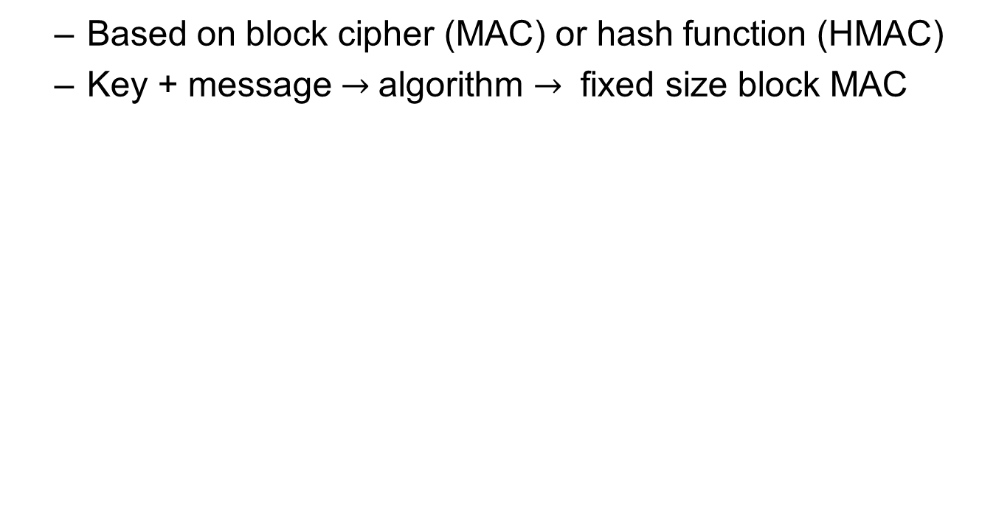
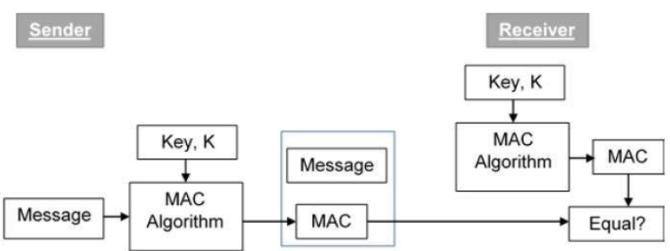
Message authentication code (MAC)
Source: https://www.tutorialspoint.com/cryptography/message_authentication.htm

Slide 22
Instructions for the seminar

Slide 23
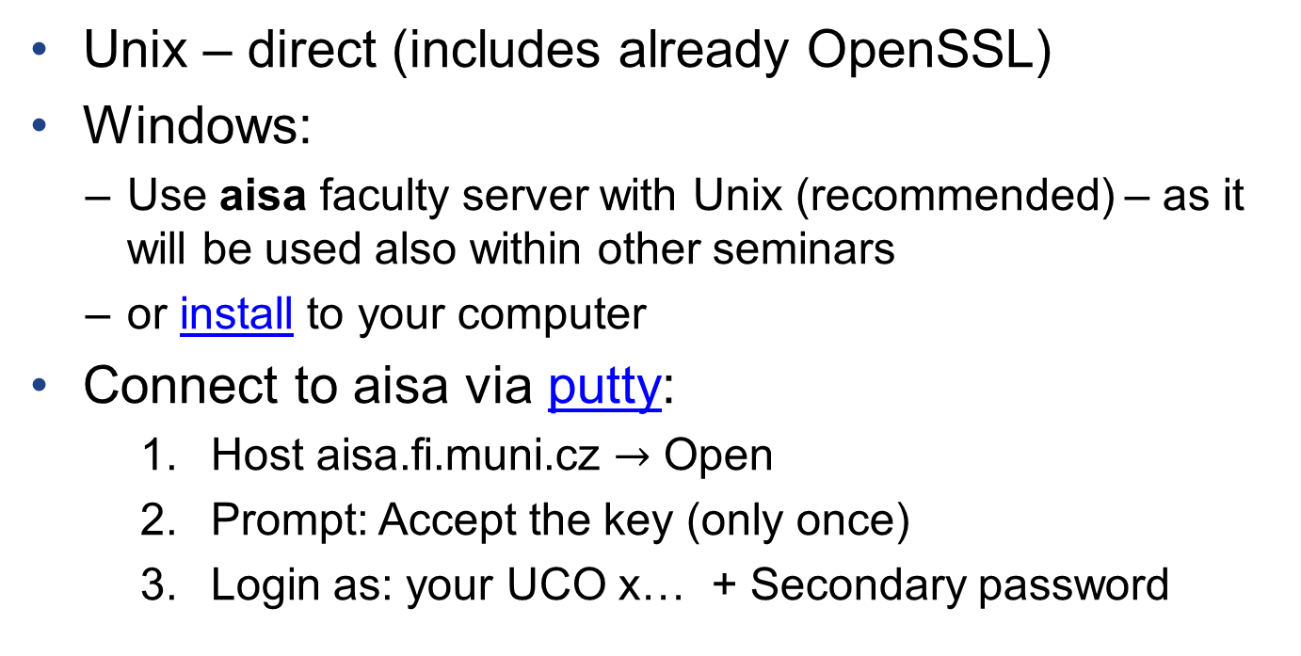
OpenSSL access
Unix – direct (includes already OpenSSL)
Windows:
  Use aisa faculty server with Unix (recommended) – as it will be used also within other seminars
  or install to your computer
Connect to aisa via putty:
    Host aisa.fi.muni.cz $→$ Open
    Prompt: Accept the key (only once)
    Login as: your UCO x… + Secondary password

Slide 24
OpenSSL materials
Books:
  free ebook OpenSSL cookbook
Useful links:
  Manual: https://www.openssl.org/docs/man1.0.2
  https://wiki.openssl.org/index.php/Command_Line_Utilities
  https://www.madboa.com/geek/openssl/

Slide 25
OpenSSL basics
Usage:
  With cmd history(prefered): openssl commands params
  Without:
    openssl (enter)
    commands params (without openssl)
Typical problems:
  order of parameters
  string: str or “str” (may represent string of 5 chars)
Help = non-recognized command
  e.g. blablabla or help

Slide 26
Symmetric crypto
OpenSSL commands:
dgst – hashing, MAC, signature
enc – encryption, base 64 encoding,…
Hashed, encrypted, … data are not readable (not ASCII characters) hence we will use rather:
  hex – byte encoded 2 chars from charset (0-9, A-F)
  or base64 – 6 bits encoded by 1 char (A-Z, a-z, 0-9, +, /)
    Padding is used (no padding, “=“, “==“)

Slide 27
Practical part
See instructions in Tasks01.txt in IS

