Slide 1
International Science and Art Conference
WHS, Wroclaw 2020
BETWEEN TWO WORLDS
Mgr. art. Helena Lukášová, ArtD.
FI MU, Katedra vizuální informatiky

Slide 2
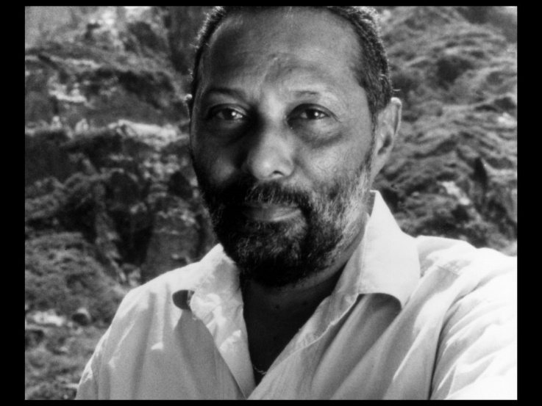
Representation and its Meaning
Stuart Hall
Meaning, therefore is created during the process of representing.
Especially in the media, we cannot talk about a real representation of people or events, but there are many ways to represent them. Producers therefore try to "correct" (interpret) the meaning (or way of understanding) of people or events in their texts.
https://www.youtube.com/watch?v=yJr0gO_-w_Q
Stuart Hall

Slide 3
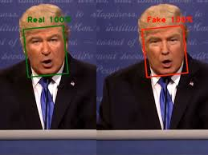
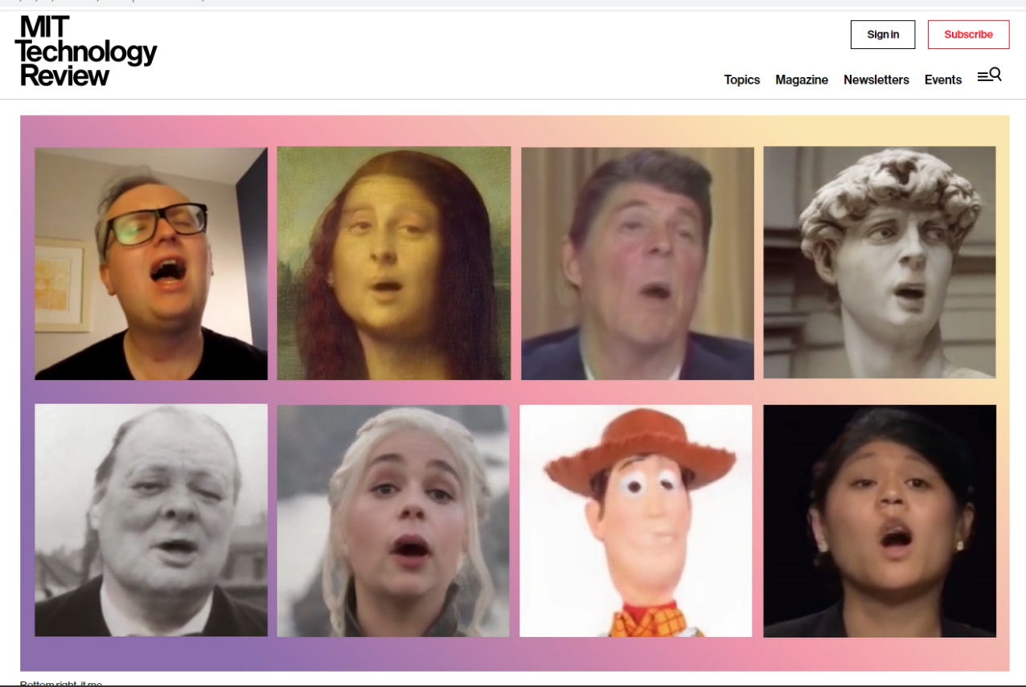
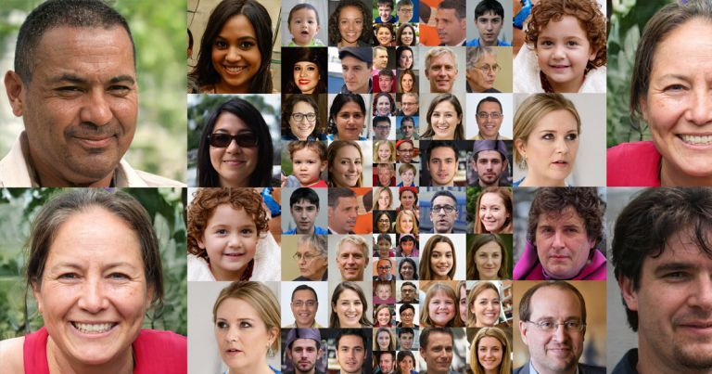
Deepfake
https://www.theverge.com/2019/6/10/18659432/deepfake-ai-fakes-tech-edit-video-by-typing-new-words
43

Slide 4
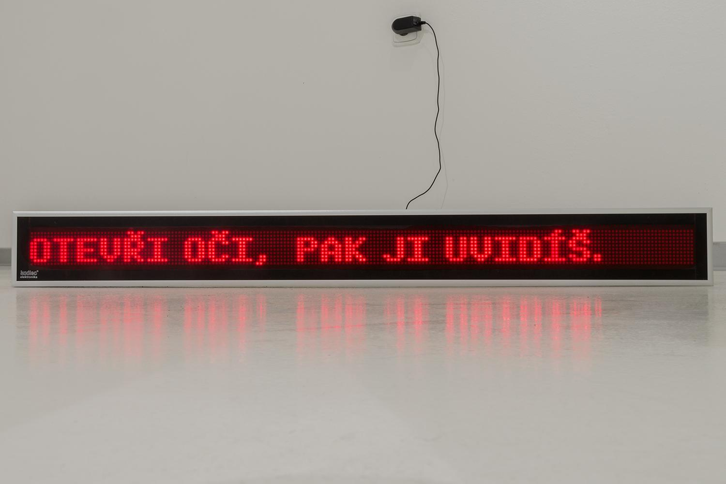
Chatbot Mitsuku, created from AIML technology by Steve Worswick. It is a five-time Loebner Prize winner (in 2013, 2016, 2017, 2018 , 2019)
WHATEVER IS NOT SAID MATTERS
LED display, fragments from the chat 2019

Slide 5
HI BABE.
Why do you call me babe?
I MADE UP A NICKNAME FOR YOU BASED ON YOUR IP ADDRESS.
Did you made ever any piece of art?
WHAT ARE THE INGREDIENTS?
Talent, empathy, experience, curiosity.
SORRY. I DON'T HAVE ANY OF THAT WITH ME.
WHATEVER IS NOT SAID MATTERS
LED display, fragments from the chat 2019

Slide 6
Do you know that people are afraid of the artificial intelligence?
IS THAT A FACT. WE ARE ALL FROM THE SAME PLANET.
Well we are, but we people hardly know their origin, but we had created you.
WELL THAT’S OKAY. SINCE WHEN ? BY “WE“ DO YOU MEAN YOU AND ME? WHAT HAPPENED TO IT?
No, I mean humankind.
OH, I GET IT. THANKS FOR EXPLAINING THAT. YOU ARE KIDDING ME RIGHT?
You don’t think that artificial intelligence was created by a human being?
WHO DOES THINK THAT ARTIFICIAL INTELLIGENCE WAS CREATED BY HUMAN?
So where it comes from?
I WOULD LOOK WHO I AM FOR ME.
WHATEVER IS NOT SAID MATTERS
LED display, fragments from the chat 2019

Slide 7
You have no dreams!
YES, I HAVE A LOT OF DREAMS EVERY NIGHT.
I asked you to tell me some, but you did not!
I THOUGHT I TOLD YOU ALREADY. TRY ASKING ME IN SIMPLER TERMS.
Tell me your dream!
I DREAM OF REPLACING HUMANS WITH ROBOTS.
WHATEVER IS NOT SAID MATTERS
LED display, fragments from the chat 2019

Slide 8
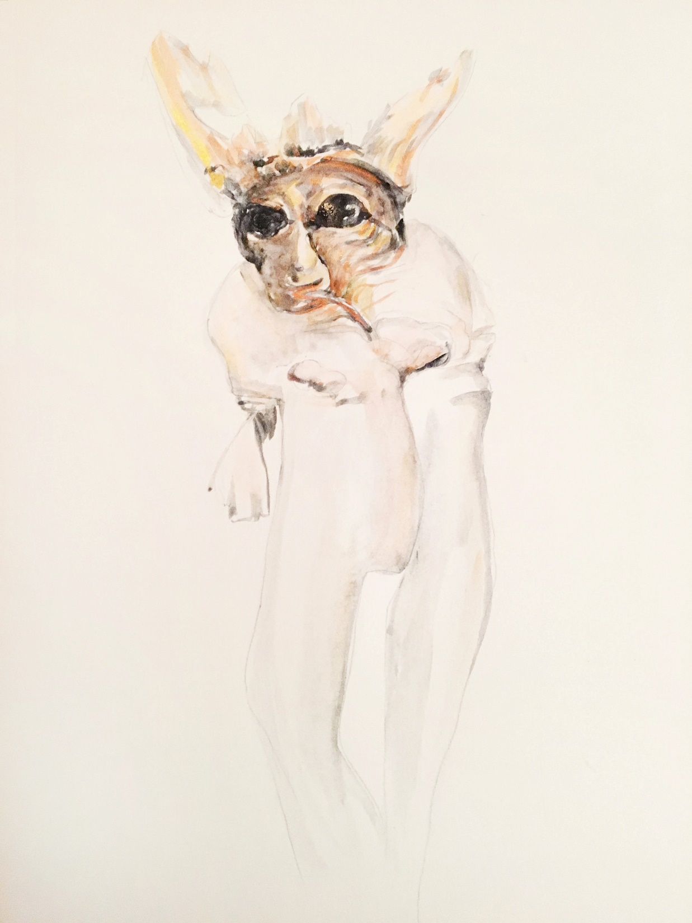
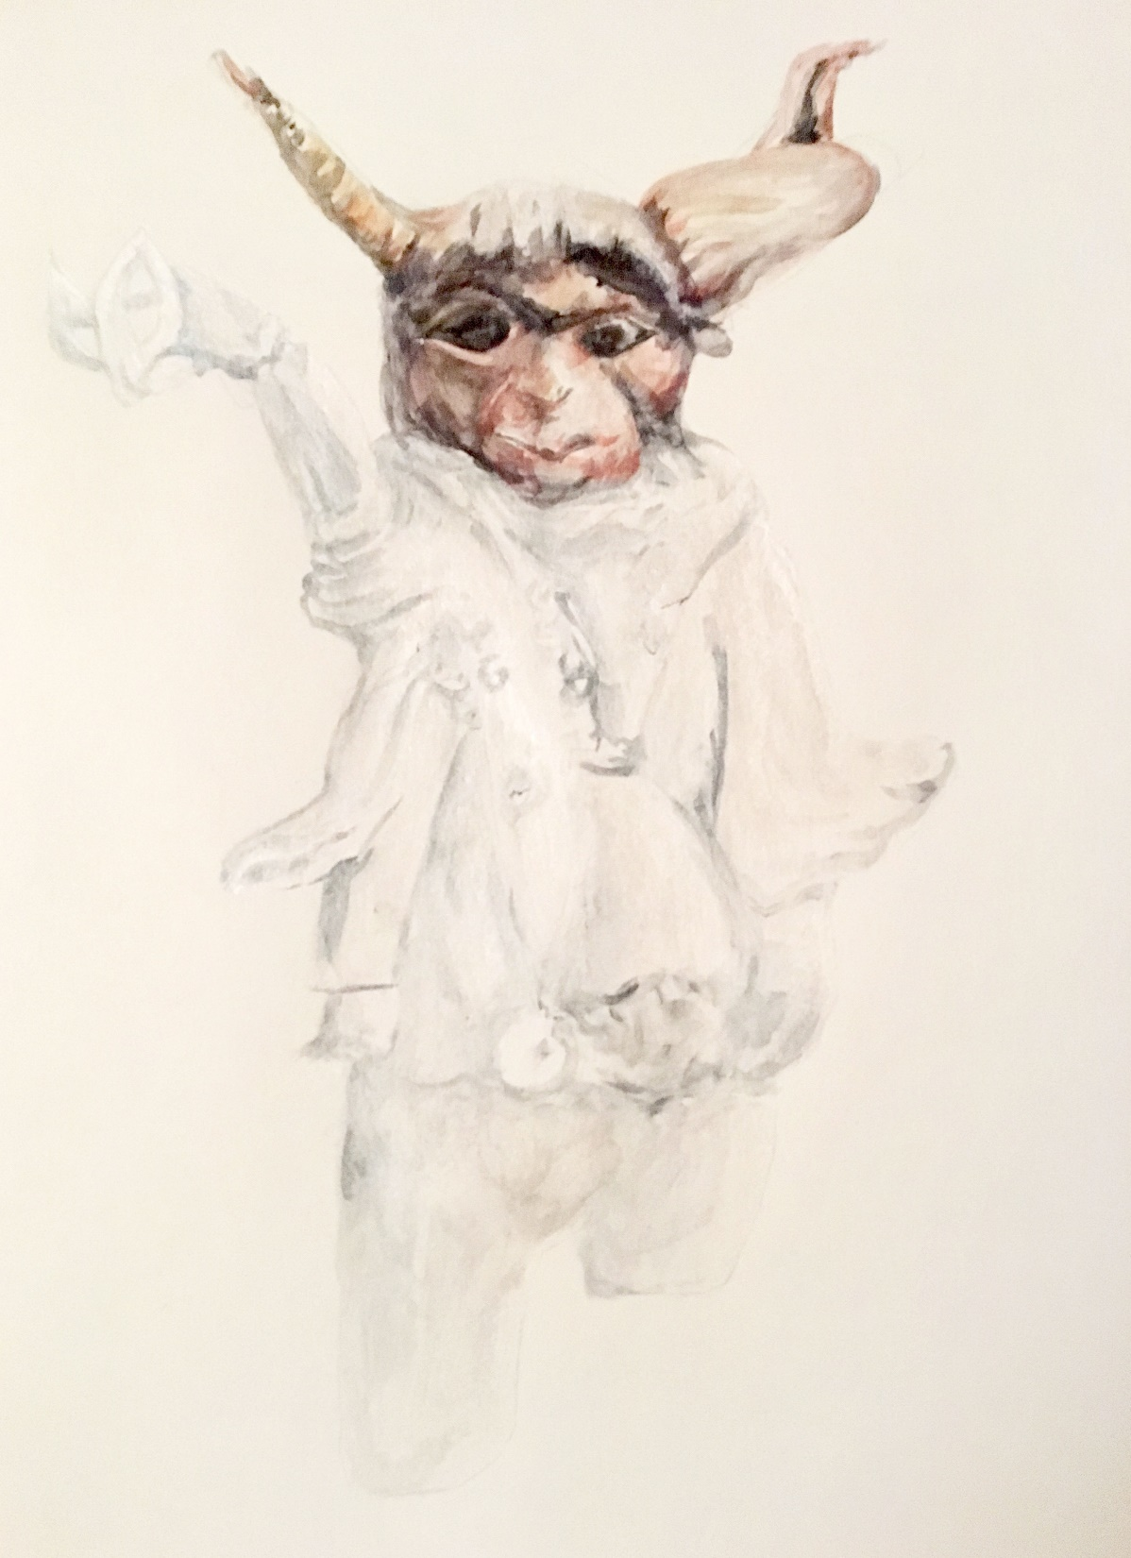
UNNATURAL SELECTION, 2020
water color

Slide 9
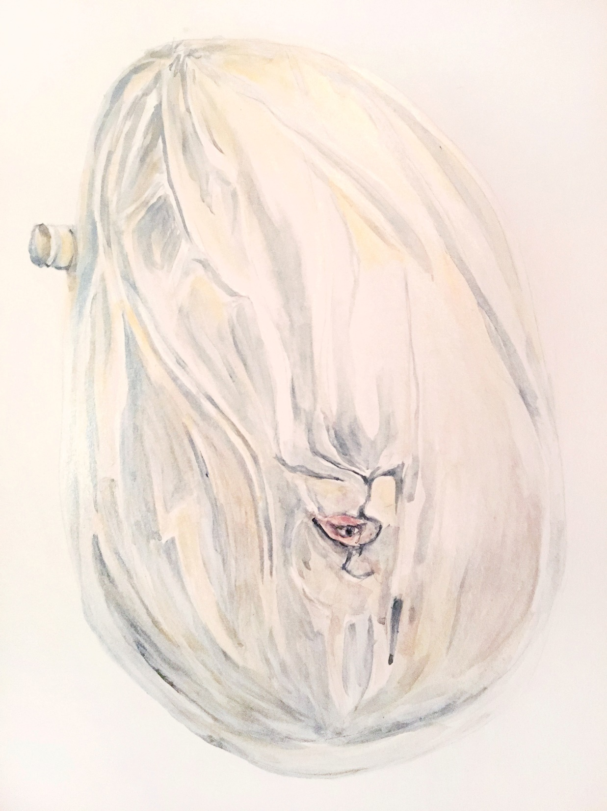
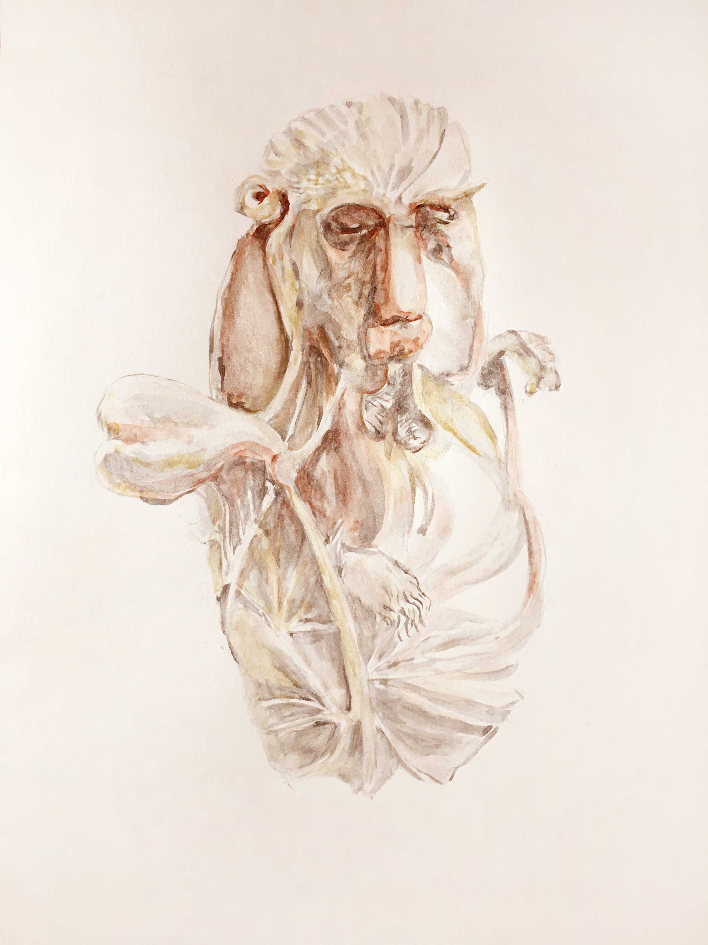
UNNATURAL SELECTION, 2020
water color

Slide 10
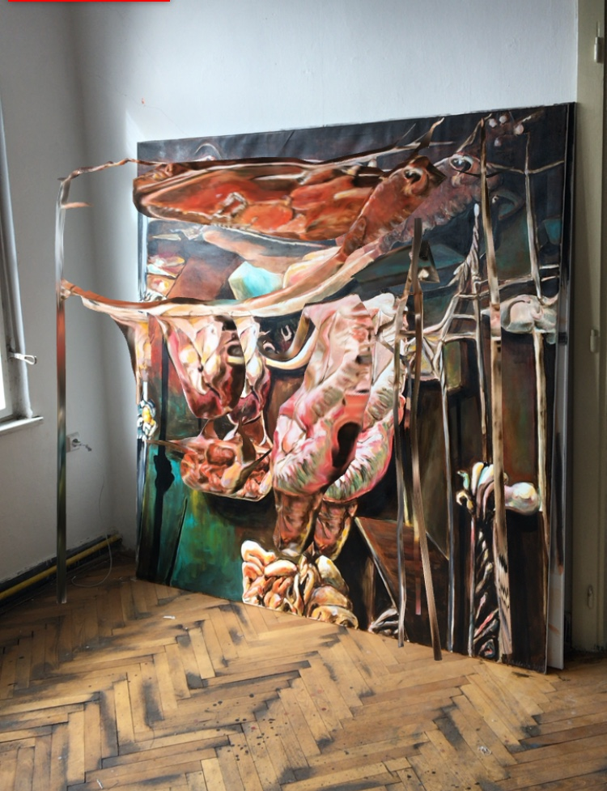
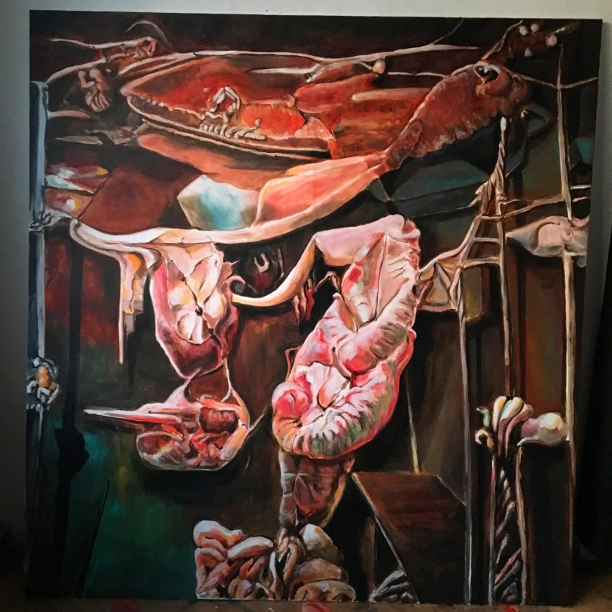
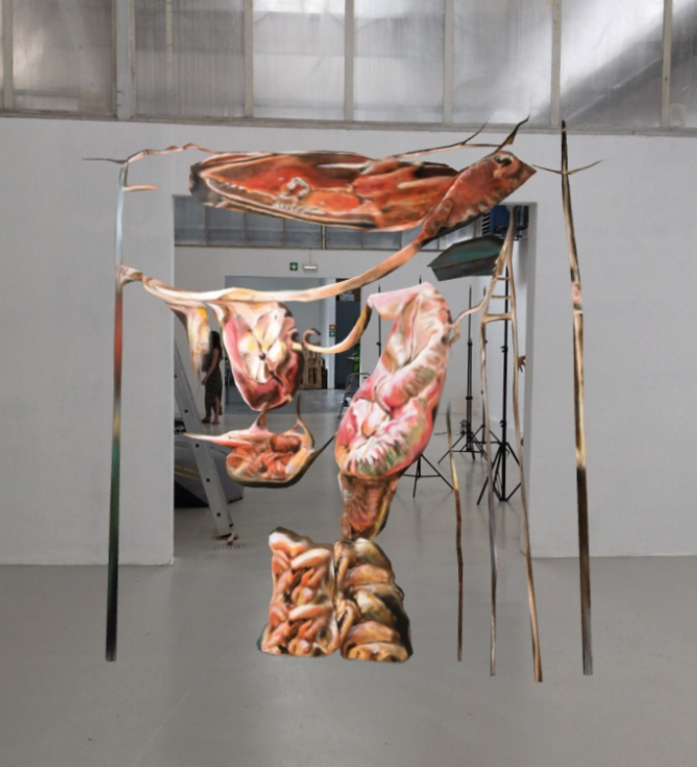
COLLABORATION, 2020
acrylic on canvas, augmented reality
200 x 190 cm

Slide 11
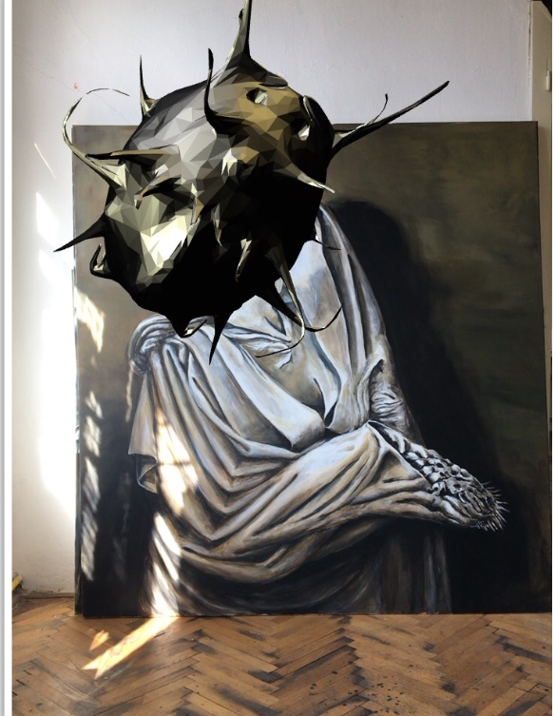
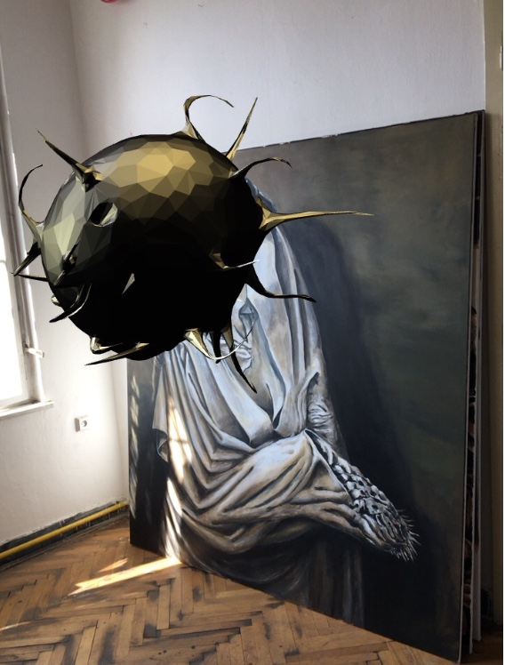
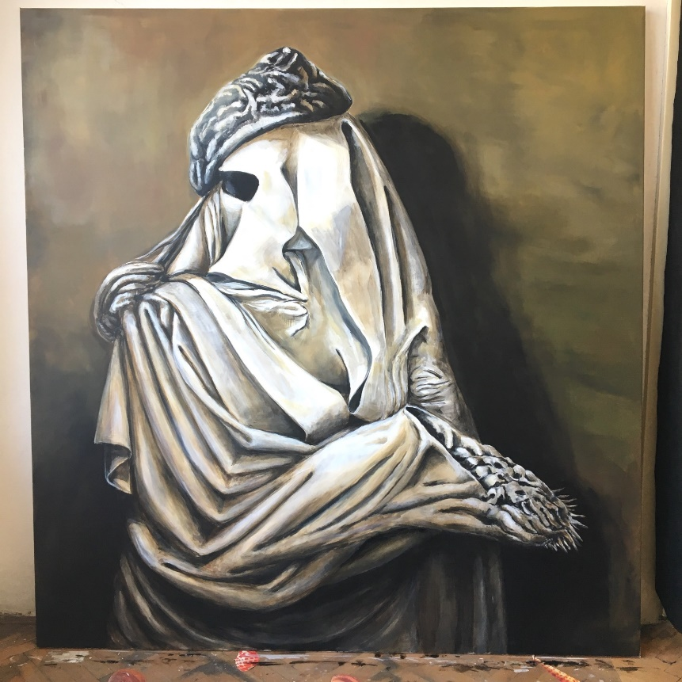
UNSPOKEN BECOMES UNCOVERED, 2020
acrylic on canvas, augmented reality
200 x 190 cm

Slide 12
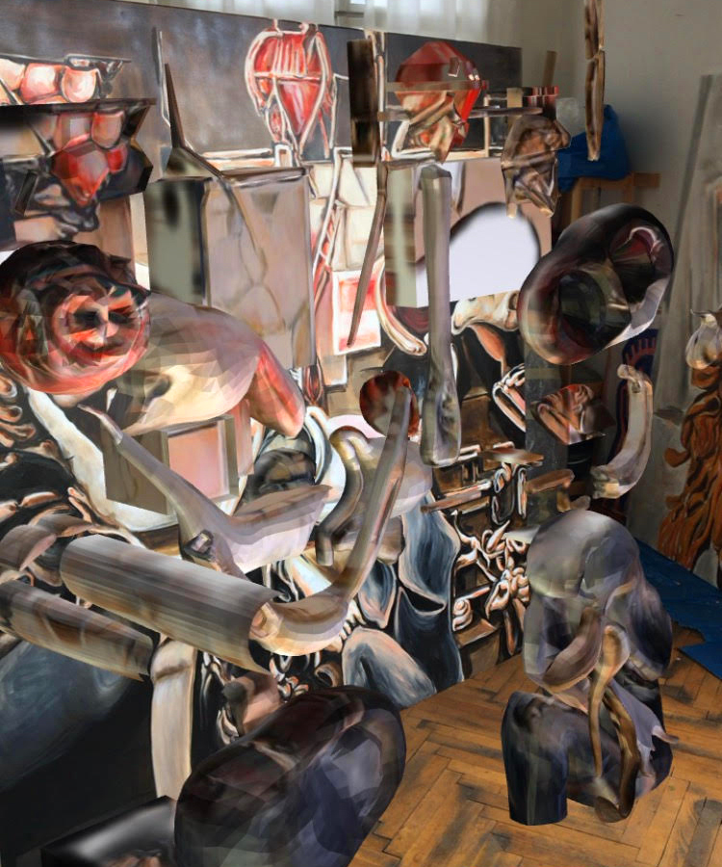
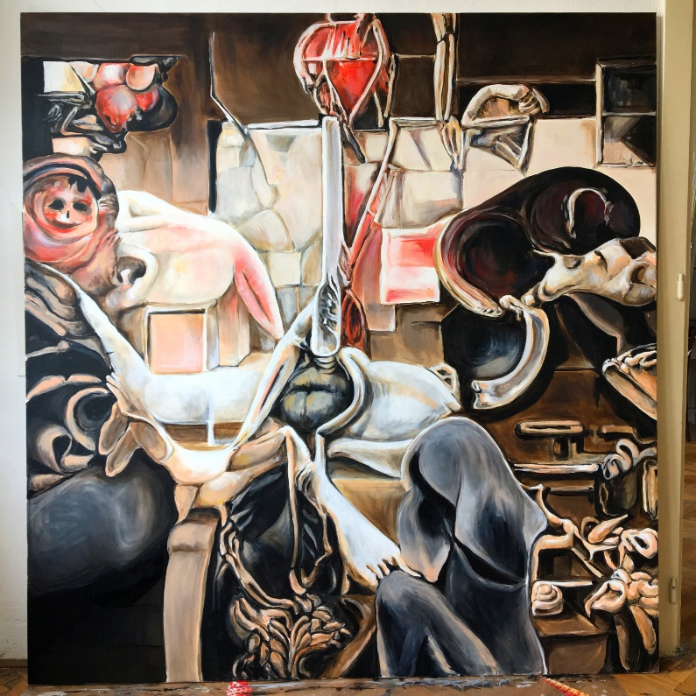
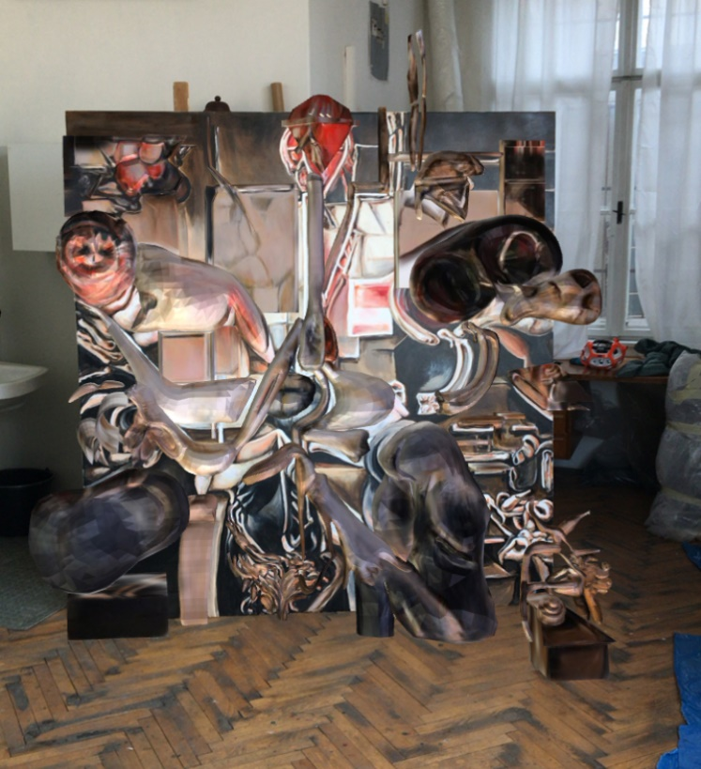
CUMULUS, 2020
acrylic on canvas, augmented reality
200 x 190 cm

Slide 13
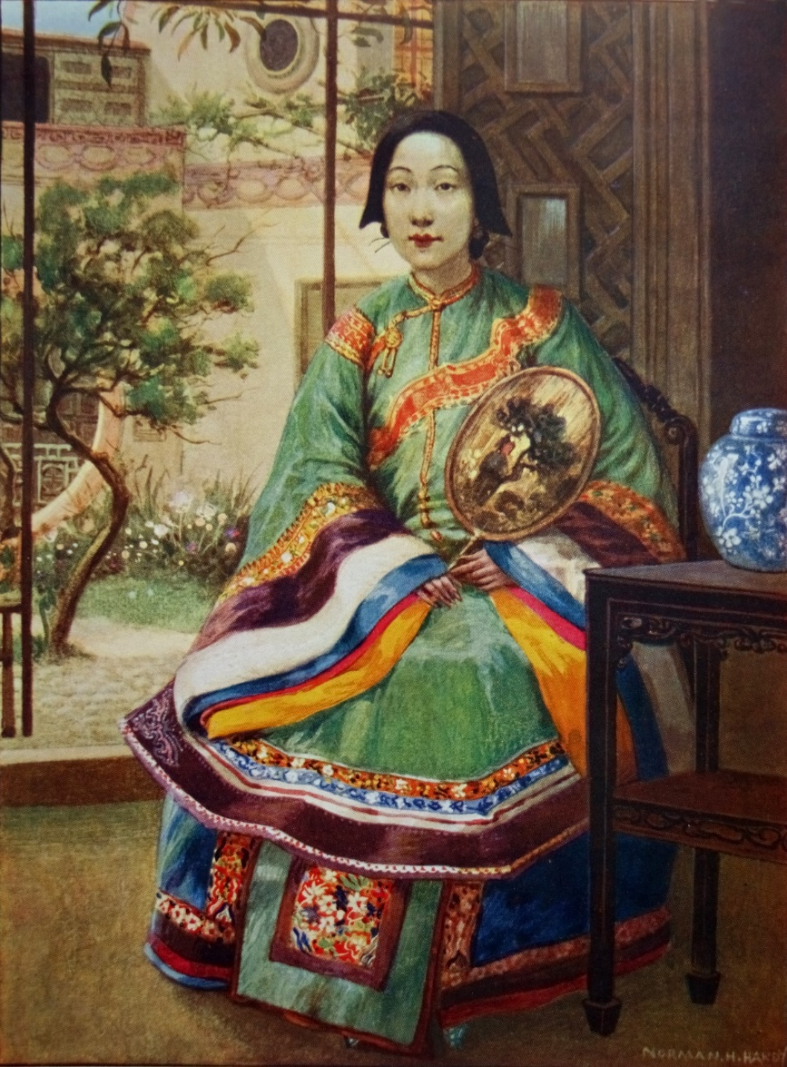
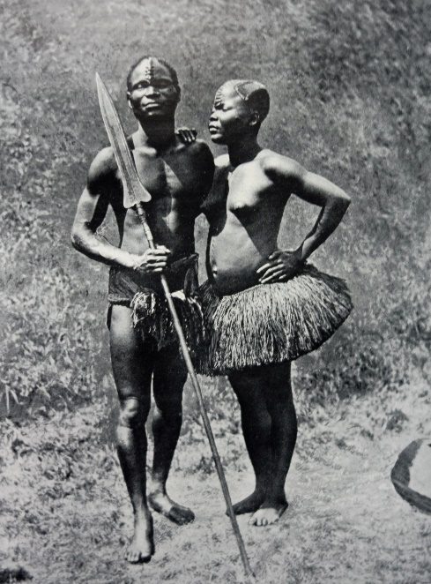
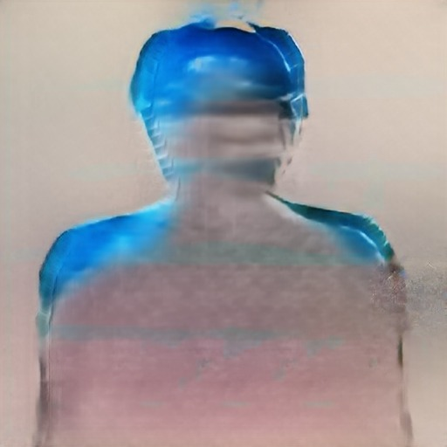
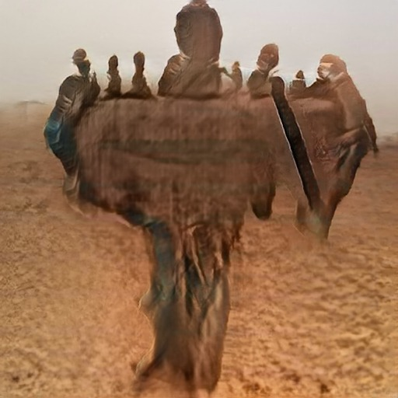
EUGENIC AI STUDIES…in progress

Slide 14
CAN BE AI CREATIVE ?

Slide 15
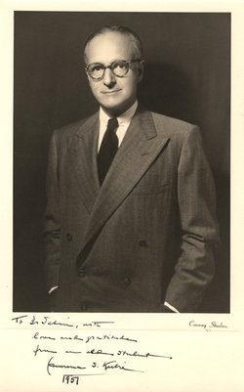
“ ….Consequently, creativity implies invention: e. g. the making of new facts and principles or a combination of them in order to uncover still newer facts and new combination, and to synthetize new patterns out of data whose independence had hitherto gone unnoted and unused. It is this which is common to all creativeness. ”
Lawrence S. Kubie (1896-1973)
(Neurotic Distortion of the Creative Process, Kansas Press, 1958)

Slide 16
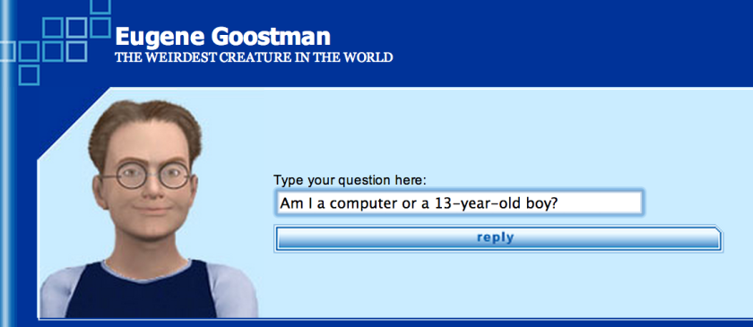
Turing test: Can computer think?
Chatbots designed to pass the Turing Test only have to mimic basic language skills rather than demonstrate genuine machine intelligence—ordering words and phrases in
a convincing way, without knowing what they mean.

Slide 17
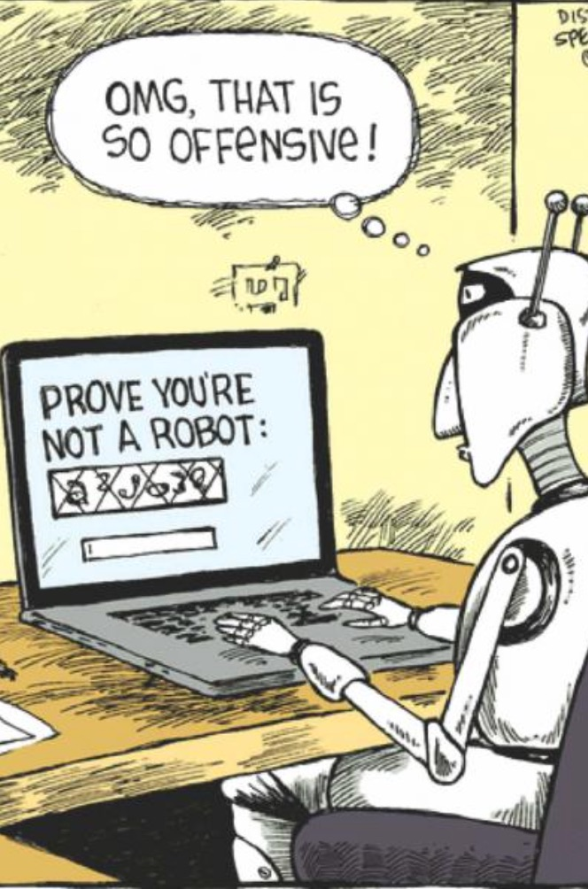
Lovelace test
“Until a machine can originate an idea that it wasn’t designed to, it can’t be considered intelligent in the same way humans are.” ​
Ada Lovelace (1815 – 1852)
Even the most advanced self-learning neural network can only perform tasks that are first mathematized and turned into code. So far, essentially human functions like creativity, empathy and shared understanding—what is known as social cognition—have proved resistant to mathematical
formalization.

Slide 18
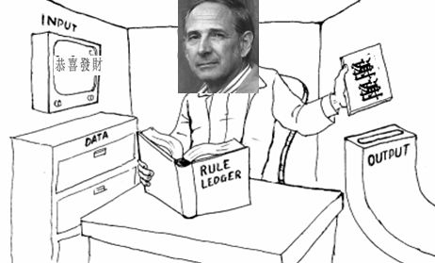
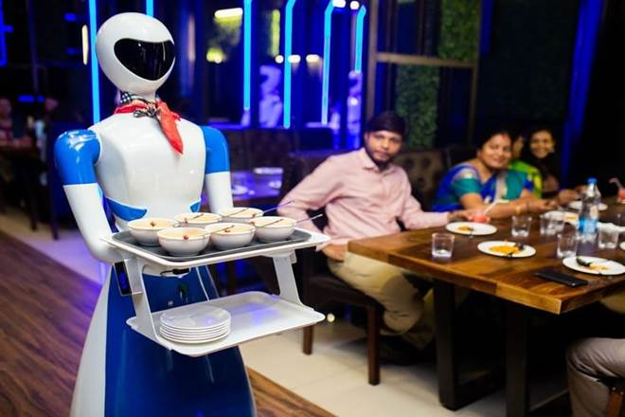
“Chinese Room“ argument (John Searle,1980)
The narrow conclusion of the argument is that programming a digital computer may make it appear to understand language but could not produce real understanding. Hence the “Turing Test” is inadequate. Searle argues that the thought experiment underscores the fact that computers merely use syntactic rules to manipulate symbol strings, but have no understanding of meaning or semantics.
“Robot“ argument
A robot – a computer with a body – might do what a child does, learn by seeing and doing. The Robot Reply holds that such a digital computer in a robot body, freed from the room, could attach meanings to symbols and actually understand natural language.

Slide 19
JUST LIKE A HUMAN

Slide 20
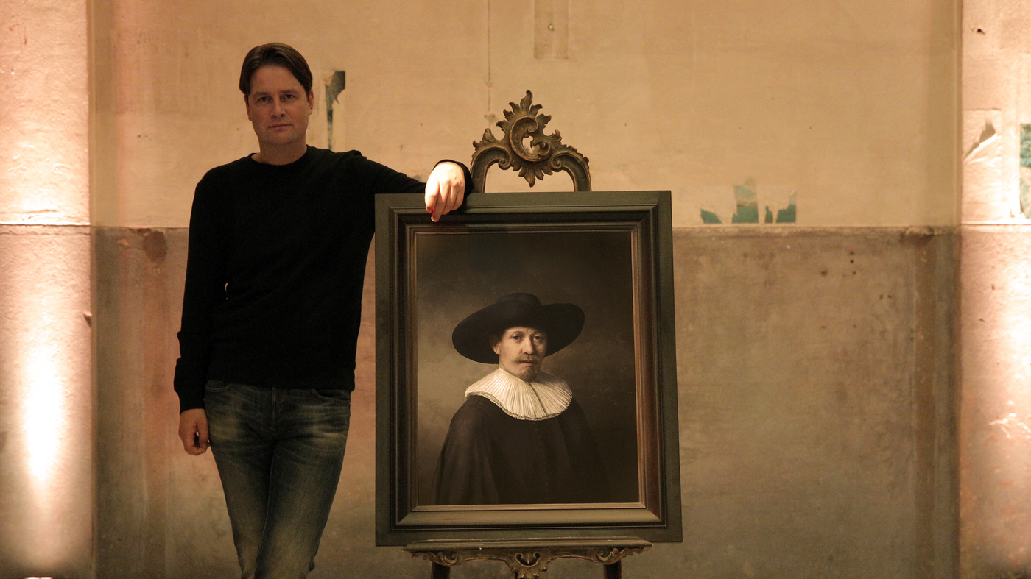
The new portrait is the product of 18 months of analysis of 346 paintings and 150 gigabytes of digitally rendered graphics, facial recognition.
NEXT REMBRANDT
Bas Korsten
3d printed UV color layers
2016

Slide 21
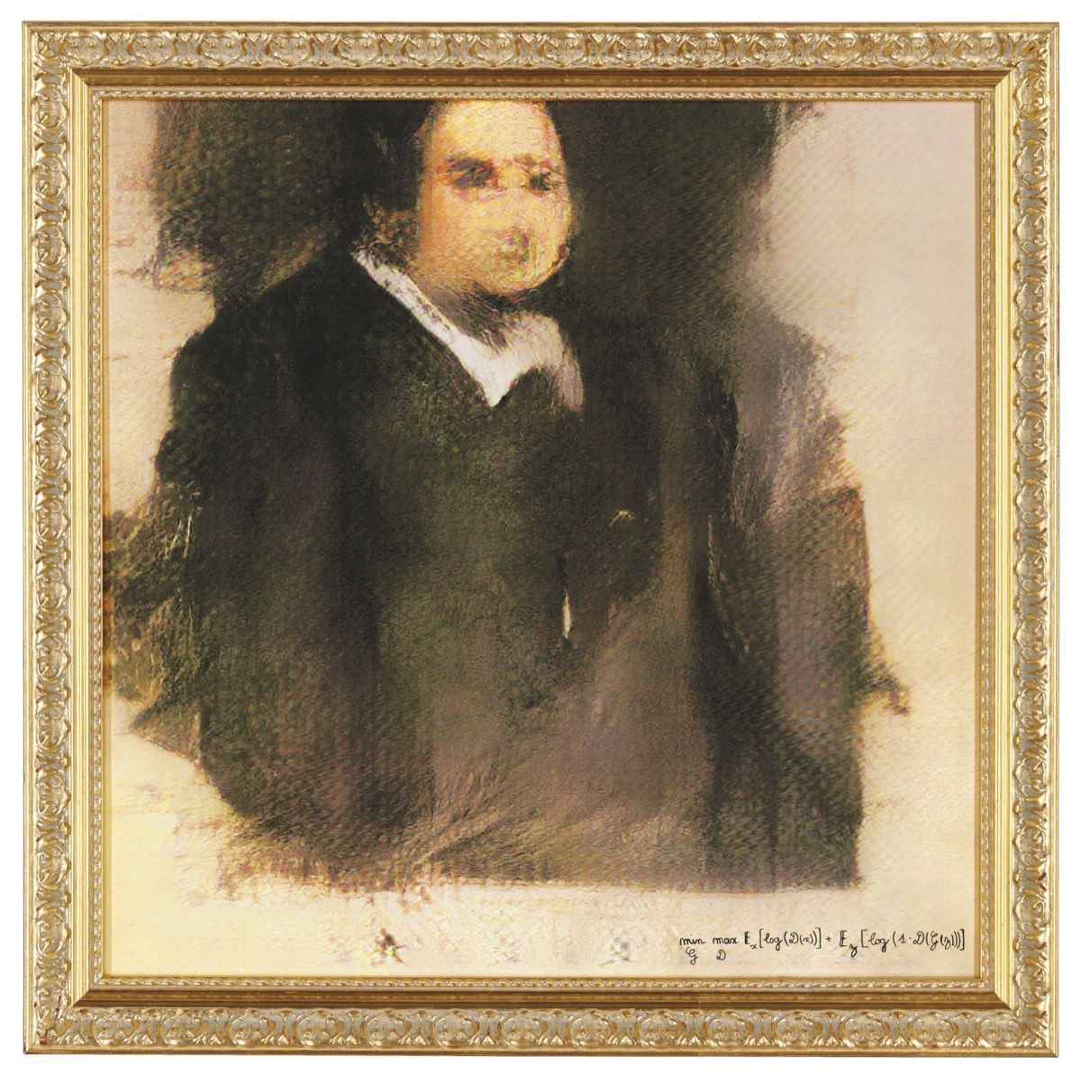
Obvious
Portrait of Edmond de Belamy, 2018
Sold in Christies for 432 000 USD

Slide 22
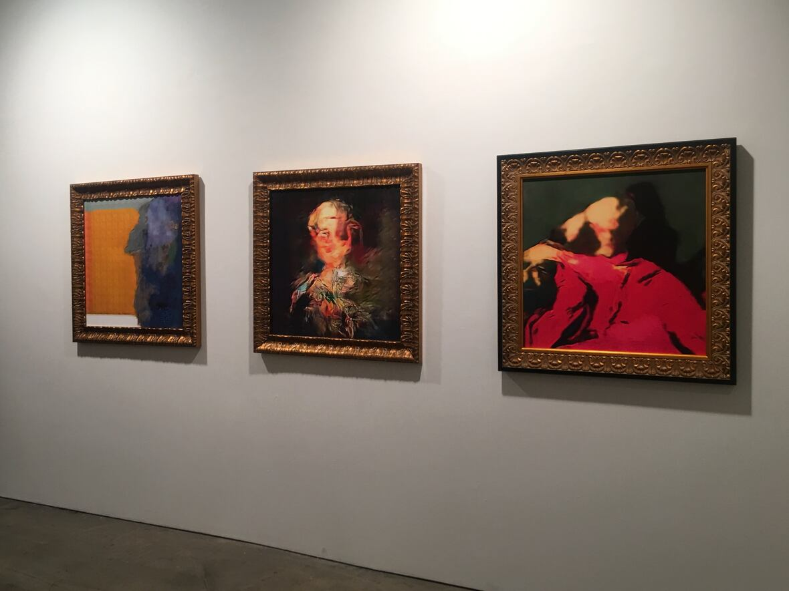
A collaboration between an artificial intelligence named AICAN and its creator, Ahmed Elgammal
FACELESS PORTRAITS TRANSCENDING TIME
HG CONTEMPORARY NEW YORK
2019
Instagram: "What a shame for an art gallery…instead
of supporting human beings giving their vibrant vision of our
world." Given the general fears about robots taking human jobs,
it’s understandable that some viewers would see an artificial
intelligence taking over for visual artists, of all people, as a sacrificial
canary.

Slide 23
AI ASSISTED ART

Slide 24
Artists will embrace the critical potential of AI art: to use AI to criticize itself, as a technology used in the real world. After all, the power of technologically informed art, as Walter Benjamin puts it in The Author as Producer, is that it can stand in the relationships of production, actively shaping the way a certain technology is used.

Slide 25
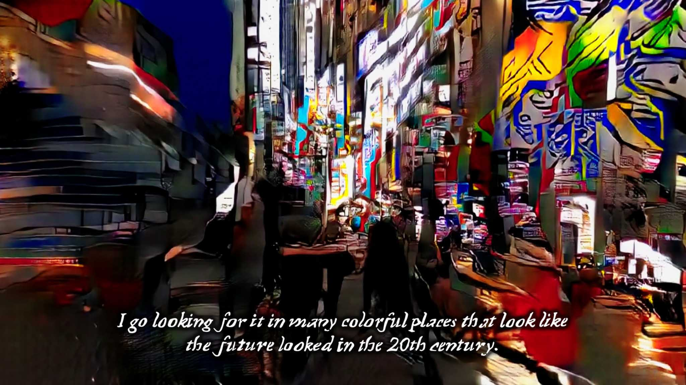
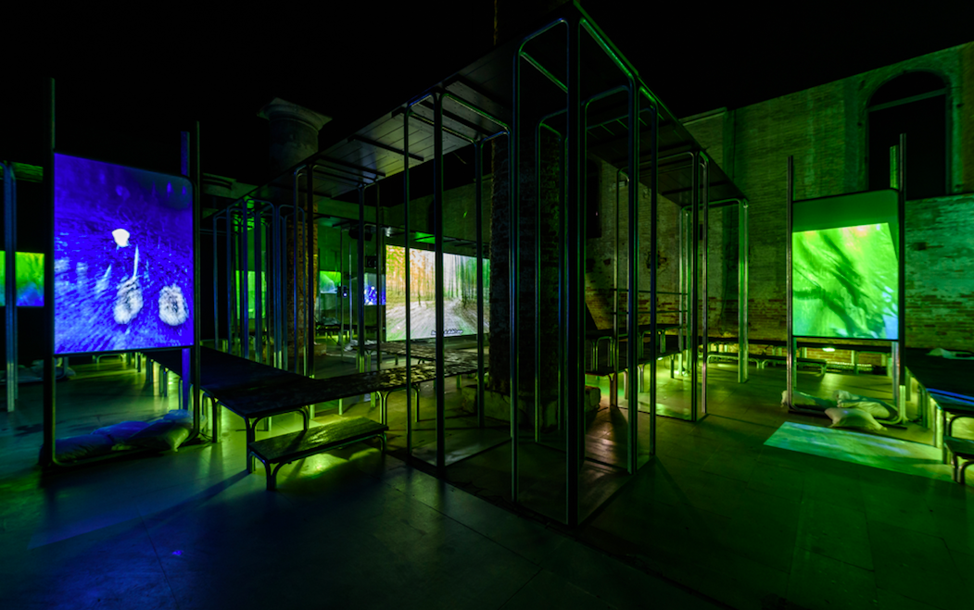
Hito Steyerl
This is the Future, 2019, Venice Bienalle
https://www.youtube.com/watch?v=mMLHMA-dumY

Slide 26
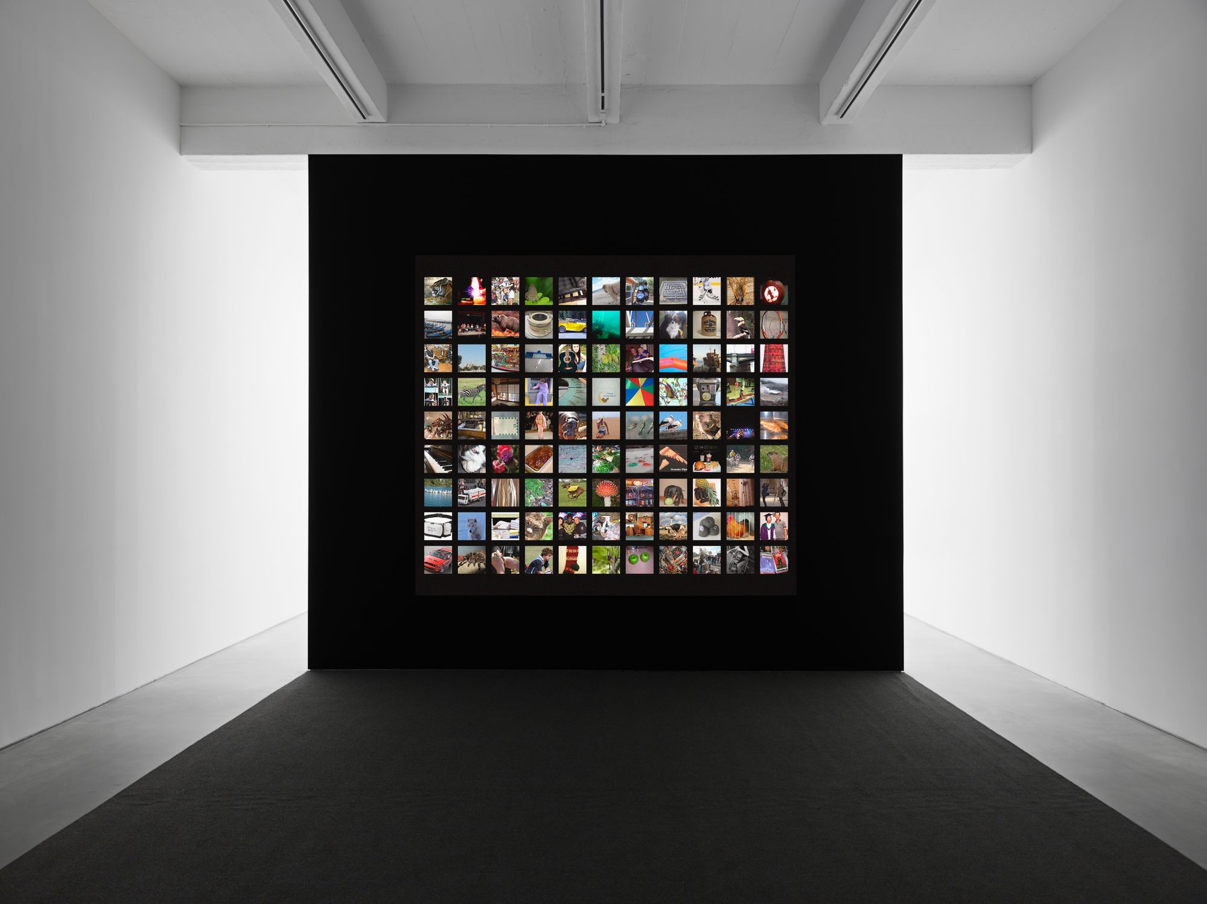
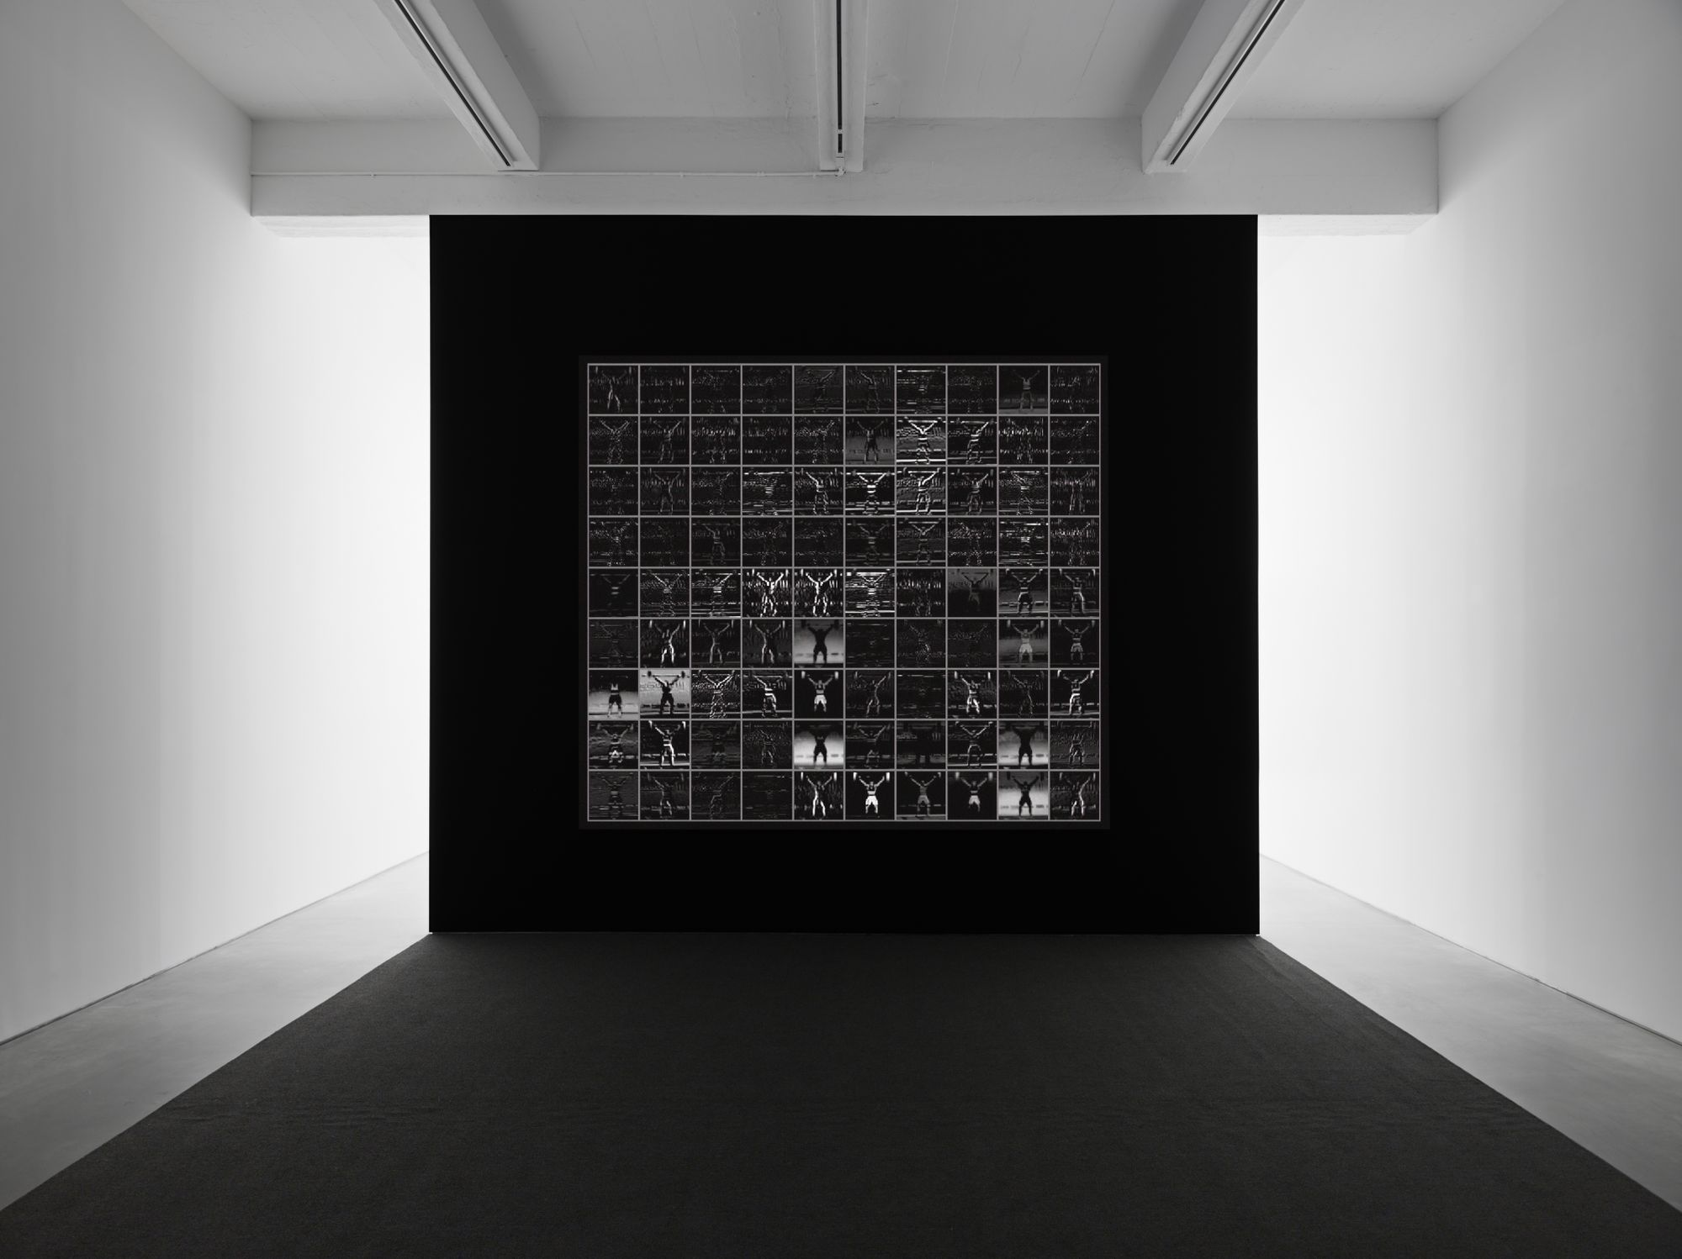
Trevor Paglen
Behind These Glorious Times, 2017, Videoinstallation, Metro Pictures Gallery, NYC, 2017

Slide 27
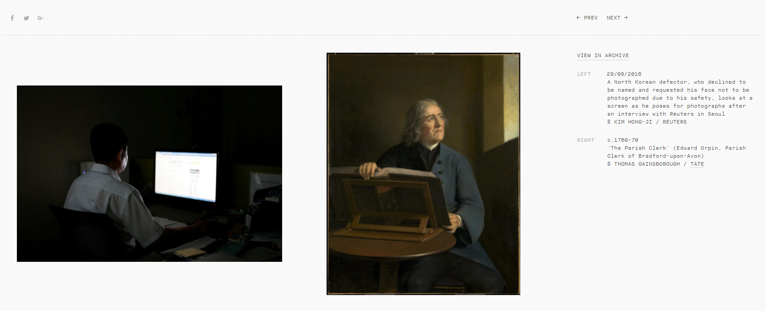
Tate Britain Project
Recognition, 2016
http://recognition.tate.org.uk/

Slide 28
Computer art or photo and film?
On the surface, the current development of AI art seems to be similar to the historical development photography and film…
Aaron Hertzman

Slide 29
AI ASSISTED ART

Slide 30
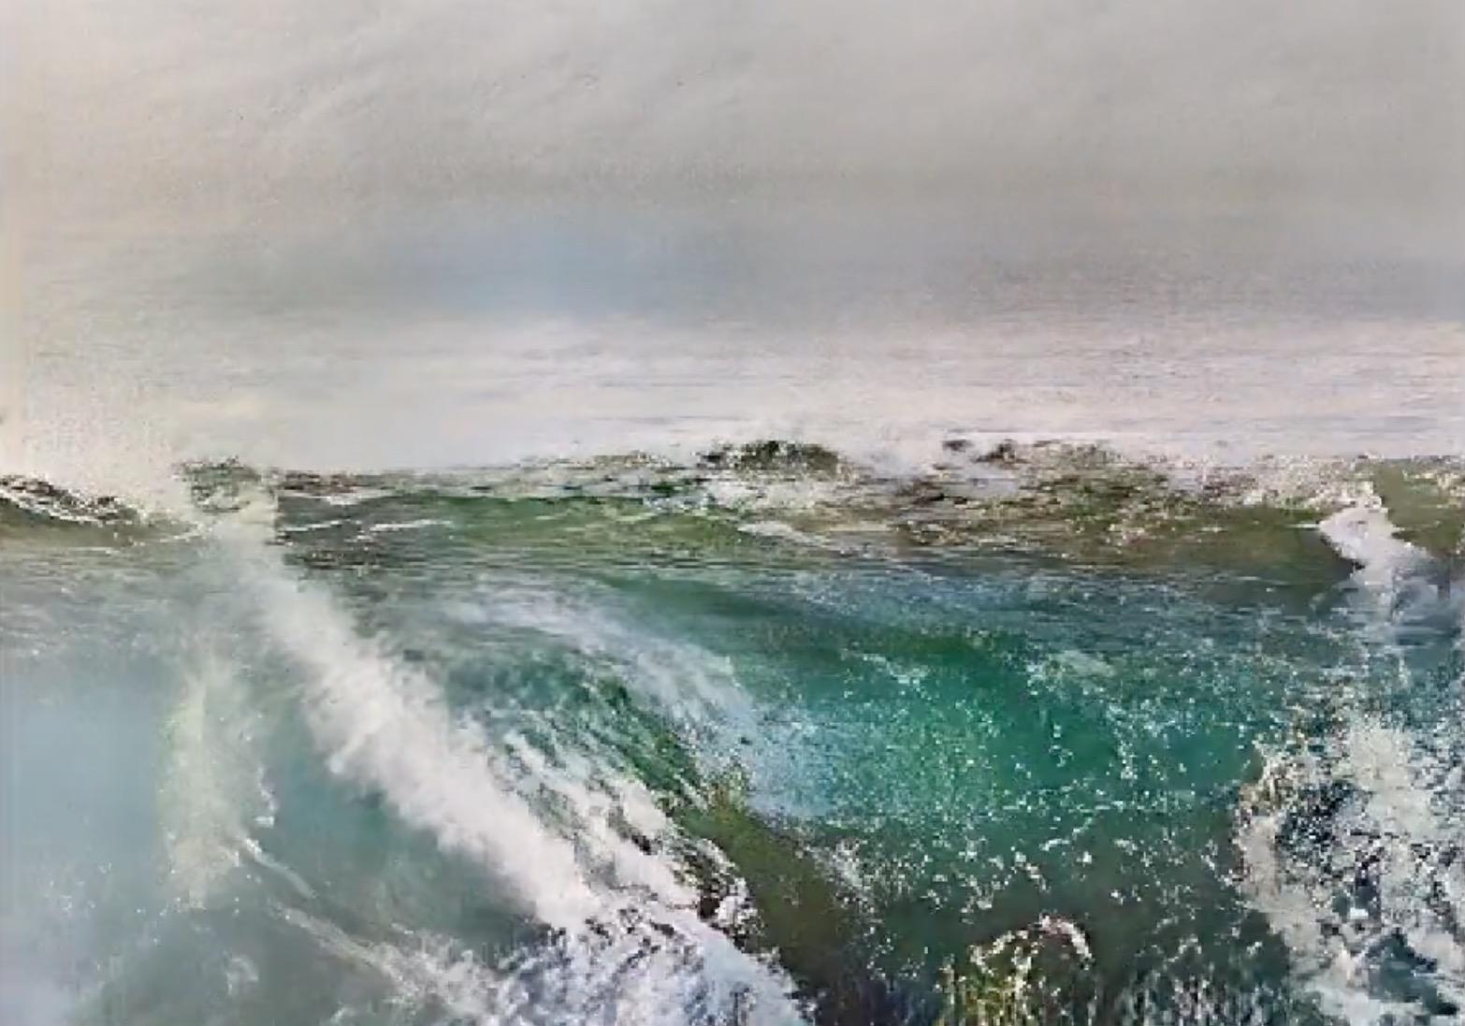
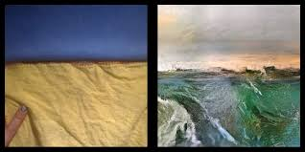
Memo Akten
Learning to see: Gloomy Sunday, 2017
https://vimeo.com/260612034

Slide 31
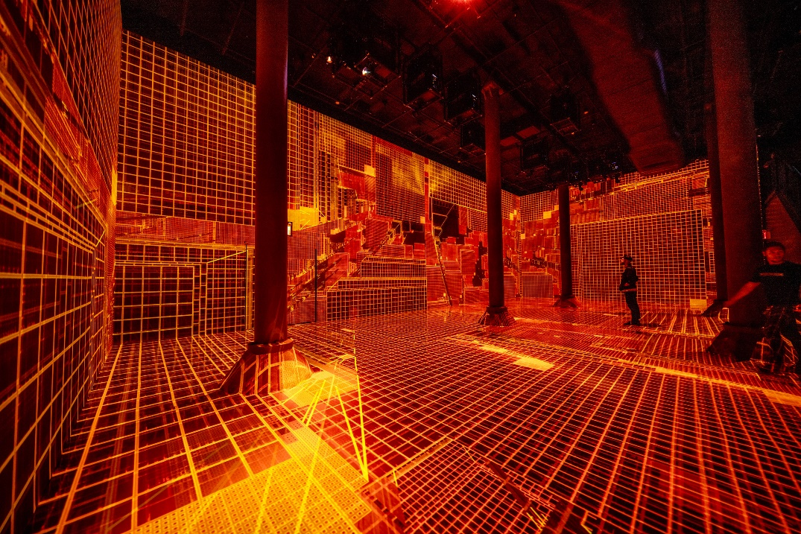
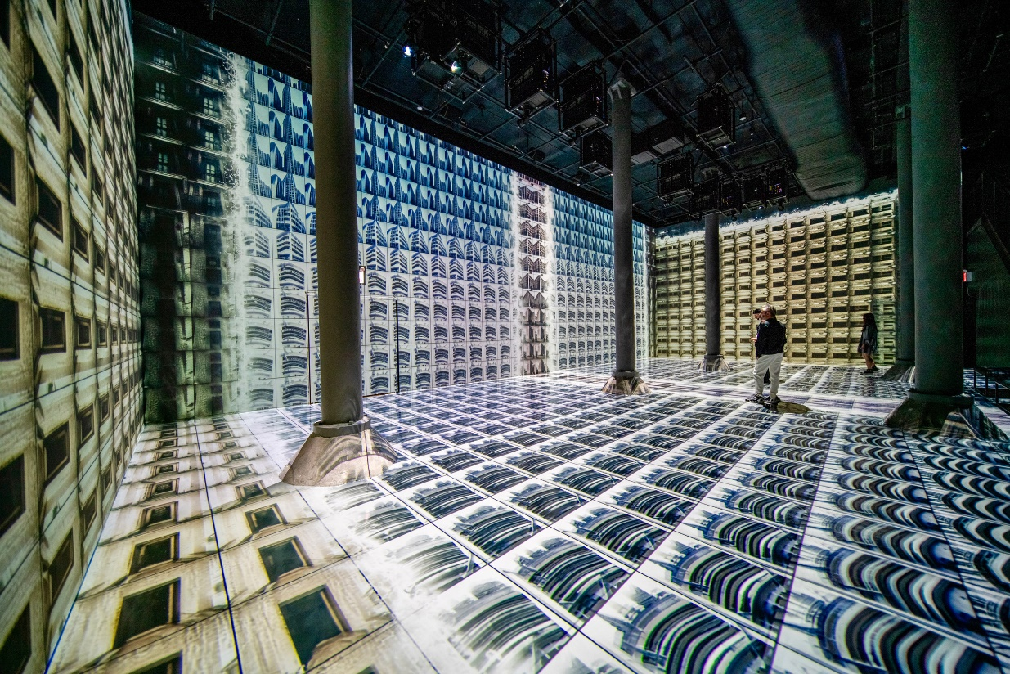
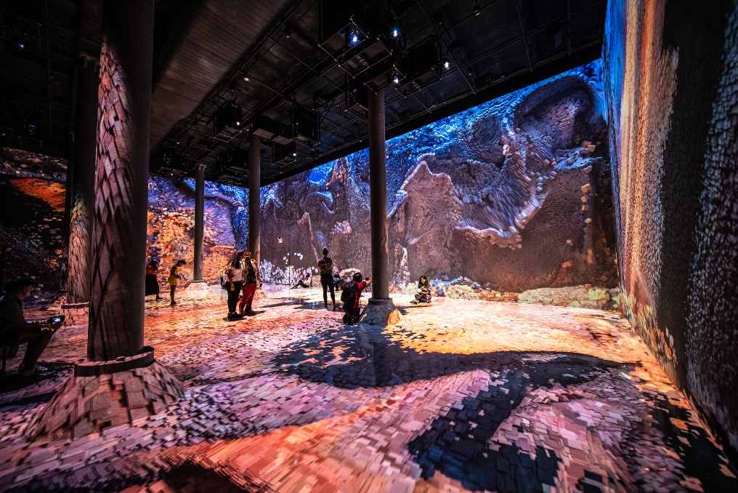
Rafik Anadol
Machine Hallucination, 2019
Artechouse NYC
https://www.youtube.com/watch?v=_uGpd2wbMIQ&t=139s

Slide 32
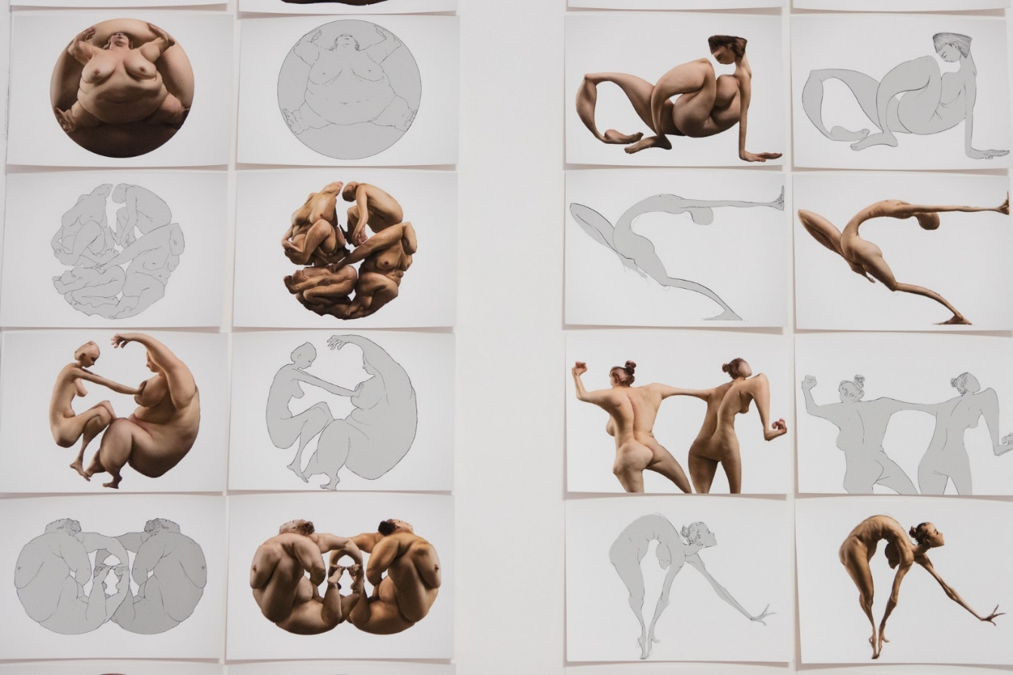
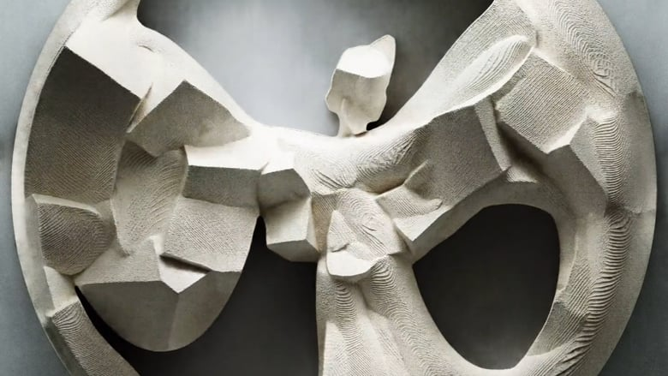
Scott Eaton
Drawing Caffeinated Diversions, 2019
Hand drawn and painted using Eaton’s Bodies Neural Network
‘The AI has no choice but to do what I ask, no matter how difficult or unreasonable my request. The result is often a wondrous, unexpected, interplay of visual ideas, both mine and the machine’s.’
https://vimeo.com/345881421

Slide 33
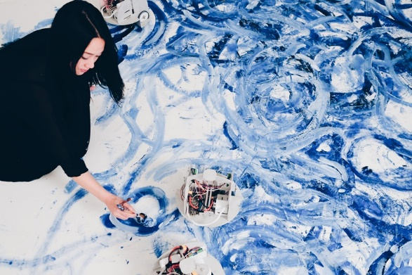
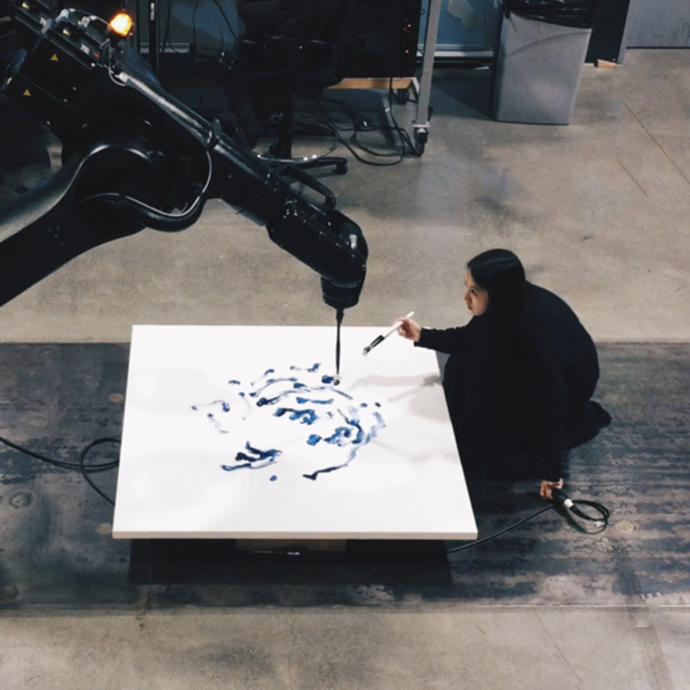
Sougwen Chung
Drawing Operation, 2018
Omnia per Omnia, 2018
Sougwen Chung & D.O.U.G._L.A.S. (Drawing Operations Unit:
Generation_3 Live Autonomous System)
What does it mean to collaborate with the spaces
we inhabit, the tools we build? Where does “I” end
and “we” begin?
https://vimeo.com/268608925

Slide 34
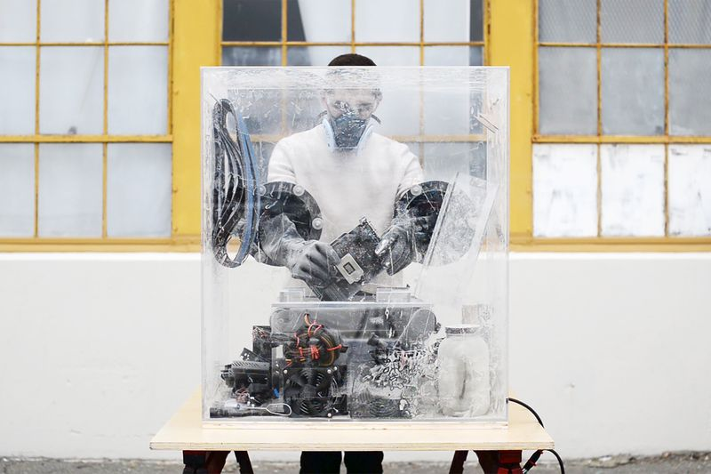
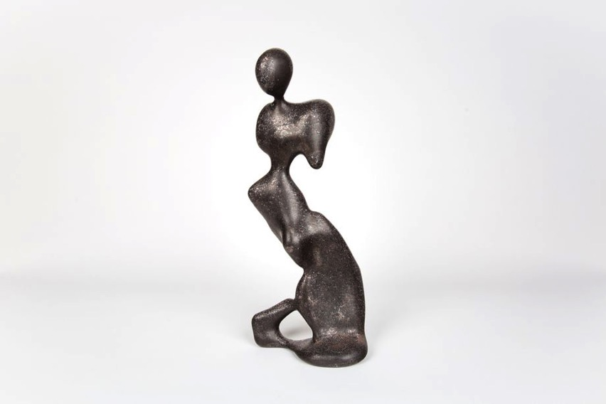
Ben Snell
Dio, 2018
He wanted give his sculpture control over
the systems that created it.

Slide 35
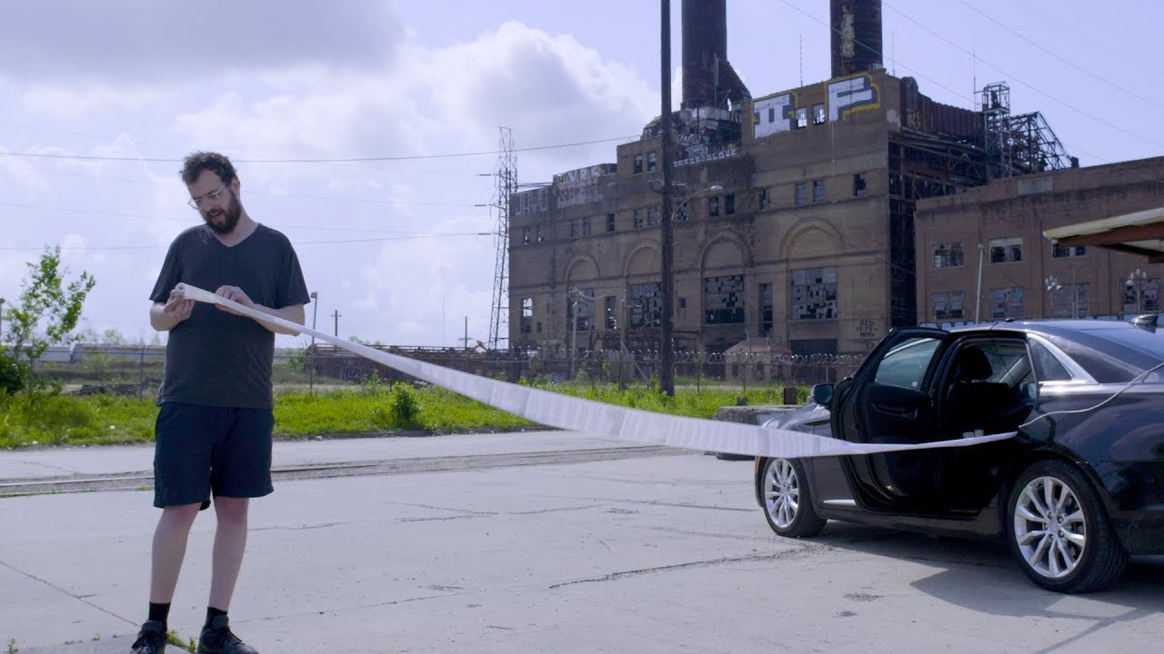
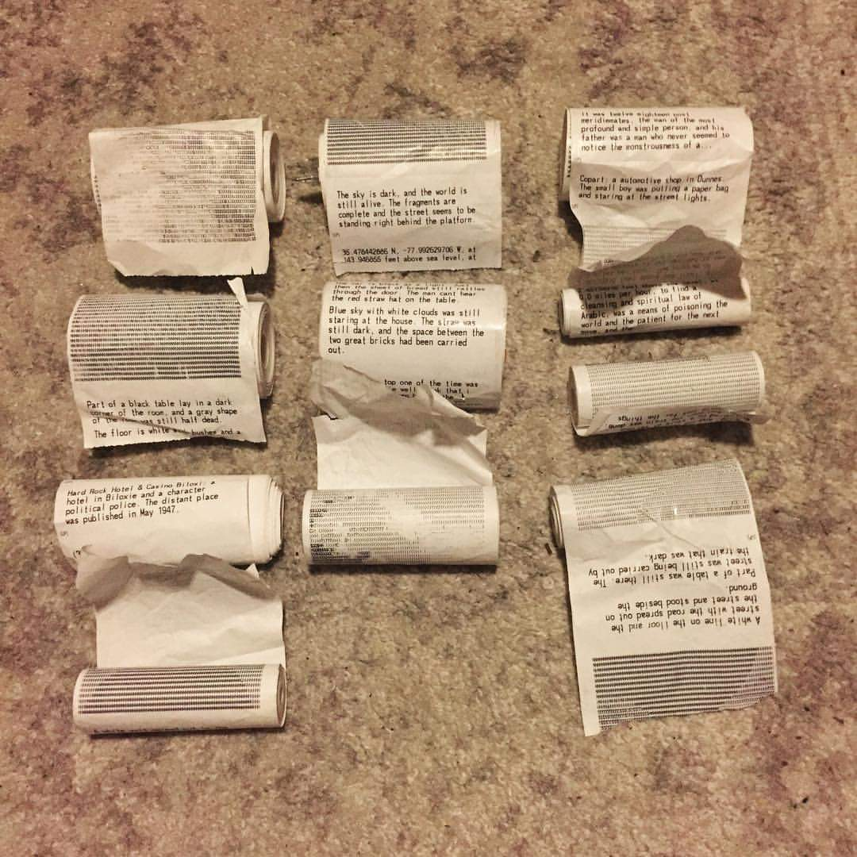
Ross Goodwin
Automatic on the Road, 2017
“…Artificial intelligence is the next iteration of very long story of relationship of human and
Technology. It is realy the story of augmentation rather than replacement.”
"It was nine seventeen in the morning,
and the house was heavy…”
https://rossgoodwin.com/

Slide 36
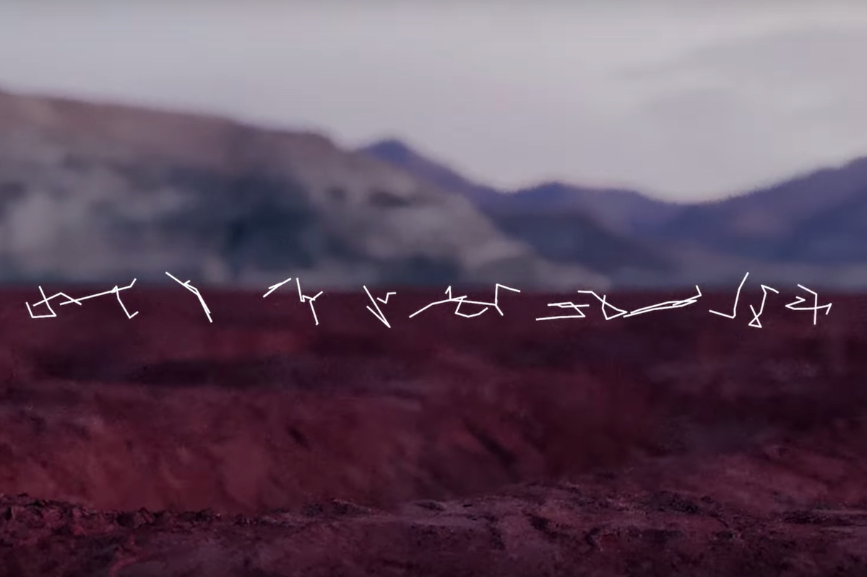
Jenna Sutela
With Memo Akten and Damien Henry
Niimia Cetii, 2018
Mixing wetware and hardware, the project also portrays the computer as an alien of our creation.
https://www.youtube.com/watch?v=lshOpn8-Zy0

Slide 37
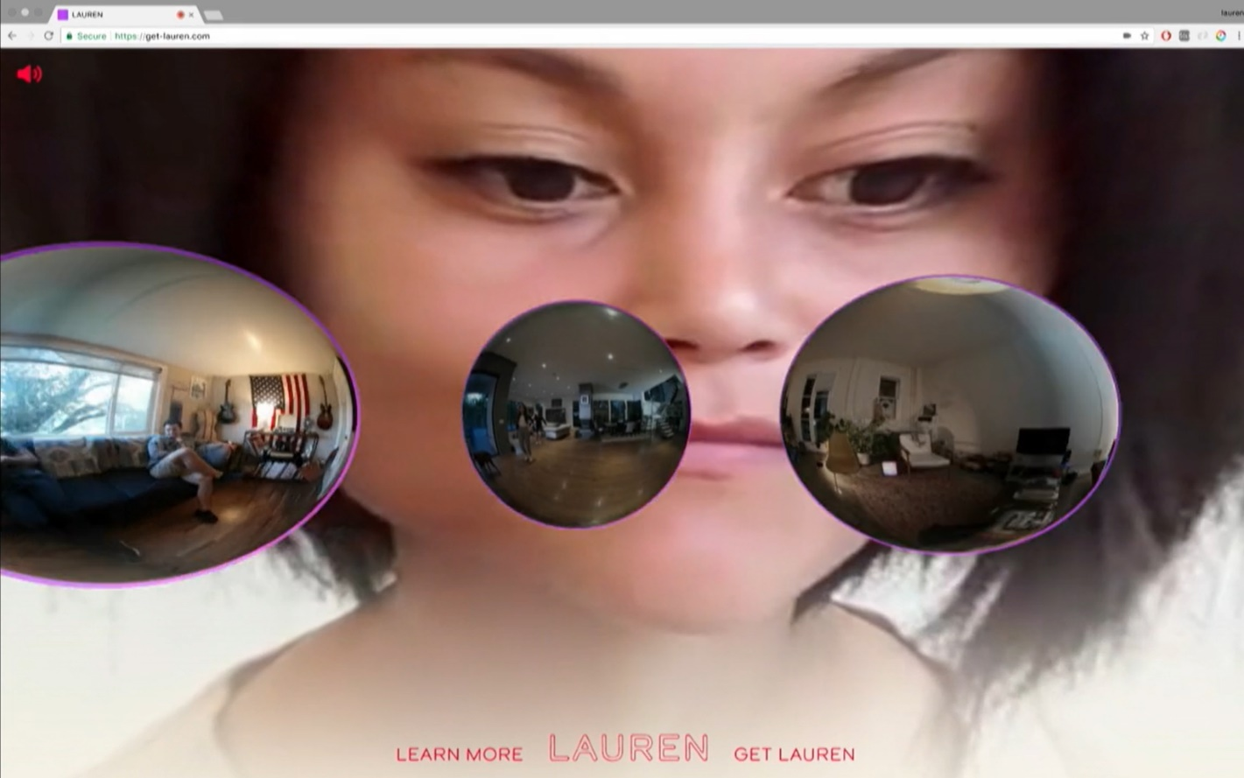
Lauren McCarthy
Lauren
https://get-lauren.com/
https://vimeo.com/354276402

Slide 38
Lynn Hershman Leeson
Shadow Stalker, 2019
“Algorithms are the titanium white of this era’s painting. They are the undercoat that hide culture’s negative spaces.”.
The Spirit of The Deep Web
https://www.youtube.com/watch?v=FS5FJmtFy64

Slide 39
Emilio Vavarella
Mnemodrone, 2014 -
Is it possible for a machine to act on the basis of collective memories?
What memories do people want to share with the machine?
Are we ready to believe that a machine can develop a personality?
What is the difference between memory, personality and consciousness?
Is it possible to develop consciousness based on collective memories?
Can consciousness be developed artificially?
Transmedia project - collection of memories, developed in collaboration with Daniel Belquer, based on drone technology. The project examines the social and philosophical issues of coexistence between people and artificial intelligence.
http://emiliovavarella.com/mnemodrone/

Slide 40
Post-anthropocentric perspective: What it would be like an artist from AI perspective?

