Slide 1

PATTERN
Inspiration
Inspiration
Inspiration
Inspiration
Inspiration
Inspiration
Inspiration
Generative Design Programming
Mgr. art. Helena Lukášová, ArtD.
Inspiration
Inspiration

Slide 2
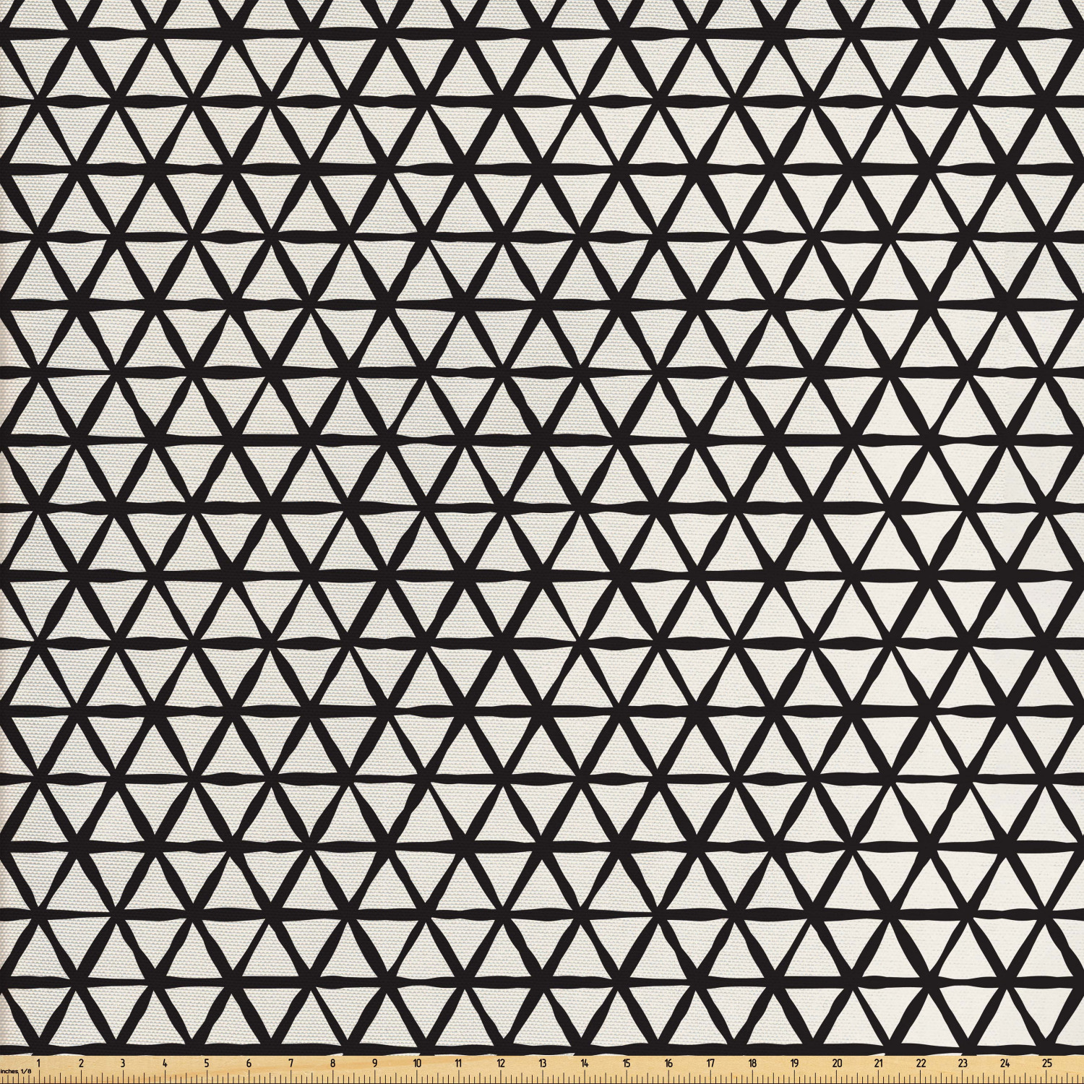
PATTERN
IS a regularity in the world, in human-made design, or in abstract ideas. As such, the elements of a pattern repeat in a predictable manner.

Slide 3
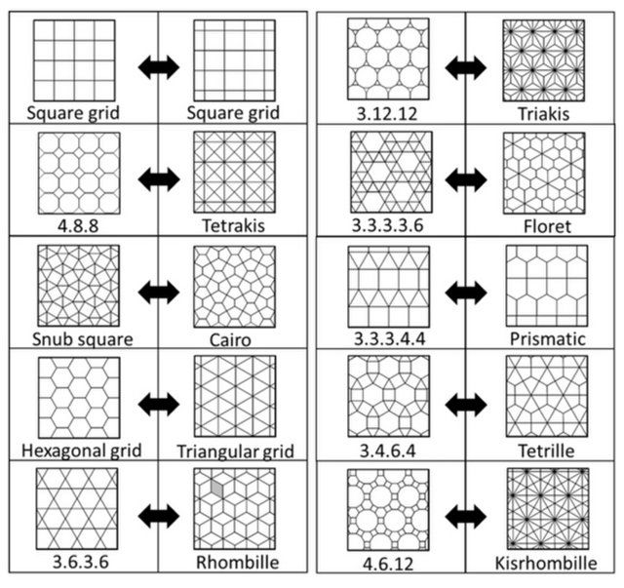
Tesselation is created when a shape is repeated over and over again covering a plane without any gaps or overlaps. Another word for a tessellation is a tiling.
https://materchristi.libguides.com/tessellations

Slide 4
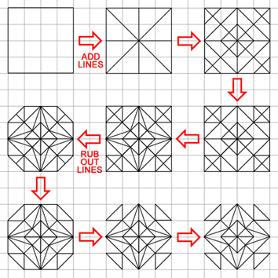
Islamic Pattern
In Islamic culture very complex geometric patterns were created. We can admire them
especially in architecture as tile walls and ceiling.
The abstract visual thining comes also from the Islamic rule not to depict
Allah. We do not see images of the real world in Islamic architecture.
The construction of the pattern is done with the straigh lines and circles.
https://artofislamicpattern.com/resources/educational-posters/

Slide 5
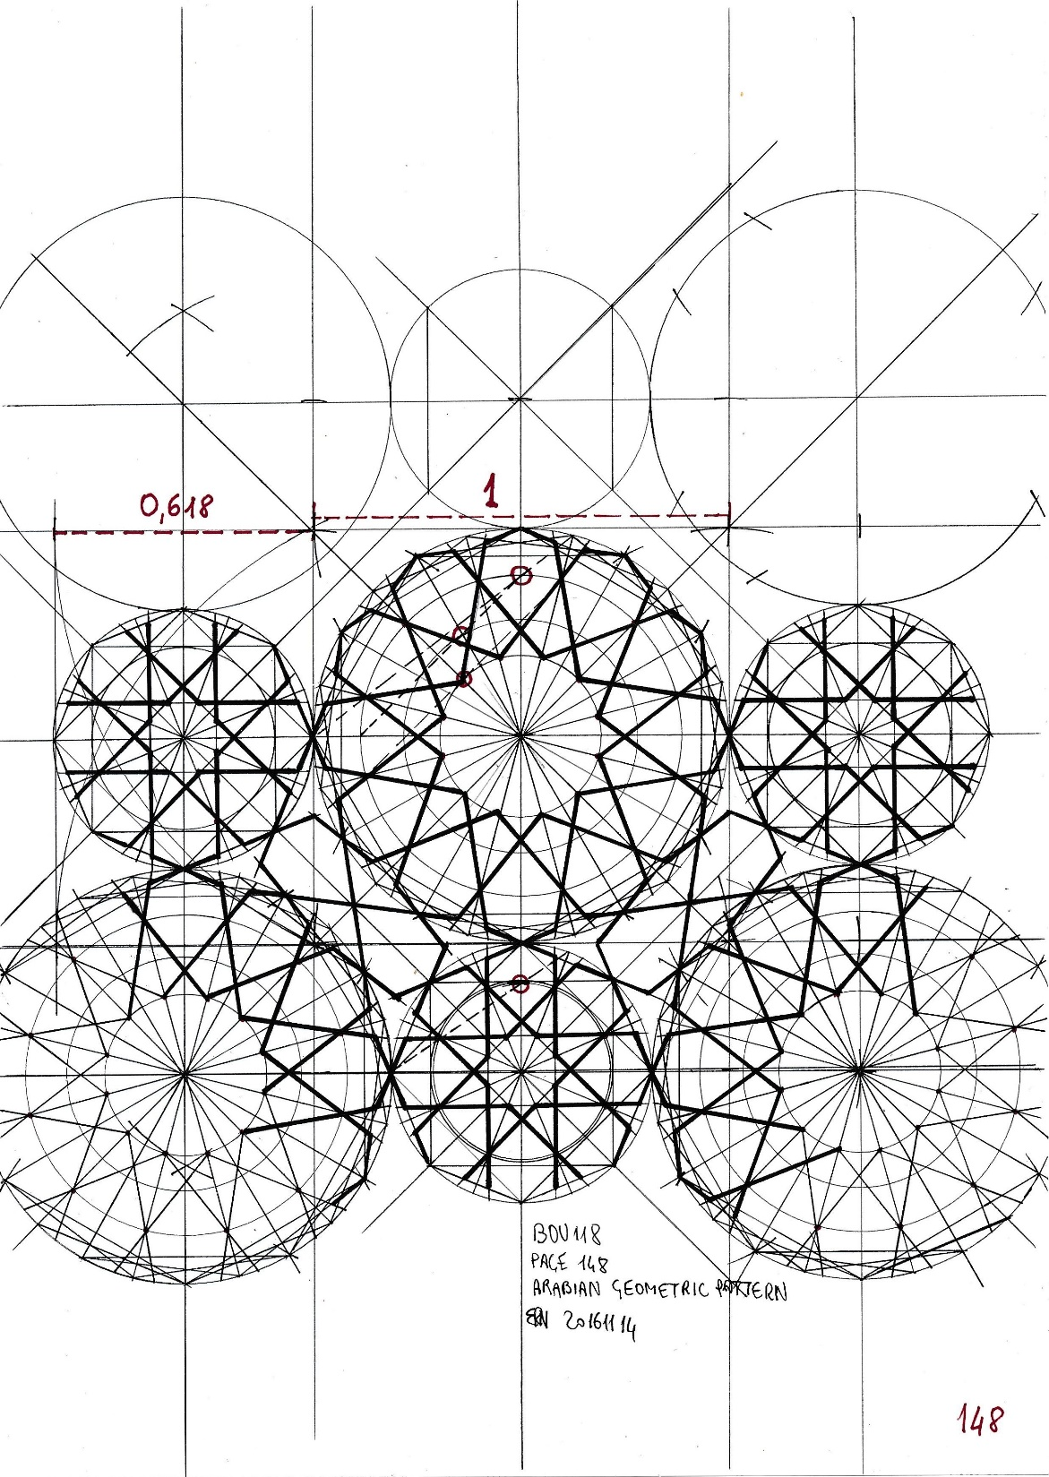
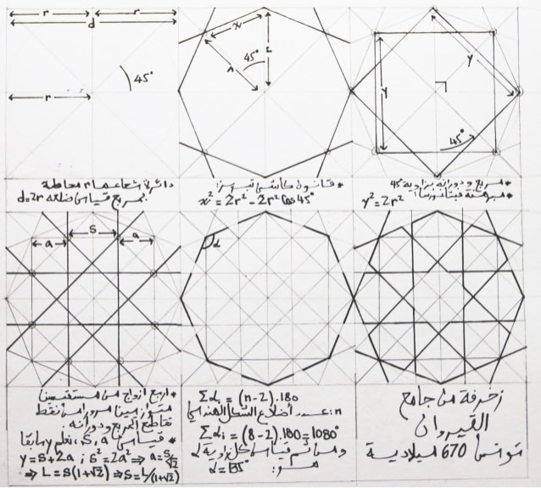
Islamic Pattern

Slide 6
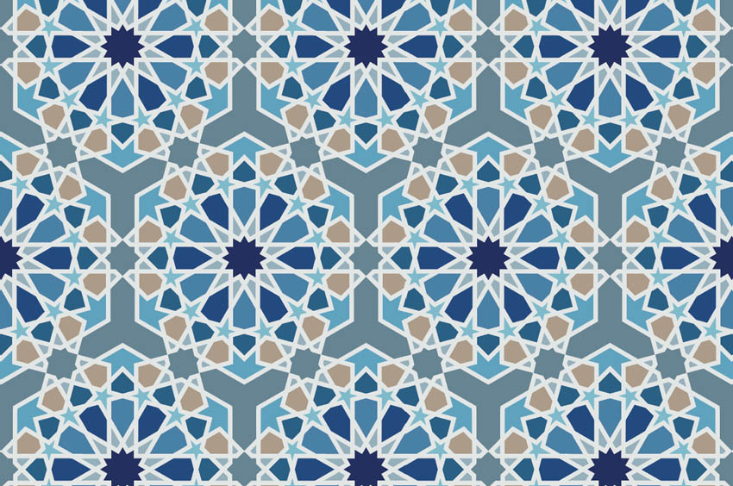
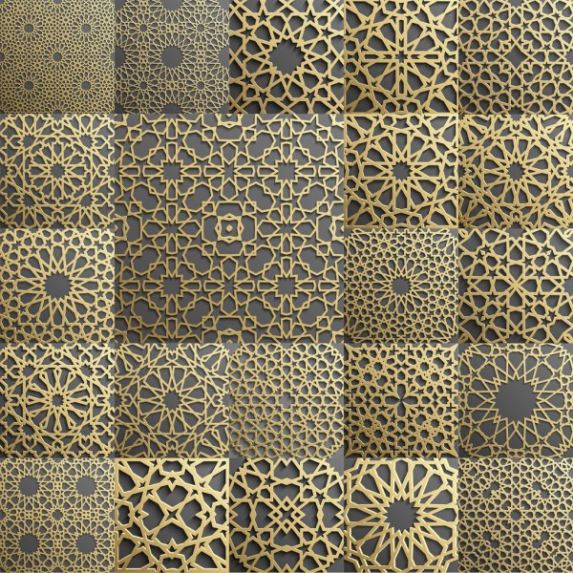
Islamic Pattern

Slide 7
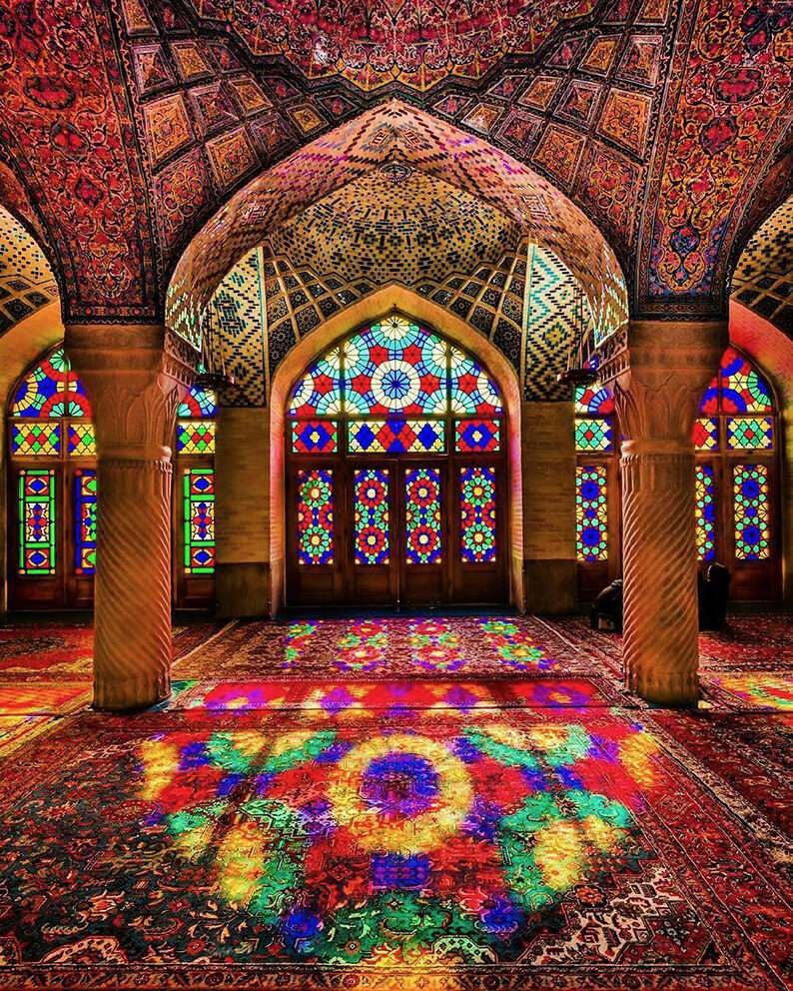
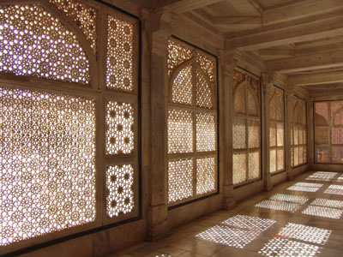
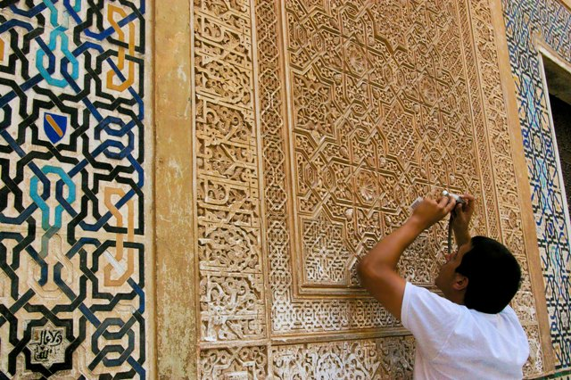
Islamic Pattern

Slide 8
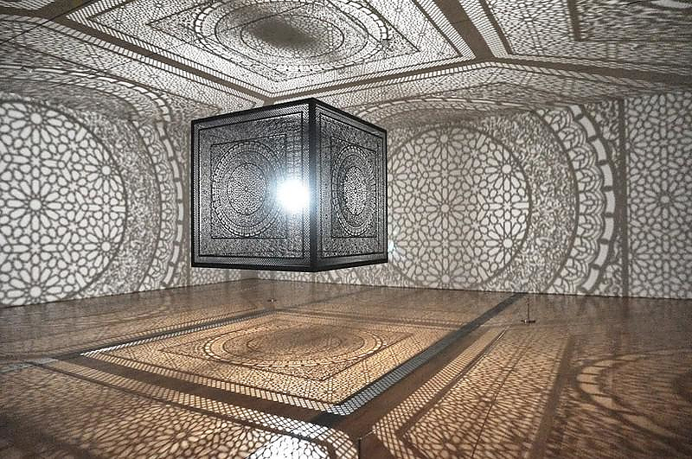
Islamic Pattern
https://laughingsquid.com/intersections-a-wooden-cube-art-installation-that-explores-boundaries-through-patterns-of-light-and-shadow/

Slide 9
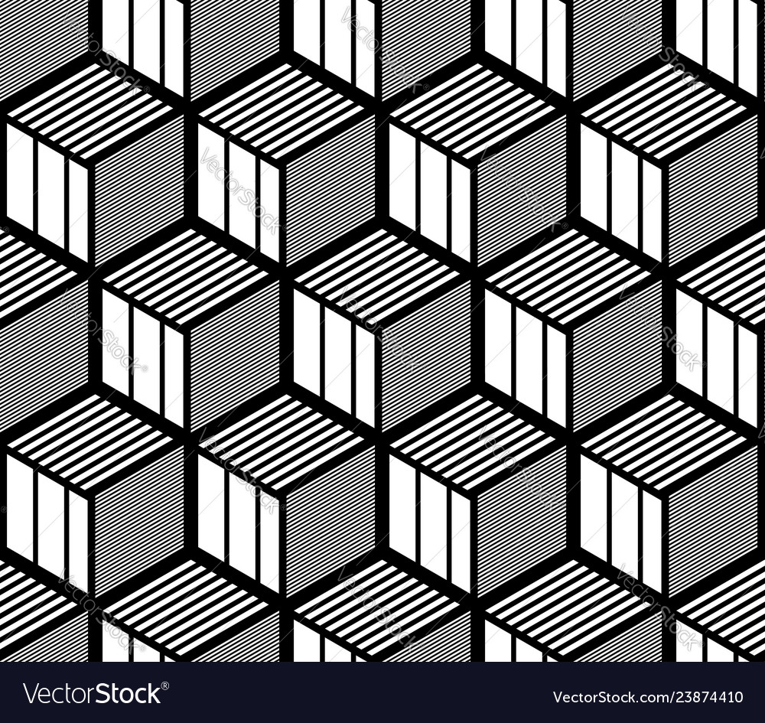
Op Art gives an illusion of 3D spatial structure or optical illusion of movement

Slide 10
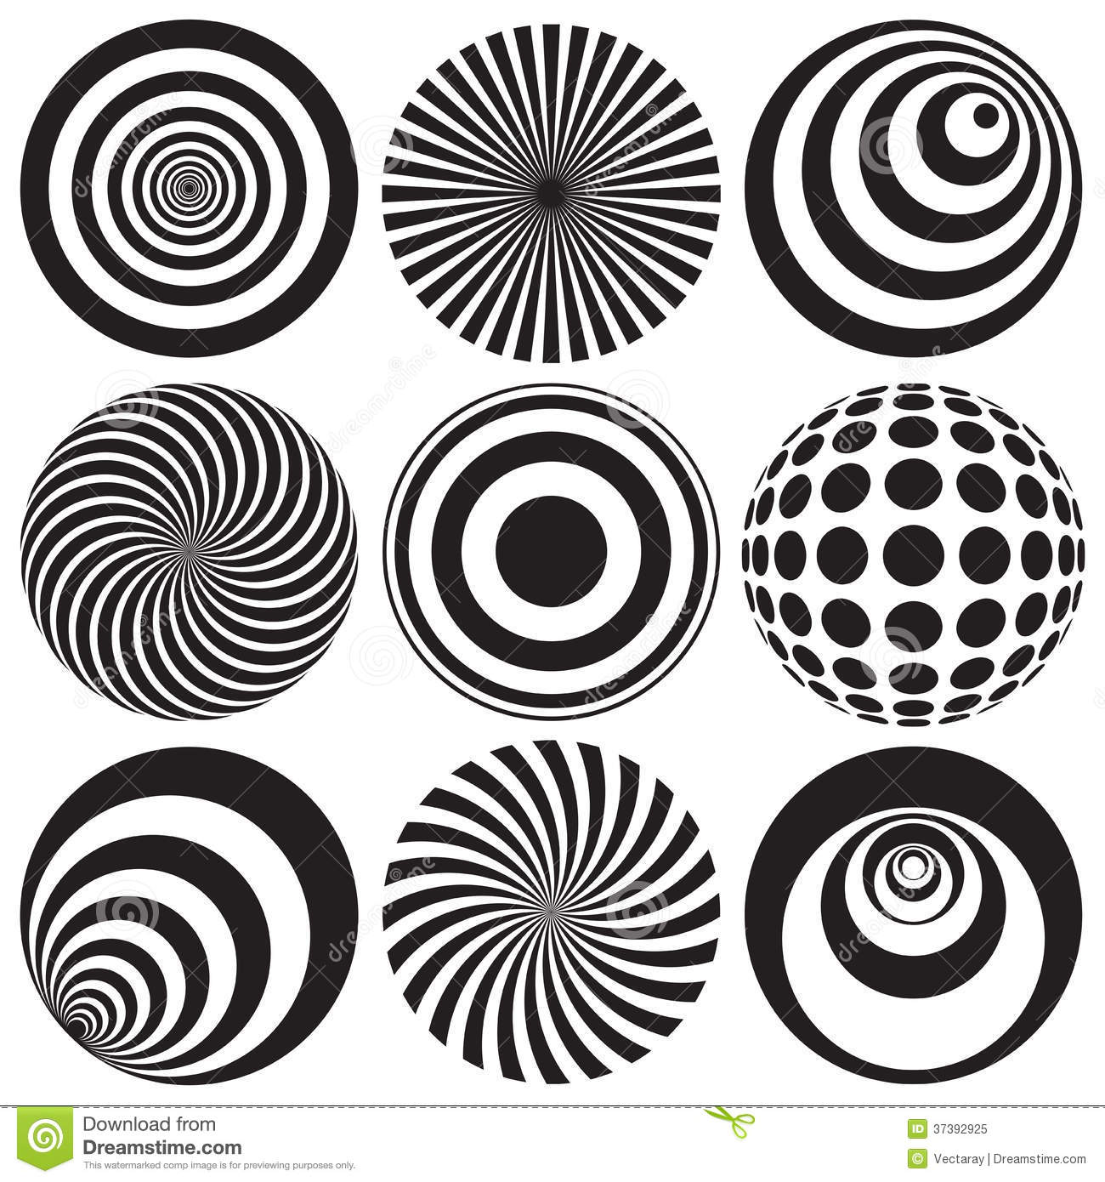
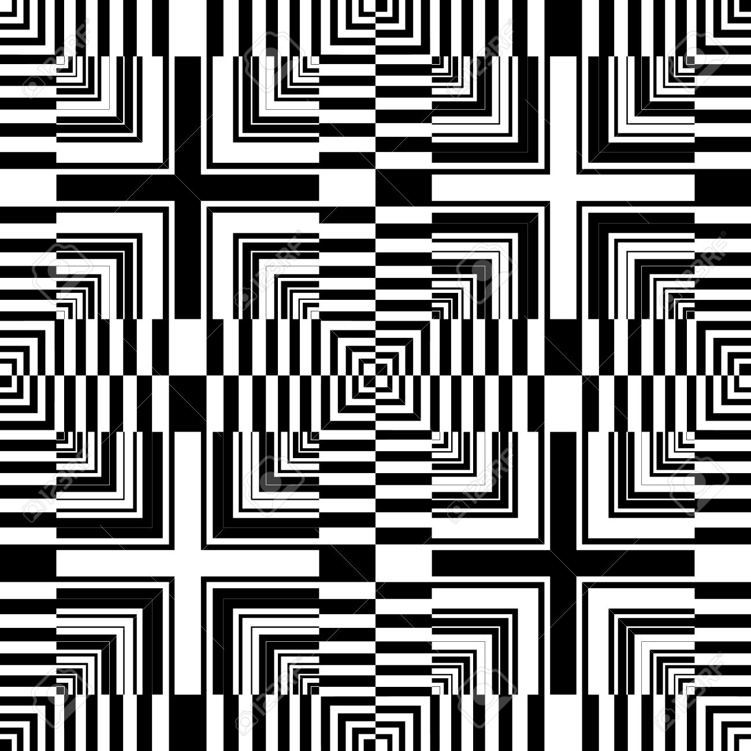
Op Art gives an illusion of 3D spatial structure or optical illusion of movement

Slide 11
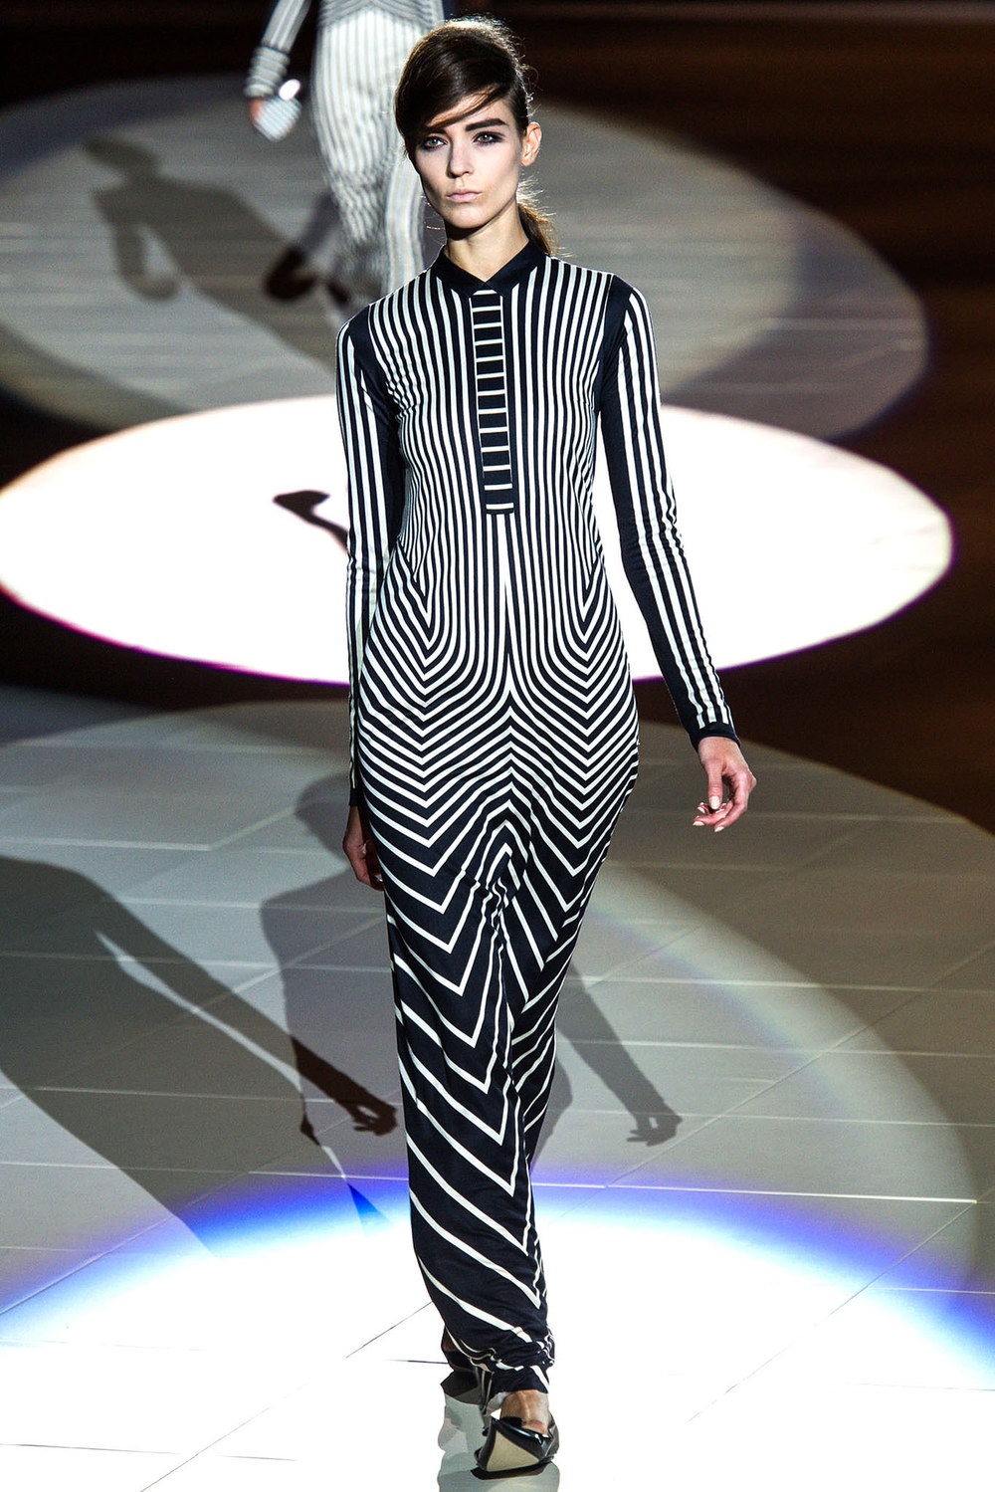
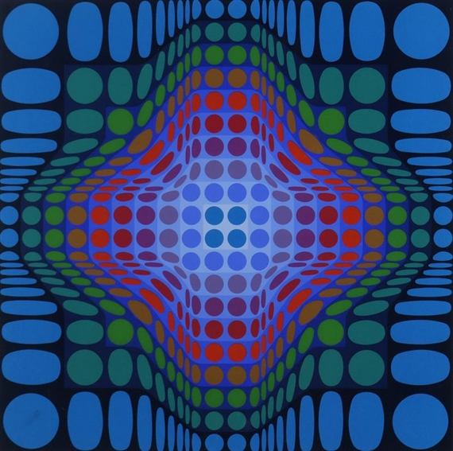
Op Art
Victor Vasarely

Slide 12
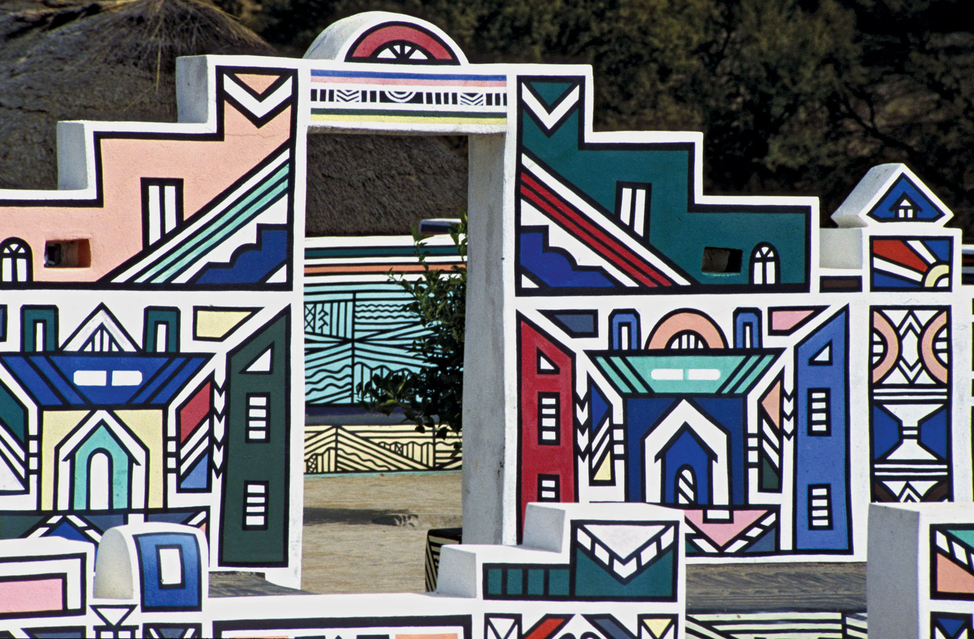
African Pattern Ndebele

Slide 13
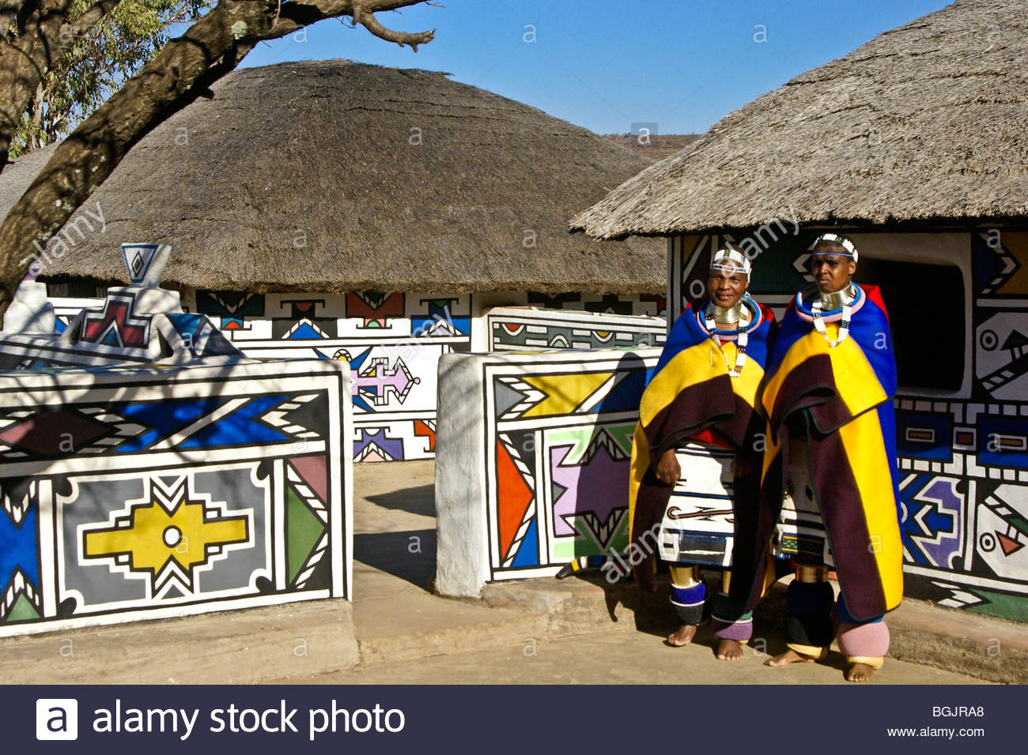
African Pattern Ndebele

Slide 14
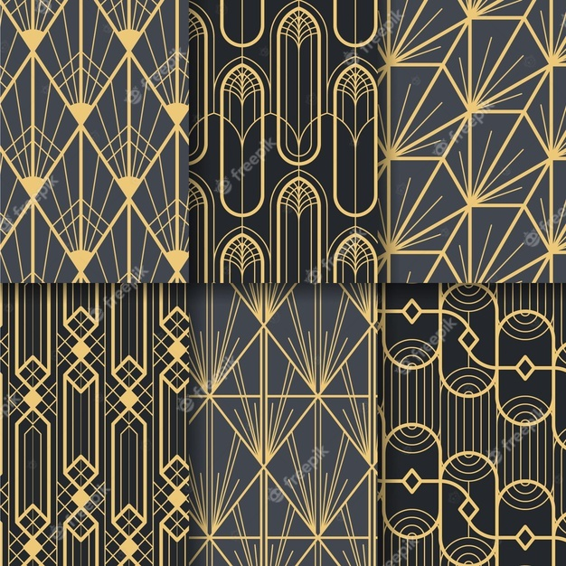
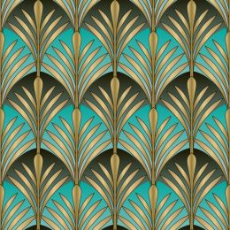
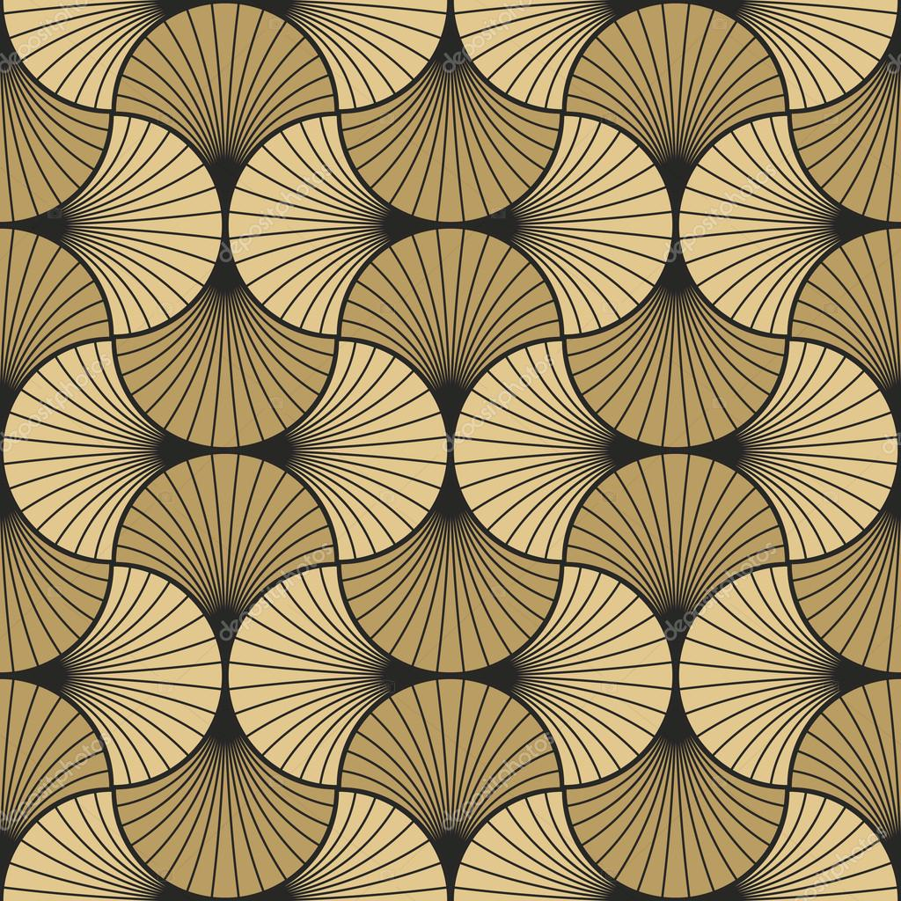
Art Deco Pattern

Slide 15
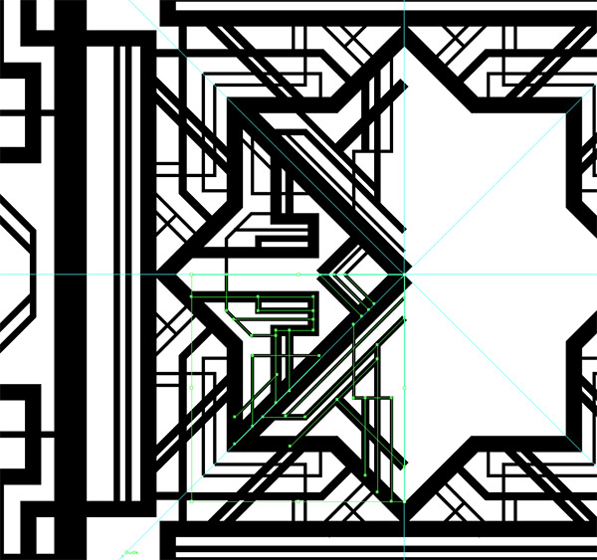
Art Deco Pattern
https://freepreset.net/how-to-create-a-great-gatsby-style-art-deco-pattern.html

Slide 16

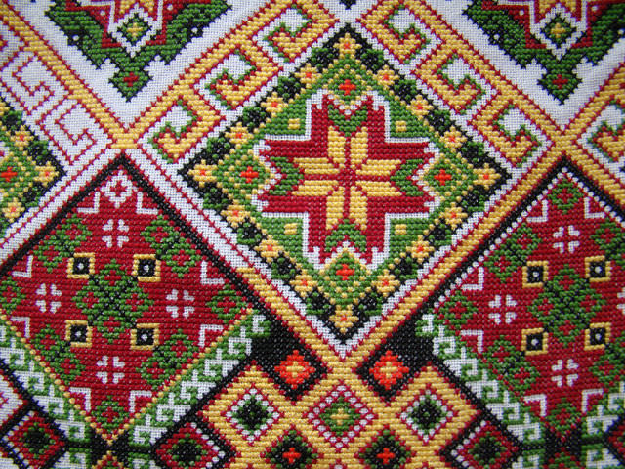
Grid Pattern

Slide 17
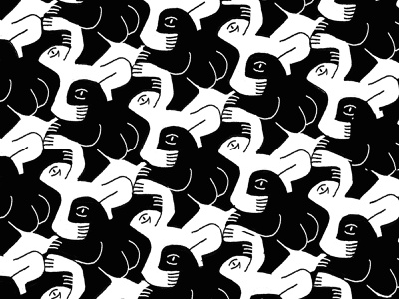
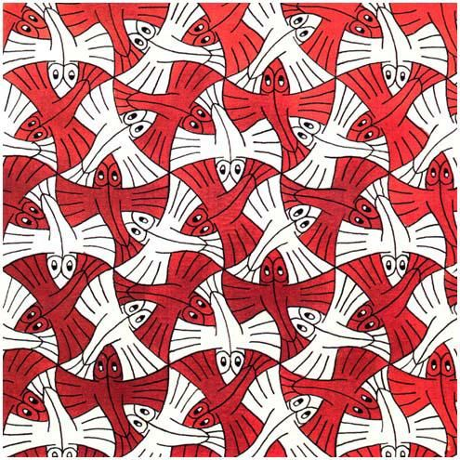
M. C. Escher Pattern

Slide 18
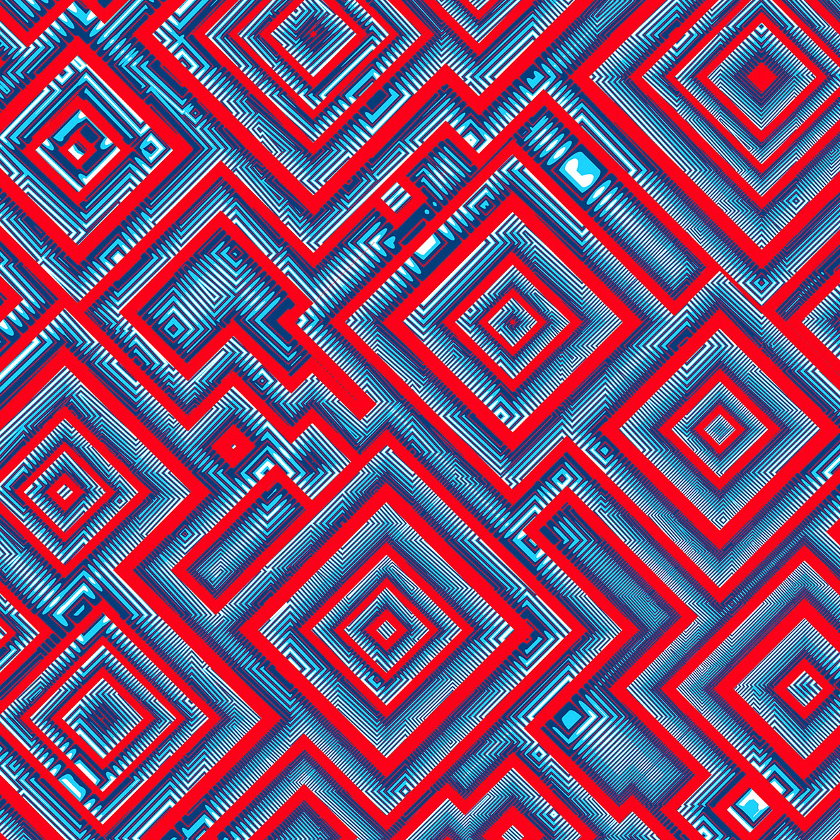
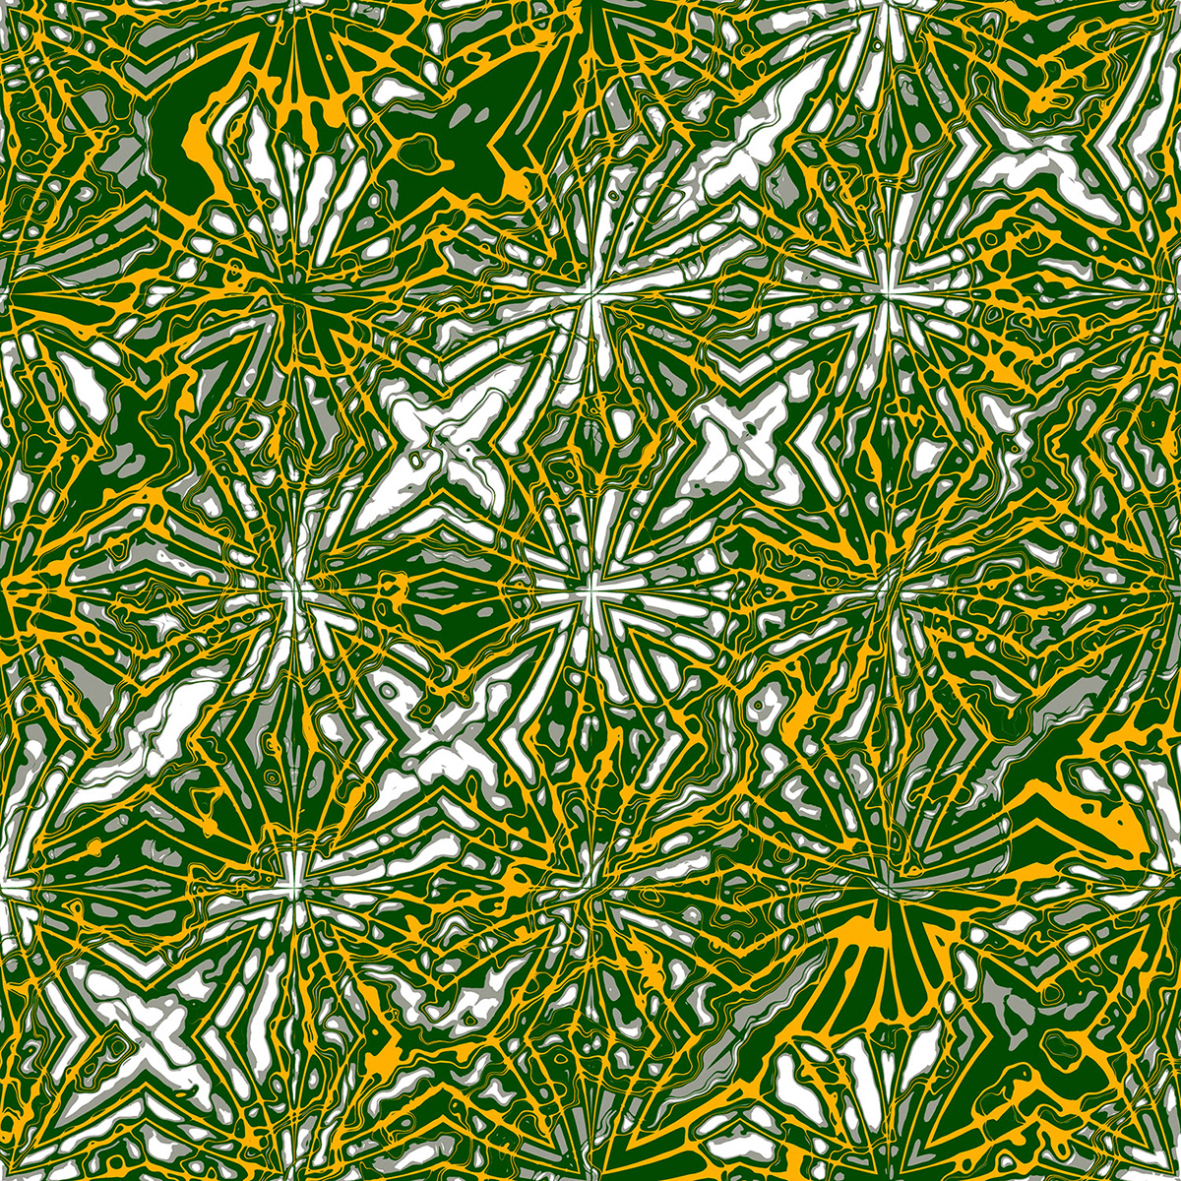
Procedurally Generated Pattern
https://www.behance.net/gallery/93361951/Procedurally-generated-patterns
https://openprocessing.org/sketch/90957/

Slide 19
Let’s unleash the beast of creativity now!

