Slide 1
Usage of 4-diamonds
Simple examples taken from Smart City domain
© Leonard Walletzký 2019

Slide 2
Transportation system – objects and items
Explore the transportation system
First identify all objects and their relationships, working in different contexts
After that, define for each object in every particular context
  Category
  Operations
  Rules
Than put all objects as items together and demonstrate their manifestation in the given context

Slide 3
Diamond See
Relationship
characteristic
characteristic
R
P
Category
R
Object
R
Rule
characteristic
R
characteristic
Operation

Slide 4
Road (street) - Objects and relationships
Name | Relationship | Name
Car | Is on | Road
Bus | Is on | Road
Bicycle | Is on | Road
Pedestrian way | Is on | Road
Driving lines | Are dividing | Road
All vehicles | Are using | Driving lines
Trafic on the road | contains | All vehicles
Trafic lights | Are managing | Trafic on the road

Slide 5
Public transport context - Objects and relationships
Name | Relationship | Name
Tram | Is on | Tracks
Bus | Is on | Road
Troleybus | Is on | Road
Bus stop | Is used by | Bus and Troleybus
Bus stop | Should be closed to | Pedestrian way
Timetable | In on every | Bus stop

Slide 6
Diamond Recognize
Category
base
R
CI-connection
Item
R
Context
R
R
Manifestation

Slide 7
Mixing contexts
Some objects are presented in more contexts
  Buses are on the road as objects on the street, but are also important in the context of public transport
  Comparing to cars, that are not interesting in the context of public transport
When we are speaking about them we must be sure what context we are using

Slide 8
Contexts
The road (street)
Public transport
Emergency services

Slide 9
Example – bus manifestation
Public trasport
How it is organized
Road
Traffic problems
Travel agency
How fast can they go?
What services they can provide?
Lines reserved for buses
How fast they are
How they are equipped?

Slide 10
Diamond Organize
GBS
R22
Goal
reaching
reaching
fulfilling
fulfilling
follower
establisher
composite
R11
Action
Agent
Flow
organizer
organizer
member
member
author
learner
covering
superior
collaborator
focusing
R01
R02
Activity
detail
R33

Slide 11
Transportation system - agents
Identify all involved agents
Identify all actions that are performed in the system
Analyze goals of the agents (only those that has relationship to the system)
Identify flows that are performer in the system
Identify actions that are performed in the system
Put the into the contexts

Slide 12
Agents
Agent | Public transport | Road
Citizen | Customer | Pedestrian Driver Biker
Employee | Driver of public transport Inspector | Policeman Fire man Emergency

Slide 13
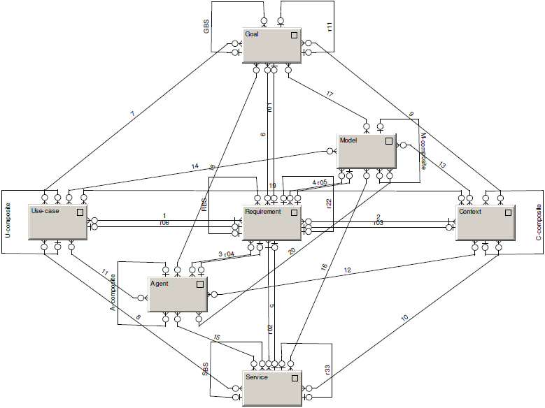
Diamond Do

Slide 14
rent a car like rent a bike, pick up the car along the road and go, any time, anywhere
Goal: drive green! car sharing! reduce traffic jam and arrange the transportation better
Requirement: we want to reduce exhalations, we want to motivate people to use public transport …..
Agent: the city or municipality, citizens, tourists ….
Model: based on the transportation research, built by the experiences
Use case: smart transportations project we can learn from
Service: real-time car booking service, service center, reg. services etc.
Context: Smart City, Transportation, Living conditions …..

Slide 15
What are the principles?
Principle of service definition - vertical
  Service is not the most important element.
  The Requirement is the key to build successful service environment
  The goals are the basement for the set of requirements
Principle of context understanding – horizontal
  Context is the part of the model, not the externality
  Use case is identified within the context (finding similar solutions)
  Requirement is forming and is formed by Use cases
Principle of completeness – z-axis
  Agents identification must be done in the relations with other elements
  Model must involve all other elements including itself

Slide 16
Context | Requirement | Service | Agent | Goal | Model | Use Case
Healthy run of the citizen | To find optimal road | Road planner | Citizen | To be healthy | Relaxing roads | Current status of weather and air pollution
Race of the moto bikers | To find optimal road | Road planner | Moto driver | To win the race | Race maps | Weather (rain / sunny), position of other participants
Emergency service | To find optimal road | Road planner | Driver of emergency vehicle | To get to the place of accident | City street map | Current situation of traffic

Slide 17
Conclusions
Design of service is never isolated, it is a part of environment
The analysis begins from goals, not from the service
The value is co-created only if we follow „right“ goals of the agents
  Synchronization of goals in Diamond Organize and Do
The value is co-created only if the service starts with proper value proposition
  Synchronization of terminology and understanding in Diamond Recognize

