Slide 1
PA194
Introduction to Service Science
© Leonard Walletzký
qwalletz@fi.muni.cz

Slide 2
Organization
Lessons (real time, recorded)
Test at the end of semester
50% open and 50% optional questions
Knowledge presented here will be examined at state exam
Information are important to understand other lessons in context of services

Slide 3
Why introduction to Service Science
To understand subject of your study
To accept new way of thinking
To adapt to new conditions
IT is the most dynamic domain in the world
Service Science is trying to interconnect IT and „the rest of the world“

Slide 4
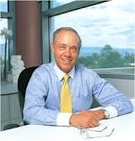

What is service?
services are processes, performances, or experiences that one person or organization does for the benefit of another
In all cases, service involves deployment of knowledge, skills, and competences that one person or organization has for the benefit of another, often done as a single, customized job (Lusch & Vargo)

Slide 5
Characteristics of a service
Services we speak about are information and knowledge intensive
Output is intangible, hard to quantifiable and measurable
Non-storable
Lack of mobility
Consumption runs simultaneously with the supply
The customer is presented on the production
Hardly specifiable

Slide 6
What is science?
to help service managers to achieve standardization
assembly of standardized modular service elements in several "customizable" but highly predictable permutations
customers seeks for value standardization because it reduces variability and usually helps bring prices down
services in the digital economy employ standardization and mass customization
a new service definition might focus on the technical nature of modern-day service

Slide 7
Key Trends
Services have become a driving force in economics around the world
Services represent more than 70% of global GDP.
The services sector in EU accounts for almost 70% of EU GDP.
Also manufacturing industries include more and more services. There are becoming part of tangible and intangible products
Services are more and more knowledge and information intensive
Service innovation is recognized as key for the economic growth and competitiveness
Academic programs and research activities in engineering and business schools didn‘t meet the needs of this sector.
Universities, governments and industry start to work together to ensure that service become a distinct and legitimate area for research and teaching.
ICT plays a major role in services innovation and realization
The most of the services are unfeasible without IT
They are necessary to provide the service
Also, they are needed to get the value from the service

Slide 8
Industry request
Industry signals that most of entry level engineers lack necessary skills especially in soft skills and in legal and economical framework.
In detail:
Ability to communicate effectively to technical and non- technical audience
Ability to self educate
Ability to work in heterogenous teams
Willing to take risks, experiments, and to be innovative
Global engagement

Slide 9
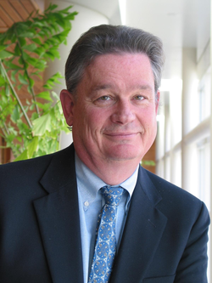
History of Service Science (SeS)
Founded by IBM (2004) by Jim Spohrer
On the field of IT
To understand how provide IT services
Basic principles
IT is a service
No matter if it is internal or external
Basic motivation is to understanding of needs of those who are final „recipients“ of the service
The founder is Jim Spohrer
Notes:
IBM to hned dělala ve spolupráci s univerzitami – se kterými??? Berkley, Carnegie Mellon, Merylend, Arizona
IBM zjistila, že došlo k takovým změnám na poli IT, že je třeba definovat nový pohled na IT – IT je primárně službou
Interní = vnitřní IT útvary non-IT firem
Externí = dodavatelé IT služeb
Proč je to potřeba? Aby bylo možné tyto potřeby co nejlépe uspokojit.

Slide 10
Relation to information
Work of informatics specialists is about work with information
Do they know all semantics and consequences?
SeS is the reaction to one serious problem on IT market
Notes:
Vysvětlení definice a její správné chápání vysvětlím na následujícím příkladu.

Slide 11
Example of the problem
Description
Organization has a problem
This problem can be solved by a IT solution (tools)
There is a lot of IT companies able to supply this kind of solution
Questions
How would IT expert recognize the right identification of customer‘s problem?
How does customer recognize the IT expert offers the right solution for his company?
Notes:
Příklad – klasická věta: To nám počítač nedovolí, přičemž se jednalo o legální a do té doby naprosto běžnou praxi – otázka aktuálního příkladu? Aplikace workflow, pokrytí firemních procesů, systémy často vyžadují zdlouhavé operace namísto urychlení akce – např. nelze autorizovat dokument přes mobilní aplikaci, ale člověk se musí přihlásit do systému apod.
Nebylo to uděláno ze zlého úmyslu IT dodavatele, ale z neznalosti věci, protože nevidí do hloubky problému.

Slide 12
Solution of problem
To be able to answer both questions we need:
IT expert that has knowledge from both sides
Is able to analyze problem on customer‘s side
He knows proper IT tools
Has multidisciplinary knowledge
IT expert is able to act on any side of the market (customer or supplier)
This expert shoud be a Service Science educated
Notes:
Oslí můstek – přes multidisciplinární znalosti ke vzdělání

Slide 13
What (dam) is the Service Science?
Service Science means curricula, training, and research programs that are designed to teach individuals to apply scientific, engineering, and management disciplines that integrate elements of computer science, operation research, industrial engineering, business strategy, management sciences, and social and legal sciences, in order to encourage innovation in how organizations create value for customers and shareholders that could not be achieved through such disciplines working in isolation. (U.S. National Innovation Investment Act, 2007)
Notes:
Začít od konce
Definice SeS, důležitost poznala i vláda USA – je to podstatné pro společnost
Použít slovo multidisciplinární
Pozor – Jim Spohrer definuje Knowledge intensive and customized service

Slide 14
Multidisciplinarity
I – shape
Dash – shape
T – shape
Deeply focused
Expert only in one domain
Interdisciplinary approach
Not expert, but is able to communicate with I-shapes
Multidisciplinary approach
Expert in one field, interdisciplinary in the others

Slide 15
T – shape professionals
Economics and finance
Soft and Other Skills
Management and marketing
Soft skills
Core disciplines
IT knowledge
Service Science
Project management

Slide 16
Growing interest and engagement in SSME worldwide

Slide 17
Academics reaction to Service Science
Mostly taken by economics universities and faculties
New way of marketing
Easily viewed potential
New tool for service analysis
Service Science succumbed to effort to cut the relation with IT
Economists are concentrated to service analysis
IT tools are not in the center of their interest
Positive – developing Service Dominant Logic (Vargo + Lush, 2004, 2006)
The center of interest is user and his needs, not a product he is using for their satisfaction
Notes:
Ověřit rok
Ekonomové se soustředili na analýzu služeb jako takových a opustili spojení s IT. Je to logické z hlediska jejich zaměření

Slide 18
Service Science on Academics Field
Informatics faculties
Different approaches
Mostly one lesson or course, added to existing programs
Only few discovered the potential and offers whole study program, designed and oriented to Service Science
Question
Is Service Science more IT or more Economic, Social, Managerial ...?
Notes:
Možné přístupy
Nezaregistrovali to
Zaregistrovali, ale nepovažují za podstatné
Většina reagovala prezentací nebo kurzech, zařazených do existujících programů

Slide 19
Why should SeS have dominant IT?
Unique relation between Services and IT
No one can provide knowledge and information intensive service without using IT.
Accounting principles are the same for more than 300 years
And marketing and management principles and approaches are changing in period of 10 – 20 years
In opposite IT is extremely dynamic domain
Technology is changing all time
Smart phones, tablets
Clouds, big data, security
Therefore, providing services needs a knowledge about the most actual IT tools, techniques and their optimal usage
Service Science is a great enrichment of IT and brings new challenges and perspectives to IT

Slide 20
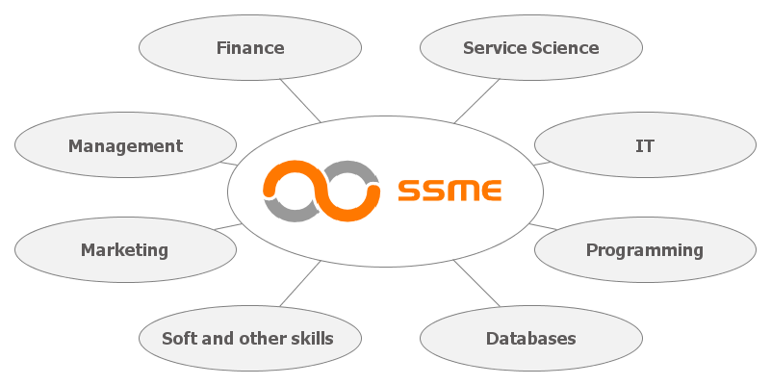
Master study program
Service Science, Management and Engineering (2008 – 2020)
Service development management (since 2020)

Slide 21
T – shape professionals
Economics and finance
Soft and Other Skills
Management and marketing
Soft skills
Core disciplines
Programing
Service Science
Project management
Databases
  The leg should be more dynamics than the roof

Slide 22
Interim project
Why?
To prove the knowledge and its structure
Unique – comparing other study programs
For the students – to gain real experience
Short (business)
For business partner
5 months, 4 days per a week
Long (research)
Mostly for research or university partners
10 months, 2.5 days per a week
For companies – to get the valuable resource

Slide 23
Laboratory of service systems
Laboratory focused to implementation of service thinking
The main topic nowadays is Smart Cities
We cooperate with the cities in Czech Republic and with main stakeholders of Smart concept (Czech Smart City Cluster, Ministry of local development)
More info: https://seslab.fi.muni.cz/
Interim
Diploma thesis
2 credits per semester

Slide 24
Content of the course
Goods and Service Dominant Logic
Role of information in in GDL and SDL
Service systems and imperfect information
Service systems
Marketing concepts in SDL
Service Science, Management and Engineering
Applications of SeS

Slide 25
Conclusion
Service Science is strongly related with IT
Service Science changed the service market
Service Science means different approach to the education
T-shape education is necessary for the success on labor market

