Slide 1

World understanding and modeling
Leonard Walletzký
2019

Slide 2




How do we model?
We are using different tools and approaches to model reality

Slide 3
But….
Do we really understand the models?
Are the models readable for others?
What if we need to communicate with people from other domains?
And what if we need to achieve understanding across domains?
How we can model in multidisciplinary way?

Slide 4
Problem
What if we need to model Smart Street?
But from what perspective?
IT devices
networks
sensors
Infrastructure
water
electricity
Equipment
street light
benches
controllers
facilities
bus stops

Slide 5

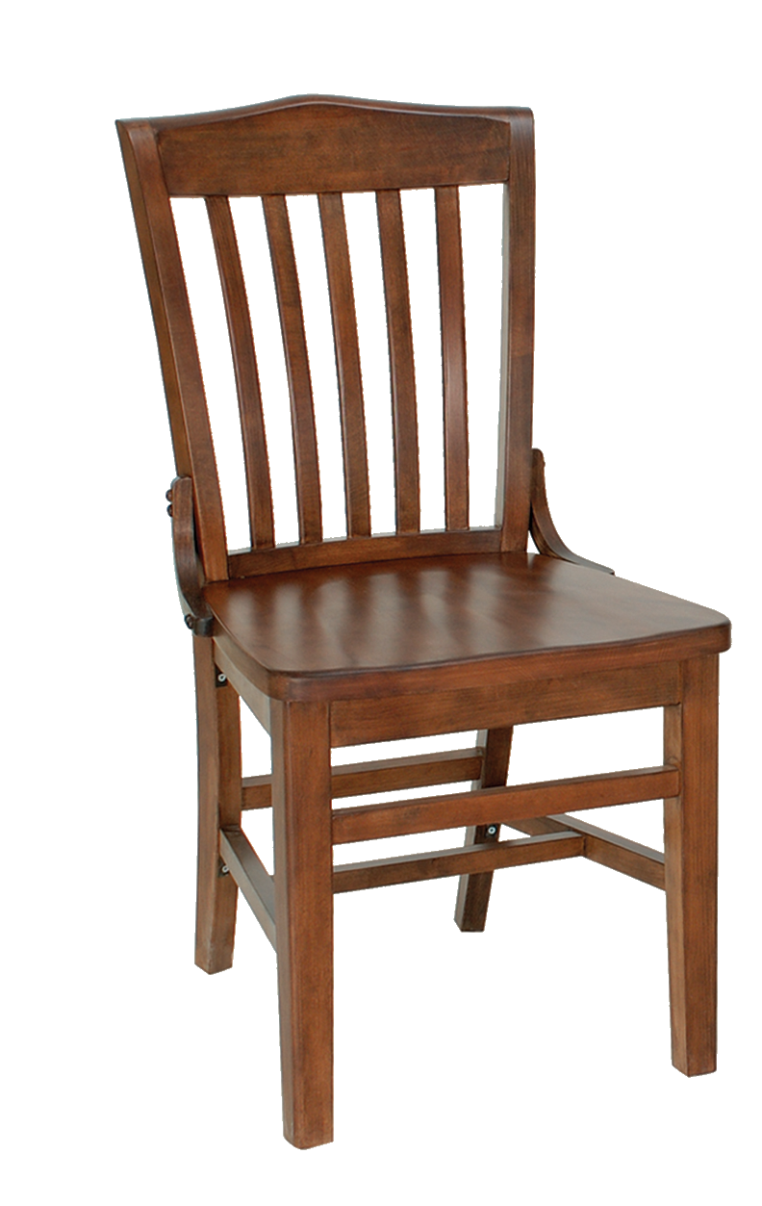
Solution is to go back to our roots and ask
What are we modeling?
The answer is – objects from the real world
How does any person build own mind model?
Where are we modeling?
The answer is - in our mind!

Slide 6
How do we model reality in our heads?
We identify...
Object
-s
...we find interesting

Slide 7
Then, we find...
Relationship
-s
...between our...
Object
-s

Slide 8
Each relationship can connect multiple objects...
Relationship
Relationship
Relationship
Object
Object
Object
...and each object can be present in multiple connections.

Slide 9
Each relationship can connect multiple objects...
Relationship is specifically
defined n-dimensional set
of objects
Relationship
projection
Object
...and each object can be present in multiple connections.

Slide 10
Which objects do we find interesting for modelling?
I can describe
anything now!
I know when
to perform
particular
operation
Relationship
projection
Now I can
change
the state
Category
Object
Rule
Operation

Slide 11
MENTION – USE duality
I am using
category here.
Relationship
R
P
Category
R
Object
R
Rule
I am thinking
about
category here.
R
Operation

Slide 12
Diamond of Attention Focussing
I am in
syntactic part
I can connect
relationship with
dynamic rule!
Relationship
characteristic
characteristic
R
P
Category
R
Object
R
Rule
I am in
dynamic part
I can connect
operation with
specific
categories!
R
characteristic
characteristic
Operation

Slide 13
Diamond of Attention Focussing
Objects and relationships among them
Mention-use duality
Modelling a modelling tool
Relationship
characteristic
characteristic
R
P
Category
R
Object
R
Rule
characteristic
R
characteristic
Operation

Slide 14
Road (street) - Objects and relationships
Name | Relationship | Name
Road | Is on | Street
Car | Is on | Road
Bus | Is on | Road
Bicycle | Is on | Road
Pedestrian way | Is on | Street
Driving lines | Are dividing | Road
Trees | Are plant on | Road

Slide 15
Example – world best known story
killing
killing
Juliet
In love with
Romeo
In love with
killing
Paris

Slide 16
We can see that some connections are somehow similar – they belong to the same category:
killing
killing
Juliet
In love with
Romeo
In love with
killing
Paris

Slide 17
It‘s possible to classify everything we see in the diagram. But how to classify our objects?
killing
killing
Juliet
In love with
Romeo
In love with
killing
Paris

Slide 18
We could certainly divide the objects to men and women:
killing
killing
Juliet
In love with
Romeo
In love with
killing
Paris

Slide 19
But won‘t it be more useful to show, which character belongs to the house of Montague and which one to the house of Capulet?
killing
killing
Juliet
In love with
Romeo
In love with
killing
Paris

Slide 20
It probably depends on a context – a mental model we want to build. Sometimes, both categorizations may be useful:
killing
killing
Juliet
In love with
Romeo
In love with
killing
Paris

Slide 21
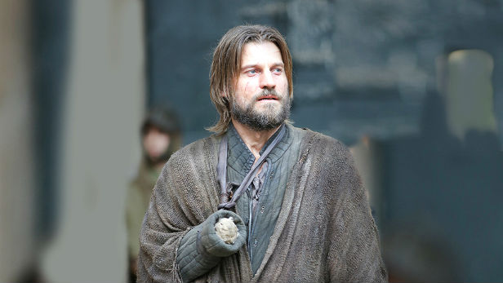
Classifications are blurred
Good or bad?

Slide 22
Certainty
Items (= objects as such, not their constructs) belongs to a category with a given certainty
Item can belong to
more categories!
Category
CI-connection
Item

Slide 23
Attention
The fact is manifested with a certain attention in a given context
Category
CI-connection
Item
Context
And context gives
a design to
the manifestation.
And here it is about
particular manifestation
of CI connection
Manifestation

Slide 24
R-edges
In some cases, it might be also useful to mention non-trivial concepts – contexts, categories, classifications or manifestations
Romeo killing Romeo
Resulting in
Juliet killing Juliet
Romeo belonging to Monteques
Romeo in love with Juliet
Juliet belonging to Capulets
Fact1
Fact2
Fact3
<fact1> and <fact2> and <fact3>
Story plot
Belonging to

Slide 25
R-edges
Category
R
CI-connection
Item
R
Context
R
R
Manifestation

Slide 26
Context base
Context serves as a model. The base edge defines the set of categories to classify its items to
One category can exist
in more contexts and
vice versa.
Category
base
R
CI-connection
Item
R
Context
R
R
Manifestation

Slide 27
Why we need it?
In the complex service environment (like Smart City) only one perspective is not enough
Already in a very simple applications we need to work with different manifestation of the same item
If we add the relation to other Services, environments (e.q. contexts) we get very complex model
To understand we need to have the possibility to analyze the manifestation of each item in all contexts

Slide 28
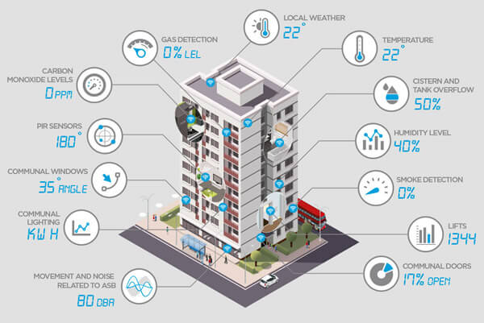
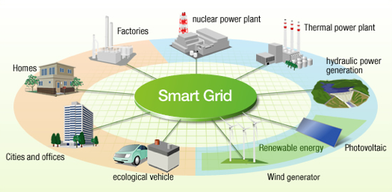
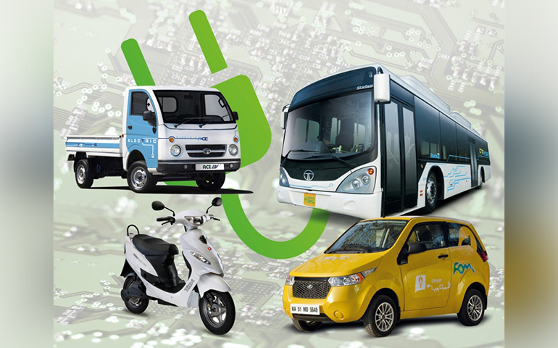
Examples

Slide 29
Conclusion
There is more than one context
Your perspective can be different from the others
Goal of the multidisciplinary team is not to move everyone to one context
Goal is to develop a way how to interconect those contexts into valueable structure

Slide 30
Sources
STANÍČEK, Zdenko. SSME* - Service Systems, Modelling, Execution, Education, Evaluation [online]. Brno, 2009. available at: https://seslab.fi.muni.cz/media/3277865/ssmestar_manuscript.pdf. Manuscript. Masaryk University, Faculty of informatics.
Walletzky, L., Carrubbo, L., Mouzhi, G. - "Exploring complex service design: Understanding the Diamonds of Context„, Naples Forum on Service, 2019
Walletzky, L., Carrubbo, L., Mouzhi, G.: Modelling Service Design and Complexity for Multi-contextual Applications in Smart Cities, ICSTCC konference proseedings, 2019
Caputo, F., Walletzky, L., Ge, M., Carrubbo, L.:Combining the pillars of the Naples forum on Service: a multi-dimensional constructive tool, Naples Forum on Service, 2017

