Slide 1
Service Modeling II
© Leonard Walletzký

Slide 2
Why do we need diamonds?
We need to describe things
And their relations
In some given context
Then we need to organize/plan operations
And execute them in some time perspective
Our natural language is
Redundant
Ambiguous

Slide 3
4 diamonds
See
Describing things (objects) and basic relations
Recognize
Adding context to relations
Organize
How agents behave to recognized objects, what kind of operations we can do
Do
Executing planned operations and getting results

Slide 4
See
We are projecting the seen object in our mind
It has
Particular shape or form
There can be some different varies of this object
It can be used for some purposes
Using this object is under some rules
There can be connections to other objects

Slide 5
Diamond See
I am in
syntactic part
I can connect
relationship with
dynamic rule!
Relationship
characteristic
characteristic
R
P
Category
R
Object
R
Rule
I am in
dynamic part
I can connect
operation with
specific
categories!
R
characteristic
characteristic
Operation

Slide 6
Diamond Recognize
One category can exist
in more contexts and
vice versa.
Category
base
R
CI-connection
Item
R
Context
R
R
Manifestation

Slide 7
3rd diamond
Organizing diamond
How is your life / position / work organized
How can be some agent
member of some team
working on projects
educated or taught someone

Slide 8
Diamond of Agent-Team Organization
Goal
follower
establisher
Agent
author
learner
superior
collaborator
Activity

Slide 9
Diamond of Agent-Team Organization
Goal
follower
establisher
Action
Agent
Flow
organizer
organizer
member
member
author
learner
superior
collaborator
Activity

Slide 10
Diamond of Agent-Team Organization
Goal
reaching
reaching
fulfilling
fulfilling
follower
establisher
Action
Agent
Flow
organizer
organizer
member
member
author
learner
covering
superior
collaborator
focusing
Activity

Slide 11
Diamond of Agent-Team Organization
GBS
Goal
reaching
reaching
fulfilling
fulfilling
follower
establisher
composite
Action
Agent
Flow
organizer
organizer
member
member
author
learner
covering
superior
collaborator
focusing
Activity
detail

Slide 12
Diamond of Agent-Team Organization
GBS
R22
Goal
reaching
reaching
fulfilling
fulfilling
follower
establisher
composite
R11
Action
Agent
Flow
organizer
organizer
member
member
author
learner
covering
superior
collaborator
focusing
Activity
detail
R33

Slide 13
Diamond of Agent-Team Organization
GBS
R22
Goal
reaching
reaching
fulfilling
fulfilling
follower
establisher
composite
R11
Action
Agent
Flow
organizer
organizer
member
member
author
learner
covering
superior
collaborator
focusing
R01
R02
Activity
detail
R33

Slide 14
Diamond of Organization - Summary
Matrix-based organization: Action vs. Flow
Activity vs. Action / Flow
R-edges
GBS
R22
Goal
reaching
reaching
fulfilling
follower
fulfilling
establisher
composite
R11
Action
Agent
Flow
organizer
organizer
member
member
author
learner
covering
superior
collaborator
focusing
R01
Activity
R02
detail
R33

Slide 15
4th Diamond - DO
Describing the service environemnt
Illustrating how the service is provided
Adding multicontextual view to service analysis
Helping to compose and decompose the services

Slide 16
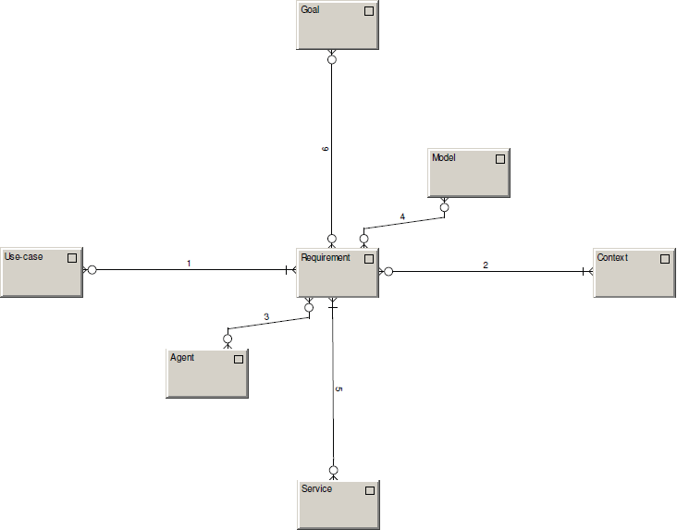
fulfilling
recorded in
forming / formed by
occurring within
addressing
solved by

Slide 17
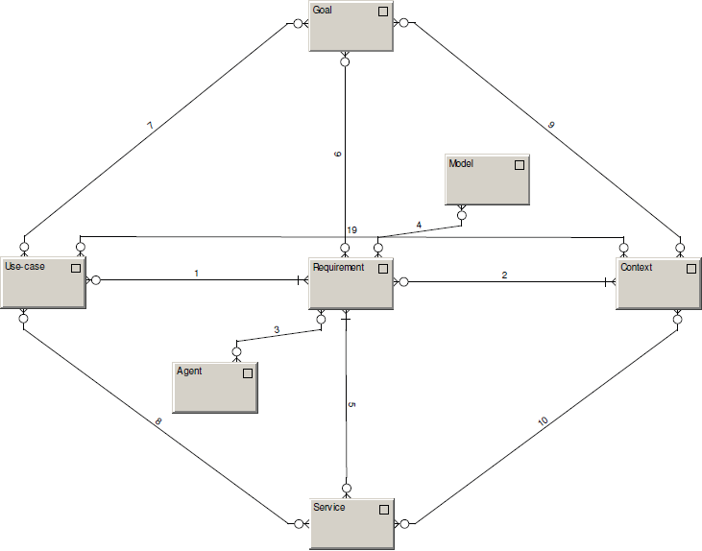
achievable within
achievable by
Identified within
creatable by
creatable within

Slide 18
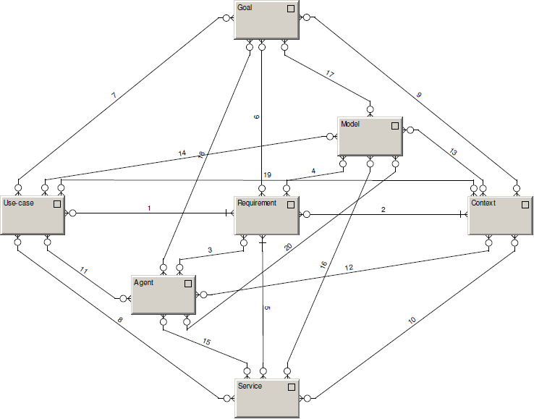
Model records.
Agent wishes, defines, does.

Slide 19
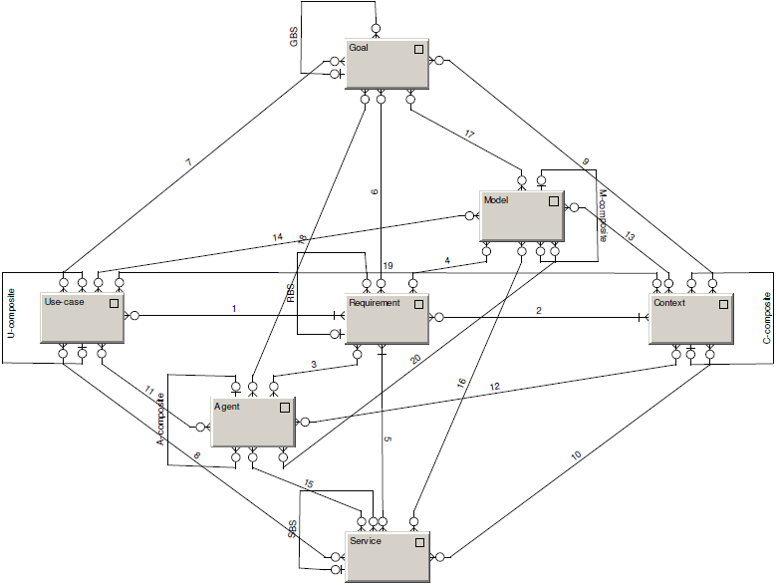
Composites

Slide 20
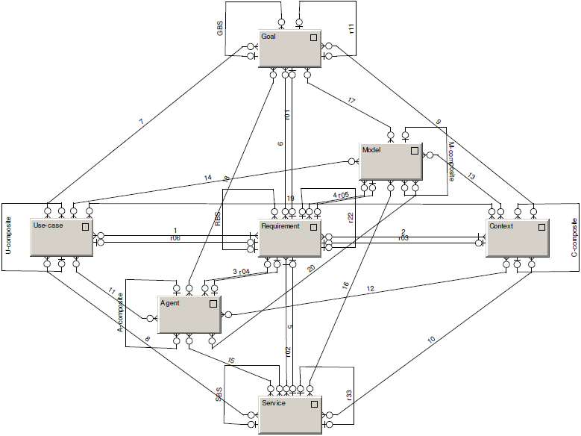
R-edges

Slide 21

Diamond of Predictive Behaviour
Depicts the motivation of agents to DO
Everything can be seen as a requirement
Forming and being formed by behavioral patterns
Models as a system memory

Slide 22
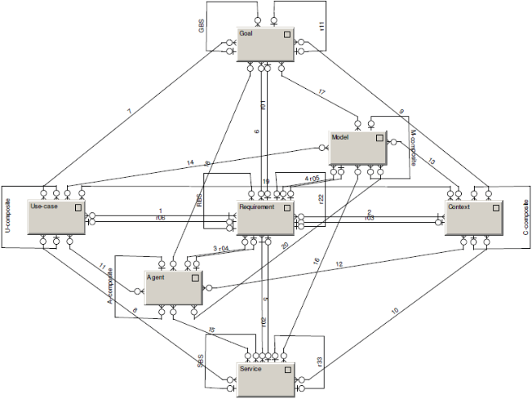
Diamond-Path Framework
Overview
See
Recognize
Organize
Do
Attention
Focussing
Cognitive
Elements
Agent-Team
Organization
Predictive
Behaviour
Category
base
R
GBS
R22
Relationship
CI-connection
R
Item
R
Context
Goal
reaching
reaching
characteristic
characteristic
fulfilling
follower
fulfilling
R
P
R
composite
establisher
R11
Category
R
Object
R
Rule
Manifestation
Action
organizer
Agent
organizer
Flow
member
member
author
learner
R
covering
superior
collaborator
focusing
characteristic
characteristic
R01
R02
Operation
Activity
detail
R33

Slide 23
Reflection
Do you find it interesting?
And useful?
Why has it remained a pure theoretical concept?
Is it too complex?
You will get the possibility to share your opinion!

