Slide 1
PV198 – One-chip Controllers
Interrupts

Slide 2
Content
What is Interrupt
How does it work
NVIC – Nested Vector Interrupt Controller
Code
Application

Slide 3
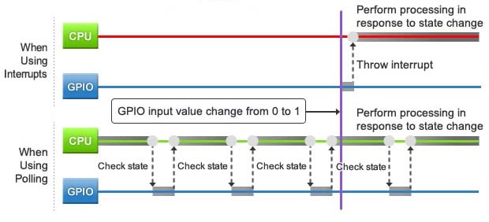
Interrupts – What it is
Signal to the processor indicating an event
https://www.motioncontroltips.com/what-is-nested-vector-interrupt-control-nvic/

Slide 4
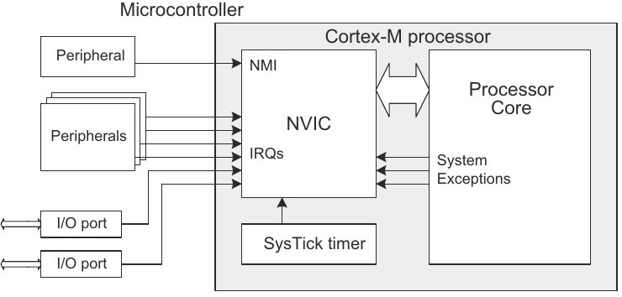
Interrupts – Types
Level / Edge trigger
HW / SW interrupt
https://www.motioncontroltips.com/what-is-nested-vector-interrupt-control-nvic/

Slide 5
Interrupts – How does it work
Interrupt is triggered
MCU finish execution of current instruction
Save current state (PC, flags, registers)
Get address of an ISR (Interrupt Service Routine) from Interrupt Vector Table
Execute ISR
Load previously saved state and continue

Slide 6
Interrupts – NVIC (FRDM-K66F)
NVIC – Nested Vector Interrupt Controller
Up to 120 interrupt sources
Up to 16 priority levels
Nested interrupts
12 clock cycles to enter/exit an ISR (Interrupt Service Routine)
6 clock cycles when switching from one ISR to another

Slide 7
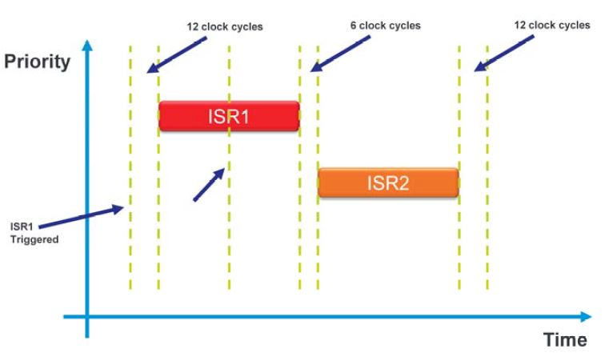
Interrupts
Tail Chaining
http://cache.freescale.com/files/training/Nested-Vector-Interrupt-Controller-Training.pdf

Slide 8
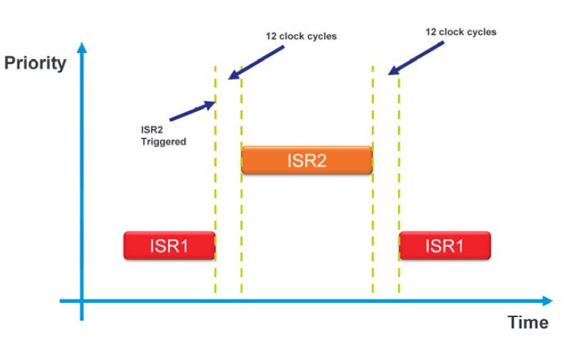
Interrupts
Preemption
http://cache.freescale.com/files/training/Nested-Vector-Interrupt-Controller-Training.pdf

Slide 9
Interrupts – Code (GPIO button)
Configure interrupt for a pin
Enable interrupts for a port
Write interrupt handler

Slide 10
Interrupts – Code (GPIO button)
Configure interrupt for a pin (button) – can be done in Pins tool
/* Interrupt configuration on PORTA10 (pin M9): Interrupt on falling edge */
PORT_SetPinInterruptConfig(BOARD_SW3_PORT, BOARD_SW3_PIN, kPORT_InterruptFallingEdge);

Slide 11
Interrupts – Code (GPIO button)
Enable interrupts for a port (GPIOA for SW3) – can be done in Peripherals tool
(Optionally) Define your handler name – Peripherals tool
/* GPIO_1 interrupt handler identifier. */
#define SW3_BUTTON_PRESSED_IRQ PORTA_IRQHandler
/* Enable interrupt PORTA_IRQn request in the NVIC */
EnableIRQ(PORTA_IRQn);

Slide 12
Interrupts – Code (GPIO button)
Write interrupt handler
Don’t forget to clear a flag that triggers interrupt
/**
* Interrupt handler for button SW3.
* Set flag when SW3 button is pressed.
*/
void SW3_BUTTON_PRESSED_IRQ(void) {
  /* Clear external interrupt flag. */
  GPIO_PortClearInterruptFlags(BOARD_SW3_GPIO, 1U << BOARD_SW3_GPIO_PIN);
  /* Change state of button. */
  g_ButtonSw3Press = true;
}

Slide 13
Application
Goal:
Write an application that prints text to a console when SW3 button is pressed. Use interrupts.
You can use the application from the previous lesson and modify it to use interrupt instead of polling

