Slide 1
PV198 – One-chip Controllers Timers

Slide 2
Content
What is Timer
What is it used for
How does it work
FRDM-K66F Timers
Periodic interrupt timers (PIT)
Code
Application

Slide 3
What is Timer
Timer / Counter
Timer – measure time intervals
Counter – count events

Slide 4
What is it used for
Using Timer vs Delay
examples

Slide 5
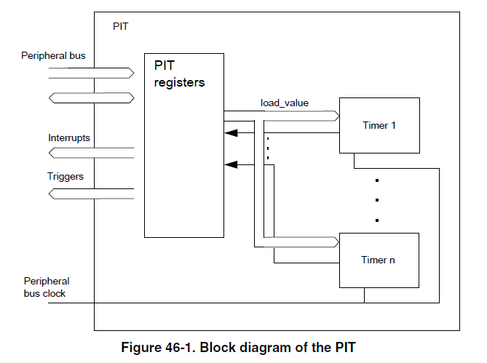
How does it work
PIT – Periodic Interrupt Timer
https://www.nxp.com/docs/en/reference-manual/K66P144M180SF5RMV2.pdf

Slide 6
FRDM-K66F Timers
Programmable delay block (PDB)
Flexible timer modules (FTM)
Low Power TPM (TPM)
Periodic interrupt timers (PIT)
Low-power timer (LPTimer)
Carrier modulator timer (CMT)
Real-time clock (RTC)
IEEE 1588 timers

Slide 7
Periodic interrupt timers (PIT) – Features
4 timers
Ability of timers to generate DMA trigger pulses
Ability of timers to generate interrupts
Independent timeout periods for each timer
Chaining of timers

Slide 8
Periodic interrupt timers (PIT)

Slide 9
Periodic interrupt timers (PIT)
Set value to a timer register Timer Load Value Register (PIT_LDVALn)
The timer will count down until it reaches 0, then it will generate an interrupt and load this register value again

Slide 10
Periodic interrupt timers (PIT)
Which value to set?
Example:
Interrupt every 0.5 seconds
Bus clock: 60 MHz -> clock period = 16.67 ns
LDVAL trigger = (period / clock period) - 1
0.5 s / 16.67 ns = 30 000 000 - 1 = 29 999 999 cycles

Slide 11
Code
void PIT_1_init(void) {
/* Initialize the PIT. */
PIT_Init(PIT_1_PERIPHERAL, &PIT_1_config);
/* Set channel 0 period to 3 s (180000000 ticks). */
PIT_SetTimerPeriod(PIT_1_PERIPHERAL, kPIT_Chnl_0, PIT_1_0_TICKS);
/* Enable interrupts from channel 0. */
PIT_EnableInterrupts(PIT_1_PERIPHERAL, kPIT_Chnl_0, kPIT_TimerInterruptEnable);
/* Enable interrupt PIT_1_0_IRQN request in the NVIC */
EnableIRQ(PIT_1_0_IRQN);
/* Start channel 0. */
PIT_StartTimer(PIT_1_PERIPHERAL, kPIT_Chnl_0);
}

Slide 12
Application
Goal:
Write an application that prints text to console every 1 second
Update it to toggle LED every 0.5 seconds

Slide 13
Homework
Write interrupt base button debouncing.
Use GPIO interrupt to detect first edge
When GPIO is triggered start Timer and wait for constant time
When Timer interrupt triggers, check GPIO value.
Add Green LED toggle when debounced button press signal is accepted.

