Slide 1
PV198 – One-chip Controllers
ADC
PV198 – One-chip Controllers, ADC / Dávid Danaj
<number>

Slide 2
Content
What is ADC
What is it used for
How does it work
FRDM-K66F ADC
Joystick
Application
PV198 – One-chip Controllers, ADC / Dávid Danaj
<number>

Slide 3
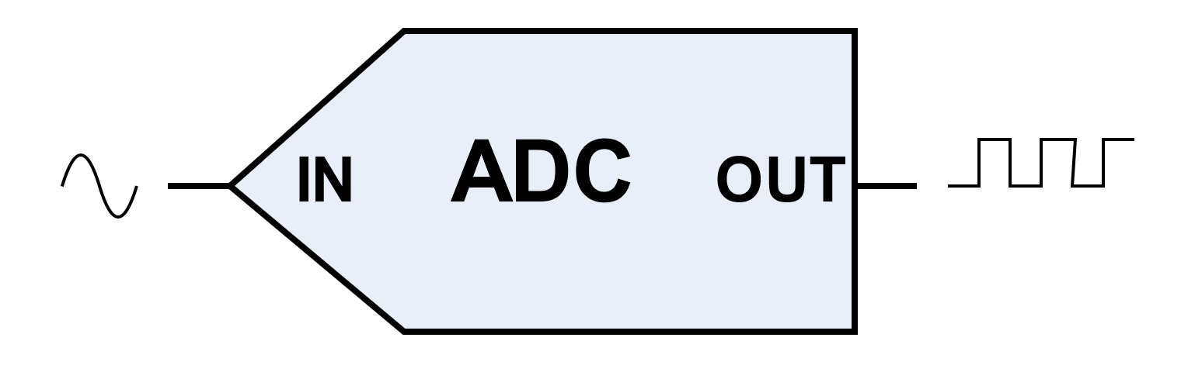
What is ADC
ADC – Analog to Digital Converter
Converting analog signal into digital values
PV198 – One-chip Controllers, ADC / Dávid Danaj
<number>

Slide 4
What is it used for
Everything that needs to transfer analog values into digital values
Audio
Sensors
Video
…
PV198 – One-chip Controllers, ADC / Dávid Danaj
<number>

Slide 5
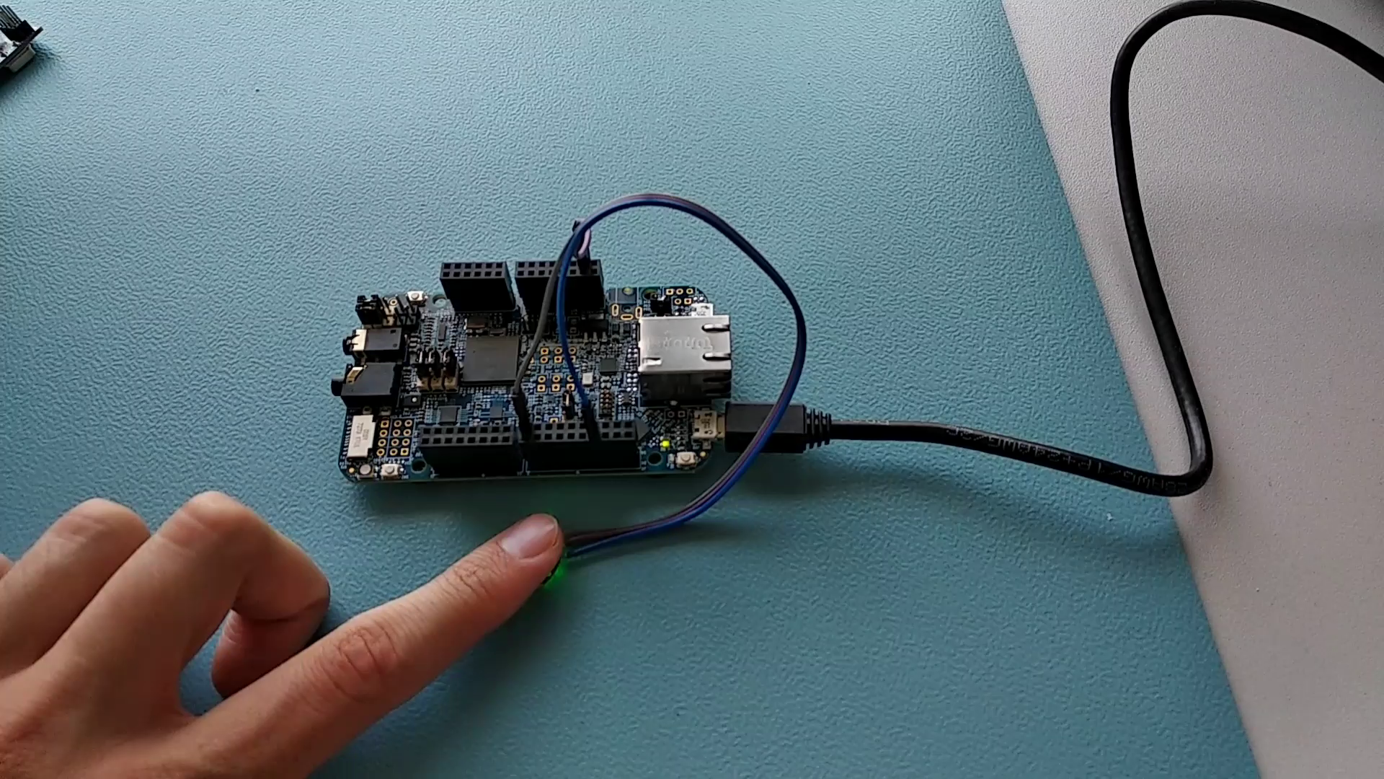
Demo – Heartbeat sensor

Slide 6
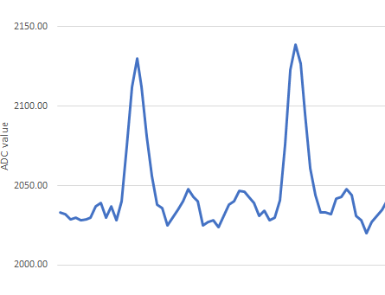
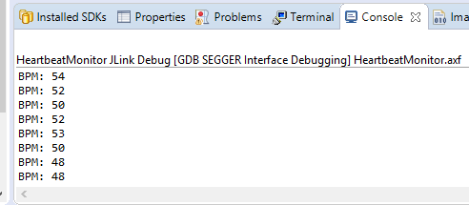
Demo – Heartbeat sensor

Slide 7
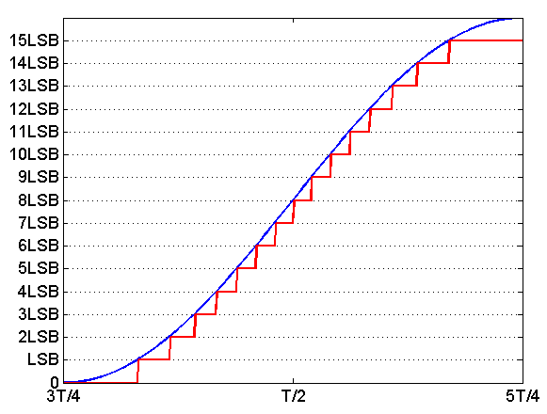
How does it work
https://www.allaboutcircuits.com/technical-articles/understanding-the-dynamic-range-specification-of-an-ADC/
PV198 – One-chip Controllers, ADC / Dávid Danaj
<number>

Slide 8
How does it work – Resolution
Smallest incremental voltage that can be recognized and thus causes a change in the digital output
Expressed as the number of bits output by the ADC
PV198 – One-chip Controllers, ADC / Dávid Danaj
<number>

Slide 9
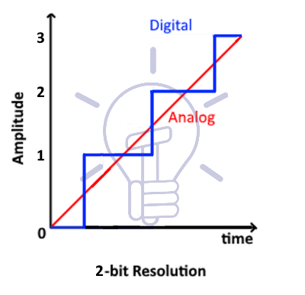
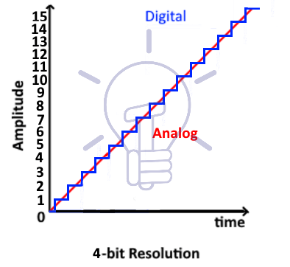
How does it work – Resolution
https://www.electricaltechnology.org/2019/02/analog-to-digital-converter-adc.html
PV198 – One-chip Controllers, ADC / Dávid Danaj
<number>

Slide 10
How does it work – Quantization error
Difference between analog value and rounded digital value (rounding error)
  Change in analog value smaller than the step of the digital value is ignored
  The quantization error is 0.5 LSB for the ADC
PV198 – One-chip Controllers, ADC / Dávid Danaj
<number>

Slide 11
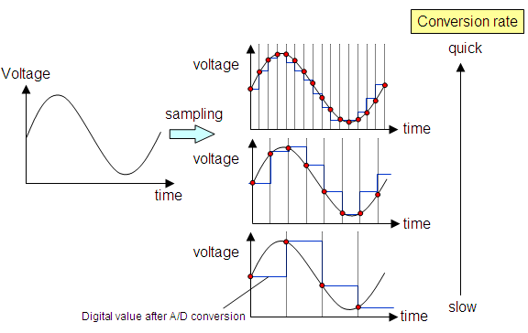
How does it work – Sampling rate
Nyquist–Shannon theorem
  ADC sampling frequency must be at least twice the analog signal frequency
PV198 – One-chip Controllers, ADC / Dávid Danaj
<number>

Slide 12
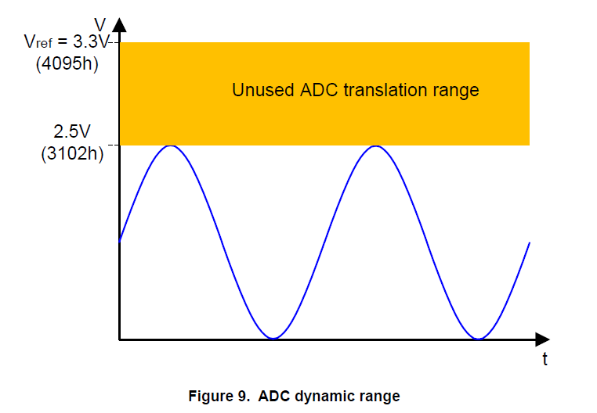
How does it work – Dynamic range
https://www.nxp.com/docs/en/application-note/AN5250.pdf
PV198 – One-chip Controllers, ADC / Dávid Danaj
<number>

Slide 13
Linear successive approximation algorithm
PV198 – One-chip Controllers, ADC / Dávid Danaj
<number>

Slide 14
Linear successive approximation algorithm
Example:
Vin = 2.1 V
Vref = 3.3 V
3-bit resolution
Step | Digital code | DAC output | Comparator output | Digital output
1 | 100 | 1.65 V | 1 | 1|00
2 | 110 | 2.475 V | 0 | 10|0
3 | 101 | 2.0625 | 1 | 101
PV198 – One-chip Controllers, ADC / Dávid Danaj
<number>

Slide 15
Linear successive approximation algorithm
Example:
Vin = 1.16 V
Vref = 3.3 V
5-bit resolution
Step | Digital code | Bit voltage | DAC output | Comparator output | Digital output
1
2
3
4
5
PV198 – One-chip Controllers, ADC / Dávid Danaj
<number>

Slide 16
FRDM-K66F ADC
Linear successive approximation algorithm with up to 16-bit resolution
Single or continuous conversion
Can work in low-power modes
HW trigger to start conversion
HW average function
Conversion complete interrupt
DMA support
PV198 – One-chip Controllers, ADC / Dávid Danaj
<number>

Slide 17
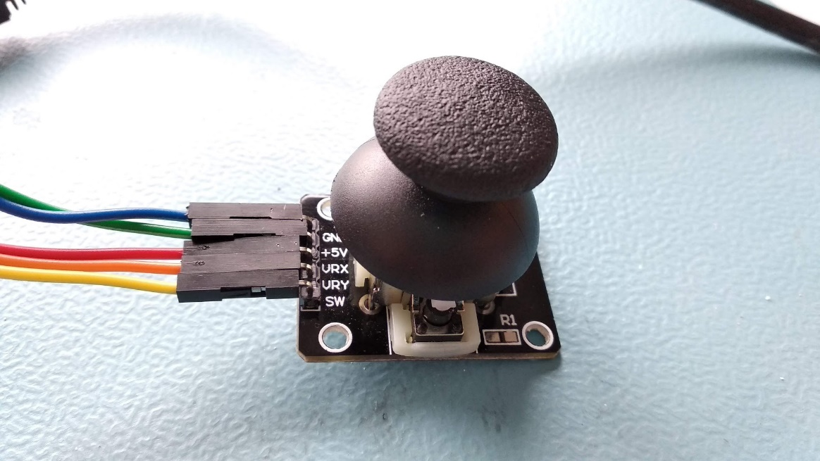
Joystick
PV198 – One-chip Controllers, ADC / Dávid Danaj
<number>

Slide 18
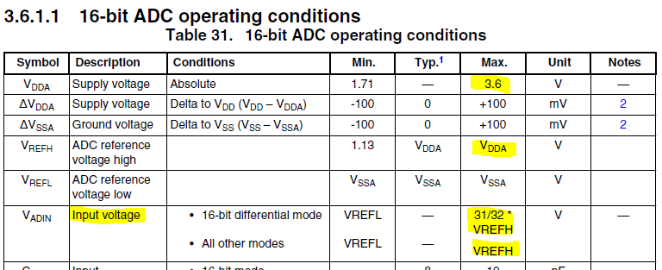
Joystick
Connection to board (do not use 5V!!!)
PV198 – One-chip Controllers, ADC / Dávid Danaj
<number>

Slide 19
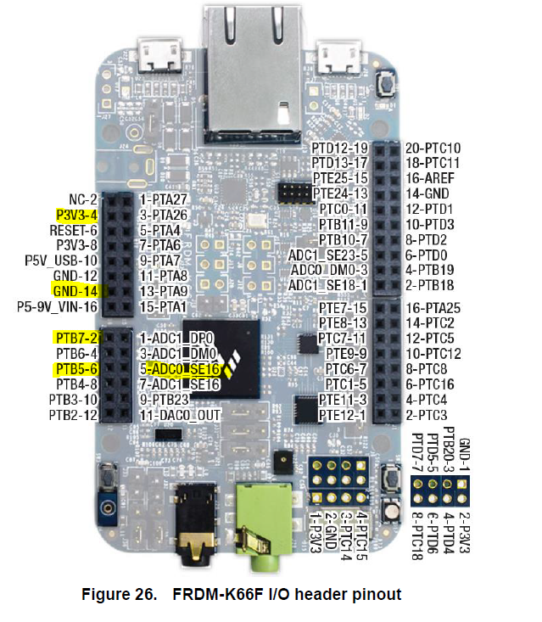
Joystick – Easy (2 ADCs)
GND
Joystick
+5V
X
Y
SW
PV198 – One-chip Controllers, ADC / Dávid Danaj
<number>

Slide 20
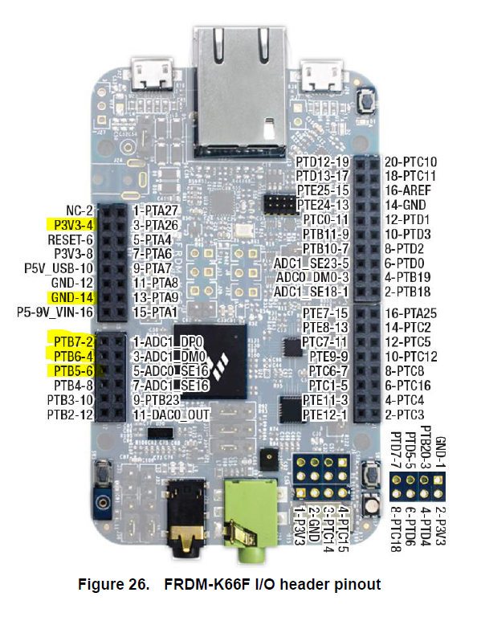
Joystick – Difficult (only 1 ADC)
GND
Joystick
+5V
X
Y
SW
PV198 – One-chip Controllers, ADC / Dávid Danaj
<number>

Slide 21
Application
Create an application that reads position of the joystick (both axes) using ADC0 and ADC1
Print position to terminal
PV198 – One-chip Controllers, ADC / Dávid Danaj
<number>

Slide 22
Application
Write periodic check into while loop to test if measurement is finished
Use PIT to initialize read only once a second
Either:
  Write ADC read only using Interrupts
  React to joystick button press
PV198 – One-chip Controllers, ADC / Dávid Danaj
<number>

Slide 23
Steps
Initialize (MCUXpresso Configuration Tools help here)​
  Pins​ (route ADC channels to pins)
  Clocks​
  Peripherals​ (configure ADC0 and ADC1)
Write application code​ (print position of the joystick)
PV198 – One-chip Controllers, ADC / Dávid Danaj
<number>

Slide 24
Homework
Use joystick to control LEDs (change intensity when joystick moves – use PWM)
Use only ADC1 peripheral, with multiple channels
Warning: ADC has special handling of interrupt flags
PV198 – One-chip Controllers, ADC / Dávid Danaj
<number>

