Slide 1
PV198 – One-chip Controllers I2C

Slide 2
Content
What is I2C
What is it used for
How does it work
FRDM-K66F I2C
Accelerometer & Magnetometer
Application

Slide 3
What is I2C
I2C – Inter-Integrated Circuit
Invented in 1982 by Philips Semiconductor (now NXP Semiconductors)

Slide 4
What is it used for
Intra-board communication
Peripherals
Sensors

Slide 5
How does it work
2 wires (Clock – SCL, Data – SDA) – pulled high
Multi-master & multi-slave
100 kbit/s – 5 Mbit/s
7-bit addressing / 10-bit addressing
Synchronous
Half-duplex

Slide 6
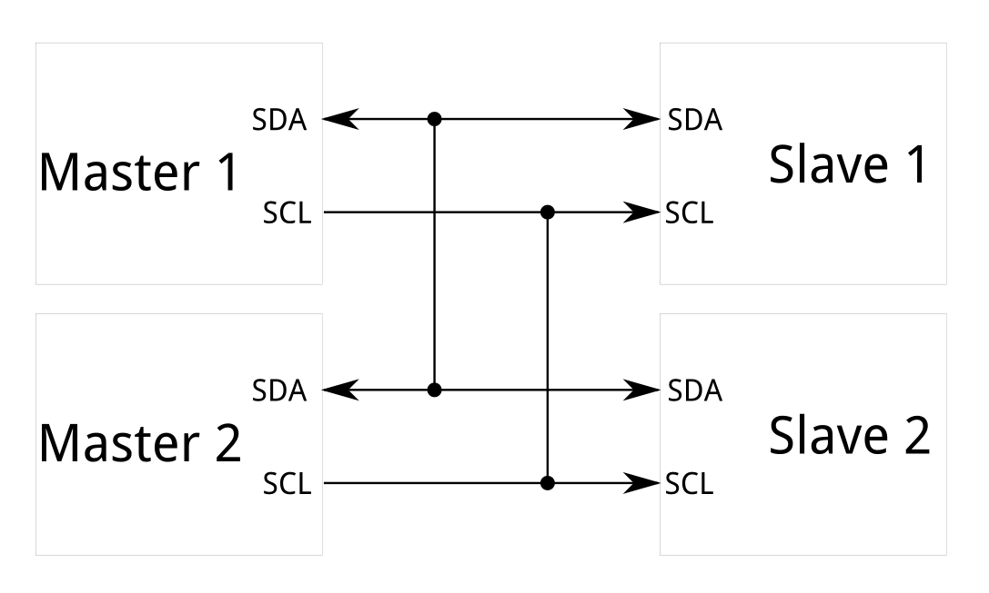
How does it work – Scheme
https://learn.sparkfun.com/tutorials/i2c/all

Slide 7
How does it work – Message
K66 Sub-Family Reference Manual, Figure 58-2.

Slide 8
FRDM-K66F I2C
4 I2C modules
Address match wakeup in low power modes
SMBus support
DMA support
Methods to use:
BOARD_I2C_Receive
BOARD_I2C_Send

Slide 9
Accelerometer & Magnetometer
FXOS8700CQ – link
3-axis, linear accelerometer + 3-axis, magnetometer combined into a single package

Slide 10
Accelerometer & Magnetometer
Connected to I2C bus and 2 GPIO signals
Freedom FRDM-K66F Development Platform User’s Guide, Table 6.

Slide 11
Application – Template
startInitialization (check sensor ID, wake-up)
setupOrientationDetection (enable detection, interrupts, etc.) – Homework
finishInitialization (setup frequency, activate sensor)

Slide 12
Application
Create an application that reads accelerometer output data registers
Print register values into console
Bonus:
Calculate tilt angle from received values

Slide 13
Homework
Create an application that detects orientation of the board (the same way as mobile phones do)
Use the feature of the sensor – do not calculate it in the MCU from XYZ register values
Use interrupt from sensor
Print current orientation into console when orientation of the board changes

Slide 14
Homework
Write your code into method setupOrientationDetection()
Link to Application note: AN4068

