Slide 1
Module 1: Basic Device Configuration
Switching, Routing and Wireless Essentials v7.0 (SRWE)
Notes:
Cisco Networking Academy Program
Switching, Routing and Wireless Essentials v7.0 (SRWE)
Module 1: Basic Device Configuration

Slide 2
Module Objectives
Module Title: Basic Device Configuration
Module Objective: Configure devices using security best practices.
Topic Title | Topic Objective
Configure a Switch with Initial Settings | Configure initial settings on a Cisco switch.
Configure Switch Ports | Configure switch ports to meet network requirements.
Secure Remote Access | Configure secure management access on a switch.
Basic Router Configuration | Configure basic settings on a router to route between two directly-connected networks, using CLI.
Verify Directly Connected Networks | Verify connectivity between two networks that are directly connected to a router.
Notes:
2
1.0 Introduction
1.0.2 What will I learn to do in this module?

Slide 3
1.1 Configure a Switch with Initial Settings
Notes:
1- Basic Device Configuration
1.1 – Configure a Switch with Initial Settings

Slide 4
Switch Boot Sequence
After a Cisco switch is powered on, it goes through the following five-step boot sequence:
  Step 1: First, the switch loads a power-on self-test (POST) program stored in ROM. POST checks the CPU subsystem. It tests the CPU, DRAM, and the portion of the flash device that makes up the flash file system.
  Step 2: Next, the switch loads the boot loader software. The boot loader is a small program stored in ROM that is run immediately after POST successfully completes.
  Step 3: The boot loader performs low-level CPU initialization. It initializes the CPU registers, which control where physical memory is mapped, the quantity of memory, and its speed.
  Step 4: The boot loader initializes the flash file system on the system board.
  Step 5: Finally, the boot loader locates and loads a default IOS operating system software image into memory and gives control of the switch over to the IOS.
Notes:
1 – Basic Device Configuration
1.1. – Configure a Switch with Initial Settings
1.1.1 – Switch Boot Sequence

Slide 5
The boot system Command
The switch attempts to automatically boot by using information in the BOOT environment variable. If this variable is not set, the switch attempts to load and execute the first executable file it can find.
The IOS operating system then initializes the interfaces using the Cisco IOS commands found in the startup-config file. The startup-config file is called config.text and is located in flash.
In the example, the BOOT environment variable is set using the boot system global configuration mode command. Notice that the IOS is located in a distinct folder and the folder path is specified. Use the command show boot to see what the current IOS boot file is set to.
Command | Definition
boot system | The main command
flash: | The storage device
c2960-lanbasek9-mz.150-2.SE/ | The path to the file system
c2960-lanbasek9-mz.150-2.SE.bin | The IOS file name
Adresář musí být
Notes:
1 – Basic Device Configuration
1.1. – Configure a Switch with Initial Settings
1.1.2 - The boot system Command

Slide 6
Kde je operační systém
Router#show version | include image
system image file is "flash:c2800nm-adventerprisek9-mz.151-4.M10.bin"

Slide 7
Bootovat můžeme od kdekud
Router(config)#boot system ?
WORD TFTP filename or URL
flash Boot from flash memory
ftp Boot from a server via ftp
mop Boot from a Decnet MOP server
rcp Boot from a server via rcp
rom Boot from rom
tftp Boot from a tftp server

Slide 8
Kde hledat bootovací příkazy
Router1#show running-config | include ^boot
boot-start-marker
boot system slot0:c3745-ipbasek9-mz.124-6.T.bin
boot system slot0:c3745-ipbasek9-mz.124-7.bin
boot system flash:
boot-end-marker
Router1#

Slide 9
Příště hledej v síti
Router(config)#config-register 0x210F

Slide 10
Přesun IOS z TFTP serveru do flash
Router1#copy tftp://172.25.1.1/c2600-ik9o3s-mz.122-12a.bin flash:
Destination filename [c2600-ik9o3s-mz.122-12a.bin]? <enter>
Accessing tftp://172.25.1.1/c2600-ik9o3s-mz.122-12a.bin...
Erase flash: before copying? [confirm] <enter>
Erasing the flash filesystem will remove all files! Continue? [confirm] <enter>
Erasing device... eeeeeeeeeeeeeeeeeeeeeeeeeeeeeeeeeeeeeeeeeeeeeeeeeeeeeeeeeeeeee ...erased
Erase of flash: complete
Loading c2600-ik9o3s-mz.122-12a.bin from 172.25.1.1 (via FastEthernet0/0.1): !!!!!!!!!!!!!!!!!!!!!!!!!!!!!!!!!!!!!!!!!!!!!!!!!!!!!!!!!!!!!!!!!!!!!!!!!!!!!!!!!!!!!!!!!!!!!!!!!!!!!!!!!!!!!!!!!!!!!!!!!!!!!!!!!!!!!!!!!!!!!!!!!!!!!!!!!!!!!!!!!!!!!!!!!!!!!!!!!!!!!!!!!!!!!!!!!!!!!!!!!!!!!!!!!!!!!!!!!!!!!!!!!!!!!!!!!!!!!!!!!!!!!!!!!!!!!!!!!!!!!!!!!!!!!!!!!!!!!!!!!!!!!!!!!!!!!!!!!!!!!!!!!!
[OK - 11135588 bytes]
Verifying checksum... OK (0xE643)
11135588 bytes copied in 82.236 secs (135410 bytes/sec)
Router1# reload
Proceed with reload? [confirm]<enter>

Slide 11
Bootování IOS image ze sítě přes ROMMON
rommon 1 > IP_ADDRESS=192.168.1.1
rommon 2 > IP_SUBNET_MASK=255.255.255.0
rommon 3 > DEFAULT_GATEWAY=192.168.1.254
rommon 4 > TFTP_SERVER=192.168.1.2
rommon 5 > TFTP_FILE=c2800nm-adventerprisek9-mz.151-4.M12a.bin
rommon 6 > tftpdnld -r

Slide 12
Co dělat když se do paměti nevejdou oba (starý i nový IOS) – starý smažeme
Router1#copy tftp://172.25.1.1/c2600-ik9o3s-mz.122-12a.bin flash:
Destination filename [c2600-ik9o3s-mz.122-12a.bin]? <enter>
Accessing tftp://172.25.1.1/c2600-ik9o3s-mz.122-12a.bin...
Erase flash: before copying? [confirm] n
Loading c2600-ik9o3s-mz.122-12a.bin from 172.25.1.1 (via FastEthernet0/0.1): !
%Error copying tftp://172.25.1.1/c2600-ik9o3s-mz.122-12a.bin (Not enough space on device)
Router1#

Slide 13
Co dělat, když se nový IOS nevejde do flash
Router1#configure terminal
Enter configuration commands, one per line. End with CNTL/Z.
Router1(config)#boot system tftp c2500-io-l.122-7a.bin 172.25.1.1
Router1(config)#boot system flash
Router1(config)#end
Router1#

Slide 14

Switch LED Indicators
System LED (SYST): Shows whether the system is receiving power and functioning properly.
Redundant Power Supply LED (RPS): Shows the RPS status.
Port Status LED (STAT): When green, indicates port status mode is selected, which is the default. Port status can then be understood by the light associated with each port.
Port Duplex LED (DUPLX): When green, indicates port duplex mode is selected. Port duplex can then be understood by the light associated with each port.
Port Speed LED (SPEED): When green, indicates port speed mode is selected. Port speed can then be understood by the light associated with each port.
Power over Ethernet LED (PoE): Present if the switch supports PoE. Indicates the PoE status of ports on the switch.
The Mode button is used to move between the different modes – STAT, DUPLX, SPEED, and PoE
Notes:
1 – Basic Device Configuration
1.1. – Configure a Switch with Initial Settings
1.1.3 – Switch LED Indicators

Slide 15
Switch LED Indicators (Cont.)
 | Off | Green | Blinking Green | Amber | Blinking Amber | Alternating Green/Amber
RPS | Off/No RPS | RPS ready | RPS up but not available | RPS standby or fault | Internal PS failed, RPS providing power | N/A
PoE | Not selected, no issues | Selected | N/A | N/A | Not selected, port issues present | N/A
When the named mode is selected, the light associated with each physical port indicates:
STAT | No link or shutdown | Link Up | Activity | Port blocked preventing loop | Port blocked preventing loop | Link fault
DUPLEX | Half-duplex | Full-duplex | N/A | N/A | N/A | N/A
SPEED | 10Mbps | 100Mbps | 1000Mbps | N/A | N/A | N/A
PoE | PoE off | PoE on | N/A | PoE disabled | PoE off due to fault | PoE denied (over budget)
Notes:
1 – Basic Device Configuration
1.1. – Configure a Switch with Initial Settings
1.1.3 – Switch LED Indicators (Cont.)

Slide 16
Recovering from a System Crash
The boot loader provides access into the switch if the operating system cannot be used because of missing or damaged system files. The boot loader has a command line that provides access to the files stored in flash memory. The boot loader can be accessed through a console connection following these steps:
  Step 1. Connect a PC by console cable to the switch console port. Configure terminal emulation software to connect to the switch.
  Step 2. Unplug the switch power cord.
  Step 3. Reconnect the power cord to the switch and, within 15 seconds, press and hold down the Mode button while the System LED is still flashing green.
  Step 4. Continue pressing the Mode button until the System LED turns briefly amber and then solid green; then release the Mode button.
  Step 5. The boot loader switch: prompt appears in the terminal emulation software on the PC.
The boot loader command line supports commands to format the flash file system, reinstall the operating system software, and recover a lost or forgotten password. For example, the dir command can be used to view a list of files within a specified directory.
Notes:
1 – Basic Device Configuration
1.1. – Configure a Switch with Initial Settings
1.1.4 – Recovering from a System Crash

Slide 17
Tradiční Password Recovery
Vypnout a zapnout switch/router.
Do jedné minuty zmáčkni Break a zařízení přejde do ROMmon (záleží na typu zařízení).
rommon 1> confreg 0x2142 a začne bootování z flashe. Obejde se tím starovací sekvence.
rommon 2> reset
hostname(config)#enable secret cisco
no shutdown na použitá rozhraní
hostname(config)#config-register 0x2102
write memory nebo copy running-config startup-config

Slide 18
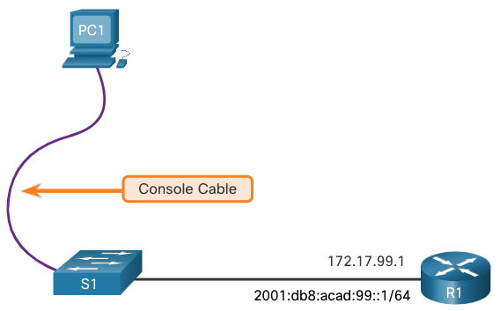
Configure a Switch with Initial Settings
Switch Management Access
To prepare a switch for remote management access, the switch must be configured with an IP address and a subnet mask.
To manage the switch from a remote network, the switch must be configured with a default gateway. This is very similar to configuring the IP address information on host devices.
In the figure, the switch virtual interface (SVI) on S1 should be assigned an IP address. The SVI is a virtual interface, not a physical port on the switch. A console cable is used to connect to a PC so that the switch can be initially configured.
Notes:
1 – Basic Device Configuration
1.1. – Configure a Switch with Initial Settings
1.1.5 – Switch Management Access

Slide 19
Switch SVI Configuration Example
By default, the switch is configured to have its management controlled through VLAN 1. All ports are assigned to VLAN 1 by default. For security purposes, it is considered a best practice to use a VLAN other than VLAN 1 for the management VLAN,
  Step 1: Configure the Management Interface: From VLAN interface configuration mode, an IPv4 address and subnet mask is applied to the management SVI of the switch.
Note: The SVI for VLAN 99 will not appear as “up/up” until VLAN 99 is created and there is a device connected to a switch port associated with VLAN 99.
Note: The switch may need to be configured for IPv6. For example, before you can configure IPv6 addressing on a Cisco Catalyst 2960 running IOS version 15.0, you will need to enter the global configuration command sdm prefer dual-ipv4-and-ipv6 default and then reload the switch.
Notes:
1 – Basic Device Configuration
1.1. – Configure a Switch with Initial Settings
1.1.6 – Switch SVI Configuration Example

Slide 20
Switch SVI Configuration Example (Cont.)
Task | IOS Commands
Enter global configuration mode. | S1# configure terminal
Enter interface configuration mode for the SVI. | S1(config)# interface vlan 99
Configure the management interface IPv4 address. | S1(config-if)# ip address 172.17.99.11 255.255.255.0
Configure the management interface IPv6 address | S1(config-if)# ipv6 address 2001:db8:acad:99::1/64
Enable the management interface. | S1(config-if)# no shutdown
Return to the privileged EXEC mode. | S1(config-if)# end
Save the running config to the startup config. | S1# copy running-config startup-config S1# wr
Notes:
1 – Basic Device Configuration
1.1. – Configure a Switch with Initial Settings
1.1.6 – Switch SVI Configuration Example (Cont.)

Slide 21
Switch SVI Configuration Example (Cont.)
Step 2: Configure the Default Gateway
The switch should be configured with a default gateway if it will be managed remotely from networks that are not directly connected.
  Note: Because, it will receive its default gateway information from a router advertisement (RA) message, the switch does not require an IPv6 default gateway.
Task | IOS Commands
Enter global configuration mode. | S1# configure terminal
Configure the default gateway for the switch. | S1(config)# ip default-gateway 172.17.99.1
Return to the privileged EXEC mode. | S1(config-if)# end
Save the running config to the startup config. | S1# copy running-config startup-config
Notes:
1 – Basic Device Configuration
1.1. – Configure a Switch with Initial Settings
1.1.6 – Switch SVI Configuration Example (Cont.)

Slide 22
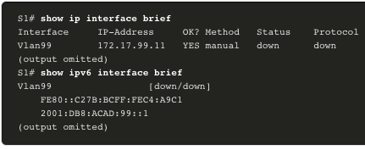
Switch SVI Configuration Example (Cont.)
Step 3: Verify Configuration
The show ip interface brief and show ipv6 interface brief commands are useful for determining the status of both physical and virtual interfaces. The output shown confirms that interface VLAN 99 has been configured with an IPv4 and IPv6 address.
  Note: An IP address applied to the SVI is only for remote management access to the switch; this does not allow the switch to route Layer 3 packets.
Notes:
1 – Basic Device Configuration
1.1. – Configure a Switch with Initial Settings
1.1.6 – Switch SVI Configuration Example (Cont.)

Slide 23
Lab – Basic Switch Configuration
In this lab, you will complete the following objectives:
Part 1: Cable the Network and Verify the Default Switch Configuration
Part 2: Configure Basic Network Device Settings
Part 3: Verify and Test Network Connectivity
Part 4: Manage the MAC Address Table
Notes:
1 – Basic Device Configuration
1.1. – Configure a Switch with Initial Settings
1.1.7 – Lab – Basic Switch Configuration

Slide 24
1.2 Configure Switch Ports
Notes:
1- Basic Device Configuration
1.2 – Configure Switch Ports

Slide 25
Duplex Communication
Full-duplex communication increases bandwidth efficiency by allowing both ends of a connection to transmit and receive data simultaneously. This is also known as bidirectional communication and it requires microsegmentation.
A microsegmented LAN is created when a switch port has only one device connected and is operating in full-duplex mode. There is no collision domain associated with a switch port operating in full-duplex mode.
Unlike full-duplex communication, half-duplex communication is unidirectional. Half-duplex communication creates performance issues because data can flow in only one direction at a time, often resulting in collisions.
Gigabit Ethernet and 10 Gb NICs require full-duplex connections to operate. In full-duplex mode, the collision detection circuit on the NIC is disabled. Full-duplex offers 100 percent efficiency in both directions (transmitting and receiving). This results in a doubling of the potential use of the stated bandwidth.
Notes:
1 – Basic Device Configuration
1.2 – Configure Switch Ports
1.2.1 – Duplex Communication

Slide 26
Configure Switch Ports at the Physical Layer
Switch ports can be manually configured with specific duplex and speed settings. The respective interface configuration commands are duplex and speed.
The default setting for both duplex and speed for switch ports on Cisco Catalyst 2960 and 3560 switches is auto. The 10/100/1000 ports operate in either half- or full-duplex mode when they are set to 10 or 100 Mbps and operate only in full-duplex mode when it is set to 1000 Mbps (1 Gbps).
Autonegotiation is useful when the speed and duplex settings of the device connecting to the port are unknown or may change. When connecting to known devices such as servers, dedicated workstations, or network devices, a best practice is to manually set the speed and duplex settings.
When troubleshooting switch port issues, it is important that the duplex and speed settings are checked.
Note: Mismatched settings for the duplex mode and speed of switch ports can cause connectivity issues. Autonegotiation failure creates mismatched settings.
All fiber-optic ports, such as 1000BASE-SX ports, operate only at one preset speed and are always full-duplex
Notes:
1 – Basic Device Configuration
1.2 – Configure Switch Ports
1.2.2 – Configure Switch Ports at the Physical Layer

Slide 27
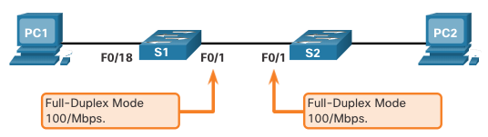
Configure Switch Ports at the Physical Layer (Cont.)
Task | IOS Commands
Enter global configuration mode. | S1# configure terminal
Enter interface configuration mode. | S1(config)# interface FastEthernet 0/1
Configure the interface duplex. | S1(config-if)# duplex full
Configure the interface speed. | S1(config-if)# speed 100
Return to the privileged EXEC mode. | S1(config-if)# end
Save the running config to the startup config. | S1# copy running-config startup-config
Notes:
1 – Basic Device Configuration
1.2 – Configure Switch Ports
1.2.2 – Configure Switch Ports at the Physical Layer (Cont.)

Slide 28
Auto-MDIX
When automatic medium-dependent interface crossover (auto-MDIX) is enabled, the switch interface automatically detects the required cable connection type (straight-through or crossover) and configures the connection appropriately.
When connecting to switches without the auto-MDIX feature, straight-through cables must be used to connect to devices such as servers, workstations, or routers. Crossover cables must be used to connect to other switches or repeaters.
With auto-MDIX enabled, either type of cable can be used to connect to other devices, and the interface automatically adjusts to communicate successfully.
On newer Cisco switches, the mdix auto interface configuration mode command enables the feature. When using auto-MDIX on an interface, the interface speed and duplex must be set to auto so that the feature operates correctly.
Note: The auto-MDIX feature is enabled by default on Catalyst 2960 and Catalyst 3560 switches but is not available on the older Catalyst 2950 and Catalyst 3550 switches.
To examine the auto-MDIX setting for a specific interface, use the show controllers ethernet-controller command with the phy keyword. To limit the output to lines referencing auto-MDIX, use the include Auto-MDIX filter. DTE a DCE
Notes:
1 – Basic Device Configuration
1.2 – Configure Switch Ports
1.2.3 – Auto-MDIX

Slide 29
Switch Verification Commands Máme rádi show ☺
Task | IOS Commands
Display interface status and configuration. | S1# show interfaces [interface-id]
Display current startup configuration. | S1# show startup-config
Display current running configuration. | S1# show running-config
Display information about flash file system. | S1# show flash
Display system hardware and software status. | S1# show version
Display history of command entered. | S1# show history
Display IP information about an interface. | S1# show ip interface [interface-id] OR S1# show ipv6 interface [interface-id]
Display the MAC address table. | S1# show mac-address-table OR S1# show mac address-table
Notes:
1 – Basic Device Configuration
1.2 – Configure Switch Ports
1.2.4 – Switch Verification Commands

Slide 30
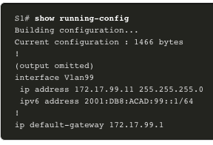
Verify Switch Port Configuration
The show running-config command can be used to verify that the switch has been correctly configured. From the sample abbreviated output on S1, some important information is shown in the figure:
Fast Ethernet 0/18 interface configured with the management VLAN 99
VLAN 99 configured with an IPv4 address of 172.17.99.11 255.255.255.0
Default gateway set to 172.17.99.1
Notes:
1 – Basic Device Configuration
1.2 – Configure Switch Ports
1.2.5 – Verify Switch Port Configuration

Slide 31
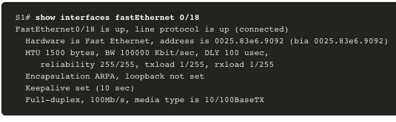
Verify Switch Port Configuration (Cont.)
The show interfaces command is another commonly used command, which displays status and statistics information on the network interfaces of the switch. The show interfaces command is frequently used when configuring and monitoring network devices.
The first line of the output for the show interfaces fastEthernet 0/18 command indicates that the FastEthernet 0/18 interface is up/up, meaning that it is operational. Further down, the output shows that the duplex is full and the speed is 100 Mbps.
Notes:
1 – Basic Device Configuration
1.2 – Configure Switch Ports
1.2.5 – Verify Switch Port Configuration (Cont.)

Slide 32

Network Access Layer Issues
The output from the show interfaces command is useful for detecting common media issues. One of the most important parts of this output is the display of the line and data link protocol status, as shown in the example.
The first parameter (FastEthernet0/18 is up) refers to the hardware layer and indicates whether the interface is receiving a carrier detect signal. The second parameter (line protocol is up) refers to the data link layer and indicates whether the data link layer protocol keepalives are being received. Based on the output of the show interfaces command, possible problems can be fixed as follows:
  If the interface is up and the line protocol is down, a problem exists. There could be an encapsulation type mismatch, the interface on the other end could be error-disabled, or there could be a hardware problem.
  If the line protocol and the interface are both down, a cable is not attached, or some other interface problem exists. For example, in a back-to-back connection, the other end of the connection may be administratively down.
  If the interface is administratively down, it has been manually disabled (the shutdown command has been issued) in the active configuration.
Notes:
1 – Basic Device Configuration
1.2 – Configure Switch Ports
1.2.6 – Network Access Layer Issues

Slide 33
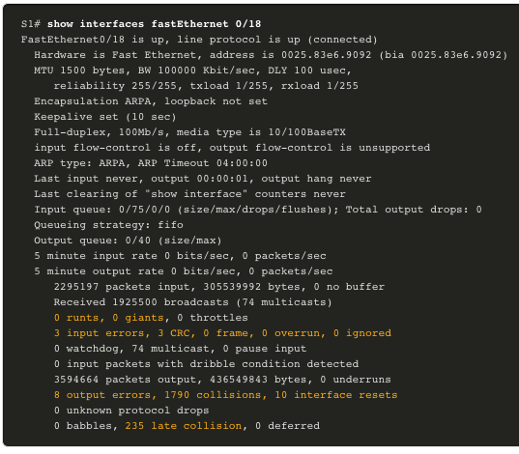
Network Access Layer Issues (Cont.)
The show interfaces command output displays counters and statistics for the FastEthernet0/18 interface, as shown here:
Notes:
1 – Basic Device Configuration
1.2 – Configure Switch Ports
1.2.6 – Network Access Layer Issues (Cont.)

Slide 34
Network Access Layer Issues (Cont.)
Some media errors are not severe enough to cause the circuit to fail but do cause network performance issues. The table explains some of these common errors which can be detected using the show interfaces command.
Error Type | Description
Input Errors | Total number of errors. It includes runts, giants, no buffer, CRC, frame, overrun, and ignored counts.
Runts | Packets that are discarded because they are smaller than the minimum packet size for the medium. For instance, any Ethernet packet that is less than 64 bytes is considered a runt.
Giants | Packets that are discarded because they exceed the maximum packet size for the medium. For example, any Ethernet packet that is greater than 1,518 bytes is considered a giant.
CRC | CRC errors are generated when the calculated checksum is not the same as the checksum received.
Output Errors | Sum of all errors that prevented the final transmission of datagrams out of the interface that is being examined.
Collisions | Number of messages retransmitted because of an Ethernet collision.
Late Collisions | A collision that occurs after 512 bits of the frame have been transmitted
Notes:
1 – Basic Device Configuration
1.2 – Configure Switch Ports
1.2.6 – Network Access Layer Issues (Cont.)

Slide 35
Interface Input and Output Errors
“Input errors” is the sum of all errors in datagrams that were received on the interface being examined. This includes runts, giants, CRC, no buffer, frame, overrun, and ignored counts. The reported input errors from the show interfaces command include the following:
  Runt Frames - Ethernet frames that are shorter than the 64-byte minimum allowed length are called runts. Malfunctioning NICs are the usual cause of excessive runt frames, but they can also be caused by collisions.
  Giants - Ethernet frames that are larger than the maximum allowed size are called giants.
  CRC errors - On Ethernet and serial interfaces, CRC errors usually indicate a media or cable error. Common causes include electrical interference, loose or damaged connections, or incorrect cabling. If you see many CRC errors, there is too much noise on the link and you should inspect the cable. You should also search for and eliminate noise sources.
Notes:
1 – Basic Device Configuration
1.2 – Configure Switch Ports
1.2.7 – Interface Input and Output Errors

Slide 36
Interface Input and Output Errors (Cont.)
“Output errors” is the sum of all errors that prevented the final transmission of datagrams out the interface that is being examined. The reported output errors from the show interfaces command include the following:
  Collisions - Collisions in half-duplex operations are normal. However, you should never see collisions on an interface configured for full-duplex communication.
  Late collisions - A late collision refers to a collision that occurs after 512 bits of the frame have been transmitted. Excessive cable lengths are the most common cause of late collisions. Another common cause is duplex misconfiguration.
Notes:
1 – Basic Device Configuration
1.2 – Configure Switch Ports
1.2.7 – Interface Input and Output Errors (Cont.)

Slide 37
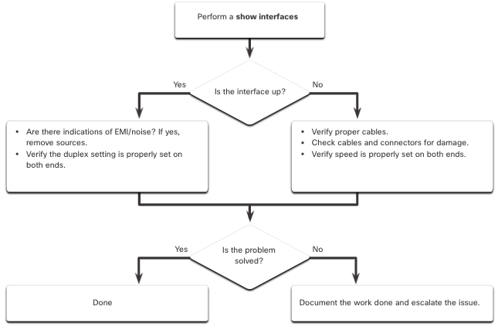
Troubleshooting Network Access Layer Issues
To troubleshoot scenarios involving no connection, or a bad connection, between a switch and another device, follow the general process shown in the figure.
electromagnetic interference
Notes:
1 – Basic Device Configuration
1.2 – Configure Switch Ports
1.2.8 – Troubleshooting Network Access Layer Issues
1.2.9 – Syntax Checker – Configure Switch Ports

Slide 38
1.3 Secure Remote Access
Notes:
1- Basic Device Configuration
1.3 – Secure Remote Access

Slide 39
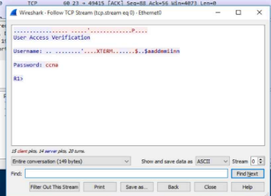
Telnet Operation
Telnet uses TCP port 23. It is an older protocol that uses unsecure plaintext transmission of both the login authentication (username and password) and the data transmitted between the communicating devices.
A threat actor can monitor packets using Wireshark. For example, in the figure the threat actor captured the username admin and password ccna from a Telnet session.
Notes:
1 – Basic Device Configuration
1.3 – Secure Remote Access
1.3.1 – Telnet Operation

Slide 40
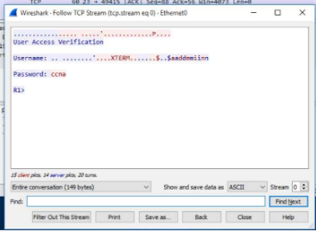
SSH Operation
Secure Shell (SSH) is a secure protocol that uses TCP port 22. It provides a secure (encrypted) management connection to a remote device. SSH should replace Telnet for management connections. SSH provides security for remote connections by providing strong encryption when a device is authenticated (username and password) and also for the transmitted data between the communicating devices.
The figure shows a Wireshark capture of an SSH session. The threat actor can track the session using the IP address of the administrator device. However, unlike Telnet, with SSH the username and password are encrypted.
Notes:
1 – Basic Device Configuration
1.3 – Secure Remote Access
1.3.2 – SSH Operation

Slide 41

Verify the Switch Supports SSH
To enable SSH on a Catalyst 2960 switch, the switch must be using a version of the IOS software including cryptographic (encrypted) features and capabilities. Use the show version command on the switch to see which IOS the switch is currently running. An IOS filename that includes the combination “k9” supports cryptographic (encrypted) features and capabilities.
The example shows the output of the show version command.
Notes:
1 – Basic Device Configuration
1.3 – Secure Remote Access
1.3.3 – Verify the Switch Supports SSH

Slide 42
Configure SSH
Before configuring SSH, the switch must be minimally configured with a unique hostname and the correct network connectivity settings.
  Step 1: Verify SSH support - Use the show ip ssh command to verify that the switch supports SSH. If the switch is not running an IOS that supports cryptographic features, this command is unrecognized.
  Step 2: Configure the IP domain - Configure the IP domain name of the network using the ip domain-name domain-name global configuration mode command (my píšeme no ip-domain lookup.)
  Step 3: Generate RSA key pairs - Generating an RSA key pair automatically enables SSH. Use the crypto key generate rsa global configuration mode command to enable the SSH server on the switch and generate an RSA key pair.
    Note: To delete the RSA key pair, use the crypto key zeroize rsa global configuration mode command. After the RSA key pair is deleted, the SSH server is automatically disabled.
  Step 4: Configure user authentication - The SSH server can authenticate users locally or using an authentication server. To use the local authentication method, create a username and password pair using the username username secret password global configuration mode command.
  Step 5: Configure the vty lines - Enable the SSH protocol on the vty lines by using the transport input ssh line configuration mode command. Use the line vty global configuration mode command and then the login local line configuration mode command to require local authentication for SSH connections from the local username database.
  Step 6: Enable SSH version 2 - By default, SSH supports both versions 1 and 2. When supporting both versions, this is shown in the show ip ssh output as supporting version 2. Enable SSH version using the ip ssh version 2 global configuration command.
Notes:
1 – Basic Device Configuration
1.3 – Secure Remote Access
1.3.4 – Configure SSH

Slide 43
Konfigurace SSH na serveru
Router(config)#hostname R1
R1(config)#ip domain-name UO.LOCAL
R1(config)#crypto key generate rsa
R1(config)#ip ssh version 2
R1(config)#line vty 0 4
R1(config-line)#transport input ssh
R1(config-line)#login local
R1(config)#username admin password moje_heslo

Slide 44
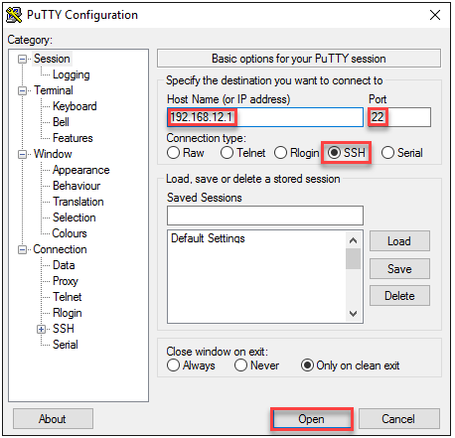
Konfigurace SSH na klientovi

Slide 45
Nastavení SSH na Packet Traceru
R2#ssh -l admin 192.168.12.1
Password:

Slide 46
Jiná Cisco zařízení
R2#ssh ?
-c Select encryption algorithm
-l Log in using this user name
-m Select HMAC algorithm
-o Specify options
-p Connect to this port
-v Specify SSH Protocol Version
-vrf Specify vrf name
WORD IP address or hostname of a remote system

Slide 47
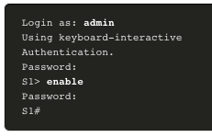
Verify SSH is Operational
On a PC, an SSH client such as PuTTY, is used to connect to an SSH server. For example, assume the following is configured:
SSH is enabled on switch S1
Interface VLAN 99 (SVI) with IPv4 address 172.17.99.11 on switch S1
PC1 with IPv4 address 172.17.99.21
Using a terminal emulator, initiate an SSH connection to the SVI VLAN IPv4 address of S1 from PC1.
When connected, the user is prompted for a username and password as shown in the example. Using the configuration from the previous example, the username admin and password ccna are entered. After entering the correct combination, the user is connected via SSH to the command line interface (CLI) on the Catalyst 2960 switch.
Notes:
1 – Basic Device Configuration
1.3 – Secure Remote Access
1.3.5 – Verify SSH is Operational

Slide 48
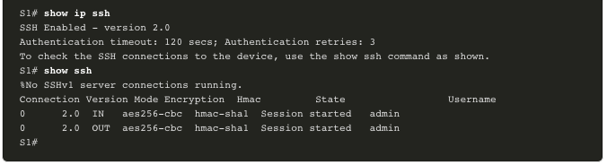
Verify SSH is Operational (Cont.)
To display the version and configuration data for SSH on the device that you configured as an SSH server, use the show ip ssh command. In the example, SSH version 2 is enabled.
Notes:
1 – Basic Device Configuration
1.3 – Secure Remote Access
1.3.5 – Verify SSH is Operational (Cont.)

Slide 49
Packet Tracer – Configure SSH
In this Packet Tracer, you will do the following:
Secure passwords
Encrypt communications
Verify SSH implementation
Notes:
1 – Basic Device Configuration
1.3 – Secure Remote Access
1.3.6 – Packet Tracer – Configure SSH

Slide 50
1.4 Basic Router Configuration
Notes:
1- Basic Device Configuration
1.4 – Basic Router Configuration

Slide 51
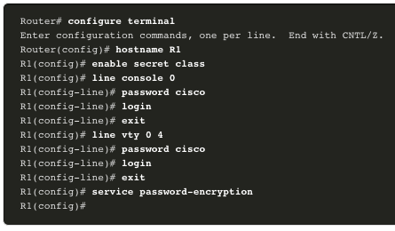
Configure Basic Router Settings
Cisco routers and Cisco switches have many similarities. They support a similar modal operating system, similar command structures, and many of the same commands. In addition, both devices have similar initial configuration steps. For example, the following configuration tasks should always be performed. Name the device to distinguish it from other routers and configure passwords, as shown in the example.
Notes:
1 – Basic Device Configuration
1.4 – Basic Router Configuration
1.4.1 – Configure Basic Router Settings

Slide 52

Configure Basic Router Settings (Cont.)
Configure a banner to provide legal notification of unauthorized access, as shown in the example.
Save the changes on a router, as shown in the example.
Notes:
1 – Basic Device Configuration
1.4 – Basic Router Configuration
1.4.1 – Configure Basic Router Settings (Cont.)
1.4.2 – Syntax Checker – Configure Basic Router Settings

Slide 53
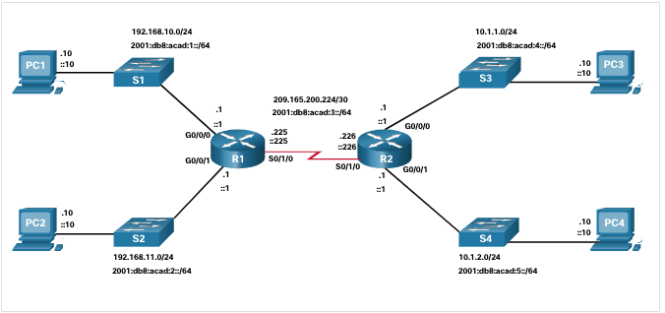
Dual Stack Topology
One distinguishing feature between switches and routers is the type of interfaces supported by each. For example, Layer 2 switches support LANs; therefore, they have multiple FastEthernet or Gigabit Ethernet ports. The dual stack topology in the figure is used to demonstrate the configuration of router IPv4 and IPv6 interfaces.
Notes:
1 – Basic Device Configuration
1.4 – Basic Router Configuration
1.4.3 – Dual Stack Topology

Slide 54
Configure Router Interfaces
Routers support LANs and WANs and can interconnect different types of networks; therefore, they support many types of interfaces. For example, G2 ISRs have one or two integrated Gigabit Ethernet interfaces and High-Speed WAN Interface Card (HWIC) slots to accommodate other types of network interfaces, including serial, DSL, and cable interfaces.
To be available, an interface must be:
  Configured with at least one IP address - Use the ip address ip-address subnet-mask and the ipv6 address ipv6-address/prefix interface configuration commands.
  Activated - By default, LAN and WAN interfaces are not activated (shutdown). To enable an interface, it must be activated using the no shutdown command. (This is similar to powering on the interface.) The interface must also be connected to another device (a hub, a switch, or another router) for the physical layer to be active.
  Description - Optionally, the interface could also be configured with a short description of up to 240 characters. It is good practice to configure a description on each interface. On production networks, the benefits of interface descriptions are quickly realized as they are helpful in troubleshooting and in identifying a third-party connection and contact information.
Notes:
1 – Basic Device Configuration
1.4 – Basic Router Configuration
1.4.4 – Configure Router Interfaces

Slide 55
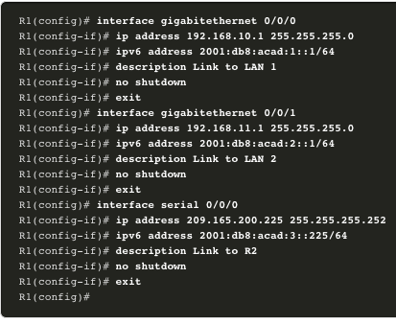
Configure Router Interfaces (Cont.)
The example shows the configure for the interfaces on R1:
Notes:
1 – Basic Device Configuration
1.4 – Basic Router Configuration
1.4.4 – Configure Router Interfaces (Cont.)
1.4.5 – Syntax Checker – Configure Router Interfaces

Slide 56
IPv4 Loopback Interfaces
Another common configuration of Cisco IOS routers is enabling a loopback interface.
The loopback interface is a logical interface that is internal to the router. It is not assigned to a physical port and can never be connected to any other device. It is considered a software interface that is automatically placed in an “up” state, as long as the router is functioning.
The loopback interface is useful in testing and managing a Cisco IOS device because it ensures that at least one interface will always be available. For example, it can be used for testing purposes, such as testing internal routing processes, by emulating networks behind the router.
Loopback interfaces are also commonly used in lab environments to create additional interfaces. For example, you can create multiple loopback interfaces on a router to simulate more networks for configuration practice and testing purposes. The IPv4 address for each loopback interface must be unique and unused by any other interface. In this curriculum, we often use a loopback interface to simulate a link to the internet.
Enabling and assigning a loopback address is simple:
Router(config)# interface loopback number
Router(config-if)# ip address ip-address subnet-mask
Notes:
1 – Basic Device Configuration
1.4 – Basic Router Configuration
1.4.6 – IPv4 Loopback Interfaces

Slide 57
Packet Tracer – Configure Router Interfaces
In this Packet Tracer activity, you will do the following:
Configure IPv4 addressing and verify connectivity
Configure IPv6 addressing and verify connectivity
Notes:
1 – Basic Device Configuration
1.4 – Basic Router Configuration
1.4.7 – Packet Tracer – Configure Router Interfaces

Slide 58
1.5 Verify Directly Connected Networks
Notes:
1- Basic Device Configuration
1.5 – Verify Directly Connected Networks

Slide 59
Interface Verification Commands
There are several show commands that can be used to verify the operation and configuration of an interface.
The following commands are especially useful to quickly identify the status of an interface:
  show ip interface brief and show ipv6 interface brief - These display a summary for all interfaces including the IPv4 or IPv6 address of the interface and current operational status.
  show running-config interface interface-id - This displays the commands applied to the specified interface.
  show ip route and show ipv6 route - These display the contents of the IPv4 or IPv6 routing table stored in RAM. In Cisco IOS 15, active interfaces should appear in the routing table with two related entries identified by the code ‘C’ (Connected) or ‘L’ (Local). In previous IOS versions, only a single entry with the code ‘C’ will appear.
Notes:
1 – Basic Device Configuration
1.5 – Verify Directly Connected Networks
1.5.1 – Interface Verification Commands

Slide 60
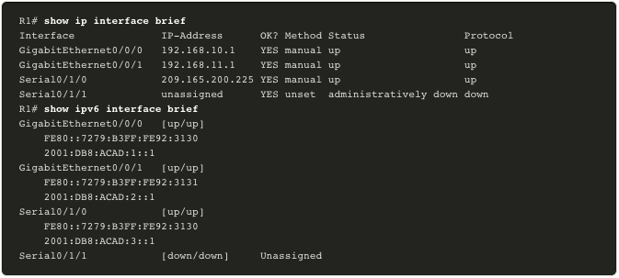
Verify Interface Status
The output of the show ip interface brief and show ipv6 interface brief commands can be used to quickly reveal the status of all interfaces on the router. You can verify that the interfaces are active and operational as indicated by the Status of “up” and Protocol of “up”, as shown in the example. A different output would indicate a problem with either the configuration or the cabling.
Notes:
1 – Basic Device Configuration
1.5 – Verify Directly Connected Networks
1.5.2 – Verify Interface Status

Slide 61
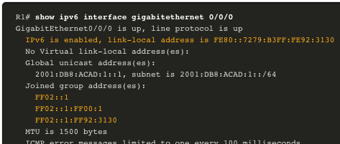
Verify IPv6 Link Local and Multicast Addresses
The output of the show ipv6 interface brief command displays two configured IPv6 addresses per interface. One address is the IPv6 global unicast address that was manually entered. The other address, which begins with FE80, is the link-local unicast address for the interface. A link-local address is automatically added to an interface whenever a global unicast address is assigned. An IPv6 network interface is required to have a link-local address, but not necessarily a global unicast address.
The show ipv6 interface gigabitethernet 0/0/0 command displays the interface status and all of the IPv6 addresses belonging to the interface. Along with the link local address and global unicast address, the output includes the multicast addresses assigned to the interface, beginning with prefix FF02, as shown in the example.
Notes:
1 – Basic Device Configuration
1.5 – Verify Directly Connected Networks
1.5.3 – Verify IPv6 Link Local and Multicast Addresses

Slide 62
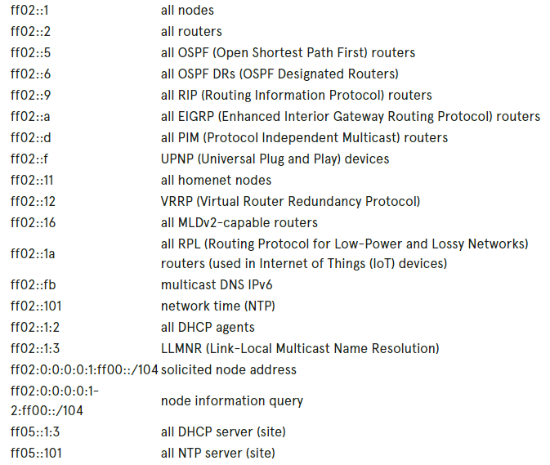
IPv6 multicast adresy (FF02 – 0 pernamentní
2 linka

Slide 63
Kterou adresou začíná a končí multicast adresa
FF02:0:0:0:0:1:FF00::/104

Slide 64
FF02:0:0:0:0:1:FF00:0000
do
FF02:0:0:0:0:1:FFFF:FFFF

Slide 65
Solicited-Node multicast address
A Solicited-Node multicast address (adresa vícesměrového vysílání vyžádaného uzlu) je adresa vícesměrového vysílání IPv6 používaná protokolem Neighbor Discovery Protocol k ověření, zda je daná adresa IPv6 již používána lokálním odkazem, či nikoli, prostřednictvím procesu zvaného DAD (Duplicate Address Detection).

Slide 66
solicited-node multicast address
FF02:0:0:0:0:1:FF00:0000
+ ::1
FF02:0:0:0:0:1:FF00:0001
Je
FF02::1:FF00:1

Slide 67
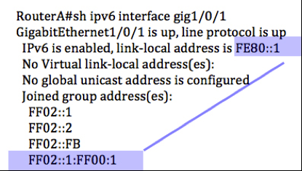
Rozhlašuji, že mám FE80::1

Slide 68
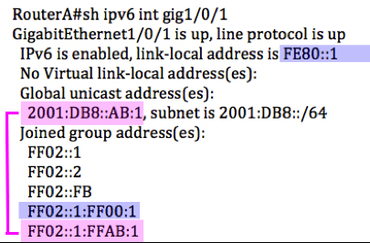
Obdobně router rozhlašuje svoji globální IPv6 adresu

Slide 69
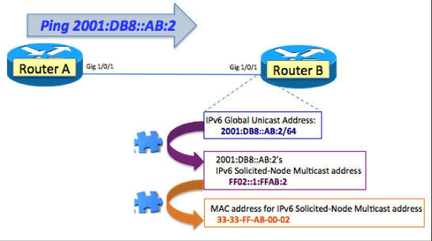
Jak z globální adresy získat MAC adresu

Slide 70

Použití pro ping

Slide 71
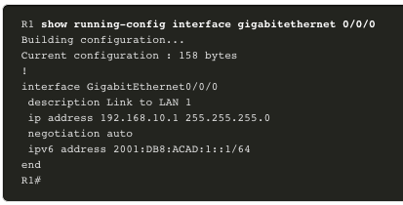
Verify Interface Configuration
The output of the show running-config interface command displays the current commands applied to the specified interface, as shown.
The following two commands are used to gather more detailed interface information:
  show interfaces - Displays interface information and packet flow count for all interfaces on the device.
  show ip interface and show ipv6 interface - Displays the IPv4 and IPv6 related information for all interfaces on a router..
Notes:
1 – Basic Device Configuration
1.5 – Verify Directly Connected Networks
1.5.4 – Verify Interface Configuration

Slide 72
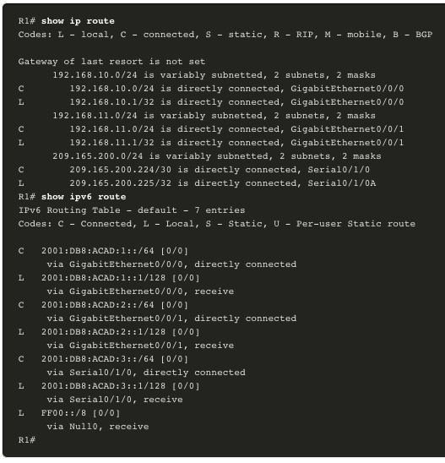
Verify Routes
The output of the show ip route and show ipv6 route commands reveal the three directly connected network entries and the three local host route interface entries, as shown in the example.
The local host route has an administrative distance of 0. It also has a /32 mask for IPv4, and a /128 mask for IPv6. The local host route is for routes on the router that owns the IP address. It is used to allow the router to process packets destined to that IP.
Notes:
1 – Basic Device Configuration
1.5 – Verify Directly Connected Networks
1.5.5 – Verify Routes

Slide 73
Verify Routes (Cont.)
A ‘C’ next to a route within the routing table indicates that this is a directly connected network. When the router interface is configured with a global unicast address and is in the “up/up” state, the IPv6 prefix and prefix length are added to the IPv6 routing table as a connected route.
The IPv6 global unicast address applied to the interface is also installed in the routing table as a local route. The local route has a /128 prefix. Local routes are used by the routing table to efficiently process packets with the interface address of the router as the destination.
Notes:
1 – Basic Device Configuration
1.5 – Verify Directly Connected Networks
1.5.5 – Verify Routes (Cont.)

Slide 74
Filter Show Command Output
Commands that generate multiple screens of output are, by default, paused after 24 lines. At the end of the paused output, the --More-- text displays. Pressing Enter displays the next line and pressing the spacebar displays the next set of lines. Use the terminal length command to specify the number of lines to be displayed. A value of 0 (zero) prevents the router from pausing between screens of output.
Another very useful feature that improves the user experience in the CLI is the filtering of show output. Filtering commands can be used to display specific sections of output. To enable the filtering command, enter a pipe (|) character after the show command and then enter a filtering parameter and a filtering expression.
There are four filtering parameters that can be configured after the pipe:
  section - Shows the entire section that starts with the filtering expression.
  include - Includes all output lines that match the filtering expression.
  exclude - Excludes all output lines that match the filtering expression.
  begin - Shows all the output lines from a certain point, starting with the line that matches the filtering expression
Notes:
1 – Basic Device Configuration
1.5 – Verify Directly Connected Networks
1.5.6 – Filter Show Command Output
1.5.7 – Syntax Checker – Filter Show Command Output

Slide 75
Command History Feature
The command history feature is useful because it temporarily stores the list of executed commands to be recalled.
To recall commands in the history buffer, press Ctrl+P or the Up Arrow key. The command output begins with the most recent command. Repeat the key sequence to recall successively older commands. To return to more recent commands in the history buffer, press Ctrl+N or the Down Arrow key. Repeat the key sequence to recall successively more recent commands.
By default, command history is enabled and the system captures the last 10 command lines in its history buffer. Use the show history privileged EXEC command to display the contents of the buffer.
It is also practical to increase the number of command lines that the history buffer records during the current terminal session only. Use the terminal history size user EXEC command to increase or decrease the size of the buffer.
Notes:
1 – Basic Device Configuration
1.5 – Verify Directly Connected Networks
1.5.8 – Command History Feature
1.5.9 – Syntax Checker – Command History Features

Slide 76
Packet Tracer – Verify Directly Connected Networks
In this Packet Tracer activity, you will complete the following objectives:
Verify IPv4 directly connected networks
Verify IPv6 directly connected networks
Troubleshoot connectivity issues
Notes:
1 – Basic Device Configuration
1.5 – Verify Directly Connected Networks
1.5.10 – Packet Tracer – Verify Directly Connected Networks
1.5.11 - Check Your Understanding – Verify Directly Connected Networks

Slide 77
1.6 Module Practice and Quiz
Notes:
1- Basic Device Configuration
1.5 – Verify Directly Connected Networks

Slide 78
Packet Tracer – Implement a Small Network
In this Packet Tracer activity, you will do the following:
Create a network topology
Configure devices and verify connectivity
Notes:
1 – Basic Device Configuration
1.6 – Module Practice and Quiz
1.6.1 – Packet Tracer – Implement a Small Network

Slide 79
Lab– Configure Basic Router Settings
In this lab, you will complete the following objectives:
Set up the topology and initialize devices
  Cable equipment to match the network topology
  Initialize and restart the router and switch
Configure devices and verify connectivity
  Assign static IPv4 and IPv6 information to the PC interface
  Configure basic router settings
  Configure the router for SSH
  Verify network connectivity
Notes:
1 – Basic Device Configuration
1.6 – Module Practice and Quiz
1.6.2 – Lab – Configure Basic Router Settings

Slide 80
Co jsme se naučili (1/3)
Po zapnutí přepínače Cisco prochází pětistupňová spouštěcí sekvence.
Proměnná prostředí BOOT se nastavuje pomocí příkazu udávajícího režim globální konfigurace spouštěcího systému.
Pomocí diod LED přepínače můžete sledovat aktivitu a výkon přepínače: SYST, RPS, STAT, DUPLX, SPEED a PoE.
Zavaděč poskytuje přístup do přepínače, i pokud operační systém nelze použít kvůli chybějícím nebo poškozeným systémovým souborům.
Chcete-li připravit přepínač pro přístup ke vzdálené správě, musí být přepínač nakonfigurován s adresou IP a maskou podsítě.
Chcete-li spravovat přepínač ze vzdálené sítě, musí být přepínač nakonfigurován s výchozí bránou.
Full-duplexní komunikace zvyšuje efektivní šířku pásma tím, že umožňuje oběma koncům připojení současně vysílat a přijímat data.
Porty přepínačů lze ručně konfigurovat s konkrétním nastavením duplexu a rychlosti.
Pokud rychlost a duplexní nastavení zařízení připojeného k portu neznámé nebo se může změnit, použijte automatické vyjednávání (autonegotiation).
Když je povolen auto-MDIX, rozhraní automaticky detekuje požadovaný typ připojení kabelu (přímé nebo křížené) a odpovídajícím způsobem nakonfiguruje připojení.

Slide 81
Co jsme se naučili (2/3)
Existuje několik příkazů show, které se mají použít při ověřování konfigurací přepínačů.
Telnet (pomocí portu TCP 23) je starší protokol, který používá nezabezpečený prostý přenos jak přihlašovacího ověřování (uživatelské jméno a heslo), tak dat přenášených mezi komunikujícími zařízeními.
SSH (pomocí portu TCP 22) poskytuje zabezpečení pro vzdálená připojení zajištěním silného šifrování, když je zařízení ověřeno (uživatelské jméno a heslo), a také pro přenášená data mezi komunikujícími zařízeními.
Název souboru IOS, který obsahuje kombinaci „k9“, podporuje kryptografické funkce a schopnosti.
Chcete-li nakonfigurovat SSH, musíte ověřit, že jej přepínač podporuje, nakonfigurovat doménu IP, generovat páry klíčů RSA, nakonfigurovat použití ověřování, nakonfigurovat řádky VTY a povolit SSH verze 2.
Chcete-li ověřit, že SSH je funkční, použijte příkaz show ip ssh k zobrazení verze a konfiguračních dat pro SSH na zařízení.
Vždy je třeba provést následující úlohy počáteční konfigurace: pojmenujte zařízení, aby se odlišilo od ostatních směrovačů, a nakonfigurujte hesla, nakonfigurujte banner, aby poskytoval legální oznámení o neoprávněném přístupu, a uložte změny na routeru.

Slide 82
Co jsme se naučili (3/3)
Jedním z charakteristických rysů mezi přepínači a směrovači je typ rozhraní, které každý podporuje. Směrovače podporují sítě LAN a WAN a mohou propojovat různé typy sítí; proto podporují mnoho typů rozhraní.
Rozhraní Loopback IPv4 je logické rozhraní, které je interní v routeru. Není přiřazen k fyzickému portu a nikdy jej nelze připojit k žádnému jinému zařízení.
Pomocí následujících příkazů můžete rychle zjistit stav rozhraní:
  show ip interface brief a show ipv6 interface brief pro souhrnné údaje (IPv4 a IPv6 adresy a operační stav),
  show running-config interface interface-id pro zobrazení příkazů použitých na zadané rozhraní a
  show ip route and show ipv6 route pro zobrazení obsahu IPv4 or IPv6 směrovací tabulky uložené v RAM.
Filtruje zobrazení příkazu pomocí znaku potrubí (|). Použijte výrazy filtru: oddíl, zahrnout, vyloučit a začít.
Ve výchozím (defaultním) nastavení je historie příkazů povolena a systém zachycuje posledních 10 příkazových řádků ve své vyrovnávací paměti historie.
K zobrazení obsahu vyrovnávací paměti použijte EXEC privilegovaný příkaz show history.

Slide 83
What Did I Learn In This Module?
After a Cisco switch is powered on, it goes through a five-step boot sequence.
The BOOT environment variable is set using the boot system global configuration mode command.
Use the switch LEDs to monitor switch activity and performance: SYST, RPS, STAT, DUPLX, SPEED, and PoE.
The boot loader provides access into the switch if the operating system cannot be used because of missing or damaged system files.
To prepare a switch for remote management access, the switch must be configured with an IP address and a subnet mask.
To manage the switch from a remote network, the switch must be configured with a default gateway.
Full-duplex communication increases effective bandwidth by allowing both ends of a connection to transmit and receive data simultaneously.
Switch ports can be manually configured with specific duplex and speed settings.
Use autonegotiation when the speed and duplex settings of the device connecting to the port are unknown or may change.
When auto-MDIX is enabled, the interface automatically detects the required cable connection type (straight-through or crossover) and configures the connection appropriately.
Notes:
1 – Basic Device Configuration
1.6 – Module Practice and Quiz
1.6.3 – What Did I Learn In This Module?
1.6.4 – Module Quiz – Basic Device Configuration

Slide 84
What Did I Learn In This Module? (Cont.)
There are several show commands to use when verifying switch configurations.
Telnet (using TCP port 23) is an older protocol that uses unsecure plaintext transmission of both the login authentication (username and password) and the data transmitted between the communicating devices.
SSH (using TCP port 22) provides security for remote connections by providing strong encryption when a device is authenticated (username and password) and also for the transmitted data between the communicating devices.
An IOS filename that includes the combination “k9” supports cryptographic features and capabilities.
To configure SSH you must verify that the switch supports it, configure the IP domain, generate RSA key pairs, configure use authentication, configure the VTY lines, and enable SSH version 2.
To verify that SSH is operational, use the show ip ssh command to display the version and configuration data for SSH on the device.
The following initial configuration tasks should always be performed: name the device to distinguish it from other routers and configure passwords, configure a banner to provide legal notification of unauthorized access, and save the changes on a router.
Notes:
1 – Basic Device Configuration
1.6 – Module Practice and Quiz
1.6.3 – What Did I Learn In This Module? (Cont.)

Slide 85
What Did I Learn In This Module? (Cont.)
One distinguishing feature between switches and routers is the type of interfaces supported by each.
Routers support LANs and WANs and can interconnect different types of networks; therefore, they support many types of interfaces.
The IPv4 loopback interface is a logical interface that is internal to the router. It is not assigned to a physical port and can never be connected to any other device.
Use the following commands to quickly identify the status of an interface:
  show ip interface brief and show ipv6 interface brief to see summary all interfaces (IPv4 and IPv6 addresses and operational status),
  show running-config interface interface-id to see the commands applied to a specified interface, and
  show ip route and show ipv6 route to see the contents of the IPv4 or IPv6 routing table stored in RAM.
Filter show command output using the pipe (|) character. Use filter expressions: section, include, exclude, and begin.
By default, command history is enabled, and the system captures the last 10 command lines in its history buffer.
Use the show history privileged EXEC command to display the contents of the buffer.
Notes:
1 – Basic Device Configuration
1.6 – Module Practice and Quiz
1.6.3 – What Did I Learn In This Module? (Cont.)
1.6.4 – Module Quiz – Basic Device Configuration

Slide 86
New Terms and Commands
boot system flash
Power over Ethernet (PoE)
duplex
speed
auto-mdix
show controllers ethernet controller X
phy
show flash
show history
show ip ssh
ip ssh version 2
Loopback Interface
interface loopback x
include
exclude
section
show history
terminal history size

Slide 87
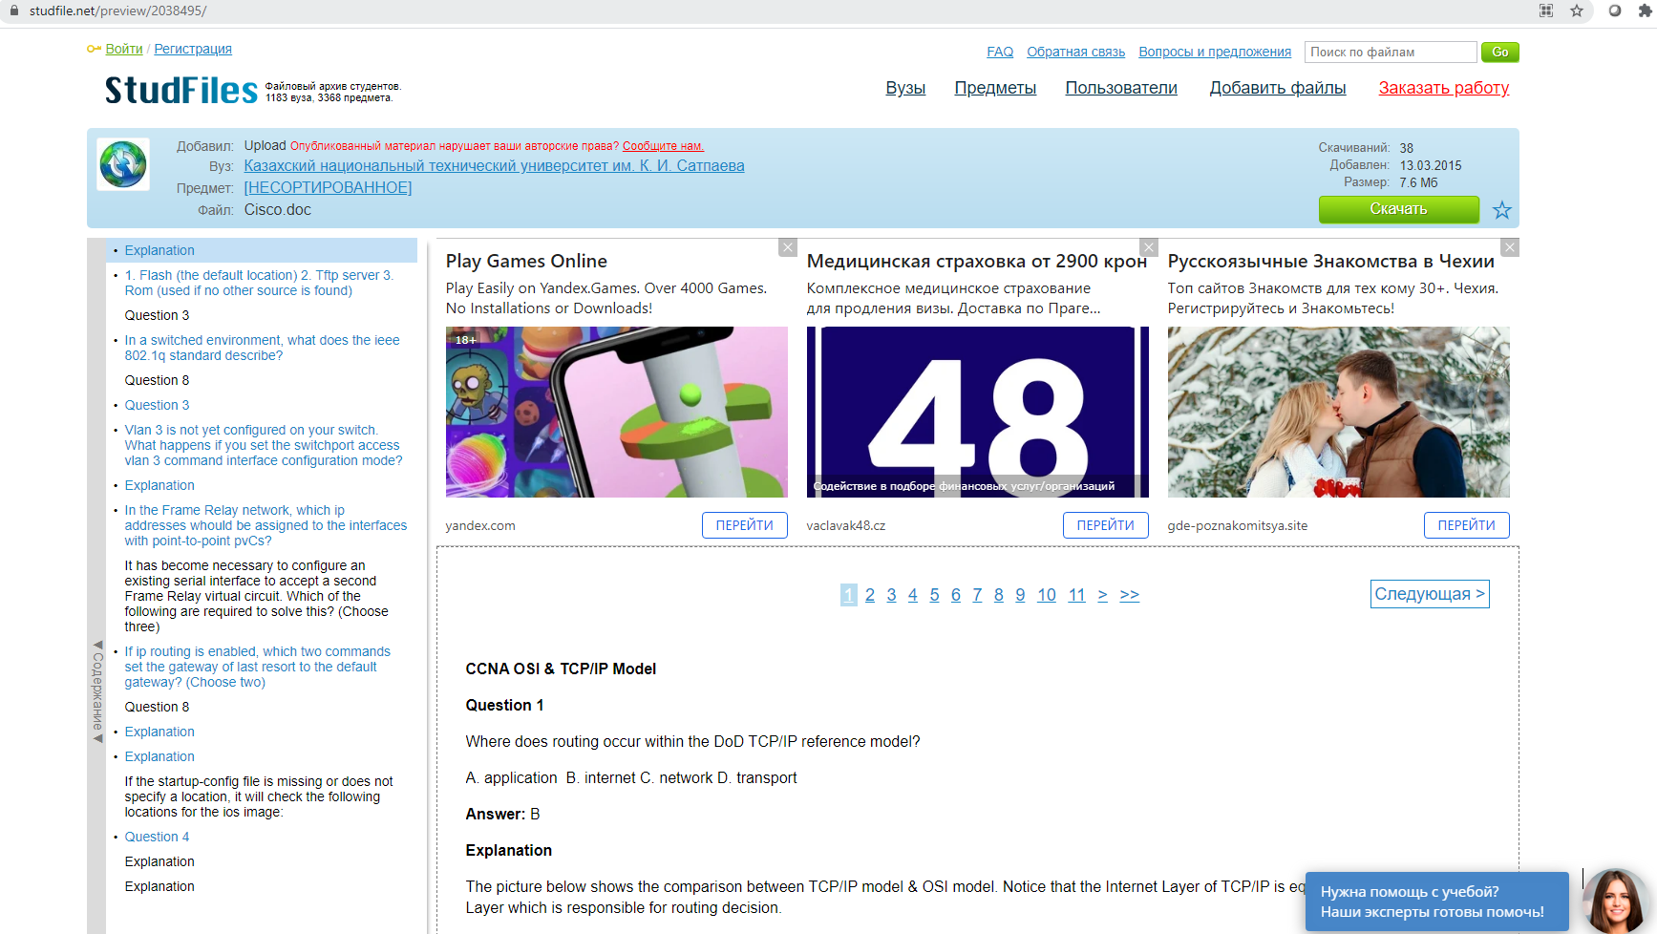

Slide 88
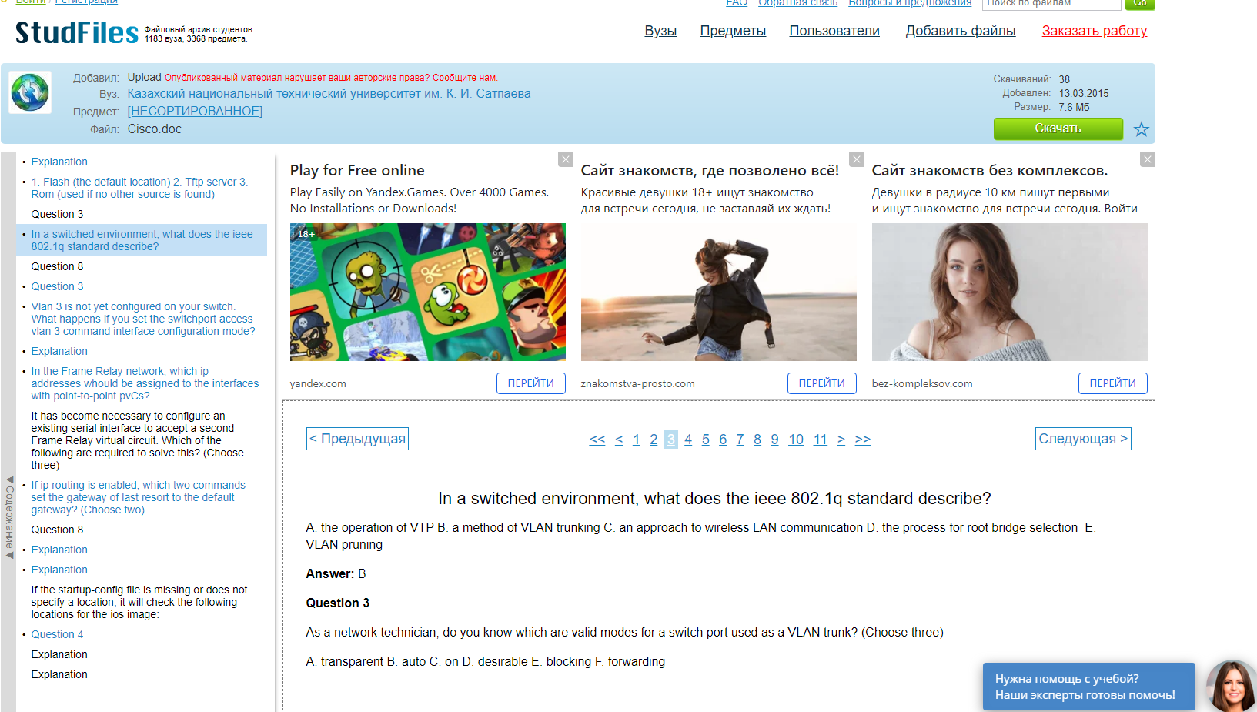

Slide 89

Sunny Classroom: https://www.youtube.com/user/sunnylearning/videos

