Slide 1
Module 3: VLANs
Switching, Routing, and Wireless Essentials v7.0 (SRWE)
Notes:
Cisco Networking Academy Program
Switching, Routing, and Wireless Essentials v7.0 (SRWE)
Module 3: VLANs

Slide 2
Module Objectives
Module Title: Protocols and Models
Module Objective: Explain how network protocols enable devices to access local and remote network resources.
Topic Title | Topic Objective
Overview of VLANs | Explain the purpose of VLANs in a switched network.
VLANs in a Multi-Switched Environment | Explain how a switch forwards frames based on VLAN configuration in a multi-switch environment.
VLAN Configuration | Configure a switch port to be assigned to a VLAN based on requirements.
VLAN Trunks | Configure a trunk port on a LAN switch.
Dynamic Trunking Protocol | Configure Dynamic Trunking Protocol (DTP).
Notes:
2
3 – VLANs
3.0 – Introduction
3.0.2 – What will I learn to do in this module?

Slide 3
3.1 Overview of VLANs
Notes:
3 – VLANs
3.1 – Overview of VLANs

Slide 4
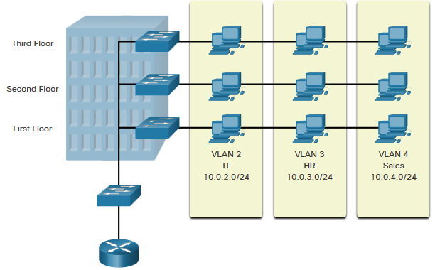
VLAN Definitions
VLANs are logical connections with other similar devices.
Placing devices into various VLANs have the following characteristics:
  Provides segmentation of the various groups of devices on the same switches
  Provide organization that is more manageable
      Broadcasts, multicasts and unicasts are isolated in the individual VLAN
      Each VLAN will have its own unique range of IP addressing
      Smaller broadcast domains
Notes:
3 – VLANs
3.1 – Overview of VLANs
3.1.1 – VLAN Definitions

Slide 5
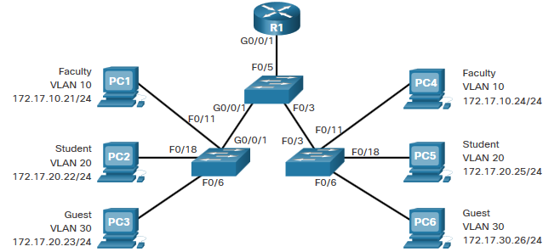
Benefits of a VLAN Design
Benefits of using VLANs are as follows:
Benefits | Description
Smaller Broadcast Domains | Dividing the LAN reduces the number of broadcast domains
Improved Security | Only users in the same VLAN can communicate together
Improved IT Efficiency | VLANs can group devices with similar requirements, e.g. faculty vs. students
Reduced Cost | One switch can support multiple groups or VLANs
Better Performance | Small broadcast domains reduce traffic, improving bandwidth
Simpler Management | Similar groups will need similar applications and other network resources
Notes:
3 – VLANs
3.1 – Overview of VLANs
3.1.2 – Benefits of a VLAN Design

Slide 6
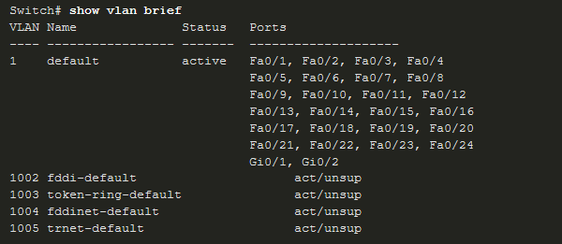
Types of VLANs
Default VLAN
VLAN 1 is the following:
  The default VLAN
  The default Native VLAN
  The default Management VLAN
  Cannot be deleted or renamed
  Note: While we cannot delete VLAN1 Cisco will recommend that we assign these default features to other VLANs
https://www.youtube.com/watch?v=vE5gvbmR8jg
Notes:
3 – VLANs
3.1 – Overview of VLANs
3.1.3 – Types of VLANs

Slide 7
Types of VLANs (Cont.)
Data VLAN
Dedicated to user-generated traffic (email and web traffic).
VLAN 1 is the default data VLAN because all interfaces are assigned to this VLAN.
Native VLAN
This is used for trunk links only.
All frames are tagged on an 802.1Q trunk link except for those on the native VLAN.
Management VLAN
This is used for SSH/Telnet VTY traffic and should not be carried with end user traffic.
Typically, the VLAN that is the SVI for the Layer 2 switch.
Notes:
3 – VLANs
3.1 – Overview of VLANs
3.1.3 – Types of VLANs (Cont.)

Slide 8
Případy použití native VLAN
Komunikace zařízení bez 802.1Q
Přenos zpráv protokolů STP, VTP, CDP, LLDP
IP telefony

Slide 9
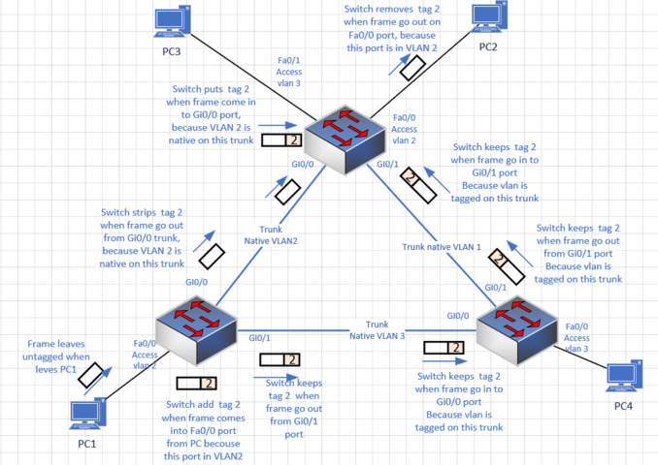
Příklad nativní a nenativní VLANy
https://www.youtube.com/watch?v=Fmq1E1Qr2W4
https://www.youtube.com/watch?v=zW_-mf6v3fs

Slide 10
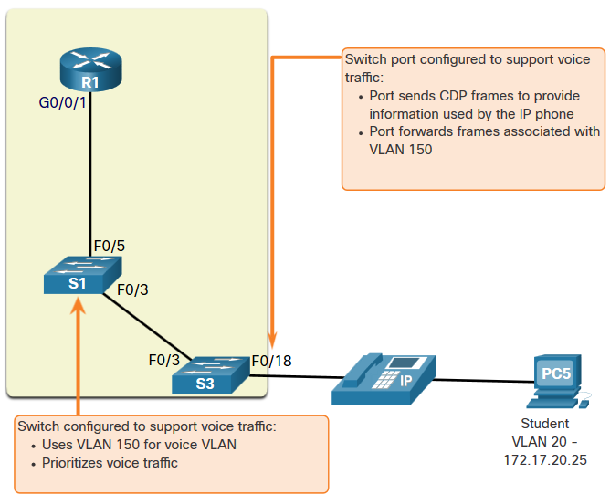
Types of VLANs (Cont.)
Voice VLAN
  A separate VLAN is required because Voice traffic requires:
      Assured bandwidth
      High QoS priority
      Ability to avoid congestion
      Delay less that 150 ms from source to destination
  The entire network must be designed to support voice.
Notes:
3 – VLANs
3.1 – Overview of VLANs
3.1.3 – Types of VLANs (Cont.)

Slide 11
Packet Tracer – Who Hears the Broadcast?
In this Packet Tracer activity, you will do the following:
  Observe Broadcast Traffic in a VLAN Implementation
  Complete Review Questions
Notes:
3 – VLANs
3.1 – Overview of VLANs
3.1.4 – Packet Tracer – Who Hears the Broadcast?
3.1.5 – Check Your Understanding – Overview of VLANs

Slide 12
3.2 VLANs in a
Multi-Switched Environment
Notes:
3 – VLANs
3.2 – VLANs in a Multi-Switched Environment

Slide 13
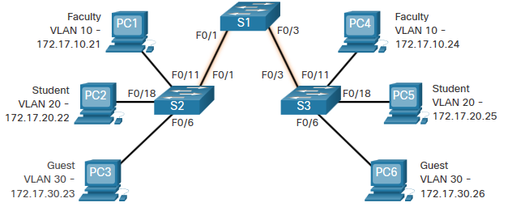
Defining VLAN Trunks
A trunk is a point-to-point link between two network devices.
Cisco trunk functions:
Allow more than one VLAN
Extend the VLAN across the entire network
By default, supports all VLANs
Supports 802.1Q trunking
Notes:
3 – VLANs
3.2 – VLANs in a Multi-Switched Environment
3.2.1 – Defining VLAN Trunks

Slide 14
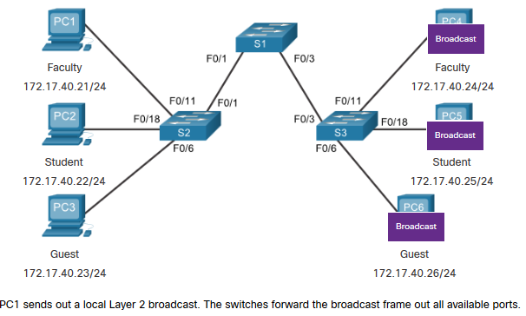
Networks without VLANs
Without VLANs, all devices connected to the switches will receive all unicast, multicast, and broadcast traffic.
Notes:
3 – VLANs
3.2 – VLANs in a Multi-Switched Environment
3.2.2 – Networks without VLANs

Slide 15
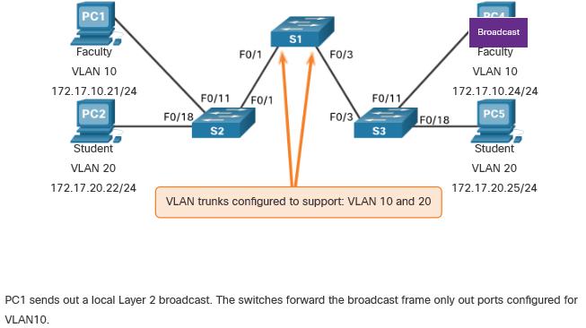
Networks with VLANs
With VLANs, unicast, multicast, and broadcast traffic is confined to a VLAN. Without a Layer 3 device to connect the VLANs, devices in different VLANs cannot communicate.
Notes:
3 – VLANs
3.2 – VLANs in a Multi-Switched Environment
3.2.3 – Networks with VLANs

Slide 16
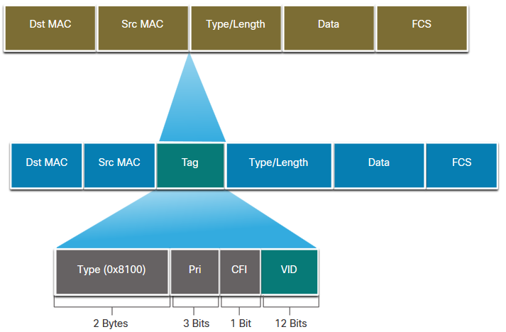
VLAN Identification with a Tag
The IEEE 802.1Q header is 4 Bytes
When the tag is created the FCS must be recalculated.
When sent to end devices, this tag must be removed and the FCS recalculated back to its original number.
802.1Q VLAN Tag Field | Function
Type | 2-Byte field with hexadecimal 0x8100 This is referred to as Tag Protocol ID (TPID)
User Priority | 3-bit value that supports
Canonical Format Identifier (CFI) | 1-bit value that can support token ring frames on Ethernet
VLAN ID (VID) | 12-bit VLAN identifier that can support up to 4096 VLANs
Notes:
3 – VLANs
3.2 – VLANs in a Multi-Switched Environment
3.2.4 – VLAN Identification with a Tag

Slide 17
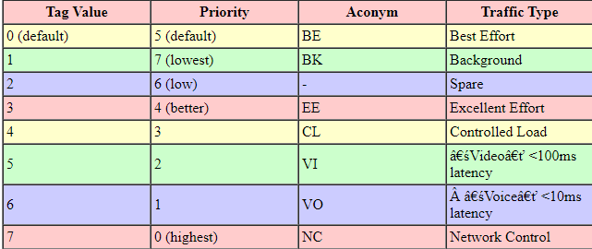
Tag a priorita – není rámec jako rámec

Slide 18
Nahlédnutí ke konkurenci
https://help.sonicwall.com/help/sw/eng/7110/26/2/4/content/Firewall_Managing_QoS.088.3.html

Slide 19
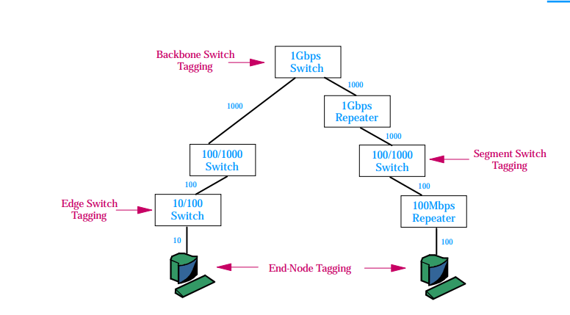
Kdo určuje prioritu?

Slide 20
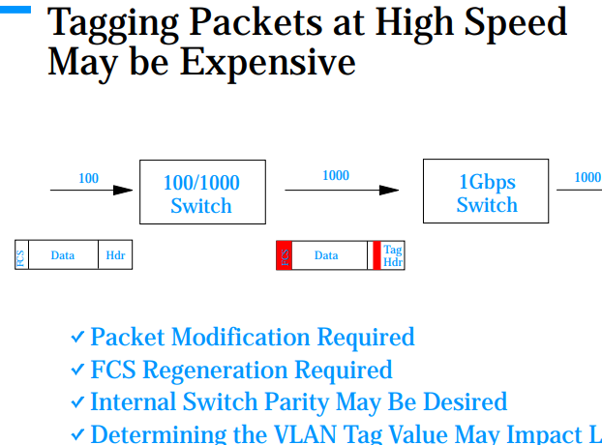
Dopovězte!

Slide 21
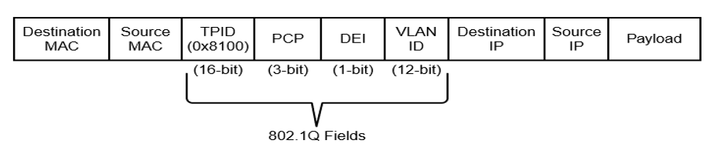
Virtuální LANy (převzato z překladu CCNP CORE)
Přidání routeru mezi segmenty LAN pomáhá zmenšit velikost kolizních domén.
Virtuální sítě LAN (VLANS) poskytují logickou segmentaci vytvořením více vysílacích domén na stejném síťovém přepínači. VLAN poskytují vyšší využití portů přepínače, protože port může být přidružen k potřebné vysílací doméně a více vysílacích domén může být umístěno na stejném přepínači.
VLANS jsou definovány ve standardu IEEE 802.1Q, který stanoví, že 32 bitů je přidáno do hlavičky paketu s následujícími poli: identifikátor protokolu protokolu (TPID – Tag Protocol Identifier), prioritní kódový bod (PCP – Priority Code Point), indikátor způsobilého poklesu (DEI - Drop Eligible Indicator, dříve CFI), a identifikátor VLAN (VLAN ID).

Slide 22
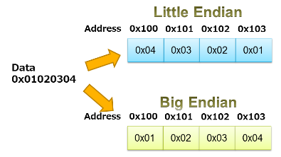
Canonical Format Indicator (CFI)
Identifikátor, který říká v jakém pořadí je přenášen rámec. Může se přenášet
kanonickým tvarem (little endian), který se používá v Ethernetu,
nebo nekanonickým (big endian), který se používá v Token Ringu a FDDI.
A ty už se nepoužívají, takže je zbytečný
A používá se Drop Eligible Indicator.

Slide 23
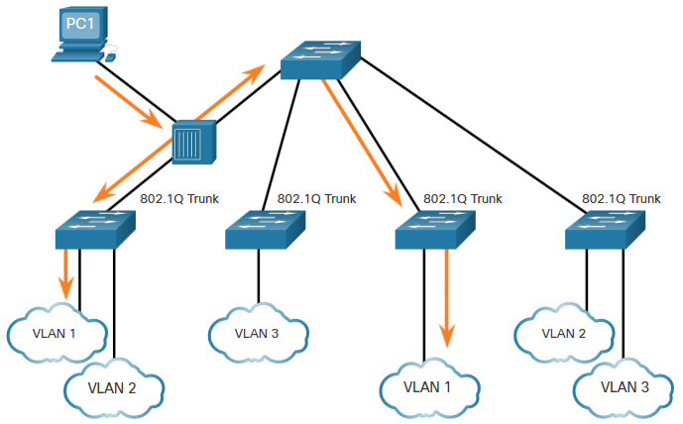
Native VLANs and 802.1Q Tagging
802.1Q trunk basics:
Tagging is typically done on all VLANs.
The use of a native VLAN was designed for legacy use, like the hub in the example.
Unless changed, VLAN1 is the native VLAN.
Both ends of a trunk link must be configured with the same native VLAN.
Each trunk is configured separately, so it is possible to have a different native VLANs on separate trunks.
Notes:
3 – VLANs
3.2 – VLANs in a Multi-Switched Environment
3.2.5 – Native VLANs and 802.1Q Tagging

Slide 24
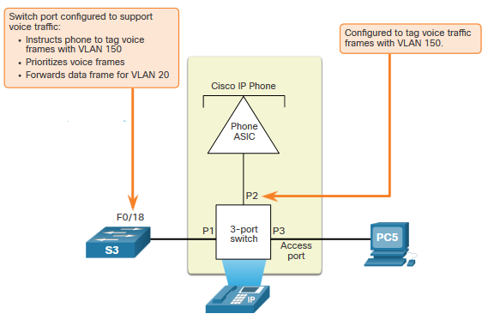
Voice VLAN Tagging
The VoIP phone is a three port switch:
The switch will use CDP to inform the phone of the Voice VLAN.
The phone will tag its own traffic (Voice) and can set Cost of Service (CoS). CoS is QoS for layer 2.
The phone may or may not tag frames from the PC.
Traffic | Tagging Function
Voice VLAN | tagged with an appropriate Layer 2 class of service (CoS) priority value
Access VLAN | can also be tagged with a Layer 2 CoS priority value
Access VLAN | is not tagged (no Layer 2 CoS priority value)
Notes:
3 – VLANs
3.2 – VLANs in a Multi-Switched Environment
3.2.6 – Voice VLAN Tagging

Slide 25
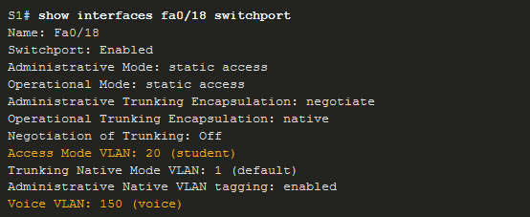
Voice VLAN Verification Example
The show interfaces fa0/18 switchport command can show us both data and voice VLANs assigned to the interface.
Notes:
3 – VLANs
3.2 – VLANs in a Multi-Switched Environment
3.2.7 – Voice VLAN Verification Example

Slide 26
Útoky typu VLAN hopping
1. Switch spoofing – Síťový útočník nakonfiguruje systém, aby se jevil emulací signalizace ISL nebo 802.1q a DTP jako přepínač. Díky tomu se útočník zdá být přepínačem s hlavním portem, a proto členem všech sítí VLAN.
2. Double tagging – Většina přepínačů dnes provádí pouze jednu úroveň dekapsulace. Když tedy první přepínač uvidí rámec se dvěma značkami, odstraní první značku z rámce a poté pošle s vnitřní značkou 802.1q na všechny porty přepínačů ve VLAN útočníka i na všechny hlavní porty. Druhý přepínač přeposílá paket na základě ID VLAN ve druhé hlavičce 802.1q. Tento typ útoku funguje, i když jsou trunk porty vypnuty.

Slide 27
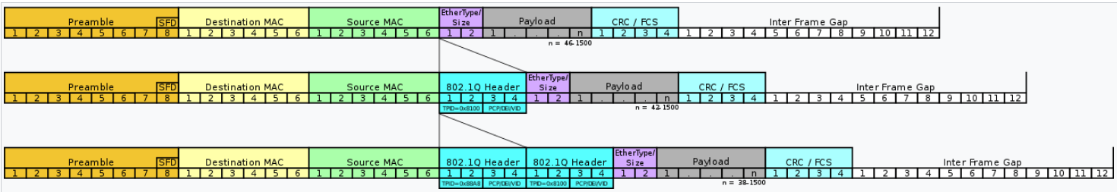
Double tagging

Slide 28
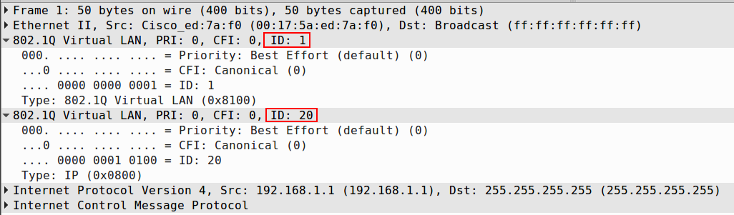
Double tags pomocí Scapy
SW1#
interface FastEthernet0/11
switchport mode access
interface FastEthernet0/24
switchport trunk encapsulation dot1q
switchport mode trunk
switchport nonegotiate
SW2#
interface FastEthernet0/2
switchport access vlan 20
switchport mode access
interface FastEthernet0/24
switchport trunk encapsulation dot1q
switchport mode trunk
>>> sendp(Ether(dst='ff:ff:ff:ff:ff:ff', src='00:17:5a:ed:7a:f0')/Dot1Q(vlan=1)/Dot1Q(vlan=20)/ IP(dst='255.255.255.255', src='192.168.1.1')/ICMP(), iface='eth2')

Slide 29
Prevence
Zakažte všechny nepoužívané porty a umístěte je do nepoužívané VLANy.
Vždy používejte vyhrazené (dedikované) ID VLAN pro všechny porty trunku.
Vypnutím DTP nastavte všechny uživatelské porty na režim non-trunking. V režimu konfigurace rozhraní použijte příkaz switchport mode access.
U páteřních (backbone) připojení typu switch-to-switch explicitně (výslovně) nakonfigurujte truning.
Nepoužívejte nativní VLAN uživatele jako nativní VLAN trunk port.
Nepoužívejte VLAN 1 pro management.

Slide 30
Konkrétně rady:
Nedávejte žádného hosta do VLAN 1 (defaultní VLANy). Na každý access port dejte „sběrnou VLANu!:
Switch (config-if)# switchport access vlan 2
Změňte nativní VLANu na všech access portech na nepoužívaný VLAN ID.
Switch (config-if)# switchport trunk native vlan 999
Můžete také všude uvést, že dot1q je nativní VLANa.
Switch(config)# vlan dot1q tag native

Slide 31
Packet Tracer – Investigate a VLAN Implementation
In this Packet Tracer activity, you will:
Part 1: Observe Broadcast Traffic in a VLAN Implementation
Part 2: Observe Broadcast Traffic without VLANs
Rozdíly mi řeknete zítra.
Notes:
3 – VLANs
3.2 – VLANs in a Multi-Switched Environment
3.2.8 – Packet Tracer – Investigate a VLAN Implementation
3.2.9 – Check Your Understanding – VLANs in a Multi-Switch Environment

Slide 32
3.3 VLAN Configuration
Notes:
3 – VLANs
3.3 – VLAN Configuration

Slide 33
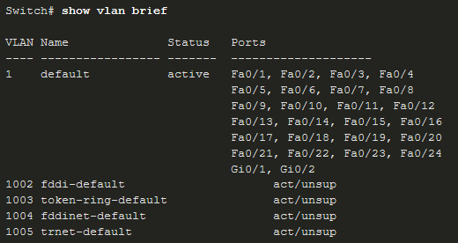
VLAN ranges on Catalyst Switches
  Catalyst switches 2960 and 3650 support over 4000 (4096) VLANs.
Normal Range VLAN 1 – 1005 | Extended Range VLAN 1006 - 4095
Used in Small to Medium sized businesses | Used by Service Providers
1002–1005 are reserved for legacy VLANs | Are in Running-Config
1, 1002–1005 are auto created and cannot be deleted | Supports fewer VLAN features
Stored in the vlan.dat file in flash | Requires VTP configurations
VTP can synchronize between switches
Notes:
3 – VLANs
3.3 – VLAN Configuration
3.3.1 – VLAN Ranges on Catalyst Switches

Slide 34
VLAN Creation Commands
  VLAN details are stored in the vlan.dat file. You create VLANs in the global configuration mode.
Task | IOS Command
Enter global configuration mode. | Switch# configure terminal
Create a VLAN with a valid ID number. | Switch(config)# vlan vlan-id
Specify a unique name to identify the VLAN. | Switch(config-vlan)# name vlan-name
Return to the privileged EXEC mode. | Switch(config-vlan)# end
Enter global configuration mode. | Switch# configure terminal
Notes:
3 – VLANs
3.3 – VLAN Configuration
3.3.2 – VLAN Creation Commands

Slide 35
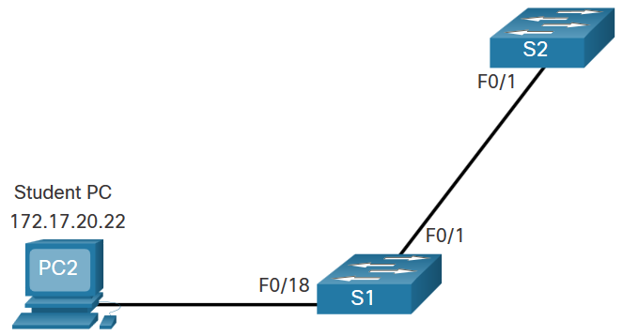
VLAN Creation Example
If the Student PC is going to be in VLAN 20, we will create the VLAN first and then name it.
If you do not name it, the Cisco IOS will give it a default name of vlan and the four digit number of the VLAN. E.g. vlan0020 for VLAN 20.
Prompt | Command
S1# | Configure terminal
S1(config)# | vlan 20
S1(config-vlan)# | name student
S1(config-vlan)# | end
Notes:
3 – VLANs
3.3 – VLAN Configuration
3.3.3 – VLAN Creation Example

Slide 36
VLAN Port Assignment Commands
Once the VLAN is created, we can then assign it to the correct interfaces.
Task | Command
Enter global configuration mode. | Switch# configure terminal
Enter interface configuration mode. | Switch(config)# interface interface-id
Set the port to access mode. | Switch(config-if)# switchport mode access
Assign the port to a VLAN. | Switch(config-if)# switchport access vlan vlan-id
Return to the privileged EXEC mode. | Switch(config-if)# end
Notes:
3 – VLANs
3.3 – VLAN Configuration
3.3.4 – VLAN Port Assignment Commands

Slide 37
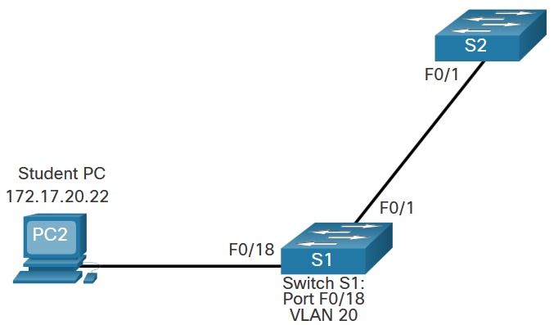
VLAN Port Assignment Example
We can assign the VLAN to the port interface.
Once the device is assigned the VLAN, then the end device will need the IP address information for that VLAN
Here, Student PC receives 172.17.20.22
Prompt | Command
S1# | Configure terminal
S1(config)# | Interface fa0/18
S1(config-if)# | Switchport mode access
S1(config-if)# | Switchport access vlan 20
S1(config-if)# | end
Notes:
3 – VLANs
3.3 – VLAN Configuration
3.3.5 – VLAN Port Assignment Example

Slide 38
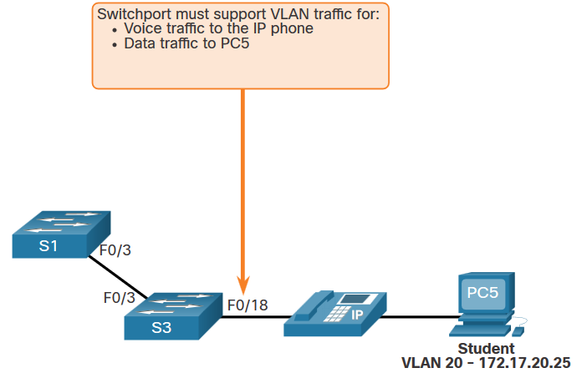
Data and Voice VLANs
An access port may only be assigned to one data VLAN. However it may also be assigned to one Voice VLAN for when a phone and an end device are off of the same switchport.
Notes:
3 – VLANs
3.3 – VLAN Configuration
3.3.6 – Data and Voice VLANs

Slide 39
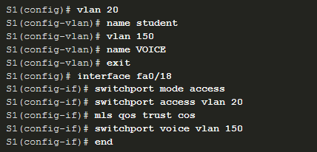
Data and Voice VLAN Example
We will want to create and name both Voice and Data VLANs.
In addition to assigning the data VLAN, we will also assign the Voice VLAN and turn on QoS for the voice traffic to the interface.
The newer catalyst switch will automatically create the VLAN, if it does not already exist, when it is assigned to an interface.
Note: QoS is beyond the scope of this course. Here we do show the use of the command.
mls qos trust [cos | device cisco-phone | dscp | ip-precedence]
dscp – Differentiated Services Codepoint
Notes:
3 – VLANs
3.3 – VLAN Configuration
3.3.7 – Data and Voice VLAN Example

Slide 40
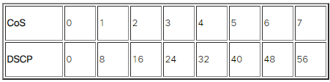
CoS a IP preference mají stejné hodnoty

Slide 41

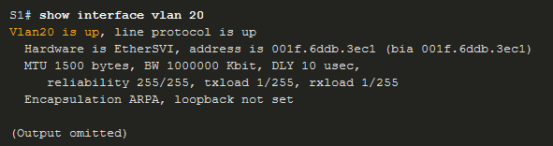
Verify VLAN Information
Use the show vlan command. The complete syntax is:
show vlan [brief | id vlan-id | name vlan-name | summary]
Task | Command Option
Display VLAN name, status, and its ports one VLAN per line. | brief
Display information about the identified VLAN ID number. | id vlan-id
Display information about the identified VLAN name. The vlan-name is an ASCII string from 1 to 32 characters. | name vlan-name
Display VLAN summary information. | summary
Notes:
3 – VLANs
3.3 – VLAN Configuration
3.3.8 – Verify VLAN Information

Slide 42
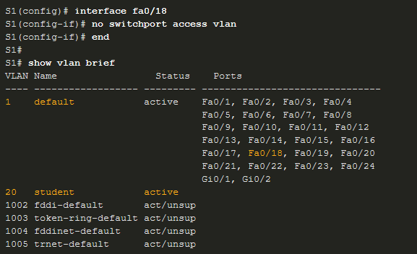
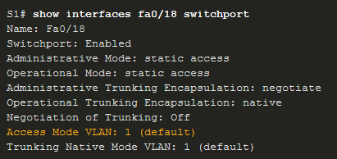
Change VLAN Port Membership
There are a number of ways to change VLAN membership:
re-enter switchport access vlan vlan-id command
use the no switchport access vlan to place interface back in VLAN 1
Use the show vlan brief or the show interface fa0/18 switchport commands to verify the correct VLAN association.
Notes:
3 – VLANs
3.3 – VLAN Configuration
3.3.9 – Change VLAN Port Membership

Slide 43
Delete VLANs
Delete VLANs with the no vlan vlan-id command.
Caution: Before deleting a VLAN, reassign all member ports to a different VLAN.
Delete all VLANs with the delete flash:vlan.dat or delete vlan.dat commands.
Reload the switch when deleting all VLANs.
Note: To restore to factory default – unplug all data cables, erase the startup-configuration and delete the vlan.dat file, then reload the device.
Notes:
3 – VLANs
3.3 – VLAN Configuration
3.3.10 – Delete VLANs
3.3.11 – Syntax Checker – VLAN Configuration

Slide 44
Packet Tracer – VLAN Configuration
In this Packet Tracer activity, you will perform the following:
  Verify the Default VLAN Configuration
  Configure VLANs
  Assign VLANs to Ports
Notes:
3 – VLANs
3.3 – VLAN Configuration
3.3.12 – Packet Tracer – VLAN Configuration

Slide 45
3.4 VLAN Trunks
Notes:
3 – VLANs
3.4 – VLAN Trunks

Slide 46
Trunk Configuration Commands
Configure and verify VLAN trunks. Trunks are layer 2 and carry traffic for all VLANs.
Task | IOS Command
Enter global configuration mode. | Switch# configure terminal
Enter interface configuration mode. | Switch(config)# interface interface-id
Set the port to permanent trunking mode. | Switch(config-if)# switchport mode trunk
Sets the native VLAN to something other than VLAN 1. | Switch(config-if)# switchport trunk native vlan vlan-id
Specify the list of VLANs to be allowed on the trunk link. | Switch(config-if)# switchport trunk allowed vlan vlan-list
Return to the privileged EXEC mode. | Switch(config-if)# end
Notes:
3 – VLANs
3.4 – VLAN Trunks
3.4.1 – Trunk Configuration Commands

Slide 47
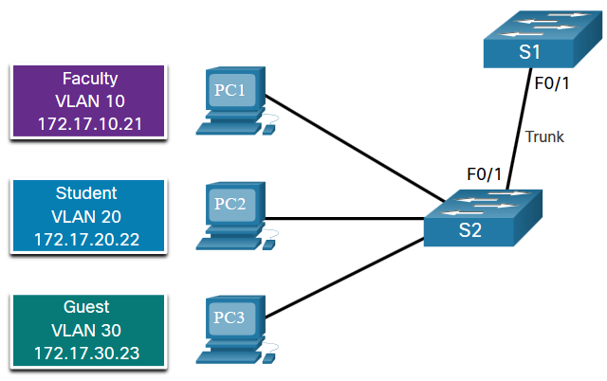
Trunk Configuration Example
The subnets associated with each VLAN are:
  VLAN 10 - Faculty/Staff - 172.17.10.0/24
  VLAN 20 - Students - 172.17.20.0/24
  VLAN 30 - Guests - 172.17.30.0/24
  VLAN 99 - Native - 172.17.99.0/24
F0/1 port on S1 is configured as a trunk port.
Note: This assumes a 2960 switch using 802.1q tagging. Layer 3 switches require the encapsulation to be configured before the trunk mode.
Prompt | Command
S1(config)# | Interface fa0/1
S1(config-if)# | Switchport mode trunk
S1(config-if)# | Switchport trunk native vlan 99
S1(config-if)# | Switchport trunk allowed vlan 10,20,30,99
S1(config-if)# | end
Notes:
3 – VLANs
3.4 – VLAN Trunks
3.4.2 – Trunk Configuration Example

Slide 48
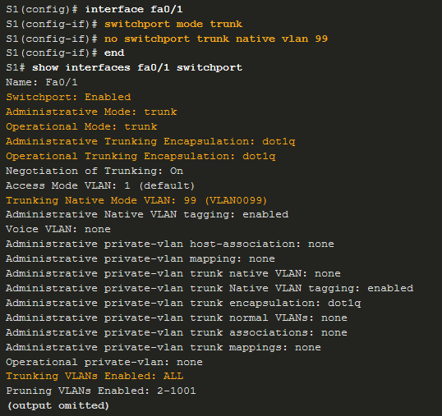
Verify Trunk Configuration
Set the trunk mode and native vlan.
Notice sh int fa0/1 switchport command:
Is set to trunk administratively
Is set as trunk operationally (functioning)
Encapsulation is dot1q
Native VLAN set to VLAN 99
All VLANs created on the switch will pass traffic on this trunk
Notes:
3 – VLANs
3.4 – VLAN Trunks
3.4.3 – Verify Trunk Configuration

Slide 49
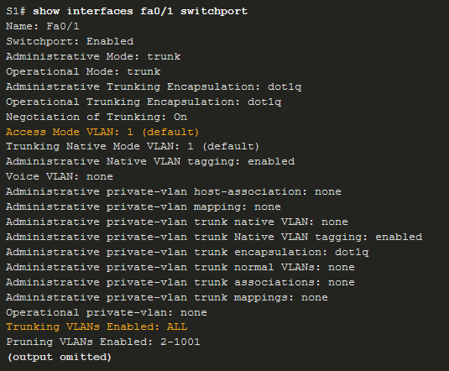

Reset the Trunk to the Default State
Reset the default trunk settings with the no command.
  All VLANs allowed to pass traffic
  Native VLAN = VLAN 1
Verify the default settings with a sh int fa0/1 switchport command.
Notes:
3 – VLANs
3.4 – VLAN Trunks
3.4.4 – Reset the Trunk to the Default State

Slide 50
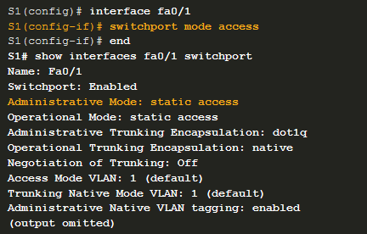
Reset the Trunk to the Default State (Cont.)
Reset the trunk to an access mode with the switchport mode access command:
  Is set to an access interface administratively
  Is set as an access interface operationally (functioning)
Notes:
3 – VLANs
3.4 – VLAN Trunks
3.4.4 – Reset the Trunk to the Default State (Cont.)

Slide 51
Packet Tracer – Configure Trunks
In this Packet Tracer activity, you will perform the following:
  Verify VLANs
  Configure Trunks
Notes:
3 – VLANs
3.4 – VLAN Trunks
3.4.5 – Packet Tracer – Configure Trunks

Slide 52
Lab – Configure VLANs and Trunks
In this lab, you will perform the following:
  Build the Network and Configure Basic Device Settings
  Create VLANs and Assign Switch Ports
  Maintain VLAN Port Assignments and the VLAN Database
  Configure an 802.1Q Trunk between the Switches
  Delete the VLAN Database
Notes:
3 – VLANs
3.4 – VLAN Trunks
3.4.6 – Lab – Configure VLANs and Trunks

Slide 53
3.5 Dynamic Trunking Protocol
Notes:
3 – VLANs
3.5 – Dynamic Trunking Protocol

Slide 54

Introduction to DTP
Dynamic Trunking Protocol (DTP) is a proprietary Cisco protocol.
DTP characteristics are as follows:
  On by default on Catalyst 2960 and 2950 switches
  Dynamic-auto is default on the 2960 and 2950 switches
  May be turned off with the nonegotiate command
  May be turned back on by setting the interface to dynamic-auto
  Setting a switch to a static trunk or static access will avoid negotiation issues with the switchport mode trunk or the switchport mode access commands.
Notes:
3 – VLANs
3.5 – Dynamic Trunking Protocol
3.5.1 – Introduction to DTP

Slide 55
Negotiated Interface Modes
The switchport mode command has additional options.
Use the switchport nonegotiate interface configuration command to stop DTP negotiation.
Option | Description
access | Permanent access mode and negotiates to convert the neighboring link into an access link
dynamic auto | Will becomes a trunk interface if the neighboring interface is set to trunk or desirable mode
dynamic desirable | Actively seeks to become a trunk by negotiating with other auto or desirable interfaces
trunk | Permanent trunking mode and negotiates to convert the neighboring link into a trunk link
Notes:
3 – VLANs
3.5 – Dynamic Trunking Protocol
3.5.2 – Negotiated Interface Modes

Slide 56
Results of a DTP Configuration
DTP configuration options are as follows:
 | Dynamic Auto | Dynamic Desirable | Trunk | Access
Dynamic Auto | Access | Trunk | Trunk | Access
Dynamic Desirable | Trunk | Trunk | Trunk | Access
Trunk | Trunk | Trunk | Trunk | Limited connectivity
Access | Access | Access | Limited connectivity | Access
Notes:
3 – VLANs
3.5 – Dynamic Trunking Protocol
3.5.3 – Results of a DTP Configuration

Slide 57
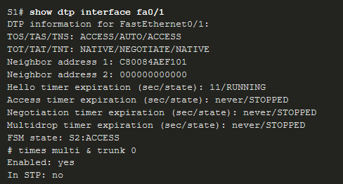
Verify DTP Mode
The default DTP configuration is dependent on the Cisco IOS version and platform.
Use the show dtp interface command to determine the current DTP mode.
Best practice recommends that the interfaces be set to access or trunk and to turnoff DTP
Notes:
3 – VLANs
3.5 – Dynamic Trunking Protocol
3.5.4 – Verify DTP Mode

Slide 58
Packet Tracer – Configure DTP
In this Packet Tracer activity, you will perform the following:
Configure static trunking
Configure and verify DTP
Notes:
3 – VLANs
3.5 – Dynamic Trunking Protocol
3.5.5 – Packet Tracer – Configure DTP
3.5.6 – Check Your Understanding – Dynamic Trunking Protocol

Slide 59
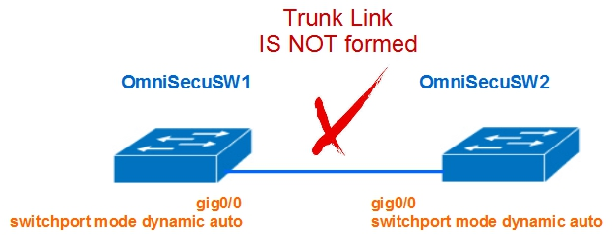
If both switch's interface are configured with "dynamic auto" mode, they will never generate Dynamic Trunking Protocol (DTP) messages and the link will be an access link.
https://www.omnisecu.com/cisco-certified-network-associate-ccna/difference-between-dtp-dynamic-desirable-and-dynamic-auto-modes.php

Slide 60
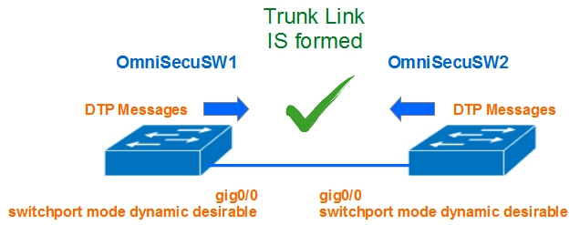
Both sides are "dynamic desirable"

Slide 61
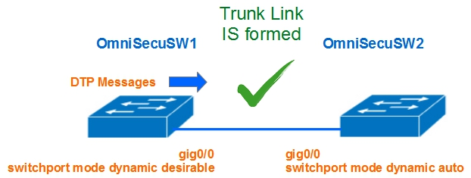
One side is "dynamic desirable" and other side is "dynamic auto"

Slide 62
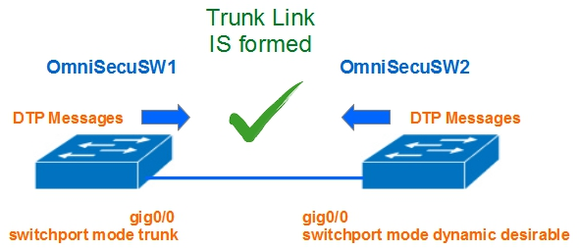
One side is "trunk" and other side is "dynamic desirable"

Slide 63
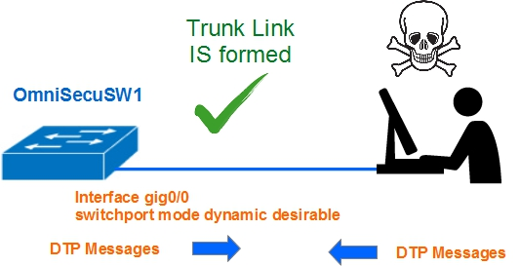
Switch Spoofing
Uvažujme situaci, kdy útočník je připojen na interface switche konfigurované v módech "dynamic desirable", "dynamic auto" nebo "trunk". Pokud je útočník schopen ze svého počítače generovat zprávy DTP, mezi počítačem a switchem se vytvoří trunkové spojení.
Jinou metodou Switch Spoofing je propojení falešného switche s rozhraním konfigurovaným jako "dynamic desirable", "dynamic auto" nebo "trunk".

Slide 64
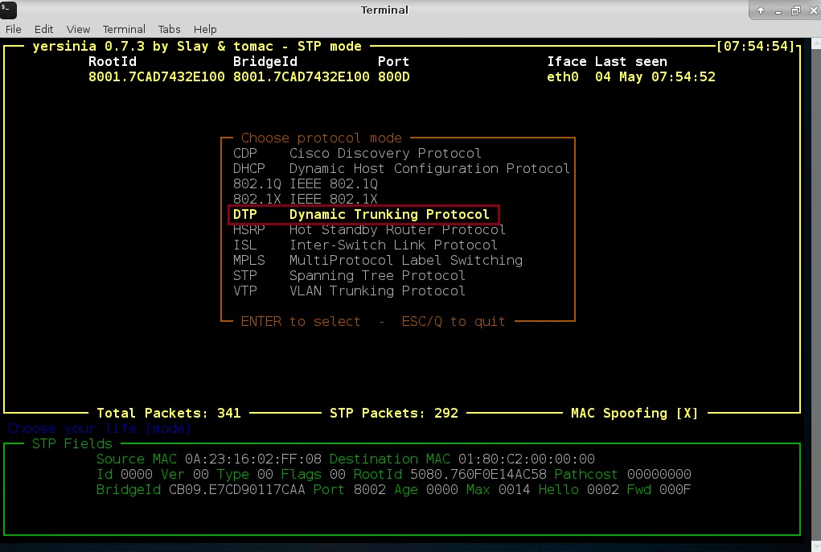
Konkrétní útok pomocí yersinie
http://www.jay-miah.co.uk/vlan-hopping-concept-attack-example-and-prevention/

Slide 65
3.6 Module Practice and Quiz
Notes:
3 – VLANs
3.6 – Module Practice and Quiz

Slide 66
Packet Tracer – Implement VLANs and Trunking
In this Packet Tracer activity, you will perform the following:
  Configure VLANs
  Assign Ports to VLANs
  Configure Static Trunking
  Configure Dynamic Trunking
Notes:
3 – VLANs
3.6 – Module Practice and Quiz
3.6.1 – Packet Tracer – Implement VLANs and Trunking

Slide 67
Lab – Implement VLANs and Trunking
In this lab, you will perform the following:
  Build the Network and Configure Basic Device Settings
  Create VLANs and Assign Switch Ports
  Configure an 802.1Q Trunk between the Switches
Notes:
3 – VLANs
3.6 – Module Practice and Quiz
3.6.2 – Lab – Implement VLANs and Trunking

Slide 68
Co jsme se naučili (1/2)
VLAN jsou založeny na logických a nikoli na fyzických připojeních.
VLAN mohou segmentovat sítě podle funkce, týmu nebo aplikace.
Každá VLAN je považována za samostatnou logickou síť.
Trunk je spojení typu point-to-point, které nese více než jednu VLAN.
Pole VLAN tag zahrnuje typ, prioritu uživatele, CFI a VID.
Pro podporu VoIP je vyžadována samostatná hlasová VLAN.
Konfigurace VLAN s normálním rozsahem jsou uloženy v souboru vlan.dat ve formátu flash.
Přístupový port může patřit pouze k jedné datové VLAN, ale může mít také Voice VLAN.

Slide 69
Co jsme se naučili (2/2)
Trunk je spojení vrstvy 2 mezi dvěma přepínači, které přenáší provoz pro všechny VLANy.
Trunky budou potřebovat označení (tagging) pro různé VLANy, obvykle 802.1q.
Značení (tagging) IEEE 802.1q umožňuje jednu nativní VLAN, která zůstane neoznačená.
Rozhraní lze nastavit na trunking nebo nontrunking (access).
Trunk negotiation (vyjednávání) je řízeno protokolem Dynamic Trunking Protocol (DTP).
DTP je proprietární protokol společnosti Cisco, který spravuje vyjednávání o nastavení trunku.

Slide 70
What did I learn in this module?
    VLANs are based on logical instead of physical connections.
    VLANs can segment networks based on function, team, or application.
    Each VLAN is considered a separate logical network.
    A trunk is a point-to-point link that carries more than one VLAN.
    VLAN tag fields include the type, user priority, CFI and VID.
    A separate voice VLAN is required to support VoIP.
    Normal range VLAN configurations are stored in the vlan.dat file in flash.
    An access port can belong to one data VLAN at a time, but may also have a Voice VLAN.
Notes:
3 – VLANs
3.6 – Module Practice and Quiz
3.6.3 – What did I learn in this module?

Slide 71
What did I learn in this module? (Cont.)
    A trunk is a Layer 2 link between two switches that carries traffic for all VLANs.
    Trunks will need tagging for the various VLANs, typically 802.1q .
    IEEE 802.1q tagging makes provision for one native VLAN that will remain untagged.
    An interface can be set to trunking or nontrunking.
    Trunk negotiation is managed by the Dynamic Trunking Protocol (DTP).
    DTP is a Cisco proprietary protocol that manages trunk negotiations.
Notes:
3 – VLANs
3.6 – Module Practice and Quiz
3.6.3 – What did I learn in this module? (Cont.)
3.6.4 – Module Quiz – Protocols and Models

Slide 72
New Terms and Commands
VLAN Logical broadcast domain Data VLAN Default VLAN Native VLAN Management VLAN show vlan brief Voice VLAN VLAN Trunk VLAN Segmentation IEEE 802.1Q VLAN Tagging Canonical Format Identifier (CFI) | User Priority VLAN ID Type show interfaces int switchport
Notes:
New Terms and Commands

Slide 73
Module Practice and Quiz
New Terms and Commands
Normal Range VLANs Extended Range VLANs vlan vlan-id name vlan-name switchport mode access switchport access vlan vlan-id interface range no switchport access vlan vlan-id no vlan vlan-id delete flash:vlan.dat | delete vlan.dat show vlan show interfaces show vlan summary show interfaces vlan vlan_id switchport mode trunk switchport trunk allowed vlan vlan_list switchport trunk native vlan vlan_id no switchport trunk allowed vlan | no switchport trunk native vlan show interfaces switchport no switchport access vlan vlan_id show interfaces trunk show interfaces int_id trunk
Notes:
New Terms and Commands

