Slide 1
Introduction
PV236 – Time management & Effectiveness
Josef Spurný, Petra kalábová

Slide 2
Course Organization
1 session each 2 weeks
To pass the course:
  Sessions not mandatory, but recommended
  After each session:
    1 homework assignment
    Short reflection (takeaway message)
  Once per semester:
    Short presentation (5-10 minutes + discussion)
    Book review / personal experience with some method or productivity app, etc.
    Aim = to inspire others ☺

Slide 3
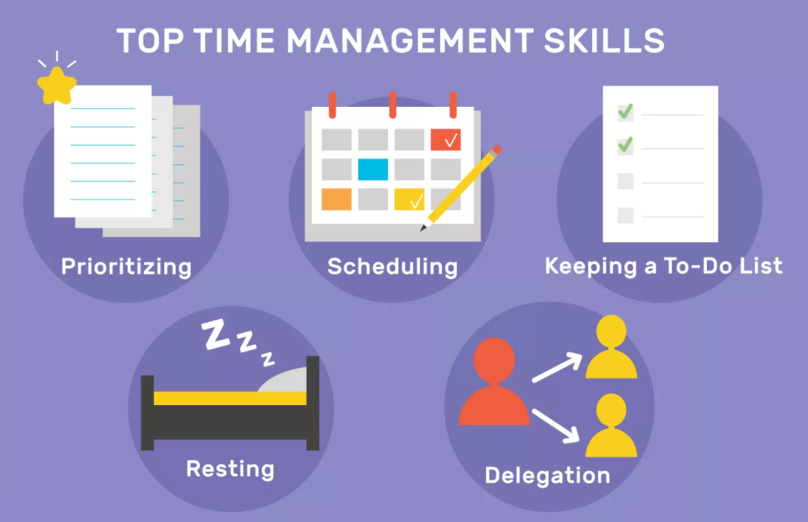

Slide 4
What is more important and why?
Are you EFFECTIVE?
        Are you EFFICIENT?
        What’s the difference?
        What’s more important?

Slide 5
What is more important and why?
Effectiveness = do the right things
Efficiency = do the thing right
So… what’s more important?

Slide 6
What is more important and why?
Eliminate
Optimize
“There is no code faster than no code”
Kevlin Henney

Slide 7
Effectiveness vs. Efficiency
Effectiveness
Focus on the accomplishment - to reach for the right goal (or fail)
Efficiency
Focus on the process – to achieve the goal with least amount of resources

Slide 8
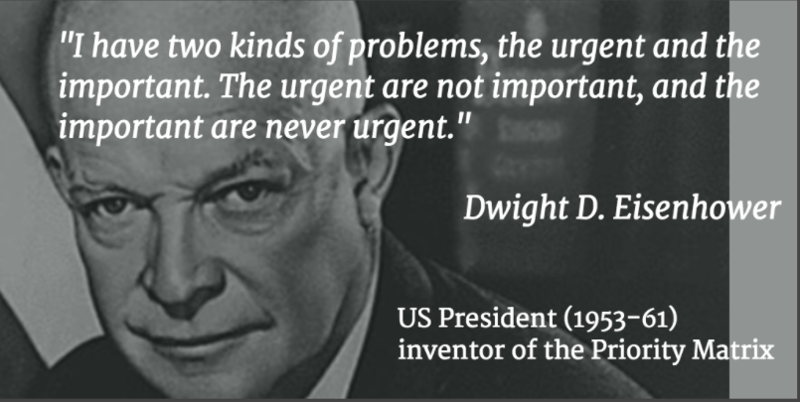
Eisenhower’s Priority Matrix

Slide 9
Important and/or Urgent?
Answer phone call from your boss
Read fresh morning FB wall feed
Choose topic for diploma thesis
Confirm calendar event for today’s pub quiz

Slide 10
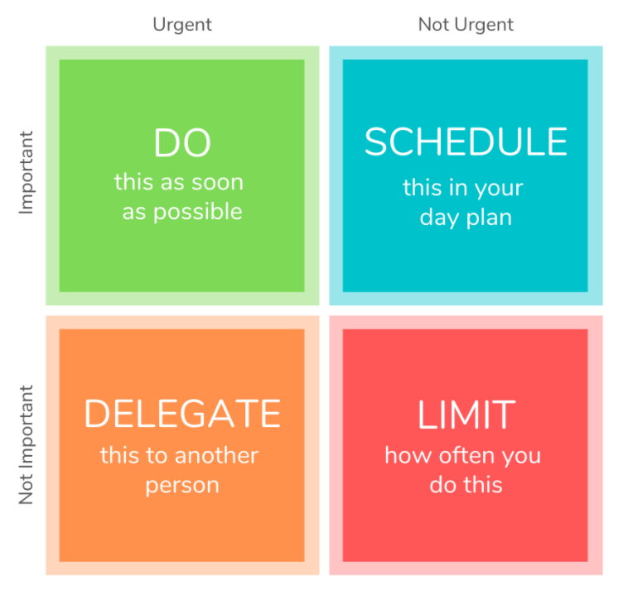
Eisenhower’s Priority Matrix

Slide 11
Setting goals
Goals motivate
Only clearly defined goals help to achieve outstanding performance
Goals must be:
  Achievable
  Measurable

Slide 12
Are these goals achievable/measurable?
I want to lose weight significantly
I want to win a lottery
I would like to get a better job to get more money
I want to work on my relationship with my wife/husband/girl-/boyfriend…

Slide 13
All kinds of goals
Professional
Personal growth
Family / Relationships
Spiritual / Meaning of life
Financial
Hobbies

Slide 14
Managing goals
Life goals → Plan of goals → Long-term plan → Yearly plan → Monthly plan → Daily plan
Long-term plans give meaning to short-term plans
Do not just think about them – write them down
Does your daily routine help to achieve your goals?
Achieving goals motivate!
Retrospect to improve!

Slide 15
Your homework assignment
Make your goals list:
Life goals → Plan of goals → Long-term plan → Yearly plan → Monthly plan → Daily plan

