Slide 1
Prioritization & Daily Habits
PV236 – Time Management and Effectiveness
Josef Spurný

Slide 2
Daily habits of (successful) people
Wake up early
Make TODO lists in the morning to clear your head
Set-up morning exercise routine
Have nutritious and healthy breakfast
When prioritizing, ask yourself “will it matter in a day, week, month…?”
Check messages only a couple of times during the day
Be a life-long learner
Practice self-care, mindfulness, meditation…
Ensure quality sleep
Socialize, choose who you are surrounded with
When socializing, avoid using smartphones
Reserve undisturbed time for writing / reading / music listening
Be grateful for what you have / future is not solution to the present
Write “idea journal”
Activate your body / do several walks throughout the day
Get rid of stress through extreme sports
Make use of your commute time
Consume motivational content
Be humble, self-reflect, self-criticize

Slide 3
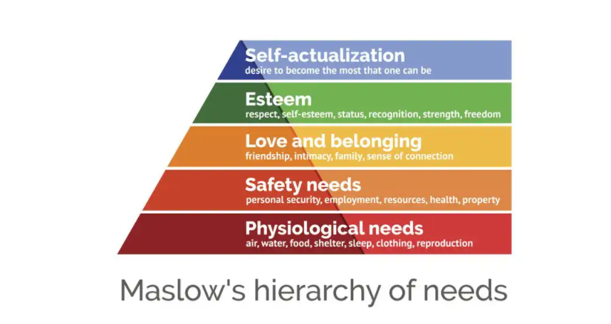
Prioritization from higher perspective

Slide 4
Aspects of prioritization
Urgency (deadline)
Difficulty (easy / challenging)
Importance
Comfort to execute
Challenging (unpopular / potentially unclear tasks first)
Availability of resources
External (material, coworker…)
Internal (energy, remaining time…)
Can be delegated?
Dependency (someone else waits for the result)
Solo vs. team

Slide 5
Communication matters
Evaluate urgency and importance while communicating with coworkers / boss
If something is not clear, ask a question!
Manage expectations
Be assertive but polite

Slide 6
Prioritization → Daily plan
Identify tasks
Estimate durations
Add priority (Eisenhower’s matrix)
Order tasks into sequence
At the end of the day, evaluate your plan (GOLD technique)

Slide 7
GOLD Technique

Slide 8
HW Assignment
Prepare a daily plan for an upcoming day
Evaluate it using GOLD

