Slide 1
Introduction of service marketing
Leonard Walletzký 2021

Slide 2
Content of the course
Motivation
Marketing methodology
Management of marketing
Analysis of market environment
Marketing and work with information
Marketing tools

Slide 3
Course evaluation
Teamwork
Students will make a group of 2 – 4 members
And prepare short presentation (5-10 minutes) of marketing of selected company (case)
Try to answer:
What is unique on this company (approach)?
Why have you chosen it?
What is the value of the service, offered to the customers?
Include interactive elements (videos, advertisements, online services) – see the example
The presentations will be held at the beginning of each lesson.
Written exam at the end of the course

Slide 4
Laboratory of service systems
Laboratory focused to implementation of service thinking
The main topic nowadays is Smart Cities
We cooperate with the cities in Czech Republic and with main stakeholders of Smart concept (Czech Smart City Cluster, Ministry of local development)
More info: https://seslab.fi.muni.cz/
Interim
Diploma thesis
2 credits per semester

Slide 5
Motivation – why to learn marketing basic
To understand the context of marketing
Basic terminology that enables to enroll advanced courses
The concepts of marketing research, its application and evaluation
The management of services is strongly related with the marketing
To describe the value
To communicate with customers
The description of marketing development helps to understand the preserving of partners, customer and other stakeholders

Slide 6
Contributions of Service Industries to Gross Domestic Product

Slide 7
Overview: Why Services Matter
Services dominate EU and worldwide economies
Services are growing dramatically
Service leads to customer retention and loyalty
Service leads to profits
Services help manufacturing companies differentiate

Slide 8
Services are more important
Health Care
hospital
Professional Services
accounting
Financial Services
banking
Hospitality
restaurant
ski resort, rafting
Travel
airline
Others
hair styling
medical practice
dentistry
eye care
legal
architectural
investment advising
insurance
hotel/motel
bed & breakfast
travel agency
theme park
pest control
plumbing
lawn maintenance
counseling services
health club
interior design

Slide 9
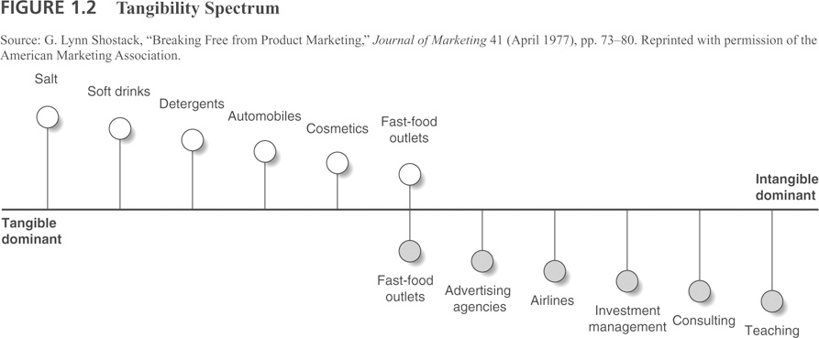
Tangibility Spectrum

Slide 10
What is marketing?
Marketing is defined by the American Marketing Association [AMA] as "the activity, set of institutions, and processes for creating, communicating, delivering, and exchanging offerings that have value for customers, clients, partners, and society at large."
This represents the approach of transactional marketing

Slide 11
The role of sevices in transactional marketing (Goods dominant logic)
Goods/Service delivery
Value destruction
Value creation
Supplier
Producer
Consumer (end user)
Supply chain
Goods/Service/Money

Slide 12
Problems with Goods dominant logic
Goods are not why we buy goods
Service (benefits) they render
Intangibles (brand, self image, social connectedness, meaning)
Inputs into experiences
Goods are not what we fundamentally “own” to exchange with others
Applied knowledge and skills (our services)
Customer is secondary and seen as value receiver and destroyer
“Consumer orientation” is an add-on--does not help

Slide 13
IHIP characteristics of the services
Value-enhancing add-ons for goods, or
A particular type good, characterized by (IHIP):
Intangibility
Heterogeneity
Inseparability
Perishability

Slide 14
Implications of Intangibility
Services cannot be inventoried
Services cannot be easily patented
Services cannot be readily displayed or communicated
Pricing is difficult

Slide 15
Implications of Heterogeneity
Service delivery and customer satisfaction depend on employee and customer actions
Service quality depends on many uncontrollable factors
There is no sure knowledge that the service delivered matches what was planned and promoted

Slide 16
Implications of Simultaneous Production and Consumption
Customers participate in and affect the transaction
Customers affect each other
Employees affect the service outcome
Decentralization may be essential
Mass production is difficult

Slide 17
Implications of Perishability
It is difficult to synchronize supply and demand with services
Services cannot be stored
Services cannot be returned or resold

Slide 18
Comparing goods and services
Goods | Services | Resulting Implications
Tangible | Intagible | Services cannot be inventoried. Services cannot be easily patented. Services cannot be readily displayed or communicated. Pricing is difficult.
Standardized | Heterogenous | Service delivery and customer satisfaction depend on employee and customer actions Service quality depends on many uncontrollable factors. There is no sure knowledge that the service delivered matches what was planned and promoted
Production separate from consumption | Simultaneous production and consumption | Customers participate in and after the transaction. Customer affect each other. Employees affect the service outcome. Decentralization may be essential. Mass production is difficult.
Nonpershable | Pershable | It is difficult to synchronize supply and demand with services. Services cannot be returned or resold.

Slide 19
Summary
Motivation to understand marketing
Importance of service marketing
Difference between goods and services

