Slide 1
Market Segmentation, Targeting, and Positioning
© Leonard Walletzký

Slide 2
Marketing framework
5C
Customer
STP
Segmentation
Marketing Mix
4P
Company
Context
Collaborators
Competitors
Targeting
Positioning
7P
4C
7C
4S

Slide 3
How do we evaluate?
Analysis is not static
How do we know we are right?
How to set key factors?
What factors can help us?

Slide 4
Marketing Metrics
Profitability
Sales
Share
Average prices
Levels of awareness
Penetration in trial
Customer satisfaction
Employee satisfaction, etc.

Slide 5


Example: How to increase profitability
Basic goal:
Increase profit
Increase revenue
Decrease costs
Increase volume
Change price
Increase % market share
Increase market size

Slide 6
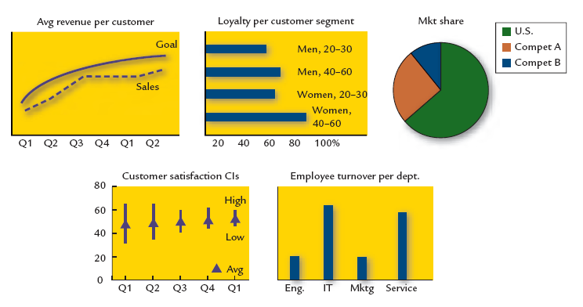
Example: Metrics

Slide 7
The STP Process
Segmentation is the process of classifying customers into groups which share some common characteristic
Targeting involves the process of evaluating each segments attractiveness and selecting one or more segments to enter
Positioning is arranging for a product to occupy a clear, distinctive and desirable place relative to competing products in the mind of the consumer

Slide 8
Target Market
A market is a set of all actual and potential buyers
A target market is a group of people toward whom a firm markets its goods, services, or ideas with a strategy designed to satisfy their specific needs and preferences.
Any marketing strategy must include a detailed (specific) description of this.

Slide 9
Advantages of Segmentation
The process of breaking up a homogeneous market into heterogeneous segments forces the marketer to analyse and consider both the needs of the market and the company’s ability to competently serve those needs – thereby making the company better informed about its customers
Competitor offerings and marketing positioning must also be analysed in this context so the company must consider what its competitive advantages and disadvantages are, helping it to clarify its own positioning strategy
Limited resources are used to best advantage, targeted at those segments that offer the best potential

Slide 10
Levels of segmentation
Mass Marketing
Same product to all customers
Niche Marketing
Different products to subgroups within segments
(more segmentation)
Segment Marketing
Different products to one or more segments
(some segmentation)
Micromarketing
Products to suit the tastes of individuals and locations
(complete segmentation)
Local Marketing
Tailoring brands/ promotions to local customer groups
Individual Marketing
Tailoring products/ programs to individual customers

Slide 11
Requirements for Effective Segmentation
Measurable
Size, purchasing power, profiles of segments can be measured
Accessible
Segments can be effectively reached and served.
Substantial
Segments are large or profitable enough to serve
Differential
Segments must respond differently to different marketing mix elements & programs.
Actionable
Effective programs can be designed to attract and serve the segments.

Slide 12
Bases for customer segmaentation
Geographic
Nation, States
Regions, Cities
Demographic
Age, gender
Family size
Life cycle, Income
Psychographic
Social class
Lifestyle
Personality
Behavioral
Occasions
Benefits sought
User status
Loyality

Slide 13
Bases for Segmenting Business Markets
Demographics
Operating characteristics
Purchasing approaches
Situational Factors
Personal Characteristics
General criteria
Broad description of the company
Industry, Company size, Customer location
Company Technology
Product Brand and Use Status
Customer capabilities
Power structure
Buyer – Seller relationships
Purchasing policies
Important factor
Urgency or order fulfillment
Product Application
Size of order
Buyer – Seller Similarities and Synergies
Individual Behaviors
Risk Management

Slide 14
Segmenting International Markets
Geographic
Economics
Political/Legal
Cultural
Intermarket

Slide 15
Evaluating Market Segments
(developing selection criteria)
Segment Size and Growth
Analyse sales, growth rates and expected profitability for various segments.
Segment Structural Attractiveness
Consider effects of: Competitors, Availability of Substitute Products and, the Power of Buyers & Suppliers.
Company Objectives and Resources
Company skills & resources relative to the segment(s).
Look for Competitive Advantages.

Slide 16
Market Targeting
Market Coverage Strategies
Company
Marketing
Market
A. Undifferentiated Marketing
Company
Marketing 1
Segment 1
Company
Marketing 2
B. Differentiated Marketing
Segment 2
Company
Marketing 3
Segment 3
Segment 1
Company
Marketing
Segment 2
C. Concentrated Marketing
Segment 3

Slide 17
Market Targeting
Company Resources
Product Variability
Product´s life cycle stage
Market Variability
Competitor´s marekting strategies

Slide 18
Positioning for Competitive Advantage
Product’s Position
Marketers must
Plan positions to give their products the greatest advantage in selected target markets,
Design marketing mixes to create these planned positions.
the way the product is defined by consumers on important attributes - the place the product occupies in consumers’ minds relative to competing products.

Slide 19
Market Positioning Strategy
Market Positioning
Competitive Frame
Point of difference
Value Proposition
Substitutes
Competitors
Economics
Functional
Emotional
Target Customers
Influences
Consumers
Purchases

Slide 20
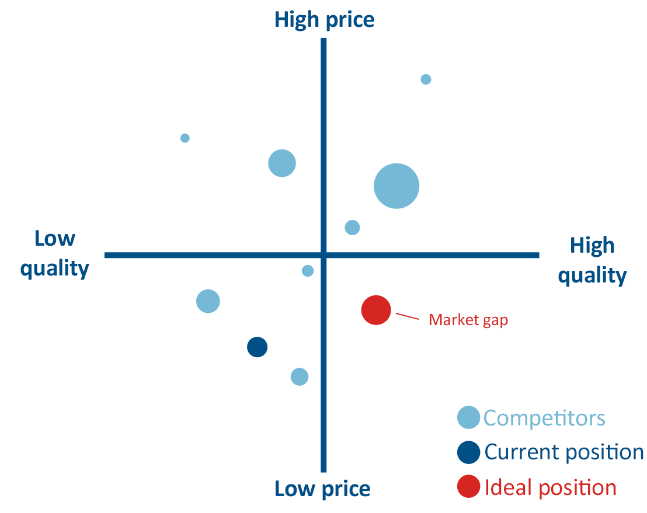
Market Positioning Strategy

Slide 21
Marketing Positioning - Strategies
Product Class
Product Atributes
Benefits Offered
Usage Occasions
User Class
Against Competitor
Away from Competitors

Slide 22
Steps to Choosing and Implementing a Positioning Strategy
Identifying Possible Competitive Advantages: Competitive Differentiation.
Selecting the Right Competitive Advantage: Unique Selling Proposition (USP).
Communicating and Delivering the Chosen Position.
Support the positioning strategy with a unique marketing

Slide 23
Developing Competitive Differentiation
Areas for Competitive Differentiation
Product
Service
Image
People

Slide 24
Steps in Market Segmentation, Targeting and Positioning
Identify the bases for segmentation
Develop Profiles of Resulting Segments
Develop Selection Criteria
Select Target Segments
Develop Positioning for Each Target Segment
Develop Marketing Mix for Each Target Segment
Market Segmentation
Market Targeting
Market Positioning

Slide 25
Summary
Segmentation
Types of segmentation
Why to do
Targeting
How to evaluate segments
How to choose the right segment
Positioning
How to develop strategy

