Slide 1
Examples of marketing survey

Slide 2
Smart City Survey
Purpose:
To explore the situation of Smart City implementation in selected Czech municipalities
Form
Structured interview with the person, responsible for the Smart City Applications (typicaly mayor, Smart City manager etc.)

Slide 3
Preparation
The key factor is the number of inhabitants
We need to focus to the situation in smaller municipalities
The bigger municipalities (20.000 inhabitants and more) can be more independent in the projects. Also, they have bigger administaration (and backoffice support)
The municipalities were divided into 4 groups
Up to 1000 inhabitants
1000 – 5000 inhabitants
5000 – 10000 inhabitants
Up to 10000 inhabitants

Slide 4
Scenario
We have developed the structure of the interview
The main part was send to the interviewed before – to get known what information we will need
Iterviewers were equipped with the more detailed structure and with the list of the questions they should put

Slide 5
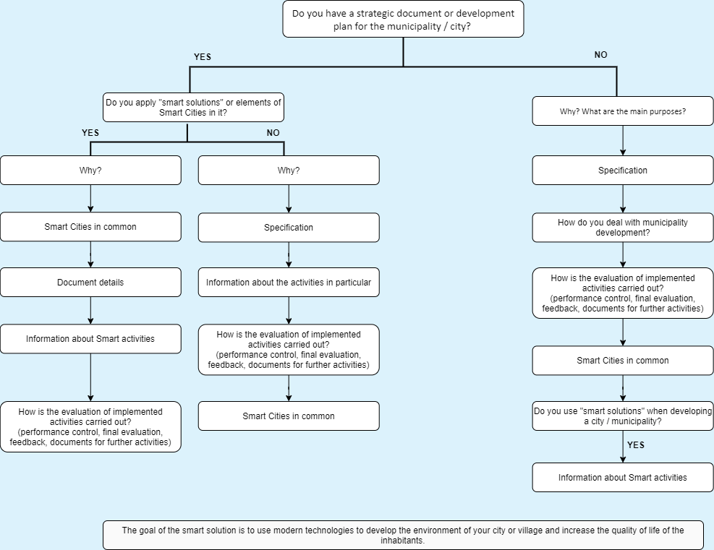
Scenario for municipalities

Slide 6
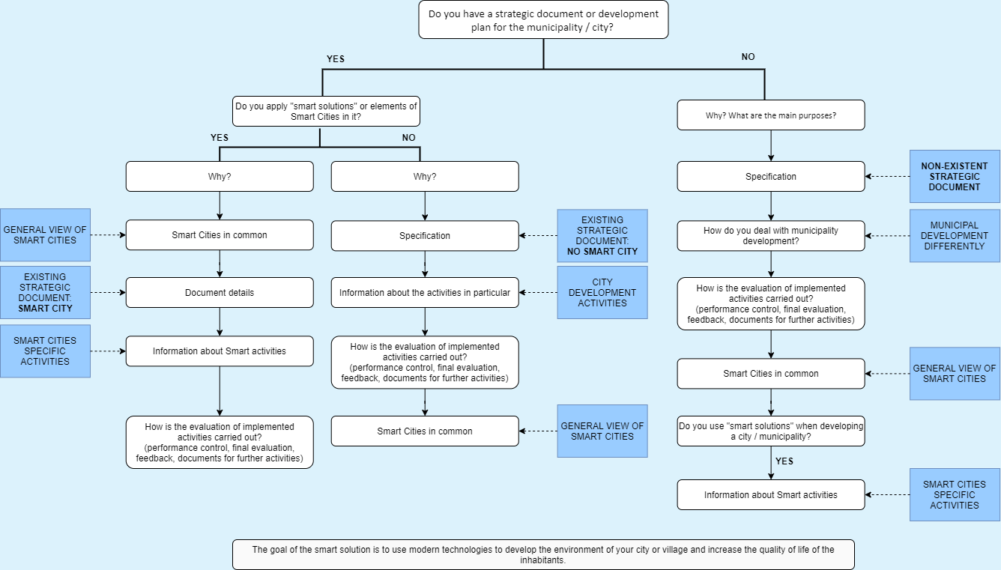
Scenario for interviewers

Slide 7
Data processing
All interviews were recorded and tranformed into the text using Speech to text service in MS Azure
Than all the answers were corrected and evaluated manually
Type of municipality (inhabitants) | No. of municipalities | Total lenght of interview (HH:MM)
0 – 1000 | 10 | 7:10
1000 - 5000 | 12 | 11:51
5000 - 10000 | 6 | 4:56
Up to 10000 | 7 | 8:01

Slide 8
Main findings – small municipalities
Approaches to Smart Applications are different in very small municipalities
It i sharder for them to see the added value
They need more specific examples of how the Smart soulitons can make tyhe life easirer
The do not trust the proclamations
They are affraid of the public financing of the projest – increasing burocracy

Slide 9
Main findings – municipalities up to 10000 inhabitants
Their approach is more conceptual
The tend to find synegistic solutions
The understand the potential of Smart solutions, even they are stil affraid of administration
The most of them is having the Smart starategy, but the main reason fo trhat is to simplify the financial sources

Slide 10
Main findings – the bigger cities
They have their independent lenst to Smart City implementation
The can pay the most of the projects from their own
The methodology is not important for them to implement Smart services, but to find other co-financing sources

Slide 11
Supporting system for qualitative survey
The thesis that are currently in finishing process made by Ezgon Korenica
https://www.qdas-ibmcloud.xyz/dashboard
Enables to create the survey, realize it via web interface and prepare the basic evaluation of the answers
Unfortunatelly, not working in Czech language
Still under the development

