Slide 1
Samir Zahreddine
UCO:496591

Slide 2
Amazon Go!
Intro to Service Marketing:
The Future of Shopping

Slide 3
Contents of The Presentation:
Here’s what I will Present:
Introductory to Amazon Go.
Amazon Go app.
Marketing Strategies and Services.

Slide 4
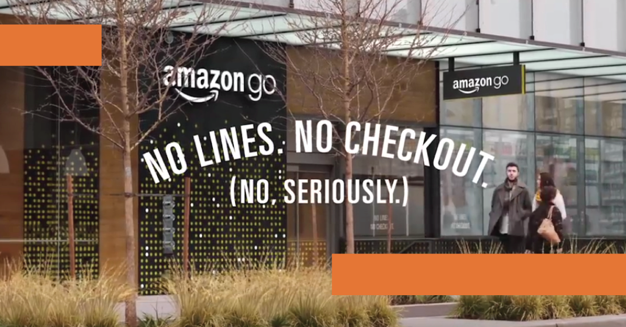
Overview:
Introduction:
The store concept uses several technologies, including computer vision, deep learning algorithms, and sensor fusion to automate much of the purchase, checkout, and payment steps associated with a retail transaction. Its concept is seen as a revolutionary model that relies on smartphones technology to streamline the customer experience, as well as supply chain and inventory management.

Slide 5
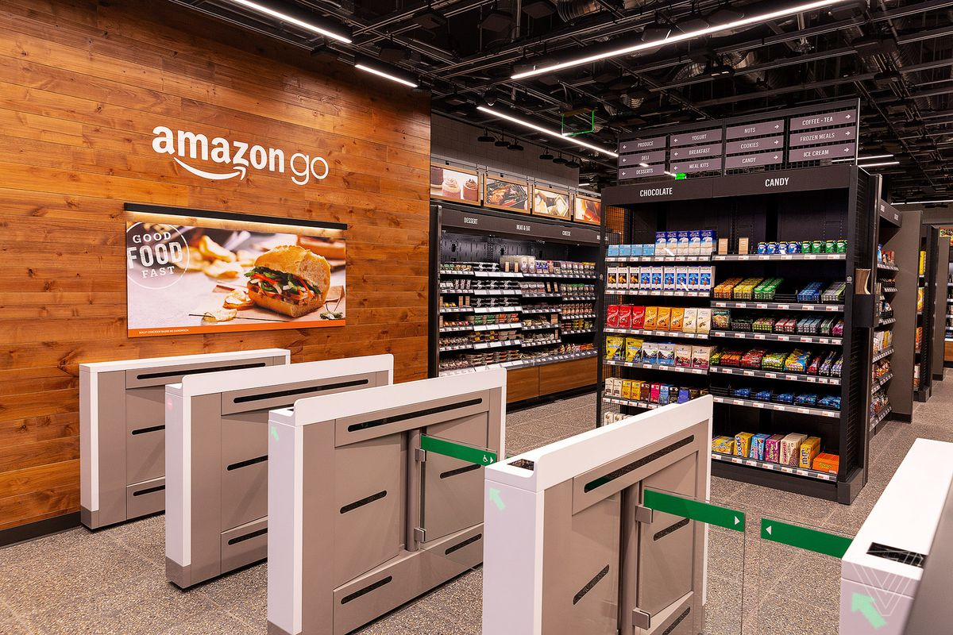
Overview:
Introduction:
The store concept uses several technologies, including computer vision, deep learning algorithms, and sensor fusion to automate much of the purchase, checkout, and payment steps associated with a retail transaction. Its concept is seen as a revolutionary model that relies on smartphones technology to streamline the customer experience, as well as supply chain and inventory management.

Slide 6
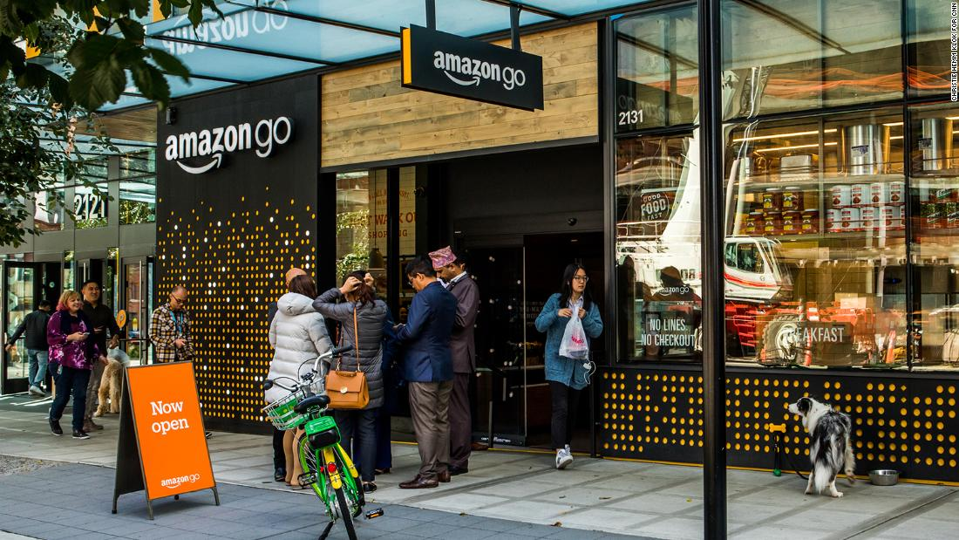
Overview:
Introduction:
The store concept uses several technologies, including computer vision, deep learning algorithms, and sensor fusion to automate much of the purchase, checkout, and payment steps associated with a retail transaction. Its concept is seen as a revolutionary model that relies on smartphones technology to streamline the customer experience, as well as supply chain and inventory management.

Slide 7
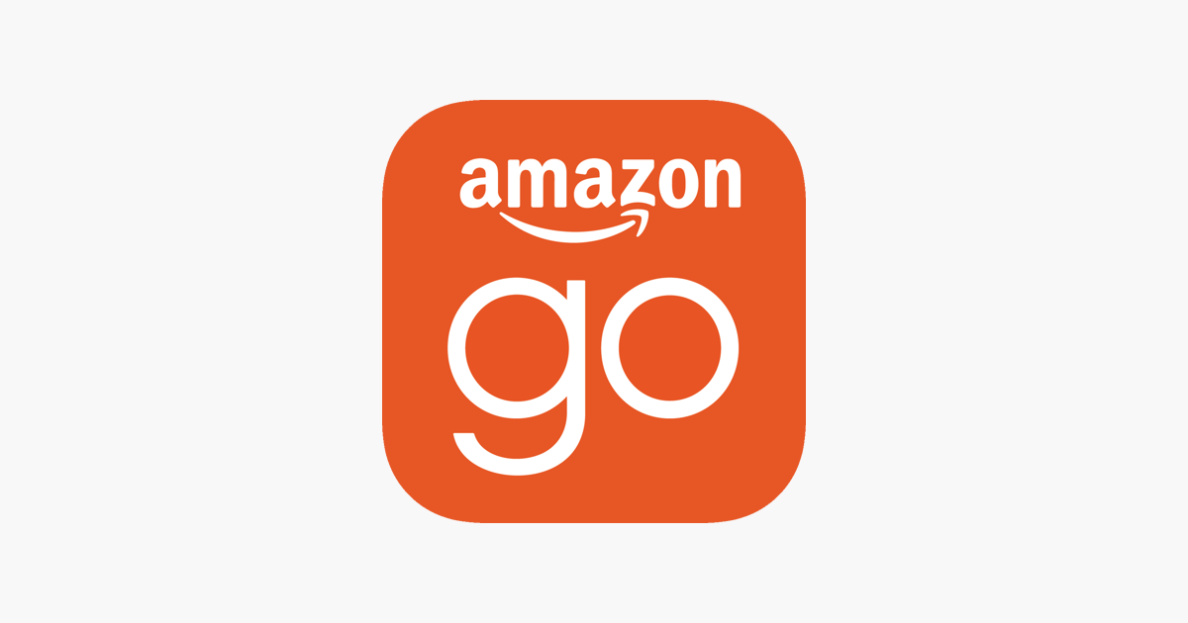
Amazon Go app
Introduction:
Customers should open Amazon Go app on their phones, then holding it to a scanning device, which works like a subway turnstile and entering the store. Customers then put away their phones and began shopping.- picking up items, putting them in bags found in-store or brought from home (without needing to scan each item).

Slide 8
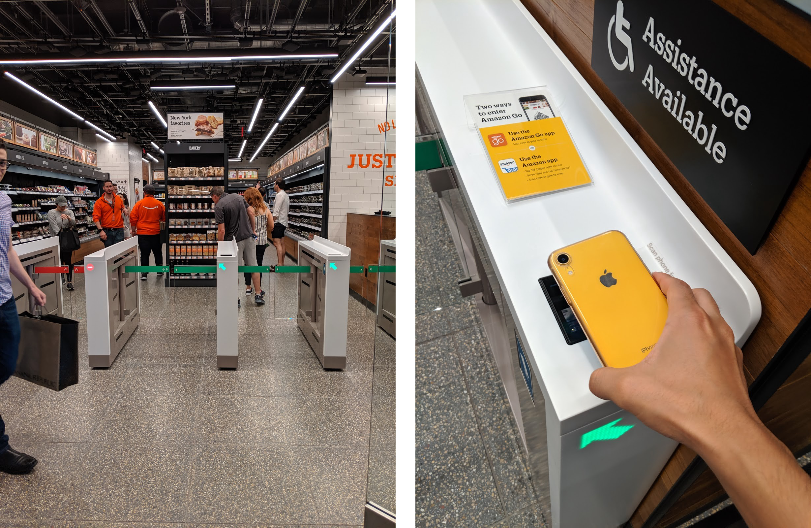
Amazon Go app
Introduction:
Your Key To Enter Amazon Go store.

Slide 9
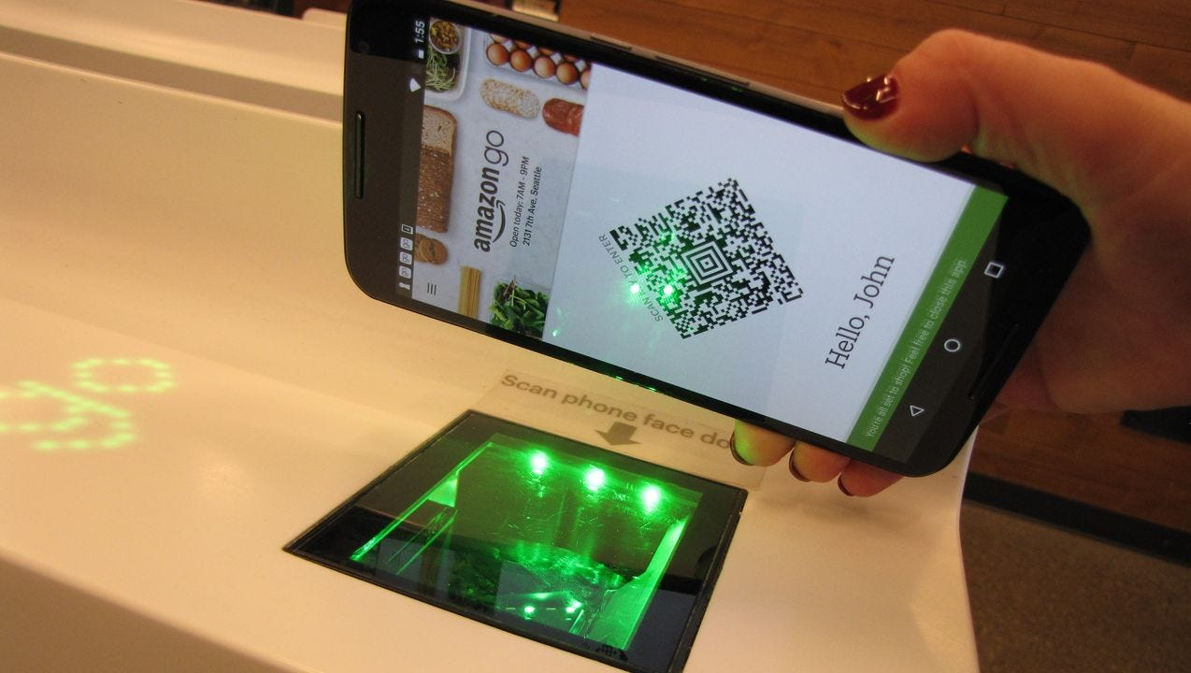
Amazon Go app
Introduction:
Barcode Technology

Slide 10
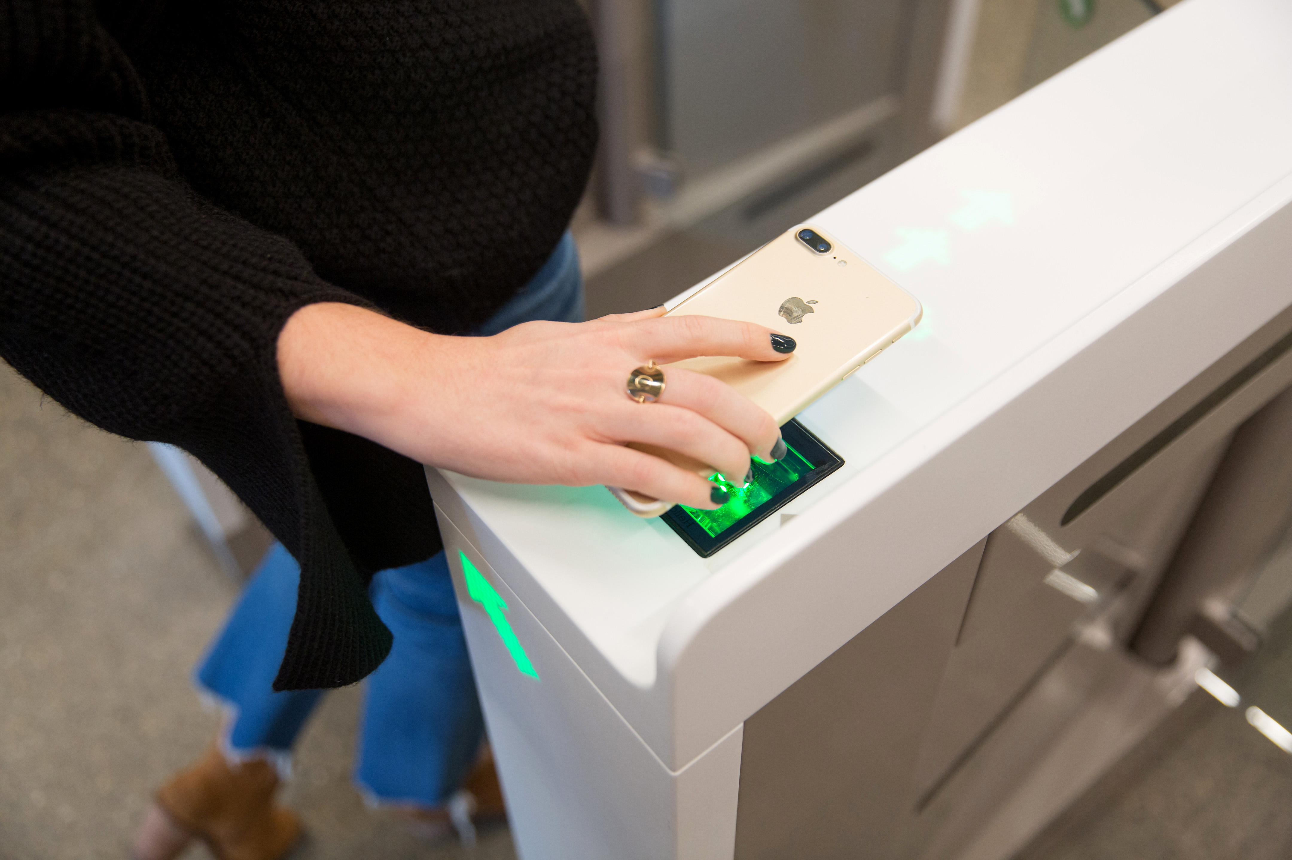
Amazon Go app
Introduction:
Bar Code Scanner

Slide 11
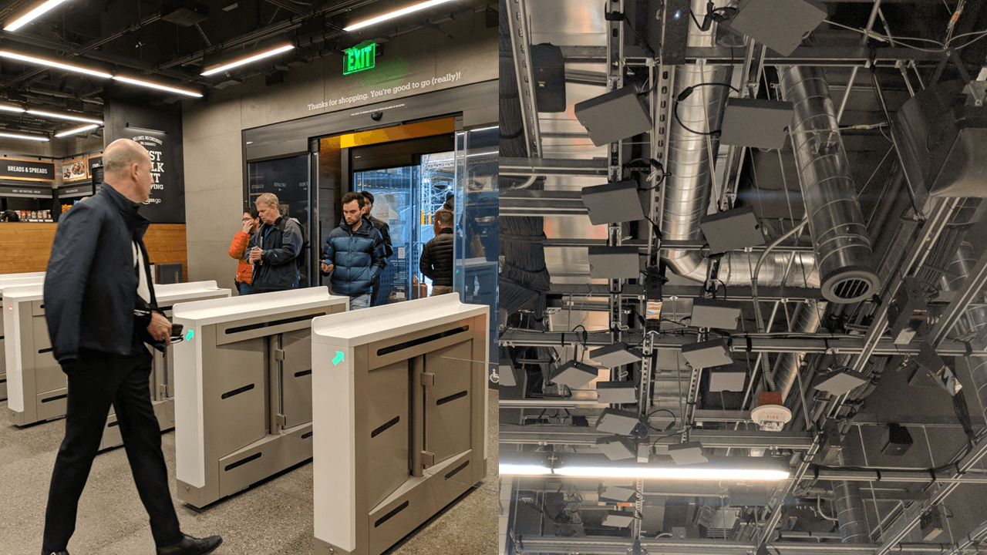

Slide 12
A Timeline Always Works Well
Procedure:
Open Amazon Go app
01
02
Scan the barcode
You can shop now
04
03
The turnstile opens

Slide 13
01
02
Breakfast:
Grocery:
03
04
Fresh Food:
Conclusion:
Provided Services:
Food on the Go! Or at the beginning of your day.
Grocery shopping products.
You can see food cocked at the spot or entrance.
Picking up food made , Easy and faster.

Slide 14
Reinforcing the Concept Using Infographics!
Marketing Strategies:
Innovation:
Eye on the future:
Testing new ideas , without fear of risk or fail, to increase customers retention
Amazon creating new Shopping Experience , where it can attract customers to try it as something new, depending on the psychological factors of customers.
Speed:
Amazon Go focus on productivity, that’s why Amazon Go is Queue-less

Slide 15
How about the Percentages in 2017?
Percentage:
Fresh Food
Break Fast
Shopping Experience
25%
65%
85%

Slide 16
Appeal:
Percentage:
90%
55%
Amazon Go
C-stores
Amazon’s Profit
Convenient Stores

Slide 17
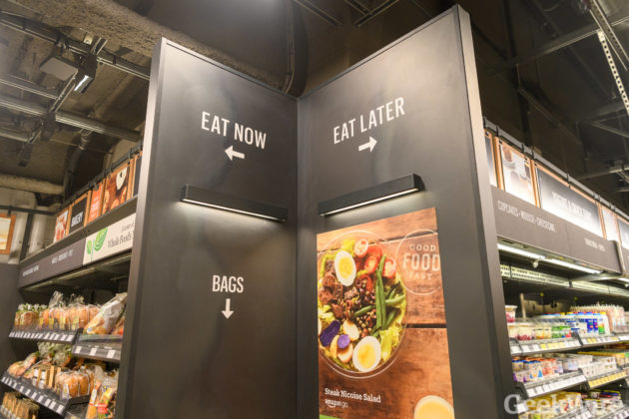
1.5 Million $
Value:
In the first opening year, and now it is valued ~ 1 Trillion $

Slide 18
Thanks!
Samir Zahreddine.
27.11.2019

Slide 19
Sources:
https://www.marketing91.com/service-triangle/
https://www.pkwydigital.com/amazon-go-digital-marketing/
https://powerdigitalmarketing.com/blog/amazon-go/#gref

