Slide 1
Evening Drawing
Week 11: One Line Drawing
Helena Lukášová, Hana Pokojná

Slide 2
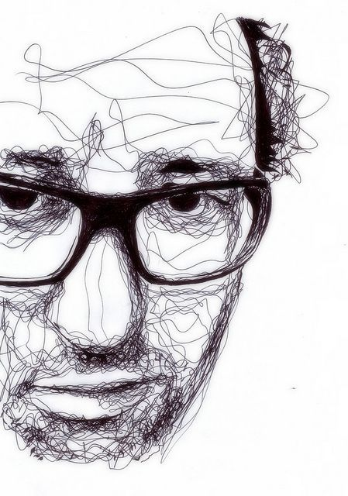
One-line- why?
We focused on measuring for past few weeks
Now it’s time to draw intuitively
Simple technique
Great for letting your hand and perfectionist self go
Less precise, more chaotic but also has character
Shorter drawing sessions but with more focus
Portrait by Kris Tappenies

Slide 3
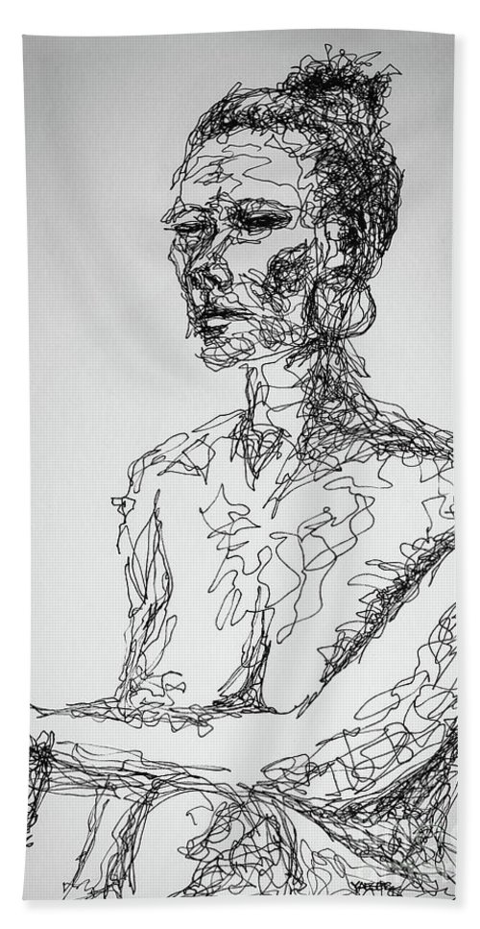
How?
Look at the model and create composition in your mind on the paper
Hover above paper with the tip of the pencil in fluid motions
Start somewhere- anywhere!
Move to some other part you find interesting cross the paper
Continue this until you can’t continue… or are told to stop
At first it will look like a messy splodge, abstractions aren’t bad
Then move to moving around darker parts- darker splodges
Gradually return to dak parts and detail
Yes-still in one go
Abstract portrait by Robert Yaeger

Slide 4
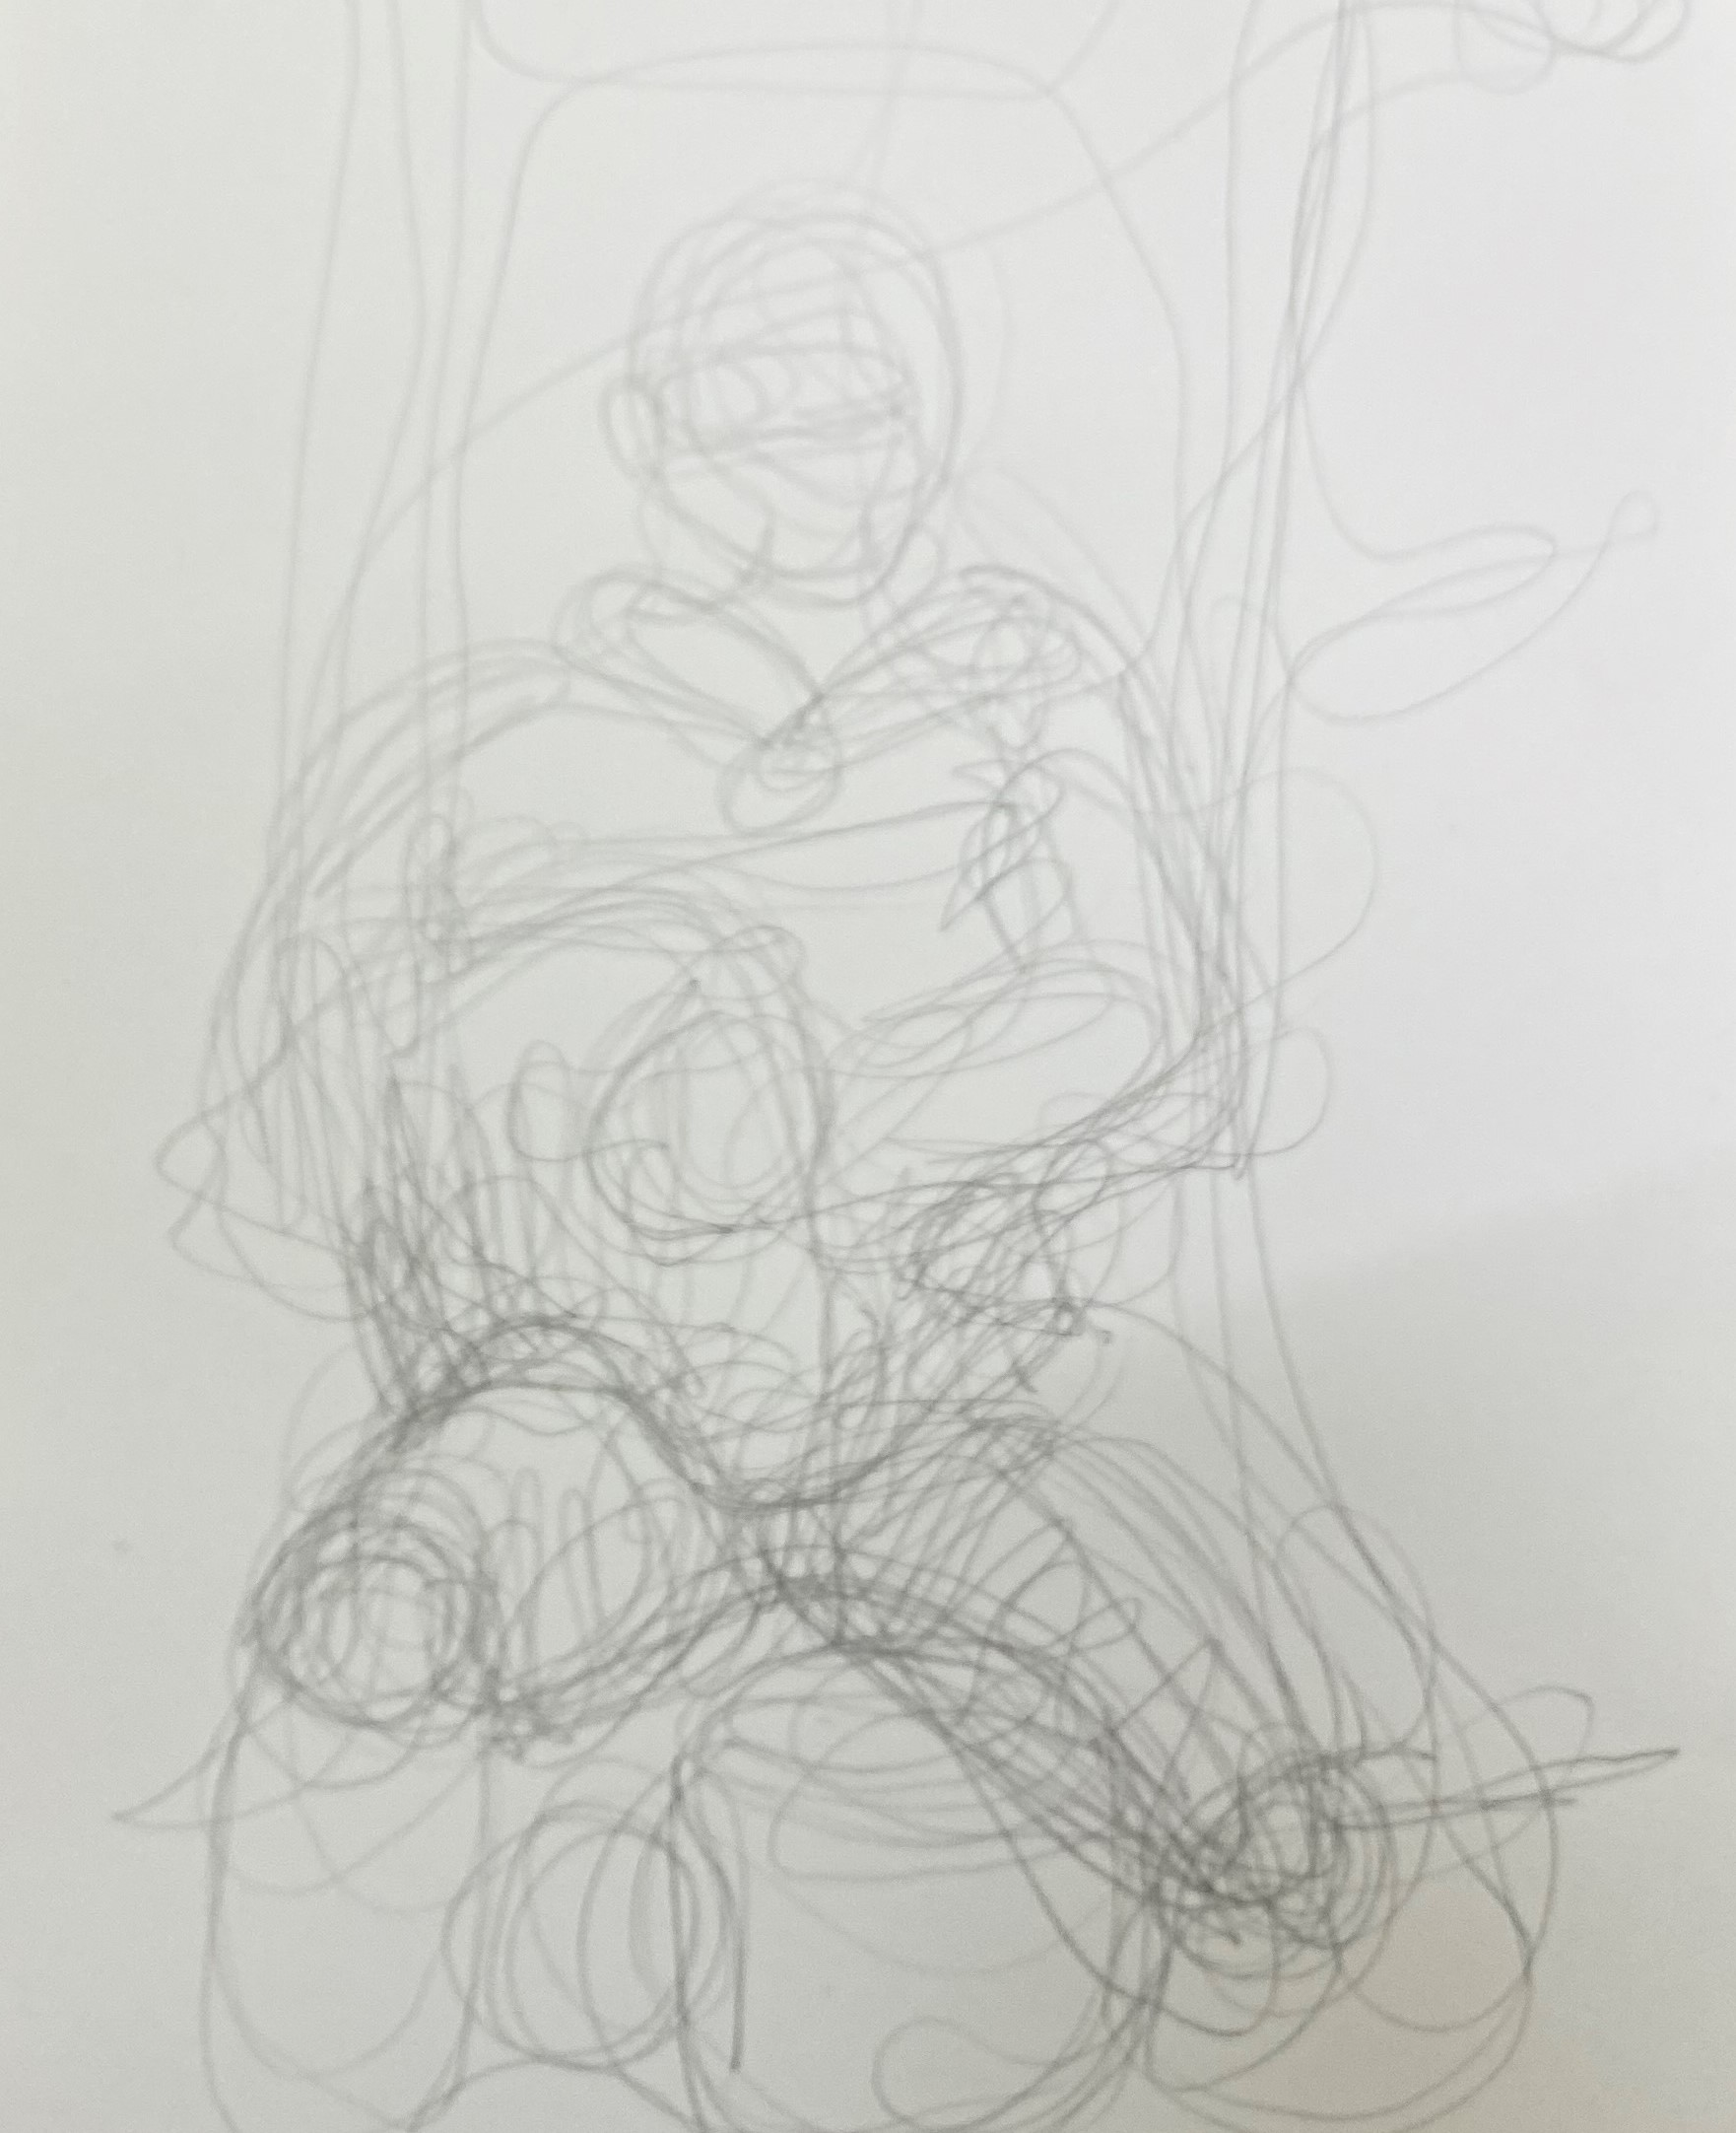
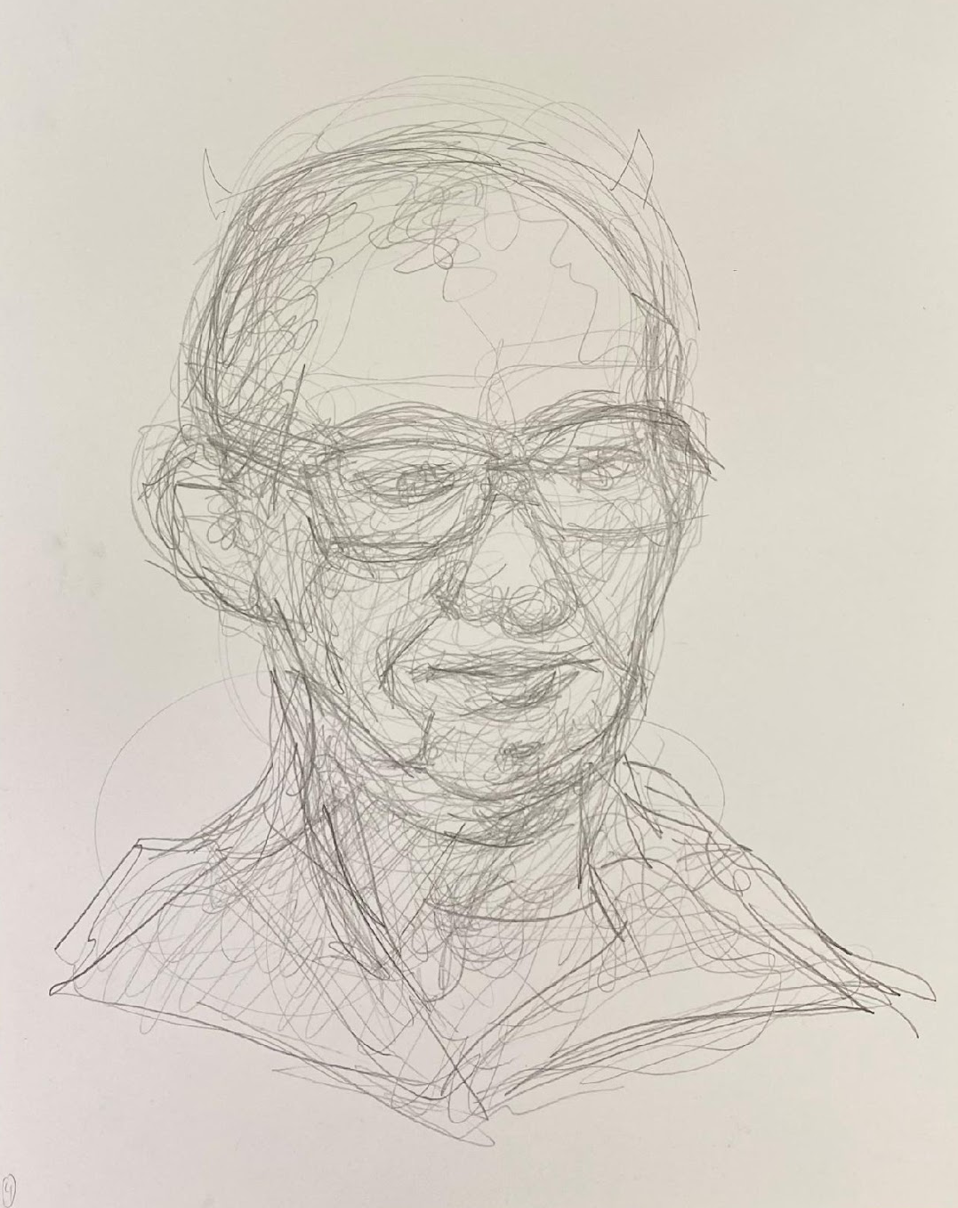
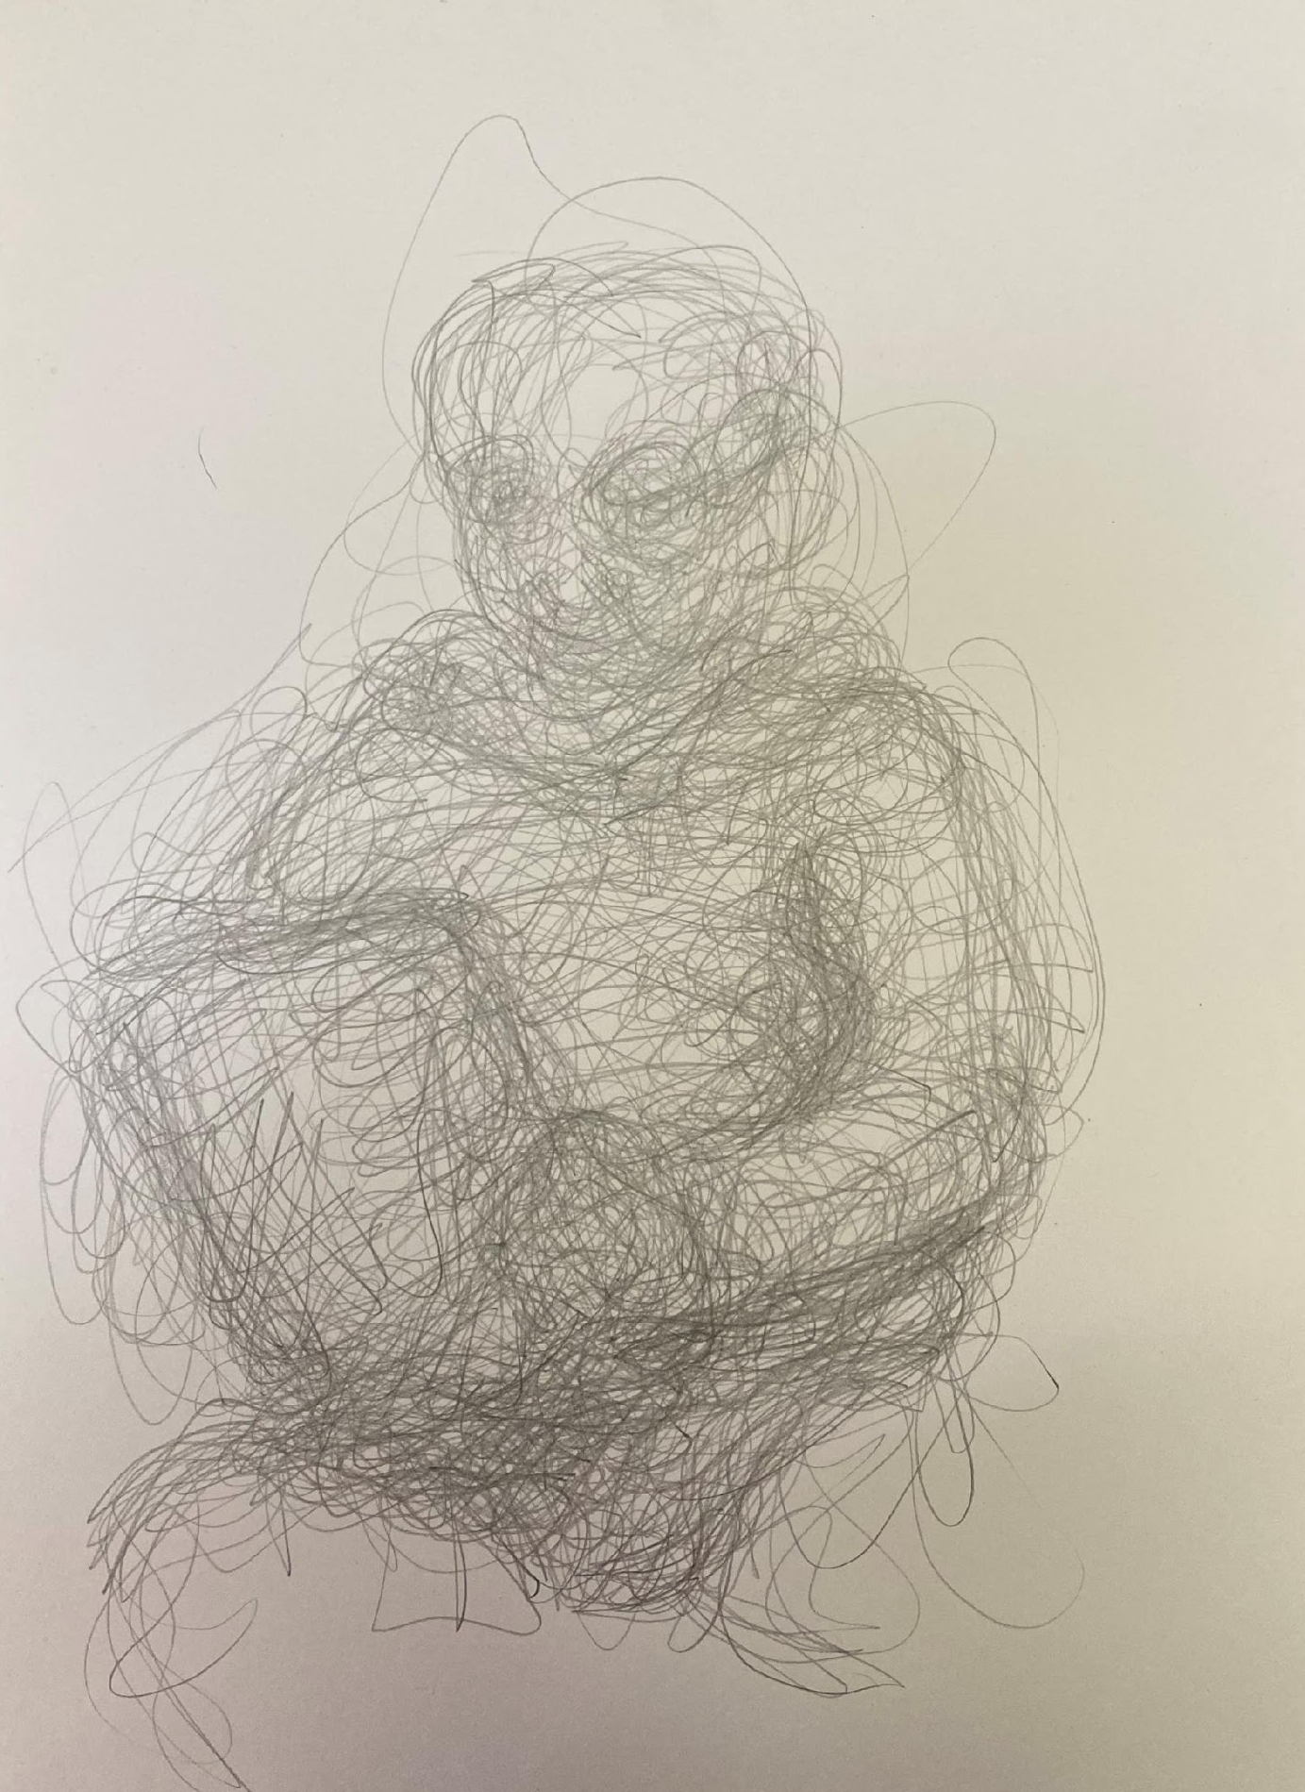
Splodges gradually gain form

Slide 5
Your turn
Yes, just one line
No, no erasers
BUT the results are nice and it’s fun to do ☺
If you pick up the pencil from the notebook it’s ok, but get back into the momentum
We will start with a whole body- try to capture the silhouette, the character. Make sure the model is recognisable based on figure and without face or any details
Later in the lesson we will do portraits, once your hand is at ease

