Slide 1
Evening Drawing
Week 2: Measurements & Proportions
Helena Lukášová, Hana Pokojná

Slide 2
Easels
You can stand or sit
Stand easel onto your drawing hand side (right handed on the right side of your body, left handed on the left side).
Stay roughly an arm’s length away.
Stand in a way where you don’t have to move your body to see the model or peek over the easel. Just move your eyes/ turn your head slightly.
The drawing paper shouldn't be too high or too low, (usually eyes roughly middle of the big paper) make sure you’re comfy.

Slide 3
Measurements
Last week we focused on quick intuitive measurements through movement. The aim was to push you to not think but to draw.
This week we will look at measuring:
Extend your arm and close one of your eyes
Have the top of pencil aligned and starting where the top of the head is
Place your thumb where the head ends (chin), this is your 1 unit.
Move the pencil along the body and see how many head measurements it is.
When measuring, don’t make heavy marks, make general marks of where key body parts are.
Everything is in a relationship with other things! Look at relations of placements in space!

Slide 4
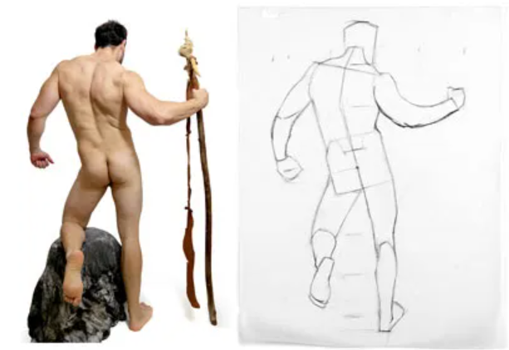
Direction
6) Pencils are also good seeing directions, for example, slouching shoulders, pelvis direction…. angles
Source (image): https://www.artistsnetwork.com/art-mediums/drawing/3-figure-drawing-mistakes/

Slide 5
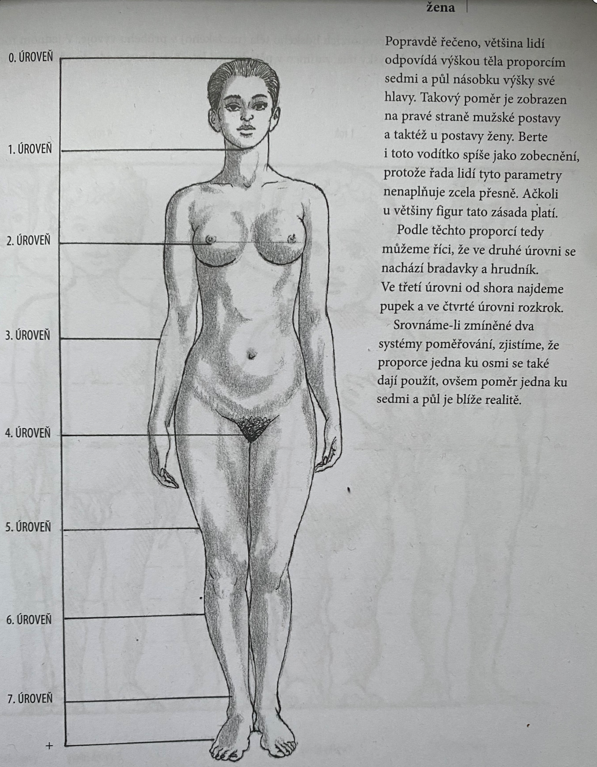
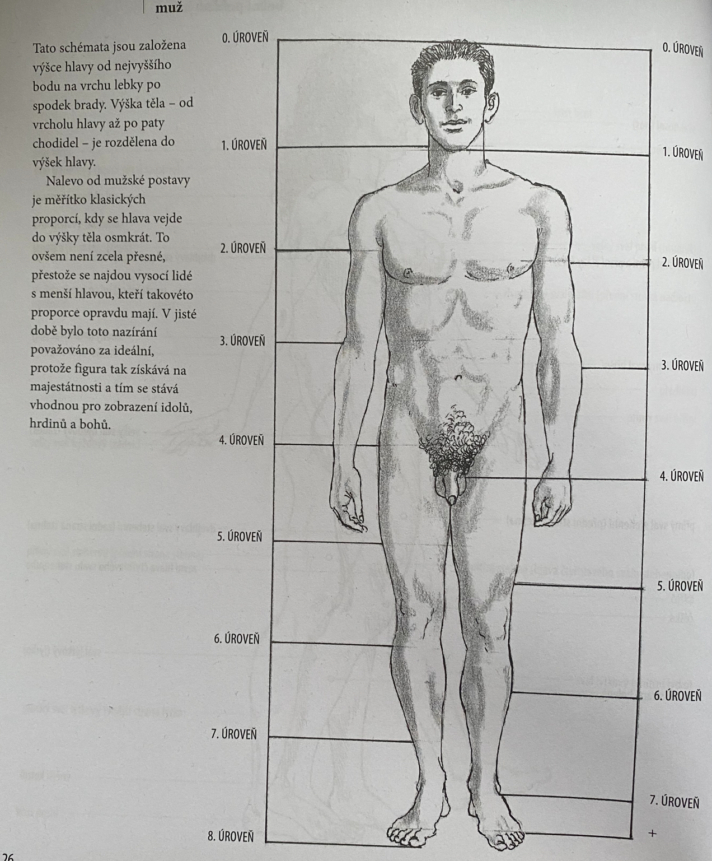
Proportions (adults)
These are the general proportions for men and women. Of coarse there are anatomical variations, but this is a great way to keep figures proportional.
General measurement is 7.5 heads ion one body
2 heads can fit between top of the scull and nipples
Source: Velká kniha anatomie pro výtvarníky by Barber and Barrington

Slide 6
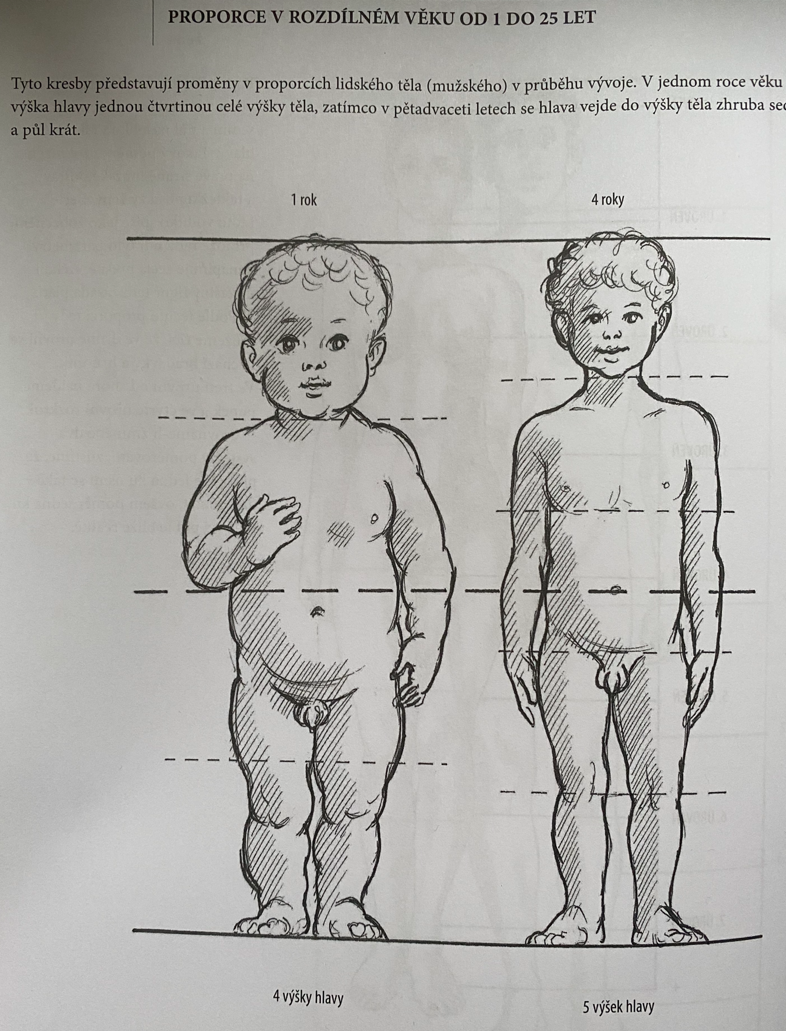
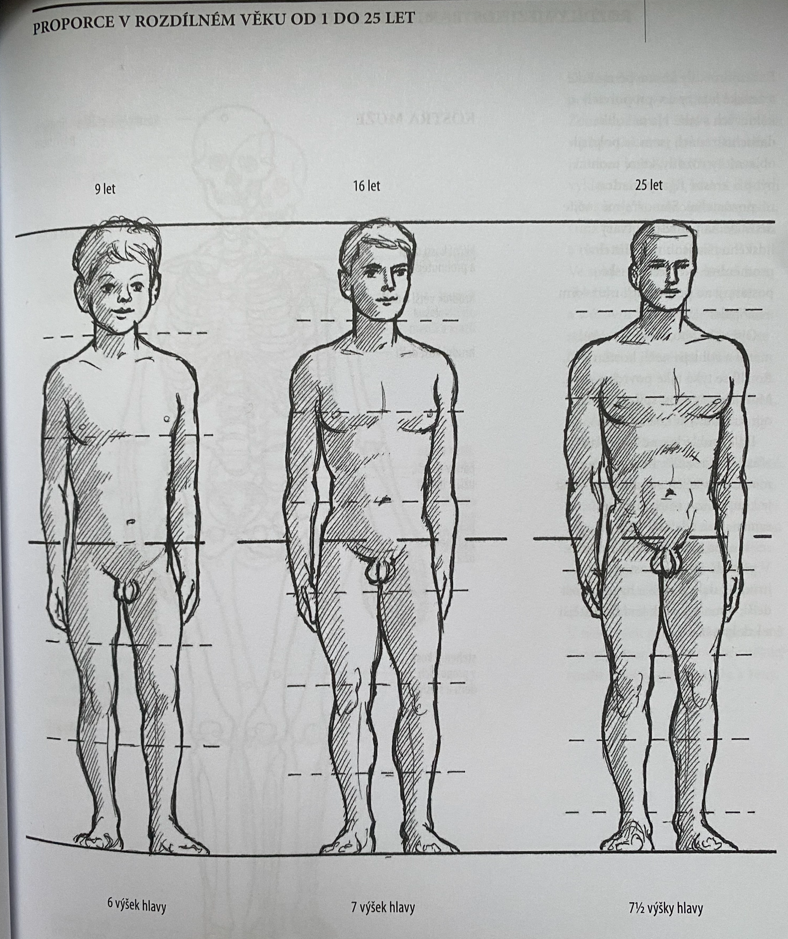
Age and proportions
Different age = different proportions
For example, 1 year old toddles
is roughly ‘4 heads tall’ compared to
adult how is about 7.5 heads tall.
Source: Velká kniha anatomie pro výtvarníky by Barber and Barrington

Slide 7
Composition
Think about proportions to fit the figure in the paper
If you can’t continue drawing and stop drawing at the end of the paper.
Please do not make an entire arm smaller just to fit it into the paper. It’s better to have better proportions and invisible appendage than the other way around….
You don’t have to draw until the end of the paper, just to make a suggestion of continuation.

