Slide 1
Evening Drawing
Week 3: Half body poses
Helena Lukášová, Hana Pokojná

Slide 2
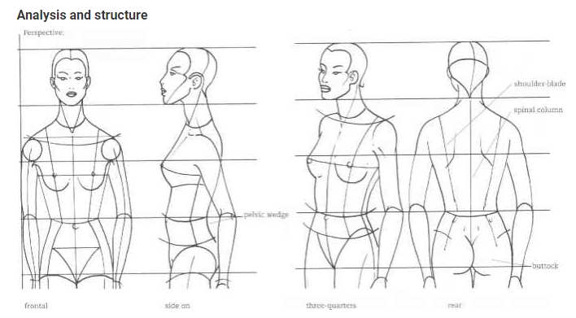
Upper body
Great for composition, sometimes the measurements are off for a full body- don’t be scared to draw just part of the body!
A sign of good artist is to draw the body: main part of the entire body, from all sides accurately
Most prominent part in
fashion design
Check out:
https://www.martelnyc.com/figure-drawing/the-upper-body.html

Slide 3
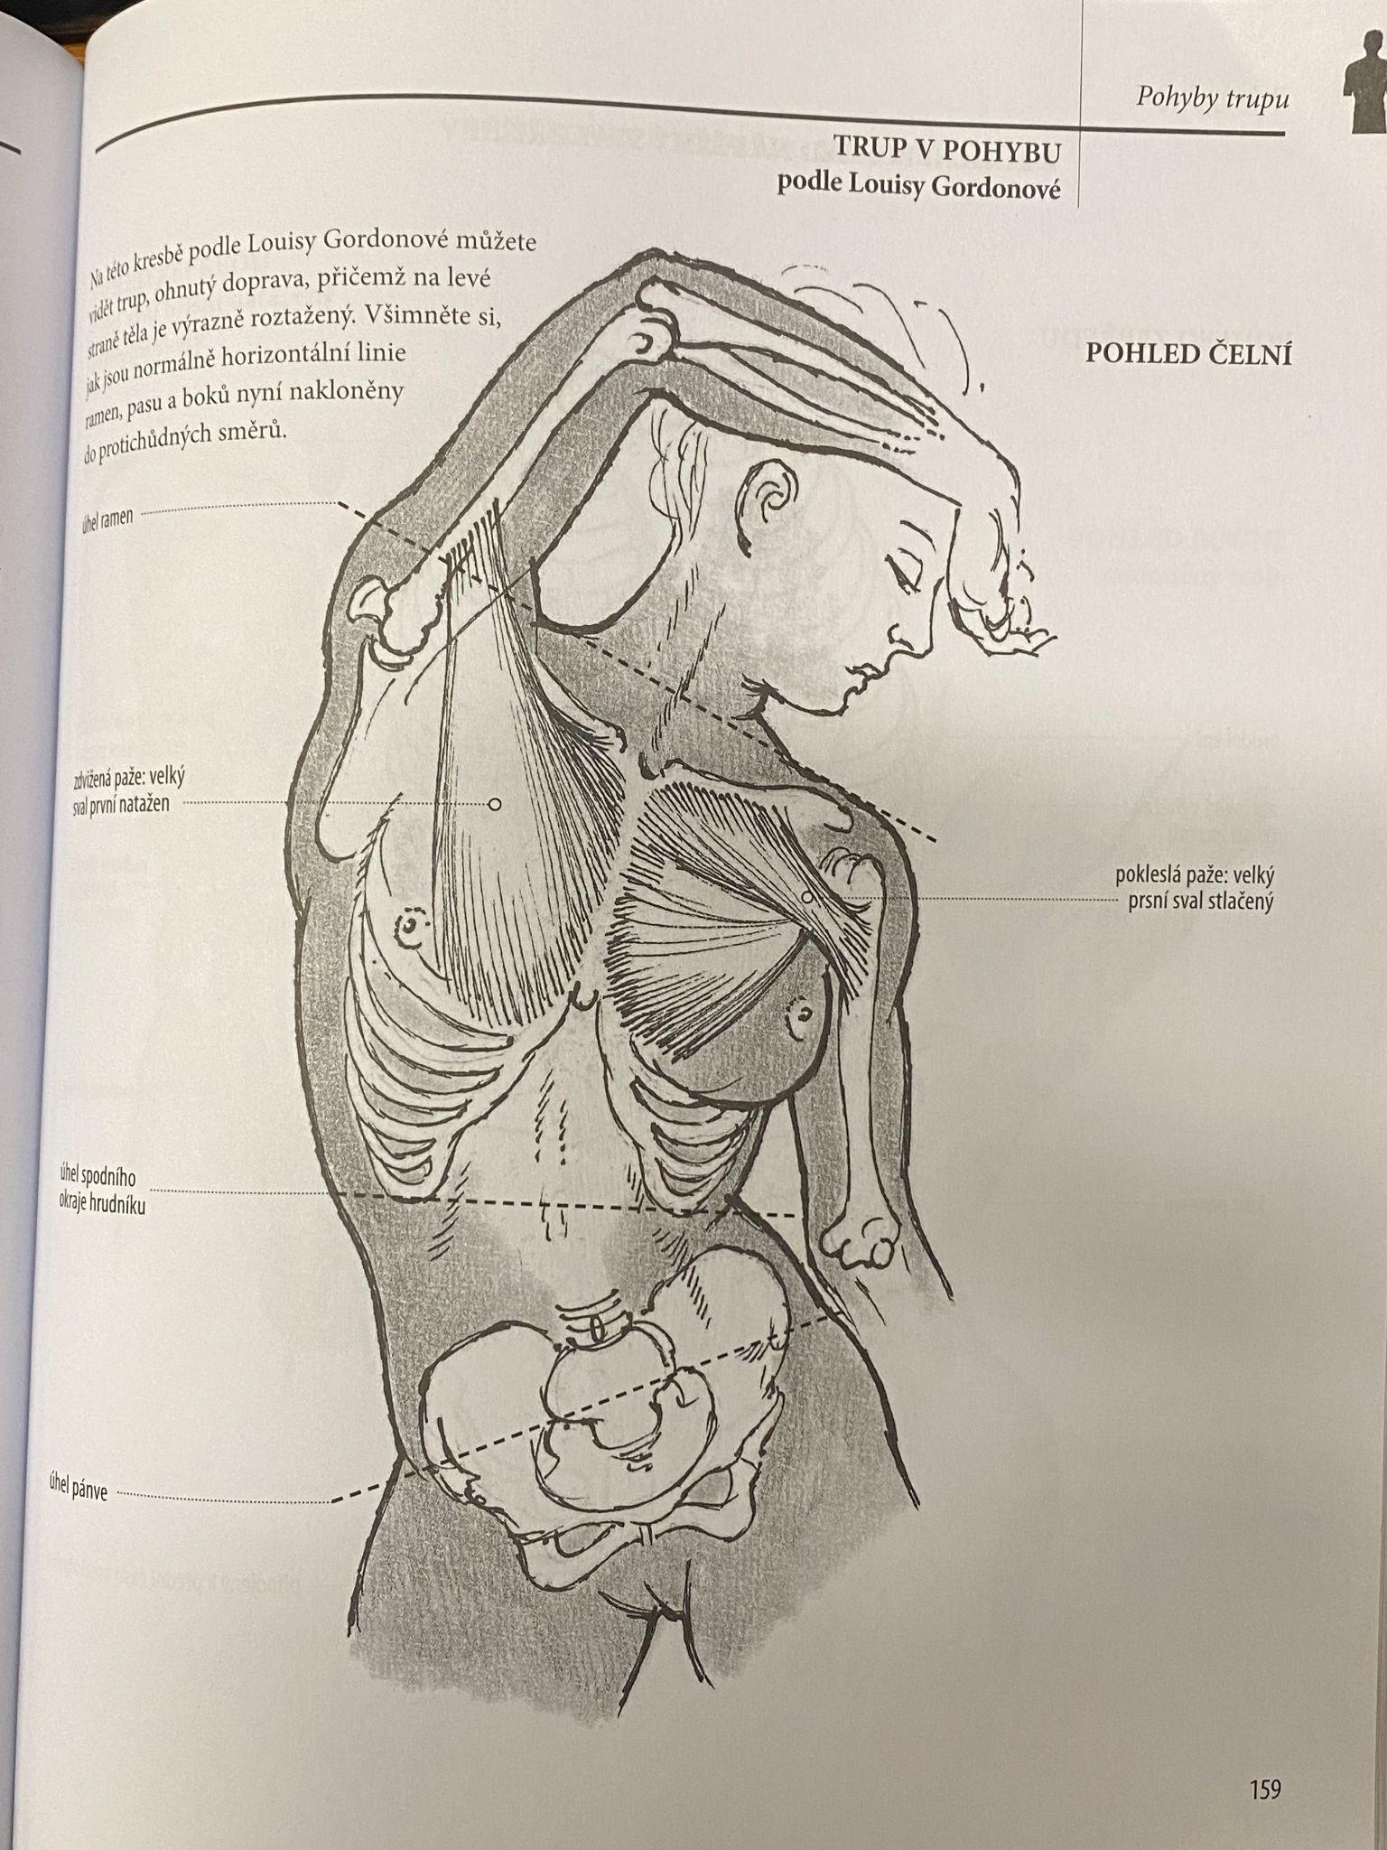
The body
Don’t forget the anatomy
Kniha Velká kniha anatomie pro výtvarníky

Slide 4
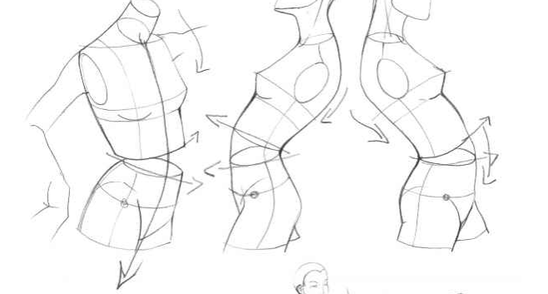
Dynamics
You can show dynamic movement with just the body, even without depicting the appendages.
https://www.martelnyc.com/figure-drawing/the-upper-body.html

Slide 5
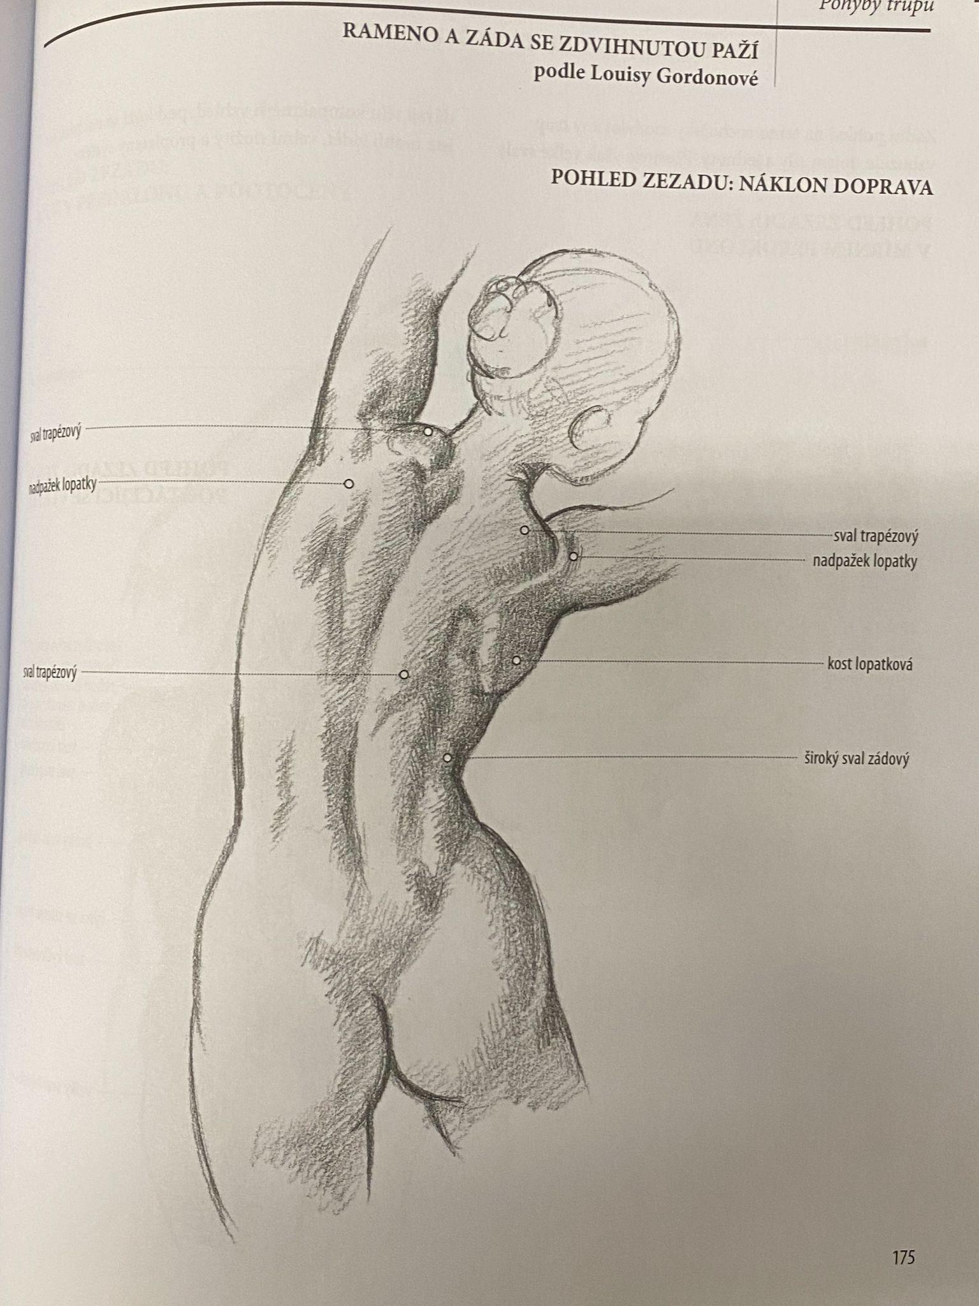
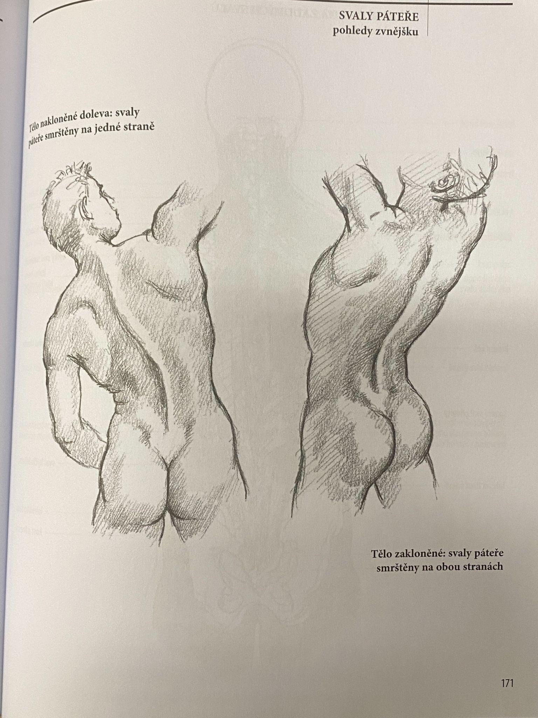

Slide 6
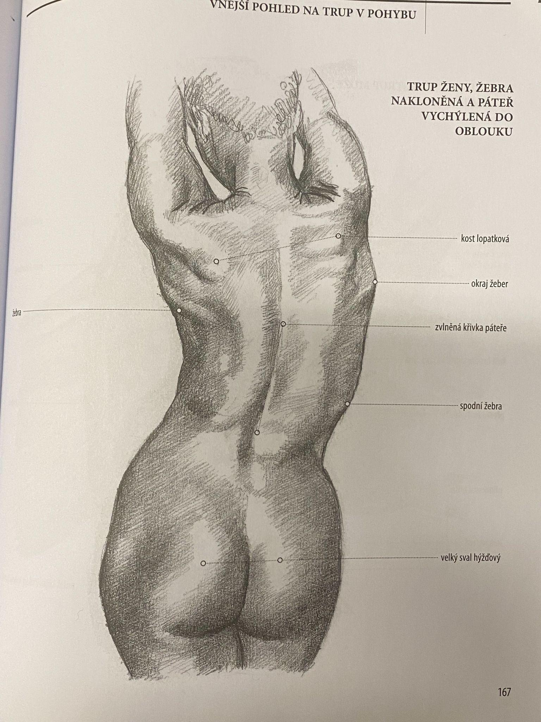
Think back to the line of action
Main part here is the spine (main body) and how the other body parts attach to it

Slide 7
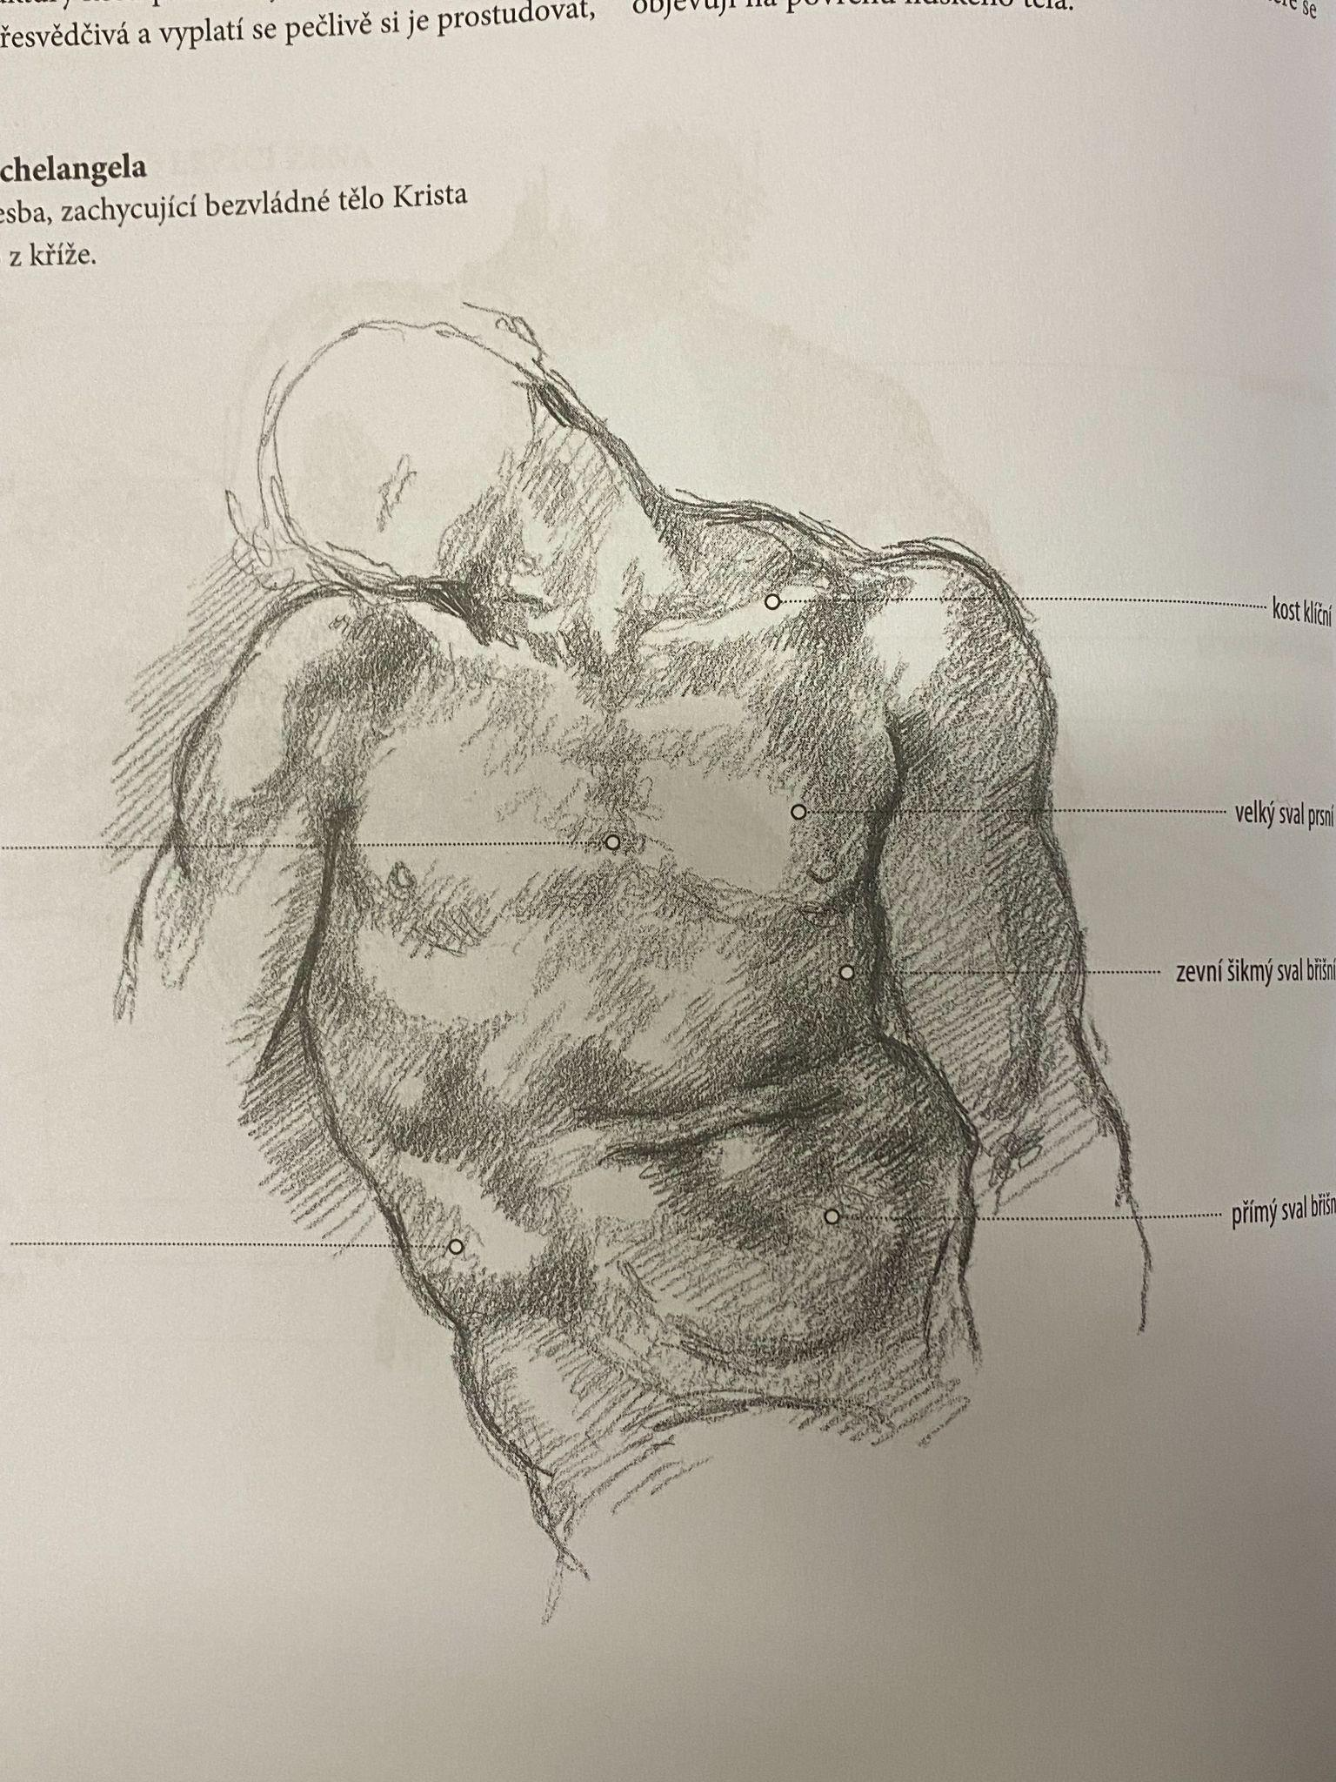
….. Or the lack of movement, but it has character without even showing the face!

