Slide 1
Evening Drawing
Week 4: Portraits and Proportions of the Face
Helena Lukášová, Hana Pokojná

Slide 2
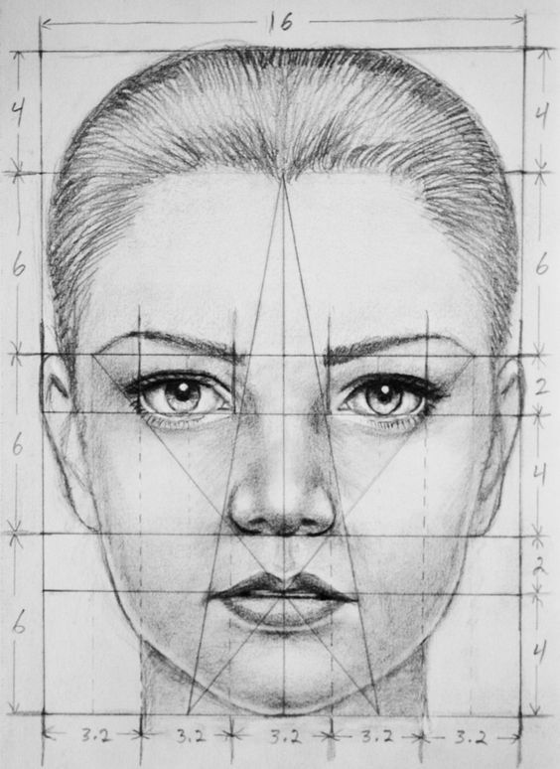
Face
https://cz.pinterest.com/pin/136515432435680155/?amp_client_id=CLIENT_ID(_)&mweb_unauth_id={{default.session}}&simplified=true

Slide 3
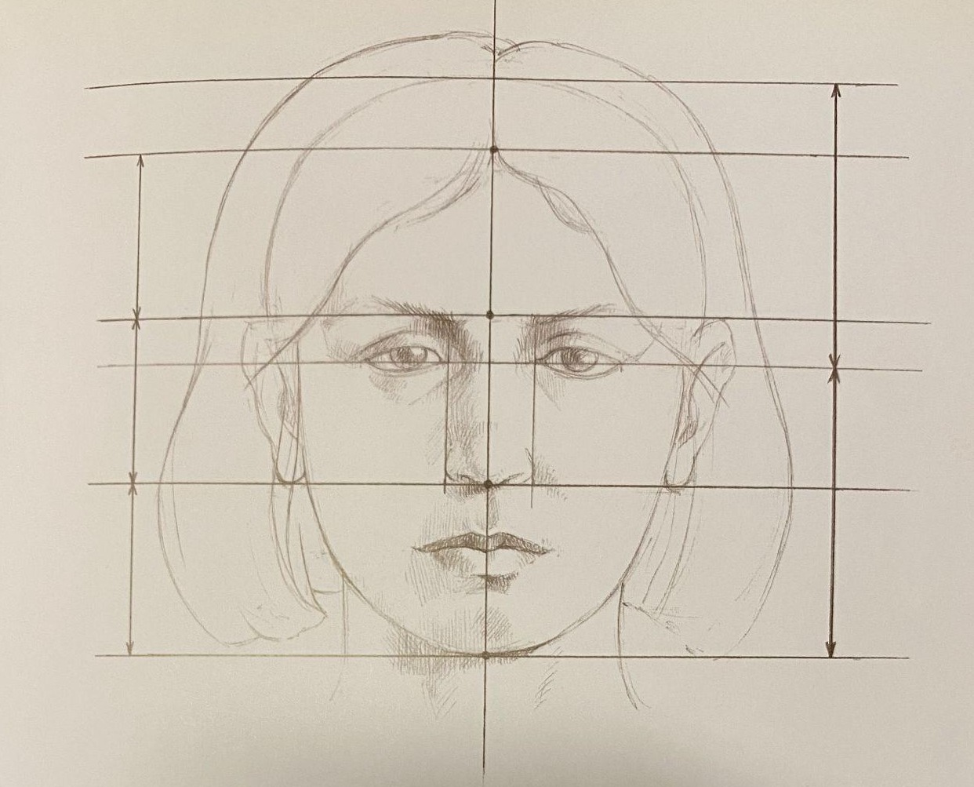
Measurements: Portrait
Divide the face in half vertically: symmetry
Horizontal line in the middle: goes through the middle of the eyes
Horizontally, can be divided into 3 equal parts:
1) chin to tip of the nose
2) tip of the nose to between eyebrows
3) middle of eyebrows to start of hairline

Slide 4
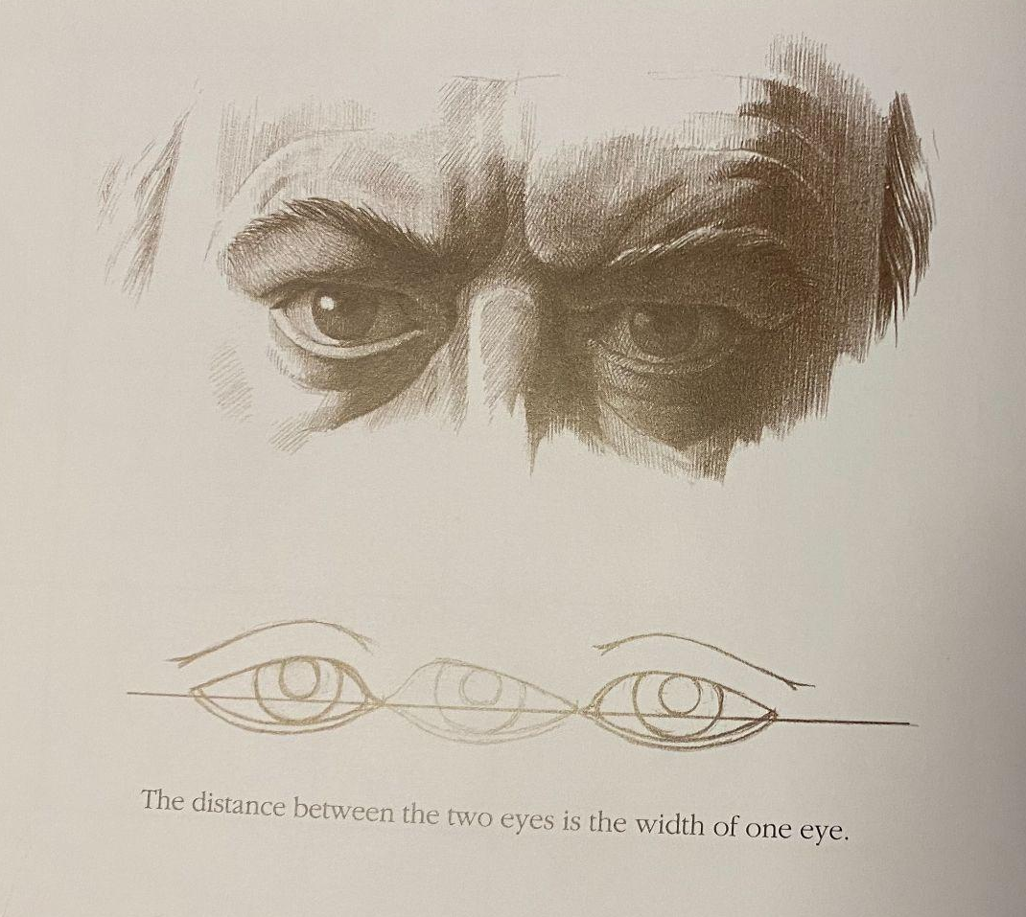
Eyes
Anatomy
Eyes are one width of eye apart
Anatomy Drawing School: Human by Andras Szunyoghy and Gyorgy Feher

Slide 5
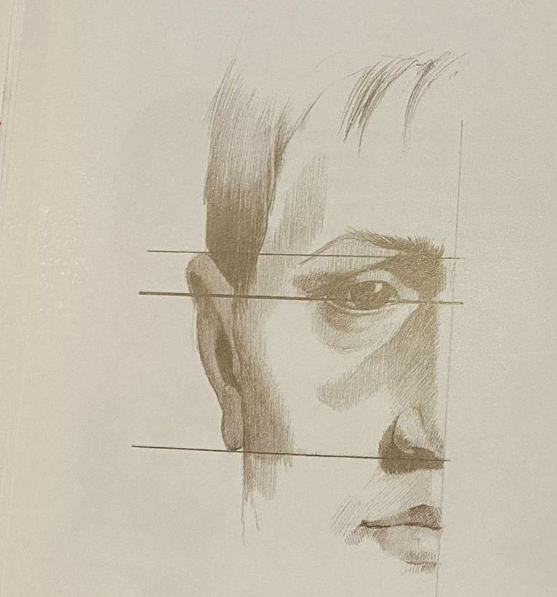
Ears
Ears are from the eyebrow line downwards to the tip of the nose

Slide 6
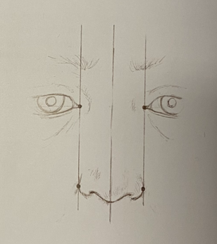
Nose
Corners of the eyes (inside) let down vertically mark outside of the nostrils/ nose width

Slide 7
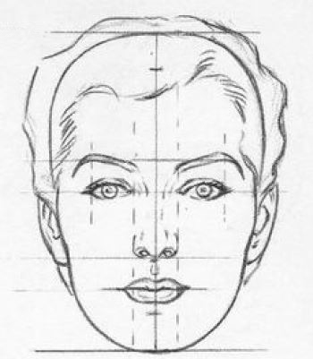
Mouth
The opening of the mouth is on the line of the 1st third from the top. Meaning that one third above forms the upper lip and space between the tip of the nose. The second third goes to the crevice on the chin. And the last third goes from the crevice on the chin to the tip of the chin.
The width of the mouth corners, where the two lips meet, are the horizontal lines from the middle of the iris of the eys
https://www.thedrawingsource.com/proportions-of-the-face.html

