Slide 1
Evening Drawing
Week 6: Colours
Helena Lukášová, Hana Pokojná

Slide 2
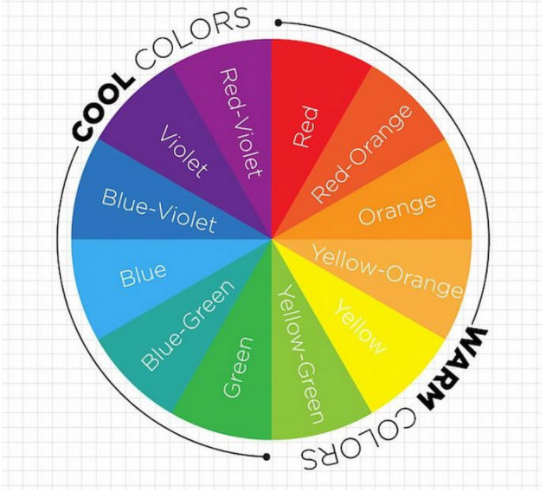
Colour
https://onextrapixel.com/what-is-color-theory/

Slide 3
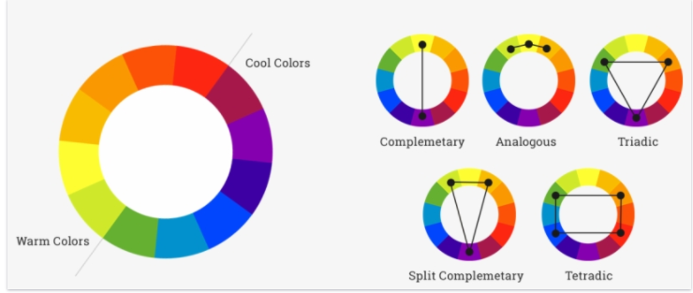
Colour Theory
Colours need to compliment each other to be harmonius
https://www.seekpng.com/ipng/u2q8r5y3t4u2u2u2_color-theory-color-wheel/

Slide 4
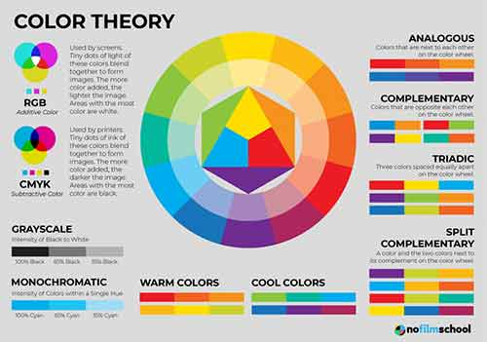
http://www.scrapnframes.com/SITE_EN/SCRAPBOOKING/HTML_PAGES/ColoursHarmonyEn.html

Slide 5
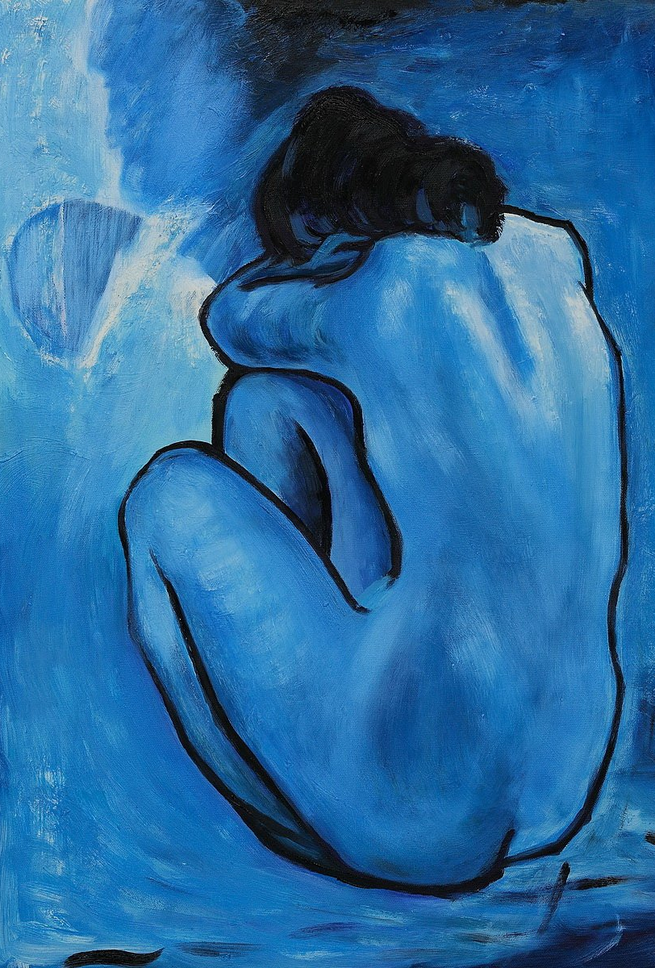
Colours and feelings
Blue Nude by Pablo Picasso, 1902
Saddness

Slide 6
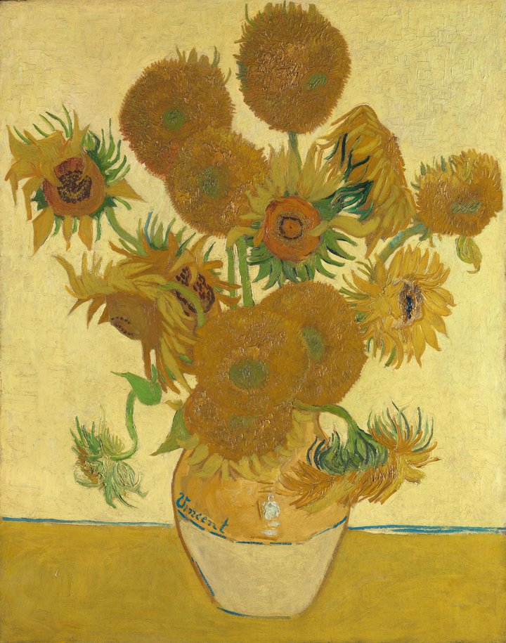
Vincent van Gogh
Rumoured that he ate yellow paint to make himself ‘happy’
Discovered pigment cadmium yellow and chrome yellow
Vincent van Gogh Sunflowers 1888 National Gallery, London

Slide 7
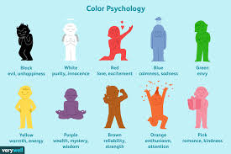
Colours are used to create feelings in real life, too. For example:
shade of green in hospitals is meant to be calming,
Yellow/ orange/ red signs on the road
White torture: room to get rid of the visual sense

Slide 8
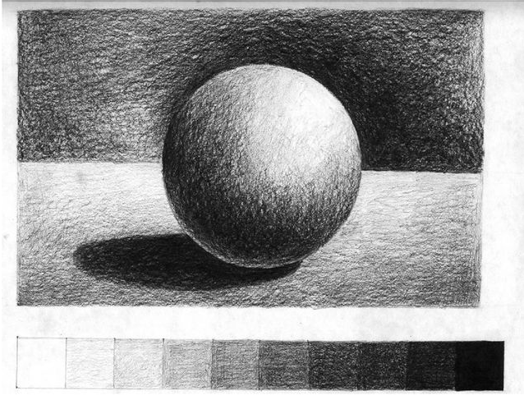
Values and tones
https://kapundahigh.weebly.com/shape-and-tone.html

Slide 9
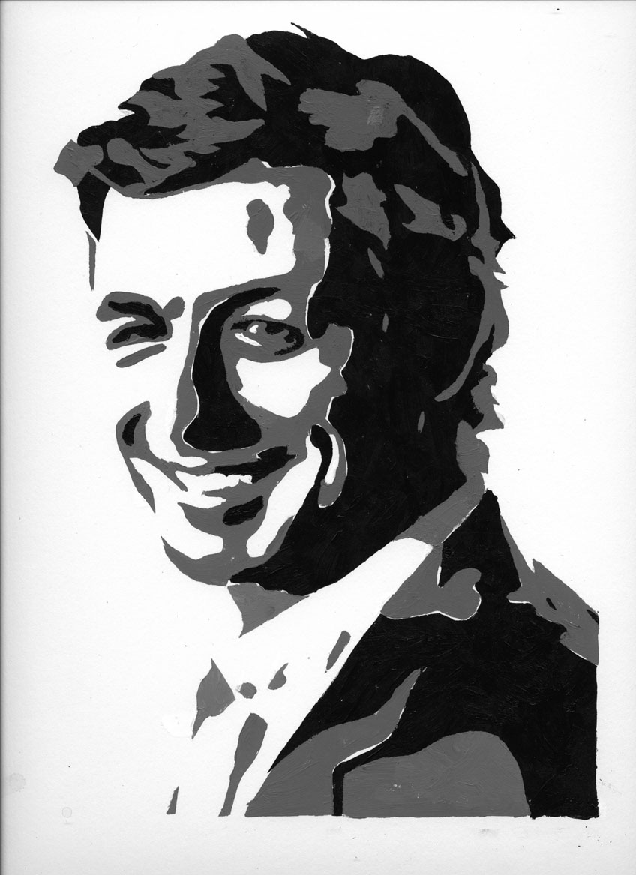
Squint your eyes!
Try to do a 3 tonal drawing
Squint your eyes and look at the darkest colours
Lightest colours
And only THEN the in-between colours
https://www.deviantart.com/sarahcaj/art/Patrick-Jane-Stencil-2-344370332

Slide 10

Divide the tonal value on the overall picture, not just , for example: black hair, white face and grey clothes. Divide it into darkest shadows, brightest highlights and other medium tones

Slide 11
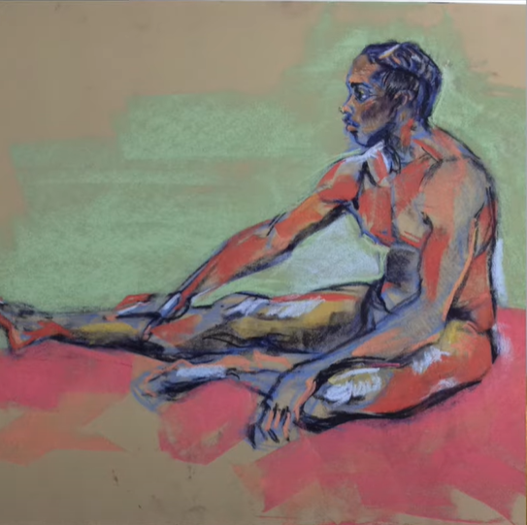
Combine
Divide your drawing into tonal ranges
Assign a colour to eah tonal range, for example, blue for the darkest tones, orange for medium ones and yellow for the light ones
Draw and have fun ☺
Great reasource: Intuitive Approach to Using Colour
https://www.youtube.com/watch?v=yPPdjHREv7w

